Slide 1

Chapter 9 Lecture - Making Capital Investment Decisions Sections (9.1, 9.2, 9.6)
Learning Objectives
After studying this chapter, you should be able to:
LO1 Determine the relevant cash flows for a proposed investment.
LO2 Evaluate an estimated NPV.

Slide 2
Relevant Cash Flows
Include only cash flows that will only occur if the project is accepted
Incremental cash flows
The stand-alone principle allows us to analyze each project in isolation from the firm simply by focusing on
Incremental Cash Flows
Corporate cash flow with the project
Minus (-)
Corporate cash flow without the project

Slide 3
Relevant Cash Flows
“Sunk” Costs ………………………… N
Opportunity Costs …………………... Y
Side Effects/Erosion……..…………… Y
Net Working Capital………………….. Y
Financing Costs….………..…………. N
Tax Effects ………………………..….. Y

Slide 4
Sunk Costs (N)
A sunk cost, by definition, is a cost we have already paid or have already incurred the liability to pay.
Such a cost cannot be changed by the decision today to accept or reject a project.
Put another way, the firm will have to pay this cost no matter what.
Based on our general definition of incremental cash flow, such a cost is clearly not relevant to the decision at hand.
So, we will always be careful to exclude sunk costs from our analysis.

Slide 5
Opportunity Costs (Y)
An opportunity cost is slightly different; it requires us to give up a benefit.
A common situation arises where a firm already owns some of the assets a proposed project will be using.
For example, we might be thinking of converting an old rustic cotton mill we bought years ago for $100,000 into “upmarket” condominiums.
If we undertake this project, there will be no direct cash outflow associated with buying the old mill since we already own it.
For purposes of evaluating the condo project, should we then treat the mill as “free”? The answer is no. The mill is a valuable resource used by the project. If we didn't use it here, we could do something else with it.

Slide 6
Side Effects (Y)
Remember that the incremental cash flows for a project include all the changes in the firm's future cash flows. It would not be unusual for a project to have side, or spillover, effects, both good and bad.
In this case, the cash flows from the new line should be adjusted downward to reflect lost profits on other lines.
In accounting for erosion, it is important to recognize that any sales lost as a result of our launching a new product might be lost anyway because of future competition. Erosion is only relevant when the sales would not otherwise be lost.

Slide 7
Net Working Capital (Y)
Net Working Capital Normally, a project will require that the firm invest in net working capital in addition to long-term assets.
For example, a project will generally need some amount of cash on hand to pay any expenses that arise. In addition, a project will need an initial investment in inventories and accounts receivable (to cover credit sales).
This balance represents the investment in net working capital.

Slide 8
Financing Costs (N) and Other Issues (Y)
Financing Costs. In analyzing a proposed investment, we will not include interest paid or any other financing costs such as dividends or principal repaid, because we are interested in the cash flow generated by the assets of the project
More generally, our goal in project evaluation is to compare the cash flow from a project to the cost of acquiring that project in order to estimate NPV.
Other Issues. First, we are only interested in measuring cash flow.
Moreover, we are interested in measuring it when it actually occurs, not when it accrues in an accounting sense.
Second, we are always interested in aftertax cash flow since taxes are definitely a cash outflow. In fact, whenever we write “incremental cash flows,” we mean aftertax incremental cash flows.

Slide 9
Evaluating NPV Estimates
NPV estimates are only estimates
Forecasting risk:
Sensitivity of NPV to changes in cash flow estimates
The more sensitive, the greater the forecasting risk
Sources of value
Be able to articulate why this project creates value

Slide 10
Scenario Analysis
Examines several possible situations:
Worst case
Base case or most likely case
Best case
Provides a range of possible outcomes

Slide 11
Scenario Analysis Example
Note: “Lower” ≠ Worst
“Upper” ≠ Best

Slide 12
Scenario Analysis Example

Slide 13
Problems with Scenario Analysis
Considers only a few possible out-comes
Assumes perfectly correlated inputs
All “bad” values occur together and all “good” values occur together
Focuses on stand-alone risk, although subjective adjustments can be made
Definition of Stand-alone Risk - The risk associated with a single operating unit of a company or asset. Standalone involves the risks created by a specific division or project, which would not exist if operations in that area were to cease.

Slide 14
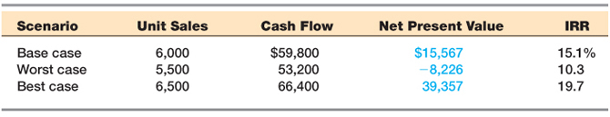
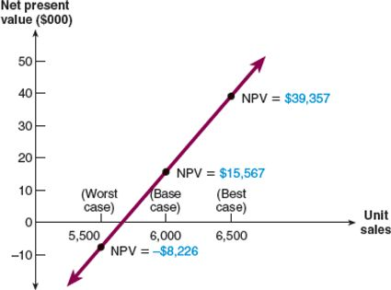
Sensitivity Analysis
Shows how changes in an input variable affect NPV or IRR
Each variable is fixed except one
Change one variable to see the effect on NPV or IRR
Answers “what if” questions

Slide 15
Sensitivity Analysis:
Strengths
Provides indication of stand-alone risk.
Identifies dangerous variables.
Gives some breakeven information.
Weaknesses
Does not reflect diversification.
Says nothing about the likelihood of change in a variable.
Ignores relationships among variables.

Slide 16
Managerial Options
Contingency planning
Option to expand
Expansion of existing product line
New products
New geographic markets
Option to abandon
Contraction
Temporary suspension
Option to wait
Capital Rationing
Capital rationing occurs when a firm or division has limited resources
Soft rationing – the limited resources are temporary, often self-imposed
Hard rationing – capital will never be available for this project
The profitability index is a useful tool when faced with soft rationing

