Slide 1


Slide 2
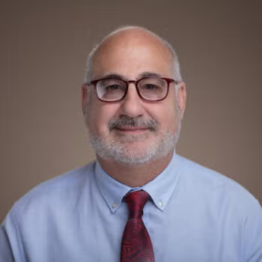
Dennis McCornac
Associate Teaching Professor
Dennis McCornac is Associate Teaching Professor of Economics at Georgetown University in Qatar. He specializes in economic development and the economies of East Asia. His research interests include the role of corruption in education and China-Vietnam economic relations.
Professor McCornac is co-author of articles that have appeared in the Journal of Asia Business Studies and Border Crossing. His teaching experience includes over a decade in Japan as a lecturer in economics and almost a decade in Vietnam where he participated in market economics training and the establishment of a business school at the National Economics University. He is also a former Fulbright Scholar to Vietnam and a Freeman Fellow in Asia Studies.
Professor McCornac received his Ph.D. in economics from the City University of New York.

Slide 3


Slide 4
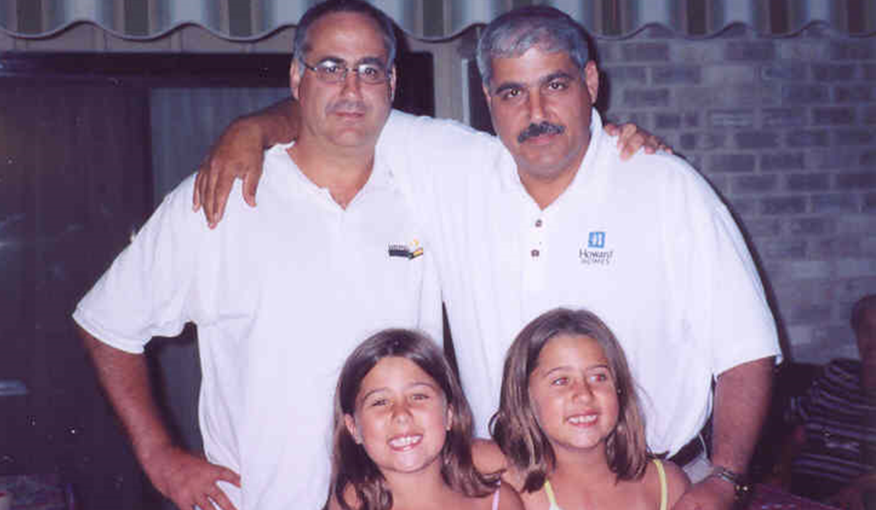

Slide 5
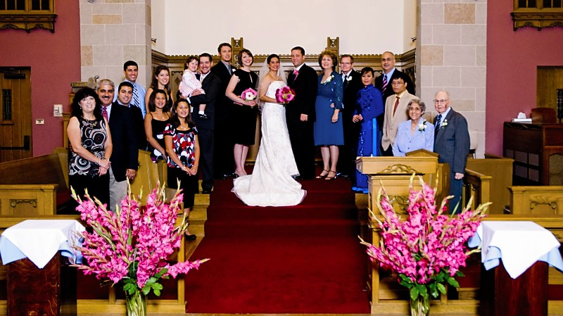

Slide 6



Slide 7
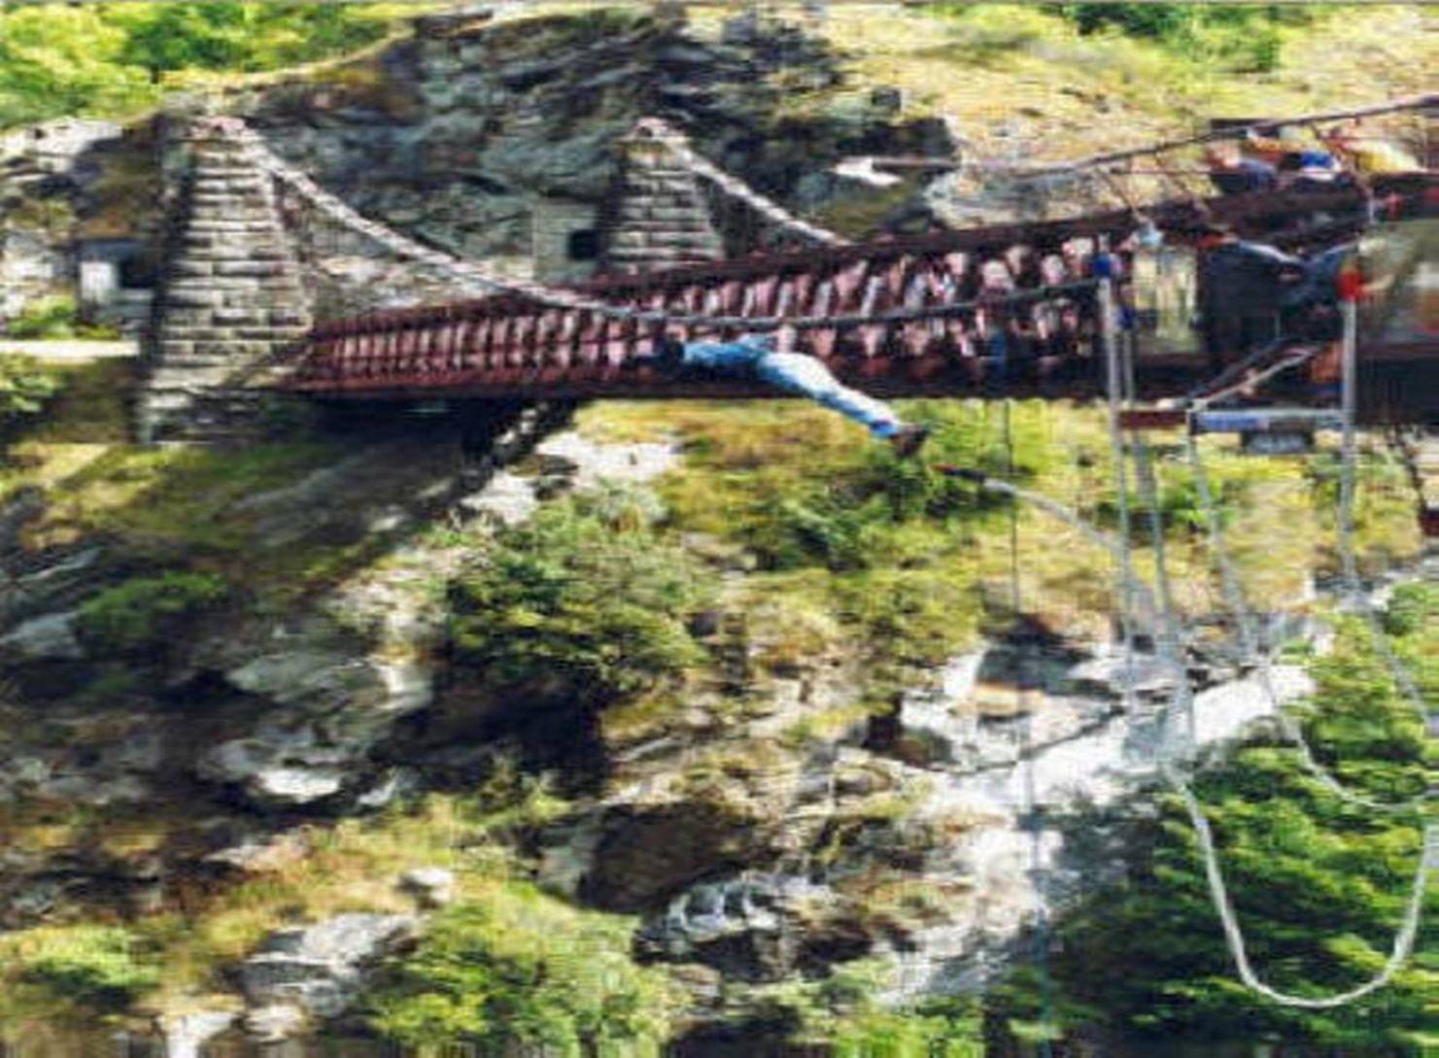

Slide 8
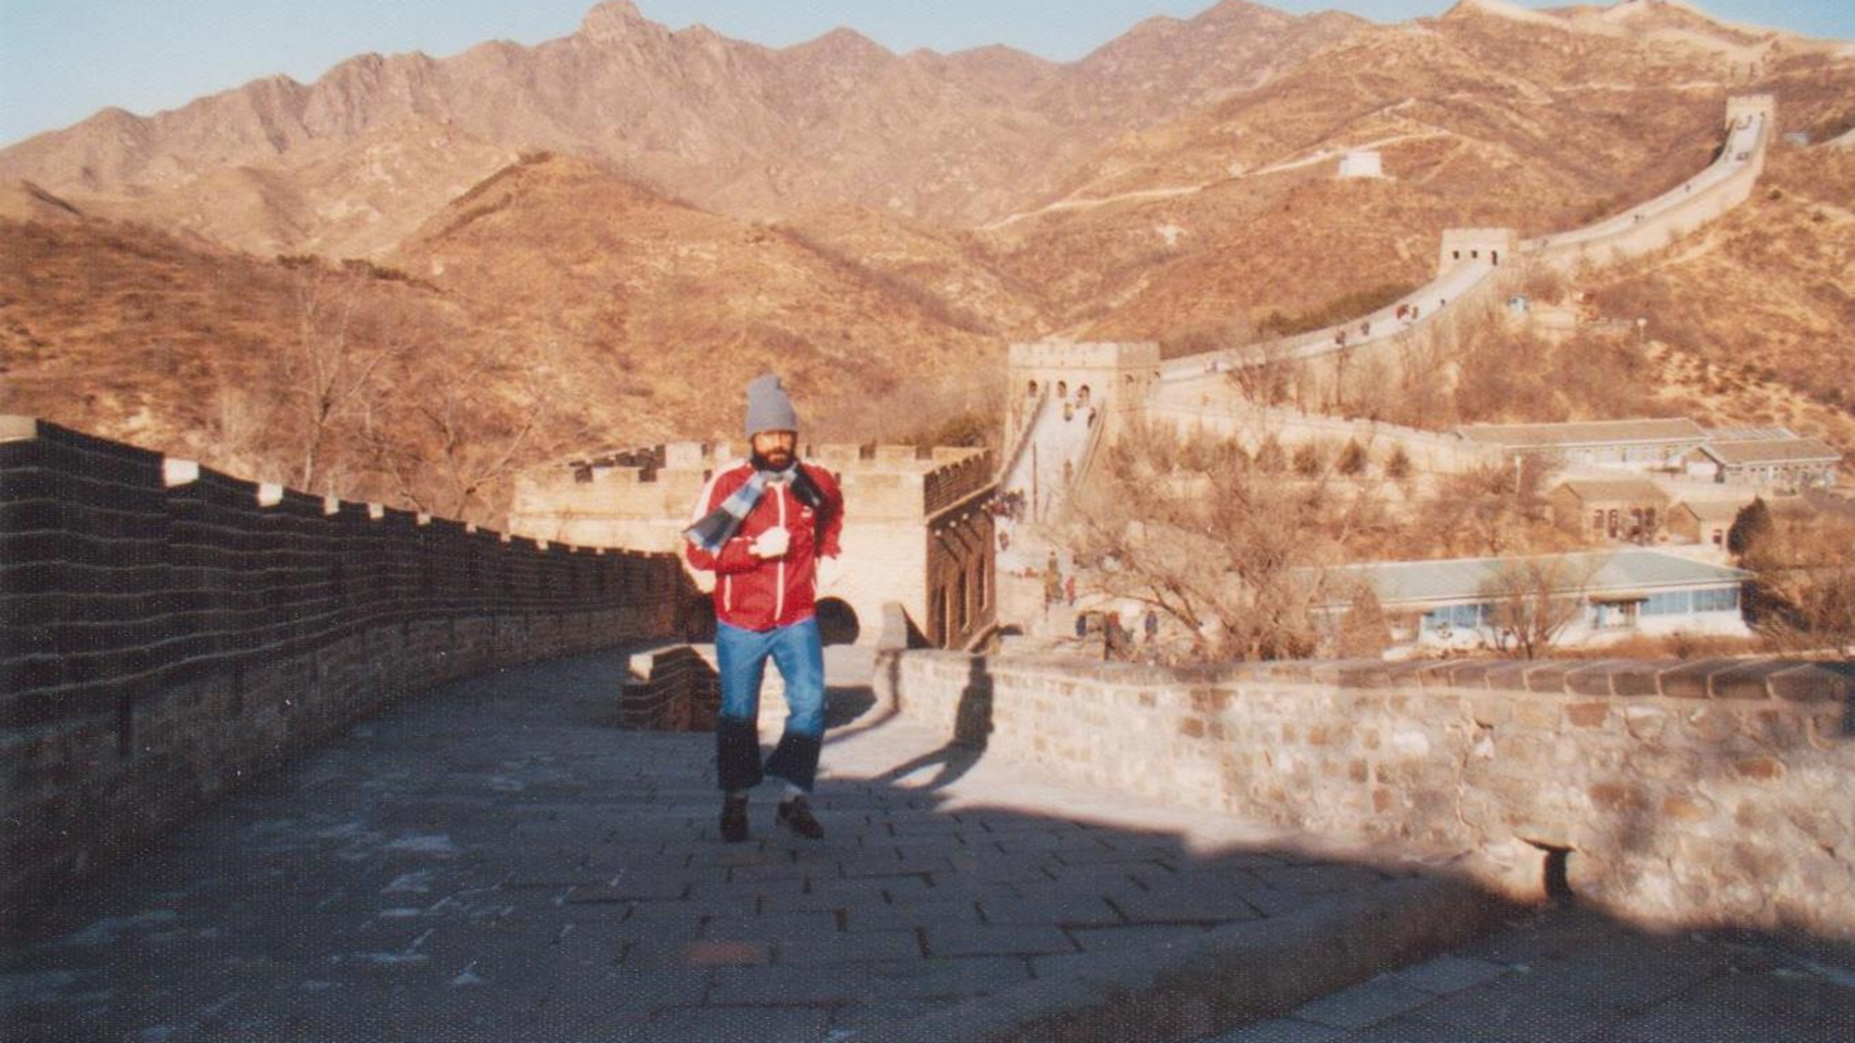
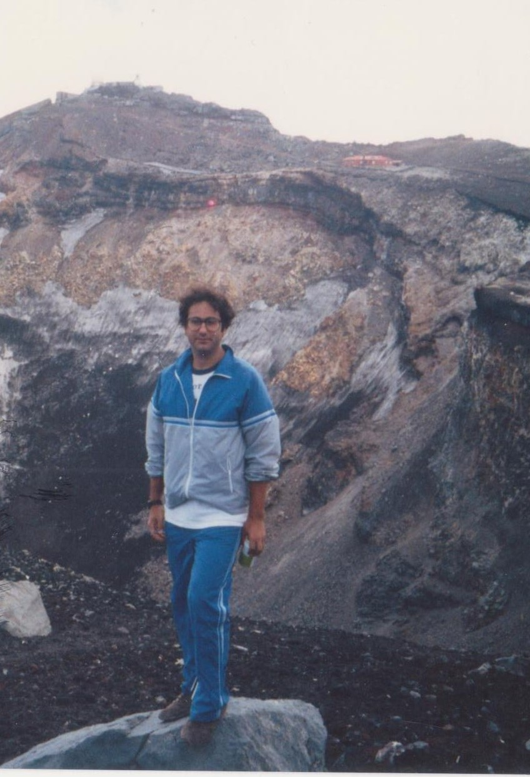

Slide 9
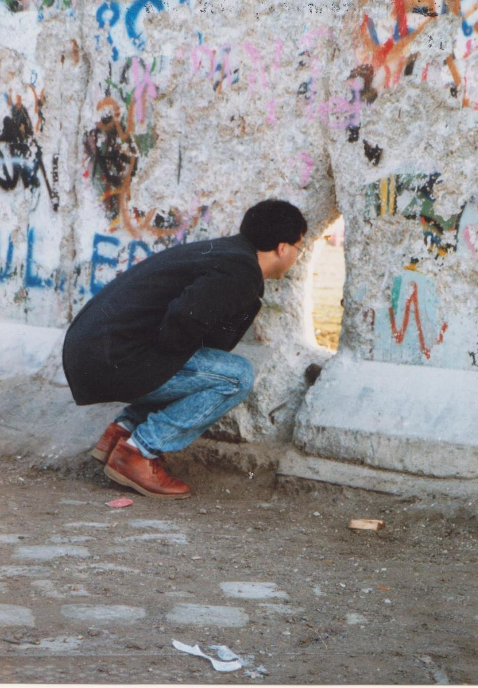

Slide 10
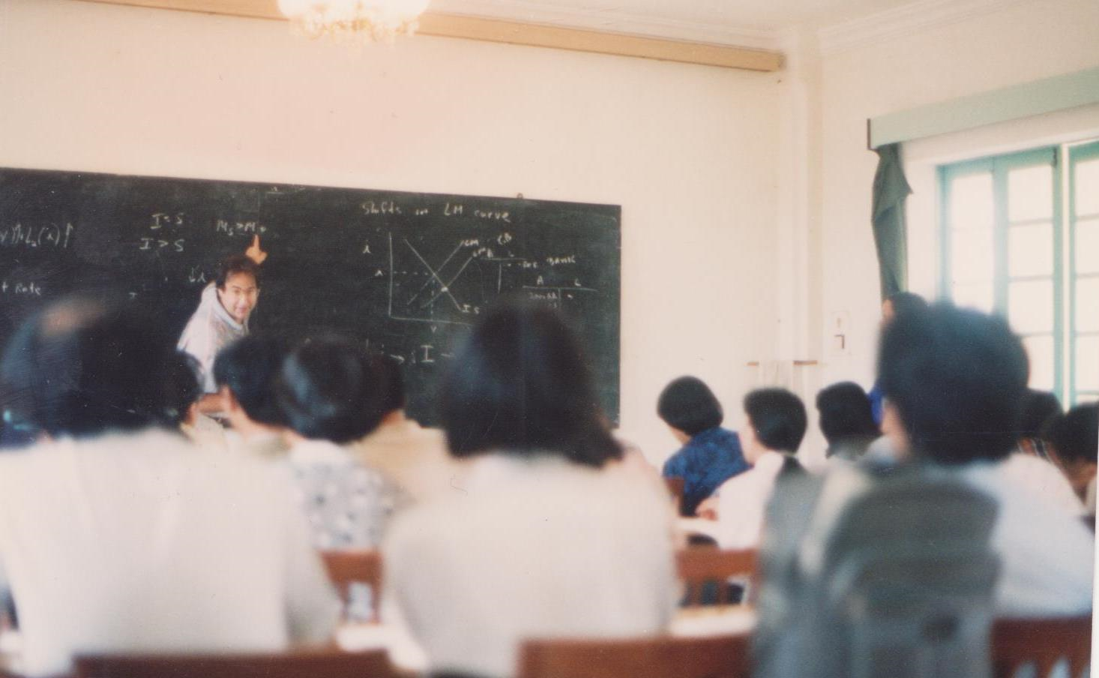

Slide 11
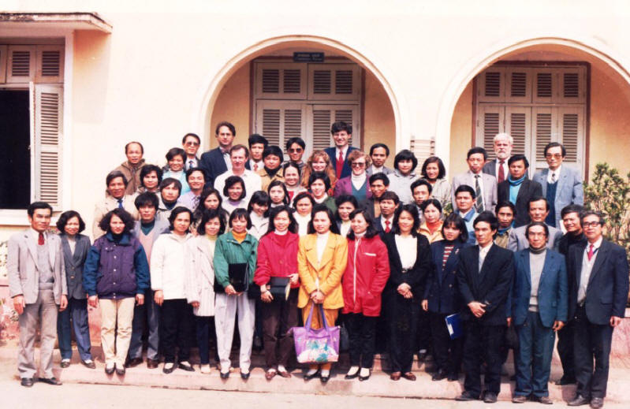

Slide 12

If you call and tell your friend you need help and could he or she come and get you a friend will ask WHY?
But a true friend will only ask “WHERE?

Slide 13



Slide 14


Slide 15
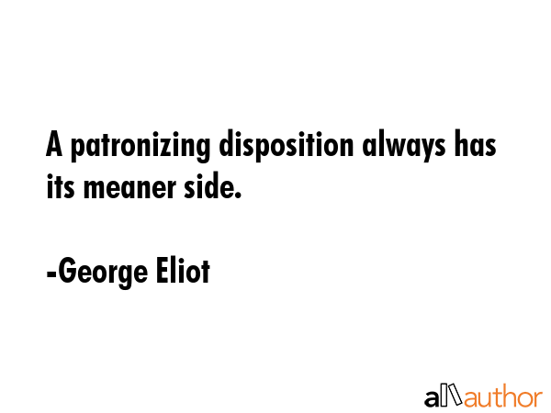

Slide 16


Slide 17


Slide 18


