Slide 1

The Role of Education in Australia’s Relationship with Asia: Should it be a Dilemma for Policymakers?
Dennis McCornac, PhD (Georgetown University Qatar)
Anne Cullen, PhD (Griffith University Australia)

Slide 2
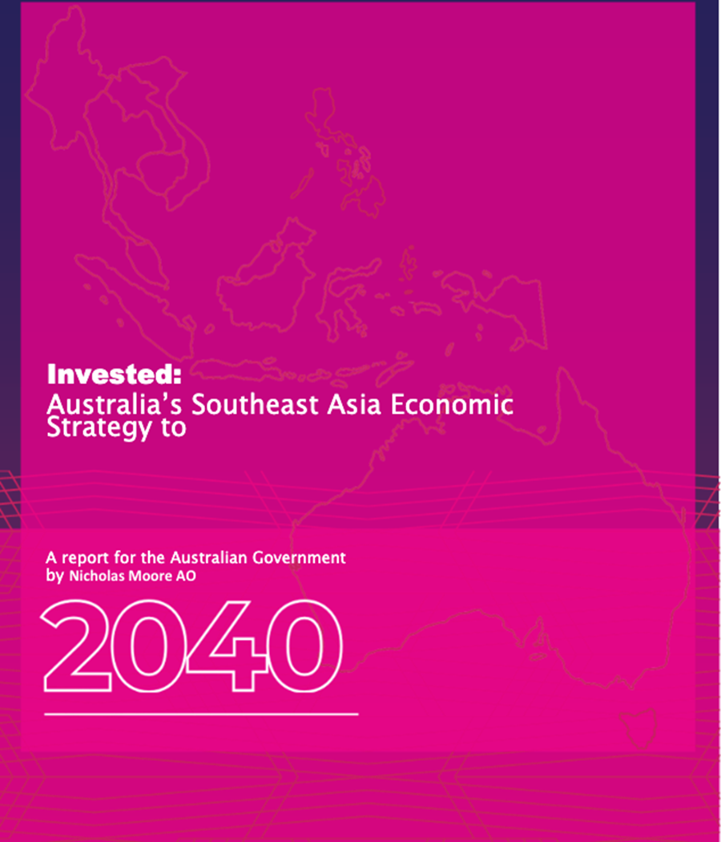
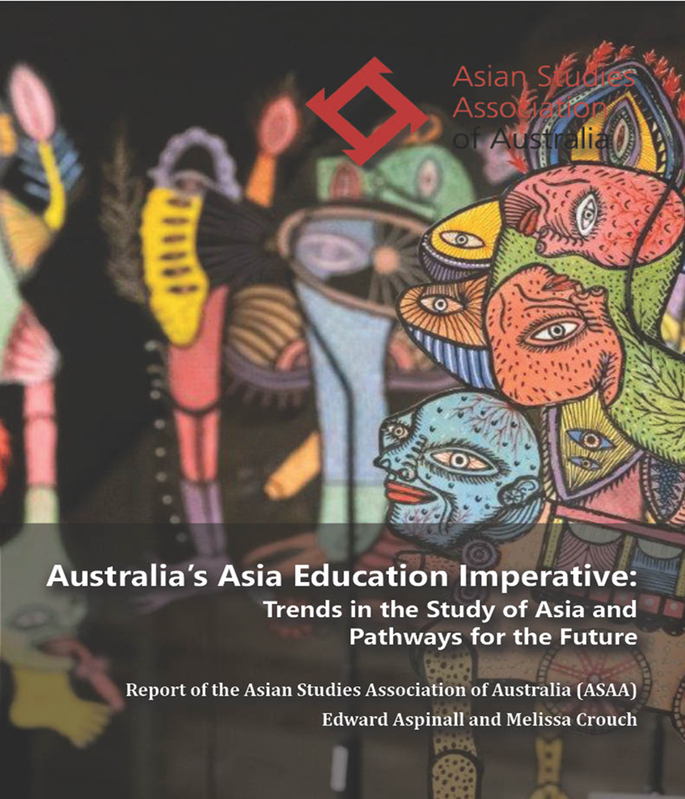
Tale of Two Reports
In 2023, two significant publications were released contemplating the relationship between Australia and Asia.
Both agree that engagement with Asia remains important to Australia’s current development and future prosperity and security.
But how that can be achieved is where the two reports diverge and mirror the bifurcated Australian community and Business School environment.

Slide 3
Invested: Australia’s Southeast Asia Economic Strategy to 2040), takes a transactional perspective.
“Australia stands to benefit from, and contribute to, [Asia’s] growth by being a reliable and high-quality supplier of commodities, including agriculture, minerals and energy, and as a provider of first-class services, particularly university education” (p.5).
Australian education is viewed as an export commodity and a means to foster market intelligence on Asia, emphasizing the dominance of trade in the relationship.
Australia’s Asia Education Imperative, emphasises the necessity for a balanced approach in Australia's economic, cultural, and security engagement with Asia.
It advocates for recognizing that the depth and quality of engagement across all fields are enhanced by knowledge of the region and advanced language skills.
The report contends that Australia's leadership in the study of Asia over the past half-century positions it favorably for such comprehensive engagement.
Together, these reports embody the dichotomy in Australia's engagement with Asia.
The word EDUCATION exemplifies the bifurcation of Australian engagement with her nearest neighbours.
EDUCATION is used in two separate, yet not separated, ways.
Education of students to create a nuanced relationship with multidisciplinary and multisectoral education.
Education as a commodity for export.

Slide 4
To understand the present relationship, we need to understand the past relationship
Pre-Colonial (1770): Makasan sea-cucumber (Trepang) fishers initiated the earliest example of Australian international trade. Indigenous Australians participated in an initially transactional trade that soon became intertwined with broader relationships, influencing culture, governance, and familial lineage.
Colonisation to WWII: trade with China and Japan despite exclusionist social policies (White Australia Policy). Australia ignored geography to align with cultures akin to the dominant “white” identity adopted for the Australian identity.
Post WWII: Dual policy:
Redolent of current realities, in the 1970s, 1980s and 1990s, Australia started slipping in per capita income behind advanced economies, while Asian tigers advanced. Singaporean Prime Minister, Lee Kuan Yew, warns Australians were on track to become “the poor white trash of Asia”
Anglophonic identity continued to shape early perceptions, limiting interactions with Asia. But the Asian Economic Miracle prompted a strategic econo-trade relation facing education.

Slide 5
Metaphors in Australia-Asia Relations
Trade focus | Relationship Focus
The Asian Century | The Cultural Mosaic
The Asian Tiger Riding the Australian Kangaroo | The Bridge Between East and West
The Two Speed Economy | The Family Dinner
The Pacific Island Asia’s Ocean | The Dance Partners
The Economic Lifeline | The Southern Anchor (security orientation)
Key Metaphors:
  TRADE-FOCUSED: imagery of economic connections.
  RELATIONSHIP-FOCUSED: reflect the evolving dynamics and complexities of Australia's engagement in the region.
  MOST ENDURING: Roller Coaster
  MOST APPROPRIATE: Trade Winds
Analysis:
  Metaphors illustrate Australia's fluctuating stance towards Asia.
Australia finds itself in a pivotal era where Asia's economic prowess is set to take centre stage -- comprising more than half the global population and contributing significantly to global GDP. As Australia navigates this transformative period, its approach to contributing to and benefiting from this shift holds significant implications for its economy and citizens.

Slide 6
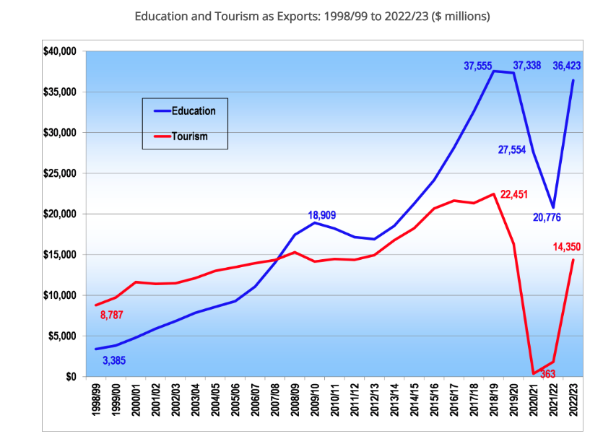
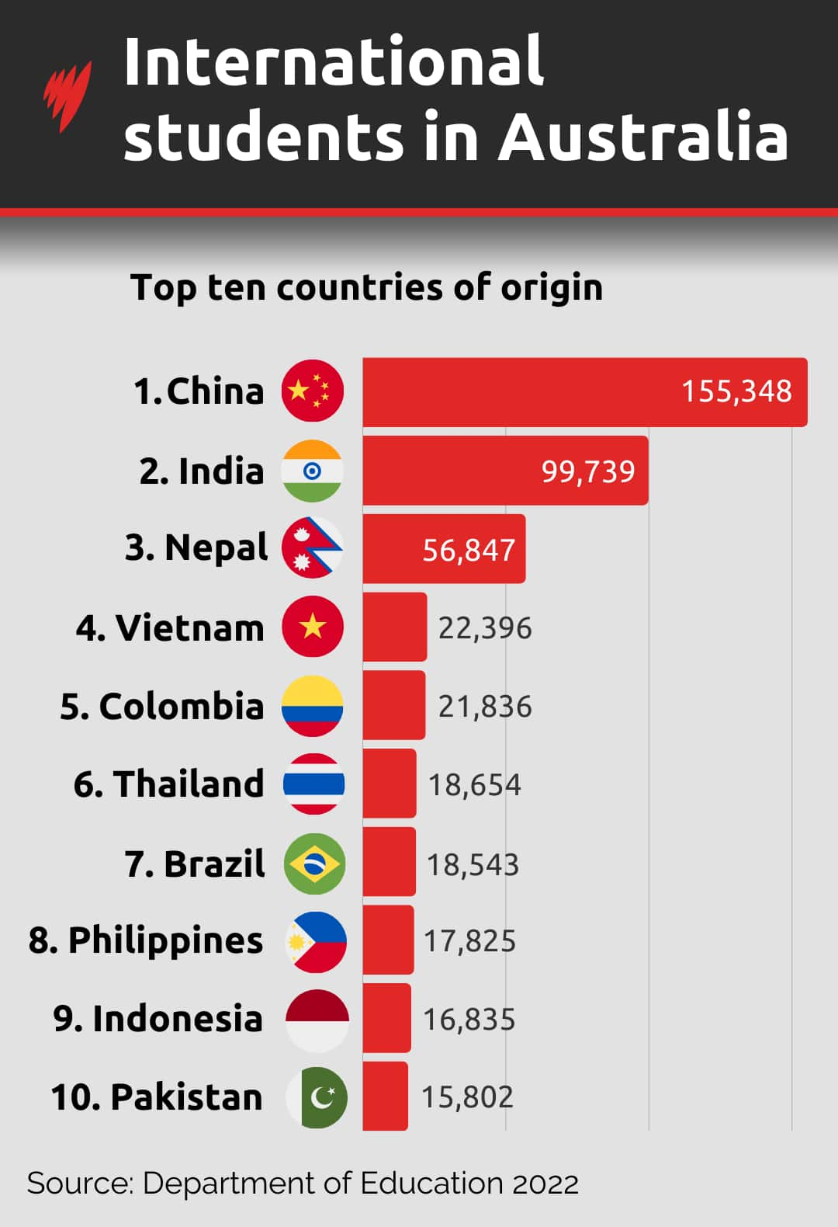
Education in 2022/23 is Australia’s fourth largest export, behind Coal, Iron Ore and Natural Gas. George Megalogenis in 2012 depicted Australia as a quarry with a view, a minerals rich continent with a physical environment attractive to international tourists. Perhaps Australia in 2024 is a quarry with a campus.
https://thekoalanews.com/education-as-an-export-for-australia-2022-23/#:~:text=Australia's%20Top%20Exports%202022%2F23,pandemic%20peak%20in%202018%2F19.
Current Dynamics

Slide 7
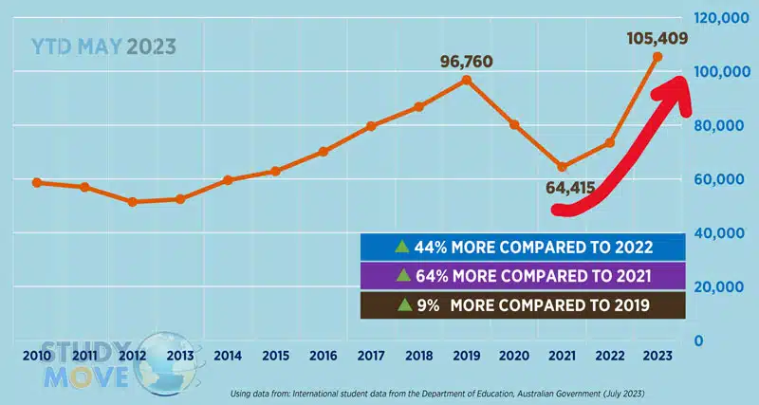
International Student Commencements in Australia

Slide 8
Current Dynamics
Present-day complexities in Australia’s engagement with Asia.
  An international cap, revealed in August 2024, means about 53,000 fewer new overseas students will be accepted in 2025 compared to 2023, a 16% cut, as the federal government responds to political pressure to reduce overall migration numbers.
Schisms in public perception, particularly towards China.
  “The whole idea that a Chinese student who wants to go to the University of Sydney will instead go to Southern Cross University is completely unrealistic. They simply won’t come to Australia,” he said.
    But what is their value? Contribution to Australian internationalism or contribution to export dollars?
Trust issues with Asian countries versus Anglophilic history.
  By focusing entirely on the impact to net overseas immigration, there is a worry that the opportunity would be missed for real reform squarely aimed at improving educational quality for Australian domestic students.

Slide 9
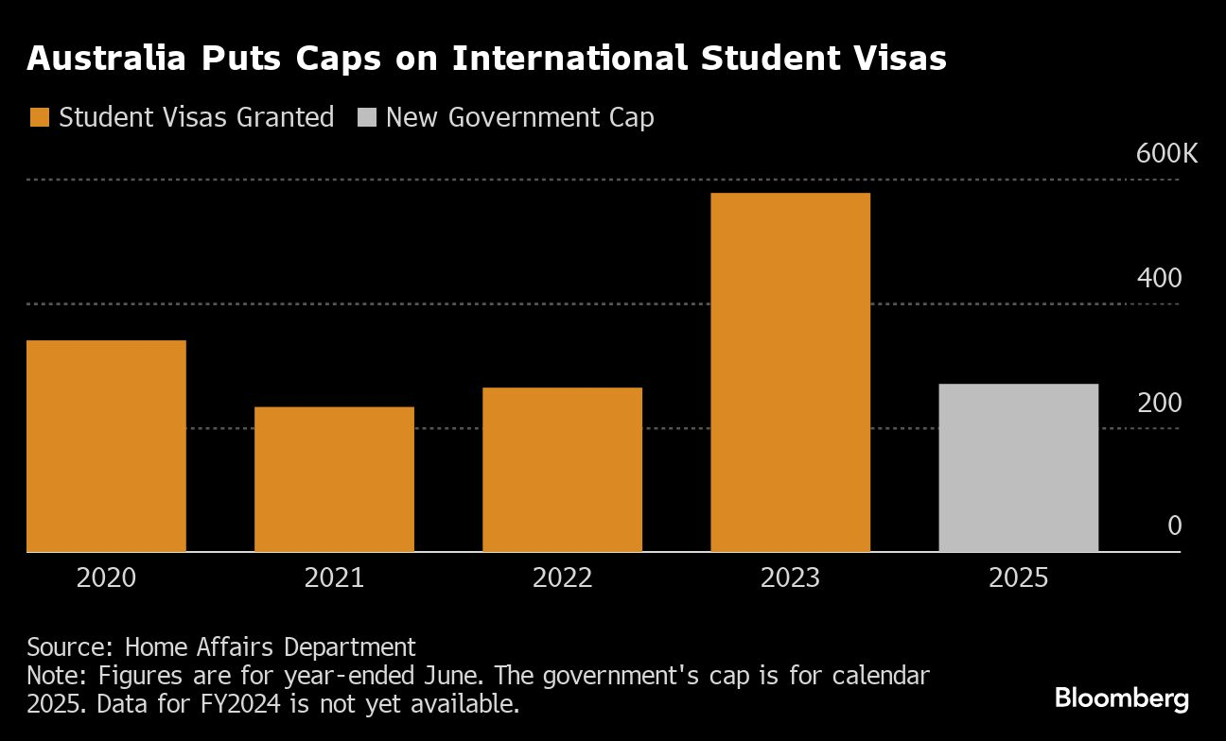

Slide 10

The Dominant Narrative
Sustainable Population Australia: “
The Australian government has allowed net migration of one million in 2022-24 and will go very close to 1.5 million, for the whole 2022-25 electoral cycle.
“Labor has perverted the purpose of education, not just by making universities and colleges dependent on the fees paid by international students, but by making it too easy for overseas graduates to gain residency.
“The desire of so many overseas students to study in Australia is less about gaining an education and more about the prospect of gaining permanent residency and working rights,” says Mr Strachan. “We have to separate immigration from education,”. “All students should be required to go home after obtaining their degree or certification and apply through normal channels for residency on an equal basis with everyone else.
“Currently, large cohorts of unqualified or unprepared students from overseas are reducing the quality and pedigree of degrees for local students. Raising entry standards for overseas students will lower numbers and restore quality learning to our universities and colleges.
Australian reports tend to fall into either a thoughtful and reflective echo-chamber or an unreflective engagement based on historical Eurocentric views.
This extract best examples the dominant popularist narrative.

Slide 11

Current Challenge:
Silences and Absences
While recognising the need for a robust trading relationship with Asian countries, reportage has historically, and remains, focused on the imperative to invest in and trade more with neighbours.
There is a resounding silence persistent in the strategies and measures required to achieve sustainable success in a rapidly evolving economic landscape.
There is a notable absence in exploring the role of education in producing Asia-capable graduates to contribute effectively to Australian trading networks. There is taciturnity on the role non-transactional education might play.
Moore’s transactional report only once mentions ‘education’ in an educational function role, when he urges the National Cabinet to consider developing a whole-of-nation plan to strengthen Southeast Asia literacy in Australian business, government, the education and training system, and the community (p.27).
Australia stands at a critical juncture where strategic thinking about education will determine her trajectory in the dynamic and flourishing economic environment of Asia. The trade winds beckon, and Australia's response will shape its future standing in the region.
So great is the importance of trade with Asia, that Australia seems to have focused specifically on the opportunity rather than the best strategy to sustain advantage within the opportunity.

Slide 12
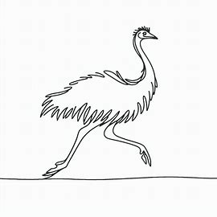
The ‘Educator’ Conundrum
How do universities equip graduates with the requisite skills to work in and with ASEAN nations as part of their future careers?
In 2024, as Australian universities are jettisoning Asian Studies the Australian government is revamping the New Columbo Plan (NCP) to encourage Asian literacy in students.
NCP (launched in 2014) offers scholarships and internships with the express objective of enhancing graduate Indo-Pacific knowledge and engagement. NCP now supports approximately 10,000 students a year.
By 2022, only 560 students took up a Southeast Asian language. Yet more than 32,000 Australian undergraduates travelled to Southeast Asia in the past decade as part of the NCP program.
Returning NCP scholars find it difficult, at best, and impossible at worst, to continue their Asian literacy journey once they return to their Australian-based university. Only 11 universities offer the Indonesian language and five offer Vietnamese – the second most spoken language in Australia.
The heady-days of the 1970-80s Australian-Asian expertise is over. It may take a generation to rebuild.
The language of the Australian Government demonstrates a keen focus on strategic security in the Indo-Pacific. Bolstering our person-to-person ties with even modest cultural and language learnings will pay outsized dividends.

Slide 13
Future ‘education’
The strategic positioning of Australia as the knowledge/business gateway to Asia, underscored by numerous free trade agreements and Prime Ministerial initiatives, reflects the nation’s commitment to leveraging its proximity for economic gain.
However, the challenges and course corrections needed for sustained success must be addressed and the absence of a focus on non-transactional education in the economic strategies poses potential risks.
This will require a comprehensive approach that integrates education into the economic strategy.
The examination of Australia's interactions with Asia through the lens of the Aspinall and Crouch report (2023) and the Moore report (2023) reveals a nuanced and evolving landscape. The contrasting perspectives presented in these publications underscore the dichotomy in Australia's approach to Asia, oscillating between a comprehensive, multidisciplinary engagement advocated by Aspinall and Crouch and a more transactional stance proposed by Moore.

Slide 14
At the core of this discussion, we are concerned about the ambiguous use of the term “education” in discussions regarding both trade opportunities and student skilling.
It is important to note that the concept of education in these reports typically aligns with a commercial perspective, emphasising education as a commodity for sale.
However, educators prioritise a broader understanding, focusing on imparting knowledge, skills, and scholarship related to Asia.
The interpretation of "education" in these reports is the dilemma for policymakers in assessing the role of education in Australia’s relationship with Asia

Slide 15
Our Words of Advice
In navigating the Asian Century, Australia stands at a critical juncture where strategic thinking, innovation, and a comprehensive approach to education and business engagement will determine its trajectory. The call for a whole-of-nation plan to strengthen Asia literacy must extend beyond surface recommendations and include a more inclusive role for Australian universities in shaping a future where Australia's engagement with Asia is not only economically advantageous but culturally informed and sustainable. The trade winds beckon and Australia's response will shape its future standing in the dynamic and flourishing economic environment of Asia.

Slide 16
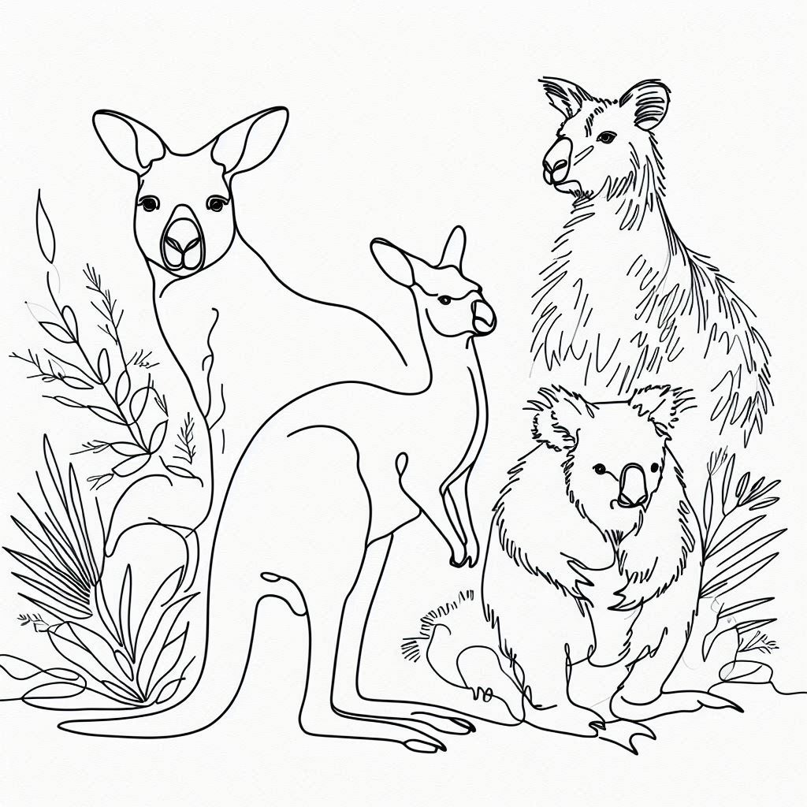
THANK YOU

