Slide 1
The Anatomy of Factor Markets
  Four factors of production are
  Labor
  Capital
  Land (natural resources)
  Entrepreneurship
  Market for Labor Services
  Labor services are the physical and mental work effort that people supply to produce goods and services.
  A labor market is a collection of people and firms who trade labor services.
  The price of labor services is the wage rate.
  Most labor markets have many buyers and many sellers and are competitive. In these labor markets, the wage rate is determined by supply and demand.

Slide 2
The Anatomy of Factor Markets
  Market for Capital Services - Capital consists of the tools, instruments, machines, buildings, and other constructions that have been produced in the past and that businesses now use to produce goods and services.
  A market for capital services is a rental market—a market in which the services of capital are hired.
  Markets for Land Services and Natural Resources - Land consists of all the gifts of nature—natural resources. The market for land as a factor of production is the market for the services of land—the use of land.
  The price of the services of land is a rental rate.
  Nonrenewable natural resources are resources that can be used only once, such as oil, natural gas, and coal.
  Entrepreneurship - Entrepreneurship services are not traded in markets.
  Entrepreneurs receive the profit or bear the loss that results from their business decisions

Slide 3
The Demand for a Factor of Production
  The demand for a factor of production is a derived demand—it is derived from the demand for the goods that it is used to produce.
  The quantities of factors of production demanded are a consequence of firms’ output decisions.
  A firm hires the quantities of factors of production that maximize its profit.
  The value to the firm of hiring one more unit of a factor of production is called the value of marginal product.
Value of marginal product of a factor = Price of a unit of output × Marginal product of the factor.
  VMP equals marginal product of labor multiplied by the market price of the good produced.
  We are assuming the firm is a price taker.

Slide 4
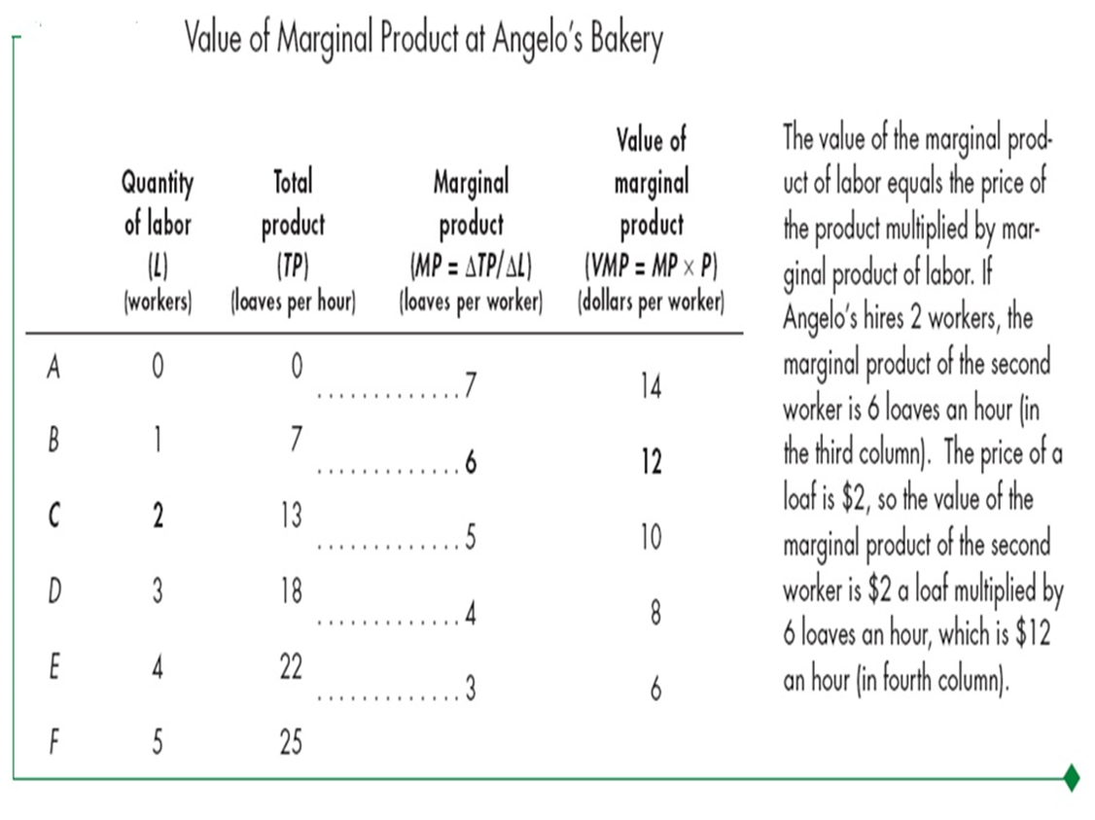

Slide 5
The Demand for a Factor of Production
The Firm’s Demand for Labor
  The value of the marginal product of labor (VMP) tells us what an additional worker is worth to a firm or the revenue that the firm earns by hiring one more worker.
  The wage rate tells us what an additional worker costs a firm.
  VMP and the wage rate together determine the quantity of labor demanded by a firm.
The firm maximizes its profit by hiring the quantity of labor at which
VMP = the wage rate or W = MPL x P
If VMP exceeds the wage rate, the firm can increase profit by employing one more worker.
If VMP is less than the wage rate, the firm can increase profit by firing one worker.
Only if VMP equals the wage rate is the firm maximizing profit.

Slide 6
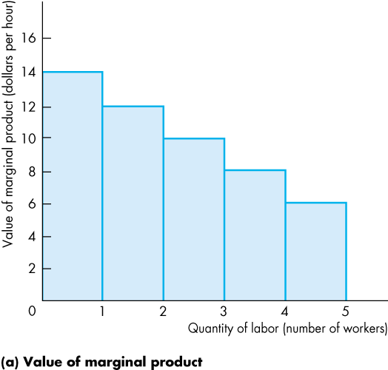
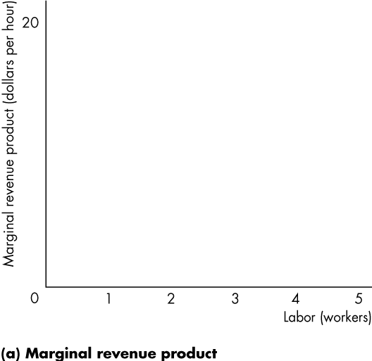
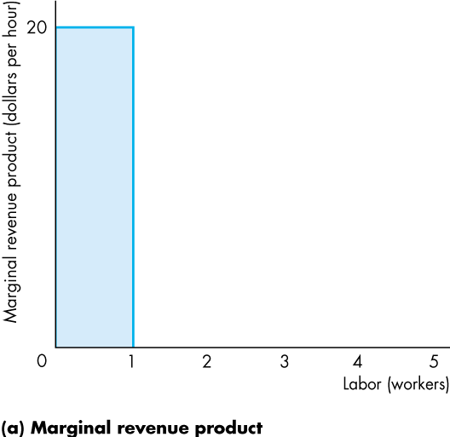
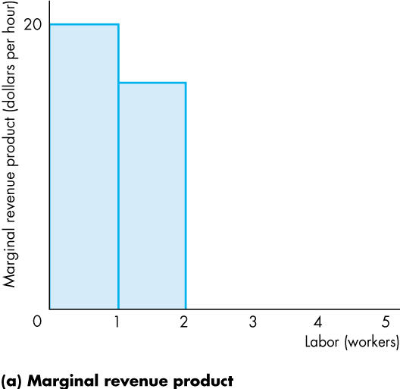
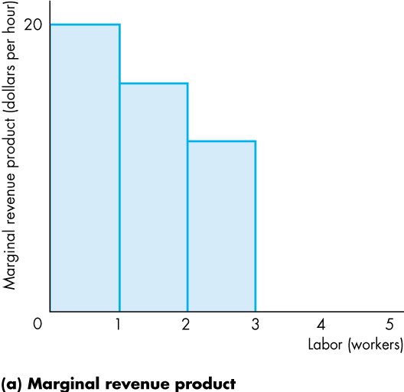
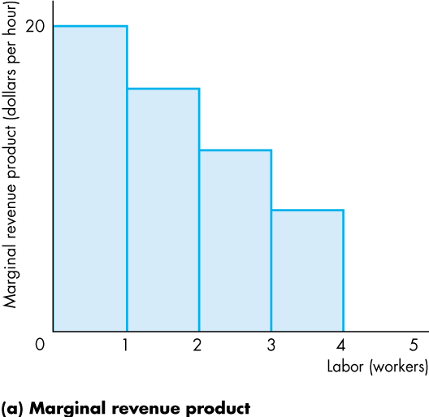
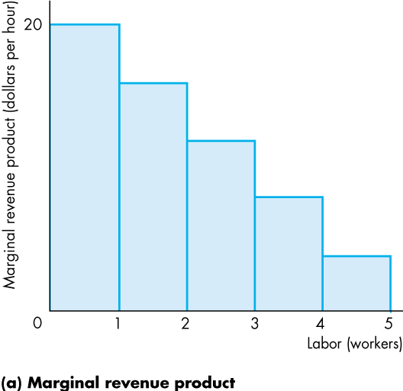
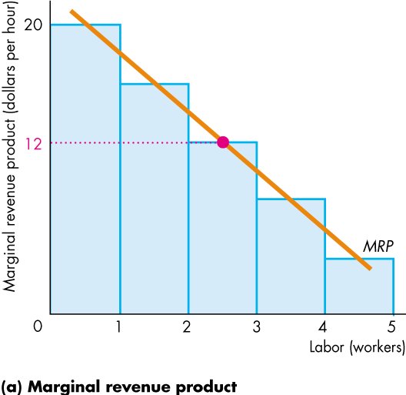
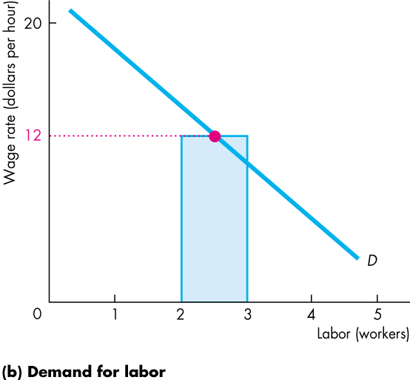
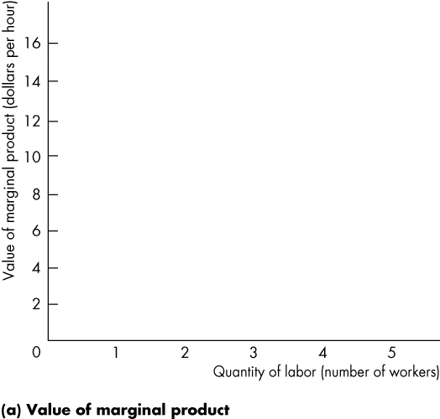
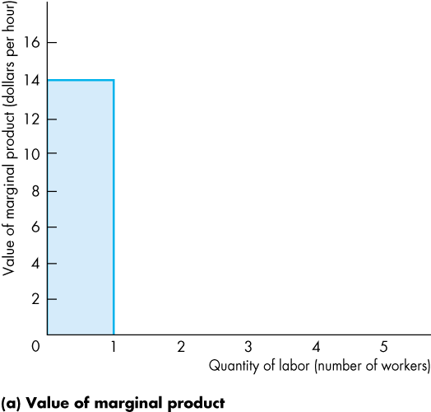
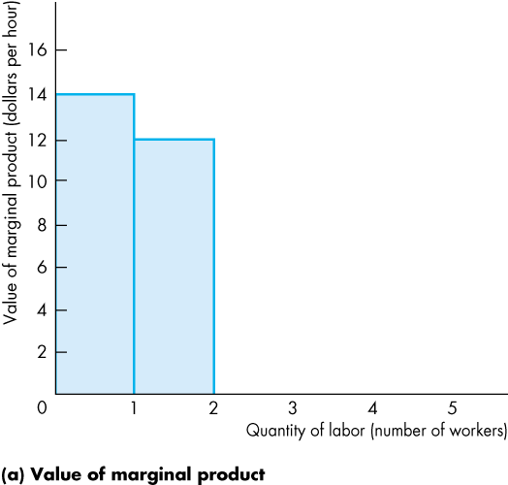
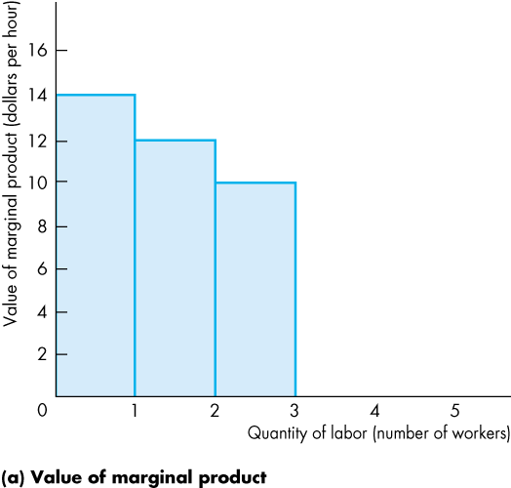
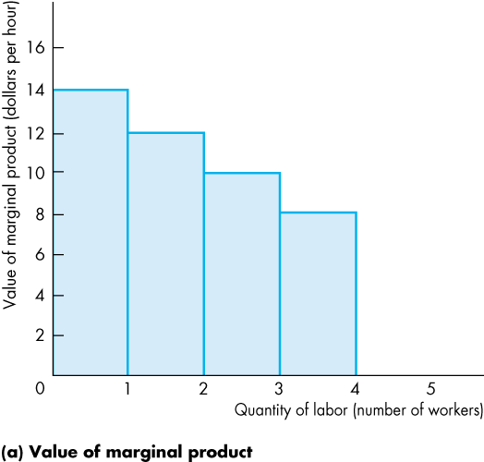
The Demand for a Factor of Production
  The figure shows the relationship between a firm’s value of marginal product and its demand for labor.
  The bars show the value of marginal product, which diminishes as the quantity of labor employed increases.

Slide 7
VMP = Firm’s Labor Demand
We assume we know the wage rate or W. The firm will hire workers such that VMP = W or MP_{L} * P = W.
$11
A
B
10
9
8
VMP
7
6
VALUE OF MARGINAL PRODUCT
(dollars per hour)
5
C
4
Wage rate
3
D
2
1
0
1
2
3
4
5
6
7
8
9
QUANTITY OF LABOR (workers per hour)
An employer will continue to hire people until the VMP has declined to the level of the market wage rate.

Slide 8
Demand for Capital and Land
Using similar logic to that for labor markets, we can show that:
VMPK (MPK x P) = R_{K} (the rental cost of capital)
R_{K} = MPK x P
VMPT (MPT x P) = R_{T} (the rental cost of land)
R_{T} = MPT x P

