Slide 1
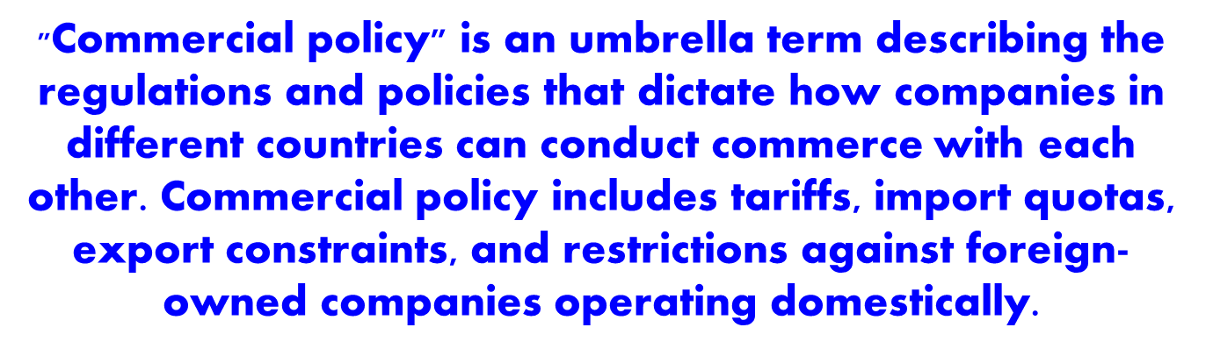
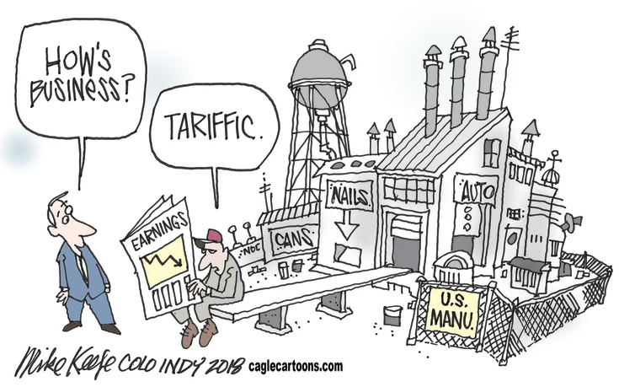
Commercial Policy

Slide 2
The Costs of Protectionism
There are several reasons why further trade opening is beneficial even if the dollar values of the gains are not that high.
keep their markets open when there is a severe downturn avoids protectionist and retaliation behavior and no one gained an advantage.
trade increases exposure of countries to each other, and in the process, it leads to new knowledge.
trade protection is grossly inefficient in achieving the goals it seeks

Slide 3
The Logic of Collective Action
Given that the costs of tariffs and quotas are high to consumers, why do consumers tolerate them?
Economist Mancur Olson’s studies make two points:
  The costs of tariffs and quotas are borne by a great many people: everyone pays a little for protection
  The benefits of protection is concentrated in a few industries: few benefit a lot from protection
  Thus, there is an asymmetry in the incentives to oppose the policy: those benefiting from protection have much greater incentives than those hurt by it to lobby for it

Slide 4
Why Nations Protect Their Industries: Revenue
In a developing country’s economy, a large percentage of economic activity is unrecorded making income taxes and sales taxes are difficult if not impossible to impose.
Tariffs, can be relatively easily collected at the ports and border crossings.
Poorer regions (Africa, South Asia, parts of the Middle East) rely more on tariffs as a source of government revenue.
Tariffs may still be used for other purposes, but for some countries, the primary goal is to generate income for the operation of government services.

Slide 5
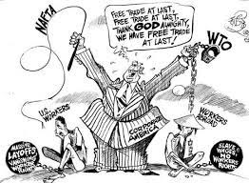
Why Nations Protect Their Industries: The Labor Argument
The Labor Argument: Protection must be used against imports from countries where wages are much lower
  – Problem: Does not consider differences in productivity between different workforces: As productivity rises, so will wages

Slide 6
Why Nations Protect Their Industries: The Infant Industry Argument
Infant Industry Argument: mainly associated with the tariff policies of developing nations to protect their “infant” industries against the competition of more mature firms in industrial countries.
- Assumes: (1) market forces do not allow for the development of a certain industry and (2) the industry has positive externalities—spillover benefits (valuable linkages to other industries or technologies)
- Problems: does not demonstrate that there is some inherent advantage in making something as opposed to buying it

Slide 7
Why Nations Protect Their Industries: The National Security Argument
National Security Argument: Certain industries must be protected in order to guard national security (military security, cultural values)
  - Prohibitions imposed on exports or tariffs on imports to develop domestic mineral or other resources are often not an optimal policy.
  - Usually more efficient to build stockpiles of minerals and other materials by buying large quantities in peacetime when less expensive.

Slide 8
Why Nations Protect Their Industries: The Cultural Protection Argument
The cultural industries include movies, television programming, music, print media, theater, and art.
Goal of protecting national cultural values is usually an argument in favor of protecting a nation’s filmmaking, television programming, and music production against complete domination by its U.S. counterparts

Slide 9
Why Nations Protect Their Industries: The Retaliation Argument
Retaliation Argument: Another country's trade barriers must be countered with trade barriers
  - Problems: Although retaliation can provide an incentive for trade negotiations, it can also lead to escalating trade wars

Slide 10
Protect a Favored Industry
P
S
Costs are borne by the (many) consumers of the product of the protected industry
Benefits go only to the (few) producers in the protected industry
a
c
b
d
D
Q
But Not Optimal

Slide 11
Un-sensible Reasons for Protection
“Un-sensible”?
  Reasons that are based on misunderstanding of what protection will actually do
Pauper Labor Argument
  “We hold that the most efficient way of protecting American labor is to prevent the importation of foreign pauper labor to compete with it in the home market…” (Democratic Party Platform, July 9, 1896)
  Based on belief that trade with poor countries will drive US wages down to the very low (“pauper”) levels of poor countries

Slide 12
Un-sensible Reasons for Protection
Pauper Labor Argument – Answer
  See Ricardian Model: Labor in poor countries earns low wages because it is less productive than labor in rich countries. Trade will in fact raise wages in both
  Caveat: Heckscher-Ohlin Model implies Factor Price Equalization (FPE)
    At level above poor-country autarky wage
    But below the rich-country autarky wage
    Thus an element of truth to the pauper labor argument
    But empirical evidence indicates technology differences account for much of the wage difference, preventing FPE
    Thus rich-country wages may fall due to trade,
    but not nearly to poor-country levels

Slide 13
Un-sensible Reasons for Protection
Fairness Argument
  It is “unfair” to make workers compete with those who are either more productive or lower paid.
  Analogy is to players in a game, who want a “level playing field” because one side must lose.
Answer
  Trade is not a “zero-sum game”: There are benefits for both countries
    If “field is tilted” favoring another country’s exports (e.g., by a subsidy, low wages, or cheap currency), we actually benefit from that through cheap imports.
  Also, even those who lose can be compensated by others in their countries, who gain

Slide 14

Un-sensible Reasons for Protection
Patriotism Argument
  “We should buy from producers inside our country, so that the benefit goes to them instead of to foreigners.”
Patriotism Argument - Answer
  This confuses costs and benefits: in fact, buyers benefit from consumption, while sellers incur the cost of production
  If we import and don’t export, then we enjoy the fruits of someone else’s labor
  If we both import and export, then comparative advantage says that we (and they) both benefit more

Slide 15
Un-sensible Reasons for Protection
Retaliation Argument
  “If others use tariffs against our exports, then we should use tariffs against their exports.”
  This assumes that their tariffs hurt us (which they do), and that we gain by fighting back
Answer
  From the theory, foreign tariffs are irrelevant to the effects of our own tariffs
  If using a tariff would hurt us when others do not protect, then it will also hurt us when they do
  So retaliation does not help us

Slide 16
Sensible Reasons for Protection
“Sensible”?
  Reasons based on effects that protection may actually have
  These too have counter-arguments
    Why they may not work
    Why another policy would work better
    (that is, protection is “second best”)

Slide 17
Sensible Reasons for Protection
Revenue Argument
  Tariffs collect revenue for government
  Tariffs may be the only tax that a weak government can manage
    Tariffs are easier to collect than other taxes, because you only have to monitor the border (not the whole inside of the country)
Counter-argument: Tariff is 2nd best
  If other taxes are feasible, then almost any other tax causes less distortion than a tariff
  Reason: A tariff distorts both supply and demand
  Example: Tax consumption…

Slide 18
Sensible Reasons for Protection
Optimal Tariff Argument
  We saw this when we analyzed a large country: Tariff can improve the country’s terms of trade and thus raise its welfare
Counter-arguments
  Optimal tariff benefits the country only at the expense of other countries
    Other countries lose more than this country gains
    Use of a tariff for this purpose is therefore both inefficient and unethical
    It’s NOT NICE!
  More practically, other countries are likely to retaliate, with tariffs of their own
    Then everybody loses (probably)

Slide 19
Sensible Reasons for Protection
Infant Industry Argument
  When a developing country is trying to start a new industry, there are reasons why a tariff may help
  We’ll discuss this further later, when we look at trade and development
Counter-argument: Protection is 2nd best
  As we will see, a direct subsidy to the industry is a less costly way of helping an infant industry (in terms of welfare, not budget)

Slide 20
Sensible Reasons for Protection
National Security Arguments
  Protect a military capability (e.g., steel, motor vehicles)
  Reduce vulnerability to disruptions of supply (e.g., oil)
  Note: Reading by Kain, which sites National Security. But his argument is not about this. We’ll see it later.
Counter-argument: Protection is 2nd best
  Direct subsidy to industry is better
  Other even better options also exist (e.g., stockpile the good, as in the US Strategic Petroleum Reserve)

Slide 21
Sensible Reasons for Protection
Cultural Argument
  Imports displace products of domestic culture
    French films
    Canadian music
  By limiting imports, distinctive domestic producers are allowed to survive
Counter-argument: Protection is 2nd best
  Direct subsidy to industry would be better
  Subsidy leaves consumers free to choose: perhaps they really prefer foreign culture

Slide 22
Sensible Reasons for Protection
Unfair Trade
  If foreign exports are “dumped” or subsidized (thus below a “fair” price), domestic producers deserve protection
  See Mastel, “Keep Anti-Dumping Laws Intact”
    He cites: industrial subsidies, market collusion, government pricing, and sanctuary markets
Counter-argument:
  Domestic import-competing firms do lose from “unfair trade,” but consumers in their country gain more than the firms lose, from the cheap imports
  Protection is “sensible” here because it does benefit domestic producers
  But here again it is second best.

Slide 23
Sensible Reasons for Protection
Protect Favored Industry
  Sometimes governments simply want to help an industry
    To get their political support
    And/or because workers in the industry are suffering
  Protection (tariff or quota) certainly does help the protected industry (area “a” in our figures)
Counter-argument: Protection is 2nd best
  Direct subsidy to industry can help just as much, at lower cost
  Subsidy is also more transparent and easier to evaluate

Slide 24
Sensible Reasons for Protection
Retaliation
  Direct effect of retaliation: Negative, as we’ve seen
    Our retaliation against foreign barriers makes us worse off
  Possible indirect effect of retaliation: May change behavior of foreign governments
    Tariffs against “unfair” trade policies: May cause those policies to cease.
    Tariffs in retaliation against optimal tariff: May cause optimal tariff to be withdrawn
  WTO uses permission to retaliate as a means of enforcing its rules

