Slide 1

ECON 243 – International Trade
Chapter 9 - Import Tariffs and Quotas Under
Imperfect Competition
© 2021 Worth Publishers
International Economics, 5e | Feenstra/Taylor

Slide 2
Questions to Consider
Can governments use trade policy to give home firms a strategic advantage in their markets?
Why would foreign firms dump their products by exporting them at a price below their costs?
Is there an argument for using infant industry protection, and has it worked in practice?

Slide 3
Introduction
Do the effects of trade policies differ when an industry is young and there are only a small number of producers, so markets are imperfectly competitive? In mature industries with only a small number of producers, can a government help these firms gain an advantage in international markets?
These questions received a lot of attention from trade economists in the 1980s, in a body of research that became known as strategic trade policy.
In this chapter, we use the extreme case of a single producer—a Home or Foreign monopoly—to see how tariffs and quotas affect prices, trade, and welfare.

Slide 4
Introduction
A specific example of a Foreign monopolist is the Foreign discriminating monopoly, which charges a lower price to Home than to firms in its own local market and is, therefore, dumping its product into the Home market.
A tariff applied against a Foreign discriminating monopoly is called an antidumping duty.
The final case we analyze is an infant industry at Home, by which we mean an industry that is too young to have achieved its lowest costs.

Slide 5
Tariffs and Quotas with Home Monopoly
Tariffs and quotas affect the trade equilibrium differently because of their impact on the Home monopoly’s market power, the extent to which a firm can set its price.
With a tariff, the Home monopolist still competes against a large number of importers, and so its market power is limited.
With an import quota, once the quota limit is reached, the monopolist is the only producer able to sell in the Home market. The monopolist is again able to exercise its market power.
This section describes the Home equilibrium with and without trade and explains the difference between tariffs and quotas.

Slide 6
Tariffs and Quotas with Home Monopoly
No-Trade Equilibrium
The extra revenue earned from selling one more unit is the marginal revenue.
To maximize its profits, the monopolist produces at the point where the marginal revenue, MR, earned from selling one more unit equals the marginal cost, MC, of producing one more unit.

Slide 7
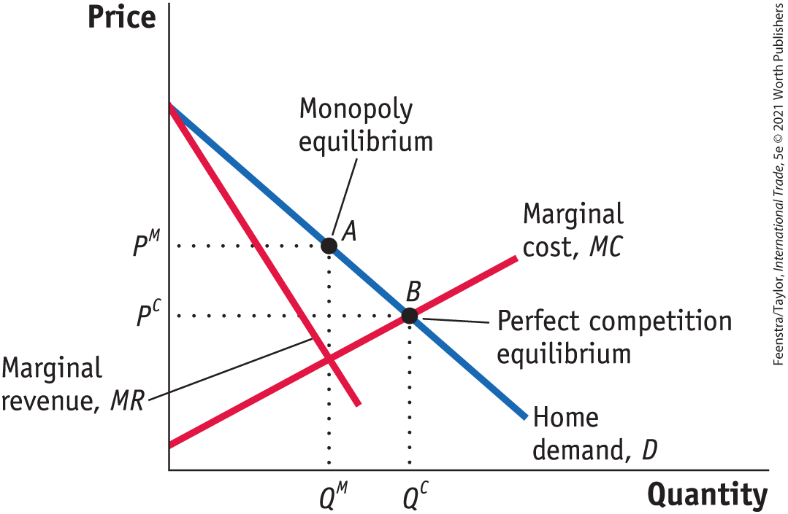
Tariffs and Quotas with Home Monopoly
No-Trade Equilibrium - FIGURE 9-1
No-Trade Equilibrium In the absence of international trade, the monopoly equilibrium at Home occurs at the quantity Q^{M}, where marginal revenue equals marginal cost.
From that quantity, we trace up to the demand curve at point A, and the price charged is P^{M}.
Under perfect competition, the industry supply curve is MC, so the no-trade equilibrium would occur where demand equals supply (point B), at the quantity Q^{C} and the price P^{C}.
Comparison with Perfect Competition - In the absence of trade, the monopolist restricts its quantity sold to increase the market price. Under free trade, however, the monopolist cannot limit quantity and raise price.

Slide 8
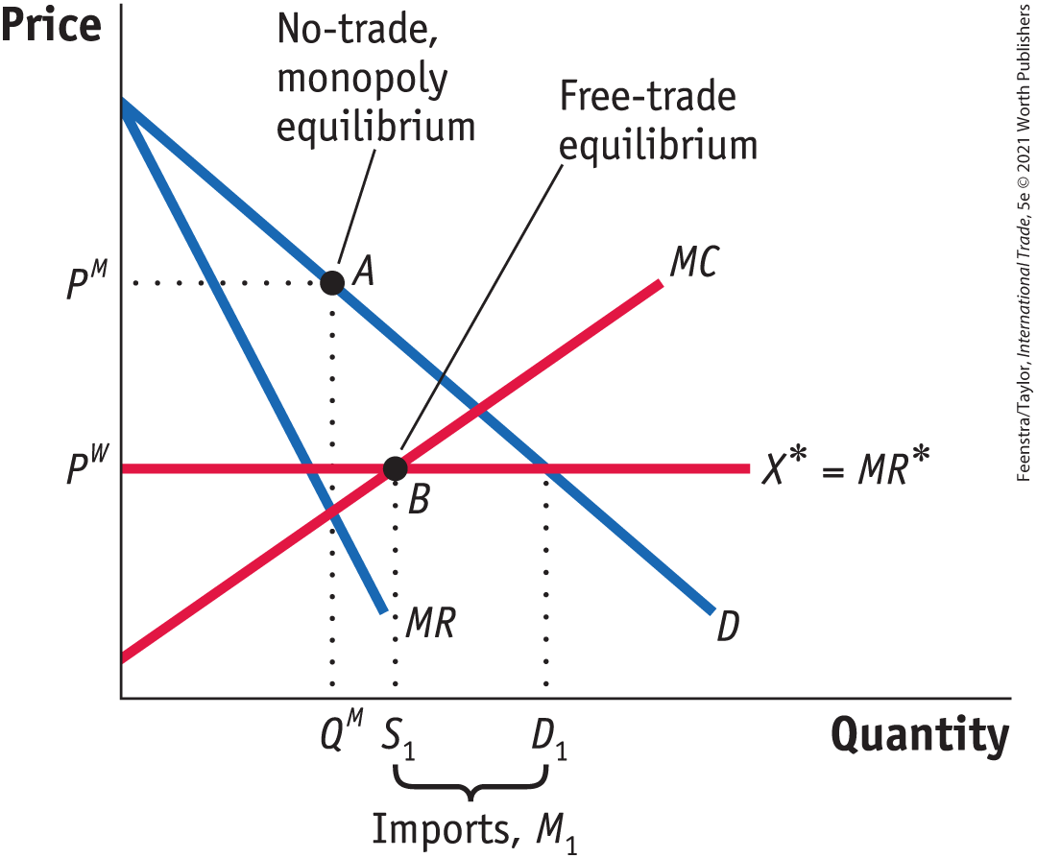
Tariffs and Quotas with Home Monopoly
Free-Trade Equilibrium - FIGURE 9-2 Home Monopoly’s Free-Trade Equilibrium
Under free trade at the fixed world price P^{W}, Home faces Foreign export supply of X*at that price.
Because the Home firm cannot raise its price above P^{W} without losing all of its customers to imports, X* is now also the demand curve faced by the Home monopolist.
Because the price is fixed, the marginal revenue MR* is the same as the demand curve. Profits are maximized at point B, where marginal revenue equals marginal costs.

Slide 9
Tariffs and Quotas with Home Monopoly
Free-Trade Equilibrium - FIGURE 9-2 Home Monopoly’s Free-Trade Equilibrium
The Home firm supplies S₁, and Home consumers demand D₁. The difference between these is imports, M₁ = D₁ − S₁.
Because the Home monopoly now sets its price at marginal cost, the same free-trade equilibrium holds under perfect competition.
Comparison with Perfect Competition Under free trade for a small country, then, a Home monopolist produces the same quantity and charges the same price as a perfectly competitive industry. The reason for this result is that free trade for a small country eliminates the monopolist’s control over price, that is, its market power.

Slide 10

A Closer Look

Slide 11
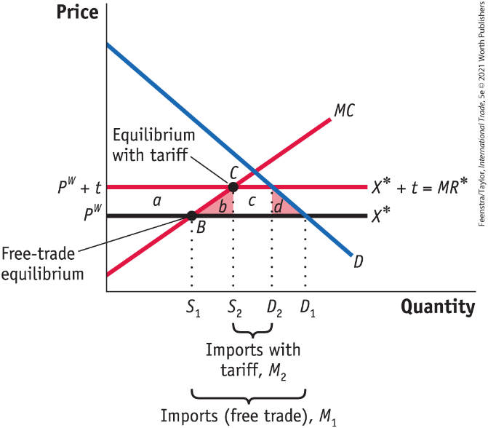
Tariffs and Quotas with Home Monopoly
Effect of a Home Tariff - FIGURE 9-3 Tariff with Home Monopoly
The result is fewer imports, M₂, because Home supply S increases and Home demand D decreases. The deadweight loss of the tariff is measured by the area (b + d). This result is the same as would have been obtained under perfect competition because the Home monopolist is still charging a price equal to its marginal cost.
Comparison with Perfect Competition Because the monopolist has limited control over its price, it behaves in the same way a competitive industry would when facing the tariff.

Slide 12
Tariffs and Quotas with Home Monopoly
Effect of a Home Tariff - FIGURE 9-3 Tariff with Home Monopoly
Initially, under free trade at the fixed world price P^{W}, the monopolist faces the horizontal demand curve (and marginal revenue curve) X*, and profits are maximized at point B.
When a tariff t is imposed, the export supply curve shifts up since Foreign firms must charge P^{W} + t in the Home market to earn P^{W}. This allows the Home monopolist to increase its domestic price to P^{W} + t, but no higher, since otherwise it would lose all of its customers to imports.
Home Loss Due to the Tariff
Fall in consumer surplus: −(a + b + c + d)
Rise in producer surplus: +a
Rise in government revenue: +c
Net effect on Home welfare: −(b + d)

Slide 13
A Closer View
Home Loss Due to the Tariff
Fall in consumer surplus: −(a + b + c + d) Rise in producer surplus: +a
Rise in government revenue: +c Net effect on Home welfare: −(b + d)

Slide 14
Tariffs and Quotas with Home Monopoly
Effect of a Home Quota
Now we can look at the effect of an import quota and compare it to the effect of a tariff.
The quota results in a higher price for Home consumers because it creates a “sheltered” market for the Home firm, allowing it to exercise its monopoly power, which leads to higher prices than under a tariff.
This is another reason why the World Trade Organization has encouraged countries to replace many quotas with tariffs.

Slide 15
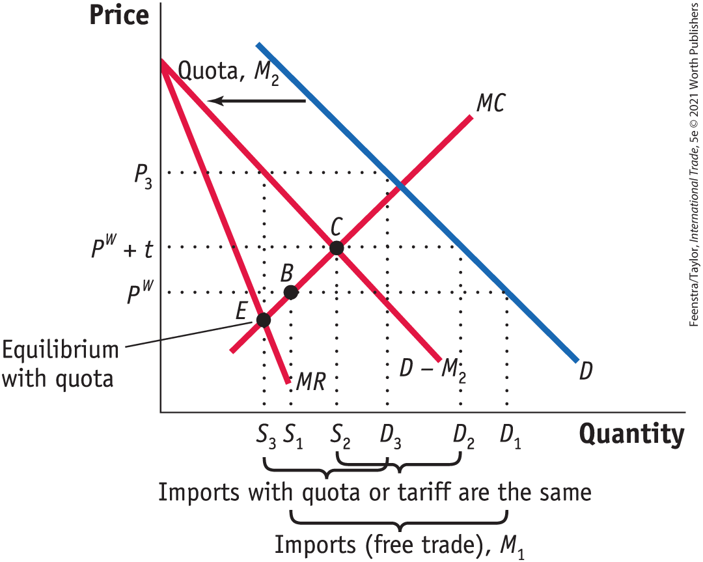
Tariffs and Quotas with Home Monopoly
Effect of a Home Quota - FIGURE 9-4 Effect of Quota with Home Monopoly
Under free trade, the Home monopolist produces at point B and charges the world price of P^{W}.
With a tariff of t, the monopolist produces at point C and charges the price of P^{W} + t. Imports under the tariff are M₂ = D₂ − S₂.
Under a quota of M₂, the demand curve shifts to the left by that amount, resulting in the demand D − M₂ faced by the Home monopolist. That is, after M₂ units are imported, the monopolist is the only firm able to sell at Home, and so it can choose a price anywhere along the demand curve D – M₂.

Slide 16
Tariffs and Quotas with Home Monopoly
Effect of a Home Quota - FIGURE 9-4 Effect of Quota with Home Monopoly
The marginal revenue curve corresponding to D − M₂ is MR, and so with a quota, the Home monopolist produces at point E, where MR equals MC.
The price charged at point E is P₃ > P^{W} + t, so the quota leads to a higher Home price than the tariff.
Home Loss Due to the Quota Because Home prices are higher with a quota than with a tariff, Home consumers suffer a greater fall in surplus because of the quota. The Home monopolist earns higher profit from the quota because its price is higher.

Slide 17

A Closer Look

Slide 18
APPLICATION: U.S. Imports of Japanese Automobiles
A well-known case of a “voluntary” export restraint (VER) for the United States occurred during the 1980s when the United States limited the imports of cars from Japan.
A recession led to less spending on durable goods (such as automobiles), and as a result unemployment in the auto industry rose sharply.
In 1980, the United Automobile Workers and Ford Motor Company applied to the International Trade Commission (ITC) for protection under Article XIX of GATT and Section 201 of U.S. trade laws.

Slide 19
APPLICATION: U.S. Imports of Japanese Automobiles
The ITC determined that the U.S. recession was a more important cause of injury to the auto industry than increased imports. It did not recommend that the auto industry receive protection.
In response, several congressional representatives with auto plants in their states pursued other means. A bill was introduced in the U.S. Senate to restrict imports.
Aware of this pending legislation, the Japanese government announced it would “voluntarily” limit Japan’s export of automobiles to the U.S. market.
By 1988, Japanese exports fell below the VER limit because Japanese firms began assembling cars in the United States.

Slide 20
APPLICATION: U.S. Imports of Japanese Automobiles
Under the VER, the average price of U.S. cars rose very rapidly: a 43% increase from 1979 to 1981.
This was due to the exercise of market power by the U.S. producers, who were sheltered by the quota.
Japanese firms benefited by combining a price increase with an improvement in quality.
The quality of U.S. cars did not rise by as much as the quality of Japanese imports, as seen in Figure 9.5.
The fact that both the Japanese and U.S. firms were able to increase their prices substantially indicates that the policy was very costly to U.S. consumers.

Slide 21
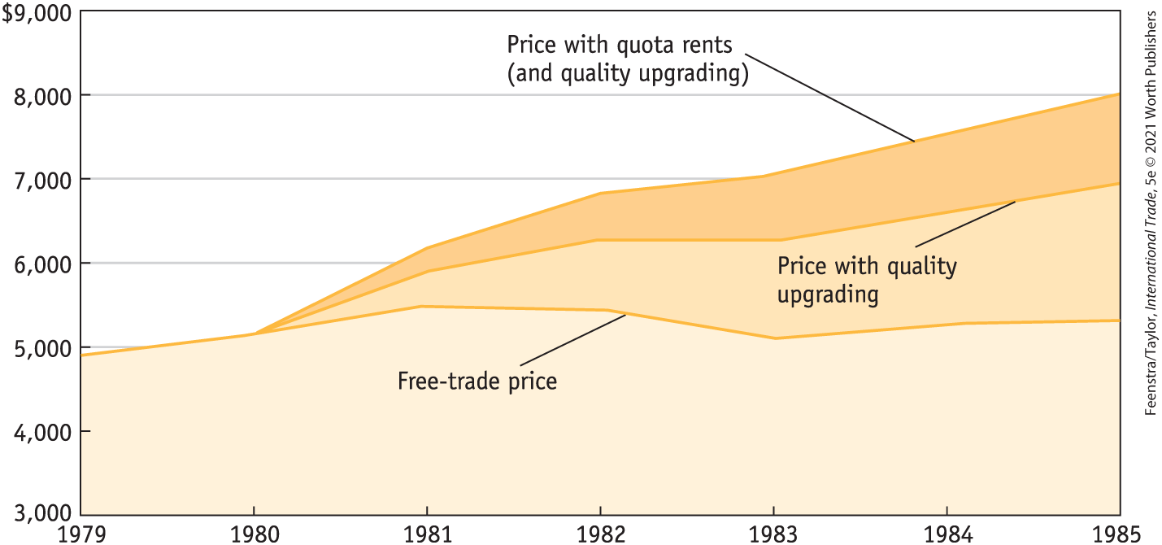
APPLICATION: U.S. Imports of Japanese Automobiles
Price and Quality of Imports - FIGURE 9-5 Prices of Japanese Car Imports
Under the “voluntary” export restraint (VER) on Japanese car imports, the average price rose from $5,150 to $8,050 between 1980 and 1985. Of that $2,900 increase, $1,100 was the result of quota rent increases earned by Japanese producers.

Slide 22
APPLICATION: U.S. Imports of Japanese Automobiles
Price and Quality of Imports - FIGURE 9-5 Prices of Japanese Car Imports
Another $1,650 was the result of quality improvements in the Japanese cars, which became heavier and wider, with improved horsepower, transmissions, and so on. The remaining $150 is the amount that import prices would have risen under free trade.

Slide 23
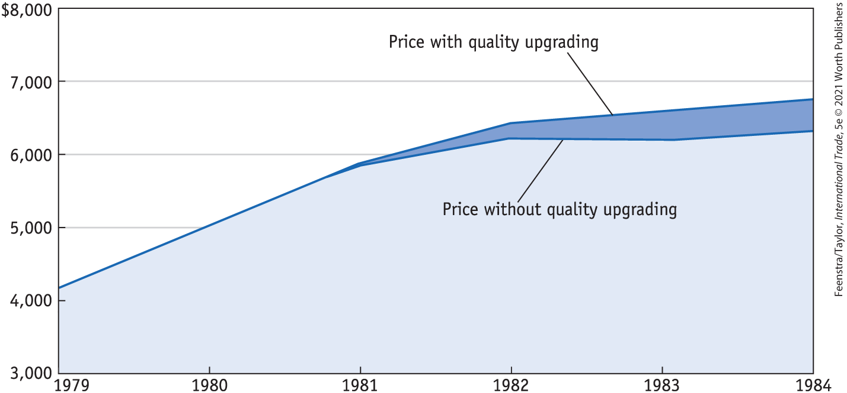
APPLICATION: U.S. Imports of Japanese Automobiles
Quota Rents, Price of U.S. Cars, The GATT and WTO - FIGURE 9-6
Prices of American Small Cars Under the VER on Japanese car imports, the average price of U.S. cars rose very rapidly when the quota was first imposed: from $4,200 in 1979 to $6,000 in 1981, or a 43% increase over two years.
Only a very small part of that increase was explained by quality improvements, and in the later years of the quota, quality in U.S. cars did not rise by as much as it did in the Japanese imports.

Slide 24
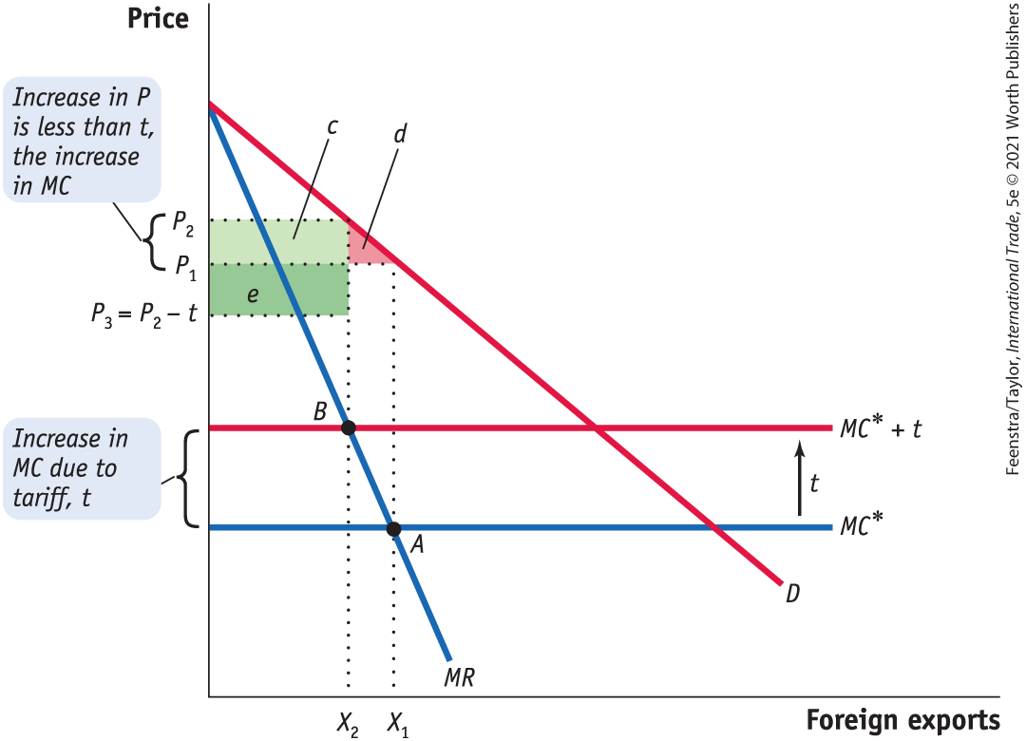
Tariffs with Foreign Monopoly
Foreign Monopoly - Free-Trade Equilibrium, Effect of a Tariff on Home Price
FIGURE 9-7
Under free trade, the Foreign monopolist charges prices P₁ and exports X₁, where marginal revenue MR equals marginal cost MC*.
When an antidumping duty of t is applied, the firm’s marginal cost rises to MC* + t, so the exports fall to X₂ and the Home price rises to P₂.
The decrease in consumer surplus is shown by the area c + d, of which c is collected as a portion of tax revenues.

Slide 25
Tariffs with Foreign Monopoly
Foreign Monopoly - Free-Trade Equilibrium, Effect of a Tariff on Home Price
FIGURE 9-7
The net-of-tariff price that the Foreign exporter receives falls to P₃ = P₂ − t. Because the net-of-tariff price has fallen, the Home country has a terms-of-trade gain, area e. Thus, the total welfare change depends on the size of the terms-of-trade gain e relative to the deadweight loss d.
Effect of the Tariff on Home Welfare
Fall in Home consumer surplus: −(c + d)
Rise in Home government revenue: +(c + e)
Net change in Home welfare: +(e − d)

Slide 26

A Closer Look
Effect of the Tariff on Home Welfare
Fall in Home consumer surplus: −(c + d)
Rise in Home government revenue: +(c + e)
Net change in Home welfare: +(e − d)

Slide 27
APPLICATION: Import Tariffs on Japanese Trucks
In the case of a Foreign monopolist, Home will experience a terms-of-trade gain from a small tariff. The reason for this gain is that the Foreign firm will lower its net-of-tariff price to avoid too large an increase in the price paid by consumers in the importing country.
To what extent do Foreign exporters actually behave that way?
We can look at the effects of a 25% tariff on imported Japanese compact trucks imposed by the United States in the early 1980s and still in place today.

Slide 28
APPLICATION: Import Tariffs on Japanese Trucks
FIGURE 9-7 (revisited)
If the terms-of-trade gain, measured by the area e in Figure 9-7, exceeds the deadweight loss d, then the Home country gains from the tariff.
This is our first example of strategic trade policy that leads to a potential gain for Home.
In principle, this potential gain arises from the tariff that the United States has applied on imports of compact trucks, which is still in place today.

Slide 29
APPLICATION: Import Tariffs on Japanese Trucks
Some economists feel that this tariff has the undesirable side effect of encouraging the U.S. automobile industry to focus on the sales of trucks since compact trucks have higher prices due to the tariff.
That strategy by U.S. producers can work when gasoline prices are low and so consumers are willing to buy trucks. At times of high gasoline prices, however, consumers instead want fuel-efficient cars, which have not been the focus of the American industry.
So high fuel prices can lead to a surge in imports and fewer domestic sales, exactly what happened in 1979 and 2008.

Slide 30
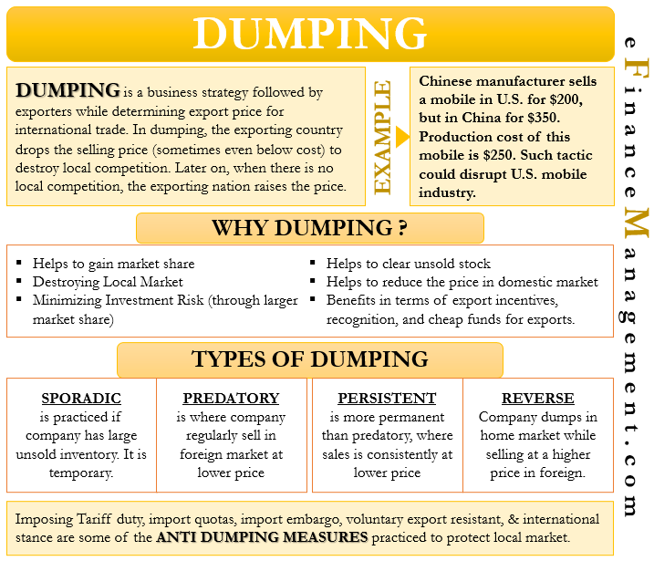

Slide 31
Dumping
With international trade, not only can firms charge a price that is higher than their marginal cost, but they can also choose to charge different prices in their domestic market as compared with their export market (this implies a firm has some ability to influence the export market).
This pricing strategy is called price discrimination because the firm can choose how much different groups of customers pay.

Slide 32
Dumping
Discriminating Monopoly
We assume that the monopolist is able to charge different prices in the two markets; this market structure is sometimes called a discriminating monopoly.
Equilibrium Condition
For the discriminating monopoly, profits are maximized when the following condition holds:
$$MR=MR^{∗}=MC^{∗}$$

Slide 33
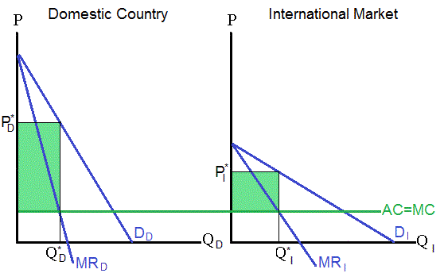
Dumping = Price Discrimination

Slide 34
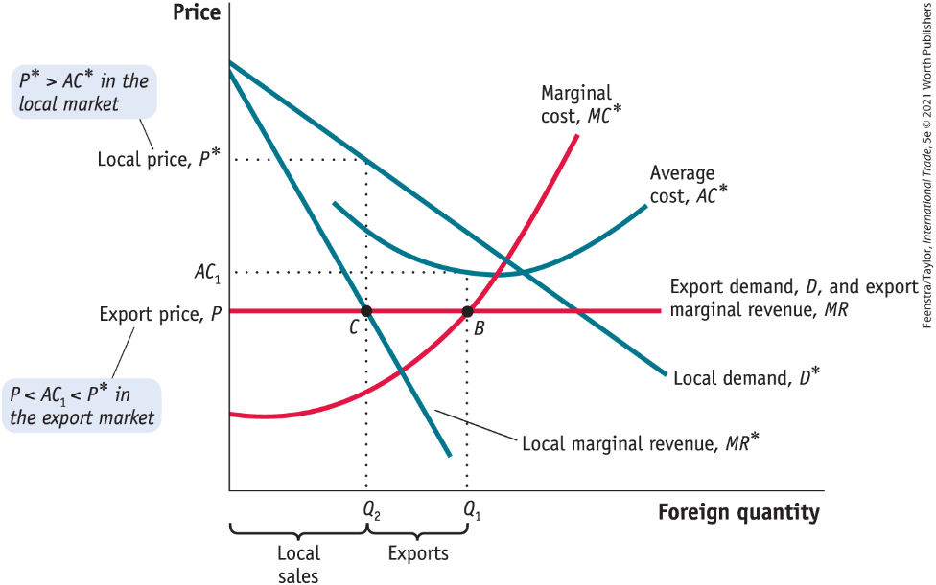
Dumping
FIGURE 9-8 Foreign Discriminating Monopoly
The Foreign monopoly faces different demand curves and charges different prices in its local and export markets. Locally, its demand curve is D* with marginal revenue MR*.
Abroad, its demand curve is horizontal at the export price P, which is also its marginal revenue of MR.
To maximize profits, the Foreign monopolist chooses to produce the quantity Q₁ at point B, where local marginal cost equals marginal revenue in the export market, MC* = MR.

Slide 35
Dumping
FIGURE 9-8 Foreign Discriminating Monopoly
The quantity sold in the local market, Q₂ (at point C), is determined where local marginal revenue equals export marginal revenue, MR* = MR.
The Foreign monopolist sells Q₂ to its local market at P*, and Q₁ – Q₂ to its export market at P.
Because P < P* (or alternatively, P < AC₁), the firm is dumping.

Slide 36
A Closer Look

Slide 37

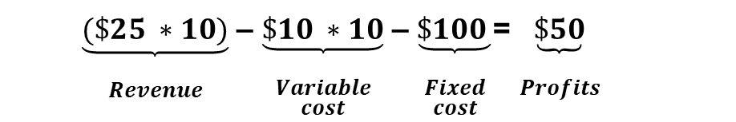
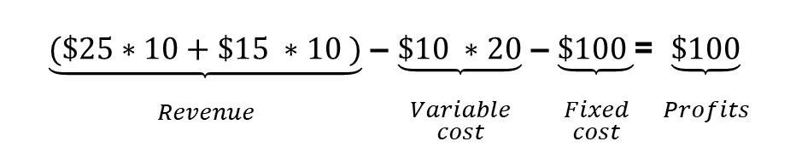
Dumping
Numerical Example of Dumping
Suppose the Foreign firm has the following cost and demand data:
Fixed costs = $100 Marginal costs = $10 per unit
Local price = $25 Local quantity = 10
Export price = $15 Export quantity = 10
The profits earned from selling in its local market are
$\underset{\begin{aligned} \\ Revenue\end{aligned}}{\underbrace{(\$25 ∗10)}}$ ‒ $\underset{\begin{aligned} \\ Variable \\ cost\end{aligned}}{\underbrace{\$10 ∗10}}$ ‒ $\underset{\begin{aligned} \\ Fixed \\ cost\end{aligned}}{\underbrace{\$100 }}$= $\underset{\begin{aligned} \\ Profits\end{aligned}}{\underbrace{\$50}}$
Average costs = $\frac{\$200}{10}$ = $20
Notice that the average costs for the firms are
Now suppose that this firm sells an additional 10 units abroad at the price of $15, which is less than its average costs of production. It is still worthwhile to sell these extra units because profits become
$\underset{\begin{aligned} \\ Revenue\end{aligned}}{\underbrace{(\$25∗10+\$15 ∗10 )}}$ ‒ $\underset{\begin{aligned} \\ Variable \\ cost\end{aligned}}{\underbrace{\$10 ∗20}}$ ‒ $\underset{\begin{aligned} \\ Fixed \\ cost\end{aligned}}{\underbrace{\$100 }}$= $\underset{\begin{aligned} \\ Profits\end{aligned}}{\underbrace{\$100}}$

Slide 38
Policy Response to Dumping
Antidumping Duties
Under the rules of the WTO, an importing country is entitled to apply a tariff, called an antidumping duty, any time that a foreign firm is dumping its product.
An imported product is being dumped if its price is below the price that the exporter charges in its own local market.
If the exporter’s local price is not available, then dumping is determined by comparing the import price with:
  A price charged for the product in a third market, or
  The exporter’s average costs of production.

Slide 39
Policy Response to Dumping
Antidumping Duties
Strategic Trade Policy?
Does the application of antidumping duties lead to a terms-of-trade gain for the Home country, making this another example of a strategic trade policy that can potentially benefit the Home country?
The answer to this question is often “no,” because the antidumping provisions of U.S. trade law are overused. These provisions create a much greater cost for consumers and larger welfare loss than does the less frequent application of tariffs under Sections 201, 232, or 301 of U.S trade law.

Slide 40
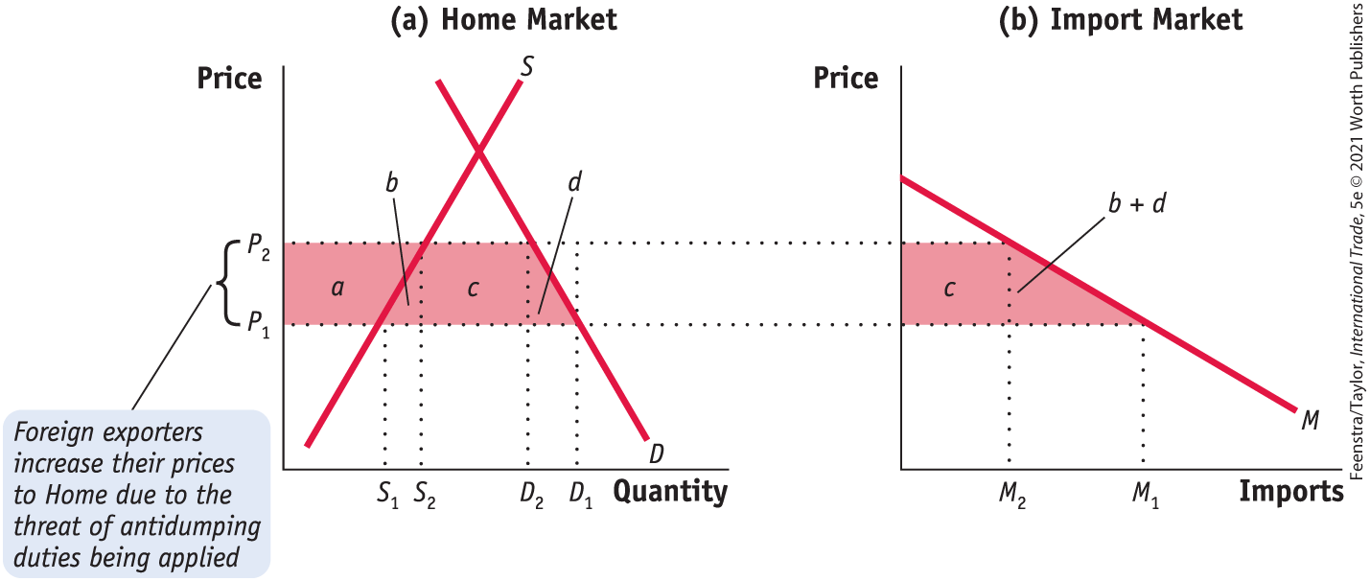
Policy Response to Dumping
Calculation of Antidumping Duty FIGURE 9-9 Home Loss Due to Threat of Duty
A charge of dumping can sometimes lead Foreign firms to increase their prices, even without an antidumping duty being applied.

Slide 41
Policy Response to Dumping
Calculation of Antidumping Duty FIGURE 9-9 Home Loss Due to Threat of Duty
In that case, there is a loss for Home consumers (a + b + c + d) and a gain for Home producers (a). The net loss for the Home country is area (b + c + d).

Slide 42
Infant Industry Protection
There are two cases in which infant industry protection is potentially justified.
First, protection may be justified if a tariff today leads to an increase in Home output that, in turn, helps the firm learn better production techniques and reduce costs in the future.
A second case in which import protection is potentially justified is when a tariff in one period leads to an increase in output and reductions in future costs for other firms in the industry, or even for firms in other industries. This type of externality occurs when firms learn from each other’s successes.
In the semiconductor industry, it is not unusual for firms to mimic the successful innovations of other firms and benefit from a knowledge spillover.
As both of these cases show, the infant industry argument supporting tariffs or quotas depends on the existence of some form of market failure.

Slide 43
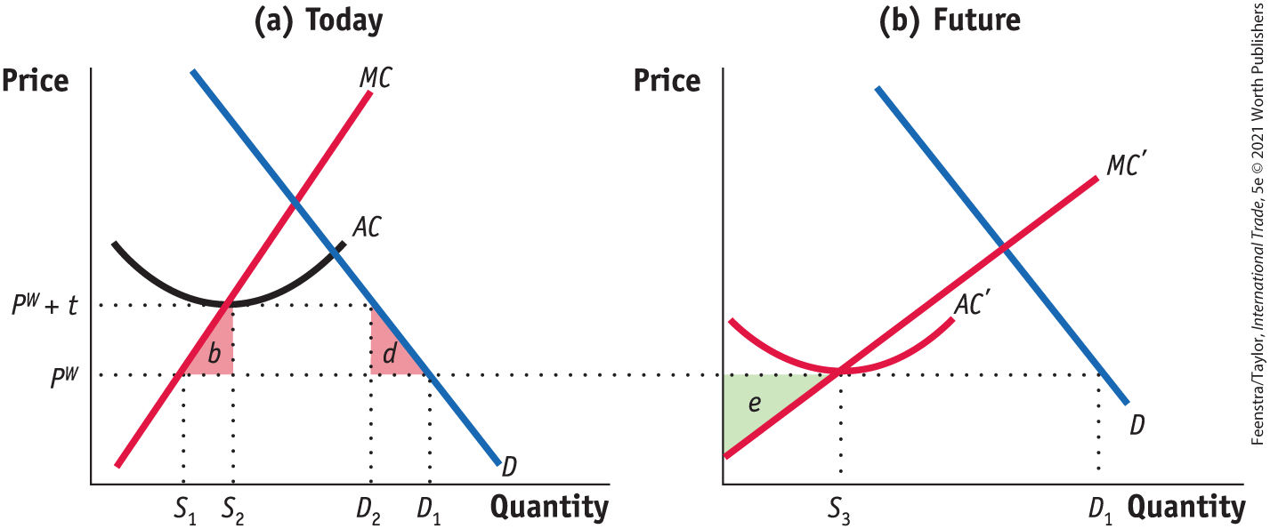
Infant Industry Protection
Free-Trade Equilibrium, Tariff Equilibrium - Equilibrium Today, Equilibrium in the Future, Effect of the Tariff on Welfare FIGURE 9-10 Infant Industry Protection
In the situation today (panel a), the industry would produce S₁, the quantity at which MC = P^{W}. Because P^{W} is less than average costs at S₁, the industry would incur losses at the world price of P^{W} and would be forced to shut down. A tariff increases the price from P^{W} to P^{W} + t, allowing the industry to produce at S₂ (and survive) with the net loss in welfare of (b + d).

Slide 44
Infant Industry Protection
Free-Trade Equilibrium, Tariff Equilibrium - Equilibrium Today, Equilibrium in the Future, Effect of the Tariff on Welfare FIGURE 9-10 Infant Industry Protection
In panel (b), producing today allows the average cost curve to fall through learning to AC′. In the future, the firm can produce the quantity S₃ at the price P^{W} without tariff protection and earn producer surplus of e.

Slide 45
APPLICATION: Example of Infant
Industry Protection
In 2009 China overtook the United States as the largest automobile market in the world. Strong competition among foreign firms located in China, local producers, and import sales have resulted in new models and falling prices.
Production in China
Beginning in the early 1980s, China permitted a number of joint ventures between foreign firms and local Chinese partners.
Various regulations, combined with high tariff duties, helped at least some of the new joint ventures achieve success.

Slide 46
APPLICATION: Examples of Infant
Industry Protection
Protecting the Automobile Industry in China
Cost to Consumers
Quotas have a particularly large impact on domestic prices when the Home firm is a monopoly. That situation applied to the sales of Volkswagen’s joint venture in Shanghai, which enjoyed a local monopoly on the sales of its vehicles. The effect of this local monopoly was to substantially increase prices in the Shanghai market, an average of 42% for the period 1995-2001.

Slide 47
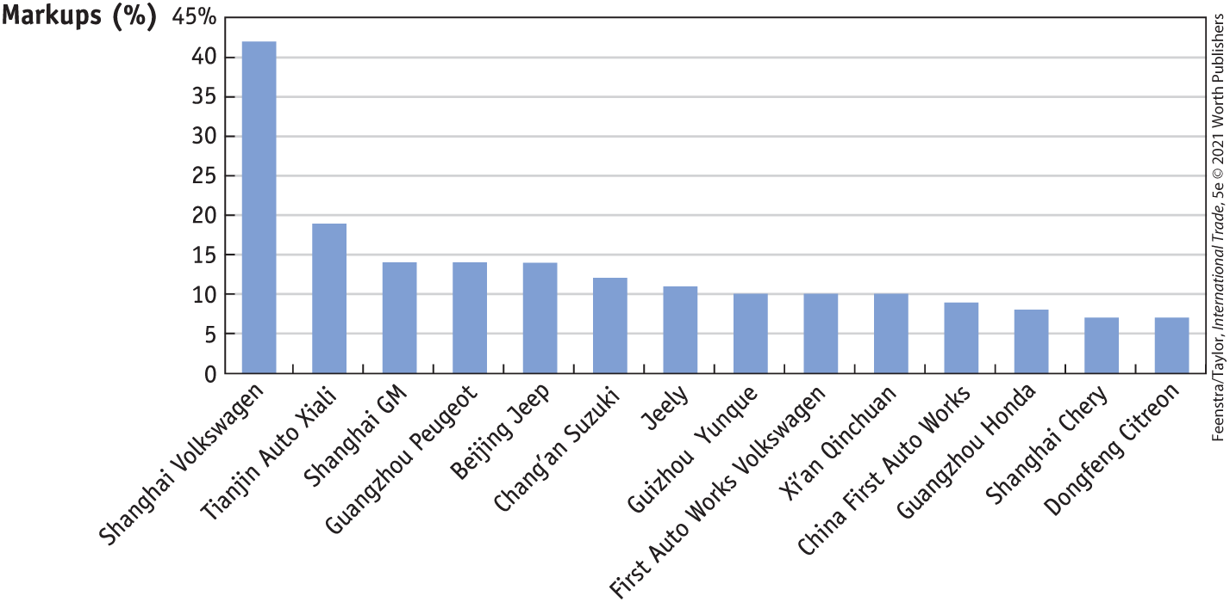
APPLICATION: Examples of Infant
Industry Protection
Protecting the Automobile Industry in China - FIGURE 9-12
Automobile Markups by Firms in China, 1995–2001 This diagram shows the percentage markups (price over marginal cost) applied to automobiles sold in China from 1995 to 2001, by various producers. The highest markup was charged by Shanghai Volkswagen, which had a local monopoly in Shanghai.

Slide 48
APPLICATION: Examples of
Infant Industry Protection
Protecting the Automobile Industry in China
Foreign Production in China
The local monopoly held by Shanghai Volkswagen has been eroded by the entry of other foreign firms, such as General Motors, Ford, Hyundai, and Tesla, into the Chinese market.
Infant Industry Protection?
For the tariffs and quotas used in China to be justified as infant industry protection, they should lead to a large enough drop in future costs so that the protection is no longer needed. China has not yet reached that point entirely, since it still imposes a 15% tariff on automobiles, so it is premature to point to the Chinese auto industry as a successful case of infant industry protection.

Slide 49
Conclusions
Under conditions of imperfect competition, the effects of a tariff and quota are very different for a Home monopoly.
With a tariff, the Home monopolist can increase its price by the amount of the tariff but cannot exercise its monopoly power.
With an import quota, the Home firm is able to charge a higher price than it could with a tariff because it enjoys a “sheltered” market. So the import quota leads to higher costs for Home consumers than the tariff, and these two policies are no longer “equivalent” as they were under perfect competition.
Under Foreign monopoly, the tariff leads to a fall in the price received by the Foreign monopolist, so the price paid by Home consumers rises by less than the full amount of the tariff.

Slide 50
Conclusions
The tariff is shared between an increase in the Home price and a decrease in the Foreign price, and the Home importer obtains a terms-of-trade gain. For small tariffs, the terms-of-trade gain exceeds the deadweight loss, and the Home country gains from the tariff.
This is an example of the use of a tariff as a strategic trade policy that can benefit the Home country at the expense of the Foreign firm.
A specific example applied against a Foreign monopoly occurs when the Foreign firm is a discriminating monopoly and dumps its output into Home at a lower price than it charges in its own local market.

Slide 51
Conclusions
When dumping occurs, the importing company is permitted by WTO rules to respond with a tariff, called an antidumping duty.
The expected outcome from antidumping duties is that Foreign exporters raise prices even when a duty is not applied, leading to Home losses. Because of these losses, the use of antidumping duties as a strategic trade policy is not effective.
Infant industry protection can allow a young industry to mature and compete in the future. Successful infant industry protection requires that the cost of temporary protection is less than the gains from having the industry continue (without protection).

Slide 52
KEY POINTS
Free trade will lead a Home monopoly in a small country to act in the same way as a perfectly competitive industry and charge a price equal to marginal cost. Therefore, competition from imports eliminates the monopoly power of the Home firm.
Quotas are not equivalent to tariffs when the Home firm is a monopolist. Because a quota limits the number of imports, the Home monopolist can charge higher prices than under a tariff, which results in greater costs to consumers.

Slide 53
KEY POINTS
When a tariff is applied against a Foreign monopolist, the results are similar to those of the large-country case analyzed in the previous chapter: the Foreign monopolist increases the price in the importing country by less than the full amount of the tariff and allows its own net-of-tariff price to fall. Hence, the tariff is shared between an increase in the Home price and a decrease in the Foreign price, a terms-of-trade gain for Home.
Dumping is the practice of a Foreign firm exporting goods at a price that is below its own domestic price or below its average cost of production. If the price charged for the exported good is above the firm’s marginal cost, then dumping is profitable. We expect to observe dumping when the Foreign firm is acting as a discriminating monopolist.

Slide 54
KEY POINTS
Countries respond to dumping by imposing antidumping duties on imports. Antidumping duties are calculated as the difference between a Foreign firm’s local price (or average costs) and its export price. To reduce or avoid the antidumping duties, Foreign firms can raise their export prices. That increase in price is a terms-of-trade loss for the importer and occurs because the Foreign firm can influence the duty.
In the United States and other countries, the use of antidumping tariffs far exceeds the use of tariffs under Section 201 and other trade laws. It is easy for domestic firms to bring a charge of dumping, and in many cases upholding the charge results in an increase in foreign prices and a decrease in competition for the domestic firm. The excessive use of antidumping cases also invites other countries to respond with their own charges of dumping.

Slide 55

KEY POINTS
An infant industry is a firm that requires protection to compete at world prices today. When a government applies a temporary tariff, it expects that costs for the firm or the industry overall will fall due to learning, thereby allowing it to compete at world prices in the future.

Slide 56


