Slide 1
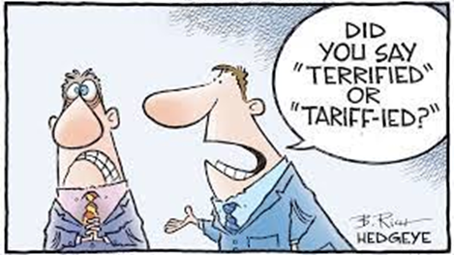
Chapter 8 - Import Tariffs and Quotas Under Perfect Competition
ECON 243 – International Trade
© 2021 Worth Publishers
International Economics, 5e | Feenstra/Taylor
1

Slide 2
Questions to Consider
Why do governments sometimes apply a tariff on imported goods?
Why does the World Trade Organization try to reduce the use of tariffs?
If the quantity of imports is restricted by a quota, how is that different from using a tariff?

Slide 3
Introduction
During the U.S. presidential campaign of 2016, the Republican candidate Donald Trump said that he would apply a 45% tariff against imports from China.
President Trump did impose significant import tariffs on China in 2018–19.
The import tariff is an example of a trade policy, a government action meant to influence the amount of international trade.
Import tariffs are sometimes used for political and not economic reasons. This is called the political economy of tariffs.
Because the gains from trade are unevenly spread, industries and labor unions often feel that the government should do something to help limit their losses (or maximize their gains) from international trade.
That “something” is trade policy, which includes the use of import tariffs (taxes on imports), import quotas (quantity limits on imports), and export subsidies.

Slide 4
Introduction
In this chapter, we begin our investigation of trade policies by focusing on the effects of tariffs and quotas in a perfectly competitive industry.
This chapter examines first the most commonly used trade policy, the tariff. We explain the reasons why countries apply tariffs and the effects of these tariffs on the producers and consumers in the importing and exporting countries.
The chapter then examines the use of an import quota, which is a limit on the quantity of a good that can be imported from a foreign country. Like a tariff, an import quota often imposes a cost on the importing country, a cost that is sometimes greater than the cost of tariffs.

Slide 5
A Brief History of the World Trade Organization
After World War II, the Allied countries met to discuss issues such as high trade barriers and unstable exchange rates.
In 1947 the General Agreement on Tariffs and Trade (GATT) was established to reduce barriers to trade between nations.
Some of the GATT’s main provisions are as follows:
  A nation must extend the same tariffs to all trading partners that are GATT members.
  Tariffs may be imposed in response to unfair trade practices such as dumping. “Dumping” is defined as the sale of export goods at a price less than that charged at home, or at a price less than costs of production and shipping. We will look at more closely in Chapter 9.

Slide 6
A Brief History of the World Trade Organization
Some of the GATT’s main provisions are as follows:
  Countries should not limit the quantity of goods and services that they import.
  Countries should declare export subsidies provided to particular firms, sectors, or industries. Article XVI deals with export subsidies and states that countries should notify each other of the extent of subsidies and discuss the possibility of eliminating them.
  Countries can temporarily raise tariffs for certain products. Article XIX, called the safeguard provision or the escape clause, is our focus in this chapter.

Slide 7
A Brief History of the World Trade Organization
Some of the GATT’s main provisions are as follows:
Regional trade agreements are permitted under Article XXIV of the GATT. The GATT recognizes the ability of blocs of countries to form two types of regional trade agreements:
  Free-trade areas, in which a group of countries voluntarily agree to remove trade barriers between themselves
  Customs unions, which are free-trade areas in which the countries also adopt identical tariffs between themselves and the rest of the world

Slide 8
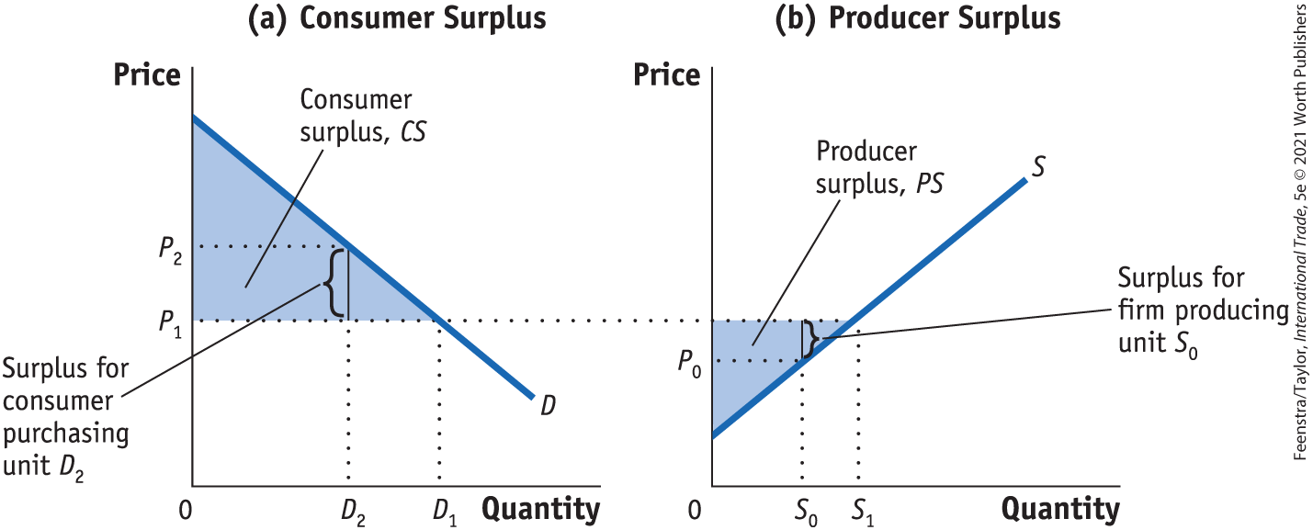
The Gains from Trade
Consumer and Producer Surplus FIGURE 8-1
In panel (a), the consumer surplus from purchasing quantity D₁ at price P₁ is the area below the demand curve and above that price. The consumer who purchases D₂ is willing to pay price P₂ but has to pay only P₁. The difference is the consumer surplus and represents the satisfaction of consumers over and above the amount paid.

Slide 9
The Gains from Trade
Consumer and Producer Surplus FIGURE 8-1
In panel (b), the producer surplus from supplying the quantity S₁ at the price P₁ is the area above the supply curve and below that price. The supplier who supplies unit S₀ has marginal costs of P₀ but sells it for P_{1.} The difference is the producer surplus and represents the return to fixed factors of production in the industry

Slide 10
A Closer Look

Slide 11
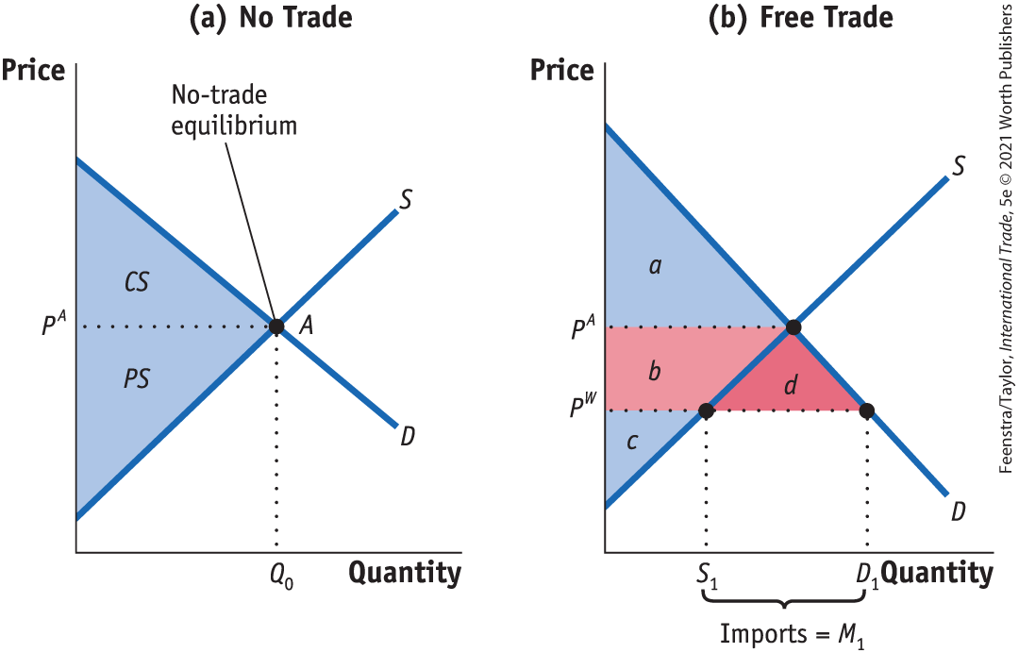
The Gains from Trade
Home Welfare - No Trade, Free Trade for a Small Country, Gains from Trade FIGURE 8-2
The Gains from Free Trade in Home With Home demand of D and supply of S, the no-trade equilibrium is at point A, at the price P^{A} producing Q₀.
With trade, the world price is P^{W}, so quantity demanded increases to D₁ and quantity supplied falls to S₁. Since quantity demanded exceeds quantity supplied, Home imports D₁ – S₁.
Consumer surplus increases by the area (b + d), and producer surplus falls by area b.
The gains from trade are measured by area d.
Rise in consumer surplus: +(b + d)
Fall in producer surplus: −b
Net effect on Home welfare: +d

Slide 12
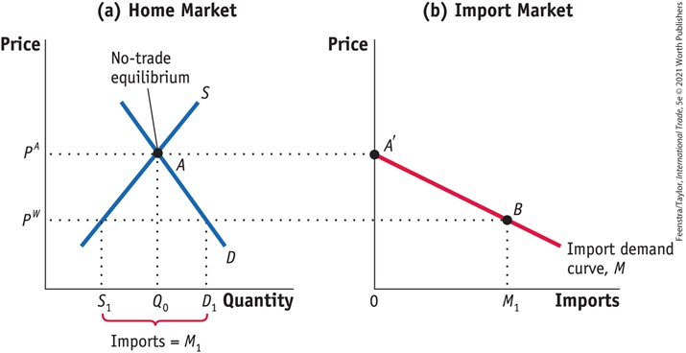
The Gains from Trade
Home Import Demand Curve - FIGURE 8-3
Home Import Demand With Home demand of D and supply of S, the no-trade equilibrium is at point A, with the price P^{A} and import quantity Q₀.
Import demand at this price is zero, as shown by the point A' in panel (b).
At a lower world price of P^{W}, import demand is M₁ = D₁ – S₁, as shown by point B.
Joining up all points between A' and B, we obtain the import demand curve, M.
The import demand curve shows the relationship between the world price of a good and the quantity of imports demanded by Home consumers.

Slide 13
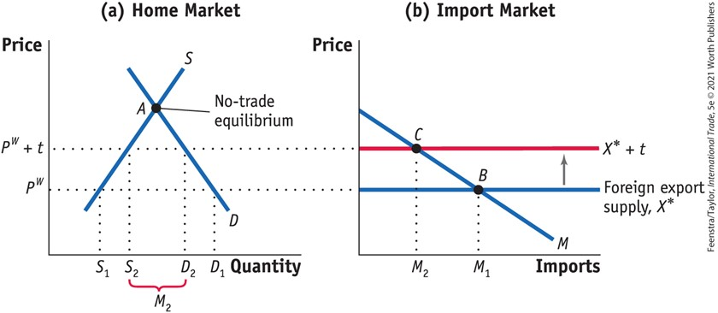
Import Tariffs for a Small Country
Free Trade for a Small Country - FIGURE 8-4 Tariff for a Small Country
Applying a tariff of t dollars will increase the import price from P^{W} to P^{W} + t. The domestic price of that good also rises to P^{W} + t. This price rise leads to an increase in Home supply from S₁ to S₂, and a decrease in Home demand from D₁ to D₂, in panel (a).

Slide 14
Import Tariffs for a Small Country
Free Trade for a Small Country - FIGURE 8-4 Tariff for a Small Country
Imports fall due to the tariff, from M₁ to M₂ in panel (b). As a result, the equilibrium shifts from point B to C.

Slide 15
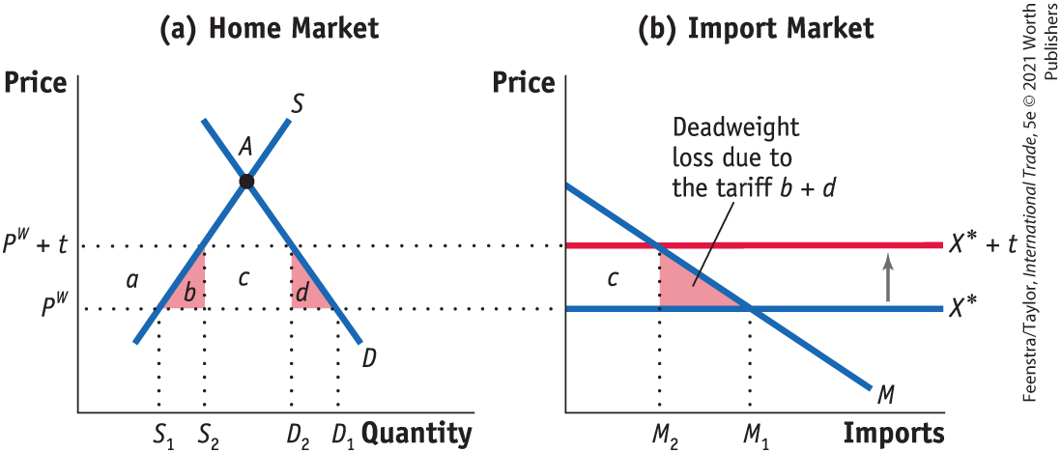
Import Tariffs for a Small Country
Effect of the Tariff on Consumer Surplus, Producer Surplus, Government Revenue; Overall Effect of the Tariff on Welfare; Production Loss; Consumption Loss - FIGURE 8-5
The tariff increases the price from P^{W} to P^{W} + t. As a result, consumer surplus falls by (a + b + c + d). Producer surplus rises by area a, and government revenue increases by the area c.

Slide 16
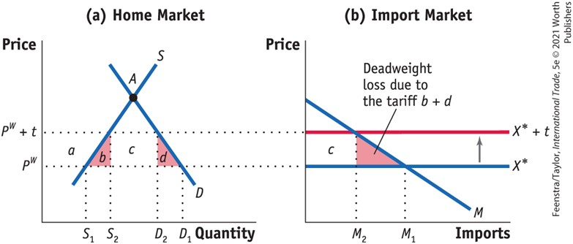
Import Tariffs for a Small Country
Effect of the Tariff on Consumer Surplus, Producer Surplus, Government Revenue; Overall Effect of the Tariff on Welfare; Production Loss; Consumption Loss - FIGURE 8-5
Therefore, the net loss in welfare, the deadweight loss to Home, is (b + d), which is measured by the two triangles b and d in panel (a) or the single (combined) triangle b + d in panel (b).
The triangle (b + d) is a deadweight loss, or a loss that is not offset by a gain elsewhere in the economy.
Fall in consumer surplus: −(a + b + c + d)
Rise in producer surplus: +a
Rise in government revenue: +c
Net effect on Home welfare: −(b + d)

Slide 17
Import Tariffs for a Small Country
Effect of the Tariff on Consumer Surplus, Producer Surplus, Government Revenue; Overall Effect of the Tariff on Welfare; Production Loss; Consumption Loss
The deadweight loss, triangles (b + d ), has the following interpretation:
The triangle b equals the increase in marginal costs for the extra units produced and can be interpreted as the production loss (or the efficiency loss) due to producing at marginal cost above the world price.

Slide 18
Import Tariffs for a Small Country
Effect of the Tariff on Consumer Surplus, Producer Surplus, Government Revenue; Overall Effect of the Tariff on Welfare; Production Loss; Consumption Loss
The triangle d can be interpreted as the drop in consumer surplus for those individuals who are no longer able to consume the units between D₁ and D₂ because of the higher price. We refer to this drop in consumer surplus as the consumption loss for the economy.
The area c is the tax revenue collected by the government.

Slide 19
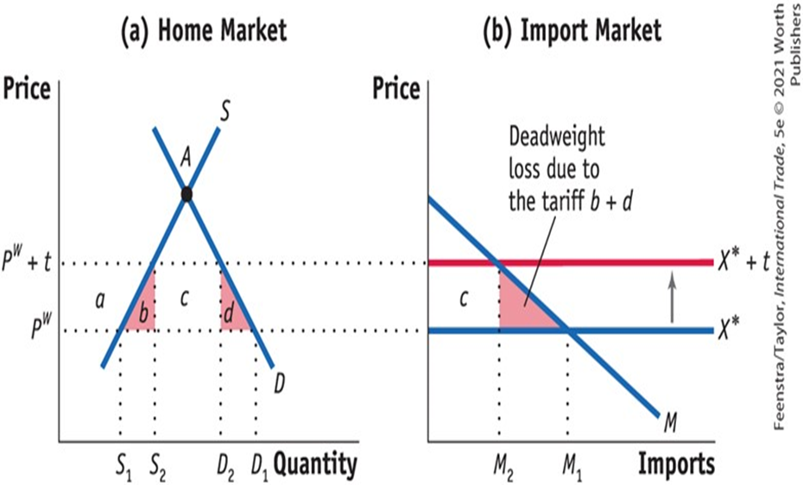
A Closer Look

Slide 20
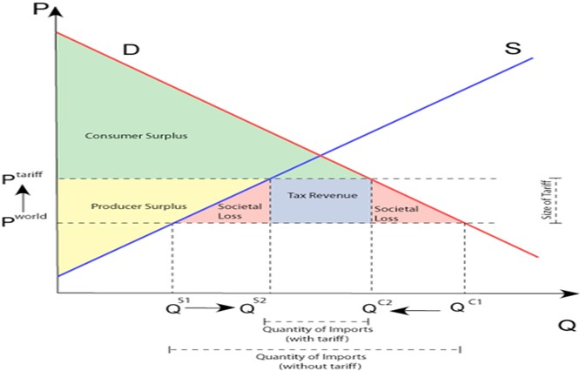
And Another Closer Look
https://slideplayer.com/slide/9850556/

Slide 21
APPLICATION: U.S. Tariffs on Steel,
2002-03
TABLE 8-1
U.S. ITC Recommended and Actual Tariffs for Steel Shown here are the tariffs recommended by the U.S. International Trade Commission for steel imports in 2002, and the actual tariffs that were applied in 2002.
Product Category | Tariff Recommended by the U.S. ITC (for 2002, %) | Actual U.S. Tariff (used in 2002, %)
Carbon and Alloy Flat Products
Slab | 20 | 30
Flat products | 20 | 30
Carbon and Alloy Long Products
Hot-rolled bar | 20 | 30
Cold-finished bar | 20 | 30
Rebar | 10 | 15
Alloy fittings and flanges | 13 | 13
Stainless and Tool Steel Products
Stainless steel bar | 15 | 15

Slide 22
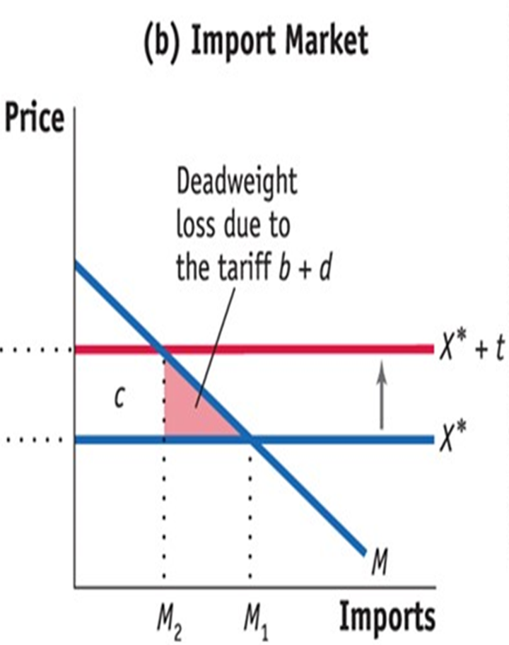
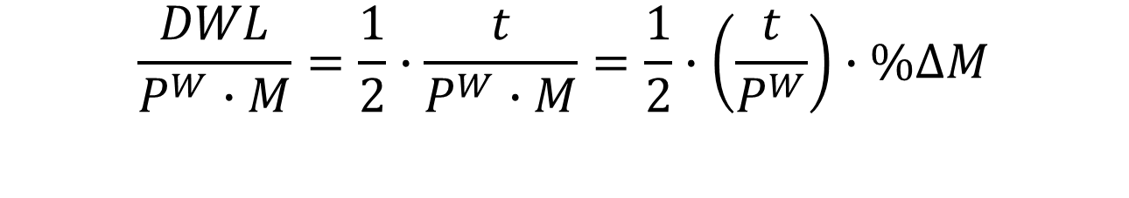
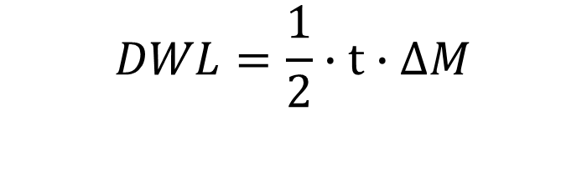
APPLICATION: U.S. Tariffs on Steel,
2002-03
Deadweight Loss Due to the Steel Tariff
$$DWL=\frac{1}{2}∙t∙∆M$$
The deadweight loss relative to the value of imports equals:
$$\frac{DWL}{P^{W}∙M}=\frac{1}{2}∙\frac{t}{P^{W}∙M}=\frac{1}{2}∙\left(\frac{t}{P^{W}}\right)∙\%∆M$$

Slide 23
APPLICATION: U.S. and Foreign Tariffs Under President Trump, 2018–19
TABLE 8-3
Welfare Impact of 2018 and 2019 U.S. Tariffs Panel (a) shows the welfare impact of the 2018 U.S. tariffs, and the initial 10% tariffs applied to $200 billion of U.S. imports from China in September 2018. Panel (b) extends those results to include the increase in the U.S. tariffs on China during 2019.
 | (1) | (2) | (3)
 | Consumer Loss from Higher Import Prices | Tariff Revenue | Deadweight Loss
Annual cost ($ billions) | 52.8 | 36.0 | 16.8
Annual cost per household ($) | 414 | 282 | 132
 | (1) | (2) | (3)
 | Consumer Loss from Higher Import Prices | Tariff Revenue | Deadweight Loss
Annual cost ($ billions) | 106 | 26.9 | 79.1
Annual cost per household ($) | 831 | 211 | 620

Slide 24
APPLICATION: The Political Economy of Tariffs
If a tariff always leads to a deadweight loss of a small importing country, why then do the United States and many other countries use tariffs as part of their trade policies?
Politics. The tariff benefits Home producers, so if the government cares more about the producer surplus than consumer surplus, it might decide to use the tariff despite the deadweight loss and consumer costs.
Because benefits are concentrated and costs are spread more thinly and widely across the country, the industry has the greater political power to persuade the government to use the tariffs.

Slide 25
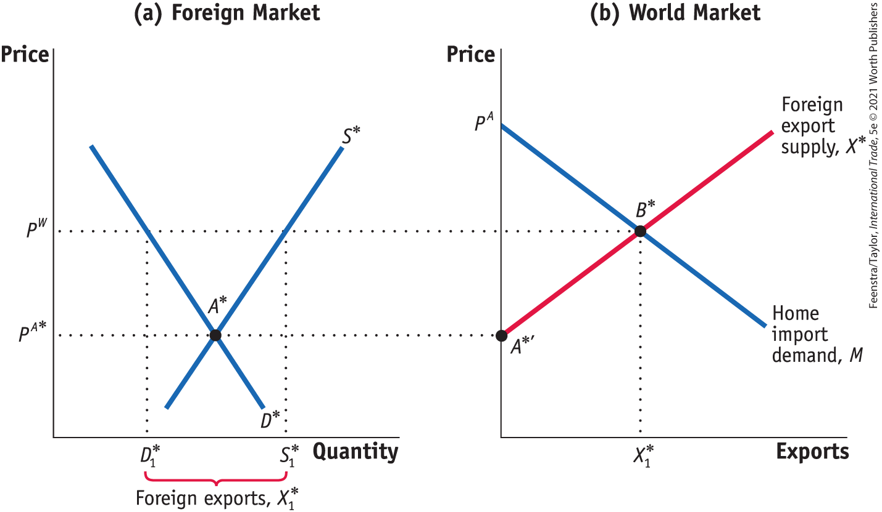
Import Tariffs for a Large Country
Foreign Export Supply - FIGURE 8-6
In panel (a), with Foreign demand of D* and Foreign supply of S*, the no-trade equilibrium in Foreign is at point A*, with the price of P^{A*}.
At this price, the Foreign market is in equilibrium and Foreign exports are zero—point A* in panel (a) and point A*′ in panel (b), respectively.

Slide 26
Import Tariffs for a Large Country
Foreign Export Supply - FIGURE 8-6
When the world price, P^{W}, is higher than Foreign’s no-trade price, the quantity supplied by Foreign, S*₁, exceeds the quantity demanded by Foreign, D*₁, and Foreign exports X*₁ = S*₁ – D*₁.
In panel (b), joining up points A*′ and B*, we obtain the upward-sloping export supply curve X*.

Slide 27
Import Tariffs for a Large Country
Foreign Export Supply - FIGURE 8-6
With the Home import demand of M, the world equilibrium is at point B*, with the price P^{W}

Slide 28
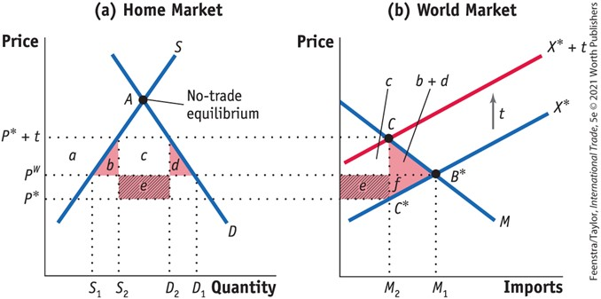
Import Tariffs for a Large Country
Effect of the Tariff on Terms of Trade, Home’s Welfare, Foreign and World Welfare - FIGURE 8-7
Tariff for a Large Country
The tariff shifts up the export supply curve from X* to X*+ t.
As a result, the Home price increases from P^{W} to P* + t, and the Foreign price falls from P^{W} to P*.
The deadweight loss at Home is the area of the triangle (b + d), and Home also has a terms-of-trade gain of area e.
Foreign loses the area (e + f), so the net loss in world welfare is the triangle (b + d + f). Area e is a measure of the terms-of-trade gain for the importer.
Fall in consumer surplus: −(a + b + c + d)
Rise in producer surplus: +a
Rise in government revenue: +(c + e)
Net effect on Home welfare: e − (b + d)

Slide 29
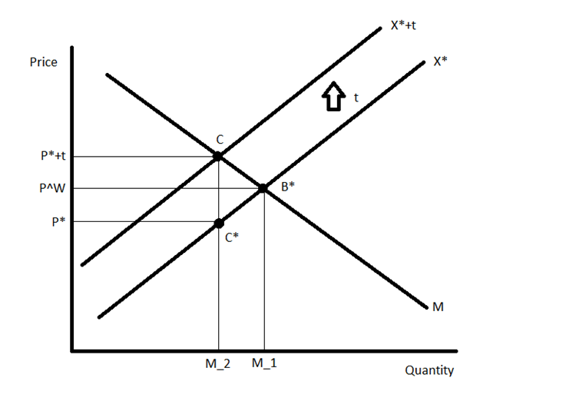
A Closer Look
Note that the increase in the price due to the tariff (the vertical distance between P* + t and P^{W} is less than the amount of the tariff.
This implies that the burden of the tariff is incurred not only by consumers at Home but also by Foreign exporters.
The price received by the Foreign exporters, P* is obtained by subtracting the tariff from the new Home price.
Because P* is less than P the price Foreign exporters receive has fallen due to the tariff.

Slide 30
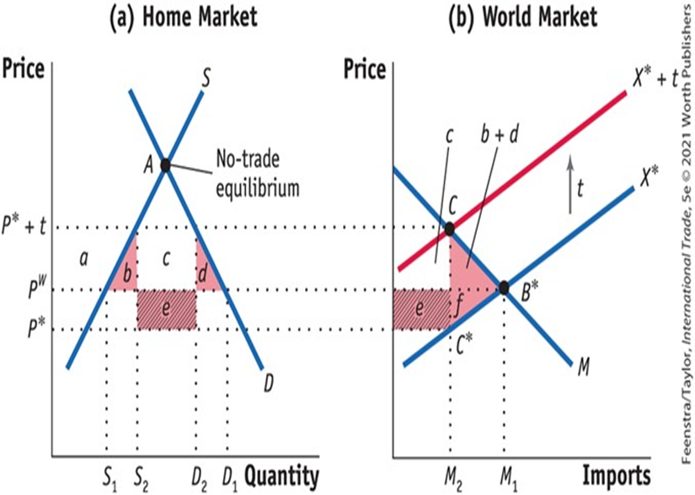
And Another Closer Look

Slide 31
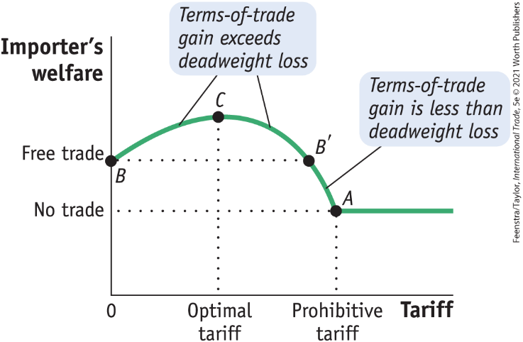
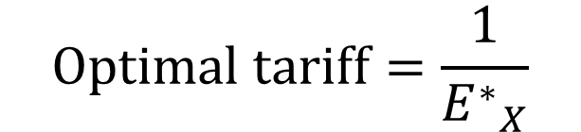
Import Tariffs for a Large Country
Foreign Export Supply - Optimal Tariff for a Large Importing Country
FIGURE 8-8
Tariffs and Welfare for a Large Country For a large importing country, a tariff initially increases the importer’s welfare because the terms-of-trade gain exceeds the deadweight loss. So the importer’s welfare rises from point B. Welfare continues to rise until the tariff is at its optimal level (point C). After that, welfare falls. If the tariff is too large (greater than at B′), then welfare will fall below the free-trade level. For a prohibitive tariff, with no imports at all, the importer’s welfare will be at the no-trade level, at point A.
Optimal Tariff Formula The formula depends on the elasticity of Foreign export supply, which we call E*_{X}:
$$Optimal tariff=\frac{1}{{E^{∗}}_{X}}$$

Slide 32
APPLICATION: U.S. Tariffs on Steel Once Again
Optimal Tariffs for Steel
(1) | (2) | (3) | (4) | (5)
Product Category | Elasticity of Export Supply | Optimal Tariff (%) | Actual Tariff (%) 2002–03 | Actual Product Tariff (%) 2018–19
Alloy steel flat- rolled products | 0.27 | 370 | 30 | 25
Iron and steel rails and railway track | 0.80 | 125 | 0 | 25
Iron and steel bars, rods, angles, shapes | 0.80 | 125 | 15–30 | 25
Ferrous waste and scrap | 17 | 6 | 0 | 25
Iron and steel tubes, pipes, and fittings | 90 | 1 | 13–15 | 25
TABLE 8-4
Optimal Tariffs for Steel Products This table shows optimal tariffs for steel products, calculated with the elasticity formula, as compared to actual tariffs used on U.S. steel imports in 2002‒03 and 2018‒19.

Slide 33
APPLICATION: U.S. and Foreign Tariffs Under President Trump Once Again
TABLE 8-5
Welfare Impact of 2018 U.S. and Foreign Tariffs, with Terms-of-Trade Effects
This table shows the welfare impact of the 2018 tariffs on U.S. imports and of the foreign retaliatory tariffs on U.S. exports. These estimates treat the United States as a large country because it can influence export prices.
 | (1) | (2) | (3) | (4)
 | Consumer Loss from Higher Import Prices | Tariff Revenue | Terms-of-Trade Gain | Net Loss
Annual cost ($ billions) | 68.8 | 39.4 | 21.6 | 7.8
Annual cost per household ($ billions) | 539 | 309 | 169 | 61

Slide 34
Import Quotas
On January 1, 2005, China was poised to become the world’s largest exporter of textiles and apparel. On that date, a system of worldwide import quotas known as the Multifibre Arrangement (MFA) was abolished.
Besides the MFA, there are other examples of import quotas.
For example, since 1993 Europe had a quota on the imports of bananas that allowed for a greater number of bananas to enter from its former colonies in Africa than from Latin America. This was converted to a tariff in 2005, which was reduced in 2009, ending this “banana war.”
Another example is the quota on U.S. imports of cars from Japan, which began in 1981 and lasted through much of the 1980’s.

Slide 35
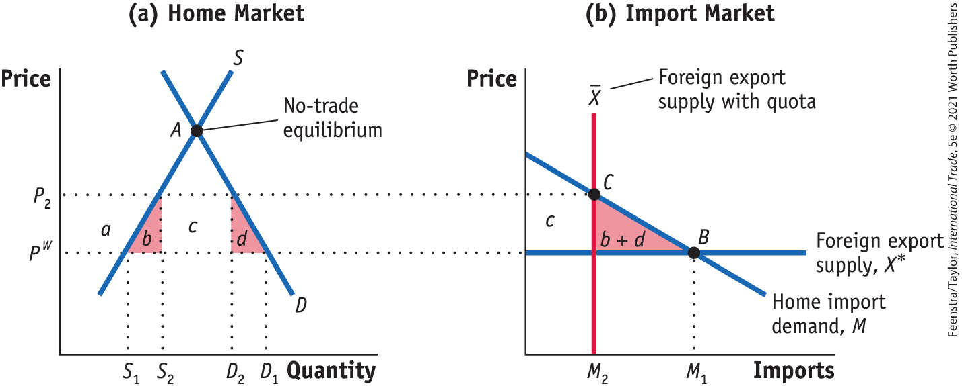
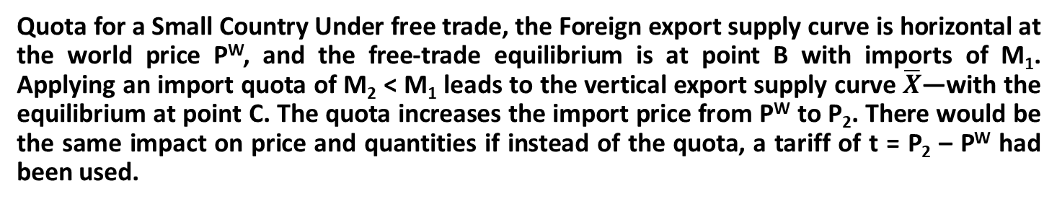
Import Quotas
Import Quota in a Small Country - Free-Trade Equilibrium, Effect of the Quota, Effect on Welfare - FIGURE 8-9
Quota for a Small Country Under free trade, the Foreign export supply curve is horizontal at the world price P^{W}, and the free-trade equilibrium is at point B with imports of M₁. Applying an import quota of M₂ < M₁ leads to the vertical export supply curve $\overline{X}$—with the equilibrium at point C. The quota increases the import price from P^{W} to P₂. There would be the same impact on price and quantities if instead of the quota, a tariff of t = P₂ – P^{W} had been used.

Slide 36
Import Quotas
Import Quota in a Small Country - Free-Trade Equilibrium, Effect of the Quota, Effect on Welfare - FIGURE 8-9
The quota and tariff differ in terms of area c in Figure 8-9, which would be collected as government revenue under a tariff.
Under the quota, this area equals the difference between the domestic price P₂ and the world price P^{W}, times the quantity of imports M₂.

Slide 37
Import Quotas
Import Quota in a Small Country
Whoever is actually importing the good will be able to earn the difference between the world price P^{W} and the higher Home price P₂ by selling the imports in the Home market.
We call the difference between these two prices the rent associated with the quota, and hence the area c represents the total quota rents.
Next we examine the four possible ways that these quota rents can be allocated.

Slide 38

Import Quotas
Import Quota in a Small Country
Giving the Quota to Home Firms
Quota licenses (i.e., permits to import the quantity allowed under the quota system) can be given to Home firms: With home firms earning the rents c, the net effect of the quota on Home welfare is
Fall in consumer surplus: −(a + b + c + d)
Rise in producer surplus: +a
Quota rents earned at Home +c
Net effect on Home welfare: −(b + d)

Slide 39
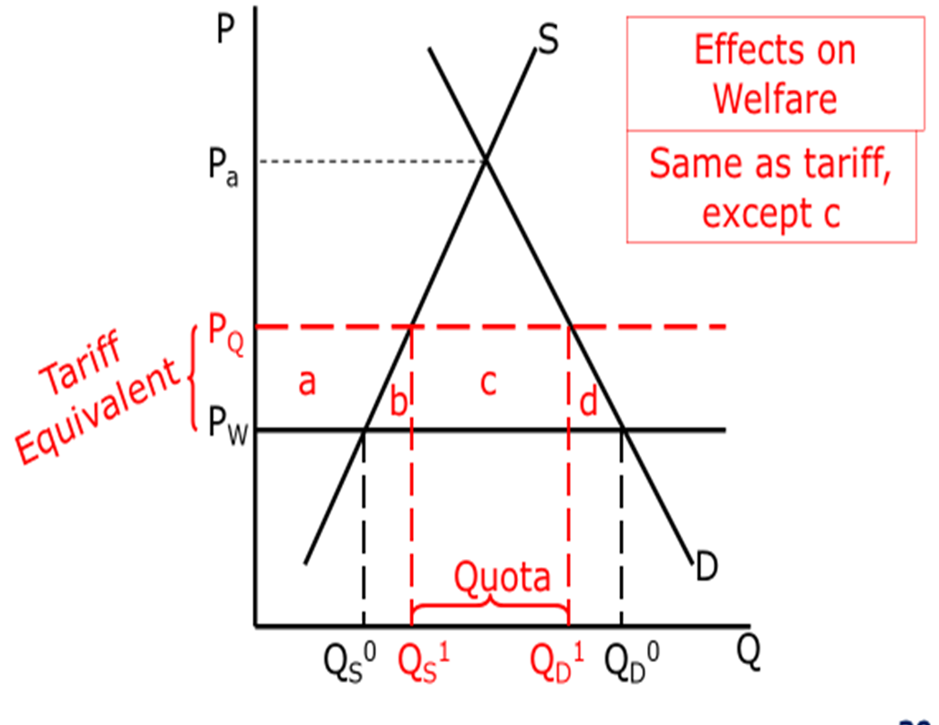
Tariff Versus Quota: Small Country

Slide 40
Import Quotas
Import Quota in a Small Country
Rent Seeking
If licenses for imported chemicals, for example, are allocated in proportion to each firm’s production of batteries in the previous years, then the Home firms will likely produce more batteries than they can sell (and at lower quality) just to obtain the import licenses for the following year.
Alternatively, firms might engage in bribery or other lobbying activities to obtain the licenses.
These kinds of inefficient activities done to obtain quota licenses are called rent seeking. If rent seeking occurs, the welfare loss due to the quota will be
Fall in consumer surplus: −(a + b + c + d)
Rise in producer surplus: +a
Net effect on Home welfare: −(b + c + d)

Slide 41
Import Quotas
Import Quota in a Small Country
Auctioning the Quota
A third possibility for allocating the rents that come from the quota is for the government of the importing country to auction off the quota licenses.
In a well-organized, competitive auction, the revenue collected should exactly equal the value of the rents, so that area c would be earned by the Home government.
Using the auction method to allocate quota rents, the net loss in domestic welfare due to the quota becomes
Fall in consumer surplus: −(a + b + c + d)
Rise in producer surplus: +a
Auction revenue earned in Home: + c
Net effect on Home welfare: −(b + d)

Slide 42
Import Quotas
Import Quota in a Small Country
“Voluntary” Export Restraint
The final possibility for allocating quota rents is for the government of the importing country to give authority for implementing the quota to the government of the exporting country.
Because the exporting country allocates the quota among its own producers, this is sometimes called a “voluntary” export restraint (VER), or a “voluntary” restraint agreement (VRA).
In the 1980s the United States used this type of arrangement to restrict Japanese automobile imports.
In this case, the quota rents are earned by foreign producers, so the loss in Home welfare equals
Fall in consumer surplus: −(a + b + c + d)
Rise in producer surplus: +a
Net effect on Home welfare: −(b + c + d)

Slide 43
Import Quotas
Import Quota in a Small Country - Costs of Import Quotas in the United States TABLE 8-6
Annual Cost of U.S. Import Protection ($ billions) Shown here are estimates of the deadweight losses and quota rents due to U.S. import quotas in the 1980s, for the years around 1985. Many of these quotas are no longer in place today.
 | U.S. Deadweight Loss (area b + d) | Quota Rents (area c)
Automobiles | 0.2–1.2 | 2.2–7.9
Dairy | 1.4 | 0.25*
Steel | 0.1–0.3 | 0.7–2.0
Sugar | 0.1 | 0.4–1.3
Textiles and apparel | 4.9–5.9 | 4.0–6.1
Import tariffs | 1.2–3.4 | 0
Total | 7.9–12.3 | 7.3–17.3

Slide 44
Conclusions
For a large country, when we add up the drop in consumer surplus, the gain in producer surplus, and the government revenue collected, it is possible for a small tariff to generate welfare gains for the importing country.
However, in this case, any gain for the importer comes at the expense of the foreign exporters. The drop in the exporter’s welfare due to the tariff is greater than the gain in the importer’s welfare. Therefore, the world loses overall because of the tariff.
Under perfect competition, the effect of applying an import quota is similar to the effect of applying an import tariff; they both lead to an increase in the domestic price in the importing country, with a loss for consumers and a gain for producers.
Quota rents are the gain to whoever can bring in the import.

Slide 45
KEY POINTS
The government of a country can use laws and regulations, called “trade policies,” to affect international trade flows. An import tariff, which is a tax at the border, is the most commonly used trade policy.
The rules governing trade policies in most countries are outlined by the General Agreement on Tariffs and Trade (GATT), an international legal convention adopted after World War II to promote increased international trade. Since 1995 the new name for the GATT is the World Trade Organization (WTO).
In a small country, the quantity of imports demanded is assumed to be very small compared with the total world market. For this reason, the importer faces a fixed world price. In that case, the price faced by consumers and producers in the importing country will rise by the full amount of the tariff.

Slide 46
KEY POINTS
The use of a tariff by a small importing country always leads to a net loss in welfare. We call that loss the “deadweight loss.”
In a large country, the decrease in imports demanded due to the tariff causes foreign exporters to lower their prices. Consumer and producer prices in the importing country still go up, since these prices include the tariff, but they rise by less than the full amount of the tariff (since the exporter price falls).
The use of a tariff for a large country can lead to a net gain in welfare because the price charged by the exporter has fallen; this is a terms-of-trade gain for the importer.

Slide 47
KEY POINTS
The “optimal tariff” is the tariff amount that maximizes welfare for the importer. For a small country, the optimal tariff is zero since any tariff leads to a net loss. For a large country, however, the optimal tariff is positive.
The formula for the optimal tariff states that it depends inversely on the foreign export supply elasticity. If the foreign export supply elasticity is high, then the optimal tariff is low, but if the foreign export supply elasticity is low, then the optimal tariff is high.
Import quotas restrict the quantity of a particular import, thereby increasing the domestic price, increasing domestic production, and creating a benefit for those who are allowed to import the quantity allotted. These benefits are called “quota rents.”

Slide 48
KEY POINTS
Assuming perfectly competitive markets for goods, quotas are similar to tariffs since the restriction in the amount imported leads to a higher domestic price. However, the welfare implications of quotas are different from those of tariffs depending on who earns the quota rents. These rents might be earned by firms in the importing country (if they have the licenses to import the good), or by firms in the exporting country (if the foreign government administers the quota), or by the government in the importing country (if it auctions off the quota licenses). The last case is most similar to a tariff since the importing government earns the revenue.

