Slide 1

ECON 243 – International Trade
Chapter 5 – Movement of Labor and Capital Between Countries
© 2021 Worth Publishers
International Economics, 5e | Feenstra/Taylor

Slide 2
Questions to Consider
Does immigration lower wages?
Which industries expand because of immigration?
Who gains when foreign companies move in?

Slide 3
Introduction
In this chapter, we will study the movement of labor across countries by explaining the case in which immigration leads to a fall in wages, as we normally expect.
First, we use the specific-factors model, the short-run model introduced in Chapter 3, in which labor moves between industries.
Next, we use the long-run Heckscher–Ohlin model, from Chapter 4, in which capital and land can also move between industries.
In the long run, an increase in labor will not lower the wage, as industries have more time to respond to the inflow of workers.
After studying what happens in the short run and long run when labor moves across countries, we study the effects of foreign direct investment (FDI), the movement of capital across countries.
We conclude the chapter by discussing the gains to the source and destination countries, and to the world, from the movement of labor or capital between countries.

Slide 4
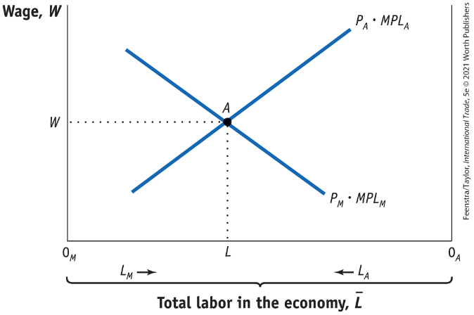
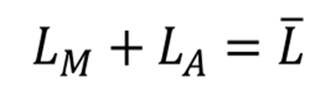
Movement of Labor Between Countries: Migration
Effects of Immigration in the Short Run: Specific-Factors Model
Determining the Wage
FIGURE 5-1 Home Labor Market
The Home wage is determined at point A, the intersection of the marginal product of labor curves P_{M} • MPL_{M} and P_{A} • MPL_{A} in manufacturing and agriculture, respectively.
The amount of labor used in manufacturing is measured from left to right, starting at the origin 0_{M}, and the amount of labor used in agriculture is measured from right to left, starting at the origin 0_{A}. At point A, 0_{M}L units of labor are used in manufacturing and 0_{A}L units of labor are used in agriculture.

Slide 5
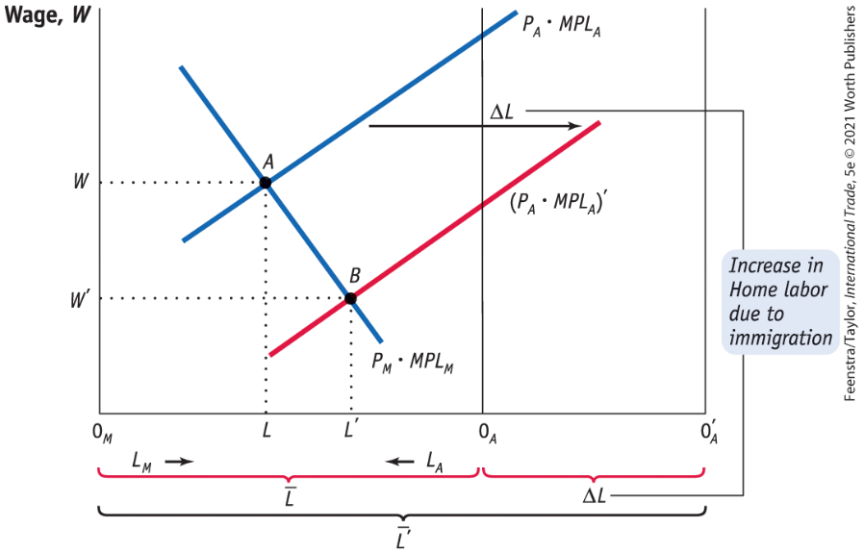
Movement of Labor Between Countries: Migration
Effects of Immigration in the Short Run: Specific-Factors Model
Effect of Immigration on the Wage in Home
FIGURE 5-2 Increase in Home Labor
When the amount of labor at Home increases by the amount ΔL, the origin for agriculture shifts to the right by that amount, from 0_{A} to 0_{A}′.
The marginal product of labor curve in agriculture also shifts right by the amount ΔL.
Equilibrium in the Home labor market is now at point B: wages have fallen to W′ and the amount of labor has increased in manufacturing (to 0_{M}L′) and in agriculture (to 0′_{A}L′).

Slide 6

A Closer Look

Slide 7
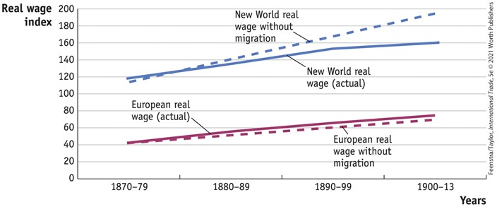
APPLICATION: Immigration to the New World
FIGURE 5-3 Wages in Europe and the New World
Large-scale migration from Europe to the New World in America and Australia closed the wage gap between the two locations. In 1870 wages in the New World were almost three times as high as wages in Europe, whereas in 1910 they were about twice as high.
Migration also slowed the growth of wages in the New World relative to what they would have been without migration and allowed for slightly faster growth of wages in Europe.

Slide 8
Movement of Labor Between Countries: Migration
Other Effects of Immigration in the Short Run
Rentals on Capital and Land
The United States and Europe have both welcomed foreign workers in specific industries: agriculture and high-tech.
They do this even though those foreign workers compete with domestic workers in those industries.
Therefore, there must be benefits to the industries.
We can measure these potential benefits by the payments to capital and land, which we refer to as “rentals.”

Slide 9
Movement of Labor Between Countries: Migration
Other Effects of Immigration in the Short Run
Rentals on Capital and Land
Under the first method for computing the rentals, we take the revenue earned in either manufacturing or agriculture and subtract the payments to labor.
If wages fall, then there is more left over as earnings of capital and land, so these rentals are higher.

Slide 10
Movement of Labor Between Countries: Migration
Other Effects of Immigration in the Short Run
Rentals on Capital and Land
Under the second method for computing rentals, capital and land earn their marginal product in each industry times the price of the industry’s good.
As more labor is hired in each industry (because wages are lower), the marginal products of capital and land both increase. The increase in the marginal product occurs because each machine or acre of land has more workers available to it, and that machine or acre of land is therefore more productive.
So under the second method, too, the marginal products of capital and land rise and so do their rentals.

Slide 11
Movement of Labor Between Countries: Migration
Other Effects of Immigration in the Short Run
Rentals on Capital and Land
We should not be surprised that owners of capital and land often support more open borders, which provides them with foreign workers who can be employed in their industries.
The restriction on immigration in a country should be seen as a compromise between the following:
Entrepreneurs and landowners might welcome the foreign labor.
Local unions and workers view migrants as a potential source of competition leading to lower wages.
Immigrant groups themselves, if they are large enough (such as the Cuban population in Miami), might also have the ability to influence the political outcome on immigration policy.

Slide 12
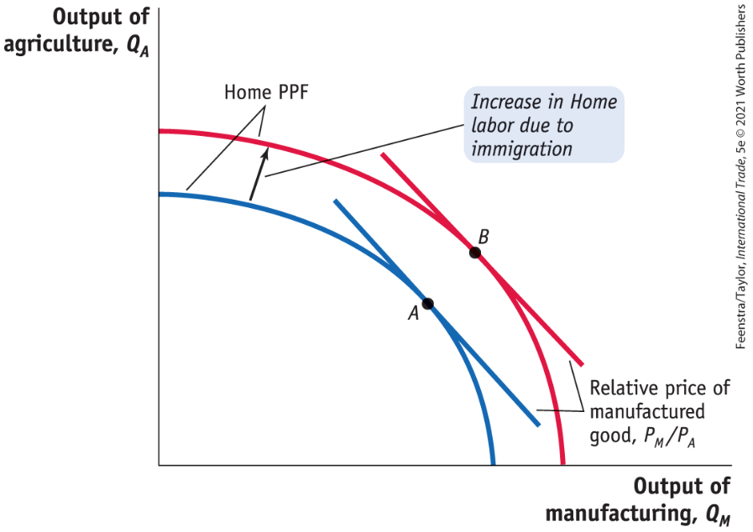
Movement of Labor Between Countries: Migration
Other Effects of Immigration in the Short Run - Effect of Immigration on Industry Output
FIGURE 5-4 Shift in Home Production Possibilities Curve
With the increase in labor at Home from immigration, the production possibilities frontier shifts outward and the output of both industries increases, from point A to point B.
Output in both industries increases because of the short-run nature of the specific-factors model; in the short run, land and capital do not move between the industries, and the extra labor in the economy is shared between both industries.

Slide 13
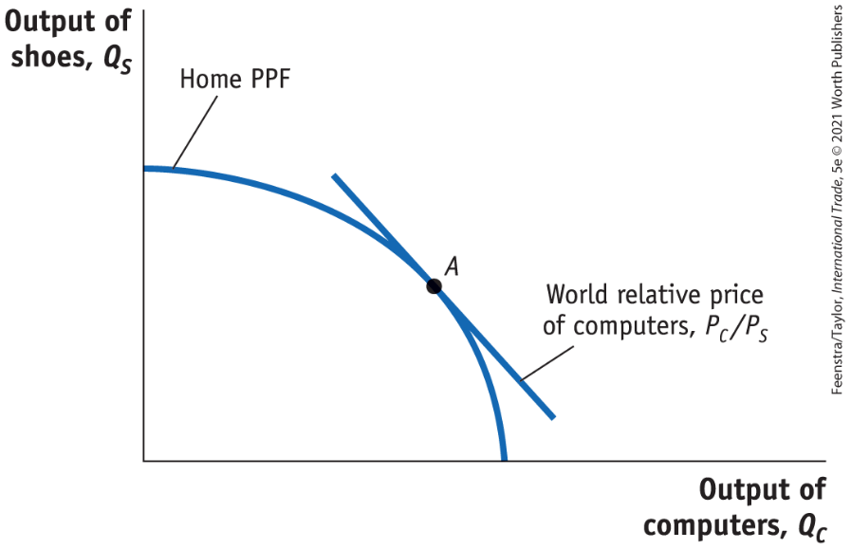
Movement of Labor Between Countries: Migration
Effects of Immigration in the Long Run - FIGURE 5-8 Production Possibilities Frontier
Shown here is the production possibilities frontier (PPF) between two manufactured goods, computers and shoes, with initial equilibrium at point A.
Domestic production takes place at point A, which is the point of tangency between the world price line and the PPF.

Slide 14
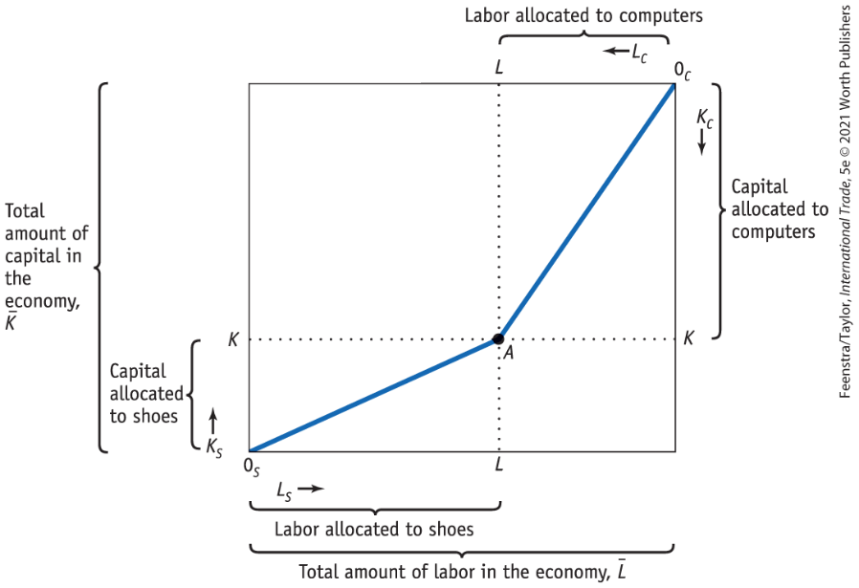

Movement of Labor Between Countries: Migration
Effects of Immigration in the Long Run - FIGURE 5-9 Allocation of Labor and
Capital in a Box Diagram
The top and bottom axes of the box diagram measure the amount of labor, $\overline{L}$, in the economy, and the side axes measure the amount of capital, $\overline{K}$.
At point A, 0_{S}L units of labor and 0_{S}K units of capital are used in shoe production, and 0_{C}L units of labor and 0_{C}K units of capital are used in computers.
The K/L ratios in the two industries are measured by the slopes of 0_{S}A and 0_{C}A, respectively.

Slide 15
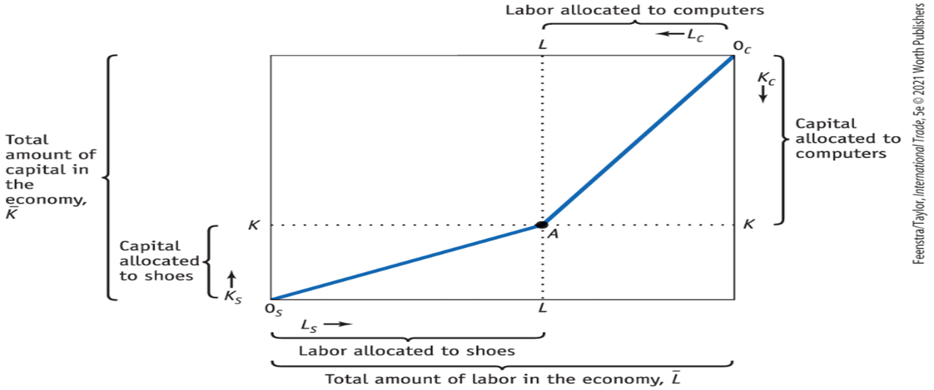
A Closer Look

Slide 16
Movement of Labor Between Countries: Migration
Effects of Immigration in the Long Run
Determination of the Real Wage and Real Rental
To determine the wage and rental in the economy, we use the marginal products of labor (MPL) and capital (MPK), which are determined by the capital–labor ratio in either industry.
If there is a higher capital–labor ratio (more machines per worker), then by the law of diminishing returns, the MPK and the real rental must be lower.
Having more machines per worker means that the MPL (and hence the real wage) is higher because each worker is more productive.

Slide 17
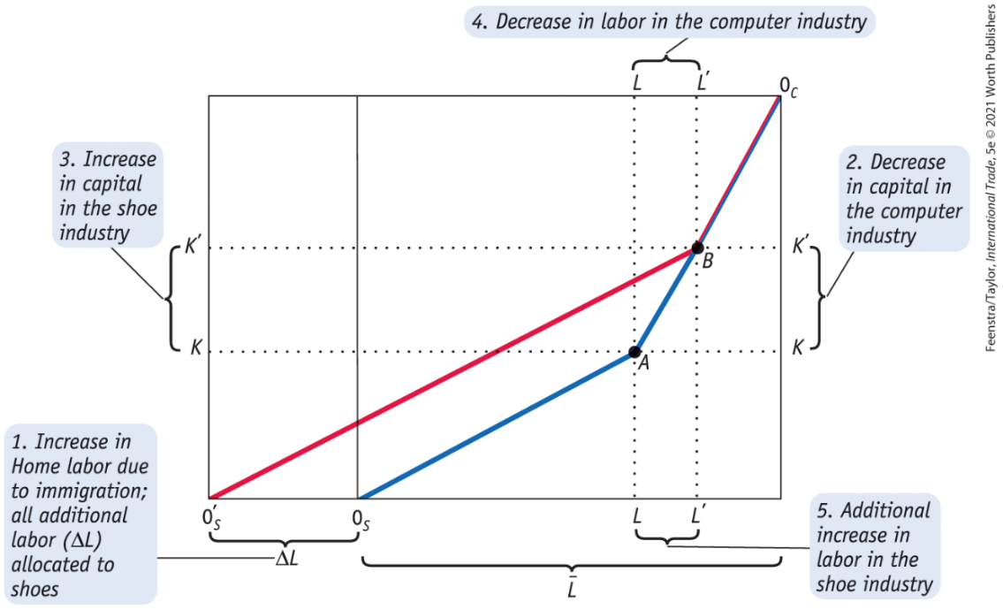
Movement of Labor Between Countries: Migration
Effects of Immigration in the Long Run - Increase in the Amount of Home Labor
FIGURE 5-10 Increase in Home Labor
With an increase in Home labor from L to L + ΔL, the origin for the shoe industry shifts from 0_{S} to 0_{S}′.
At point B, 0′_{S}L′ units of labor and 0′_{S}K′ units of capital are used in shoes, while 0_{C}L′ units of labor and 0_{C}K′ units of capital are used in computers.

Slide 18
Movement of Labor Between Countries: Migration
FIGURE 5-10 Increase in Home Labor (continued)
In the long run, industry outputs adjust so that the capital–labor ratios in each industry at point B (the slopes of 0′ _{S}B and 0_{C}B) are unchanged from the initial equilibrium at point A (the slopes of 0_{S}A and 0_{C}A).
To achieve this outcome, all new labor resulting from immigration is allocated to the shoe industry, and capital and additional labor are transferred from computers to shoes, keeping the capital–labor ratio in both industries unchanged.

Slide 19

A Closer Look

Slide 20
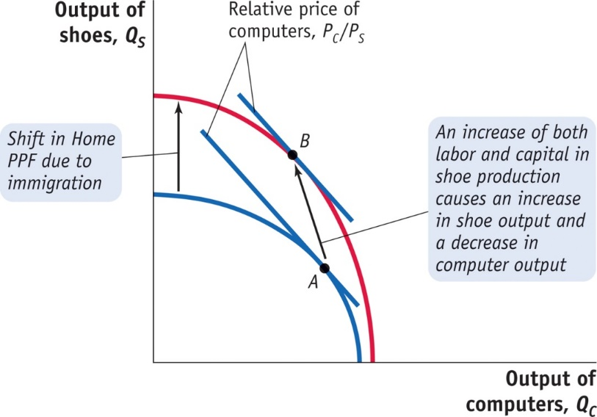
Movement of Labor Between Countries: Migration
Effects of Immigration in the Long Run - Effect of Immigration on Industry Outputs
FIGURE 5-11 The Long-Run Effect on Industry Outputs of an Increase in Home Labor
With an increase in the amount of labor in Home, the PPF shifts outward.
The output of shoes increases, while the output of computers declines as the equilibrium moves from point A to B.
The prices of goods have not changed, so the slopes of the PPFs at points A and B (i.e., the relative price of computers) are equal.

Slide 21
Movement of Labor Between Countries: Migration
Rybczynski Theorem
The Rybczynski theorem states that, in the Heckscher–Ohlin model with two goods and two factors, an increase in the amount of a factor found in an economy will increase the output of the industry using that factor intensively and decrease the output of the other industry.
We have proved the Rybczynski theorem for the case of immigration, where labor in the economy grows.
Later we will show that the same theorem holds when capital in the economy grows: in this case, the industry using capital intensively expands and the other industry contracts.

Slide 22
Movement of Labor Between Countries: Migration
Effect of Immigration on Factor Prices
Factor prices do not need to change as a result of immigration.
The reason that factor prices do not need to change is that the economy can absorb the extra amount of a factor by increasing the output of the industry using that factor intensively and reducing the output of the other industry.
The finding that factor prices do not change is sometimes called the factor price insensitivity result.
Factor Price Insensitivity Theorem
The factor price insensitivity theorem states that: in the H–O model with two goods and two factors, an increase in the amount of a factor found in an economy can be absorbed by changing the outputs of the industries, without any change in the factor prices.

Slide 23
Movement of Capital Between Countries:
Foreign Direct Investment
We turn now to look at how capital can move from one country to another through foreign direct investment (FDI).
FDI occurs when a firm from one country owns a company in another country.
According to the Department of Commerce, if a foreign company acquires 10% or more of a U.S. firm, that is counted as an FDI inflow to the United States, and if a U.S. company acquires 10% or more of a foreign firm, that is counted as an FDI outflow for the United States.

Slide 24
Movement of Capital Between Countries:
Foreign Direct Investment
Greenfield Investment
Our focus in this section will be on greenfield investment, that is, the building of new plants abroad.
We model FDI as a movement of capital between countries, just as we modeled the movement of labor between countries.
The key question we ask is: How does the movement of capital into a country affect the earnings of labor and capital there?
This question is similar to the one we asked for immigration, so the earlier graphs that we developed can be modified to address FDI.

Slide 25
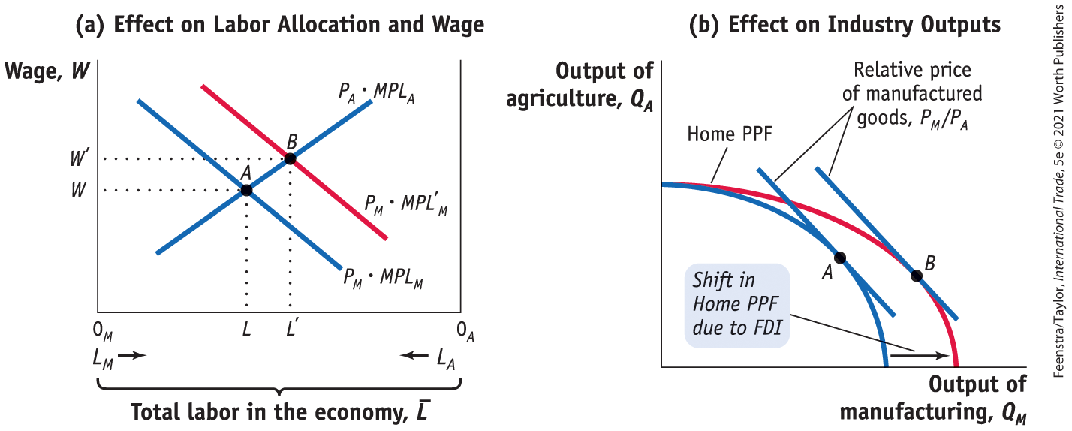
Movement of Capital Between Countries:
Foreign Direct Investment
FDI in the Short Run: Specific-Factors Model - FIGURE 5-13 - Increase in the Capital Stock in the Short Run
The equilibrium in the labor market moves from point A to B, and the wage increases from W to W ′. Labor used in the manufacturing industry increases from 0_{M}L to 0_{M}L′. These workers are pulled out of agriculture, so the labor used there shrinks from 0_{A}L to 0_{A}L ′.
In panel (a), an inflow of capital into the manufacturing sector shifts out the marginal product of labor curve in that sector.

Slide 26
Movement of Capital Between Countries:
Foreign Direct Investment
FDI in the Short Run: Specific-Factors Model - FIGURE 5-13 - Increase in the Capital Stock in the Short Run
Because labor has been drawn out of agriculture, the output of that sector falls. These changes in outputs are shown by the outward shift of the PPF (due to the increase in capital) and the movement from point A to point B.
In panel (b), with the inflow of capital into manufacturing, and the extra labor used in that sector, the output of manufacturing increases.

Slide 27

A Closer Look

Slide 28
Movement of Capital Between Countries:
Foreign Direct Investment
FDI in the Short Run: Specific-Factors Model
Effect of FDI on the Wage
As a result of the shift in P_{M} • MPL_{M}, the equilibrium wage increases, from W to W′. More workers are drawn into the manufacturing industry, and the labor used there increases.
Effect of FDI on the Industry Outputs
An FDI inflow and the shift in P_{M} • MPL_{M} will cause workers to be pulled out of agriculture, and since there is no change in the amount of land used there, output of the agriculture industry must fall.
With an increase in the number of workers and capital used in manufacturing, output in the manufacturing industry must rise.

Slide 29
Movement of Capital Between Countries:
Foreign Direct Investment
FDI in the Short Run: Specific-Factors Model
Effect of FDI on the Rentals
With regard to the rental on land, we know that with an inflow of FDI, fewer workers are employed in agriculture, and each acre of land cannot be cultivated as intensively.
    The value of marginal product of land, R_{T} = P_{A} • MPT_{A}, falls.
    If MPT_{A} falls and P_{A} remains unchanged, then land rental must fall.
  The rental on capital will also fall.

Slide 30
HEADLINES: The Myth of Asia’s Miracle
Once upon a time, Western opinion leaders found themselves both impressed and frightened by the extraordinary growth rates achieved by a set of Eastern economies.
  These extraordinary growth rates seemed to call into question the dominance not only of Western power but also of Western ideology.
  The leaders of those nations did not share our faith in free markets or unlimited civil liberties.
  What time period are we referring to?
We are referring to the 1960s and the economic growth of the Soviet Union and its satellite nations. Are there similarities to Asia’s economic growth?

Slide 31

Gains from Labor and Capital Flows
Foreign investment and immigration are both controversial policy issues.
Most countries have at some point in their development controlled FDI but later became open to foreign investment.
Nearly all countries impose limits on immigration.

Slide 32
Gains from Labor and Capital Flows
Gains from Immigration
Does immigration provide an overall gain to the host country, not including the gains to the immigrants themselves? Are there overall gains to the destination country, in the same way as we have found overall gains from trade?
Immigration benefits the host country in the specific factors model.
If we include the immigrant earnings with Foreign income, then we find that emigration benefits the Foreign country, too. The same argument can be made for FDI.

Slide 33
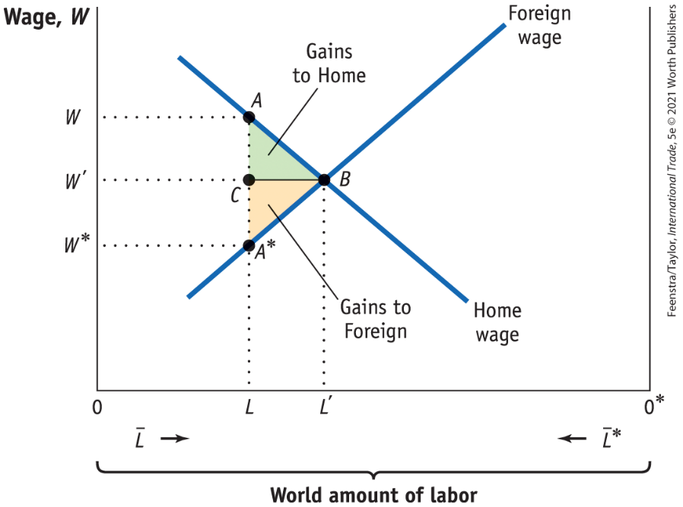
Gains from Labor and Capital Flows
Gains from Immigration - FIGURE 5-16 World Labor Market
Initially, Home has 0L workers and Foreign has 0*L workers. The Home wage is W, as determined at point A, which is higher than the Foreign wage W* at A*. Workers will move from Foreign to Home to receive higher wages. The equilibrium with full migration is at point B, where wages are equalized at W’. The gain to Home from migration is measured by triangle ABC, and the triangle A*BC represents the gain to Foreign.

Slide 34
APPLICATION: Immigrants and Their Remittances
TABLE 5-4 Remittances Between Major Regions of the World, 2017
Shown here are the remittances sent and received by regions of the world ($ billions, with larger values in bold). Emigrants from countries in Asia and in Europe who work in those same regions send a high value of remittances back home. In addition, Europe sends a high value of remittances to Asia and to Central and South America. The total value of remittances was $613 billion in 2017.
 |  | Receiving Country: Africa | Receiving Country: Asia | Receiving Country: Central and South America | Receiving Country: Europe | Receiving Country: North America
 | Africa | 12.8 | 2.3 | 0.0 | 2.8 | 0.2
 | Asia | 21.8 | 161.8 | 1.1 | 15.4 | 1.3
Sending Country | Central and South America | 0.1 | 1.5 | 9.1 | 5.7 | 2.8
 | Europe | 25.9 | 46.4 | 7.9 | 97.2 | 1.8
 | North America | 11.4 | 73.1 | 63.9 | 22.1 | 1.5
 | World | 72.8 | 297.2 | 82.2 | 149.3 | 8.0

Slide 35
APPLICATION: Immigrants and Their Remittances
The wages received by migrants are often returned to their families.
TABLE 5-5 Workers’ Remittances and Net Foreign Aid, 2017
Country | Remittances Received ($ billions) | Net Aid Received ($ billions)
Albania | 1.5 | 0.2
Bangladesh | 15.6 | 3.7
Colombia | 6.4 | 0.8
Dominican Republic | 6.8 | 0.1
Guatemala | 8.5 | 0.4
India | 78.8 | 3.1
Mexico | 35.6 | 0.7
Morocco | 6.9 | 1.9
Nigeria | 22.0 | 3.4
Philippines | 32.8 | 0.2
Sudan | 0.4 | 0.8
Vietnam | 15.9 | 2.4
Shown here are the remittances received by various developing countries from their citizens working abroad. In nearly all cases, these remittances are much larger than the official aid received by the countries. An exception was Sudan, which was experiencing a humanitarian crisis, so aid was high.

Slide 36
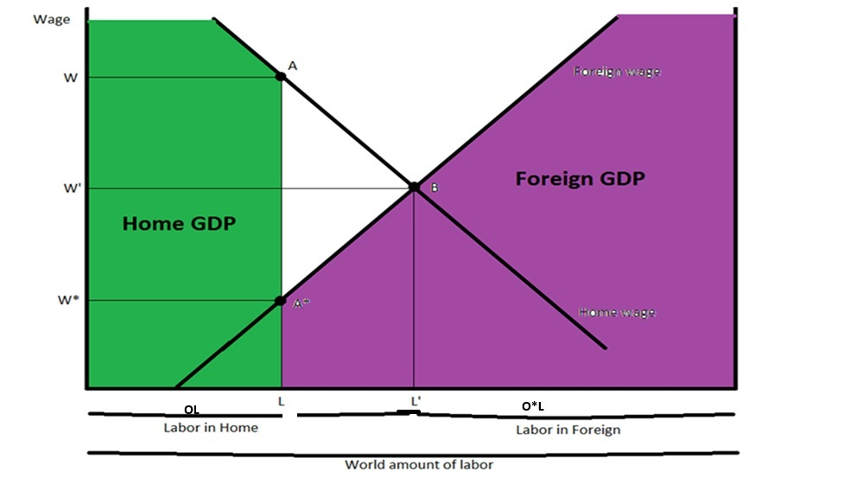
World GDP Before Migration

Slide 37
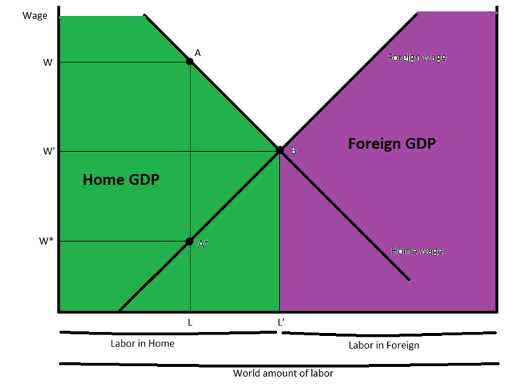
World GDP After Migration
One thing to keep in mind is that GDP of a country is the value of output within the boundaries of the country. Thus, when immigrants leave one country for another, what they produce is counted towards the GDP of the host country.

Slide 38
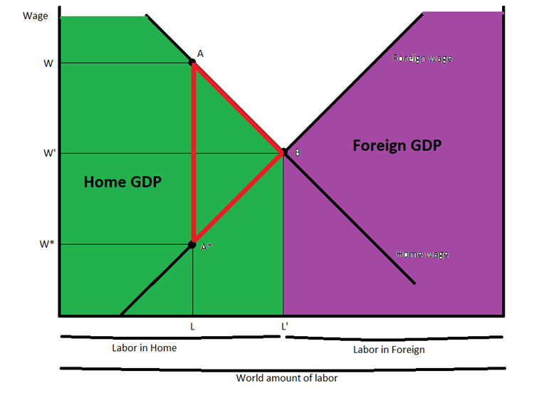
World Gains in GDP from Migration

Slide 39
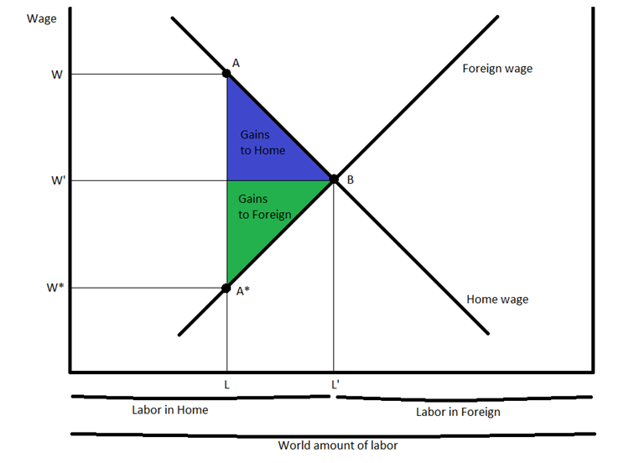
Gains from Migration
World gains from migration is the area represented by triangle AA*B, which denotes the increase in the world GDP due to immigration.
For example, when the first migrant leaves Foreign to Home, the GDP in the former country falls by W* whereas that in the latter increases by W. The gain in world welfare due to the movement of the first migrant is equal to the difference between the Home and Foreign wages.

Slide 40
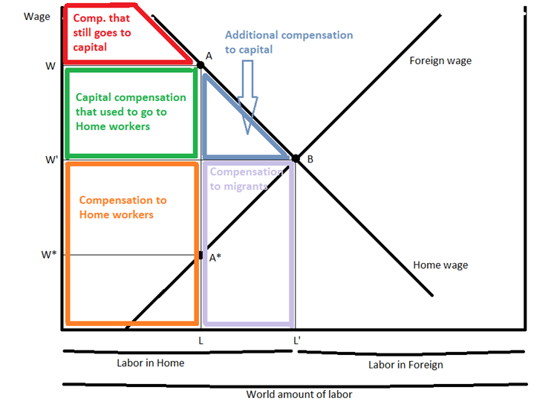
Change in Home GDP in More Detail

Slide 41
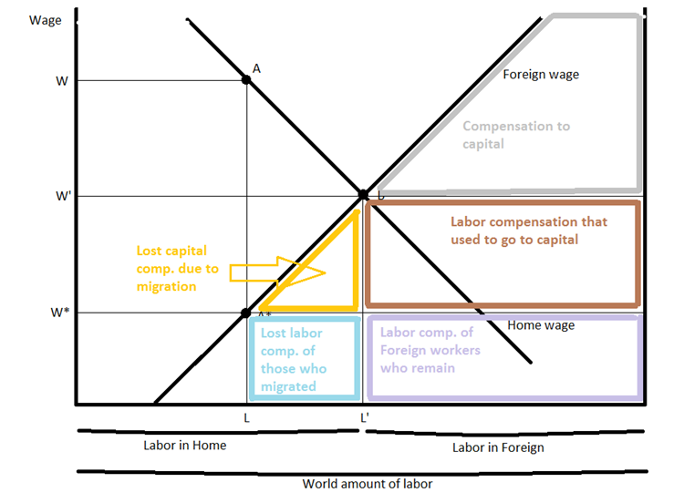
Change in Foreign GDP in More Detail

Slide 42
Summary
To summarize, we find that the earnings to capital owners at Home increases since there are more workers, which means that the marginal product of capital increases.
The earnings to capital owners in Foreign decreases since there are less workers, which means that the marginal product of capital decreases.

Slide 43
Conclusions
Immigration, the movement of workers between countries, potentially affects the wages in the host country in which the workers arrive.
In the short-run specific-factors model, a larger supply of workers due to immigration will lower wages. The arrival of immigrants is beneficial to owners of capital and land because as wages are reduced in the short run, rentals on capital and land will increase.
In the long run, when capital can move between industries, the fall in wages will not occur. Industries that use labor intensively can expand and other industries contract, so that immigrants become employed without any fall in wages. This change in industry outputs is the main finding of the Rybczynski theorem.

Slide 44
Conclusions
Foreign direct investment (FDI), the movement of capital between countries, has effects analogous to immigration.
In the short run, the entry of foreign capital into a country will lower the rental on capital, raise wages, and lower the rental on land.
In the long run, when capital and land can move between industries, these changes in the wage and rentals need not occur, as industry outputs adjust according to the Rybczynski theorem.
Both immigration and FDI create world gains as labor and capital move from countries with low marginal products to countries with high marginal products.

Slide 45
KEY POINTS
Holding the amount of capital and land fixed in both industries, as in the specific-factors model, immigration leads to a fall in wages. This was the case, for example, with the mass migration to the New World in the nineteenth century.
As wages fall because of immigration, the marginal products of the specific factors (capital and land) rise, and therefore their rentals also increase.
Fixing the amount of capital and land in a country is a reasonable assumption in the short run, but in the longer run, firms will move capital between industries, which will change the effect of immigration on wages and rentals.

Slide 46
KEY POINTS
In a long-run model with two goods and two factors, both of which are perfectly mobile between the industries, additional labor from immigration will be absorbed entirely by the labor-intensive industry. Furthermore, the labor-intensive industry will also absorb additional capital and labor from the capital-intensive industry, so its capital–labor ratio does not change in the long run. Because the capital–labor ratio in each industry does not change, the wage and rentals remain the same as well. This results in what is known as factor price insensitivity.
According to the Rybczynski theorem, immigration will lead to an increase in output in the labor-intensive industry and a decrease in the output of the capital-intensive industry. This result is different from that of the short-run specific-factors model, in which immigration leads to increased output in both industries.

Slide 47
KEY POINTS
Besides trade in goods and the movement of labor, another way that countries interact with one another is through investment. When a company owns property, plant, or equipment in another country, it is called foreign direct investment, or FDI.
In the short run, FDI lowers the rentals on capital and land and raises wages. In the long run, the extra capital can be absorbed in the capital-intensive industry without any change in the wage or rental.
According to the Rybczynski theorem, FDI will lead to an increase in the output of the capital-intensive industry and a decrease in the output of the labor-intensive industry.
The movement of capital and labor generates overall gains for both the source and host countries, provided that the income of the emigrants is included in the source country’s welfare. Hence, there are global gains from immigration and FDI.

Slide 48


