Slide 1
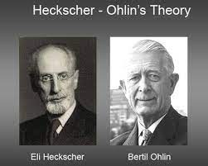
ECON 243 – International Trade
Chapter 4 - Trade and Resources:
The Heckscher–Ohlin Model

Slide 2
Questions to Consider
Why does the United States export agricultural products and airplanes?
What country has the most capital (i.e., factories) as compared with its GDP?
How does trade affect the earnings of labor and capital?

Slide 3
Introduction
In this chapter, we outline the Heckscher–Ohlin (HO) model, a model that assumes that trade occurs because countries have different resources.
Canada has a large amount of land and therefore exports agricultural and forestry products, as well as petroleum.
The United States, Western Europe, and Japan have many highly skilled workers and much capital, and these countries export sophisticated services and manufactured goods.
Asian countries have a large number of workers and moderate but growing amounts of capital, and they export less sophisticated manufactured goods.

Slide 4
Introduction
Our first goal is to describe the Heckscher–Ohlin (HO) model of trade.
  The specific-factors model that we studied in the previous chapter was a short-run model because capital and land could not move between the two industries.
  In contrast, the HO model is a long-run model because all factors of production can move between the industries.
Our second goal is to examine the empirical evidence on the Heckscher–Ohlin model. To obtain better predictions, we extend the model:
  By allowing for more than two factors of production
  By also allowing countries to differ in their technologies, as in the Ricardian model
.

Slide 5
Introduction
Both of these extensions make the predictions from the Heckscher–Ohlin model match more closely the trade patterns in the world economy today.
The third goal of the chapter is to investigate how the opening of trade between two countries affects the payments to labor and to capital in each of them

Slide 6
Heckscher–Ohlin Model
We define:
L_{S} is amount of labor in shoes, L_{C} is amount of labor in computers.
K_{S} is amount of capital in shoes, K_{C} is amount of capital in computers.
L_{S}/K_{S} is labor/capital ratio in shoes
L_{C}/K_{C} is labor/capital ratio in computers
Assumptions of the Heckscher–Ohlin Model
Assumption 1: Both factors, labor and capital, can move freely between the industries.
Assumption 2: Shoe production is labor-intensive; that is, it requires more labor per unit of capital to produce shoes than computers, so
L_{S}/K_{S} > L_{C}/K_{C} .

Slide 7
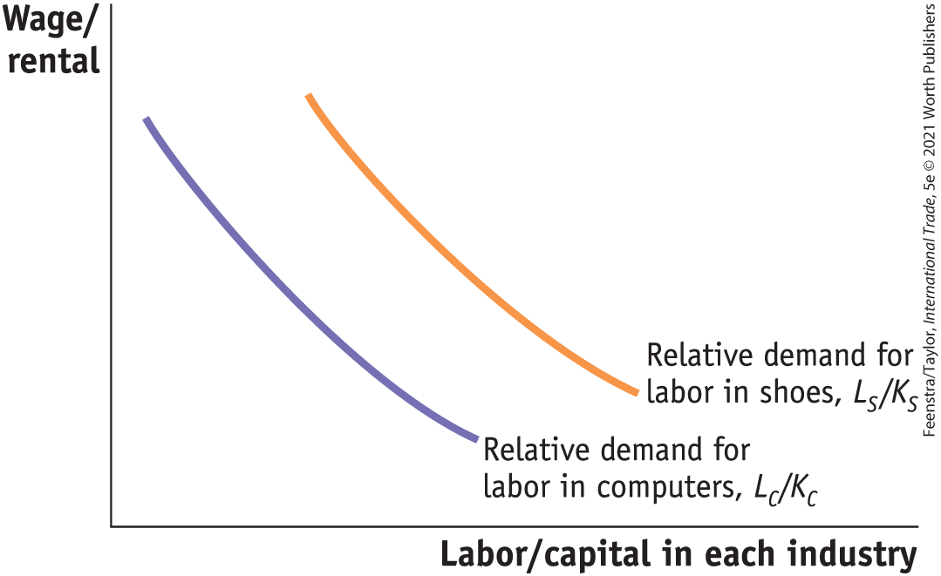
Heckscher–Ohlin Model
Labor Intensity of Each Industry
Shoe production being more labor-intensive than computers implies:
L_{S}/K_{S} > L_{C}/K_{C}
These two curves slope down just like regular demand curves, but in this case, they are relative demand curves for labor.
FIGURE 4-1

Slide 8
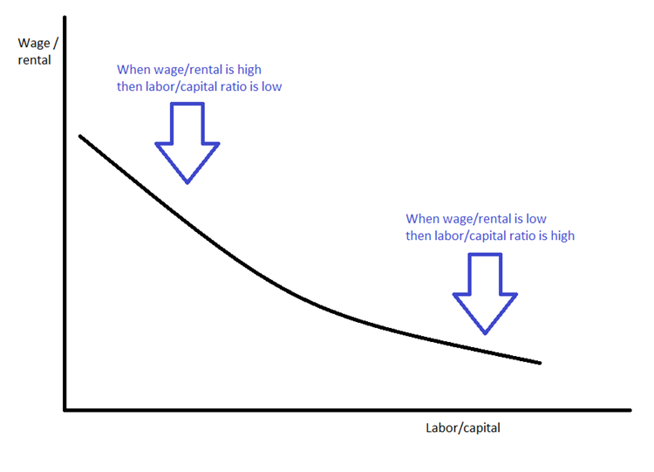
Relative Labor Demand

Slide 9

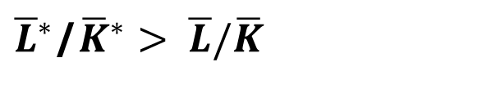
Heckscher–Ohlin Model
Assumptions of the Heckscher–Ohlin Model
Assumption 3: Foreign is labor-abundant, by which we mean that the labor–capital ratio in Foreign exceeds that in Home,
${\overline{L}}^{∗}$/${\overline{K}}^{∗}> \overline{L}/\overline{K}$
$\overline{K}/\overline{L}$ > ${\overline{K}}^{∗}$/${\overline{L}}^{∗}$.
Equivalently, Home is capital-abundant, so that
Assumption 4: The final outputs, shoes and computers, can be traded freely (i.e., without any restrictions) between nations, but labor and capital do not move between countries.
Assumption 5: The technologies used to produce the two goods are identical across the countries.
Assumption 6: Consumer tastes are the same across countries, and preferences for computers and shoes do not vary with a country’s level of income.

Slide 10
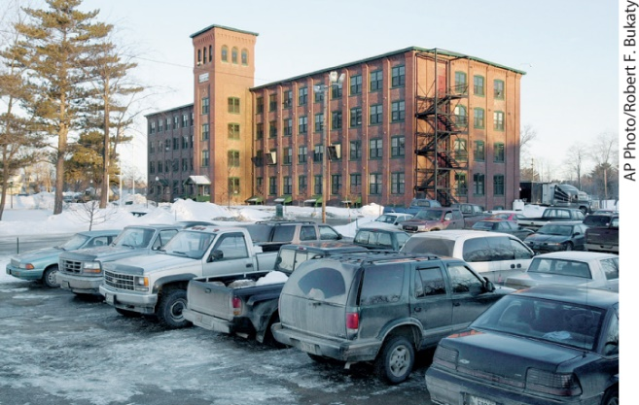
APPLICATION: Are Factor Intensities the Same Across Countries?
While much of the footwear in the world is produced in developing nations, the United States retains a small number of shoe factories.
In India, the sewing machine used to produce footwear is cheaper than the computer used in a call center. Footwear production in India is labor-intensive as compared with the call center, which is the opposite of what holds in the United States.
This example illustrates a reversal of factor intensities between the two countries.
In the United States, agriculture is capital-intensive. In many developing countries, it is labor-intensive.

Slide 11
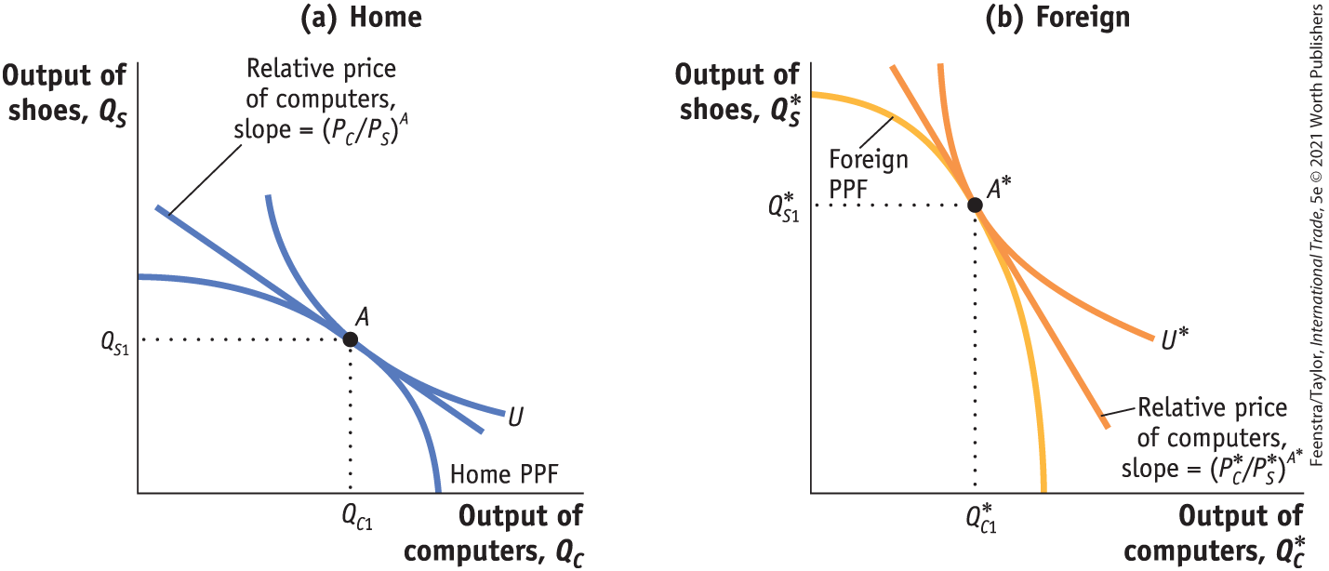
Heckscher–Ohlin Model
No-Trade Equilibrium - Production Possibilities Frontiers, Indifference Curves, and No-Trade Equilibrium Price
FIGURE 4-2 No-Trade Equilibria in Home and Foreign
The Home production possibilities frontier (PPF) is shown in panel (a), and the Foreign PPF is shown in panel (b).
Because Home is capital-abundant and computers are capital-intensive, the Home PPF is skewed toward computers.

Slide 12
Heckscher–Ohlin Model
No-Trade Equilibrium - Production Possibilities Frontiers, Indifference Curves, and No-Trade Equilibrium Price
FIGURE 4-2 No-Trade Equilibria in Home and Foreign
Home preferences are summarized by the indifference curve, U.
The Home no-trade (or autarky) equilibrium is at point A.
The flat slope indicates a low relative price of computers, (P_{C}/P_{S})^{A}.

Slide 13
Heckscher–Ohlin Model
No-Trade Equilibrium - Production Possibilities Frontiers, Indifference Curves, and No-Trade Equilibrium Price
FIGURE 4-2 - No-Trade Equilibria in Home and Foreign
Foreign is labor-abundant and shoes are labor-intensive, so the Foreign PPF is skewed toward shoes. Foreign preferences are summarized by the indifference curve, U*.
The Foreign no-trade equilibrium is at point A*, with a higher relative price of computers, as indicated by the steeper slope of (P*_{C}/P*_{S})^{A}*.

Slide 14
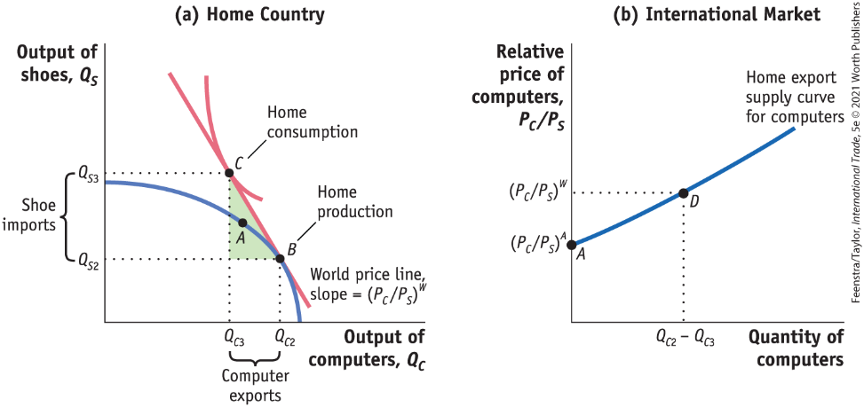
Heckscher–Ohlin Model
No-Trade Equilibrium to Home Equilibrium with Free Trade
FIGURE 4-3 - International Free-Trade Equilibrium in Home
At the free-trade world relative price of computers, (P_{C}/P_{S})^{W}, Home produces at point B in panel (a) and consumes at point C, exporting computers and importing shoes. Point A is the no-trade equilibrium.
The “trade triangle” has a base equal to the Home exports of computers (the difference between the amount produced and the amount consumed with trade, Q_{C2} − Q_{C3}).

Slide 15
Heckscher–Ohlin Model
No-Trade Equilibrium to Home Equilibrium with Free Trade
FIGURE 4-3 - International Free-Trade Equilibrium in Home
The height of this triangle is the Home imports of shoes (the difference between the amount consumed of shoes and the amount produced with trade, Q_{S3} − Q_{S2}).
In panel (b), we show Home exports of computers equal to zero at the no-trade relative price, (P_{C}/P_{S})^{A}, and equal to (Q_{C2} − Q_{C3}) at the free-trade relative price, (P_{C}/P_{S})^{W}.

Slide 16
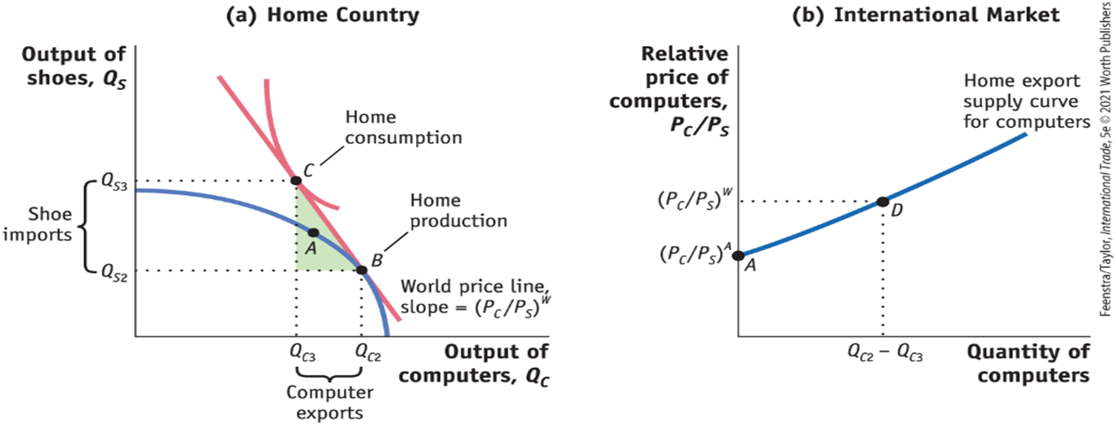
A Closer Look

Slide 17
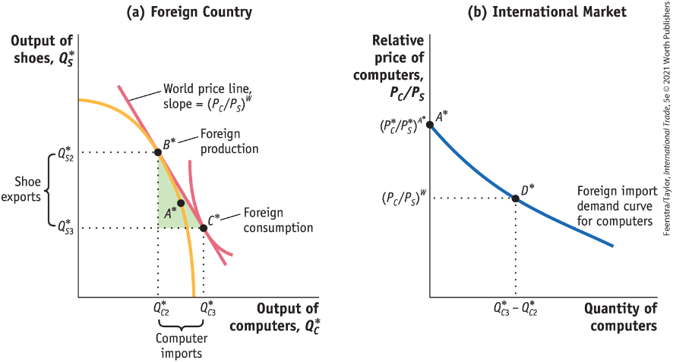
Heckscher–Ohlin Model
No-Trade Equilibrium to Foreign Equilibrium with Free Trade
FIGURE 4-4 - International Free-Trade Equilibrium in Foreign
At the free-trade world relative price of computers, (P_{C}/P_{S})^{W}, Foreign produces at point B* in panel (a) and consumes at point C*, importing computers and exporting shoes. Point A* is the no-trade equilibrium.
The “trade triangle” has a base equal to Foreign imports of computers (the difference between the consumption of computers and the amount produced with trade, Q*_{C3} − Q*_{C2}).

Slide 18
Heckscher–Ohlin Model
No-Trade Equilibrium to Foreign Equilibrium with Free Trade
FIGURE 4-4 - International Free-Trade Equilibrium in Foreign
The height of this triangle is Foreign exports of shoes (the difference between the production of shoes and the amount consumed with trade, Q*_{S2} − Q*_{S3}).
In panel (b), we show Foreign imports of computers equal to zero at the no-trade relative price, (P*C/P*S)A*, and equal to (Q*_{C3} − Q*_{C2} ) at the free-trade relative price, (P_{C}/P_{S})^{W}

Slide 19

A Closer Look

Slide 20
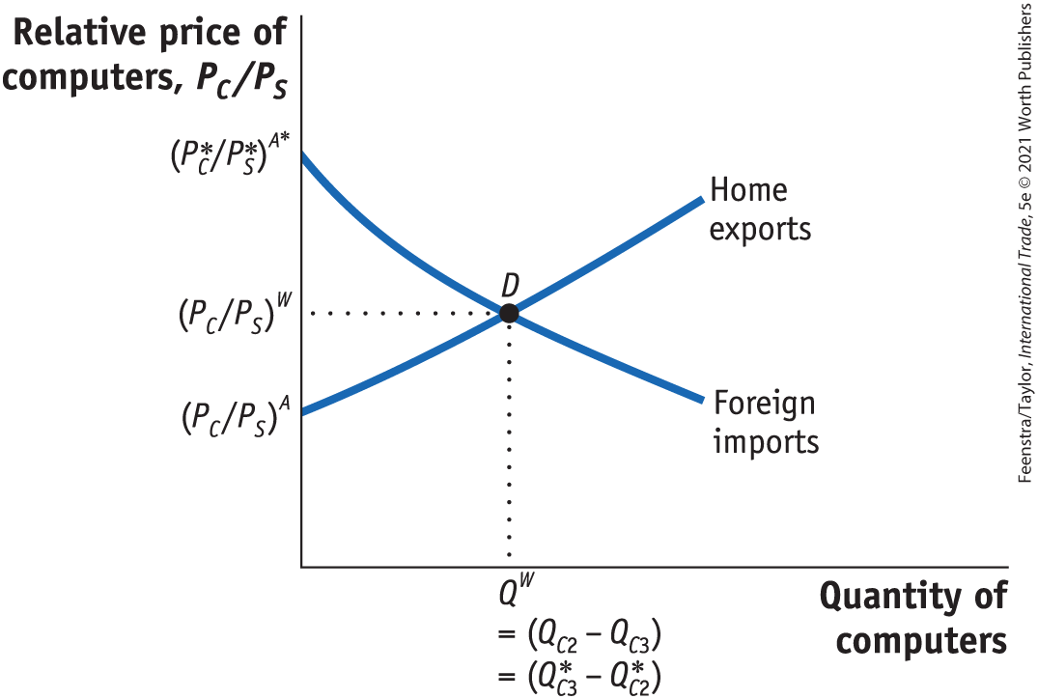
Heckscher–Ohlin Model
Free Trade Equilibrium - Equilibrium Price with Free Trade
The world relative price of computers in the free-trade equilibrium is determined at the intersection of the Home export supply and Foreign import demand, at point D.
At this relative price, the quantity of computers that Home wants to export, (Q_{C2} − Q_{C3}), just equals the quantity of computers that Foreign wants to import, (Q*_{C3} − Q*_{C2}).
FIGURE 4-5 Determination of the Free-Trade World Equilibrium Price
Notes:
.

Slide 21

A Closer Look

Slide 22
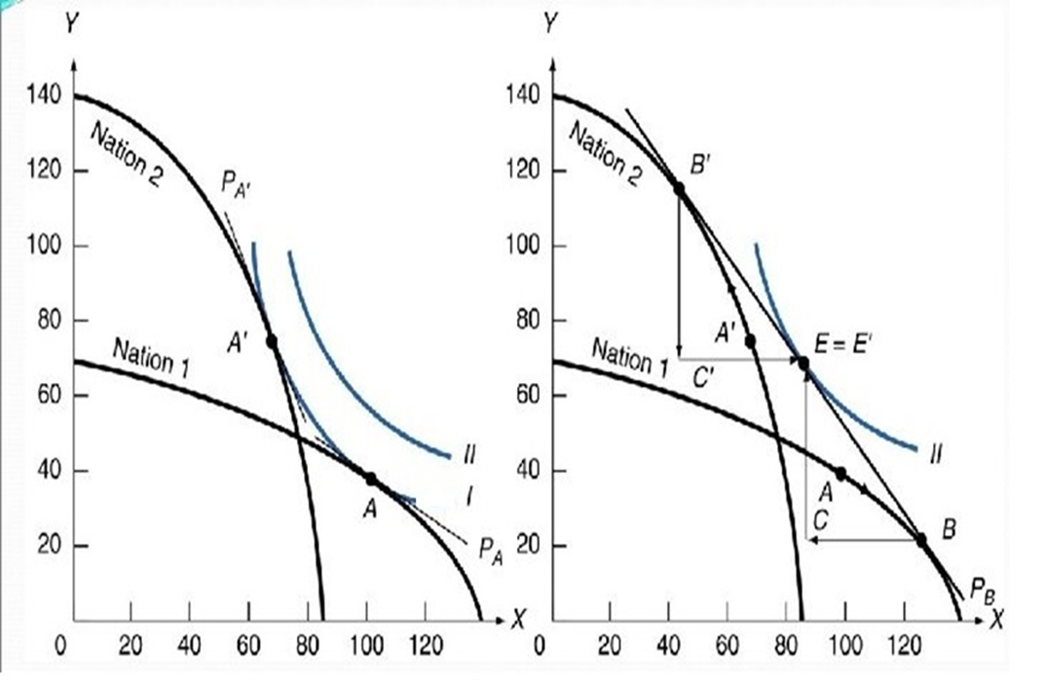
The Heckscher–Ohlin Model
https://slidetodoc.com/chapter-five-factor-endowments-and-the-heckscherohlin-theory/

Slide 23
Heckscher–Ohlin Theorem
Free Trade Equilibrium
Pattern of Trade
  Home exports computers, the good that uses intensively the factor of production (capital) found in abundance at Home.
  Foreign exports shoes, the good that uses intensively the factor of production (labor) found in abundance there.
  This important result is called the Heckscher–Ohlin theorem.

Slide 24
Heckscher–Ohlin Theorem Assumptions
Once Again
Assumption 1: Labor and capital flow freely between the industries.
Assumption 2: The production of shoes is labor-intensive as compared with computer production, which is capital-intensive.
Assumption 3: The amounts of labor and capital found in the two countries differ, with labor abundant in Foreign and capital abundant in Home.
Assumption 4: There is free international trade in goods.
Assumption 5: The technologies for producing shoes and computers are the same across countries.
Assumption 6: Tastes are the same across countries.

Slide 25
Conclusions from Assumptions
Heckscher–Ohlin Theorem
  When Home opens to trade, its relative price of computers rises from the no-trade equilibrium relative price (P_{C}/P_{S})^{A} to the free-trade equilibrium price (P_{C} /P_{S})^{W}, giving Home firms an incentive to export computers.
  Similarly, when Foreign opens to trade, its relative price of computers falls from the no-trade equilibrium price (P*_{C}/P*_{S})^{A}* to the trade equilibrium price (P_{C} /P_{S})^{W} , encouraging Foreign consumers to import computers from Home.

Slide 26
Testing the Heckscher–Ohlin Model
The first test of the Heckscher–Ohlin theorem was performed by economist Wassily Leontief in 1953 using data for the United States from 1947.
Leontief supposed correctly that in 1947 the United States was abundant in capital relative to the rest of the world.
  Leontief assumed that U.S. and foreign technologies were the same due to the limited data on foreign technology, which is consistent with H–O theorem.
Thus, from the Heckscher–Ohlin theorem, Leontief expected that the United States would export capital-intensive goods and import labor-intensive goods.
What Leontief actually found, however, was just the opposite: the capital–labor ratio for U.S. imports was higher than the capital–labor ratio found for U.S. exports.
This finding contradicted the Heckscher–Ohlin theorem and came to be called Leontief’s paradox.

Slide 27
Testing the Heckscher–Ohlin Model
TABLE 4-1 Leontief’s Test
Leontief used the numbers in this table to test the Heckscher–Ohlin theorem. Each column shows the amount of capital or labor needed to produce $1 million worth of exports from, or imports into, the United States in 1947. As shown in the last row, the capital–labor ratio for exports was less than the capital–labor ratio for imports, which is a paradoxical finding.
 | Exports | Imports
Capital ($ millions) | 2.55 | 3.1
Labor (person-years) | 182 | 170
Capital/labor ($/person) | 14,000 | 18,200

Slide 28
Testing the Heckscher–Ohlin Model
Leontief’s Paradox
Explanations
  U.S. and foreign technologies are not the same, in contrast to what the H–O theorem and Leontief assumed.
  By focusing only on labor and capital, Leontief ignored land abundance in the United States.
  Leontief should have distinguished between high-skilled and low-skilled labor (because it would not be surprising to find that U.S. exports are intensive in high-skilled labor).
  The data for 1947 may be unusual because World War II had ended just two years earlier, and so trade patterns may have been unusual.
  Because of import tariffs between countries, the United States was not engaged in completely free trade, as the Heckscher–Ohlin theorem assumes.

Slide 29
Testing the Heckscher–Ohlin Model
Leontief’s Paradox Once Again
Capital Abundance: It is hard to estimate the U.S. share of capital stock in the postwar years. But given the devastation of the capital stock in Europe and Japan due to World War II, we can presume that the U.S. share of world capital was more than 37%. That estimate means that the U.S. share of world capital exceeds the U.S. share of world GDP, so that the U.S. was abundant in capital in 1947.
Labor Abundance: If we do not correct labor for productivity differences across countries, then the population of each country is a rough measure of its labor force. The U.S. share of population for the sample of 30 countries in 1947 was very small. This estimate of labor abundance is much less than the U.S. share of GDP, which means the United States was scarce in labor.

Slide 30
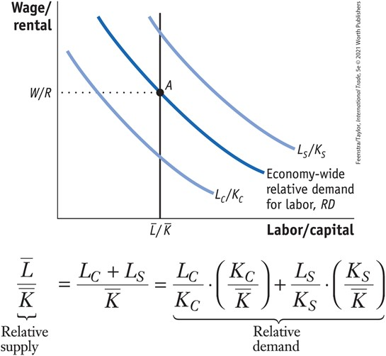
Effects of Trade on Factor Prices
Effect of Trade on the Wage and Rental of Home - Economy-Wide Relative Demand for Labor - FIGURE 4-11 Determination of Home Wage/Rental
The economy-wide relative demand for labor, RD, is an average of the L_{C}/K_{C} and L_{S}/K_{S} curves and lies between these curves.
The relative supply, L/K, is shown by a vertical line because the total amount of resources in Home is fixed.
The equilibrium point A, at which relative demand RD intersects relative supply L/K, determines the wage relative to the rental, W/R.

Slide 31
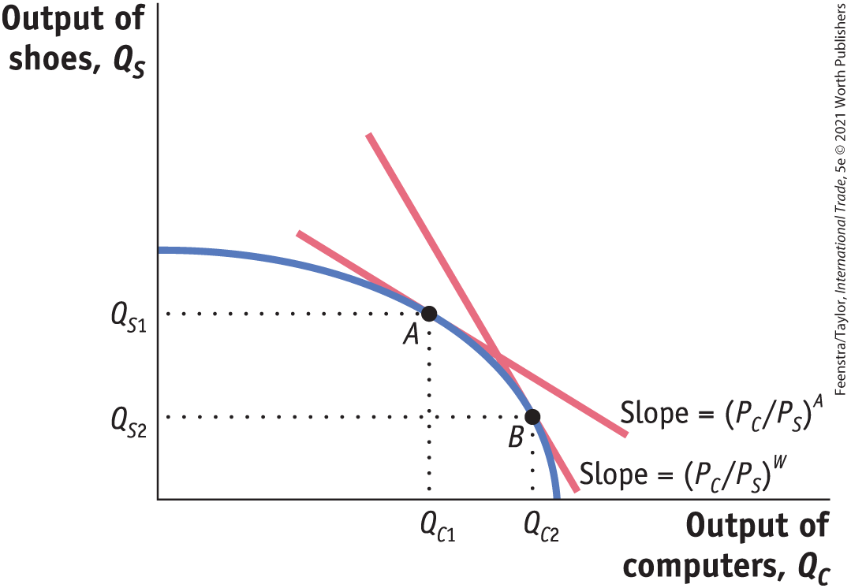
Effects of Trade on Factor Prices
Effect of Trade on the Wage and Rental of Home - Increase in the Relative Price of Computers -FIGURE 4-12 Increase in the Price of Computers
Initially, Home is at a no-trade equilibrium at point A with a relative price of computers of (P_{C}/P_{S})^{A}.
An increase in the relative price of computers to the world price, as illustrated by the steeper world price line, (P_{C}/P_{S})^{W}, shifts production from point A to B.
At point B, there is a higher output of computers and a lower output of shoes, Q_{C2} > Q_{C1} and Q_{S2} < Q_{S1}.

Slide 32
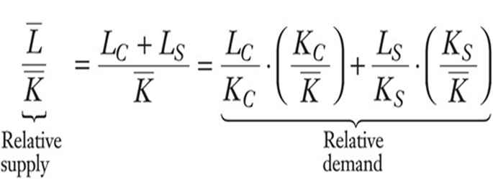
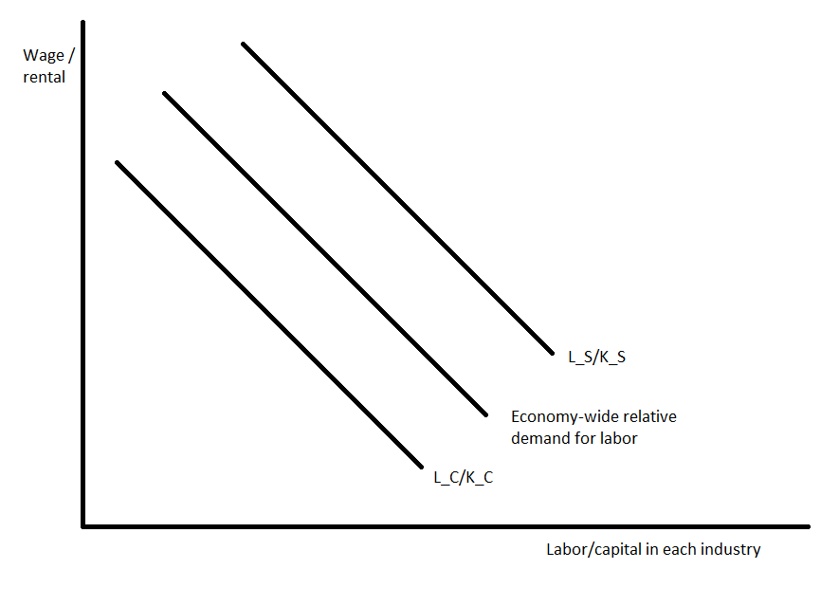
Relative Demand
The relative demand for labor is a weighted-average of the labor/capital ratio in each industry.

Slide 33
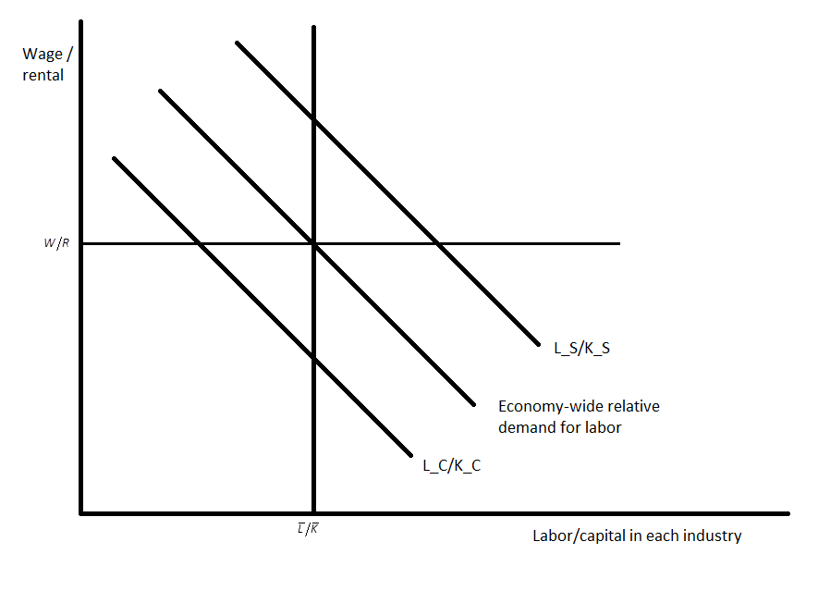
Relative Demand (with Supply)
Notice that the relative supply curve depends on the total amount of factor resources in the economy and not on the relative wages, so it is represented by a vertical line.
The equilibrium relative wage at Home is determined by the intersection of the relative supply and relative demand curves.

Slide 34
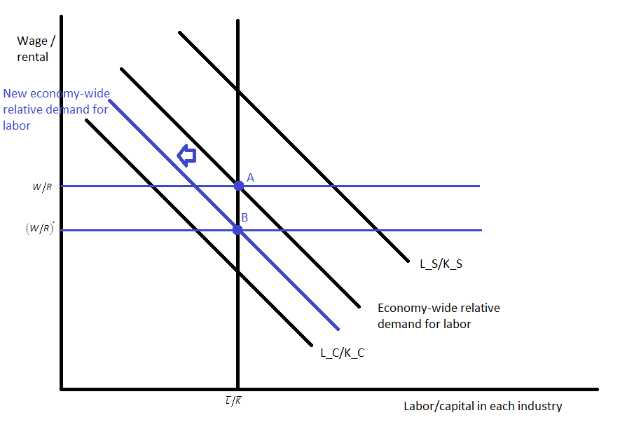

Changes in Home wage/rental
Changes in Home wage/rental
Because of free trade, Home faces a higher relative price of computers. Home will increase computer production at the expense of shoe production.
This implies that
and since capital has shifted to the computer industry. This implies the following in the diagram
Thus, it implies that wage/rental decline.
The lower wage/rental induces an increase in the number of workers hired per unit of capital in each industry, shown by the movement along the relative demand curves.

Slide 35
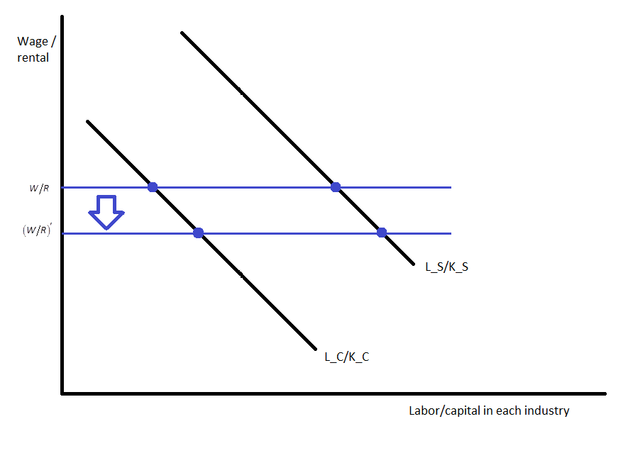
Changes in Labor/Capital Ratio
Thus, the increase in the relative price of computers resulting from free trade leads to a rise in the labor/capital ratio in both industries.

Slide 36
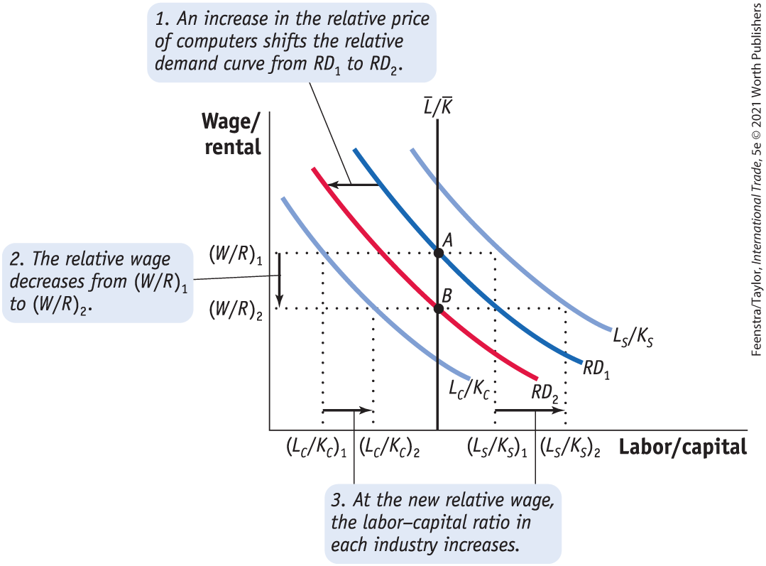
Effects of Trade on Factor Prices Once Again
Effect of Trade on the Wage and Rental of Home - Increase in the Relative Price of Computers –
FIGURE 4-13 Effect of a Higher Relative Price of Computers on Wage/Rental
An increase in the relative price of computers shifts the economy-wide relative demand for labor, RD₁, toward the relative demand for labor in the computer industry, L_{C}/K_{C}. The new relative demand curve, RD₂, intersects the relative supply curve for labor at a lower relative wage, (W/R)₂.

Slide 37
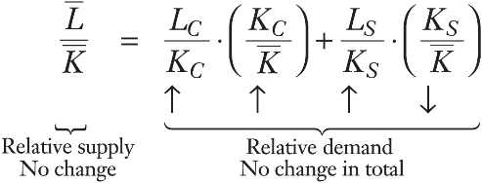
Effects of Trade on Factor Prices
Effect of Trade on the Wage and Rental of Home - Increase in the Relative Price of Computers - FIGURE 4-13 Effect of a Higher Relative Price of Computers on Wage/Rental
As a result, the wage relative to the rental falls from (W/R)₁ to (W/R)₂.
The lower relative wage causes both industries to increase their labor–capital ratios, as illustrated by the increase in both L_{C}/K_{C} and L_{S}/K_{S} at the new relative wage.

Slide 38
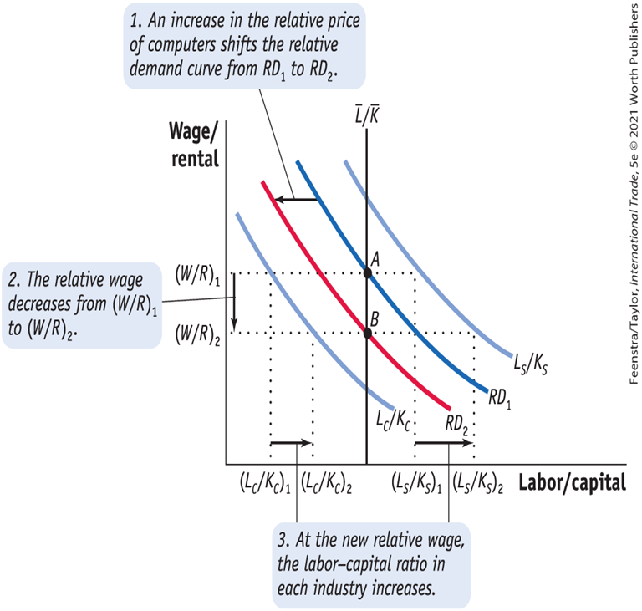
A Closer Look

Slide 39
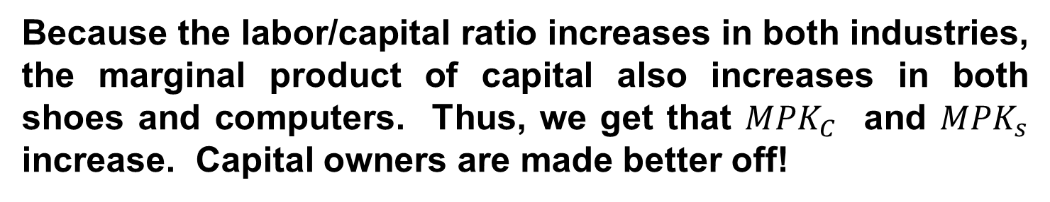
Effects of Trade on Factor Prices (Home)
Change in the Real Rental
$$R=P_{C} ∙ {MPK}_{C} and R=P_{S} ∙ {MPK}_{S}$$
Because the labor/capital ratio increases in both industries, the marginal product of capital also increases in both shoes and computers. Thus, we get that ${MPK}_{C}$ and ${MPK}_{s}$ increase. Capital owners are made better off!
${MPK}_{C}={R/P}_{C}↑ and {MPK}_{s}={R/P}_{S}$ $↑$

Slide 40
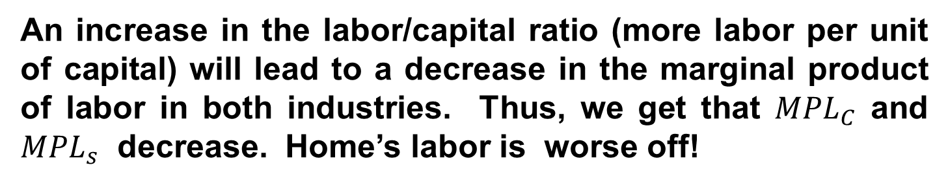
Effects of Trade on Factor Prices (Home)
Change in the Real Wage
$$W=P_{C} ∙ {MPL}_{C} and W=P_{S} ∙ {MPL}_{S}$$
An increase in the labor/capital ratio (more labor per unit of capital) will lead to a decrease in the marginal product of labor in both industries. Thus, we get that ${MPL}_{C}$ and ${MPL}_{s}$ decrease. Home’s labor is worse off!
${MPL}_{C}={W/P}_{C}↓and {MPL}_{s}={W/P}_{S}$ $↓$

Slide 41
Effects of Trade on Factor Prices (Foreign)
We get the opposite result in Foreign. By opening to trade, Foreign experiences a fall in the real rental of capital and a rise in real wages. This means that labor in Foreign is better off with free trade and the capital owners are worse off.
${MPL}_{C}={W/P}_{C} and {MPL}_{s}={W/P}_{S}$

Slide 42
Effects of Trade on Factor Prices
Determination of the Real Wage and Real Rental
Stolper–Samuelson Theorem
In the long run, when all factors are mobile, an increase in the relative price of a good will increase the real earnings of the factor used intensively in the production of that good and decrease the real earnings of the other factor.
For our example, the Stolper–Samuelson theorem predicts that when Home opens to trade and faces a higher relative price of computers, the real rental on capital in Home rises and the real wage in Home falls. In Foreign, the changes in real factor prices are just the reverse.

Slide 43
Effects of Trade on Factor Prices
General Equation for the Long-Run Change in Factor Prices
The long-run results of a change in factor prices can be summarized in the following equation:
For an increase in the price of computers
The relationship between the changes in product prices to changes in factor prices is called the “magnification effect” because it shows how changes in the prices of goods have a magnified effect on the earnings of factors.
For a decrease in the price of computers
For an increase in the price of shoes

Slide 44
Conclusions
The Heckscher–Ohlin model isolates the effect of different factor endowments across countries and determines the impact of these differences on trade patterns, relative prices of goods between countries, and factor returns.
The Heckscher‒Ohlin model predicts that countries export goods that use their abundant factor intensively.
Leontief paradoxically found that the exports from the United States were relatively labor-intensive. This paradox was explained with later research showing that the United States was abundant in effective labor, as measured by productivity, in 1947.
Adjusting factors of production for their productivity also explains the changing abundancy and scarcity of arable land in the United States and of R&D scientists in China.

Slide 45
Conclusions
When firms have differentiated products and increasing returns to scale, the potential exists for gains from trade above and beyond those under perfect competition.
By focusing on the factor intensities among goods (i.e., the relative amount of labor and capital used in production), the Heckscher‒Ohlin (HO) model also explains who gains and who loses from the opening of trade.
The HO model predicts real gains for the factor used intensively in the export good, whose relative price goes up with the opening of trade, and real losses for the other factor.
Having just two factors, both of which are fully mobile between the industries, leads to a clear prediction about who gains and who loses from trade in the long run.

Slide 46
KEY POINTS
In the Heckscher–Ohlin model, we assume that the technologies are the same across countries and that countries trade because the available resources (labor, capital, and land) differ across countries.
Unlike the short-run specific-factors model, in which capital and land resources cannot move between industries, the Heckscher–Ohlin model is a long-run framework that assumes that labor, capital, and other resources can move freely between the industries.
With two goods, two factors, and two countries, the Heckscher–Ohlin model predicts that a country will export the good that uses its abundant factor intensively and import the other good.

Slide 47
KEY POINTS
The first test of the Heckscher–Ohlin model was made by Leontief using U.S. data for 1947. He found that U.S. exports were less capital-intensive and more labor-intensive than U.S. imports. This was a paradoxical finding because the United States was abundant in capital.
The assumption of identical technologies used in the Heckscher–Ohlin model does not hold in practice. Current research has extended the empirical tests of the Heckscher–Ohlin model to allow for many factors and countries, along with differing productivities of factors across countries. When we allow for different productivities of labor in 1947, we find that the United States is abundant in effective—or skilled—labor, which explains the Leontief paradox.

Slide 48
KEY POINTS
According to the Stolper–Samuelson theorem, an increase in the relative price of a good will cause the real earnings of labor and capital to move in opposite directions: the factor used intensively in the industry whose relative price goes up will find its earnings increased, and the real earnings of the other factor will fall.
Putting together the Heckscher–Ohlin theorem and the Stolper–Samuelson theorem, we conclude that a country’s abundant factor gains from the opening of trade (because the relative price of exports goes up), and its scarce factor loses from the opening of trade.

