Slide 1

ECON 243 – International Trade
Chapter 3 - Gains and Losses from Trade in the Specific-Factors Model

Slide 2
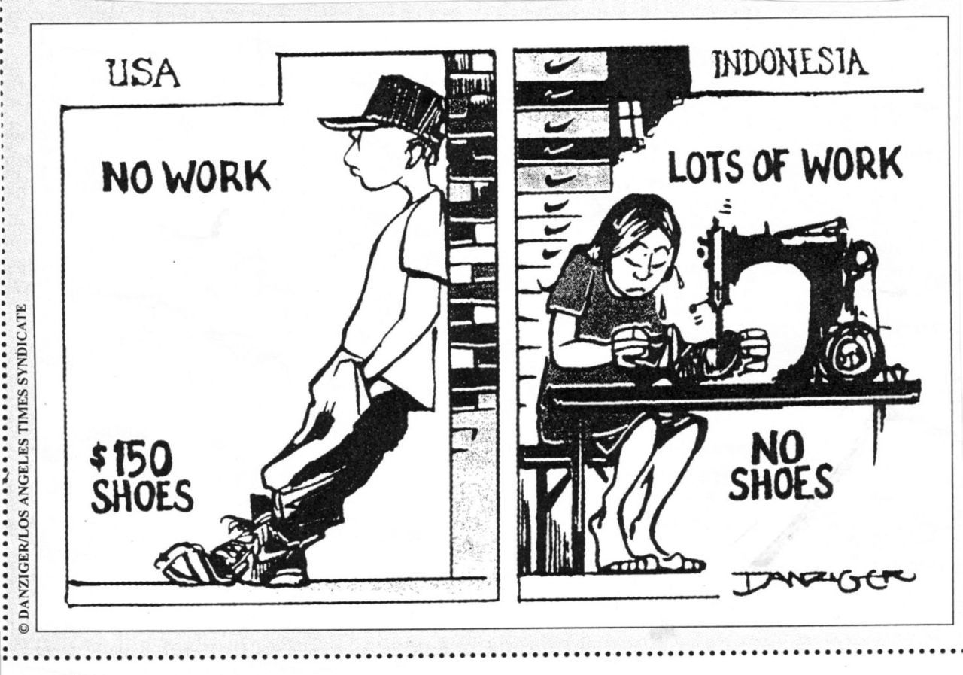
Questions to Consider
Do you personally gain from inexpensive imported goods?
Besides you, who gains and who loses from trade?
What government policies can help firms and workers that lose from trade?

Slide 3
Introduction
The argument from the Ricardian model that trade generates gains for all workers is too simple because labor is the only factor of production in that model.
We relax that assumption with the specific-factors model, where land can be used only in the agriculture sector and capital can be used only in the manufacturing sector; labor is used in both sectors.
From the Ricardian model, we learned that free trade affects relative prices, and this in turn affects the earnings of factors of production.
The question addressed by the specific-factors model is how trade, through changes in relative prices, affects the earnings of labor, land, and capital.
A key lesson from this chapter is that in most cases, opening a country to trade generates winners and losers.

Slide 4
Specific-Factors Model
The specific-factors model we will develop has the following features:
  Once again there are two countries: Home and Foreign.
  Manufacturing uses labor and capital, and agriculture uses labor and land.
  In each industry, increases in the amount of labor used are subject to diminishing returns; that is, the marginal product of labor declines as the amount of labor used in the industry increases.
  For now let’s focus on the Home country.

Slide 5
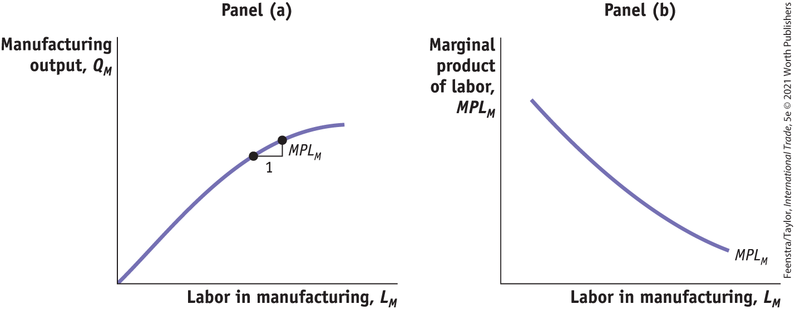
Specific-Factors Model
The Home Country
FIGURE 3-1
Panel (a) Manufacturing Output As more labor is used, manufacturing output increases, but it does so at a diminishing rate.
Panel (b) Diminishing Marginal Product of Labor An increase in the amount of labor used in manufacturing lowers the marginal product of labor.

Slide 6
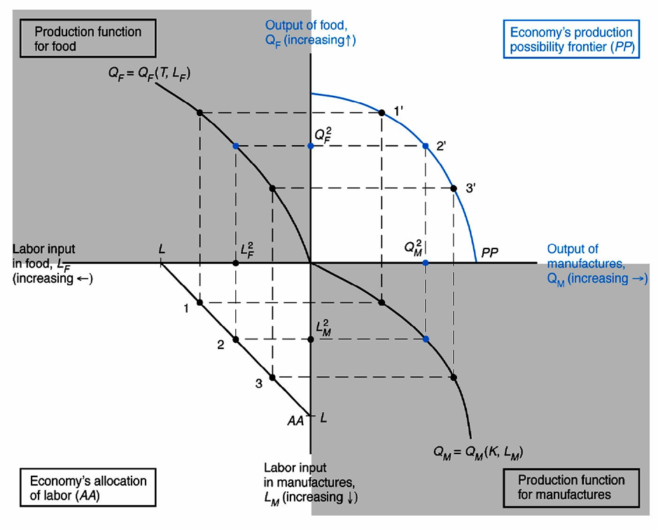
Deriving the Production Possibilities Frontier
(Food is considered Agriculture {A})

Slide 7
Slope of the PPF

Slide 8
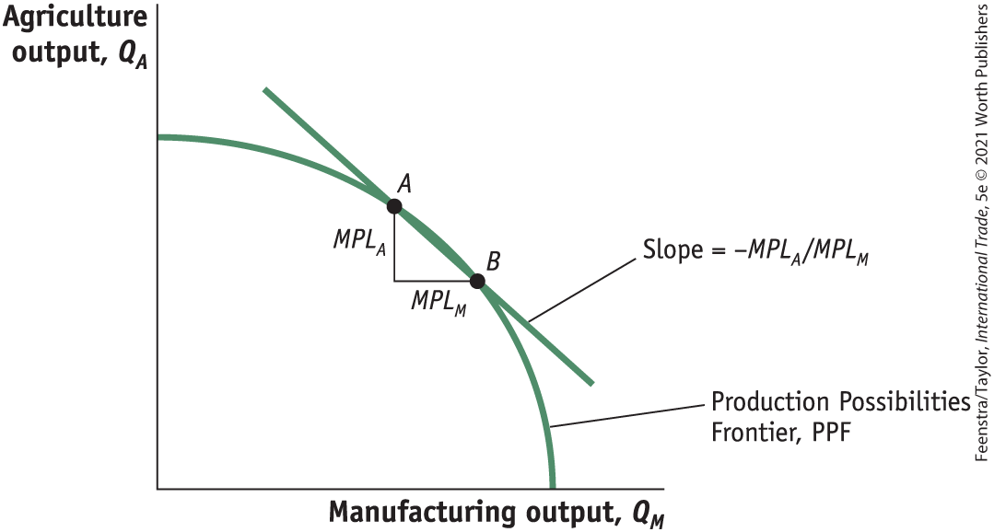
Specific-Factors Model
The Home Country Production Possibilities Frontier
FIGURE 3-2
Production Possibilities Frontier
The production possibilities frontier shows the amount of agricultural and manufacturing outputs that can be produced in the economy with labor.

Slide 9


Specific-Factors Model
The Home Country - Opportunity Cost and Prices
As in the Ricardian model, the slope of the PPF equals the opportunity cost or relative price of the good on the horizontal axis; here it is manufacturing.
Firms hire labor up to the point where the cost of one more hour of labor (the wage) equals the value of one more hour of labor in production.
$$W=P_{M} ∙ {MPL}_{M}$$
$$W=P_{A} ∙ {MPL}_{A}$$

Slide 10
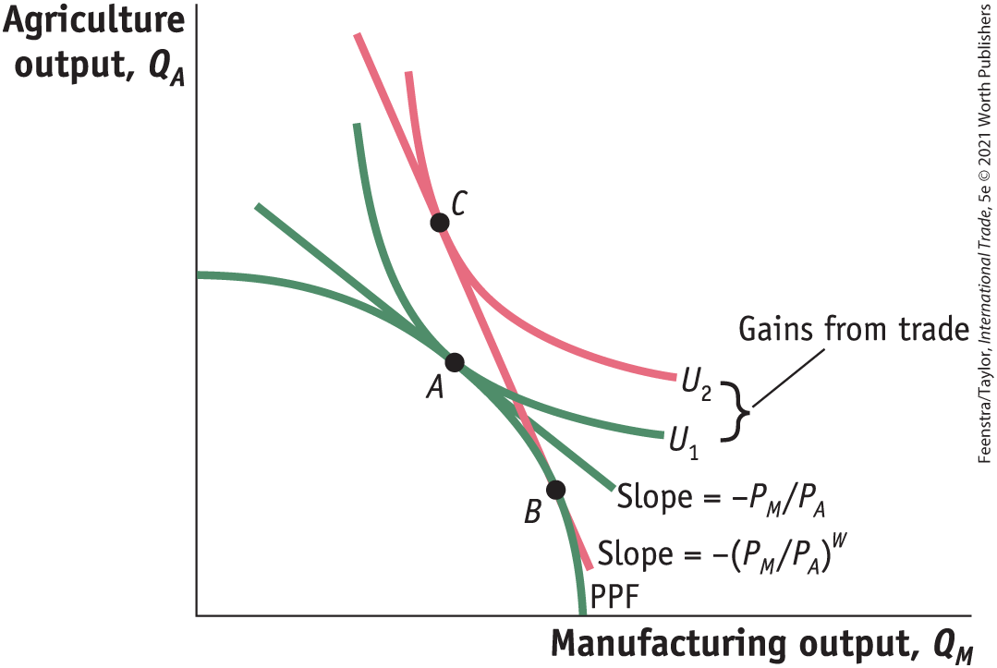
Specific-Factors Model
The Home Country Opportunity Cost and Prices
FIGURE 3-3
In the absence of international trade, the economy produces and consumes at point A.
The relative price of manufactures, P_{M}/P_{A}, is the slope of the line tangent to the PPF and indifference curve U₁, at point A.
With international trade, the economy is able to produce at point B and consume at point C.
The world relative price of manufactures, (P_{M}/P_{A})^{W}, is the slope of the line BC.
The rise in utility from U₁ to U₂ is a measure of the gains from trade for the economy.

Slide 11
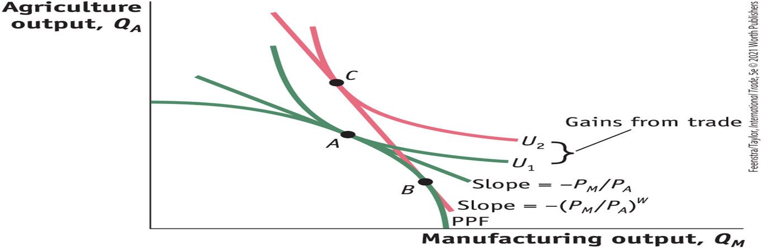
A Closer Look

Slide 12
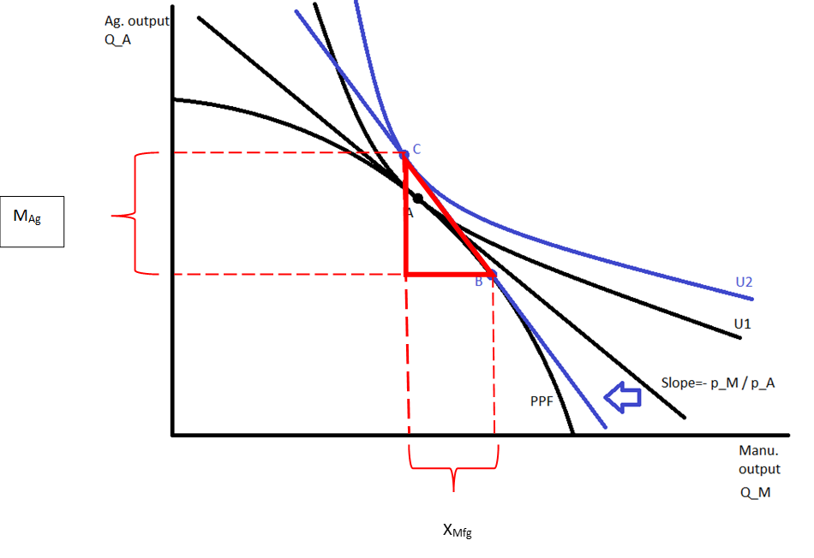
An Even Closer Look
B is the production bundle and C is the consumption bundle under free trade. In contrast to the Ricardian model, specialization is incomplete.

Slide 13
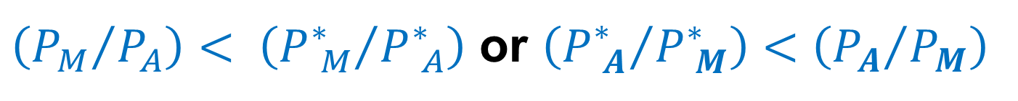
Specific-Factors Model
The Home and The Foreign Country
  Let us assume that the Home no-trade relative price of manufacturing is lower than the Foreign relative price.
$\left({P_{M}}/{P_{A}}\right)< \left({P_{ M}^{∗}}/{P_{ A}^{∗}}\right)$ or $\left({P_{ A}^{∗}}/{P_{ M}^{∗}}\right)<\left({P_{A}}/{P_{M}}\right)$
  This means that Home can produce manufactured goods relatively cheaper than Foreign.
  Put another way, Home has a comparative advantage in manufacturing.
  Foreign has a comparative advantage in agriculture

Slide 14
Specific-Factors Model
Overall Gains from Trade
  The good whose relative price goes up (manufacturing, for Home) is exported.
  The good whose relative price goes down (agriculture, for Home) is imported.
  By exporting manufactured goods at a higher price and importing food at a lower price, Home is better off than it was in the absence of trade.

Slide 15
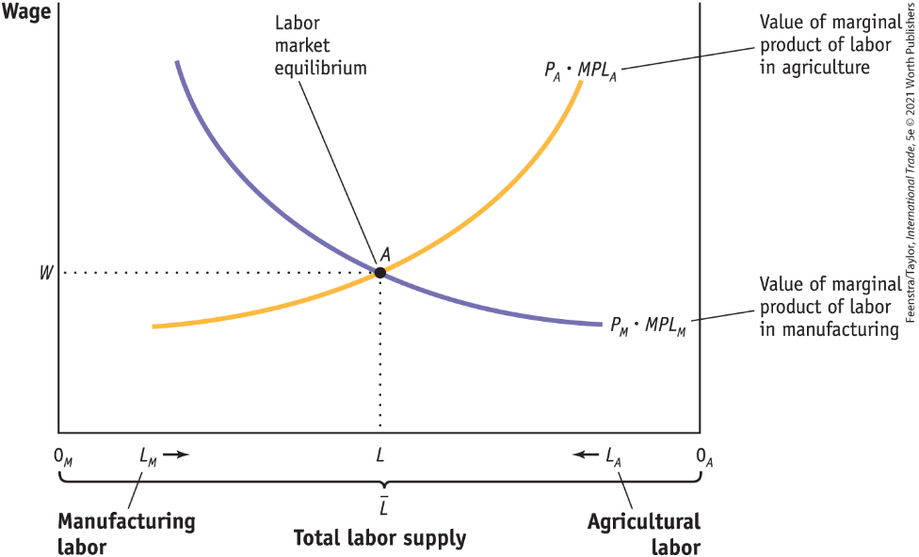
Earnings of Labor
Determination of Wages
FIGURE 3-4 (1 of 2)
The amount of labor used in manufacturing is measured from left to right along the horizontal axis, and the amount of labor used in agriculture is measured from right to left.
Labor market equilibrium is at point A. At the equilibrium wage of W, manufacturing uses 0_{M}L units of labor and agriculture uses 0_{A}L units

Slide 16
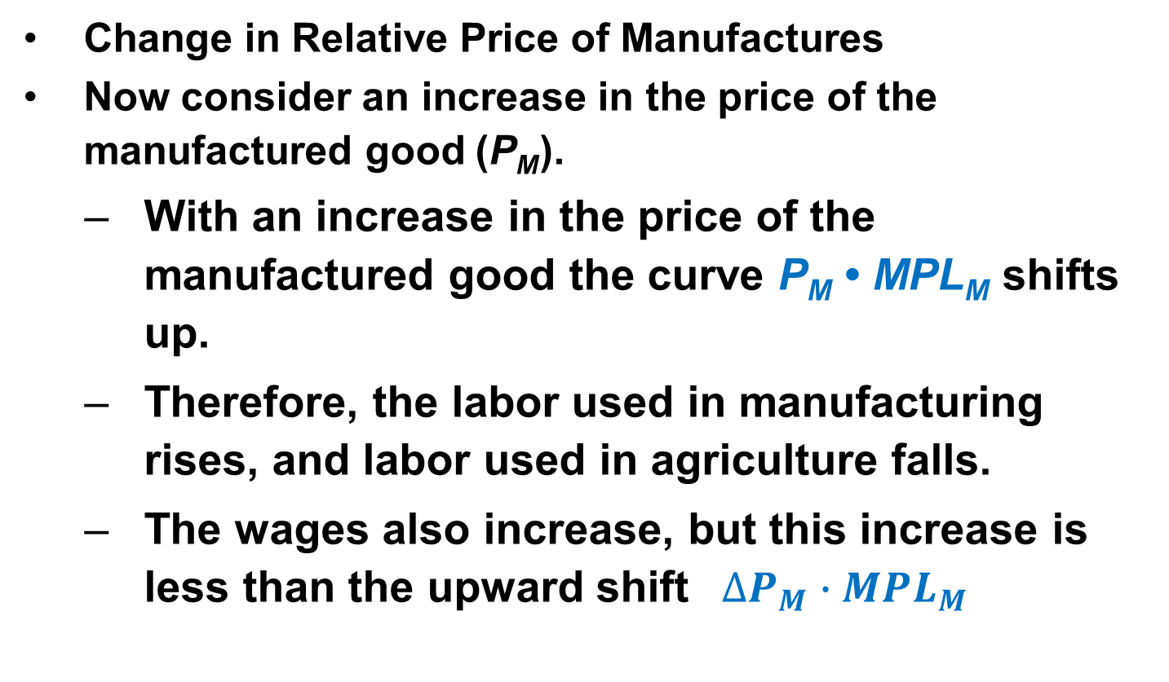
Earnings of Labor
Change in Relative Price of Manufactures
Now consider an increase in the price of the manufactured good (P_{M}).
  With an increase in the price of the manufactured good the curve P_{M} • MPL_{M} shifts up.
  Therefore, the labor used in manufacturing rises, and labor used in agriculture falls.
  The wages also increase, but this increase is less than the upward shift ${ ∆P}_{M} ∙MPL_{M}$

Slide 17
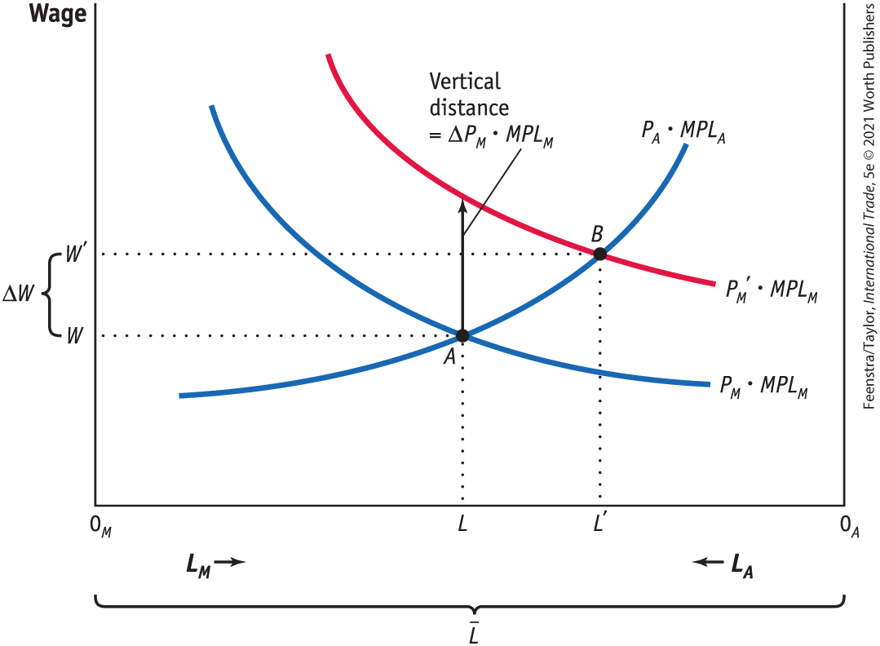
Earnings of Labor
Change in Relative Price of Manufactures
FIGURE 3-5
Increase in the Price of Manufactured Goods
With an increase in the price of the manufactured good, the curve P_{M} • MPL_{M} shifts up to P_{M}′ • MPL_{M} and the equilibrium shifts from point A to B.
The labor used in manufacturing rises from 0_{M}L to 0_{M}L′, and labor used in agriculture falls from 0_{A}L to 0_{A}L′.
The wage increases from W to W′, but this increase is less than the upward shift ΔP_{M} • MPL_{M}.

Slide 18
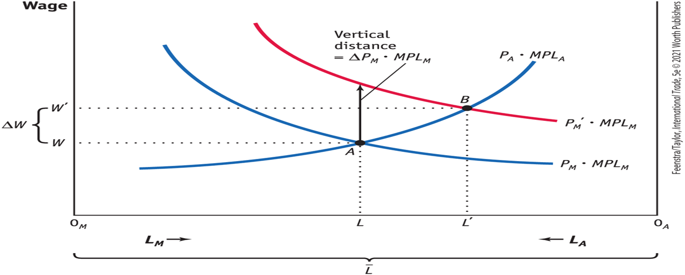
A Closer Look - Figure 3-5

Slide 19
Earnings of Labor
Change in Relative Price of Manufactures
Effect on Real Wages
  As we can see from Figure 3-5, the increase in the wage from W to W′ is less than the vertical increase ΔP_{M} • MPL_{M}
  Since ΔW/W < ΔP_{M} /P_{M} , the percentage increase in the wage is less than the percentage increase in the price of the manufactured good.
  This inequality means that the amount of the manufactured good that can be purchased with the wage has fallen.
  Therefore, the real wage in terms of the manufactured good W/P_{M} has decreased.

Slide 20
Earnings of Labor
Change in Relative Price of Manufactures Effect on Real Wages
FIGURE 3-5
Once again, since ΔW/W < ΔP_{M} /P_{M}, the percentage increase in the wage is less than the percentage increase in the price of the manufactured good.
The manufactured good that can be purchased with the wage has fallen.
Therefore, the real wage in terms of the manufactured good W/P_{M} has decreased.

Slide 21
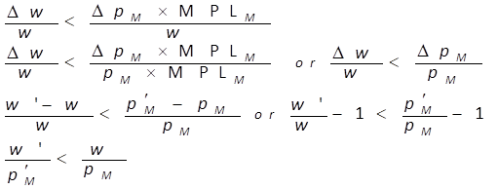
Proof

Slide 22
Effect on Real Wages
The fact that the wage has risen does not really tell us whether workers are better off or worse off in terms of the amount of food and manufactured goods they can buy.
To answer this question, we have to take into account any change in the prices of these goods.
For instance, the amount of food that a worker can afford to buy with his or her hourly wage is W/P_{A}.
Because W has increased from W to W ′ and we have assumed that P_{A} has not changed, workers can afford to buy more food.
In other words, the real wage has increased in terms of food.

Slide 23
Earnings of Labor
Change in Relative Price of Manufactures Overall Impact on Labor
  In the specific-factors model, the increase in the price of the manufactured good has an ambiguous effect on the real wage and therefore an ambiguous effect on the well-being of workers. Although ambiguous, this conclusion is important.
  The result is different from what was found in the Ricardian model, where labor unambiguously earned a higher real wage.
  This warns us that one cannot make unqualified statements about the effects of trade on workers.
  The effect of trade on real wages can be complex.

Slide 24
Earnings of Labor
Change in Relative Price of Manufactures Unemployment in the Specific-Factors Model
  It is hard to combine business cycle models with international trade models to isolate the effects of trade on workers.
  Once we recognize that workers can find new jobs—possibly in export industries that are expanding—we still cannot conclude that trade is necessarily good or bad for workers.
  Next we look at some evidence from the United States on the amount of time it takes to find new jobs and on the wages earned; we also look at attempts by governments to compensate workers who lose their jobs because of import competition. This type of compensation is called Trade Adjustment Assistance (TAA) in the United States.

Slide 25
APPLICATION: The “China Shock” and Employment in the United States
In the specific-factors model we assumed that workers leaving one industry could be absorbed freely into the other.
After China joined the WTO in 2001, U.S. imports from China grew rapidly, from 10% of total imports in 2001 to 23% in 2009.
The large increase in the share of U.S. imports coming from China and its impact on employment in manufacturing are called the “China shock.”
Studies have found that 2 million jobs or more were lost in U.S. manufacturing industries.
In reality, we see that with a very large change in prices (as occurred with the “China shock”), it takes more than one decade for enough jobs to be created in export industries to balance the losses in import industries.

Slide 26
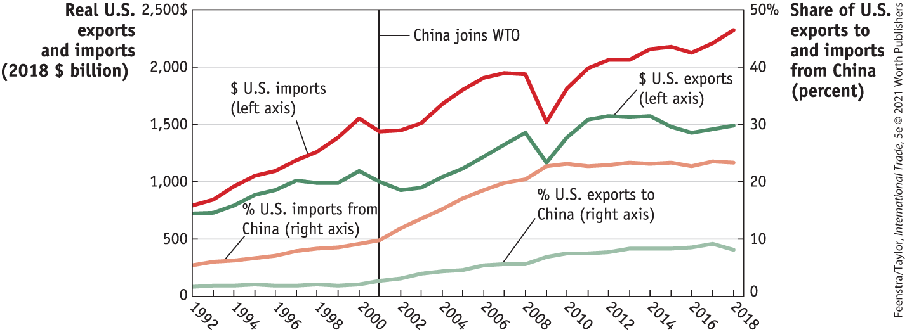
APPLICATION: The “China Shock” and Employment in the United States
FIGURE 3-8 Real U.S. Imports and Exports and the China Share, 1992–2018
Real values (in 2018 dollars) of U.S. nonpetroleum imports (the red line) and exports (the green line) to the world are shown on the left axis. The share of U.S. imports coming from China (the orange line) and the share of U.S. exports going to China (the light green line) are shown on the right axis.

Slide 27
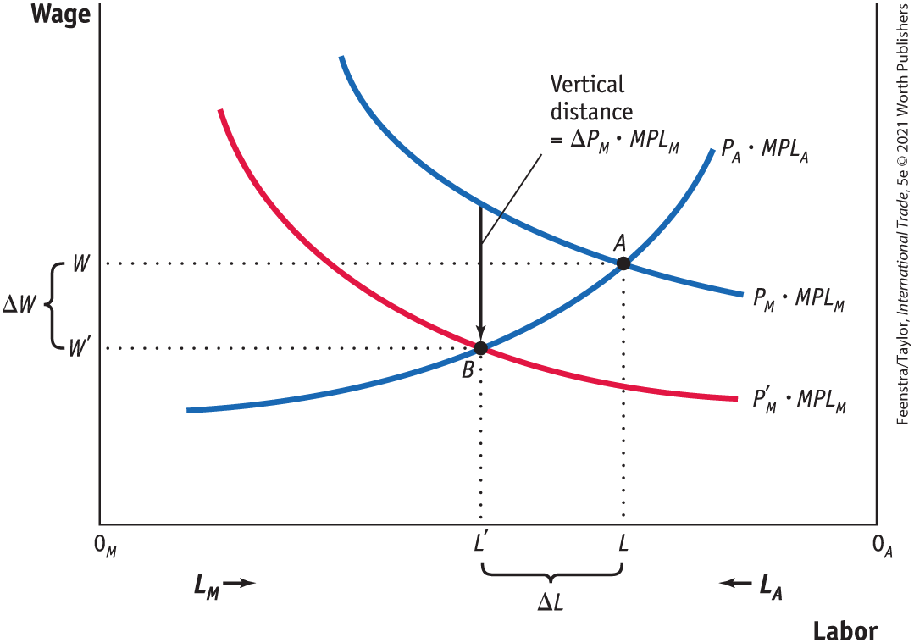
APPLICATION: The “China Shock” and Employment in the United States
FIGURE 3-9 Decrease in the Price of Manufactured Goods
With a decrease in the price of manufactured goods, the curve P_{M} • MPL_{M} shifts down to P'_{M} • MPL_{M} and the equilibrium shifts from point A to point B. The amount of labor in manufacturing falls to 0_{M}L' and the amount of labor in agriculture rises to 0_{A}L'. The wage falls to W'.

Slide 28
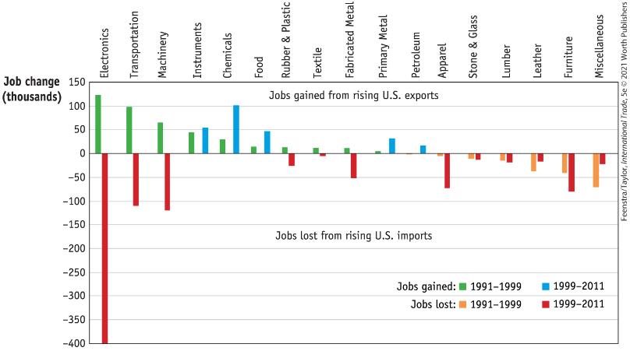
APPLICATION: The “China Shock” and Employment in the United States
FIGURE 3-10 Job Gains and Job Losses in U.S. Manufacturing Industries,1991–1999, 1999–2011
For the period 1991–1999, estimated job gains due to rising U.S. exports are shown in green, and the estimated job losses due to rising U.S. imports are shown in orange. For the period 1999–2011, estimated job gains due to rising U.S. exports are shown in blue, and the estimated job losses due to rising U.S. imports are shown in red.

Slide 29
Earnings of Capital and Land
Determining the Payments to Capital and Land
If Q_{M} is the output in manufacturing and Q_{A} is the output in agriculture, the revenue earned in each industry is P_{M} • Q_{M} and P_{A} • Q_{A}, and the payments to capital and to land are:
$$Payment to capital=P_{M}∙Q_{M}−W∙L_{M}$$
$$Payments to land=P_{A}∙Q_{A}−W∙L_{A}$$

Slide 30
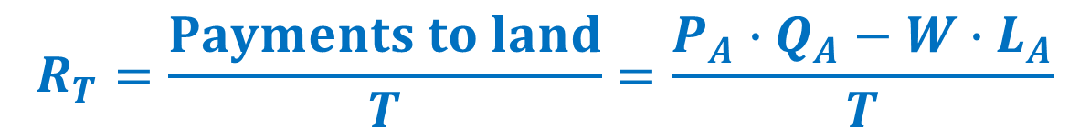
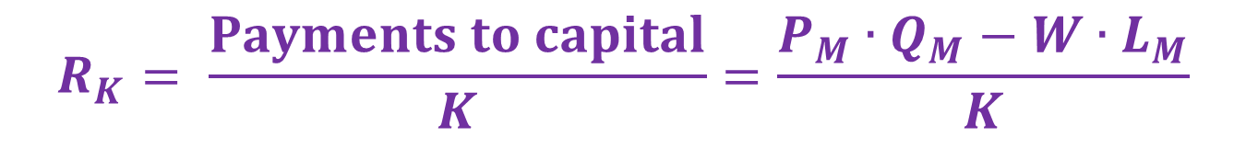
Earnings of Capital and Land
Determining the Payments to Capital and Land
The earnings of one unit of capital (a machine, for instance), which we call R_{K}, and the earnings of an acre of land, which we call R_{T}, are calculated as:
$$R_{K}= \frac{Payments to capital}{K}=\frac{P_{M}∙Q_{M}−W∙L_{M}}{K}$$
$$R_{T}=\frac{Payments to land}{T}=\frac{P_{A}∙Q_{A}−W∙L_{A}}{T}$$
Economists call R_{K} the rental on capital and R_{T} the rental on land.

Slide 31
Earnings of Capital and Land
Determining the Payments to Capital and Land
Change in the Real Rental on Capital
  As more labor is used in manufacturing, the marginal product of capital will rise because each machine has more labor to work it.
  In addition, as labor leaves agriculture, the marginal product of land will fall because each acre of land has fewer laborers to work it.
  The general conclusion is that an increase in the quantity of labor used in an industry will raise the marginal product of the factor specific to that industry, and a decrease in labor will lower the marginal product of the specific factor.

Slide 32
Earnings of Capital and Land
Determining the Payments to Capital and Land
With labor leaving agriculture, the marginal product of each acre falls, so R_{T} /P_{A} also falls.
The fact that R_{T} /P_{A} falls means that the real rental on land in terms of food has gone down, so landowners cannot afford to buy as much food.
Thus, landowners are clearly worse off from the rise in the price of the manufactured good because they can afford to buy less of both goods.

Slide 33
Changes in the Real Rental on Capital

Slide 34
Changes in the Real Rental on Capital

Slide 35
Changes in the Real Rental on Land

Slide 36
Earnings of Capital and Land
Determining the Payments to Capital and Land Summary
  An increase in the relative price of an industry’s output will increase the real rental earned by the factor specific to that industry but will decrease the real rental of factors specific to other industries.
  This conclusion means that:
    The specific factors used in export industries will generally gain as trade is opened.
    The relative price of exports rises.
    The specific factors used in import industries will generally lose as trade is opened and the relative price of imports falls.

Slide 37
Examining the Distribution of Income
Suppose that P_{M} increases by 10% (assuming P_{A} remains constant. Then, we would expect the wage to rise by less than 10%, say by 5%.
What is the economic effect of this price increase on the incomes of the following three groups?
  Workers: We cannot say whether workers are better or worse off; this depends on the relative importance of manufactures and food in workers’ consumption.
Owners of capital: They are definitely better off.
Landowners: They are definitely worse off.

Slide 38
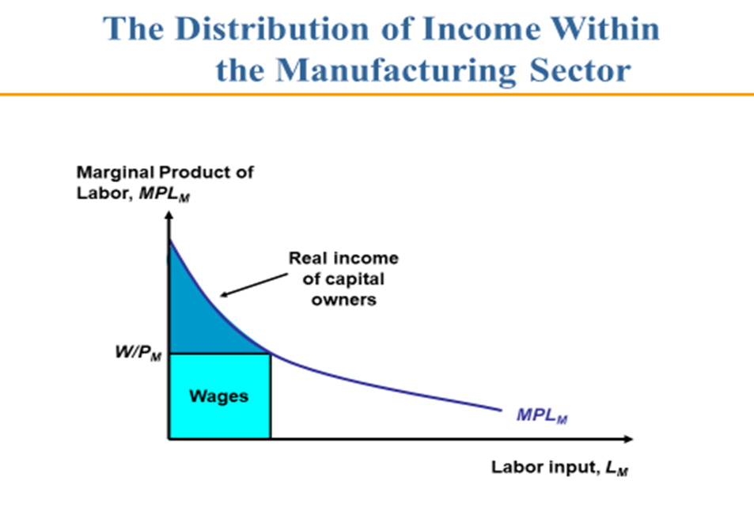

Slide 39
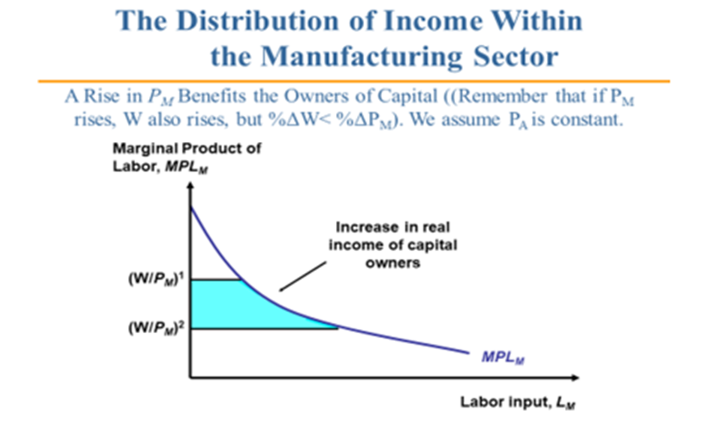

Slide 40
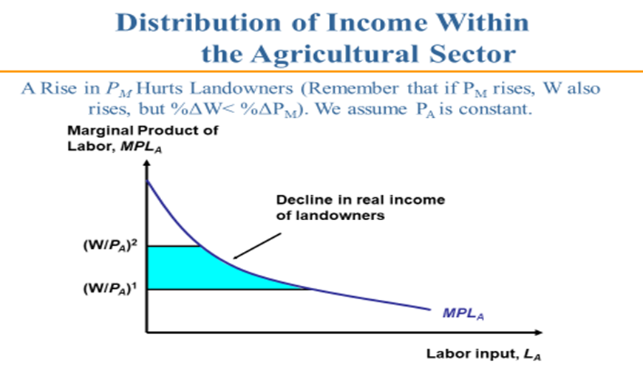

Slide 41
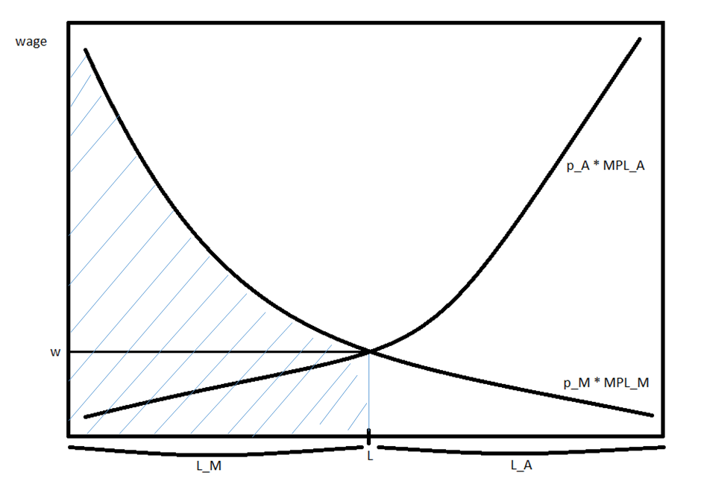
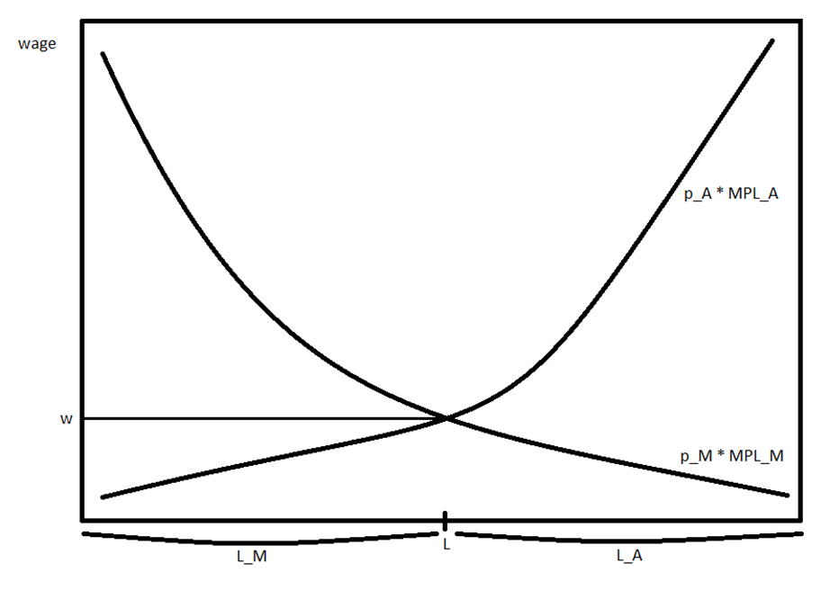
GDP Distribution
We can also show graphically how Total Product (GDP) is divided among earnings of capital owners, earnings of land owners, and the wage bill … the shaded area is the Total Product in Manufacturing. The “triangle” above the equilibrium wage is the capital owners’ earnings; the rectangle below the equilibrium wage to the left of L is the wage bill in manufacturing. Similarly for the agriculture sector
The specific factors used in export industries will gain as trade is opened. The specific factors used in import industries will lose as trade is opened and the relative price of imports falls.

Slide 42

A Simple Problem

Slide 43
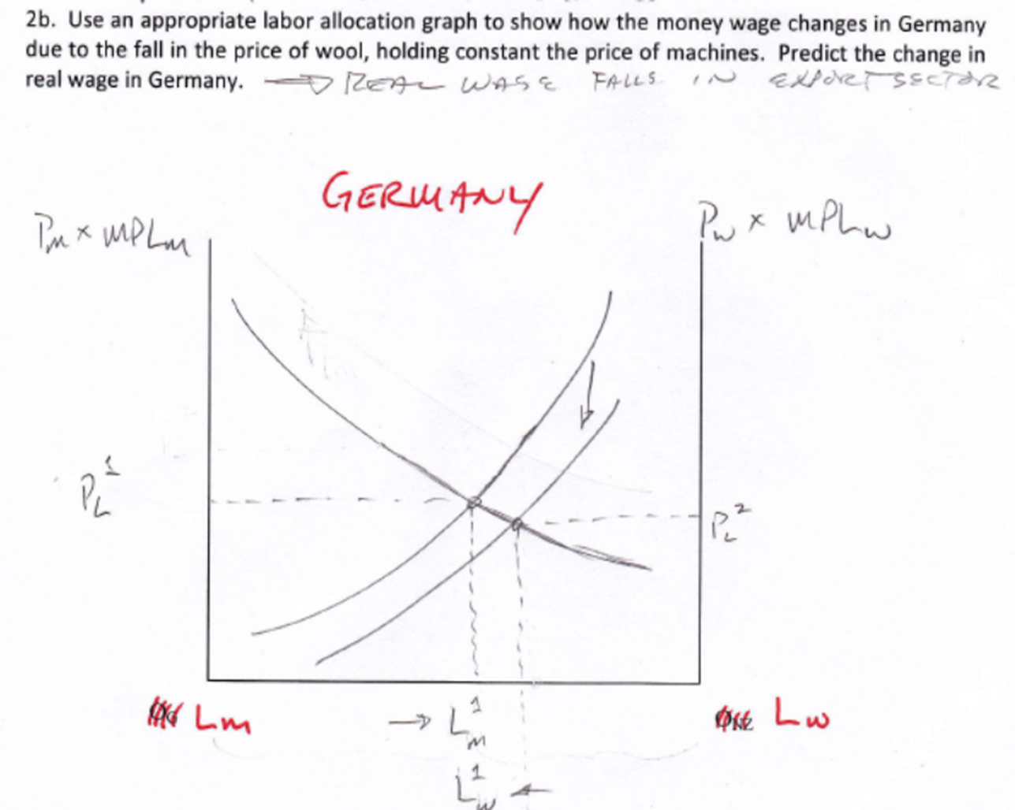

Slide 44
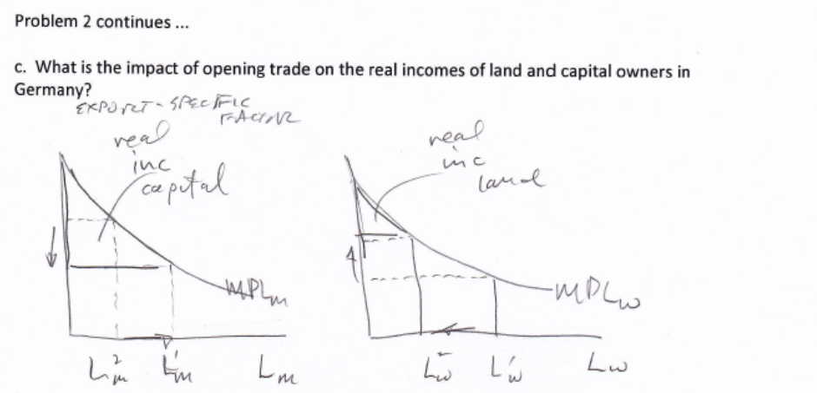

Slide 45
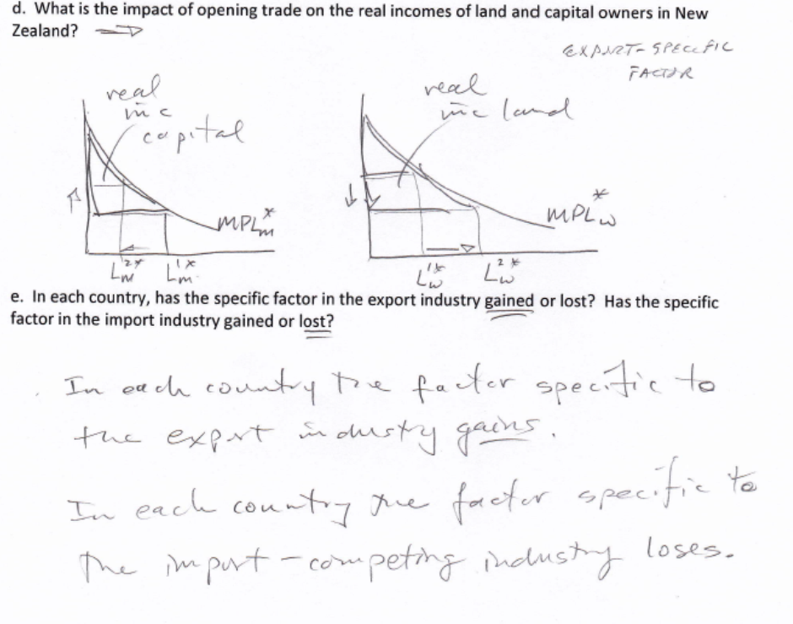

Slide 46
Conclusions
As long as the relative price with international trade differs from the no-trade relative price, a country will gain from international trade.
The change in relative prices due to the opening of trade creates winners and losers. Some factors of production gain in real terms, and other factors of production lose.
The factor that is specific to the importing-competing industry will lose. That industry suffers a drop in its relative price due to international trade, which leads to a fall in the real rental on the specific factor in that industry.
The specific factor in the export industry, whose relative price rises with the opening of trade, enjoys an increase in real rental.

Slide 47
Conclusions
Labor is mobile between the two industries, which allows it to avoid such extreme changes in wages. Real wages rise in terms of one good but fall in terms of the other good, so we cannot tell whether workers are better off or worse off after a country opens to trade.
In theory, the gains of individuals as a result of the opening of trade exceed the losses. That means, in principle, that the government could tax the winners and compensate the losers in such a way that everyone would be better off. This has proven to be very challenging in practice.

Slide 48
KEY POINTS
Opening a country to international trade leads to overall gains, but in a model with several factors of production, some factors of production will lose.
In the specific-factors model, factors of production that cannot move between industries will gain or lose the most from opening a country to trade. The factor of production that is specific to the import industry will lose in real terms, as the relative price of the import good falls. The factor of production that is specific to the export industry will gain in real terms, as the relative price of the export good rises.
In the specific-factors model, labor can move between the industries and earns the same wage in each. When the relative price of either good changes, then the real wage rises when measured in terms of one good but falls when measured in terms of the other good. Without knowing how much of each good workers prefer to consume, we cannot say whether workers are better off or worse off because of trade.

