Slide 1
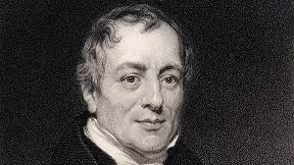
ECON 243 – International Trade
Chapter 2 - Trade and Technology:
The Ricardian Model

Slide 2
Questions to Consider
What are reasons for countries to trade?
Will the country that is best at producing a good always export it?
How can countries compete with low-wage exporters, like China?

Slide 3

Anyone Want to Trade?

Slide 4

Where did Cloe Kim’s snowboard come from?
  In 2018 the United States imported (i.e., purchased from other countries) $28.5 million worth of snowboards from 19 different countries.
  China exported (i.e., sold to another country) nearly $12.7 million worth of snowboards to the United States in 2018.

Slide 5
Table 2-1 shows that the U.S. imported 366,089 snowboards from 19 countries in 2018 that were worth more than $28 million.
This pattern raises a question: With all the manufacturing capability in the United States, why does it purchase snowboards from these countries at all instead of producing them domestically?
TABLE 2-1
U.S. Imports of Snowboards, 2018
Rank | Country | Value of Imports ($ thousands) | Quantity of Snowboards (thousands) | Average Price ($/board)
1 | China | $12,664 | 224,018 | $57
2 | Austria | 6,940 | 53,318 | 130
3 | United Arab Emirates | 5,028 | 40,232 | 125
4 | Taiwan | 2,547 | 36,393 | 70
5 | Tunisia | 454 | 3,729 | 122
6 | Canada | 381 | 3,667 | 104
7 | Australia | 98 | 710 | 139
8 | Poland | 91 | 274 | 331
9 | Switzerland | 70 | 435 | 161
10 | Netherlands | 55 | 563 | 97
11 | Japan | 34 | 168 | 205
12 | Hong Kong | 27 | 871 | 31
13–19 | All other countries | 75 | 1,711 | 44
 | Total | 28,463 | 366,089 | 78

Slide 6
Reasons countries trade goods with each other
  Differences in the technology used in each country (i.e., differences in each country’s ability to manufacture products)
  Differences in the total amount of resources (including labor, capital, and land) found in each country
  Differences in the costs of offshoring (i.e., producing the various parts of a good in different countries and then assembling them into the finished product in a final location)
  The proximity of countries to each other (i.e., how close they are to one another). The closer countries are, the lower the costs of transportation.

Slide 7
In this chapter, we focus on technology differences across countries as an explanation for trade, called the Ricardian model.
  The Ricardian model explains how the level of a country’s technology affects its trade pattern.
  It also explains the concept of comparative advantage and why it works as an explanation for trade patterns.

Slide 8
Reasons for Trade
Proximity
  The closer countries are, the lower the costs of transportation. For example, the largest trading partner of many European countries is another European country.
Resources
  Geography includes natural resources, as well as labor resources and capital. A country’s resources are often collectively called its factors of production, the land, labor, and capital used to produce goods and services.

Slide 9
Reasons for Trade
Absolute Advantage
  When a country has the best technology for producing a good, it has an absolute advantage in the production of that good.
  Absolute advantage is not a good explanation for trade patterns.
Comparative Advantage
  Instead, comparative advantage is the primary explanation for trade among countries.
  A country has comparative advantage in producing those goods that it produces best compared with how well it produces other goods.

Slide 10
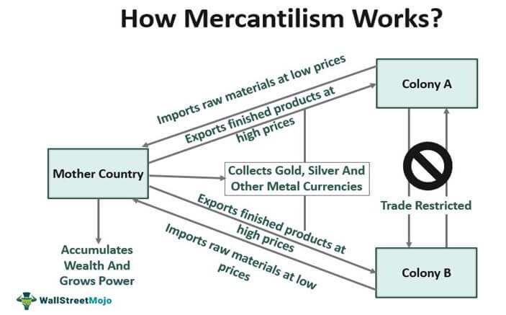

Slide 11
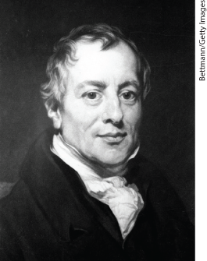
David Ricardo and Mercantilism
Mercantilists believed that exporting was
good because it generated gold and
importing was bad because it drained gold from the national treasury.
Mercantilists were in favor of high tariffs to ensure high exports and low imports.
Ricardo showed that countries could benefit from international trade without having to use tariffs.
Many of today’s major international institutions around the world were founded at least in part on the idea that free trade between countries brings gains for all trading partners.

Slide 12
A Few Comments
The principle of comparative advantage is not obvious. What important people have said about comparative advantage:
David Ricardo first demonstrated the principle of comparative advantage in the early 19th century. [Principles of Political Economy was published in 1817]
Paul Krugman has said that “comparative advantage is an idea that conflicts directly with both stubborn popular prejudices and powerful interests.”
Paul Samuelson described it as “…the best example I know of an economic principle that is undeniably true, yet not obvious to intelligent people.”

Slide 13
Ricardian Model of Trade
The Home Country
To develop a Ricardian model of trade, we will use an example with two goods:
  Wheat and other grains are major exports of the United States and Europe.
  Many types of cloth are imported into these countries.
  For simplicity, we will ignore the role of land and capital and suppose that both goods are produced with labor alone.

Slide 14
Ricardian Model of Trade
The Home Country
We assume that labor is the only resource used to produce goods. The marginal product of labor (MPL) is the extra output obtained by using one more unit of labor.
  In Home, one worker produces 4 bushels of wheat, so MPL_{W} = 4.
  Alternatively, one worker can produce 2 yards of cloth, so MPL_{C} = 2.

Slide 15
Ricardian Model of Trade
The Home Country
Home Production Possibilities Frontier
  We can graph Home’s production possibilities frontier (PPF) using the marginal products for wheat and cloth.
  The slope of the PPF is also the opportunity cost of wheat, the amount of cloth that must be given up to obtain one more unit of wheat.
  If Home had 25 workers and all were employed in wheat, Home could produce 100 bushels. If all were employed in cloth, they could produce 50 yards.

Slide 16
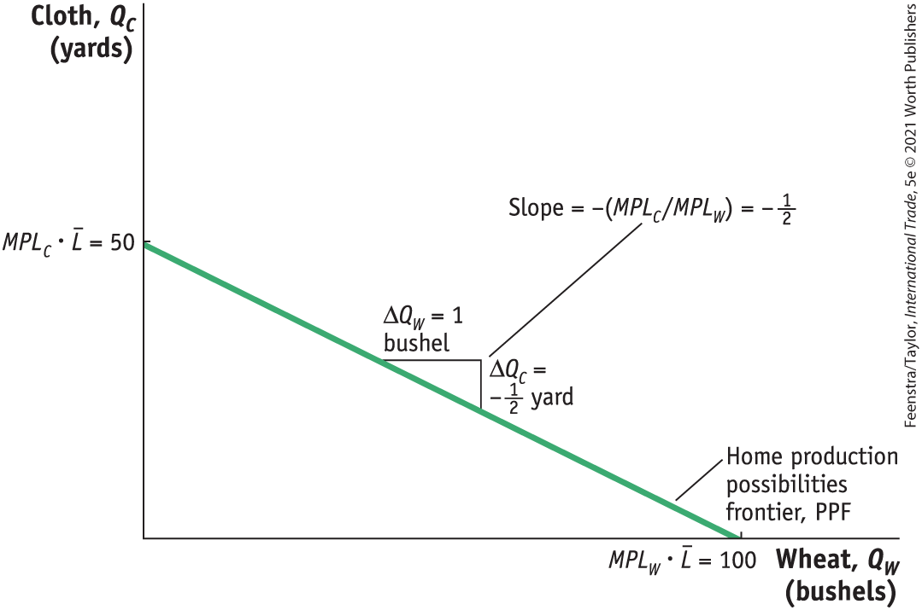
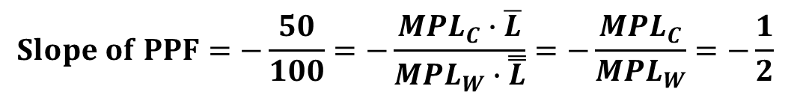
Ricardian Model of Trade
The Home Country
Home Production Possibilities Frontier -The Home PPF is a straight line between 50 yards of cloth and 100 bushels of wheat. The slope of the PPF equals the negative of the opportunity cost of wheat. Equivalently, the magnitude of the slope can be expressed as the ratio of the marginal products of labor for the two goods.
FIGURE 2-1
$$Slope of PPF=−\frac{50}{100}=−\frac{MPL_{C}∙\overline{L}}{MPL_{W}∙\overset{̿}{L}}=−\frac{MPL_{C}}{MPL_{W}}=−\frac{1}{2}$$

Slide 17

A Closer Look

Slide 18
Ricardian Model of Trade
The Home Country
Home Indifference Curve
  We will represent demand in the home economy using indifference curves that have the following properties:
  All points on an indifference curve have the same level of utility.
  Points on higher indifference curves have higher utility.
  Each indifference curve shows the combinations of two goods, such as wheat and cloth, that a person or economy can consume and be equally satisfied.

Slide 19
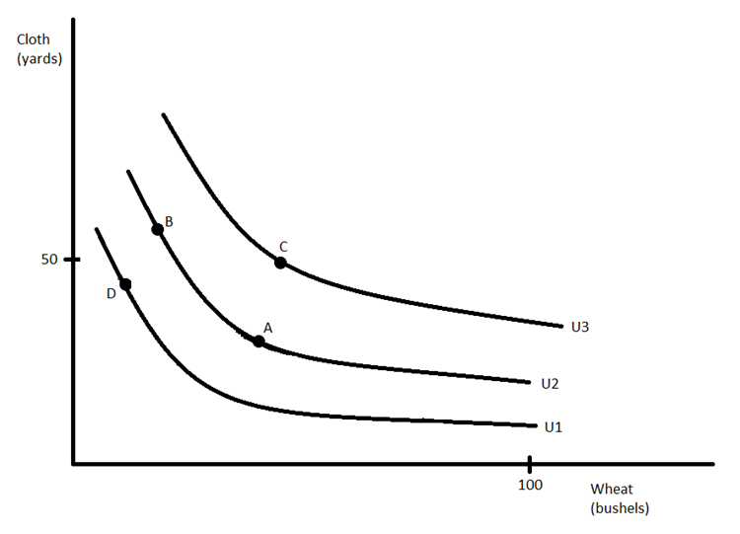
Indifference Curves Once Again
The consumer is indifferent between A and B but prefers C.
The slope represents how many units of cloth you would give up in exchange for one unit of wheat (and remain indifferent).
Remember from micro principles that the slope of an indifference curve at a given point is MUx/MUy at that point (the Marginal Rate of Substitution).
When you consume little wheat, you are willing to give up a lot of cloth for one unit of wheat. That is why the IC is very steep when wheat consumption is low.
When you consume a lot of wheat, you are willing to give up very little cloth for one unit of wheat. That is why the IC is less steep as wheat consumption increases.

Slide 20
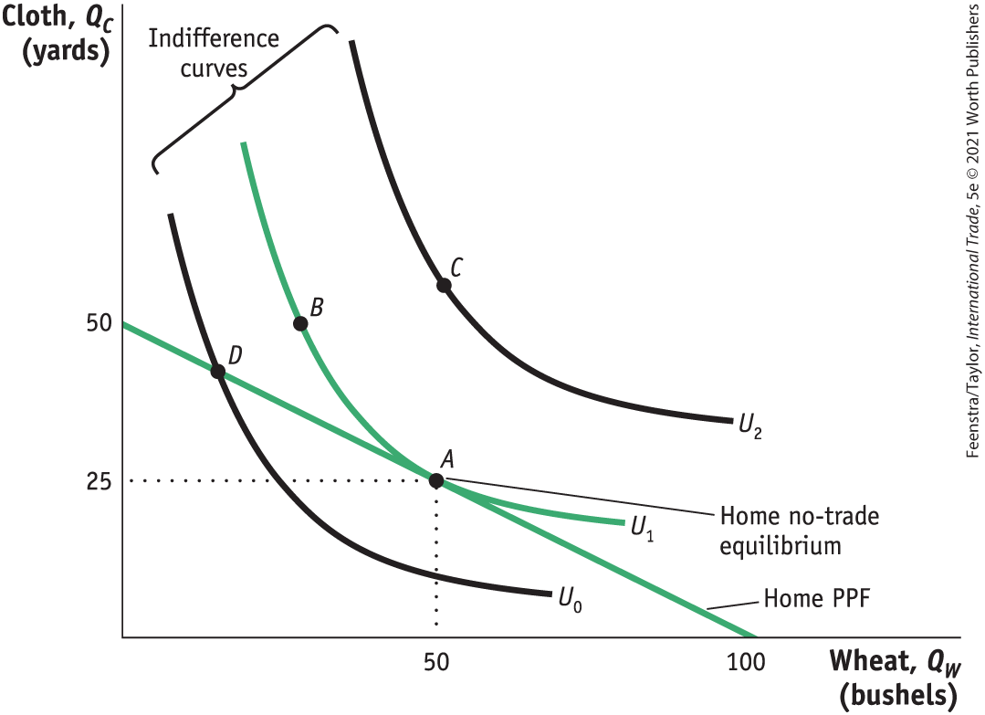
Ricardian Model of Trade
FIGURE 2-2
The Home Country
Home Indifference Curve
Points A and B lie on the same indifference curve and give the Home consumers the level of utility U1.
The highest level of Home utility on the PPF is obtained at point A, which is the no-trade equilibrium.
Point D is also on the PPF but would give lower utility.
Point C represents a higher utility level but is off of the PPF, so it is not attainable in the absence of international trade.
Home Equilibrium with No Trade

Slide 21
Ricardian Model of Trade
The Home Country
Home Equilibrium
  In the absence of international trade, the production possibilities frontier acts like a budget constraint for the country, and with perfectly competitive markets, the economy will produce at the point f highest utility subject to the limits imposed by its PPF.
  The point of highest utility is at point A in Figure 2-2, where Home consumes 25 yards of cloth and 50 bushels of wheat.
  We will refer to point A as the “no-trade” or the “pre-trade” equilibrium for Home.

Slide 22

A Closer Look - Figure 2-2

Slide 23
Ricardian Model of Trade
The Home Country
Opportunity Cost and Prices
  The slope of the PPF reflects the opportunity cost of producing one more bushel of wheat.
  Under perfect competition the opportunity cost of wheat should also equal the relative price of wheat.
  Price reflects the opportunity cost of a good.

Slide 24
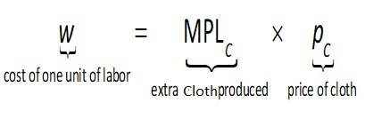
Ricardian Model of Trade
The Home Country
Wages
  In competitive markets, firms hire workers up to the point at which the hourly wage equals the value of one more hour of production.
  The value of one more hour of labor equals the amount of goods produced in that hour (MPL) times the price of the good.
  Labor will be hired up to the point where wage equals P • MPL for each industry.

Slide 25
Ricardian Model of Trade
The Home Country
Wages
  Use the equality of the wage across industries to obtain the following equation:
  P_{W} • MPL_{W} = P_{C} • MPL_{C}
  Rearranging terms, we see that
  P_{W} /P_{C} = MPL_{C} /MPL_{W}
  The right-hand side of the equation is the slope of the production possibilities frontier (the opportunity cost of one more bushel of wheat).
  The left-hand side of the equation is the relative price of wheat.

Slide 26
Ricardian Model of Trade
The Foreign Country
  Assume a Foreign worker can produce 1 bushel of wheat or 1 yard of cloth.
  MPL*_{W} = 1, MPL*_{C} = 1
  Assume there are 100 workers available in Foreign.
  If all workers were employed in wheat, they could produce 100 bushels.
  If all workers were employed in cloth, they could produce 100 yards.
  It is worth noting that Home has absolute advantage in both goods but will export only one, as explained later.
  Remember Home : MPL_{W} =4, MPL_{C} =2

Slide 27
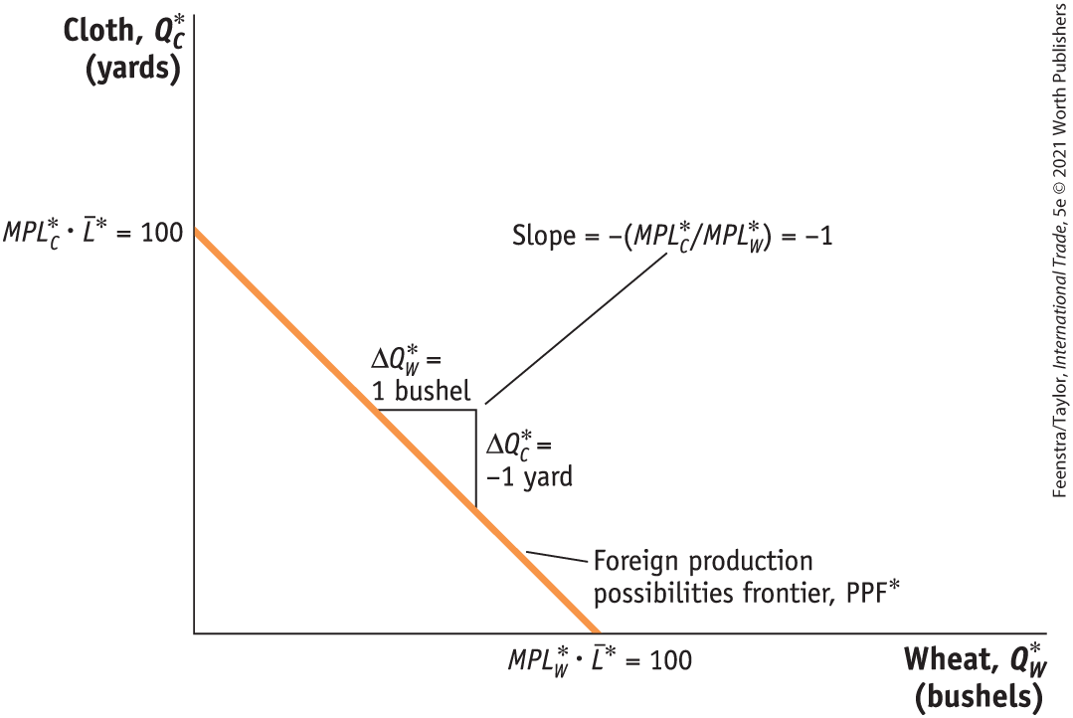
Ricardian Model of Trade
The Foreign Country
The Foreign Production Possibilities Frontier
The Foreign PPF is a straight line between 100 yards of cloth and 100 bushels of wheat.
The slope of the PPF equals the negative of the opportunity cost of wheat.
The opportunity cost is the amount of cloth that must be given up (1 yard) to obtain 1 more bushel of wheat.
FIGURE 2-3

Slide 28

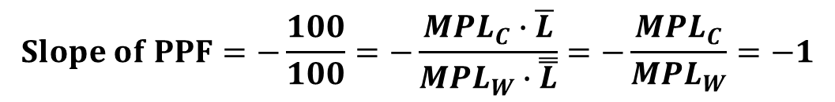
A Closer Look
$$Slope of PPF=−\frac{100}{100}=−\frac{MPL_{C}∙\overline{L}}{MPL_{W}∙\overset{̿}{L}}=−\frac{MPL_{C}}{MPL_{W}}=−1$$

Slide 29
Ricardian Model of Trade
The Foreign Country
Comparative Advantage
A country has a comparative advantage in a good when it has a lower opportunity cost of producing than another country.
By looking at the chart we can see that Foreign has a comparative advantage in producing cloth. Home has a comparative advantage in producing wheat.
 | Cloth (1 Yard) | Wheat (1 Bushel)
Home | 2 Bushels of Wheat | ½ Yard of Cloth
Foreign | 1 Bushel of Wheat | 1 Yard of Cloth

Slide 30
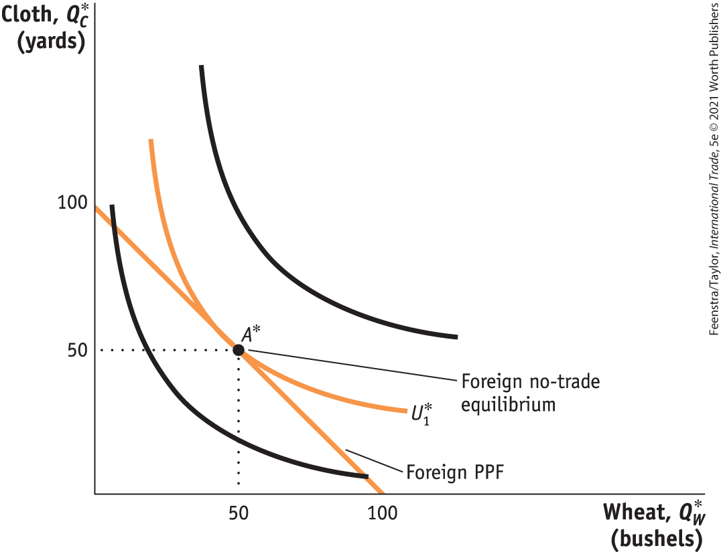
Ricardian Model of Trade
The Foreign Country
Comparative Advantage
The highest level of Foreign utility on the PPF is obtained at point A*, which is the no-trade equilibrium.
Foreign Equilibrium with No Trade
FIGURE 2-4

Slide 31
Application: Comparative Advantage in Apparel, Textiles, and Wheat
This table presents sales per employee for the apparel and textile industries in the United States and China, as well as bushels per hour in producing wheat. The United States has an absolute advantage in all of these products. But China has a lower opportunity cost and a comparative advantage in producing textiles and apparel.
TABLE 2-2
Apparel, Textiles, and Wheat in the United States and China
 | United States | China | Absolute Advantage
 | Sales/Employee | Sales/Employee | U.S./China Ratio
Apparel | $58,000 | $35,000 | 1.7
Textiles | $135,000 | $34,000 | 4
 | Bushels/Worker | Bushels/Worker | U.S./China Ratio
Wheat | 13,500 | 450 | 30
 | Comparative Advantage: United States | Comparative Advantage: China
 | Bushels/$ | Bushels/$
Opportunity cost of apparel | 0.23 | 0.01
Opportunity cost of Textiles | 0.10 | 0.01

Slide 32
Determining the Pattern of International Trade
International Trade Equilibrium
  What happens when goods are traded between Home and Foreign? We will see:
  That a country’s no-trade relative price determines which product it will export and which it will import
  The no-trade relative price equals its opportunity cost of production
  The pattern of exports and imports will be determined by the opportunity costs of production in each country—their comparative advantage

Slide 33
Determining the Pattern of International Trade
International Trade Equilibrium
  Examining each country’s no-trade relative price, we can determine which product it will export and which it will import.
  The relative price of cloth in Foreign is P_{C} /P_{W} = 1.
  The relative price of cloth in Home is P_{C} /P_{W} = 2.
  Therefore, Foreign would want to export cloth to Home if they can make it for $1 and export it for more than $1.
  Home will export wheat, and Foreign will export cloth.
  Both countries export the good for which they have the comparative advantage.

Slide 34
Determining the Pattern of International Trade
International Trade Equilibrium
  The two countries are in an international trade equilibrium when the relative price of wheat is the same in the two countries.
  To fully understand the international trade equilibrium, we are interested in two issues:
  Determining the relative price of wheat (or cloth) in the trade equilibrium
  Seeing how the shift from the no-trade equilibrium to the trade equilibrium affects production and consumption in both Home and Foreign

Slide 35
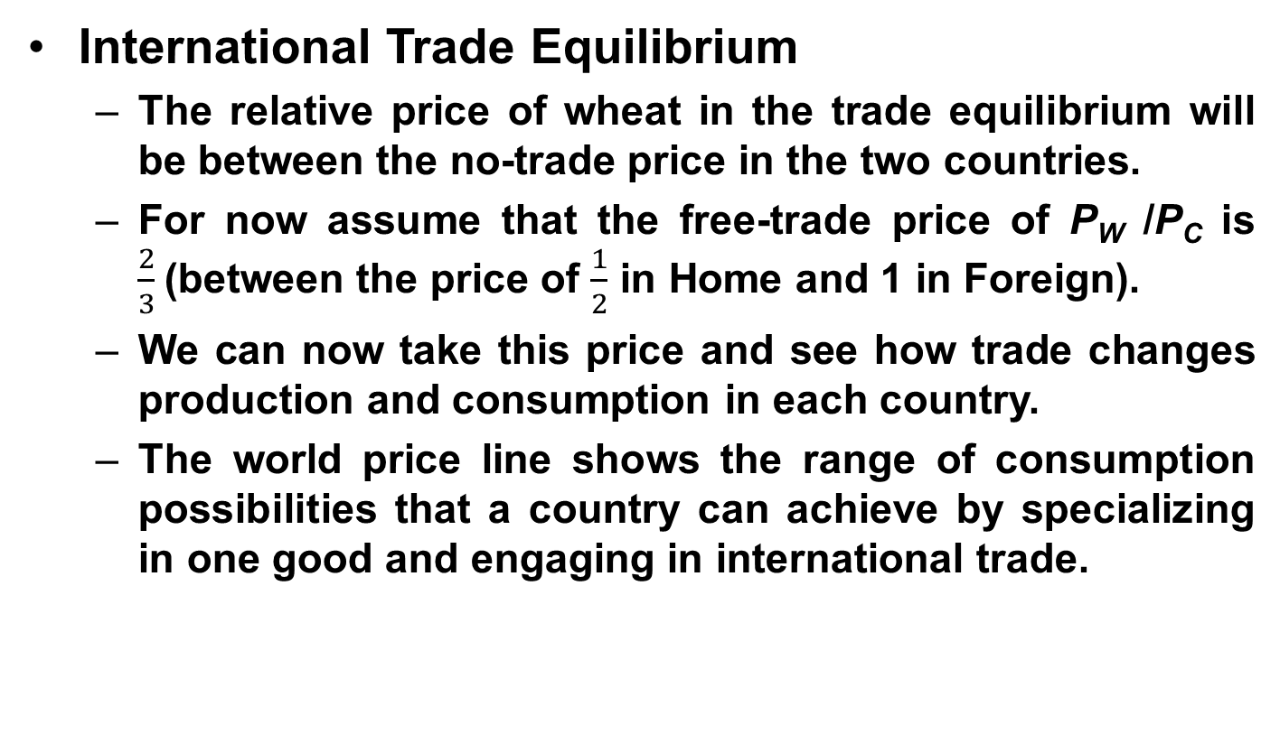
Determining the Pattern of International Trade
International Trade Equilibrium
  The relative price of wheat in the trade equilibrium will be between the no-trade price in the two countries.
  For now assume that the free-trade price of P_{W} /P_{C} is $\frac{2}{3}$(between the price of $\frac{1}{2}$ in Home and 1 in Foreign).
  We can now take this price and see how trade changes production and consumption in each country.
  The world price line shows the range of consumption possibilities that a country can achieve by specializing in one good and engaging in international trade.

Slide 36
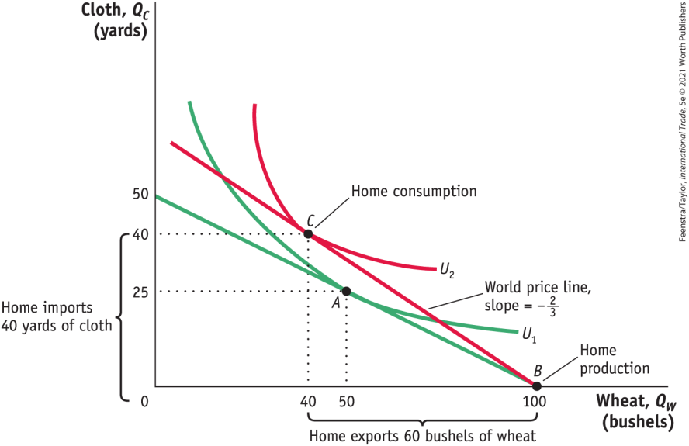

Determining the Pattern of International Trade
International Trade Equilibrium
Change in Production and Consumption
  With a world relative price of wheat of $\frac{2}{3}$, Home production will occur at point B.
  Through international trade, Home is able to export each bushel of wheat it produces in exchange for $\frac{2}{3}$ yard of cloth.
FIGURE 2-5
Home Equilibrium with Trade

Slide 37
Determining the Pattern of International Trade
International Trade Equilibrium
Change in Production and Consumption
  As wheat is exported, Home moves up the world price line BC. Home consumption occurs at point C, at the tangent intersection with indifference curve U₂, since this is the highest possible utility curve on the world price line.
FIGURE 2-5
Home Equilibrium with Trade

Slide 38
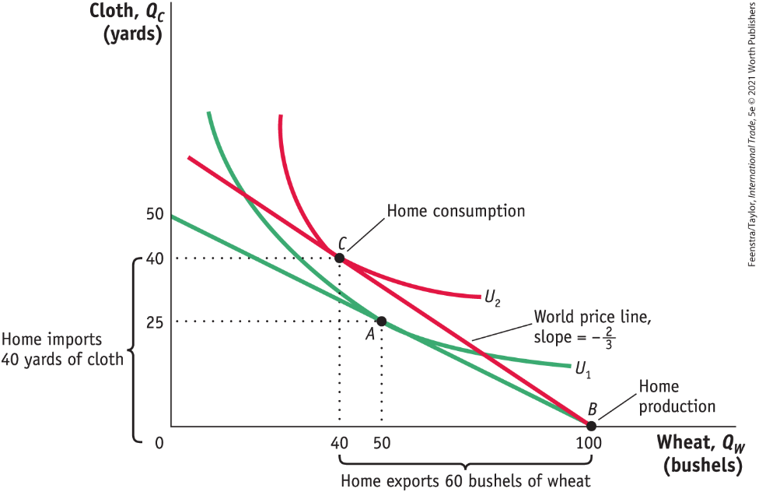
Determining the Pattern of International Trade
International Trade Equilibrium
Change in Production and Consumption
  Given these levels of production and consumption, we can see that total exports are 60 bushels of wheat in exchange for imports of 40 yards of cloth and also that Home consumes 10 fewer bushels of wheat and 15 more yards of cloth relative to its pre-trade levels.
FIGURE 2-5 Home Equilibrium with Trade

Slide 39
Determining the Pattern of International Trade
International Trade Equilibrium
International Trade
  Home obtains a higher utility with international trade than in the absence of trade (U₂ is higher than U₁).
  The finding that Home’s utility increases with trade is our first demonstration of the gains from trade.
FIGURE 2-5 (revisited)
Home Equilibrium with Trade

Slide 40
A Closer Look at Home

Slide 41
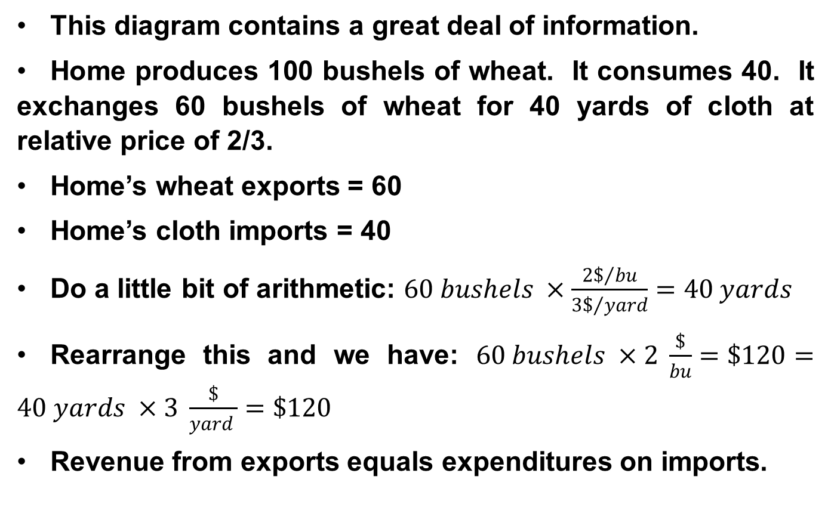
Information
This diagram contains a great deal of information.
Home produces 100 bushels of wheat. It consumes 40. It exchanges 60 bushels of wheat for 40 yards of cloth at relative price of 2/3.
Home’s wheat exports = 60
Home’s cloth imports = 40
Do a little bit of arithmetic: $60 bushels ×\frac{2\$/{bu}}{3\$/{yard}}=40 yards$
Rearrange this and we have: $60 bushels ×2 \frac{\$}{bu}=\$120=40 yards ×3 \frac{\$}{yard }=\$120$
Revenue from exports equals expenditures on imports.

Slide 42
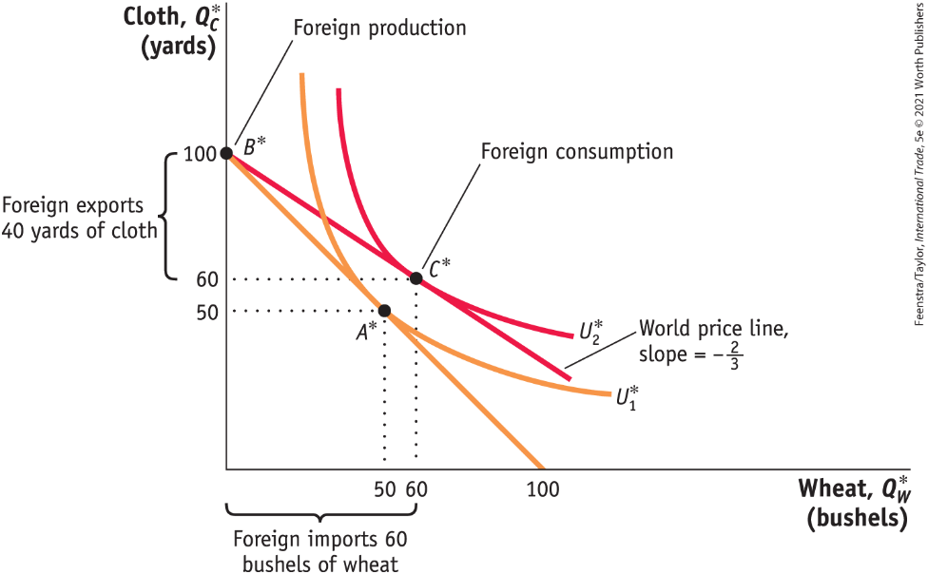
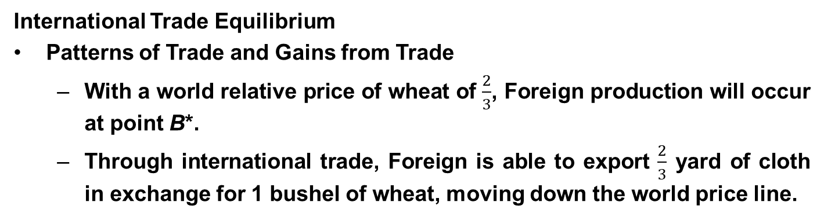
Determining the Pattern of International Trade
International Trade Equilibrium
Patterns of Trade and Gains from Trade
  With a world relative price of wheat of $\frac{2}{3}$, Foreign production will occur at point B*.
  Through international trade, Foreign is able to export $\frac{2}{3}$ yard of cloth in exchange for 1 bushel of wheat, moving down the world price line.
FIGURE 2-6 - Foreign Equilibrium with Trade

Slide 43
Determining the Pattern of International Trade
International Trade Equilibrium
Patterns of Trade and Gains from Trade
  Foreign consumption occurs at point C*, and total exports are 40 yards of cloth in exchange for imports of 60 bushels of wheat. Relative to its pre-trade wheat and cloth consumption (point A*), Foreign consumes 10 more bushels of wheat and 10 more yards of cloth.
FIGURE 2-6 - Foreign Equilibrium with Trade

Slide 44

A Closer Look

Slide 45
Determining the Pattern of International Trade
International Trade Equilibrium
Patterns of Trade and Gains from Trade
  Each country is exporting the good for which it has the comparative advantage.
    This confirms that the pattern of trade is determined by comparative advantage.
      This is the first lesson of the Ricardian model.
  There are gains from trade for both countries.
      This is the second lesson of the Ricardian model.

Slide 46


Determining the Pattern of International Trade
Solving for Wages Across Countries with a world relative price of wheat of 2/3
Home Wage = $\left\{\begin{aligned}{MPL}_{w}=4 bushels of wheat \\ or \\ \left({P_{w}}/{P_{c}}\right).{MPL}_{w}= \frac{8}{3} yard of cloth\end{aligned}\right.$
$$Foreign Wage=\left\{\begin{aligned}({P_{C}^{∗}}/{P_{W}^{∗})∙MPL_{C}^{∗}=\frac{3}{2} bushels of wheat} \\ or \\ MPL_{C}^{∗}=1 yard of cloth\end{aligned}\right.$$
Absolute Advantage
As our example shows, wages are determined by absolute advantage. In contrast, the pattern of trade in the Ricardian model is determined by comparative advantage.

Slide 47
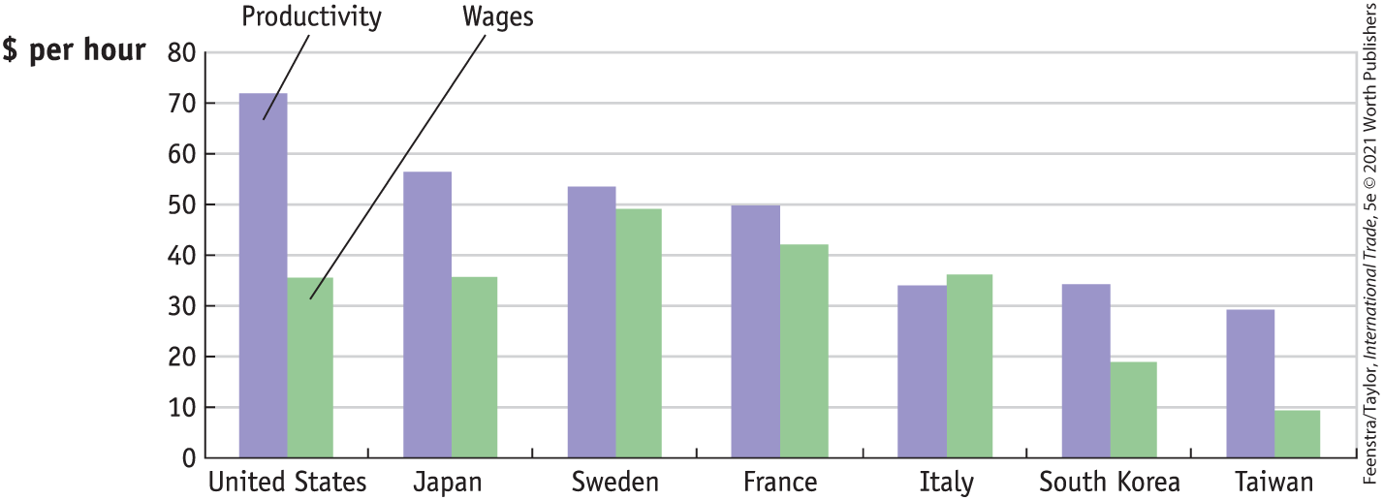
Application: Labor Productivity and Wages
FIGURE 2-7
Labor Productivity and Wages, 2012 Labor productivity is measured by value-added per hour of work and can be compared with the wages paid in manufacturing in various countries.

Slide 48
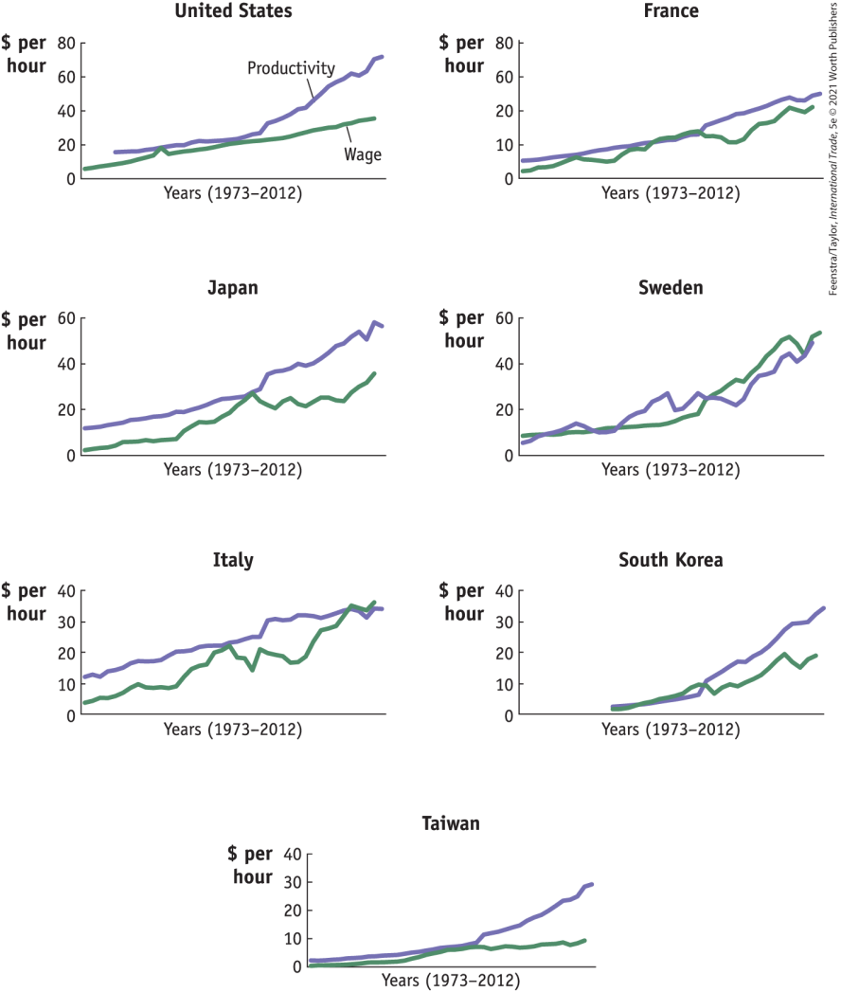
Application: Labor Productivity and Wages
FIGURE 2-8
The trends in labor productivity and real wages in manufacturing can also be graphed over time.
The general upward movement in labor productivity is matched by upward movements in wages, as predicted by the Ricardian model.

Slide 49
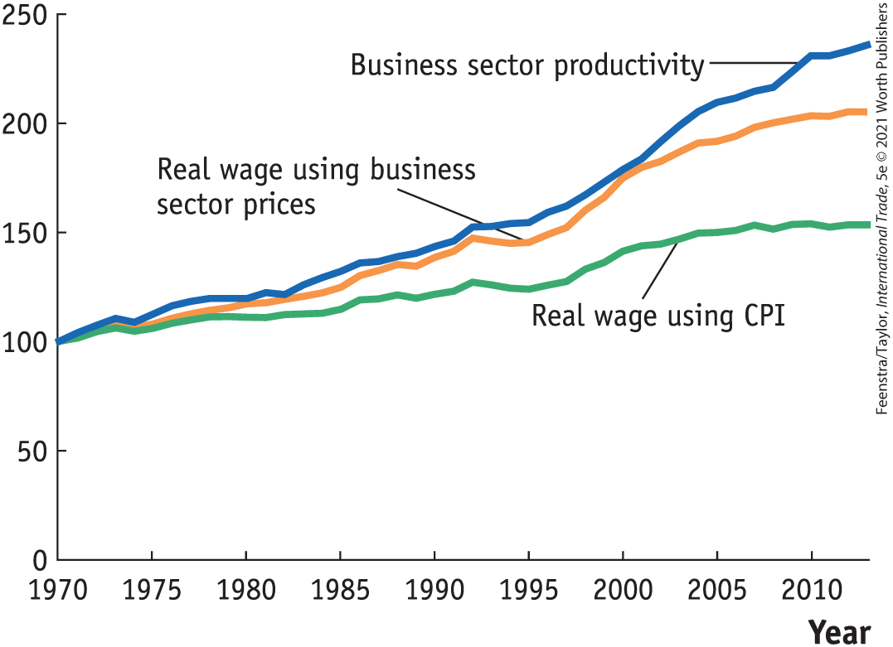
Application: Labor Productivity and Wages
FIGURE 2-9
The trends in labor productivity and real wages are shown for the business sector, including the production of goods and services, in the United States.
When the real wage is measured relative to the business sector prices, then its growth is similar to labor productivity.

Slide 50
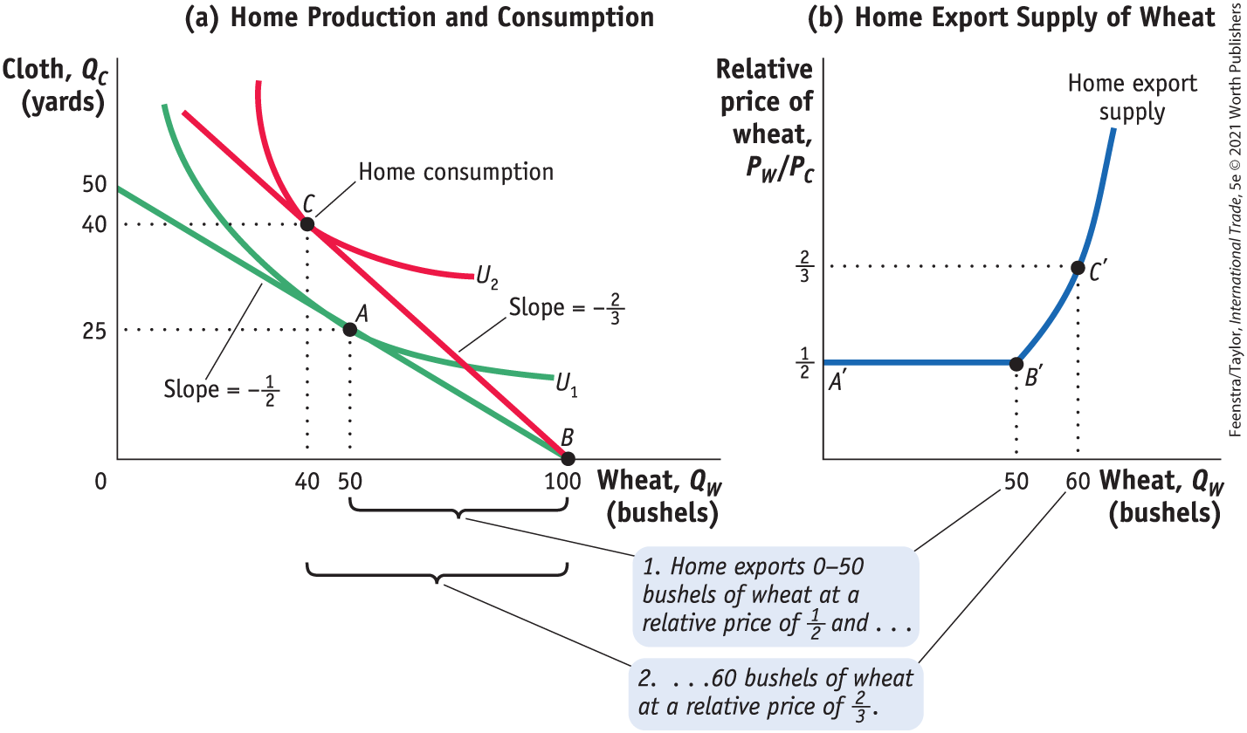
Solving for International Prices
FIGURE 2-10 Home Export Supply Curve
Home Export Supply Panel (a) repeats Figure 2-5, showing the trade equilibrium for Home with production at point B and consumption at point C. Panel (b) shows the home export supply of wheat.

Slide 51
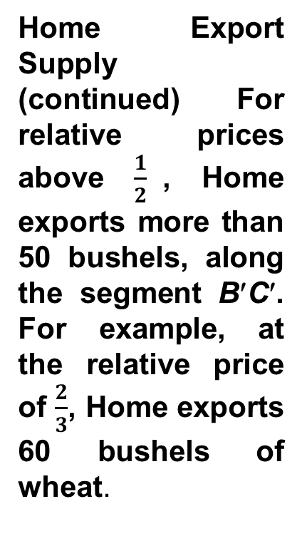
Solving for International Prices
FIGURE 2-10 Home Export Supply Curve
Home Export Supply (continued) For relative prices above $\frac{1}{2}$, Home exports more than 50 bushels, along the segment B′C′. For example, at the relative price of $\frac{2}{3}$, Home exports 60 bushels of wheat.

Slide 52

A Closer Look

Slide 53
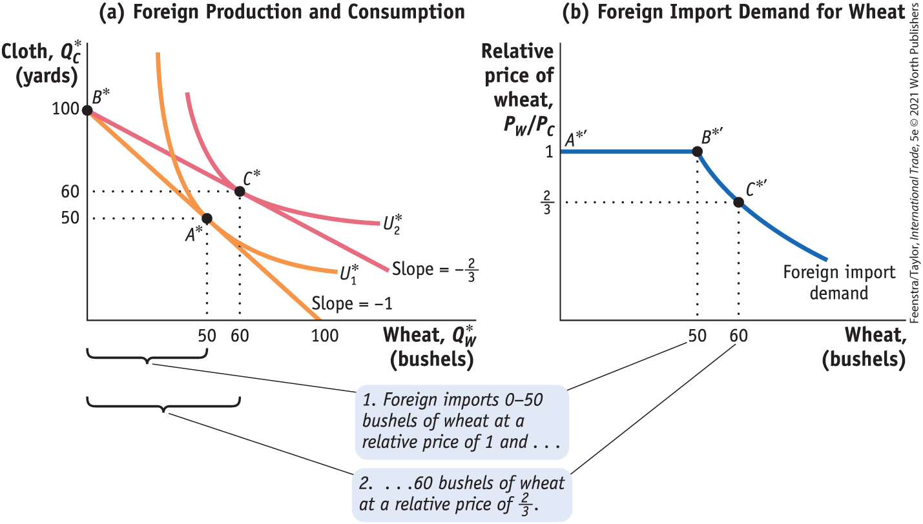
Solving for International Prices
Figure 2-11 - Foreign Import Demand Curve
Foreign Import Demand Panel (a) repeats Figure 2-6. Panel (b) shows foreign import demand for wheat. When the relative price of wheat is 1, Foreign will import any amount of wheat between 0 and 50 bushels, along the segment A*' B*' of the foreign import demand curve.

Slide 54
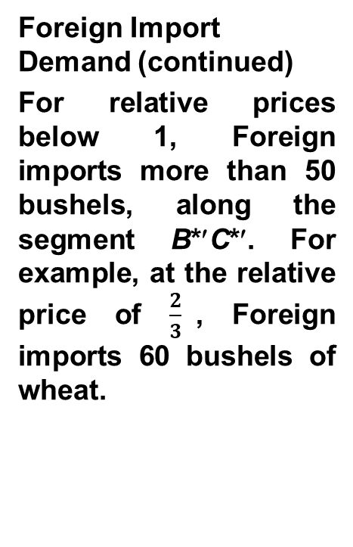
Solving for International Prices
Figure 2-11 - Foreign Import Demand Curve
Foreign Import Demand (continued)
For relative prices below 1, Foreign imports more than 50 bushels, along the segment B*′C*′. For example, at the relative price of $\frac{2}{3}$, Foreign imports 60 bushels of wheat.

Slide 55

A Closer Look

Slide 56
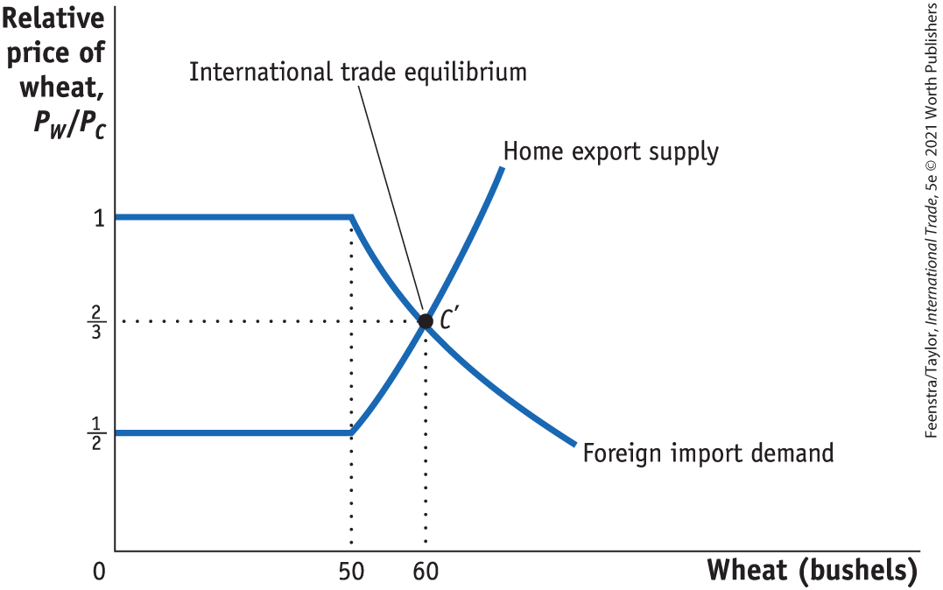
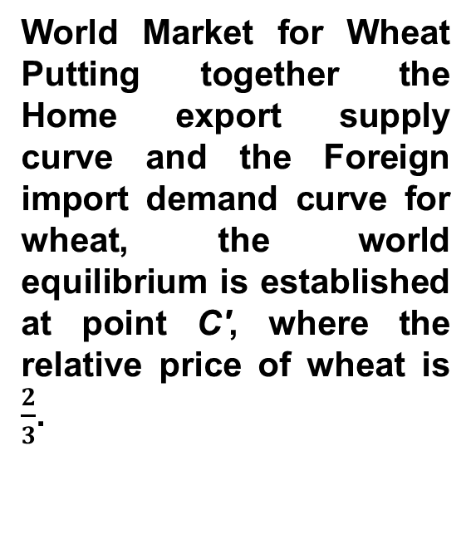
Solving for International Prices
International Trade Equilibrium
FIGURE 2-12
World Market for Wheat Putting together the Home export supply curve and the Foreign import demand curve for wheat, the world equilibrium is established at point C', where the relative price of wheat is $\frac{2}{3}$.

Slide 57

A Closer Look

Slide 58
Solving for International Prices
International Trade Equilibrium
The Terms of Trade
  The price of a country’s exports divided by the price of its imports is called the terms of trade.
  Because Home exports wheat, (P_{W}/P_{C}) is its terms of trade.
  Foreign exports cloth, so (P_{C} /P_{W}) is its terms of trade.
  In this case, having a higher price for cloth (Foreign’s export) or a lower price for wheat (Foreign’s import) would make the foreign country better off.

Slide 59
Application: The Terms of Trade for
Primary Commodities
Economists Raúl Prebisch and Hans Singer argued that the price of primary commodities would decline over time relative to the price of manufactured goods.
Support for Hypothesis
  As people/countries become richer, they spend a smaller share of their income on food.
  For mineral products, industrialized countries continually find substitutes in the production of manufactured products.
Evidence Against Hypothesis
  Technological progress in manufactured goods can certainly lead to a fall in the price of these goods as they become easier to produce.
  At least for oil, the cartel restricting prices has caused an increase in the terms of trade for oil-exporting countries.

Slide 60
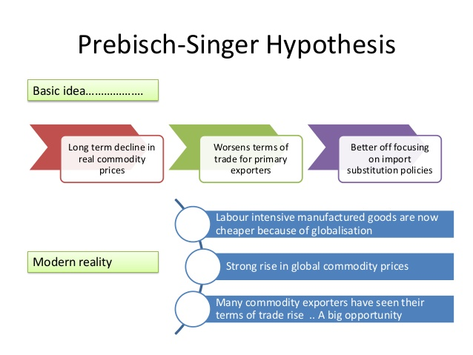
The Prebisch-Singer Hypothesis (PSH) is more of an observation rather than a complex theory. It suggests that over the long run the price of primary goods such as coal, coffee cocoa declines in proportion to manufactured goods such as cars, washing machines and computers
https://www.slideshare.net/tutor2u/topical-issues-in-trade-and-development

Slide 61
Conclusions
The Ricardian model was developed as a response to the mercantilist idea that exports are good and imports are bad.
Using differences in technology and opportunity cost, Ricardo demonstrated that the pattern of trade is determined by comparative advantage and that both countries gain from trade.
Wages depend on the marginal products of labor in each country and are determined by absolute advantage: a country with better technology will be able to pay higher wages.
The fact that only labor is used in the Ricardian model, with a constant marginal product of labor, makes it special. The PPF is a straight line, and the export supply and import demand curves each have a flat segment.

Slide 62
Key Points
A country has a comparative advantage in producing a good when the country’s opportunity cost of producing the good is lower than the opportunity cost of producing the good in another country.
The pattern of trade between countries is determined by comparative advantage. This means that even countries with poor technologies can export the goods in which they have a comparative advantage.
All countries experience gains from trade. That is, the utility of an importing or exporting country is at least as high as it would be in the absence of international trade.

Slide 63
The level of wages in each country is determined by its absolute advantage, that is, by the amount the country can produce with its labor. This result explains why countries with poor technologies are still able to export: their low wages allow them to overcome their low productivity.
The equilibrium price of a good on the world market is determined at the point where the export supply of one country equals the import demand of the other country.
A country’s terms of trade equal the price of its export good divided by the price of its import good. A rise in a country’s terms of trade makes it better off because it is exporting at higher prices or importing at lower prices.

Slide 64


