Slide 1

ECON 243 – International Trade
Chapter 1 - Trade in the Global Economy

Slide 2
Trade in the Global Economy
Questions to Consider
  How does international trade today differ from trade in the past?
  How does the United States’ recent use of tariffs compare with the past?
  How does the movement of companies and people around the world compare with the movement of goods and services?

Slide 3
Introduction
In this course, we will study international trade in goods and services.
The second international trade topic that we will study is migration, the movement of people across borders to live elsewhere.
The third facet of international trade that we will study is foreign direct investment (FDI), which occurs when a firm in one country owns some or all of a firm located in another country.
We will also learn about the policies that governments use to shape trade patterns among countries.

Slide 4
The Basics of World Trade
  Countries buy and sell goods and services from one another constantly.
  An export is a product sold from one country to another.
  An import is a product bought by one country from another.
  A country’s trade balance is the difference between its total value of exports and its total value of imports (usually including both goods and services).
  Countries that export more than they import, such as China, run a trade surplus.
  Countries that import more than they export, such as the United States, run a trade deficit.
  The bilateral trade balance is the difference between exports and imports between two countries.

Slide 5
Basics of World Trade
The Basics of World Trade
  The U.S. bilateral trade balance with China, for example, has been a trade deficit of more than $200 billion every year between 2005 and the present.
  In 2013, the iPhone 5 16GB was valued at about $227 when it was shipped from China to the United States, and it sold for about $650 in the United States.
  However, only $8 of that amount reflects the value-added by Chinese labor used in the assembly. The rest of the $219 export value was very likely imported into China from other countries.
  Nevertheless, the entire $227 is counted as an export from China to the United States.

Slide 6
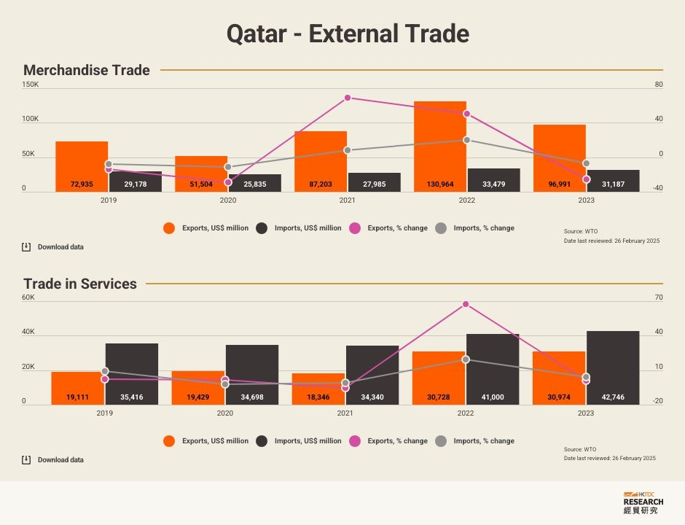
Qatar Trade Data
https://thepeninsulaqatar.com/article/17/02/2021/Qatar%E2%80%99s-trade-surplus-at-QR24.7bn-in-Q4,-2020

Slide 7
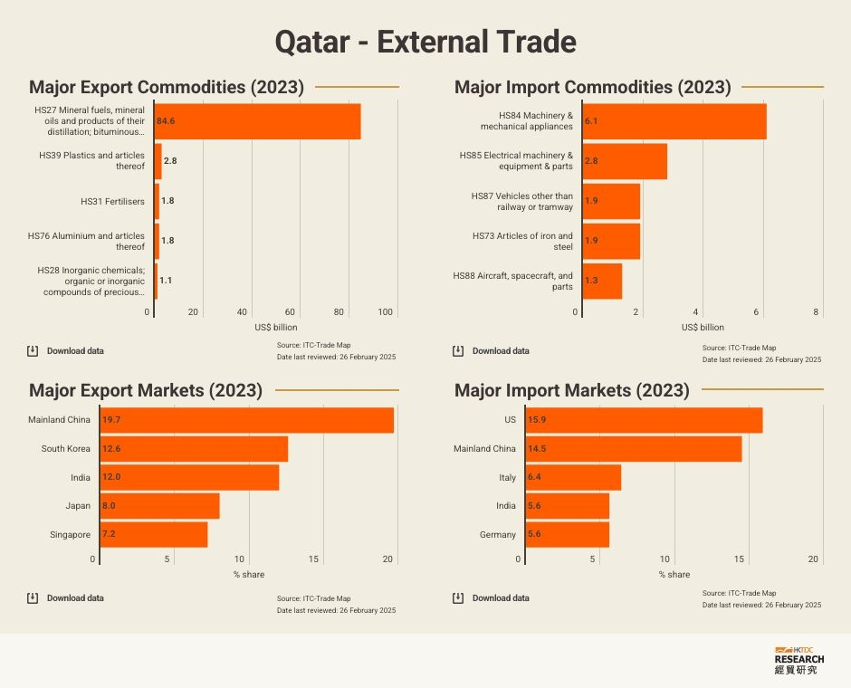

Slide 8
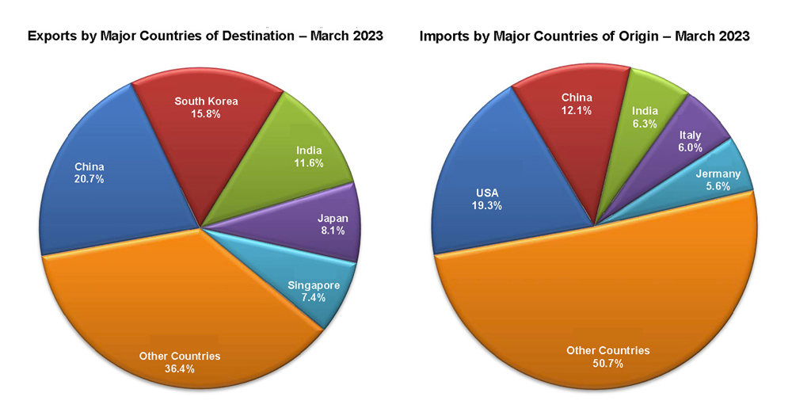
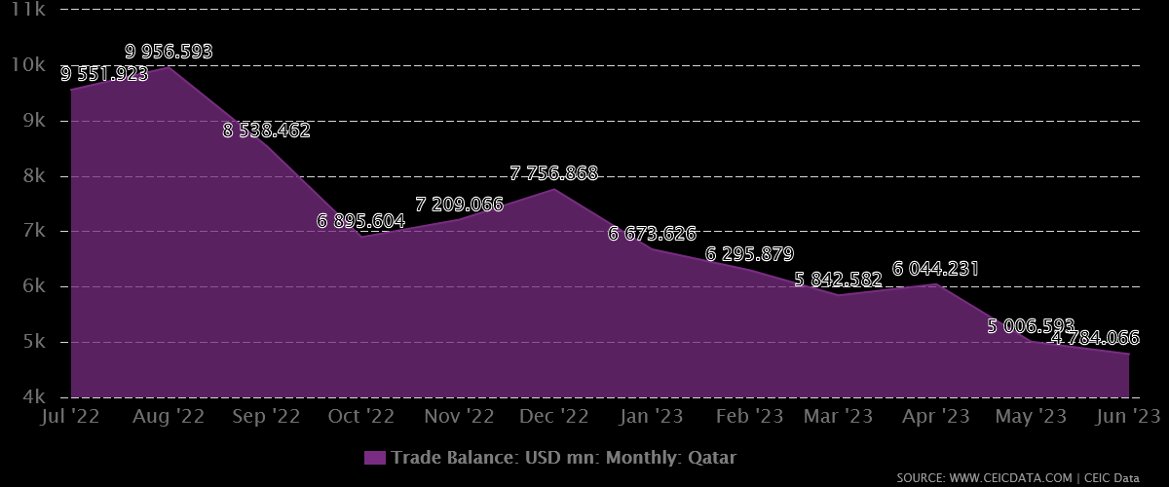
Qatar Data

Slide 9
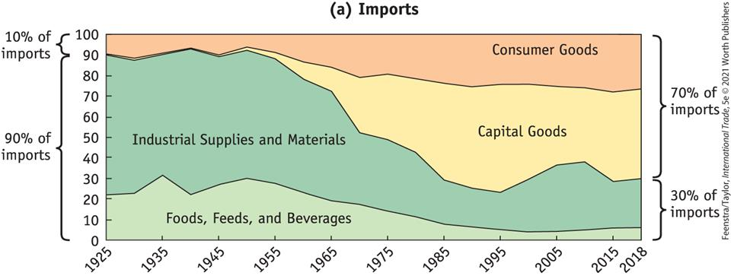
Application: Is Trade Today Different from the Past?
FIGURE 1-1 (a)
The Changing Face of U.S. Import Industries, 1925–2018 The types of goods imported by the United States have changed drastically over the past century. Foods, feeds, and beverages and industrial supplies were 90% of imports in 1925, but represented only 30% in 2018. Capital plus consumer goods plus automobiles have increased from 20% of exports in 1925 to 60% of exports in 2018.

Slide 10
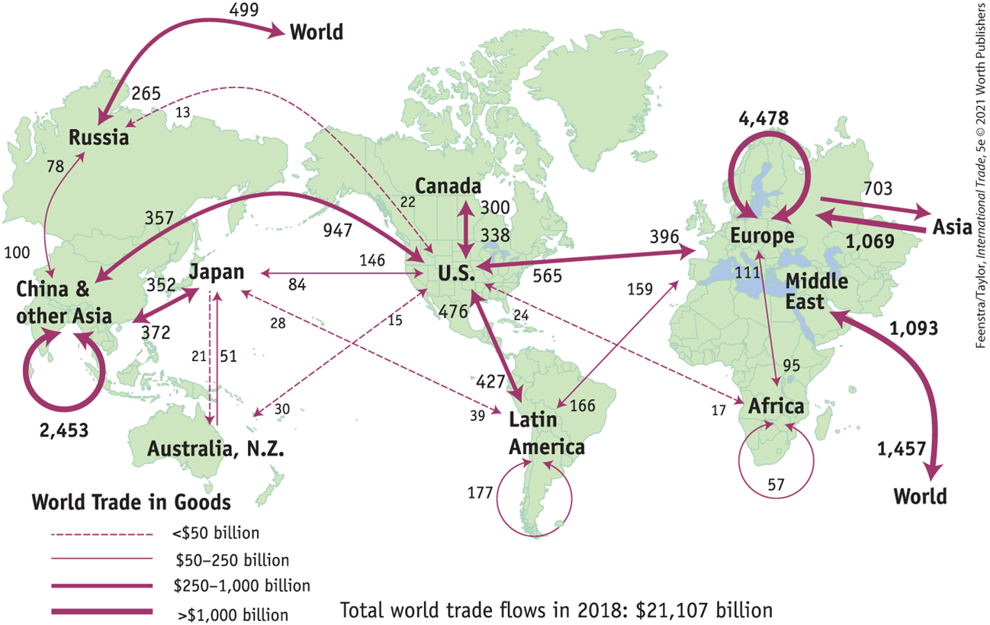
International Trade Flows
Map of World Trade
FIGURE 1-2
World Trade in Goods, 2018 ($ billions) This figure shows trade in merchandise goods between selected countries and regions of the world.

Slide 11
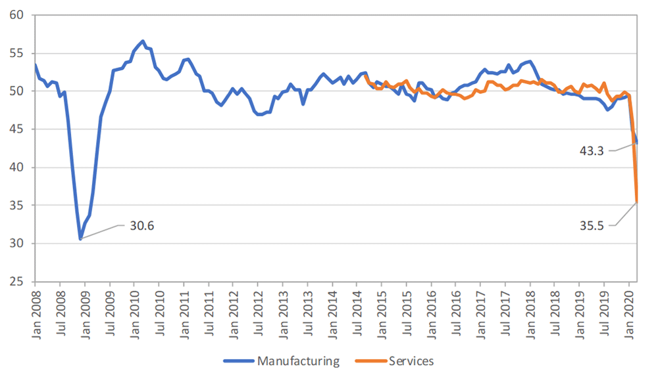
Effect of Covid

Slide 12
Map of World Trade
European and U.S. Trade
  The largest amount of trade shown in Figure 1-2 is the flow of goods within Europe, $4.5 trillion, or 21%, of world trade.
  The European countries trade a great deal with one another because there are many countries located near to each other, so it is easy to ship from one country to another, and also because import tariffs are low.
  There are also large trade flows between the United States and Europe. The United States exported nearly $400 billion of goods to Europe in 2018 and imported $565 billion from Europe.
  This shows that a large amount of world trade occurs between countries that are similar in their levels of advanced industrialization.

Slide 13
Map of World Trade
Trade in the Americas
  There is also a large amount of trade recorded within the Americas, that is, between North America, Central America, South America, and the Caribbean.
  Trade within the Americas in 2018 was $1.7 trillion, about 8% of world trade.
  The vast majority of international trade within the Americas is between Canada, the United States, and Mexico. The three countries are part of a free-trade area as defined by the United States–Mexico–Canada Agreement (USMCA), which took effect in 2020.

Slide 14
Map of World Trade
Trade with Asia
  Exports from Asia totaled about $6.1 trillion in 2018, or nearly one-third (29%) of world trade, as shown in Table 1-1.
  Remember that this total includes only trade in goods and omits trade in services, which is becoming increasingly important.
  India, for example, performs a wide range of services such as accounting, customer support, computer programming, and research and development tasks for firms in the United States and Europe.

Slide 15
Map of World Trade
Other Regions
  The exports of the Middle East and Russia combined (together with countries around Russia such as Azerbaijan and Kazakhstan) total $1.9 trillion, or another 9% of world trade.
  And then there is Africa. Africa has the closest trade links with the European nations, reflecting both its proximity to Europe and the former colonial status of many African countries.
  Adding up all its exports, the continent of Africa accounts for only 2% of world trade, a very small number given that Africa accounts for 20% of the Earth’s land mass and 17% of its population.

Slide 16
Map of World Trade
Trade Compared with GDP
  So far, we have discussed the dollar amounts of trade crossing international borders.
    There is a second way that trade is often reported, as a ratio of a country’s trade to its gross domestic product (GDP), the value of all final goods produced in a year.
    For the United States, the average value of imports and exports (for goods and services) expressed relative to GDP was 16% in 2018.
    Most other countries have a higher ratio of trade to GDP.

Slide 17
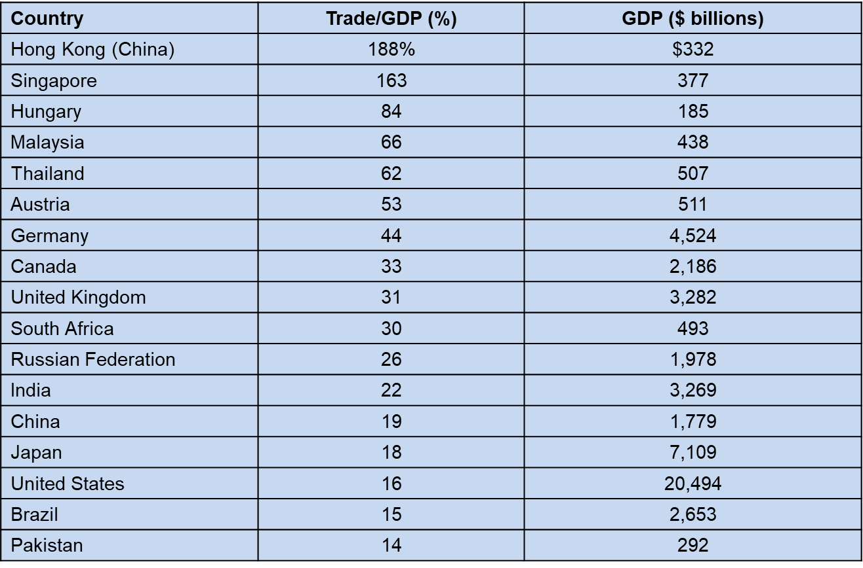
Trade Compared with GDP
TABLE 1-2
Trade/GDP Ratio in 2018 This table shows the ratio of total trade to GDP for each country, where trade is calculated as (Imports + Exports)/2, including both merchandise goods and services. Countries with the highest ratios of trade to GDP tend to be small in economic size.

Slide 18
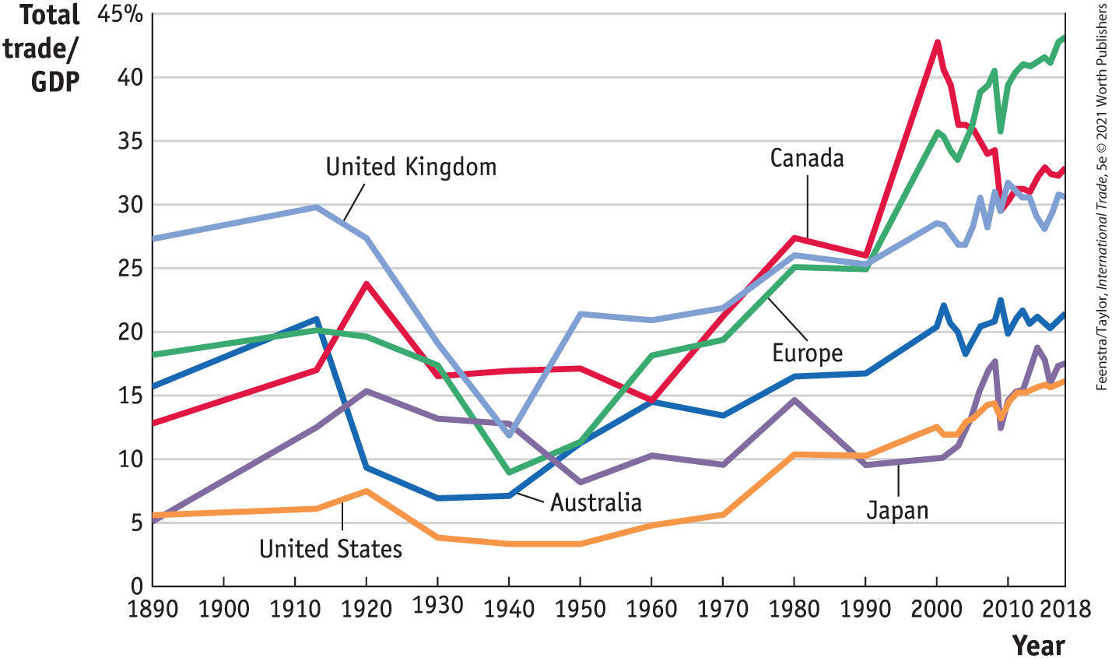
Barriers to Trade
FIGURE 1-3
Trade in Goods and Services Relative to GDP
This diagram shows total trade in merchandise goods and services for each country divided by GDP.
There was a considerable increase in the ratio of trade to GDP between 1890 and 1913. This trend was ended by World War I and the Great Depression.
Most of the industrial countries shown did not reach the level of trade prevailing in 1913 until the 1970s.
The term trade barriers refers to all factors that influence the amount of goods and services shipped across international borders.

Slide 19
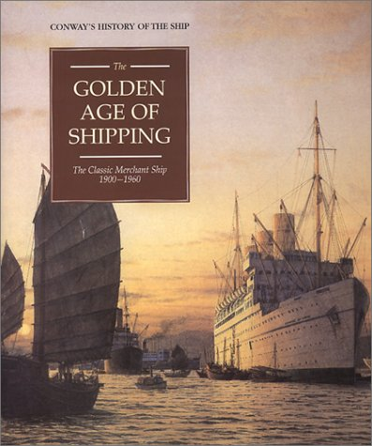
“First Golden Age” of Trade
  The period from 1890 until World War I (1914–1918) is sometimes referred to as a “golden age” of international trade.
  Those years saw dramatic improvements in transportation, such as the steamship and the railroad, that allowed for a great increase in the amount of international trade.

Slide 20
Political Economy of Tariffs
  Explanations for tariffs that combine both economic and political reasoning are referred to as political economy.
  In 1865 the United States had high tariffs to raise revenue during the U.S. Civil War (1861–1865).
  U.S. tariffs fluctuated in the decades leading up to World War I but remained much higher than in the rest of the world.
  The Tariff Act of 1890 substantially raised tariffs to protect U.S. industries that were mainly located in the North.
  Tariffs were raised again in 1897, not as an end in themselves, but rather as a tool to negotiate an overall lowering of tariffs with trade partners.

Slide 21
Political Economy of Tariffs
Interwar Period
  Signed into law in June 1930, the Smoot–Hawley Tariff Act raised tariffs to as high as 60% on some categories of imports.
  These tariffs were meant to protect farmers and other industries, but they backfired by causing other countries to retaliate, a situation called a trade war.
  Canada retaliated by applying high tariffs of its own against the United States.
  France used import quotas, a limitation on the quantity of an imported good allowed into a country, to restrict imports from the United States.

Slide 22
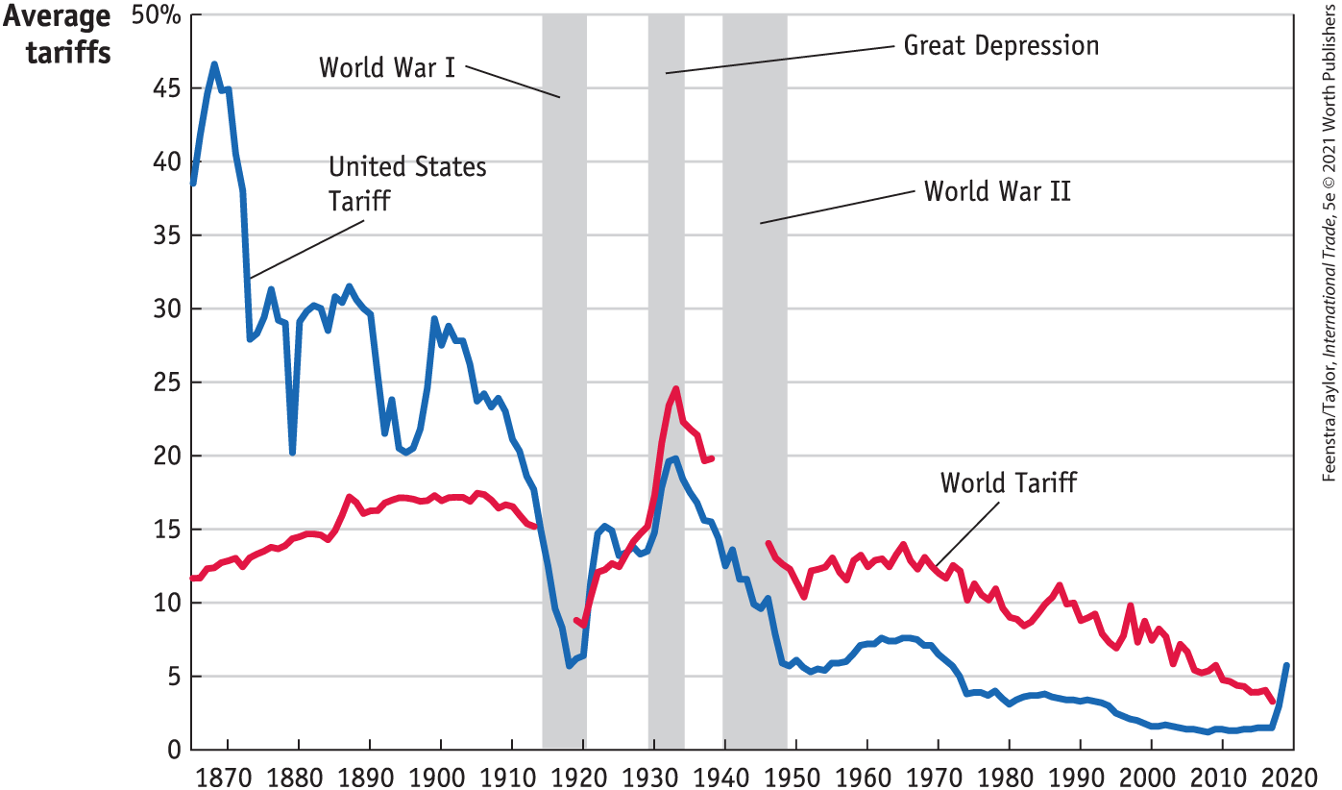
Political Economy of Tariffs - Interwar Period
FIGURE 1-4
Average Worldwide Tariffs, 1860–2019
This diagram shows the world average tariff for 35 countries. The average tariff fluctuated around 15% from 1860 to 1913. After World War I, however, the average tariff rose sharply because of the Smoot–Hawley Tariff Act in the United States and the reaction by other countries, reaching 25% by 1933. Since the end of World War II, tariffs have fallen.

Slide 23
“Second Golden Age of Trade”
  In addition to the end of World War II and tariff reductions under the General Agreement on Tariffs and Trade (GATT), lower transportation costs contributed to the growth in trade.
  The shipping container, invented in 1956, allowed goods to be moved by ship, rail, and truck more cheaply than before.
  World trade grew steadily after 1950 in dollar terms and as a ratio to GDP. For this reason, the period after 1950 is called the “second golden age” of trade and globalization.

Slide 24
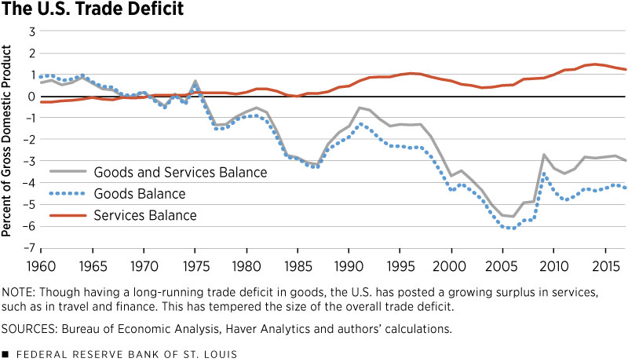
U.S. Trade Deficit

Slide 25
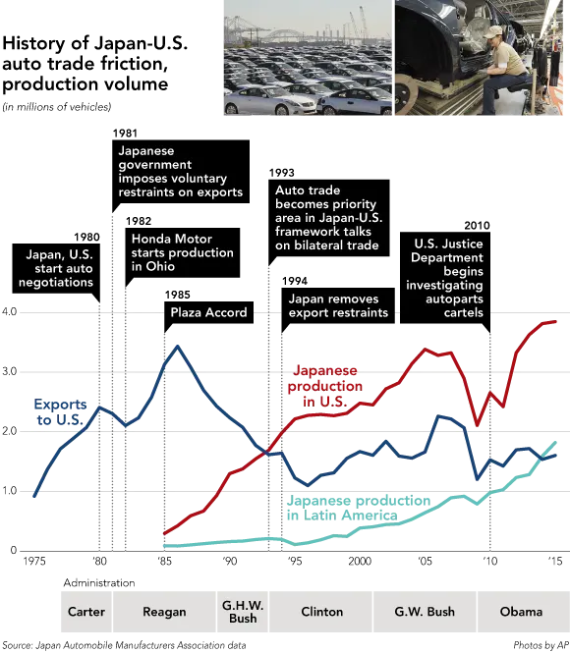
U.S. - Japan Trade Friction

Slide 26
The U.S.–China Trade War
  In July 2018 President Trump applied import tariffs against China that were very different from those imposed by other modern U.S. presidents because the tariffs were applied only against China and at high levels.
  By September 2019 the tariffs applied to nearly all U.S. imports from China. China responded in kind by applying tariffs against more imports from the United States.
  Figure 1-5 shows that the average U.S tariff against imports from China rose from 3.1% in January 2018 to 21% in September 2019, and the average Chinese tariff on U.S. imports rose from 8% to 21.8% over the same period.

Slide 27
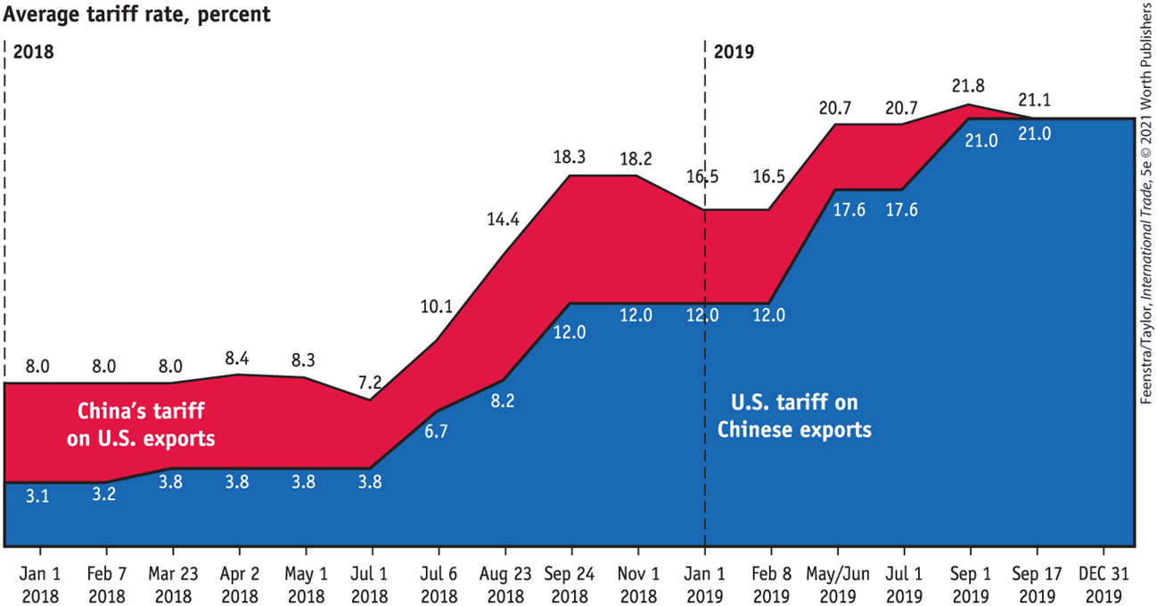
The U.S.–China Trade War
Figure 1-5

Slide 28
The U.S.–China Trade War
  Why did President Trump impose these tariffs on China?
  He hoped to gain concessions from China in negotiating with the Chinese over their own trade barriers.
  The United States would like China to reduce import tariffs on products such as automobiles and other consumer goods, increase its purchases of U.S. agricultural products, be more open to the entry of foreign firms, and more strongly enforce its protection for intellectual property
  American companies have already begun shifting production away from China as a result of the trade war.

Slide 29
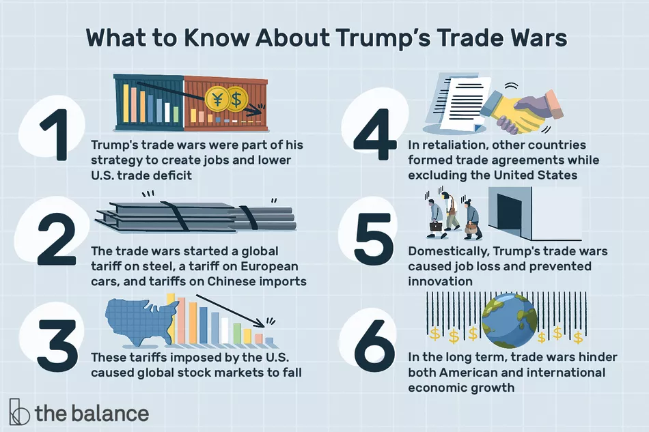

Slide 30
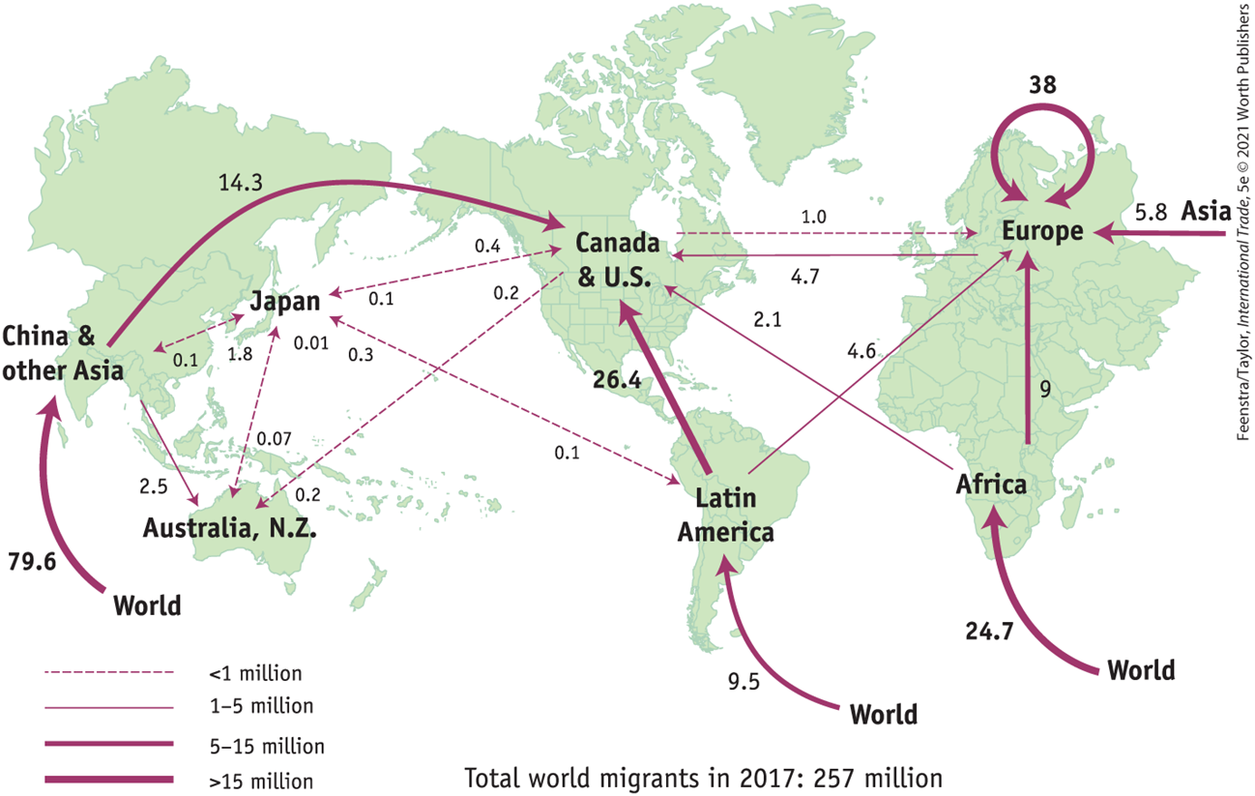
Map of Migration
FIGURE 1-6
Foreign-Born Migrants, 2017 (millions) This figure shows the number of foreign-born migrants living in selected countries and regions of the world for 2017 in millions of people.

Slide 31
Map of Migration
  In 2017 more than one-half (53%) of the foreign-born people worldwide were living in the Organisation for Economic Co-operation and Development (OECD) countries, while only less than one-quarter (23%) of the OECD-born people were living in another country.
  Most migration occurs from countries outside the OECD, with more than one-half of migrants moving to countries within the OECD.
  Comparing the map of immigration in Figure 1-6 with that of international trade in Figure 1-2, we see a big difference: while more trade arrows point in both directions (countries both import from and export to their trading partners), the immigration arrows often point in one direction only, from lower-income to higher-income countries.
  International trade can act as a substitute for movements of labor or capital across borders by raising the living standard of workers.

Slide 32
Political Economy of Migration
Migration in the EU
  Prior to 2004 the European Union (EU) consisted of 15 countries in western Europe, and labor mobility between them was very open.
  After 10 more countries joined the EU on May 1, 2004, a large difference in per capita income and wages in these countries created a strong incentive for labor migration from low-wage to high-wage countries within the EU.
  26 countries in the EU created the Schengen Area of open borders.
  Refugee migration from Africa and Asia since 2015 has created a controversy in Europe over which countries should take them in and whether they can move to other countries.
  This played a role in the 2016 vote in the United Kingdom to leave the EU.

Slide 33
Political Economy of Migration
Migration in the United States
  As shown in Figure 1-6, there were 26 million people from Latin America living in the United States and Canada in 2017.
  The largest group of these migrants was composed of Mexicans living in the United States. It is estimated that there are about 11 million Mexicans living in the United States, and slightly less than one-half of these (5 million) are undocumented immigrants.
  The concern that immigration will drive down wages applies to Mexican migration to the United States.
  Recent increases in persons attempting to cross the U.S.–Mexico border come from citizens of Guatemala, Honduras, and El Salvador who transit through Mexico.
  Immigration policy is a frequent topic of debate in the United States.

Slide 34
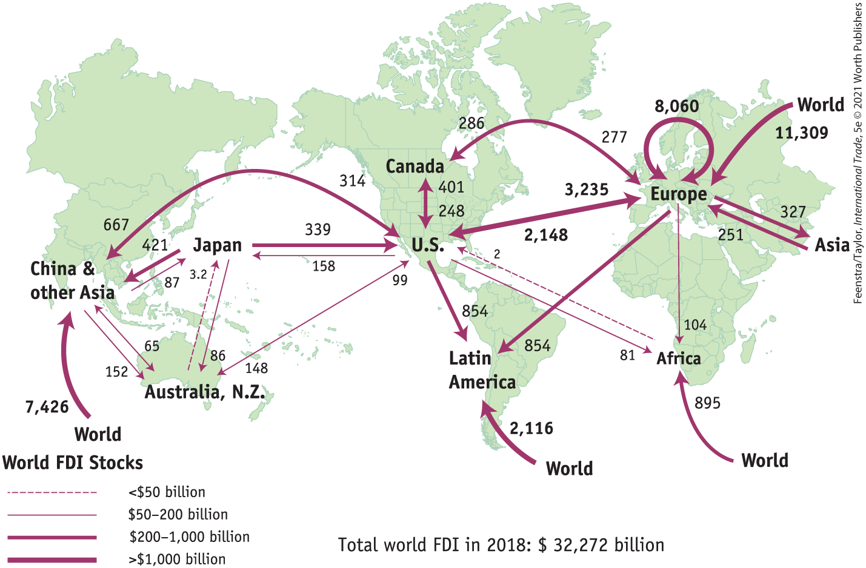
Map of Foreign Direct Investment
FIGURE 1-7
Stock of Foreign Direct Investment, 2018 ($ billions) This figure shows the stock of foreign direct investment (FDI) between selected countries and regions of the world for 2018 in billions of dollars. The largest stocks have the heaviest lines.

Slide 35
Map of Foreign Direct Investment
The majority of world flows of foreign direct investment occur between industrial countries.
  In 2018 the total value of foreign direct investment (FDI) stocks worldwide was $32.3 trillion.
  The stocks that are both owned by and located in European countries is $8.1 trillion (25% of the total world stock of FDI).
  The flow of FDI stock into China and other Asian countries is $7.4 trillion.
  Most of this FDI is from industrial countries, but Chinese firms have begun to acquire land in Africa and Latin America for agriculture and resource extraction.

Slide 36
Map of Foreign Direct Investment
Horizontal FDI
  The majority of foreign direct investment occurs between industrial countries, when a firm from one industrial country owns a company in another industrial country. We refer to these flows between industrial countries as horizontal FDI.
Vertical FDI
  The other form of foreign direct investment occurs when a firm from an industrial country owns a plant in a developing country, which we call vertical FDI. Low wages are the principal reason that firms shift production abroad to developing countries.

Slide 37
Conclusions
Globalization means many things: the flow of goods and services across borders, the movement of people and firms, the spread of culture and ideas among countries, and the tight integration of financial markets around the world.
Although it might seem as if such globalization is new, international trade and the integration of financial markets were also very strong in the period before World War I.
Migration across countries is not as free as international trade, and all countries have restrictions on immigration.
FDI is largely unrestricted in its flows between high-income countries but sometimes faces some restrictions in developing countries.

Slide 38
KEY POINTS
The trade balance of a country is the difference between the value of its exports and the value of its imports, and it is determined by macroeconomic conditions in the country.
The type of goods being traded between countries has changed from the period before World War I, when standardized goods (raw materials and basic processed goods like steel) were predominant. Today, the majority of trade occurs in highly processed consumer and capital goods, which might cross borders several times during the manufacturing process.
A large portion of international trade takes place between industrial countries. Trade within Europe and trade between Europe and the United States accounts for roughly one-quarter of total world trade.
Many of the trade models we study emphasize the differences between countries, but it is also possible to explain trade between countries that are similar. Similar countries will trade different varieties of goods with each other.

Slide 39
KEY POINTS
Larger countries tend to have smaller shares of trade relative to GDP because so much of their trade occurs internally. Hong Kong (China) and Singapore have ratios of trade to GDP that exceed 100%, whereas the United States’ ratio of trade to GDP is 16%.
Trade wars occur when countries respond to tariffs of one country by applying higher tariffs themselves. There was a global trade war during the Great Depression, and there was a U.S.–China trade war in 2018–19.
The majority of world migration comes from developing countries, and, when possible, the migrants prefer to enter wealthier, industrial countries.
International trade in goods and services acts as a substitute for migration and allows workers to improve their standard of living through working in export industries, even when they cannot migrate to earn higher incomes.
There is even more FDI than international trade between high-income countries like those in Europe and the United States, and there is less FDI than trade between high-income and middle- or low-income countries.

Slide 40
