Slide 1

Chapter 11 - International Agreements on Trade and the Environment
ECON 243 – International Trade
© 2021 Worth Publishers
International Economics, 5e | Feenstra/Taylor
1

Slide 2
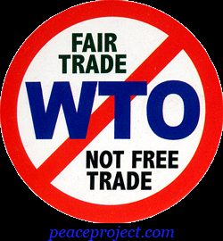
Questions to Consider
Why is the World Trade Organization needed?
Do all countries gain when a regional free-trade area is formed?
Does international trade help or harm the environment?

Slide 3
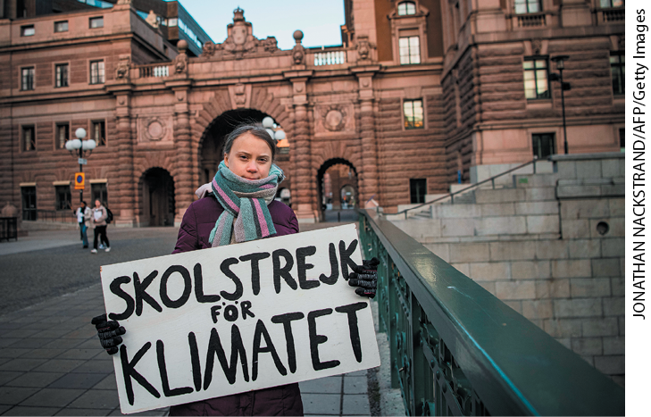
Introduction
In 2019 Greta Thunberg was named Time magazine’s “Person of the Year” for her activism on climate change.
Despite strong public opinion, international agreements to limit global climate change are difficult to maintain.
A high point came in 2015, when close to 200 countries adopted what is called the Paris Agreement, a resolution to limit the increase in global temperature.
In 2017 President Trump decided to pull the United States out of the Paris Agreement.

Slide 4
Introduction
The same problems arise when trying to reach international agreements on international trade.
The World Trade Organization (WTO) was established in 2001 to encourage countries to reduce tariffs and allow for freer international flows of goods and services
The latest discussions, which started in Doha in 2001, failed in 2015 in Nairobi, Kenya, when trade ministers of the 164 WTO countries failed to reaffirm the Doha Round.
The goal of this chapter is to examine why international agreements like those negotiated under the WTO for trade, and those negotiated for environmental reasons such as the Paris climate talks, are needed and why they do not have support from all countries.

Slide 5
Introduction
Import tariffs increase the import price for consumers in large countries but lower the price received by foreign exporting firms.
The reduction in the price received by exporters is a terms-of-trade gain for the importing country.
We show in this chapter that when two or more countries apply tariffs against each other in an attempt to capture this terms-of-trade gain, they both end up losing.
The WTO is a multilateral agreement involving many countries, with an agreement to lower tariffs between all the members.
There are also smaller regional trade agreements involving several countries often located near each other.

Slide 6
Introduction
The U.S.‒Mexico‒Canada Agreement (USMCA) and the European Union (EU) are examples of regional trade agreements.
We discuss the effects of these agreements both on the countries included and on the countries left out.
We also discuss international agreements on the environment. We argue that for “global” pollutants such as carbon dioxide, countries do not fully recognize or take into account the environmental costs of their economic activity.
We need international agreements to ensure that countries recognize these environmental costs.

Slide 7
Multilateral Trade Agreements
When countries seek to reduce trade barriers between themselves, they enter into a trade agreement—a pact to reduce or eliminate trade restrictions.
Under the most favored nation principle of the WTO, the lower tariffs agreed to in multilateral negotiations must be extended equally to all WTO members.
Countries joining the WTO enjoy the low tariffs extended to all member countries but must also agree to lower their own tariffs.
The goal of this section is to demonstrate the logic of multilateral agreements. The important feature of multilateral agreements is that no countries are left out of the agreement.

Slide 8
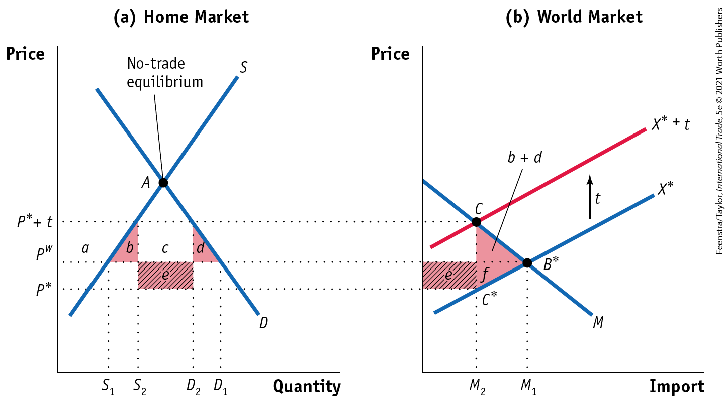
Multilateral Trade Agreements
The Logic of Multilateral Trade Agreements Tariffs for a Large Country - FIGURE 11-1
The tariff shifts up the export supply curve from X* to X* + t.
As a result, the Home price increases from P^{W} to P* + t, and the Foreign price falls from P^{W} to P*.

Slide 9
Multilateral Trade Agreements
The Logic of Multilateral Trade Agreements Tariffs for a Large Country - FIGURE 11-1
The deadweight loss in Home is the area of the triangle (b + d)
Home also has a terms-of-trade gain of area e.
Foreign loses the area (e + f)
The net loss in world welfare is the triangle (b + d + f).

Slide 10
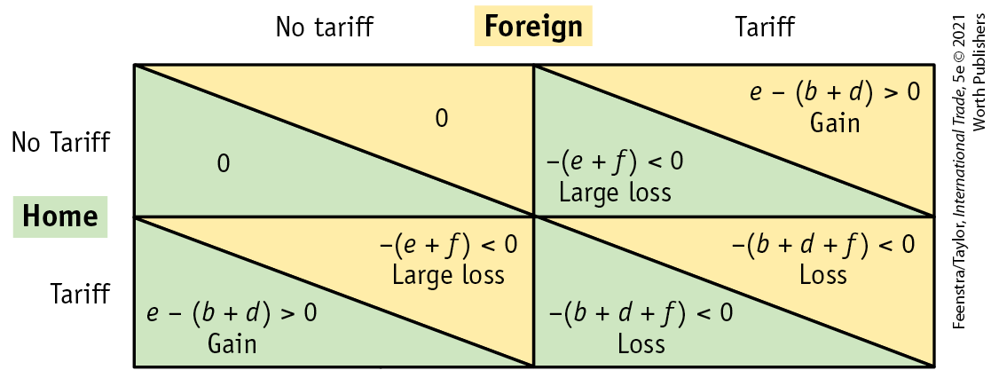
Multilateral Trade Agreements
The Logic of Multilateral Trade Agreements Payoff Matrix - FIGURE 11-2
Payoffs in a Tariff Game This payoff matrix shows the welfare of the Home and Foreign countries as compared with free trade (upper-left quadrant in which neither country applies a tariff). Welfare depends on whether one or both countries apply a tariff. The structure of payoffs is similar to the “prisoner’s dilemma” because both countries suffer a loss when they both apply tariffs, and yet this is the unique Nash equilibrium.

Slide 11
Multilateral Trade Agreements
The Logic of Multilateral Trade Agreements Payoff Matrix - FIGURE 11-2
Nash Equilibrium The only Nash equilibrium in Figure 11-2 is for both countries to apply a tariff (lower-right quadrant). The Nash equilibrium in this case leads to an outcome that is undesirable for both countries even though it is the best outcome for each country given that the other country is imposing a tariff.

Slide 12
Multilateral Trade Agreements
WTO Dispute Settlement: The dispute settlement mechanism acts as a mediation procedure to settle differences between countries.
  The EU filed a case at the WTO objecting to tariffs on steel applied by President Bush. The threat of retaliatory tariffs led Bush to eliminate the tariffs ahead of schedule.
  Countries may not agree that the payoffs for themselves and other countries are similar in size, which can prevent a deal. Trade in services such as banking and insurance and patent protections for medicinal drugs are examples of cases where the gains to the developed countries were too lopsided to allow a deal to be made with the developing countries.

Slide 13
Multilateral Trade Agreements
The United States and the WTO: The administration of President Trump was skeptical of the dispute settlement procedure of the WTO.
In 2018‒19 the United States used several provisions of trade law to apply tariffs that had been rarely used in that way. Many countries objected to the imposition of these tariffs.
Foreign countries then applied tariffs against U.S. exports.
Since 2019 the WTO has been unable to issue rulings in dispute cases because the United States blocked the appointment of new judges, diminishing the ability of the WTO to resolve differences between countries.

Slide 14
Multilateral Trade Agreements
The End of the Trade War? The trade war between the United States and China was brought to a temporary resolution by a “phase one” agreement on January 15, 2020. The higher tariffs on many goods remained in place, however, as did higher tariffs on other countries.
Why did the United States and its trading partners find themselves in this situation?
  The United States was skeptical of the WTO’s ability to reach fair and timely decisions when there were disagreements.
  The United States was seeking different objectives than lowering tariffs.

Slide 15
Multilateral Trade Agreements
In return, China agreed to enforce intellectual property laws more vigorously, which would prevent Chinese firms from copying American and other foreign products and technology.
In addition China agreed to allow foreign firms to establish plants there without needing local partners. This means that foreign firms would not have to share their technology with local partners.

Slide 16
Multilateral Trade Agreements
Managed Trade: The most important provision in the “phase one” agreement was China’s commitment to purchase $200 billion more exports from the United States by 2021 than it had in 2017. Specifying the amount that a country must purchase from another is called managed trade.
This would require China to buy less from other countries, a shift that would lead to strong objections at the WTO because it would not reflect normal trade patterns.
The managed trade commitment of phase one is not the approach to increasing trade favored by most economists, who believe the best way to increase trade between two countries is to mutually reduce tariffs, without tying that reduction to a specific increase in the amount of trade.

Slide 17
Regional Trade Agreements
Under regional trade agreements, several countries eliminate tariffs among themselves but maintain tariffs against countries outside the region.
Regional trade agreements are sometimes called preferential trade agreements, to emphasize that the countries included are favored over other countries.
Characteristics of Regional Trade Agreements
Free-Trade Area
A free-trade area is a group of countries agreeing to eliminate tariffs (and other barriers to trade) among themselves but keeping whatever tariffs they formerly had with the rest of the world.

Slide 18
Regional Trade Agreements
Characteristics of Regional Trade Agreements
Customs Union
A customs union is similar to a free-trade area, except that in addition to eliminating tariffs among countries in the union, the countries within a customs union also agree to a common schedule of tariffs with each country outside the union.
Rules of Origin
Free-trade areas have complex rules of origin that specify what type of goods can be shipped duty-free within the free-trade area. These rules are not needed in a customs union because, in that case, the tariffs on outside countries are the same for all members of the union.

Slide 19
APPLICATION: Brexit and Rules of Origin
In 2016 the citizens of the United Kingdom voted in favor of leaving the European Union (EU), in what is called Brexit. As of 2020, this separation has yet to take place.
Why the delay? Geography and rules of origin. Before the United Kingdom left the EU, Northern Ireland (as part of the United Kingdom) and the Republic of Ireland, which is on the same island as Northern Ireland but not part of the United Kingdom, were both in the EU. Because the EU is a customs union, all tariffs on outside countries are the same.
When the United Kingdom leaves the EU, Northern Ireland will also leave as part of the United Kingdom. The United Kingdom will be free to establish new tariffs with other countries, so Northern Ireland and the Republic of Ireland will have different tariffs.
To enforce rules of origin to prevent countries from shipping goods to Northern Ireland and then into the EU through the Republic of Ireland, a customs border must be established. The difficult issue of where to put this customs border is one reason Brexit has been so hard and taken so long.

Slide 20
Regional Trade Agreements
Trade Creation and Trade Diversion
When a regional trade agreement is formed and trade increases between member countries, the increase in trade can be of two types.
The first type of trade increase, trade creation, occurs when a member country imports a product from another member country that formerly it produced for itself.
The second reason for trade to increase within a regional agreement is trade diversion, which occurs when a member country imports a product from another member country that it formerly imported from a country outside of the new trade region.

Slide 21
Trade Creation
Trade creation means that a country imports goods that it would have otherwise produced on its own.
Suppose that we consider the following case with CAFTA with jewelry imports.
Suppose that it costs $12 to produce jewelry in the US, $11 in Honduras, and $10 in China.
Beginning with a tariff of 25%, the United States finds it cheaper to produce domestically. With CAFTA, the US will import from Honduras. This is trade creation. CS in the US will rise and PS in Honduras will rise.
 | Production Cost | Pre-CAFTA |  |  | Post-CAFTA
 |  | Tariff | Cost | Tariff Rev | Tariff | Cost | Tariff Rev
Honduras | 11 | 25% | 13.75 | N/A | 0 | 11.00 | 0
China | 10 | 25% | 12.50 | N/A | 25% | 12.50 | N/A
US | 12 | N/A | 12.00 | N/A | N/A | 12.00 | N/A

Slide 22
Trade Diversion
Trade diversion means one member imports from a member country instead of outside exporters due to lower tariffs under the regional trade agreement.
Suppose the initial tariff on jewelry imports to the United States is 15%. If there were no CAFTA, the US would import jewelry from China.
However, when CAFTA is introduced, the United States will import jewelry from Honduras instead of from China. The US is made worse off by the regional free trade agreement! Before, the net-of-tariff price was $10 and now the US pays $11. US gains $0.50 but loses $1.50 in tariff revenue.
 | Production Cost | Pre-CAFTA |  |  | Post-CAFTA
 |  | Tariff | Cost | Tariff Rev | Tariff | Cost | Tariff Rev
Honduras | 11 | 15% | 12.65 | N/A | 0 | 11.00 | 0
China | 10 | 15% | 11.50 | 1.50 | 15% | 11.50 | N/A
US | 12 | N/A | 12.00 | N/A | N/A | 12.00 | N/A

Slide 23
Regional Trade Agreements
Numerical Example of Trade Creation and Diversion
TABLE 11-1 Cost of Importing an Automobile Part
This table shows the cost to the United States of purchasing an automobile part from various source countries, with and without tariffs. If there is a 20% tariff on all countries, then it would be cheapest for the United States to buy the auto part from itself (for $22). But when the tariff is eliminated on Mexico after USMCA, then the United States would instead buy from that country (for $20), which illustrates the idea of trade creation. If instead, we start with a 10% tariff on all countries, then it would be cheapest for the United States to buy from Asia (for $20.90). When the tariff on Mexico is eliminated under USMCA, then the United States would instead buy there (for $20), illustrating the idea of trade diversion.
 | U.S. Tariff: 0% | U.S. Tariff: 10% | U.S. Tariff: 20%
From Mexico, before USMCA | $20 | $22 | $24
From Asia, before USMCA | $19 | $20.90 | $22.80
From Mexico, after USMCA | $20 | $20 | $20
From Asia, after USMCA | $19 | $20.90 | $22.80
From the United States | $22 | $22 | $22

Slide 24
International Agreements on the Environment
Environmental Issues in the GATT and WTO
The WTO does not directly address environmental issues; other international agreements, called multilateral environmental agreements, deal specifically with the environment.
Article XX, known as the “green provision,” allows countries to adopt their own laws in relation to environmental issues, provided that these laws are applied uniformly to domestic and foreign producers so that the laws do not discriminate against imports.

Slide 25
International Agreements on the Environment
Environmental Issues in the GATT and WTO - TABLE 11-2
Case | Issue | Outcome
Tuna–Dolphin In 1991 Mexico appealed to the GATT against a U.S. ban on Mexican tuna imports. | The United States put a ban on imports of tuna from Mexico that were not caught with nets that were safe for dolphins (as required in the United States under the Marine Mammal Protection Act). | In 1992 the GATT ruled in favor of Mexico that the U.S. import ban violated GATT rules. But the strong consumer response led to the use of safe nets and to the labeling of imported tuna as “dolphin safe.”
Shrimp–Turtle In 1996 India, Malaysia, Pakistan, and Thailand appealed to the WTO against a U.S. ban on shrimp imports. | The United States put a ban on imports of shrimp from India, Malaysia, Pakistan, and Thailand that were not caught with nets safe for sea turtles (as required in the United States under the Species Act). | In 1998 the WTO ruled in favor of India, Malaysia, Pakistan, and Thailand that the U.S. import ban violated WTO rules. But the United States could still require these exporting countries to use turtle-safe nets, provided that adequate notice and consultation were pursued.

Slide 26
Case | Issue | Outcome
Gasoline In 1994 Venezuela and Brazil appealed to the GATT against a U.S. ban on gasoline imports. | The United States put a ban on imports of gasoline from Venezuela and Brazil because the gas exceeded the maximum amount allowed of a smog-causing chemical (under the U.S. Clean Air Act). | In 1996 the WTO ruled in favor of Venezuela and Brazil that the U.S. import restriction violated equal treatment of domestic and foreign producers. The United States adjusted the rules to be consistent with the WTO and still pursued its own clean air goals.
Biotech Food In 2003 the United States appealed to the WTO that Europe was keeping out genetically modified food and crops. | Since 1998 no imports of genetically modified food or crops had been approved in the EU. | In 2006 the WTO ruled that the European actions violated the principle that import restrictions must be based on “scientific risk assessments.” But labeling and consumer concerns in Europe have nonetheless limited such imports.

Slide 27
International Agreements on the Environment
Does Trade Help or Harm the Environment?
Externalities
An externality occurs when one person’s production or consumption of a good affects another person.
Externalities can be positive, such as when one firm’s discoveries from research and development (R&D) are used by other firms, or negative, such as when the production of a good leads to pollution.
Closely related to the concept of externalities is the idea of market failure, which means that the positive or negative effects of the externality on other people are not paid for.

Slide 28
International Agreements on the Environment
Does Trade Help or Harm the Environment?
Externalities and Trade
Does trade lead to more of a negative externality, making the outcome worse, or offset it, making the outcome better?
In some cases, having more trade raises the externality and lowers welfare, but there are other cases in which having more trade reduces the externality and increases welfare.
An example is when the good can be imported more cheaply and this reduces the externality associated with domestic production.

Slide 29
International Agreements on the Environment
Negative Production Externality
It is possible that the consumption of a good can also lead to an externality. Consumption of automobiles that use gasoline contributes to smog and global climate change.
A particular type of negative consumption externality occurs when people have free access to a resource they all desire. The resource may then be subject to overuse, an outcome called the tragedy of the commons, based on people grazing their animals on a plot of land they all have access to, called the “commons.”
Because none of the individuals own the land, there is an incentive to keep letting more animals graze until the grass is depleted. The private marginal cost of letting another animal onto the common is zero, but the social marginal cost is positive because the grass is being used.

Slide 30
International Agreements on the Environment
Negative Consumption Externality
Trade in Fish
Because of overharvesting, many species of fish are no longer commercially viable and, in some cases, are close to extinction.
According to one scientific study, 29% of fish and seafood species have collapsed; that is, their catch declined by 90% or more between 1950 and 2003.
The fundamental cause of the overharvesting of fish is not that the resource is traded internationally but that it is treated as common property by the people who are harvesting it.
Overharvesting could be avoided if there was a system of international rules that assigned property rights to the fish and limited the harvest of each nation.

Slide 31
International Agreements on the Environment
Negative Consumption Externality
Trade in Buffalo
Another case in which international trade has interacted with the tragedy of the commons was the slaughter of the Great Plains buffalo from 1870 to 1880.
In this case, an invention in London circa 1871 that allowed the buffalo hides to be tanned for industrial use created a huge demand in Europe for the hides.
Figure 11-5 convincingly shows that international trade, combined with the innovation in tanning technology in London and the absence of property rights over the buffalo, was responsible for the slaughter of the buffalo.

Slide 32
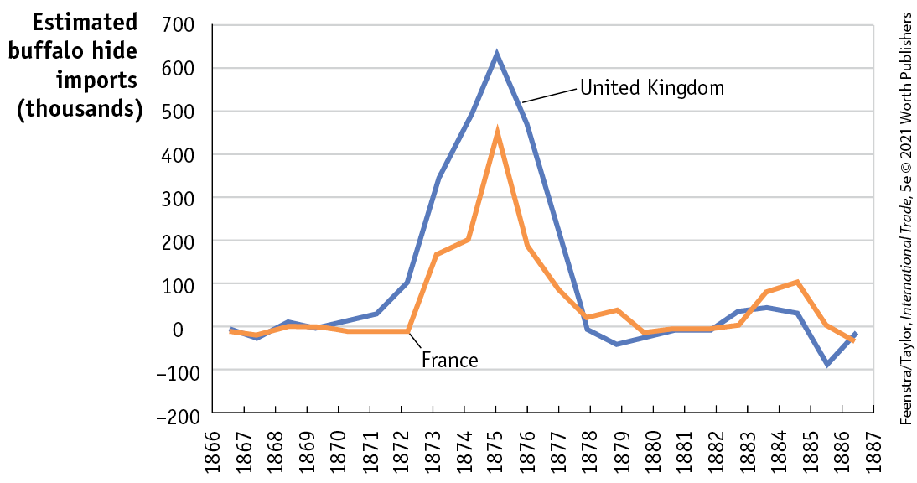
International Agreements on the Environment
Negative Consumption Externality - Trade in Buffalo - FIGURE 11-5

Slide 33
International Agreements on the Environment
Trade in Solar Panels
In contrast to the overharvesting of fish and the slaughter of buffalo, international trade in solar panels can bring added social gains.
Opening to free trade in solar panels lowers the price of electricity and reduces pollution from the use of fossil fuels, which have a negative production externality, leading to extra social gains.
Tariffs on imported solar panels reduce these social gains. Recognizing this, the EU ended its tariff protection in 2018.
The United States continued tariff use, although these have had the effect of an infant industry tariff by encouraging domestic production.

Slide 34
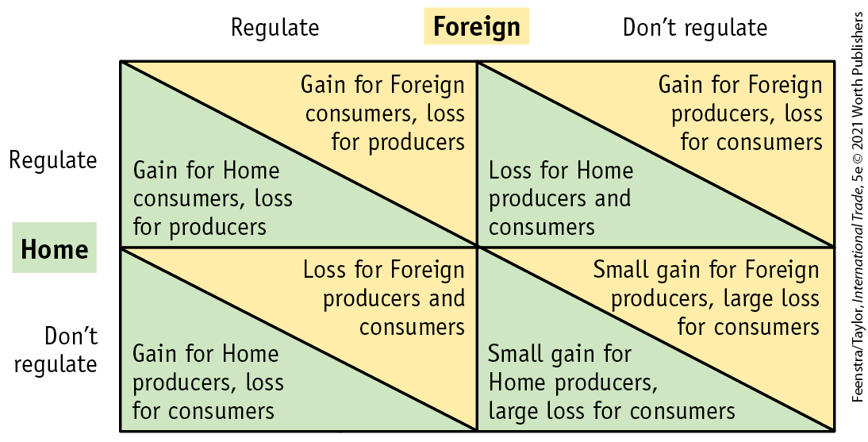
International Agreements on the Environment
International Agreements on Pollution - Global Pollutants, Payoff Matrix, Nash Equilibrium FIGURE 11-6
Payoffs in an Environmental Game
This payoff matrix shows the gains and losses for Home and Foreign countries, depending on whether they adopt environmental regulations. If governments weigh producer surplus more than consumer surplus, then the structure of payoffs is similar to the prisoner’s dilemma because the Nash equilibrium is to have both countries not adopt regulations. That outcome can occur with “global” pollutants.
Multilateral Agreements
One example of an international agreement is the Montreal Protocol on Substances that Deplete the Ozone Layer, which has successfully eliminated the use of chlorofluorocarbons (CFCs).

Slide 35

A Closer Look

Slide 36
APPLICATION: The Kyoto Protocol, the Paris Agreement, and the Green Deal
The Kyoto Protocol built on the United Nations’ 1992 treaty on climate change, which established specific targets for reductions in greenhouse gas emissions: the industrial countries should cut their emissions of greenhouse gases by a collective 5.2% less than their 1990 levels.
More than 160 countries ratified this agreement, including about 40 industrial countries. Russia ratified the treaty in 2004, bringing the amount of greenhouse gases accounted for by members to more than 55% of the world total.
The United States did not ratify this treaty, the only large industrial country to not join the effort.

Slide 37
APPLICATION: The Kyoto Protocol, the Paris Agreement, and the Green Deal
Why did the United States refuse to join?
  Although the evidence toward global warming is strong, we still do not understand all the consequences of policy actions.
  The United States is the largest emitter of greenhouse gases and meeting the Kyoto targets would negatively affect its economy.
  Kyoto failed to include the developing countries, especially China and India.

Slide 38
APPLICATION: The Kyoto Protocol, the Paris Agreement, and the Green Deal
The first point has become less plausible over time as the evidence of global warming becomes more apparent.
The second point is no longer true, as since 2005 China is the largest emitter. The costs of U.S. reductions have also turned out to be less than expected. This is partly due to the low price of natural gas, an alternative to coal, due to fracking. The term fracking refers to a process for releasing oil and gas by injecting fluids into underground fissures to force them open and release the gas.
That the Kyoto Protocol left out developing countries such as China and India is perhaps the major reason the United States did not ratify the treaty.

Slide 39
APPLICATION: The Kyoto Protocol, the Paris Agreement, and the Green Deal
The language of the Paris Agreement makes it an extension of the United Nations’ 1992 treaty on climate change. The main goal is to limit the emissions of greenhouse gases so that the global average temperature does not rise by more than 2 degrees Celsius.
The limits to emissions in the Paris Agreement apply to all countries and are voluntary.
Because it is technically not a new agreement, President Obama ratified the Paris Agreement by executive order in September 2016.
In June 2017, President Trump announced U.S. withdrawal from the Paris Agreement effective November 4, 2020.

Slide 40
APPLICATION: The Kyoto Protocol, the Paris Agreement, and the Green Deal
The goals of the Paris Agreement are reinforced by other commitments, such as the Green Deal in the EU.
Under this plan, the EU intends to be “carbon neutral” by 2050. Achieving this goal will require a great investment in renewable energy, and firms in Europe will have to adopt expensive new production methods.
The EU is also considering applying a carbon tariff on imports; the United States has warned the EU that this is unacceptable and that it will respond with its own tariffs against the EU.
In the United States a similar Green New Deal has been proposed but has not made headway in the U.S. Congress.

Slide 41
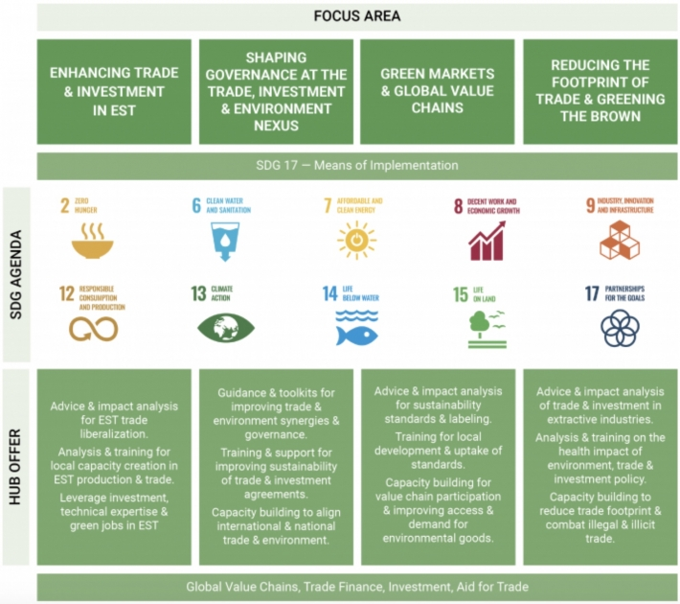
Environment and Trade Hub (UNEP)

Slide 42
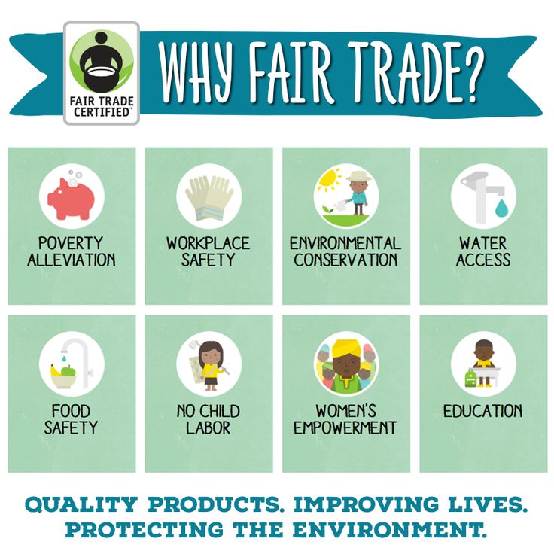
Fair Trade (Your Comments Please)

Slide 43
Conclusions
International agreements are needed because there are strong temptations for countries to use tariffs for their own benefit or to avoid adopting environmental regulations, as occurs when countries do not face the costs of their own global pollutants.
In these situations, countries have an incentive to use tariffs or not regulate, but when all countries act in this manner, they end up losing: the outcome can be high tariffs or high pollution.
Halfway steps toward the complete use of markets (as with complete free trade) can also have bad results. Such an outcome is possible with regional trade agreements, also called “preferential trade agreements,” if the amount of trade diversion caused by the agreement is more than the amount of trade creation.

Slide 44
Conclusions
Because preferential trade agreements provide zero tariffs only to the countries included in the agreement but maintain tariffs against all outside countries, such agreements might make member countries worse off if the lowest-cost producers are excluded from the agreement.
Another case in which a halfway step toward open markets can make countries worse off is with the overharvesting of resources. In the absence of property rights for an exhaustible resource such as fish, opening countries to free trade can lead to even more harvesting, even to the point of extinction.
Actions by individuals to improve the environment are also important. The WTO is more willing to take into account environmental concerns in its rulings in part due to international pressure.

Slide 45
KEY POINTS
There are two primary types of free-trade agreements: multilateral and regional. Multilateral agreements are negotiated among large groups of countries (such as all countries in the WTO) to reduce trade barriers among them, whereas regional agreements operate among a smaller group of countries, often in the same region.
Under perfect competition, we can analyze the benefits of multilateral agreements by considering the Nash equilibrium of a two-country game in which the countries are deciding whether to apply a tariff. The unique Nash equilibrium for two large countries is to apply tariffs against each other, which is an example of a “prisoner’s dilemma.” By using an agreement to remove tariffs, both countries become better off by eliminating the deadweight losses of the tariffs.

Slide 46
KEY POINTS
Regional trade agreements are also known as preferential trade agreements, because they give preferential treatment (i.e., free trade) to the countries included within the agreement, but maintain tariffs against outside countries. There are two types of regional trade agreements: free-trade areas (such as USMCA) and customs unions (such as the EU).
The welfare gains and losses that arise from regional trade agreements are more complex than those that arise from multilateral trade agreements because only the countries included within the agreement have zero tariffs, while tariffs are maintained against the countries outside the agreement. Under a free-trade area, the countries within the regional trade agreement each have their own tariffs against outside countries, whereas, under a customs union, the countries within the regional trade agreement have the same tariffs against outside countries.

Slide 47
KEY POINTS
Trade creation occurs when a country within a regional agreement imports a product from another member country that formerly it produced for itself. In this case, there is a welfare gain for both the buying and the selling country.
Trade diversion occurs when a member country imports a product from another member country that it formerly imported from a country outside of the new trade region. Trade diversion leads to losses for the former exporting country and possibly for the importing country and the new trading region as a whole.
The WTO does not deal directly with the environment, but environmental issues come up as the WTO is asked to rule on specific cases. A review of these cases shows that the WTO has become friendlier to environmental considerations in its rulings.

Slide 48
KEY POINTS
In the presence of externalities, international trade might make a negative externality worse, bringing a social cost that offsets the private gains from trade. International trade can also reduce a negative externality, leading to a social gain that is in addition to the private gains from trade. From this logic and real-world examples, we conclude that free trade can help or hurt the environment.
International agreements on the environment are needed for the same reasons that agreements on tariffs are needed—to avoid a prisoner’s dilemma type of outcome, which is bad for all countries. The Kyoto Protocol agreed to in 1997, and implemented in 2005, had only limited success because the United States did not agree to participate, and developing countries such as China and India were excluded. The Paris Agreement of nearly 200 countries in 2015 originally included the United States, but it later withdrew.

