Slide 1

Chapter 10 - Export Policies in Resource-Based and High-Technology Industries
ECON 243 – International Trade
© 2021 Worth Publishers
International Economics, 5e | Feenstra/Taylor

Slide 2
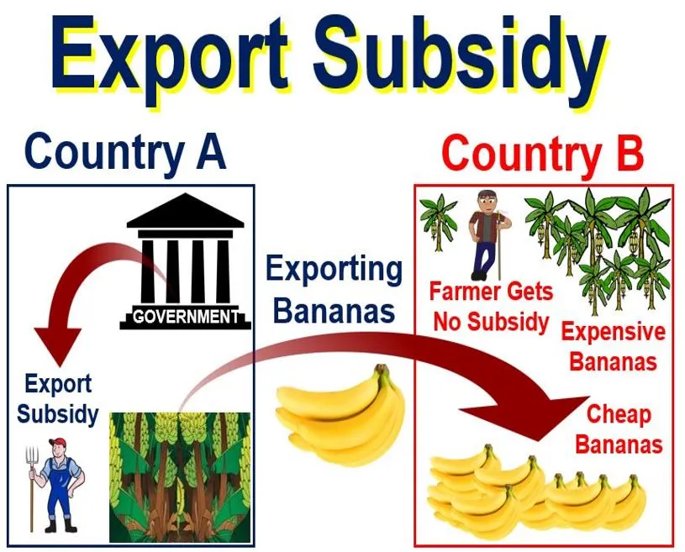
Questions to Consider
Why do countries subsidize their farmers?
Can countries control the export of their rare natural resources?
Why do countries subsidize their high-tech exports?

Slide 3
Introduction
On July 21, 2008, representatives of the 152 countries belonging to the WTO met in Geneva, Switzerland, to discuss reforms of the world trading system. Like earlier meetings, it was marked by large-scale protests
The first goal of this chapter is to explain the impact of agricultural subsidies on prices and the welfare of different groups.
The second goal of this chapter is to explain the effect of two other export policies: export tariffs and export quotas.
The third goal of the chapter is to examine how governments can strategically use export subsidies to bolster high-technology companies and industries.

Slide 4
Agricultural Subsidies
Agricultural Export Subsidies
An export subsidy is a payment to firms for every unit exported (either a fixed amount or a fraction of the sales price). Governments give subsidies to encourage domestic firms to produce more in particular industries.
The EU has historically maintained a system of agricultural subsidies known as the Common Agricultural Policy (CAP), which subsidizes farmers in order to raise their incomes.
Other countries maintain similarly generous subsidies. For example, the United States pays cotton farmers to grow more cotton and subsidizes agribusiness and manufacturers to buy American cotton.

Slide 5
Export Subsidy
An export subsidy can also be specific or ad valorem:
  A specific subsidy is a payment per unit exported.
  An ad valorem subsidy is a payment as a proportion of the value exported.
An export subsidy raises the price in the exporting country, decreasing its consumer surplus (consumers worse off) and increasing its producer surplus (producers better off).

Slide 6
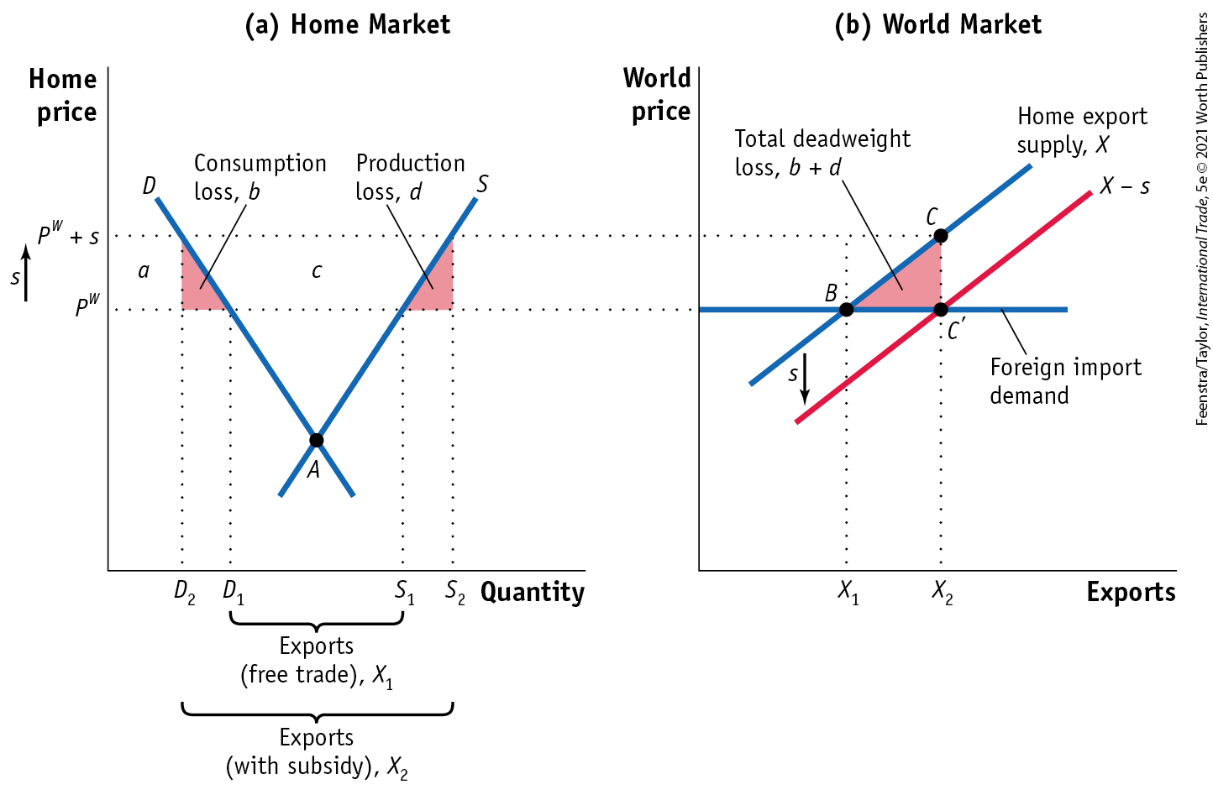
Export Subsidies in a Small Home Country
Impact of an Export Subsidy- FIGURE 10-1 Export Subsidy for a Small Country
Applying a subsidy of s dollars per unit exported will increase the price that Home exporters receive from P^{W} to P^{W} + s.
As a result, the domestic price of the similar good will also rise by that amount. This price rise of the similar good leads to an increase in Home quantity supplied from S₁ to S₂ and a decrease in Home quantity demanded from D₁ to D₂, in panel (a).

Slide 7
2) Export Subsidies in a Small Home Country
Impact of an Export Subsidy- FIGURE 10-1 Export Subsidy for a Small Country
Exports rise as a result of the subsidy, from X₁ to X₂ in panel (b).
The Home export supply curve shifts down by exactly the amount of the subsidy since the marginal cost of a unit of exports decreases by exactly s.
As in the case of a tariff, the deadweight loss as a result of the subsidy is the triangle (b + d), the sum of consumer loss b and producer loss d.

Slide 8
Export Subsidies in a Small Home Country
Impact of an Export Subsidy
Impact of the Subsidy on Home Welfare
The rise in Home price lowers consumer surplus by the amount (a + b).
The price increase raises producer surplus by the amount (a + b + c).
The export subsidy costs the government s per unit exported, shown by the area (b + c + d).
The triangle (b + d) is the net loss or deadweight loss due to the subsidy in a small country.

Slide 9
A Closer Look

Slide 10
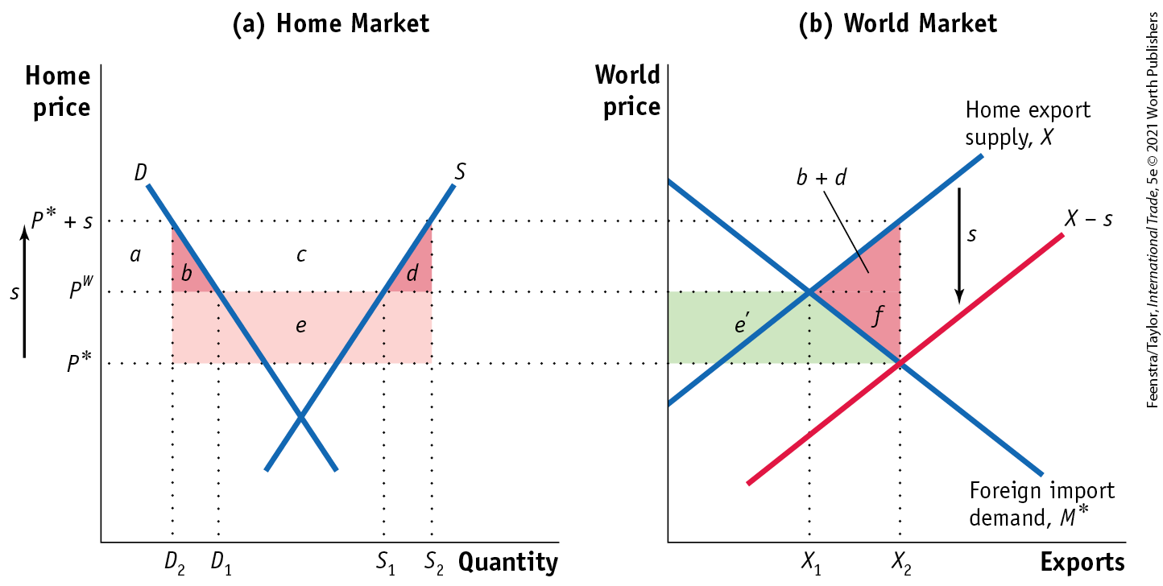
Export Subsidies in a Large Home Country
Effect of the Subsidy - FIGURE 10-2 Export Subsidy for a Large Country
Panel (a) shows the effects of the subsidy at Home. The Home price increases from P^{W} to P*+ s, Home quantity demanded decreases from D₁ to D₂, and Home quantity supplied increases from S₁ to S₂. The deadweight loss for Home is the area of triangle (b + d), but Home also has a terms-of-trade loss of area e.

Slide 11
Export Subsidies in a Large Home Country
Effect of the Subsidy - FIGURE 10-2 Export Subsidy for a Large Country
In the world market, the Home subsidy shifts out the export supply curve from X to X − s, reflecting the lower marginal cost of exports. As a result, the world price falls from P^{W} to P*.
The Foreign country gains the consumer surplus area e′, so the world deadweight loss due to the subsidy is the area (b + d + f). The extra deadweight loss f arises because only a portion of the Home terms-of-trade loss is a Foreign gain.

Slide 12

A Closer Look

Slide 13
Export Subsidies in a Large Home Country
Effect of the Subsidy
Home Welfare
The increase in the Home price from P^{W} to P* + s reduces consumer surplus by the amount (a + b) and increases producer surplus by the amount (a + b + c).
Due to the terms-of-trade effect, the revenue cost of the subsidy to the government is the area (b + c + d + e), which equals s • X₂. The net effect on welfare is −(b + d + e).
Foreign and World Welfare
While there is a terms-of-trade gain of e′ for the foreign country, there is still an overall deadweight loss for the world, measured by the area (b + d + f ).

Slide 14
Production Subsidies
Suppose the government provides a subsidy of s dollars for every unit that a Home firm produces. This is a production subsidy because it is a subsidy to every unit produced and not just to units that are exported.
There are several ways that a government can implement such a subsidy.
The government might guarantee a minimum price to the farmer and make up the difference between the minimum price and any lower price for which the farmer sells.
Alternatively, it might provide subsidies to users of the crop to purchase it, thus increasing demand and raising market prices; this would act as a subsidy to every unit produced.

Slide 15
Export Quotas
There is one other export policy that also benefits the large country applying it: an export quota, which is a limit on the amount that firms are allowed to export.
The most well-known system of export quotas in the world today is the system used by the Organization of Petroleum Exporting Countries (OPEC).
OPEC sets limits on the amount of oil that can be exported by each country, and by limiting oil exports in this way, it keeps world petroleum prices high.
Those high prices benefit not only OPEC’s member countries but also other oil-exporting countries that do not belong to OPEC.

Slide 16
High-Technology Export Subsidies
Governments subsidize high-technology industries because they may create benefits that spill over to other firms in the economy.
That is, governments believe that the high-technology industry produces a positive externality.
This argument for a subsidy is similar to the infant industry argument used to justify protective tariffs.

Slide 17
High-Technology Export Subsidies
“Strategic” Use of High-Tech Export Subsidies
In addition to the spillover argument, governments and industries also argue that export subsidies might give a strategic advantage to export firms that are competing with a small number of rivals in international markets.
To examine whether countries can use their subsidies strategically, we use the assumption of imperfect competition.
With imperfect competition, we allow for two firms in the market, which is called a duopoly.
To capture the strategic decision making of two firms, we use game theory, the modeling of strategic interactions (games) between firms as they choose actions that will maximize their returns.

Slide 18
Game Theory - Prisoner's Dilemma
Famous example of game theory.
Strategies must be undertaken without the full knowledge of what other players will do.
Players adopt dominant strategies, but they don't necessarily lead to the best outcome.
Two prisoners (A and B)are held in separate cells for a serious crime that they did in fact commit.
The prosecutor has only enough hard evidence to convict them of a minor offense, for which the penalty is a year in jail.
Each prisoner is told that if one confesses while the other remains silent, the confessor will get parole while the other spends life years in prison.
If both confess, they will both get a sentence of 20 years.

Slide 19
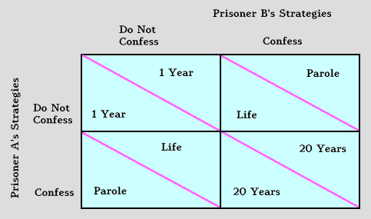
Prisoner's Dilemma

Slide 20
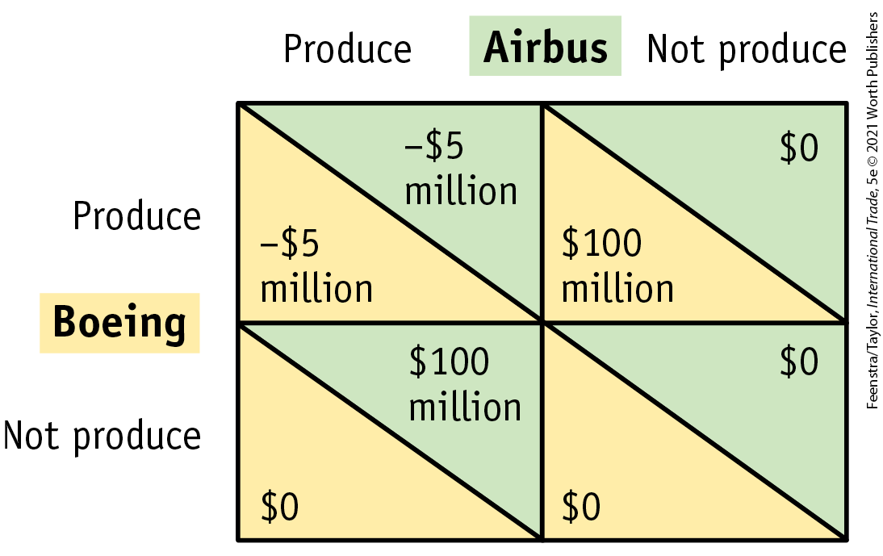
High-Technology Export Subsidies
“Strategic” Use of High-Tech Export Subsidies
Payoff Matrix In Figure 10-9, we show a payoff matrix for Boeing and Airbus, each of which has to decide whether to produce the new aircraft.
FIGURE 10-9
Payoff Matrix Between Two Firms The lower-left number in each quadrant shows the profits of Boeing, and the upper-right number shows the profits of Airbus. Each firm must decide whether to produce a new type of aircraft. A Nash equilibrium occurs when each firm is making its best decision, given the action of the other. For this pattern of payoffs, there are two Nash equilibria, in the upper-right and lower-left quadrants, where one firm produces and the other does not.
Nash Equilibrium The idea of a Nash equilibrium is that each firm must make its own best decision, taking as given each possible action of the rival firm. When each firm is acting that way, the outcome of the game is a Nash equilibrium. The action of each player is the best possible response to the action of the other player.

Slide 21
High-Technology Export Subsidies
“Strategic” Use of High-Tech Export Subsidies - FIGURE 10-9
Best Strategy for Boeing If Airbus produces, then Boeing is better off not producing. This finding proves that having both firms produce is not a Nash equilibrium. Boeing would never stay in production, since it prefers to drop out of the market whenever Airbus produces.
Best Strategy for Airbus The decision illustrated in the lower-left quadrant, with Airbus producing and Boeing not producing, is a Nash equilibrium because each firm is making its best decision given what the other is doing.

Slide 22
High-Technology Export Subsidies
“Strategic” Use of High-Tech Export Subsidies - FIGURE 10-9
Multiple Equilibria The upper-right quadrant, with Boeing producing and Airbus not producing, is also a Nash equilibrium. When Boeing produces, then Airbus’s best response is to not produce, and when Airbus does not produce, then Boeing’s best response is to produce.
When there are two Nash equilibria, there must be some force from outside the model that determines in which equilibrium we are. An example of one such force is the first mover advantage, which means that one firm is able to decide whether to produce before the other firm

Slide 23
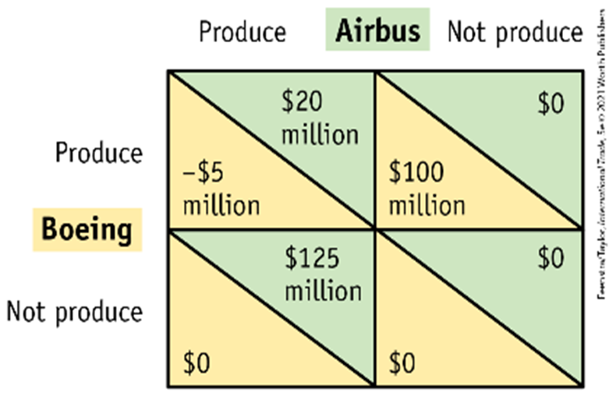
High-Technology Export Subsidies
Effect of a Subsidy to Airbus - FIGURE 10-10
Payoff Matrix with Foreign Subsidy When the European governments provide a subsidy of $25 million to Airbus, its profits increase by that much when it produces a new aircraft. Now there is only one Nash equilibrium, in the lower-left quadrant, with Airbus producing but Boeing not producing. The profits for Airbus have increased from 0 to $125 million, while the subsidy cost only $25 million, so there is a net gain of $100 million in European welfare.
Best Strategy for Airbus With the subsidy, Airbus now earns $20 million by producing instead of losing $5 million.
Best Strategy for Boeing Boeing will want to drop out of the market. Once Boeing makes the decision not to produce, Airbus’s decision doesn’t change.

Slide 24

High-Technology Export Subsidies
Effect of a Subsidy to Airbus - FIGURE 10-10
Payoff Matrix with Foreign Subsidy When the European governments provide a subsidy of $25 million to Airbus, its profits increase by that much when it produces a new aircraft. Now there is only one Nash equilibrium, in the lower-left quadrant, with Airbus producing but Boeing not producing. The profits for Airbus have increased from 0 to $125 million, while the subsidy cost only $25 million, so there is a net gain of $100 million in European welfare.
Nash Equilibrium The lower-left quadrant is a unique Nash equilibrium: each firm is making its best decision, given the action of the other. It is the only Nash equilibrium.

Slide 25
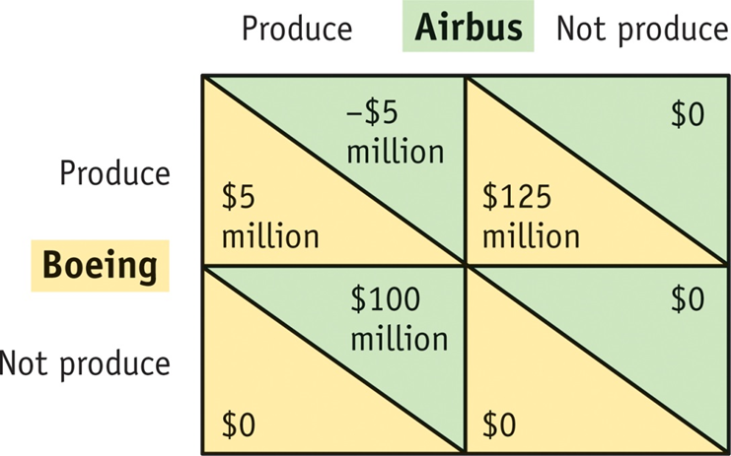
High-Technology Export Subsidies
Cost Advantage for Boeing - FIGURE 10-11
If Boeing has a cost advantage in the production of aircraft, the payoffs are as shown here.
Boeing earns profits of $5 million when both firms are producing and profits of $125 million when Airbus does not produce.
Now there is only one Nash equilibrium, in the upper-right quadrant, where Boeing produces and Airbus does not.

Slide 26
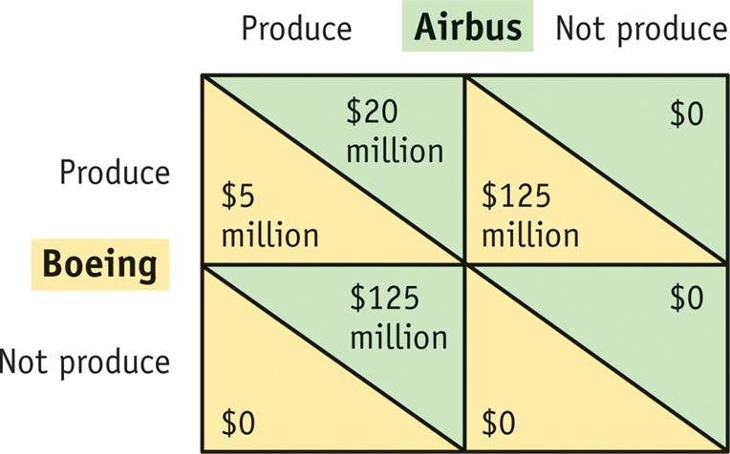
High-Technology Export Subsidies
Subsidy with Cost Advantage for Boeing - FIGURE 10-12
When the European governments provide a subsidy of $25 million to Airbus, its profits increase by that much when it produces. Now the only Nash equilibrium is in the upper-left quadrant, where both firms produce.
The profits for Airbus have increased from 0 to $20 million, but the subsidy costs $25 million, so there is a net loss of $5 million in European welfare.

Slide 27
APPLICATION: WTO Controversies Due to Subsidies in Commercial Aircraft
The large passenger aircraft industry is effectively a duopoly, with Boeing in the United States and Airbus in Europe. Various types of subsidies have been used to support these companies:
  Indirect subsidies that arise because the R&D for military versions effectively subsidize R&D for the civilian aircraft;
  Direct subsidies for the R&D of new aircraft;
  Subsidies on the interest rates that aircraft buyers pay when they borrow money to purchase aircraft.

Slide 28
APPLICATION: WTO Controversies Due to Subsidies in Commercial Aircraft
The Superjumbo and the Dreamliner
The EU was accused of subsidizing the A380, while the United States was accused of subsidizing Boeing’s 787 Dreamliner.
Over the years, the WTO has ruled in favor of both companies, finding that the EU gave up to $18 billion in subsidized financing to Airbus, while the United States gave up to $4 billion in subsidized financing to Boeing.
The United States was allowed to apply tariffs on $7.5 billion in imported goods from the EU as a “countermeasure.”
Did the development subsidies provided by the European governments to the Airbus A380 increase their national welfare?
ANSWER QUESTION

Slide 29

Comments

Slide 30
Conclusions
Countries use export subsidies in a wide range of industries, including agriculture, mining, and high technology.
For agriculture, the underlying motivation for the export subsidies is to prop up food prices, thereby raising the real incomes of farmers.
Export subsidies raise prices for producers, thereby increasing their real income (in the specific-factors model) and their producer surplus (using supply curves).
Shifting income toward farmers comes with a cost to consumers, however, because of the higher food prices in the exporting country.

Slide 31
Conclusions
When we add up the loss in consumer surplus, the gain in producer surplus, and the revenue cost of the subsidy, we obtain a net loss for the exporting country as a result of the subsidy. This deadweight loss is similar to that from a tariff in a small country.
In a large country, an import tariff and an export subsidy have different welfare implications. Both policies lead to a rise in domestic prices (of either the import good or the export good) and a fall in world prices.
For an export subsidy, the fall in world prices is a terms-of-trade loss for the exporting country. This means that applying an export subsidy in a large exporting country leads to even greater losses than applying it to a small country: there is no possibility of gain, as we found for a large-country import tariff.

Slide 32
Conclusions
The losses arising from an export subsidy, for either a small or a large country, are less severe for a production subsidy.
A production subsidy provides an extra payment for every unit produced, regardless of whether it is sold at home or abroad. So consumer prices do not change from their world level.
The losses experienced by an exporting country due to subsidies are reversed when countries instead use export tariffs. With export tariffs in a large country, the exporter obtains a terms-of-trade gain through restricting supply of its exports and driving up the world price. This is at the expense of its trade partners, a “beggar thy neighbor” policy.
In high-technology industries, it is possible for an export subsidy to lead to gain for the exporting country by increasing profits.

Slide 33
KEY POINTS
An export subsidy leads to a fall in welfare for a small exporting country facing a fixed world price. The drop in welfare is a deadweight loss and is composed of a consumption and production loss, similar to an import tariff for a small country.
In the large-country case, an export subsidy lowers the price of that product in the rest of the world. The decrease in the export price is a terms-of-trade loss for the exporting country. Therefore, the welfare of the exporters decreases because of both the deadweight loss of the subsidy and the terms-of-trade loss. This is in contrast to the effects of an import tariff in the large-country case, which generates a terms-of-trade gain for the importing country.

Slide 34
KEY POINTS
Export subsidies applied by a large country create a benefit for importing countries in the rest of the world, by lowering their import prices. Therefore, the removal of these subsidy programs has an adverse effect on those countries. In fact, many of the poorest countries are net food importers that will face higher prices as agricultural subsidies in the European Union and the United States are removed.
Production subsidies to domestic producers also have the effect of increasing domestic production. However, consumers are unaffected by these subsidies. As a result, the deadweight loss of a production subsidy is less than that for an equal export subsidy, and the terms-of-trade loss is also smaller.

Slide 35
KEY POINTS
An export tariff or quota applied by a large country creates a terms-of-trade gain for these countries, by raising the price of their export product. In addition, the export tariff or quota creates a deadweight loss. If the terms-of-trade gain exceeds the deadweight loss, then the exporting country gains overall.
It is common for countries to provide subsidies to their high-technology industries because governments believe that these subsidies can create a strategic advantage for their firms in international markets. Because these industries often have only a few global competitors, we use game theory (the study of strategic interactions) to determine how firms make their decisions under imperfect competition.

Slide 36
KEY POINTS
A Nash equilibrium is a situation in which each player is making the best response to the action of the other player. In a game with multiple Nash equilibria, the outcome can depend on an external factor, such as the ability of one player to make the first move.
Export subsidies can affect the Nash equilibrium of a game by altering the profits of the firms. If a subsidy increases the profits to a firm by more than the subsidy cost, then it is worthwhile for a government to undertake the subsidy. As we have seen, though, subsidies are not always worthwhile unless they can induce the competing firm to exit the market altogether, which may not occur.

