Slide 1
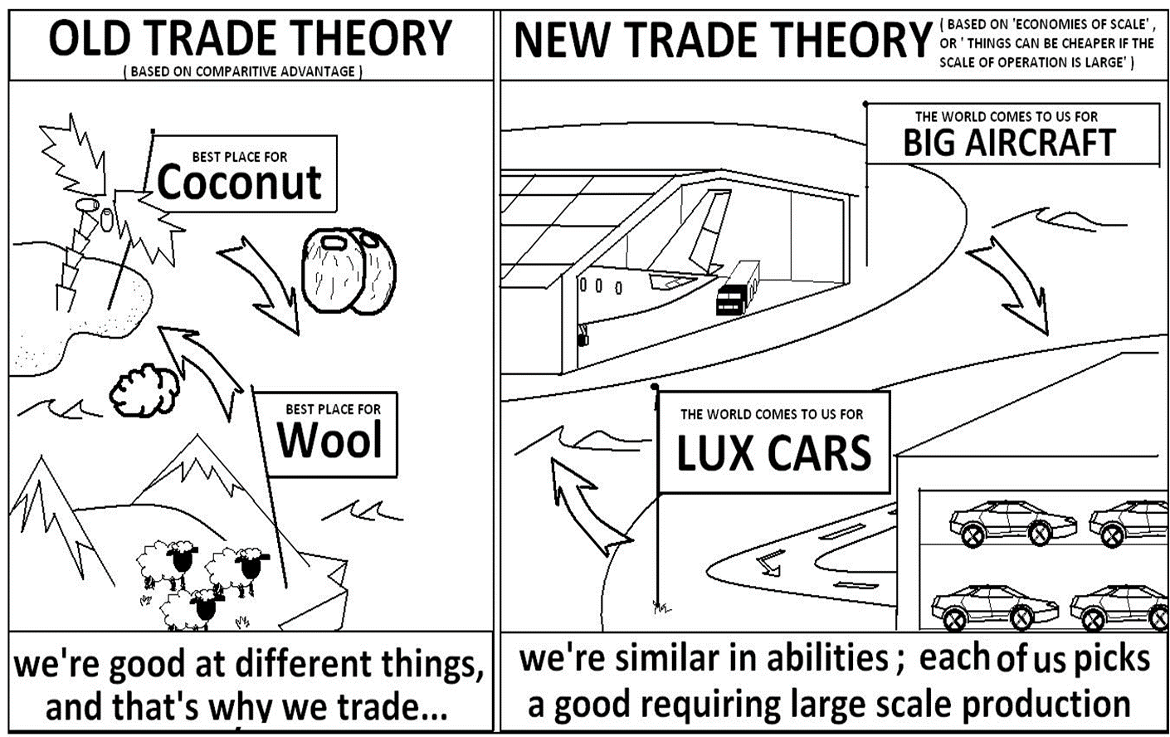
Beyond Comparative Advantage

Slide 2
Introduction:
More Reasons to Trade
Trade models built exclusively on the idea of comparative advantage have a mixed record when it comes to predicting a country’s trade patterns.
It is exceedingly difficult to precisely measure a country’s comparative advantage
A large share of international trade is not based on comparative advantage.

Slide 3

Intra-industry and Inter-industry Trade
Intra-industry trade: International trade of products made within the same industry (steel-for-steel, bread-for-bread)
Intra-industry trade is growing increasingly important in international trade especially between industrial countries
Inter-industry trade: International trade of products between two different industries (steel-for-bread)

Slide 4
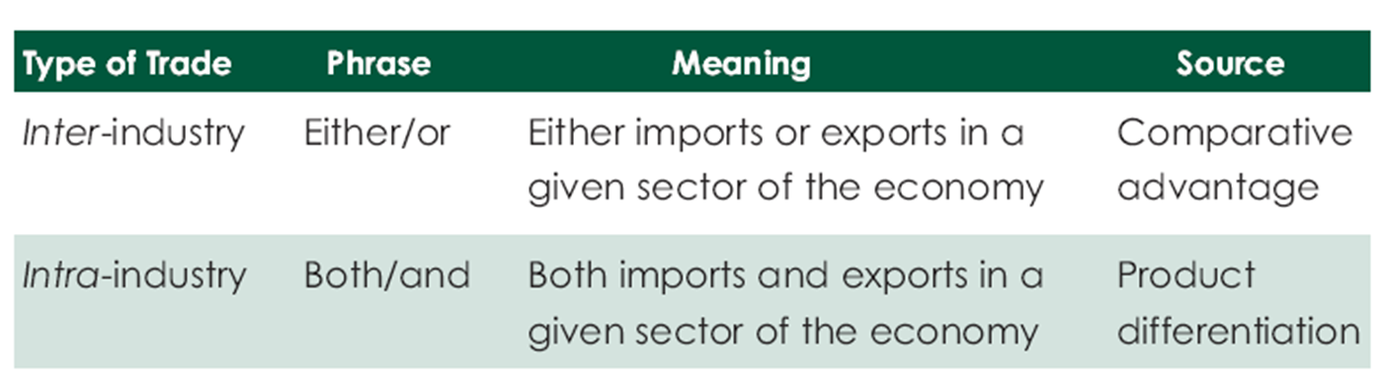
Intra-industry and Inter-industry Trade

Slide 5
Characteristics of Intra-industry Trade Once Again
Intra-industry trade between industrial countries is common
Fundamental problem is defining an industry.
For example, if computers are defined as office machinery, then computers and pencil sharpeners are in the same industry,
More broadly an industry is defined, the more trade appears to be intra-industry
Evidence suggests that intra-industry trade is greater
  in high technology industries
  where there is more scope for product differentiation
  in countries more open to trade
  in nations that have received larger amounts of foreign direct investment

Slide 6
The Gains from
Intra - industry Trade
Lower prices: An increase in the size of the market allows for scale economies, which lowers production costs and eventually prices to consumers
Increase in the number of firms: There is a high likelihood that intra industry trade expands the number of domestic firms and the quantity of domestic output
Increase in consumer choices: Intra-industry trade tends to give access to a much greater variety of goods than produced domestically

Slide 7
Trade and Geography
Two fundamental links exist between trade and geography:
  A place may pull in economic activity because it is close to a market (cities are low cost for expansion)
  A place may offer firms the opportunity to find critical inputs (skilled labor)

Slide 8
Geography, Transportation Costs, and Internal Economies of Scale
For most manufactured goods, it is not practical to produce next to each market due to economies of scale (producing cars next to dealerships)
Not all types of manufacturing have same level of transportation costs (presence of scale economies makes near market production impractical)
Most foreign investment today is directed towards high income countries (to access larger markets), not developing countries
All else equal, lower transportation costs often outweigh other costs that might be higher (southward shift of U.S. car manufacturing to be closer to final assemblers)

Slide 9
External Economies of Scale
External economies of scale occur when firms become more productive as the number of firms in an industry increases
  If a firm in a region produce similar products, they will benefit from knowledge spillovers
  When the presence of a large number of producers in one area creates a deep labor market for specialized skills
  If an area holds a dense network of input suppliers, manufacturers locate near the suppliers

Slide 10
Trade and External Economies
Geographical concentration may be self-reinforcing:
For example, as firms attract skilled workers or specialized input suppliers, the increased availability of high-quality inputs creates feedback leading to more firms in the same industry locating in the area.

Slide 11
Industrial Policy
Industrial policy: A government’s policy designed to create new industries or support existing industries
  industrial policies are controversial
  in some cases they clearly are politically motivated and end up wasting huge amounts of money.

Slide 12
Industrial Policy Tools
Common practices used by governments in some newly industrializing countries:
sell foreign exchange to targeted firms at below-market prices
provide government loans to private firms at below-market interest rates
provide government guarantees on loans obtained from the private sector
governments provide special tax treatment to targeted industries

Slide 13
Industrial Policy Tools
Governments use their own purchases as a way to develop an industry.
firms are guaranteed a profit on the development of new products
Governments often support industries by encouraging firms to work together, either
  through the direct funding of the research done by consortia and/or
  through the relaxation of antitrust laws.

Slide 14
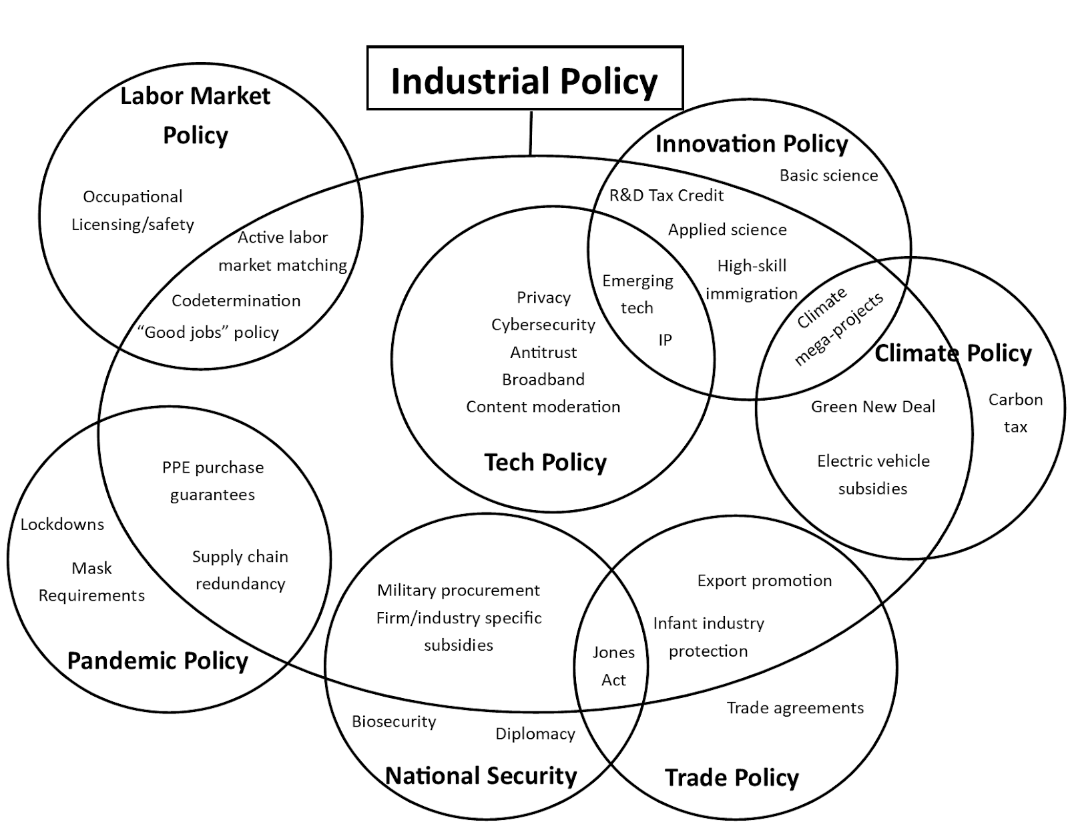

Slide 15
Industrial Policies Example from USA
Export-Import Bank (Eximbank)
  Independent agency of the U.S. government
  Guarantees of working capital loans for U.S. exporters to cover pre-export costs
  Export credit insurance that protects U.S. exporters or their lenders against commercial or political risks of nonpayment by foreign buyers
  Guarantees of commercial loans to creditworthy foreign buyers of U.S. goods and services
  Direct loans to these foreign buyers when private financing is unavailable
  Special programs to promote U.S. exports of environmentally beneficial goods and services
  Asset-based financing for large commercial aircraft and other appropriate exports
  Project financing to support U.S. exports to international infrastructure projects

Slide 16
Problems with Industrial Policies
A basic problem is that it is difficult to obtain the information necessary to measure the extent of market failure.
Second problem is determining which industry to target.
Industrial policies encourage rent seeking.
Rent seeking: An activity, such as lobbying, by individuals, firms, or special interests to alter the distribution of income in their favor

Slide 17
Problems with Industrial Policies
Opponents of industrial policies:
Sound macroeconomic policies,
High rates of saving and investment, and
High levels of schooling were the keys to success, not industrial policies
Proponents:
Opponents reasoning is ideological

Slide 18

New Trade Theory
New trade theory suggests that the ability of firms to gain economies of scale (unit cost reductions associated with a large scale of output) can have important implications for international trade
Countries may specialize in the production and export of particular products because in certain industries, the world market can only support a limited number of firms
  new trade theory emerged in the 1980s
  Paul Krugman won the Nobel prize for his work in 2008

Slide 19
What Are The Implications Of
New Trade Theory For Nations?
Nations may benefit from trade even when they do not differ in resource endowments or technology
  a country may dominate in the export of a good simply because it was lucky enough to have one or more firms among the first to produce that good
Governments should consider strategic trade policies that nurture and protect firms and industries where first mover advantages and economies of scale are important

Slide 20
What Is Porter’s Diamond Of Competitive Advantage?
Michael Porter (1990) tried to explain why a nation achieves international success in a particular industry
Porter identified four attributes that promote or impede the creation of competitive advantage
  Factor endowments
  Demand conditions
  Relating and supporting industries
  Firm strategy, structure, and rivalry

Slide 21
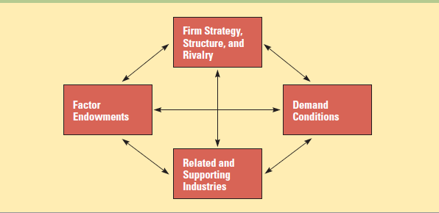
What Is Porter’s Diamond Of Competitive Advantage?
Determinants of National Competitive Advantage: Porter’s Diamond

Slide 22
Does Porter’s Theory Hold?
Government policy can
  affect demand through product standards
  influence rivalry through regulation and antitrust laws
  impact the availability of highly educated workers and advanced transportation infrastructure.
The four attributes, government policy, and chance work as a reinforcing system, complementing each other and in combination creating the conditions appropriate for competitive advantage
  So far, Porter’s theory has not been sufficiently tested to know how well it holds up

Slide 23


Slide 24

Thoughts?

