Slide 1

ECON 243 – International Trade
Chapter 6 – Increasing Returns to Scale and Monopolistic Competition
© 2021 Worth Publishers International Economics, 5e | Feenstra/Taylor
1

Slide 2
Questions to Consider
Why do countries export and import similar goods?
How much do consumers benefit from having products available from many countries?
Do all firms gain from having access to larger markets?

Slide 3
TABLE 6-1 U.S. Imports and Exports of Golf Clubs, 2018
This table shows the value, quantity, and average price for golf clubs imported into and exported from the United States. Many of the same countries both sell golf clubs to and buy golf clubs from the United States, illustrating what we call intra-industry trade.
Rank | Country | Value of Imports ($ thousands) | Quantity of Golf Clubs (thousands) | Average Price ($/club)
1 | China | $293,890 | 9,441 | $31
2 | Mexico | 82,312 | 1,644 | 50
3 | Vietnam | 22,839 | 833 | 27
4 | Japan | 11,709 | 106 | 111
5 | Taiwan | 9,960 | 131 | 76
6 | Canada | 528 | 5.2 | 101
7 | Hong Kong | 503 | 6.6 | 76
8 | Thailand | 168 | 1.9 | 89
9 | United Kingdom | 159 | 2.1 | 76
10 | South Korea | 67 | 1.5 | 44
11 | Australia | 24 | 0.1 | 162
12 | Germany | 16 | 0.3 | 49
13-20 | Various countries | 47 | 0.6 | 83
 | All 20 countries | 422,222 | 12,174 | 35

Slide 4
Introduction
Why does the United States export and import golf clubs to and from the same countries?
To answer this question, we introduce a new explanation for trade based on the model of monopolistic competition.
In perfectly competitive markets, the goods produced are homogeneous. In this chapter, we assume that goods are differentiated, and we allow for imperfect competition.

Slide 5
Introduction
In this chapter we examine:
The basics of the monopolistic competition model
How consumer choices and prices are affected under monopolistic competition when trade opens between two countries
The gains from international trade under monopolistic competition
The gains and adjustment costs for Mexico and the United States under NAFTA
The gravity equation, which states that countries with higher GDP, or that are close, will trade more

Slide 6
Introduction
Most goods are differentiated goods; that is, they are not identical.
When we allow for imperfect competition, firms can influence the prices they charge.
Monopolistic competition has two key features:
The goods produced by different firms are differentiated.
Firms enjoy increasing returns to scale, by which we mean that the average costs for a firm fall as more output is produced.

Slide 7
Introduction
Intra-industry trade deals with imports and exports in the same industry.
Large countries (as measured by their GDP) should trade the most. This is the prediction of the gravity equation.
The monopolistic competition model also helps us to understand the effects of free-trade agreements, in which free trade occurs among a group of countries.
Next, we will compare and contrast the cases of monopoly and duopoly, specifically, the demand characteristics in each type of market.

Slide 8
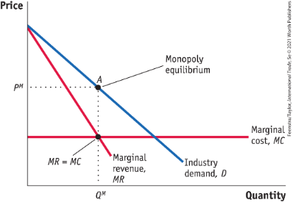
Basics of Imperfect Competition
Monopoly Equilibrium - The extra revenue earned from selling one more unit is called the marginal revenue. FIGURE 6-1
Monopoly Equilibrium
The monopolist chooses the profit-maximizing quantity, Q^{M}, at which marginal revenue equals marginal cost.
From that quantity, we trace up to the demand curve and over to the price axis to see that the monopolist charges the price P^{M}.
The monopoly equilibrium is at point A.

Slide 9
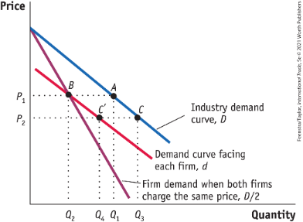
Basics of Imperfect Competition (Identical Goods)
Demand with Duopoly - FIGURE 6-2 Demand Curves with Duopoly
When there are two firms in the market and they both charge the same price, each firm faces the demand curve D/2.
At the price P₁, the industry produces Q₁ at point A and each firm produces Q₂ = Q₁/2 at point B.
If both firms produce identical products and one firm lowers its price to P₂, all consumers will buy from that firm only; the firm that lowers its price will face the demand curve, D and sell Q₃ at point C.

Slide 10
Discussion (Identical goods)
Notice that d is flatter than D/2; at any particular quantity, d is more elastic than D/2.
In particular, at the point where d and D/2 intersect, d is more elastic than D/2. If the competitor held its price constant, then the firm that lowered its price could increase its market share at the expense of the competitor.
But! The two firms are identical, so they behave exactly alike (independently, identically, and concurrently), and always set the same price. Thus, equilibrium price and quantity will always be on the D/2 demand curve. We could refer to the D/2 demand curve as each firm’s market share demand curve.

Slide 11
Basics of Imperfect Competition (Differentiated Goods)
Demand with Duopoly - FIGURE 6-2 Demand Curves with Duopoly
Alternatively, if the products are differentiated, the firm that lowers its price will take some, but not all, sales from the other firm; it will face the demand curve, d, and at P₂ it will sell Q₄ at point C′.

Slide 12
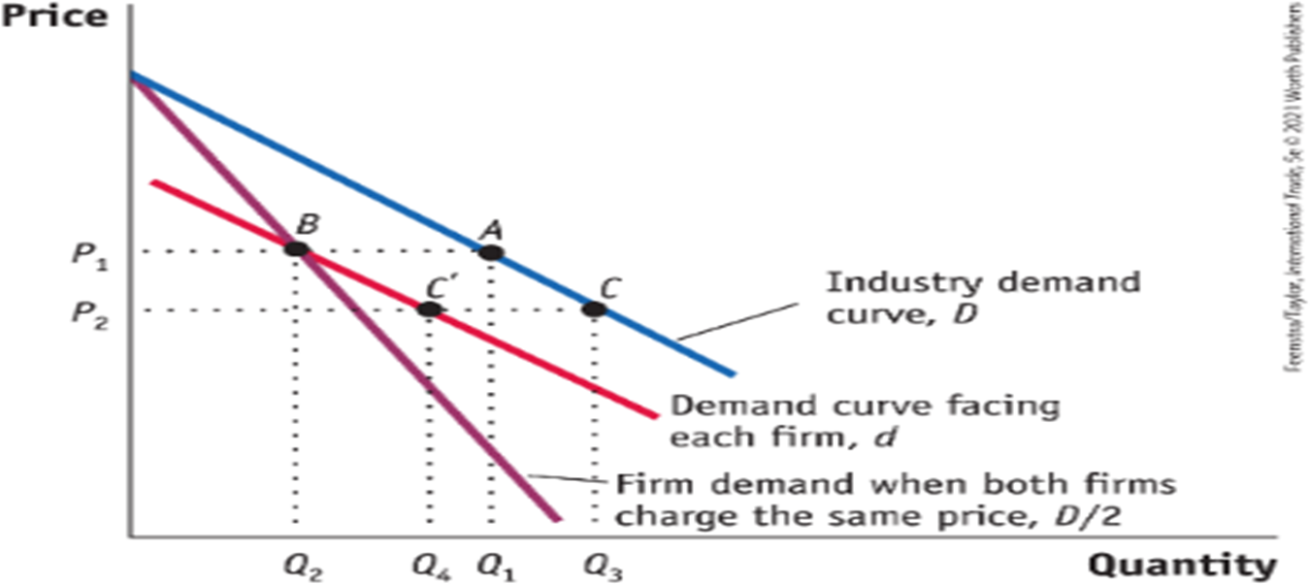
Myopic Demand Curve
Let’s refer to the red demand curve labeled d as the firm’s “myopic” or “naïve” demand curve.
This is the demand curve it believes it faces if the other firm’s price is held constant.
It is as if the firm were oblivious of the presence of its competitor and equally oblivious of D/2.

Slide 13
Trade Under Monopolistic Competition
Assumptions of the model of monopolistic competition:
Assumption 1: Each firm produces a good that is similar to but differentiated from the goods that other firms in the industry produce.
Each firm faces a downward-sloping demand curve for its product and has some control over the price it charges.
Assumption 2: There are many firms in the industry.
If the number of firms is N, then D/N is the share of demand that each firm faces when the firms are all charging the same price.
When only one firm lowers its price, however, it will face a flatter demand curve d.

Slide 14
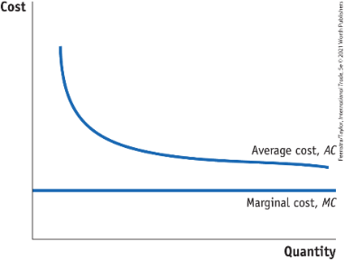
Trade Under Monopolistic Competition
Assumption 3: Firms produce using a technology with increasing returns to scale. FIGURE 6-3
Increasing Returns to Scale This diagram shows the average cost, AC, and marginal cost, MC, of a firm.
Increasing returns to scale cause average costs to fall as the quantity produced increases.
Marginal cost is below average cost and is drawn as constant for simplicity.

Slide 15
Trade Under Monopolistic Competition
Numerical Example of Increasing Returns to Scale TABLE 6-2
Cost Information for the Firm This table illustrates increasing returns to scale, in which average costs fall as quantity rises.
Quantity Q | Variable Costs = Q · MC (MC = $10) | Total Costs = Variable Costs + Fixed Costs (FC = $100) | Average Costs = Total Costs/Quantity
10 | $100 | $200 | $20
20 | 200 | 300 | 15
30 | 300 | 400 | 13.3
40 | 400 | 500 | 12.5
50 | 500 | 600 | 12
100 | 1,000 | 1,100 | 11
Large Q | 10 · Q | 10 · Q + 100 | Close to 10
Whenever the price charged is above average costs, then a firm earns monopoly profits.

Slide 16
Trade Under Monopolistic Competition
Assumption 4: Because firms can enter and exit the industry freely, monopoly profits are zero in the long run.
Firms will enter as long as it is possible to make monopoly profits, and the more firms that enter, the lower profits per firm become.
Profits for each firm end up as zero in the long run, just as in perfect competition.

Slide 17
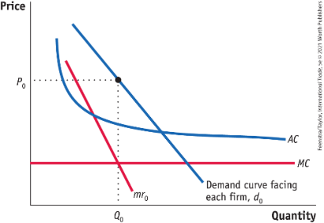
Equilibrium Without Trade Under Monopolistic Competition
Equilibrium Without Trade - Short-Run Equilibrium FIGURE 6-4
Short-Run Monopolistic Competition Equilibrium Without Trade The short-run equilibrium under monopolistic competition is the same as a monopoly equilibrium. The firm chooses to produce the quantity Q₀ at which the firm’s marginal revenue, mr₀, equals its marginal cost, MC. The price charged is P₀. Because price exceeds average cost, the firm makes a monopoly profit.

Slide 18
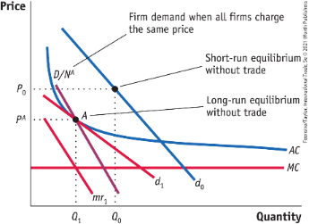
Equilibrium Without Trade Under Monopolistic Competition
Equilibrium Without Trade - Long-Run Equilibrium FIGURE 6-5
Drawn by the possibility of making profits in the short-run equilibrium, new firms enter the industry and the firm’s demand curve, d₀, shifts to the left and becomes more elastic (i.e., flatter), shown by d₁.
The long-run equilibrium under monopolistic competition occurs at the quantity Q₁ where the marginal revenue curve, mr₁ (associated with demand curve d₁), equals marginal cost.
At that quantity, the no-trade price, P^{A}, equals average costs at point A.

Slide 19
Equilibrium Without Trade Under Monopolistic Competition
Equilibrium Without Trade - Long-Run Equilibrium FIGURE 6-5
In the long-run equilibrium, firms earn zero monopoly profits and there is no entry or exit. The quantity produced by each firm is less than in short-run equilibrium (Figure 6-4). Q₁ is less than Q₀ because new firms have entered the industry.
With a greater number of firms and hence more varieties available to consumers, the demand for each variety d₁ is less then d₀. The demand curve D/N^{A} shows the no-trade demand when all firms charge the same price.

Slide 20

A Closer View

Slide 21
Trade Under Monopolistic Competition
Equilibrium with Free Trade
Short-Run Equilibrium with Trade
Assume Home and Foreign are exactly the same.
Same number of consumers, same technology and cost curves, same number of firms in the no-trade equilibrium.
Without economies of scale, there would be no reason for trade. Similarly:
Under the Ricardian model, countries with identical technologies would not trade (no trade relative prices would be equal).
Under the Heckscher–Ohlin model, countries with identical factor endowments would not trade. (no trade relative prices would be equal).
Under monopolistic competition, two identical countries will still engage in trade!

Slide 22
Trade Under Monopolistic Competition
Equilibrium with Free Trade
Short-Run Equilibrium with Trade
The number of firms in the no-trade equilibrium in each country is N^{A}. The quantity demanded from each firm when all firms charge the same price is D/N^{A}.
First, we will consider each country in long-run equilibrium without trade.
When trade opens, the number of customers doubles.
Since there are twice as many consumers, but also twice as many firms, the ratio stays the same.
The product varieties also double.
With the greater number of varieties available, the demand for each individual variety will be more elastic.

Slide 23
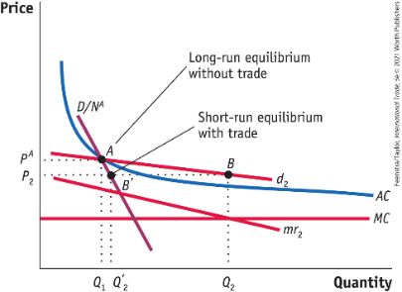
Trade Under Monopolistic Competition
Equilibrium with Free Trade - FIGURE 6-6 - Short-Run Monopolistic Competition Equilibrium with Trade
When trade is opened, the larger market makes the firm’s demand curve more elastic, as shown by d₂ (with marginal revenue curve, mr₂).
The firm chooses to produce the quantity Q₂ at which marginal revenue equals marginal costs, corresponding to a price of P₂.
With sales Q₂ at price P₂, the firm makes monopoly profits since price is greater than AC.

Slide 24
Trade Under Monopolistic Competition
Equilibrium with Free Trade - FIGURE 6-6 - Short-Run Monopolistic Competition Equilibrium with Trade
When all firms lower their prices to P₂, however, the relevant demand curve is D/N^{A}, which indicates that they can sell only Q′₂ at price P₂.
At this short-run equilibrium (point B′), price is less than average cost and all firms incur losses.
As a result, some firms are forced to exit the industry.

Slide 25

A Closer Look

Slide 26
Trade Under Monopolistic Competition
Equilibrium with Free Trade
Long-Run Equilibrium with Trade
Since firms are making losses, some of them will exit the industry.
Firm exit will increase demand for the remaining firms’ products and decrease the available product varieties to consumers.
We now have N^{T} firms (number of firms in each country after trade), which is fewer than the N^{A} firms we had before trade.
The new demand D/N^{T} lies to the right of D/N^{A}.
D/N^{T} > D/N^{A}.

Slide 27
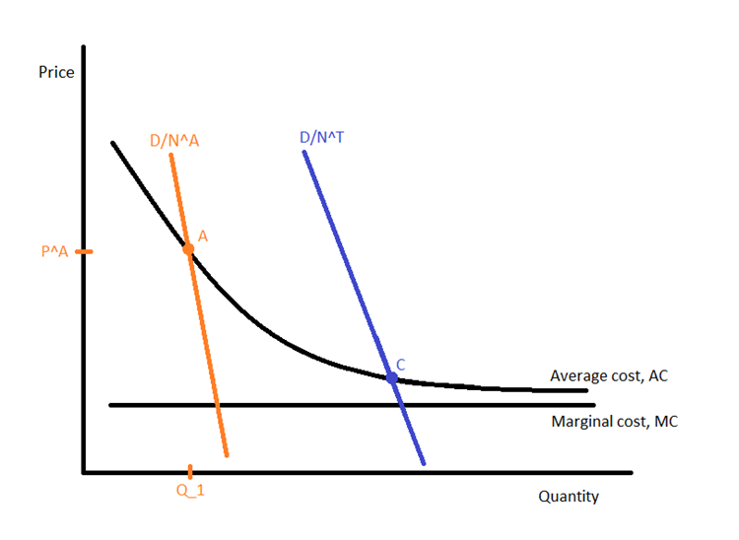
Slope of Market Share Line with Trade Flatter Since D/N^{T} > D/N^{A}.

Slide 28
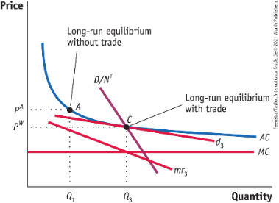
Trade Under Monopolistic Competition
Equilibrium with Free Trade - FIGURE 6-7 - Long-Run Monopolistic Competition Equilibrium with Trade
The long-run equilibrium with trade occurs at point C.
At this point, profits are maximized for each firm producing Q₃ (which satisfies mr₃ = MC) and charging price P^{W} (which equals AC). Since monopoly profits are zero when price equals average cost, no firms enter or exit the industry.

Slide 29
Trade Under Monopolistic Competition
Equilibrium with Free Trade - FIGURE 6-7 - Long-Run Monopolistic Competition Equilibrium with Trade
Compared with the long-run equilibrium without trade (Figure 6-5), d₃ (along with mr₃) has shifted out as domestic firms exited the industry and has become more elastic due to the greater total number of varieties with trade, 2N^{T} > N^{A}.
Compared with the long-run equilibrium without trade at point A, the trade equilibrium at point C has a lower price and higher sales by all surviving firms.

Slide 30

A Closer Look
Greater total number of varieties with trade,
2N^{T} > N^{A}.

Slide 31
Long-Run
It must be that:

Slide 32
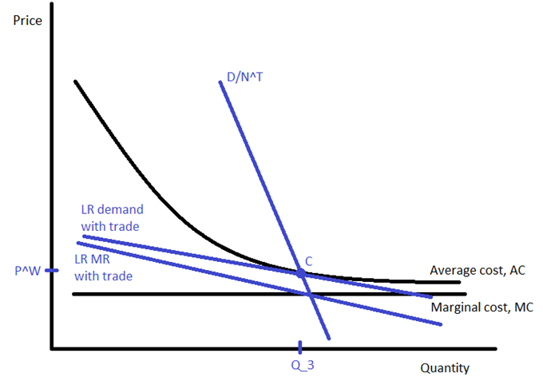
Long-run Equilibrium with Trade

Slide 33
Trade Under Monopolistic Competition
Equilibrium with Free Trade
Gains from Trade
The long-run equilibrium at point C has two sources of gains from trade for consumers:
A drop in price
The lower price is a result of the increased productivity of the surviving firms coming from increasing returns to scale.
An increase in variety
Although there are fewer product varieties made within each country (by fewer firms), consumers have more product variety because they can choose products of the firms from both countries after trade.

Slide 34
Trade Under Monopolistic Competition
Equilibrium with Free Trade
Adjustment Costs from Trade
There are adjustment costs associated with monopolistic competition, as some firms shut down or exit the industry.
Workers in those firms experience a spell of unemployment.
Over the long run, however, we could expect those workers to find new jobs, so we view these costs are temporary.
There are both short-run and long-run adjustment costs.

Slide 35
Intra-Industry Trade and the Gravity Equation
The index of intra-industry trade tells us what proportion of trade in each product involves both imports and exports:
A high index (up to 100%) indicates that an equal amount of the good is imported and exported.
A low index (0%) indicates that the good is either imported or exported but not both.
$$\left(Index of intra−industry trade=\frac{Minimum of imports and exports}{\frac{1}{2}\left(Imports+exports\right)}\right)$$

Slide 36
Intra-Industry Trade and the Gravity Equation
Index of Intra-Industry Trade - TABLE 6-5
Product | Value of Imports ($ millions) | Value of Exports ($ millions) | Index of Intra- Industry Trade (%)
Natural gas | $6,546 | $4,551 | 82%
Whiskey | 2,157 | 1,360 | 77
Vaccines | 5,754 | 2,364 | 58
Telephones | 273 | 90 | 50
Golf clubs | 422 | 140 | 50
Mattresses | 413 | 106 | 41
Apples | 241 | 940 | 41
Golf carts | 35 | 137 | 41
Sunglasses | 1,657 | 399 | 39
Frozen orange juice | 10 | 2 | 33
Small cars | 106,478 | 17,394 | 28
Large passenger aircraft | 4,400 | 187,477 | 5
Men’s shorts | 1,172 | 26 | 4

Slide 37
Intra-Industry Trade and the Gravity Equation
The Gravity Equation
Dutch economist and Nobel laureate Jan Tinbergen was trained in physics and thought about comparing the trade between countries to the force of gravity between objects.
In physics, objects with a larger mass, or those that are close together, have greater gravitational pull between them.
In economics, the gravity equation for trade states that countries with larger GDPs, or that are close to each other, will have more trade between them.

Slide 38
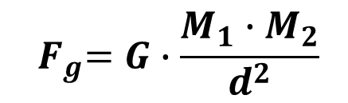

Intra-Industry Trade and the Gravity Equation
The Gravity Equation
Newton’s Universal Law of Gravitation
Suppose you have two objects with masses M₁ and M₂ and they are located distance d apart.
The force of gravity between two masses is:
$${ F}_{g}=G∙\frac{M_{1}∙M_{2}}{d^{2}}$$
The larger the objects are or the closer they are, the greater the force of gravity between them.
In the case of trade, the larger the two countries are, or the closer they are, the greater the amount of trade.
The Gravity Equation in Trade
$Trade=B∙\frac{{GDP}_{1}∙{GDP}_{2 } }{{dist}^{n}}$ (B is a constant)

Slide 39
Intra-Industry Trade and the Gravity Equation
The Gravity Equation
The gravity equation has important implications for the monopolistic competition model with trade.
Larger countries export more because they produce more product varieties, and they import more because their demand is higher.
The demand for Country 1’s goods depends on:
The relative size of the importing country
The distance between the two countries
To measure the relative size of a country, we use its share of world GDP: Share₂ = GDP₂/GDP_{W}

Slide 40
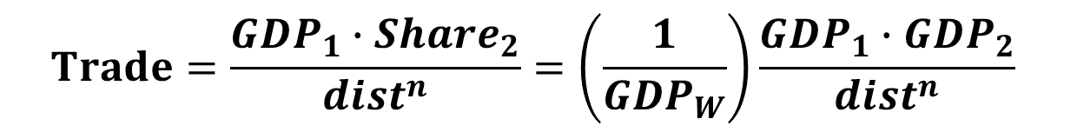
Deriving the Gravity Equation
To derive the gravity equation, we assume that each country produces a differentiated product to apply the monopolistic competition model.
With a differentiated product, the import demand for goods produced by Country 1 depends on (1) the relative size of the importing country and (2) the distance between the two countries.
The relative size of the importing country (Country 2) is measured by its GDP as compared with the rest of the world.
The distance between the two countries provides a measure for the transportation costs associated with exporting the good from one country to another.
Using the distance between Country 1 and Country 2 raised to a power, or dist ^{n}, we see that the exports from the former to the latter are equal to the following equation:
$$Trade=\frac{{GDP}_{1}∙{Share}_{2}}{{dist}^{n}}=\left(\frac{1}{{GDP}_{W}}\right)\frac{{GDP}_{1}∙{GDP}_{2}}{{dist}^{n}}$$
By denoting the term (1/GDPW) as a constant term, B, we have the gravity equation.

Slide 41
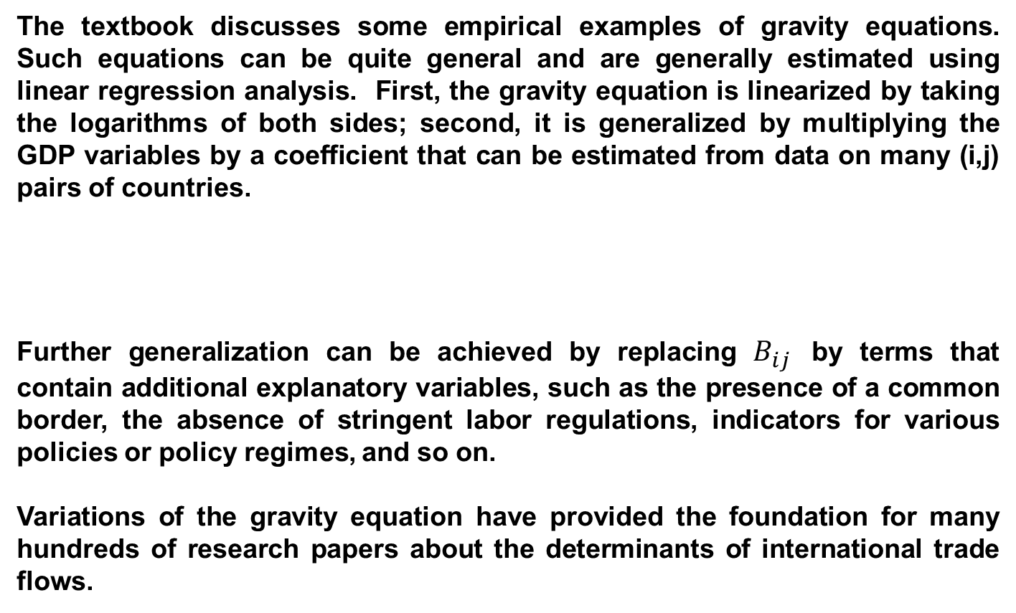
Estimating the Gravity Equation
The textbook discusses some empirical examples of gravity equations. Such equations can be quite general and are generally estimated using linear regression analysis. First, the gravity equation is linearized by taking the logarithms of both sides; second, it is generalized by multiplying the GDP variables by a coefficient that can be estimated from data on many (i,j) pairs of countries.
Further generalization can be achieved by replacing $B_{ij}$ by terms that contain additional explanatory variables, such as the presence of a common border, the absence of stringent labor regulations, indicators for various policies or policy regimes, and so on.
Variations of the gravity equation have provided the foundation for many hundreds of research papers about the determinants of international trade flows.

Slide 42
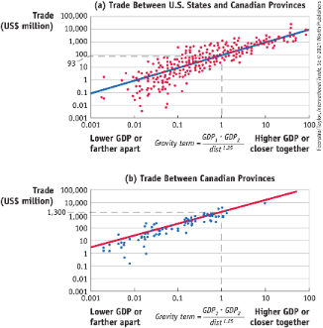
APPLICATION: The Gravity Equation for Canada and the United States
FIGURE 6-9 Gravity Equation for the United States and Canada, 1993
Plotted in these figures are the dollar value of exports in 1993 and the gravity term (plotted in log scale). Panel (a) shows these variables for trade between 10 Canadian provinces and 30 U.S. states. When the gravity term is 1, for example, the amount of trade between a province and state is $93 million.

Slide 43
APPLICATION: The Gravity Equation for Canada and the United States
FIGURE 6-9 Gravity Equation for the United States and Canada, 1993
Panel (b) shows these variables for trade between 10 Canadian provinces. When the gravity term is 1, the amount of trade between the provinces is $1.3 billion, 14 times larger than between a province and a state. These graphs illustrate two important points: there is a positive relationship between country size (as measured by GDP) and trade volume, and there is much more trade within Canada than between Canada and the United States.

Slide 44
APPLICATION: The Gravity Equation for Canada and the United States
If trade across borders happens to be less than trade within countries, there must be barriers to trade between those countries.
Factors that make it easier or more difficult to trade goods between countries are often called border effects, and they include the following:
Taxes imposed when imported goods enter into a country: tariffs
Limits on the number of items allowed to cross the border: quotas
Other administrative rules and regulations affecting trade, including the time required for goods to clear customs
Geographic factors such as whether the countries share a border
Cultural factors such as whether the countries have a common language that might make trade easier

Slide 45
Conclusions
When firms have differentiated products and increasing returns to scale, the potential exists for gains from trade above and beyond those under perfect competition.
The model of monopolistic competition shows that trade will occur between countries even if these countries are identical.
There is trade within the same industries across countries because there is a potential to sell in a larger market.
This will induce firms to lower their prices below those charged in the absence of trade.
As firms exit, remaining firms increase their output, and average cost falls. Lower costs result in lower prices for consumers in the importing country.

Slide 46
Conclusions
Lower prices and higher product variety are the gains from trade under monopolistic competition.
When some firms have to exit the market, short-run adjustment costs arise due to worker displacement.
Examples from Canada, Mexico, and the United States demonstrated that the short-run adjustment costs are less than the long-run gains.
Regional trade agreements like NAFTA and the USMCA are a good application of the monopolistic competition model.
Another application is the “gravity equation.”
The gravity equation predicts that the larger two countries are, or the closer they are, the greater the amount of trade.

Slide 47
KEY POINTS
The monopolistic competition model assumes differentiated products, many firms, and increasing returns to scale. Firms enter whenever there are profits to be earned, so profits are zero in the long-run equilibrium.
When trade opens between two countries, the demand curve faced by each firm becomes more elastic, as consumers have more choices and become more price sensitive. Firms then lower their prices in an attempt to capture consumers from their competitors and obtain profits. When all firms do so, however, some firms incur losses and are forced to leave the market.

Slide 48
KEY POINTS
Introducing international trade under monopolistic competition leads to additional gains from trade for two reasons: (i) lower prices as firms expand their output and lower their average costs and (ii) additional imported product varieties available to consumers. There are also short-run adjustment costs, such as unemployment, as some firms exit the market.
The assumption of differentiated goods helps us to understand why countries often import and export varieties of the same type of good. That outcome occurs with the model of monopolistic competition.
The gravity equation states that countries with higher GDP, or that are close, will trade more. In addition, research has shown that there is more trade within countries than between countries.

