Slide 1
Chapter 8: Continuous Probability Distributions
Uniform
Normal
f (x)
f (x)
x
x

Slide 2
Introduction
This chapter completes our presentation of probability by introducing continuous random variables and their distributions, which are used to calculate the probability associated with an interval variable.
We introduce probability density functions and use the uniform density function to demonstrate how probability is calculated.
Later, we focus on the normal distribution, one of the most important distributions because of its role in the development of statistical inference.

Slide 3
Continuous Random Variable
A continuous random variable can assume an uncountable number of values, and differs from a discrete variable in several respects:
We cannot list the possible values of a continuous random variable because there is an infinite number of them.
Because there is an infinite number of values, the probability of each individual value is virtually 0.
Thus, we can only calculate the probability of a range of values.
The following requirements apply to a probability density function f(x) whose range is a ≤ x ≤ b.
f(x) ≥ 0 for all x between a and b.
The total area under the curve between a and b is 1.

Slide 4
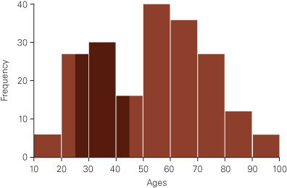
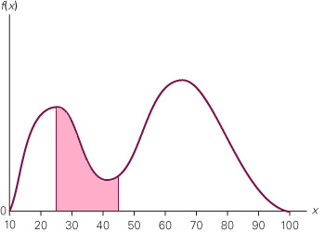
Probability Density Functions
Estimated Probability between 25 and 45 Years from the Histogram in Example 3.1
Probability Density Function (PDF) for Example 3.1
In Example 3.1, we could only estimate the relative frequency that an ACBL member is between 25 and 45 by multiplying base × height for each dark brown rectangle, knowing that the sample size is 200.
If we can determine a probability density function, which is essentially a smooth histogram drawn from a large population and made of infinite small rectangles, we can calculate the exact probability.

Slide 5
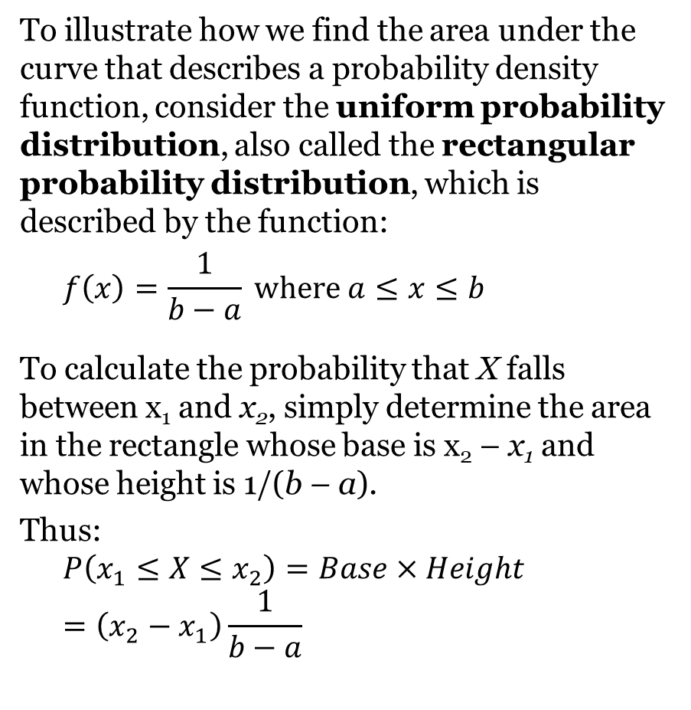
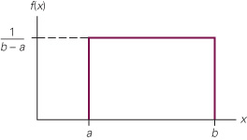
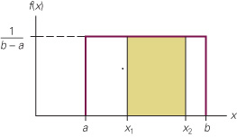
Uniform Distribution
Uniform Distribution
P(x₁ ≤ X ≤ x₂)

Slide 6
Uniform Probability Distribution
Expected Value of x
E(x) = (a + b)/2
Variance of x
Var(x) = (b - a)²/12
where: a = smallest value the variable can assume
b = largest value the variable can assume

Slide 7
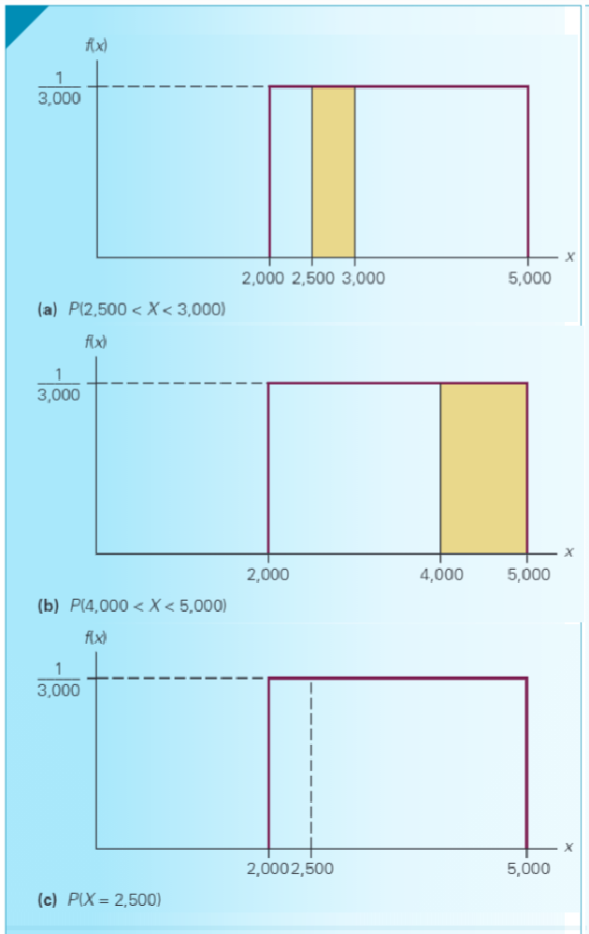
Uniformly Distributed Gasoline Sales
The amount of gasoline sold daily at a service station is uniformly distributed between 2,000 and 5,000 gallons. Find the following:
Probability that daily sales fall between 2,500 and 3,000 gallons.
Probability that the service station sells at least 4,000 gallons.
Probability that the station sells exactly 2,500 gallons.

Slide 8
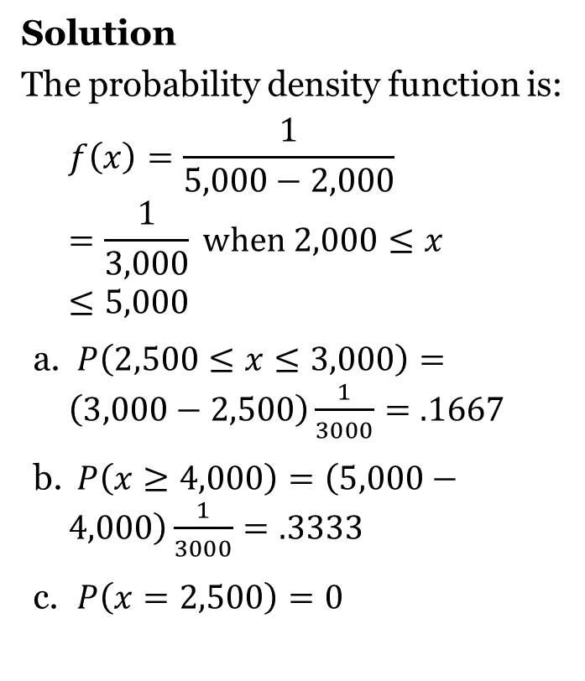
Example 8.1 – Uniformly Distributed Gasoline Sales

Slide 9
Uniform Probability Distribution Example
Slater buffet customers are charged for the amount of salad they take. Sampling suggests that the amount of salad taken is uniformly distributed between 5 ounces and 15 ounces.
Uniform Probability Density Function
f(x) = 1/10 for 5 < x < 15
= 0 elsewhere
where:
x = salad plate filling weight

Slide 10
Uniform Probability Distribution
Expected Value of x
E(x) = (a + b)/2
= (5 + 15)/2
= 10
Variance of x
Var(x) = (b - a)²/12
= (15 – 5)²/12
= 8.33

Slide 11
Uniform Probability Distribution
Uniform Probability Distribution for Salad Plate Filling Weight
f(x)
1/10
x
0
5
10
15
Salad Weight (oz.)

Slide 12
Uniform Probability Distribution
What is the probability that a customer will take between 12 and 15 ounces of salad?
f(x)
P(12 < x < 15) = 1/10(3) = .3
1/10
x
12
0
5
10
15
Salad Weight (oz.)

Slide 13
Uniform Probability Distribution
(Another Example)
Example: Flight time of an airplane traveling from Chicago to New York
Suppose the flight time can be any value in the interval from 120 minutes to 140 minutes.
Uniform Probability Density Function
f(x) = 1/20 for 120 < x < 140
= 0 elsewhere
where:
x = Flight time of an airplane traveling from Chicago to New York

Slide 14
Uniform Probability Distribution
Another Example
Expected Value of x
E(x) = (a + b)/2
= (120 + 140)/2
= 130
Variance of x
Var(x) = (b - a)²/12
= (140 – 120)²/12
= 33.33

Slide 15
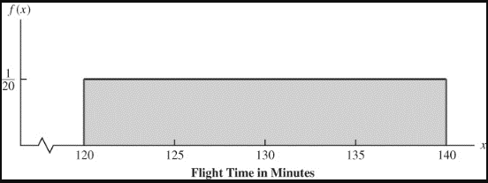
Uniform Probability Distribution
Example: Flight time of an airplane traveling from Chicago to New York

Slide 16
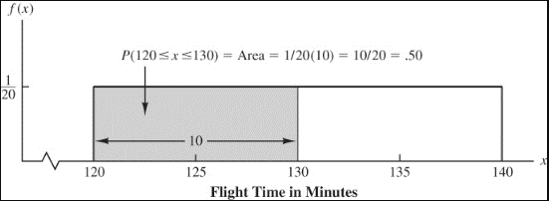
Uniform Probability Distribution
Example: Flight time of an airplane traveling from Chicago to New York
Probability of a flight time between 120 and 130 minutes
P(120 < x < 130) = 1/20(10) = .5

Slide 17
Area as a Measure of Probability
The area under the graph of f(x) and probability are identical.
This is valid for all continuous random variables.
The probability that x takes on a value between some lower value x₁ and some higher value x₂ can be found by computing the area under the graph of f(x) over the interval from x₁ to x₂.

Slide 18
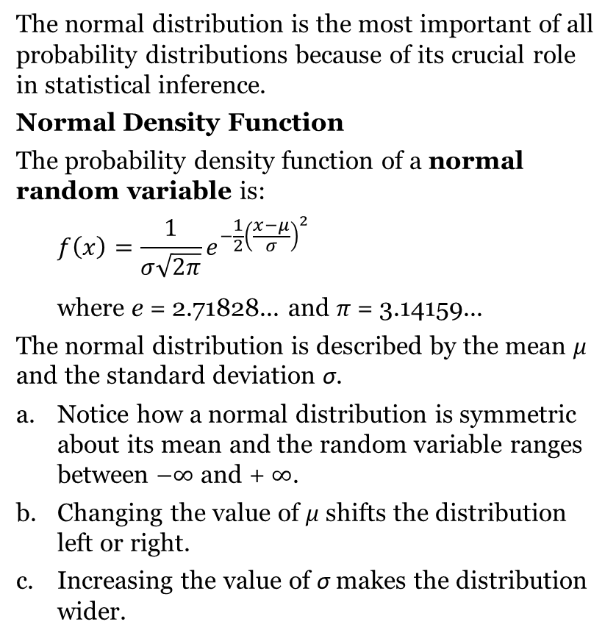
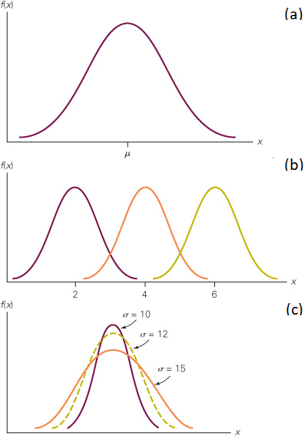
Normal Distribution

Slide 19
Normal Probability Distribution
Characteristics
The distribution is symmetric; its skewness
measure is zero.
x

Slide 20
Normal Probability Distribution
Characteristics
The entire family of normal probability distributions
is defined by its mean μ and its standard deviation σ .
Standard Deviation σ
x
Mean μ

Slide 21
Normal Probability Distribution
Characteristics
The highest point on the normal curve is at the
mean, which is also the median and mode.
x

Slide 22
Normal Probability Distribution
Characteristics
The mean can be any numerical value: negative,
zero, or positive.
x
-10
0
25

Slide 23
Normal Probability Distribution
Characteristics
The standard deviation determines the width of the
curve: larger values result in wider, flatter curves.
σ = 15
σ = 25
x

Slide 24
Normal Probability Distribution
Characteristics
Probabilities for the normal random variable are
given by areas under the curve. The total area
under the curve is 1 (.5 to the left of the mean and
.5 to the right).
.5
.5
x

Slide 25
Normal Probability Distribution
Characteristics (basis for the empirical rule)
of values of a normal random variable
are within of its mean.
68.26%
+/- 1 standard deviation
of values of a normal random variable
are within of its mean.
95.44%
+/- 2 standard deviations
of values of a normal random variable
are within of its mean.
99.72%
+/- 3 standard deviations

Slide 26
Normal Probability Distribution
Characteristics (basis for the empirical rule)
99.72%
95.44%
68.26%
x
μ
μ – 3σ
μ – 1σ
μ + 1σ
μ + 3σ
μ – 2σ
μ + 2σ

Slide 27
Standard Normal Probability Distribution
A random variable having a normal distribution with a mean of 0 and a standard deviation of 1 is said to have a standard normal probability distribution.
Characteristics
The letter z is used to designate the standard
normal random variable.
σ = 1
z
0

Slide 28
Standard Normal Probability Distribution
Converting to the Standard Normal Distribution
We can think of z as a measure of the number of
standard deviations x is from μ.

Slide 29
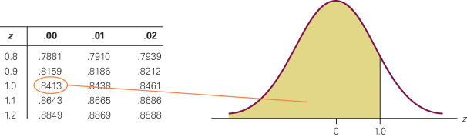
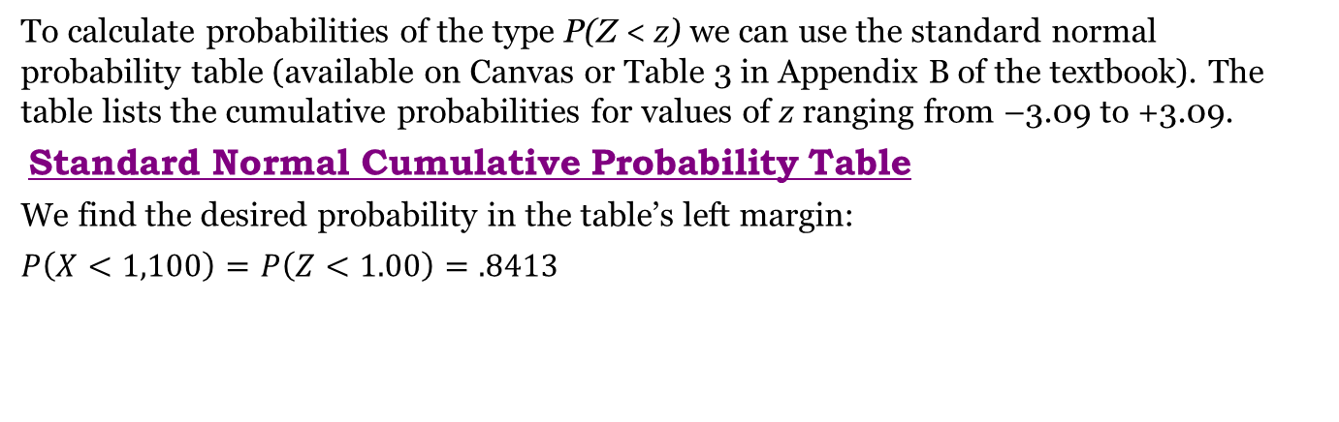
Example – Calculating Normal Probabilities
To calculate probabilities of the type P(Z < z) we can use the standard normal probability table (available on Canvas or Table 3 in Appendix B of the textbook). The table lists the cumulative probabilities for values of z ranging from –3.09 to +3.09.
Standard Normal Cumulative Probability Table
We find the desired probability in the table’s left margin:
$$P\left(X<1,100\right)=P\left(Z<1.00\right)=.8413$$

Slide 30
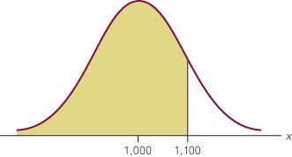
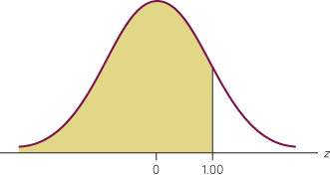
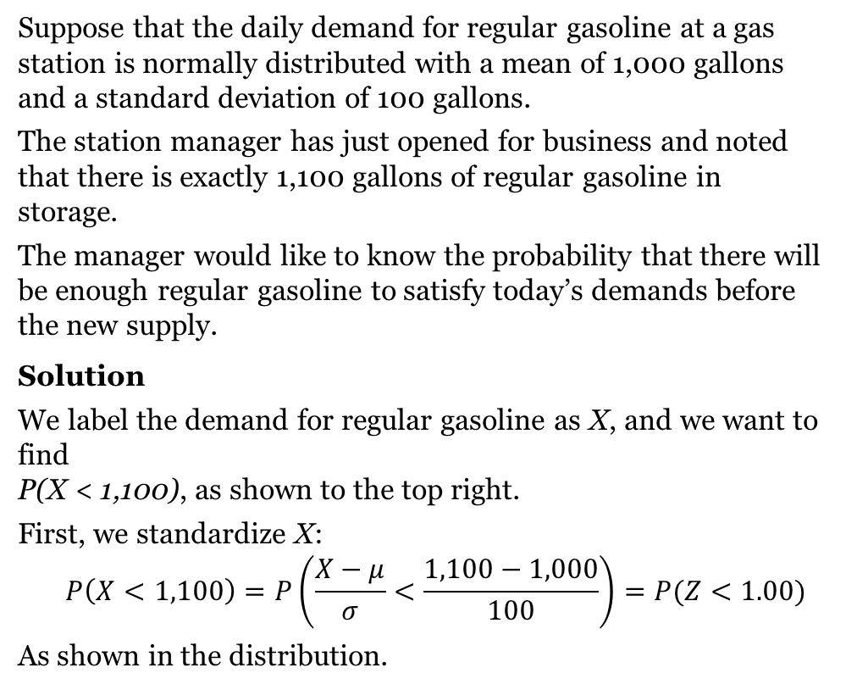
Example – Standardize the Normal Variable
Suppose that the daily demand for regular gasoline at a gas station is normally distributed with a mean of 1,000 gallons and a standard deviation of 100 gallons.
The station manager has just opened for business and noted that there is exactly 1,100 gallons of regular gasoline in storage.
The manager would like to know the probability that there will be enough regular gasoline to satisfy today’s demands before the new supply.
Solution
We label the demand for regular gasoline as X, and we want to find
P(X < 1,100), as shown to the top right.
First, we standardize X:
$$P\left(X<1,100\right)=P\left(\frac{X−μ}{σ}<\frac{1,100−1,000}{100}\right)=P(Z<1.00)$$
As shown in the distribution.
P(X < 1,100)
P(Z < 1.00)

Slide 31
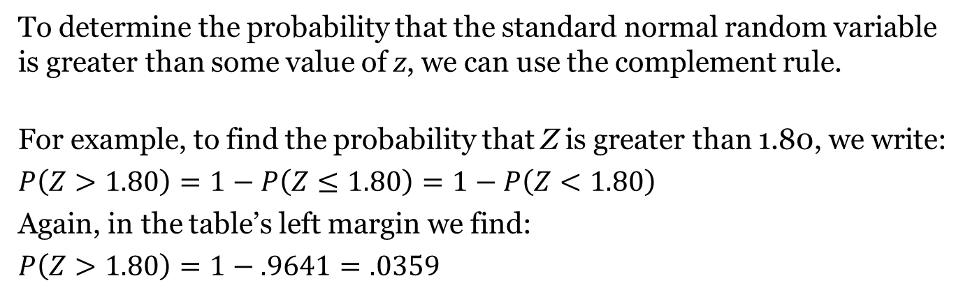
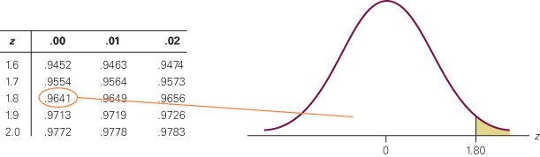
Calculating Probabilities

Slide 32
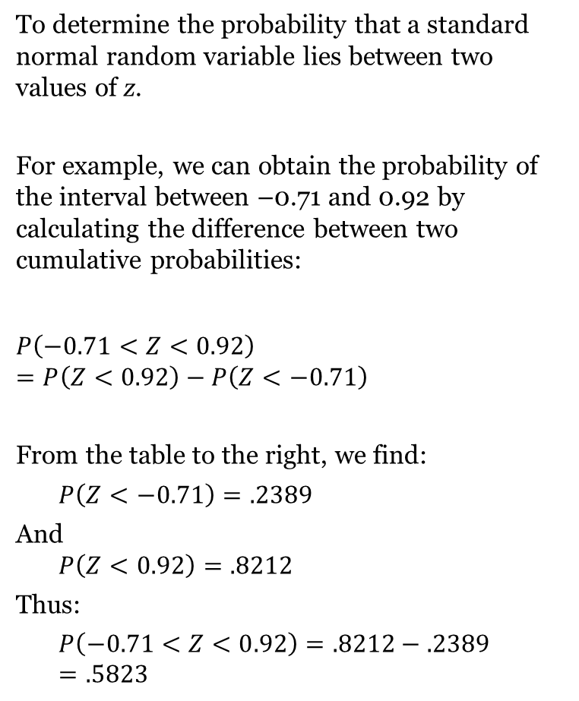
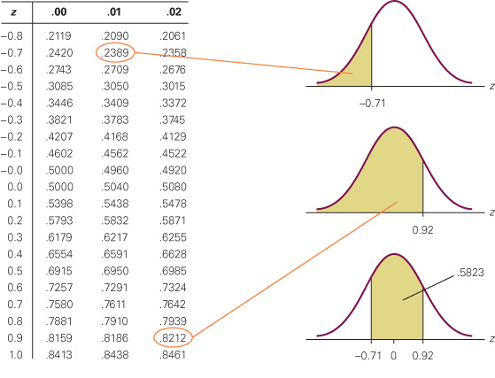
Probability of an Interval

Slide 33
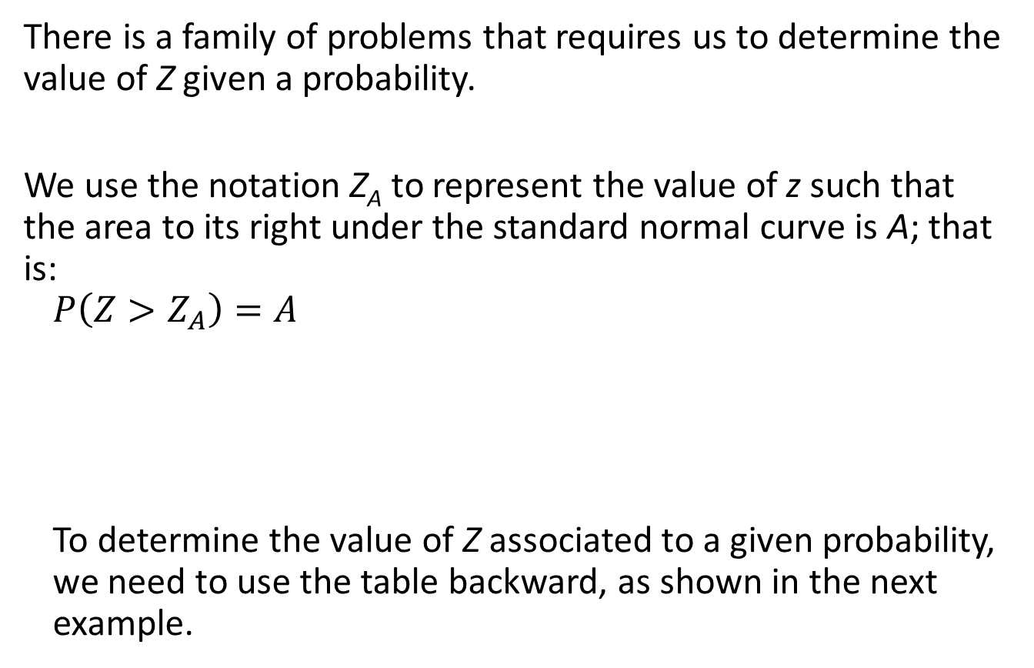
Finding Values of Z

Slide 34
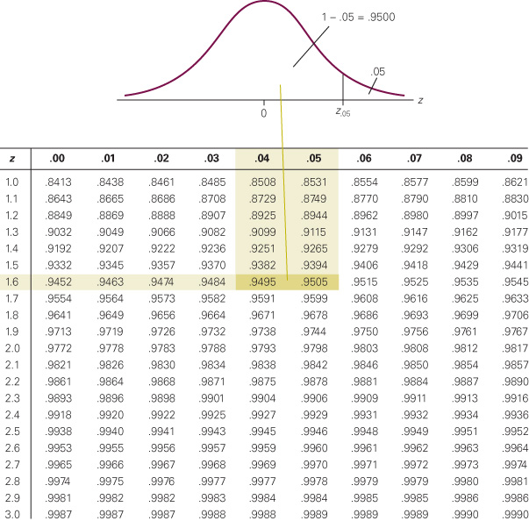
Finding Z for .05
Find the value of a standard normal random variable such that the probability that the random variable is greater than this quantity is 5% (Z_{.05}). P(Z > Z_{.05}) = 0.05
Solution
The probability that z is less than Z_{.05} must be
1 – .05 = .9500. To find Z_{.05}, we locate .9500 in the table.
As you can se from the figure to the right, there are two values of Z that are equally close: .9495 and .9505.
Those two probabilities correspond to the Z-values of 1.64 and 1.65, respectively.
Thus, we can say that: Z_{.05} = 1.645.

Slide 35
Finding the value of x
Question: Knowing that the mean of this distribution is 8 and the standard deviation is 1.6. What is the value of the variable corresponding to this standard normal random variable.
In other words, we are asked to find the X corresponding to this specific value of Z:
𝑍=(𝑋−𝜇)/𝜎 → X = 𝜎 Z + 𝜇 = 1.6* 1.645 + 8 = 2.632 + 8 = 10.632
We say that we unstandardized Z.

Slide 36
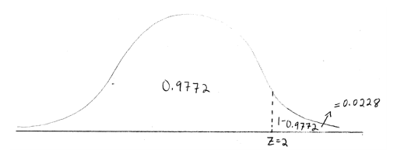
Z-value and percentiles
Example, for z = 2:
According to our Z-Table, the area to the left of Z=2 is equal to 0.9772
This means that the area to the right of Z=2 must be equal to 1 – 0.9772 = 0.0228
This means that:
The value in our distribution whose Z-Score = 2 is greater than 97.72% of the values in the distribution, and less than 2.28% of the values in the distribution.
The value (x) whose Z-Score = 2 is 97.72nd percentile
The probability that a randomly selected value from our distribution has a Z-Score of less than 2 (in other words, the probability it is smaller than the value whose Z-Score = 2) is equal to 0.9772, and the probability that a random value has a Z-score of greater than 2 (the probability that that it is greater than the value whose Z-Score = 2) is equal to 0.0228

Slide 37
Using excel to compute standard normal probabilities
Excel has two functions for computing probabilities and z values for a standard normal probability distribution.
NORM.S.DIST function computes the cumulative probability given a z value.
NORM.S.INV function computes the z value given a cumulative probability.
  “S” in the function names reminds us that these functions relate to the standard normal probability distribution.

Slide 38
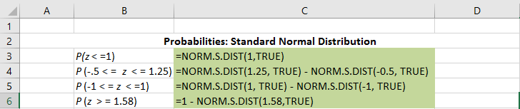
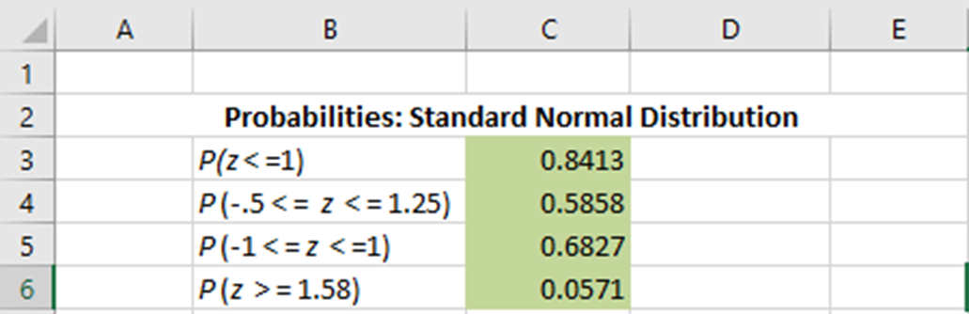
Using Excel to compute Standard Normal Probabilities
Excel Formula Worksheet

Slide 39
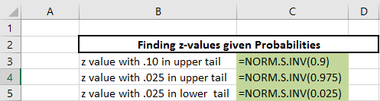
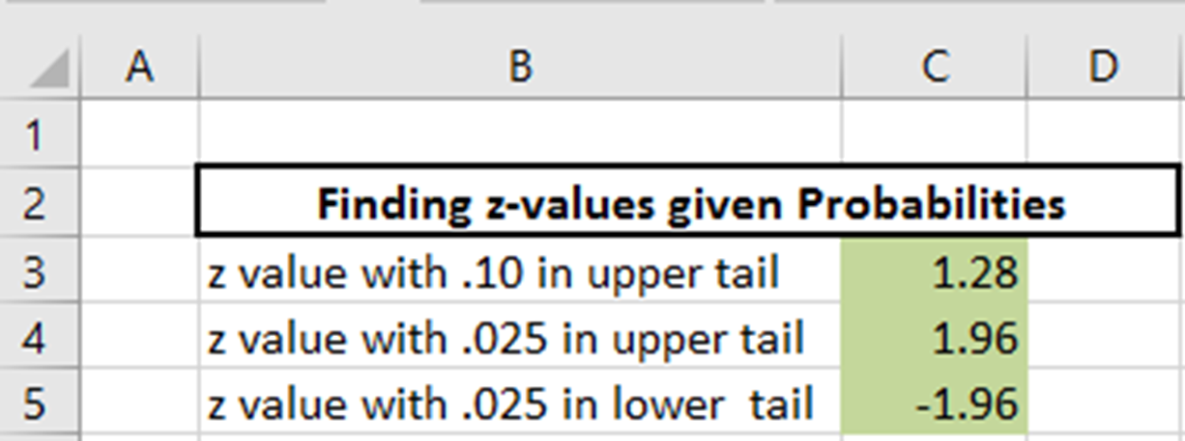
Using Excel to compute Standard Normal Probabilities
Excel Formula Worksheet

Slide 40
Standard Normal Probability Distribution
Example: Grear Tire Company Problem
Grear Tire company has developed a new steel-belted radial tire to be sold through a chain of discount stores. But before finalizing the tire mileage guarantee policy, Grear’s managers want probability information about the number of miles of tires will last.
It was estimated that the mean tire mileage is 36,500 miles with a standard deviation of 5000. The manager now wants to know the probability that the tire mileage x will exceed 40,000.
P(x > 40,000) = ?

Slide 41
Standard Normal Probability Distribution
Example: Grear Tire Company Problem
Solving for the Probability
Step 1: Convert x to standard normal distribution.
z = (x - μ)/σ
= (40,000 – 36,500)/5,000
= .7
Step 2: Find the area under the standard normal curve to the left of z = .7.

Slide 42
Standard Normal Probability Distribution
Example: Grear Tire Company Problem
Cumulative Probability Table for the Standard Normal Distribution
P(z < .7) = .7580
z | .00 | .01 | .02 | .03 | .04 | .05 | .06 | .07 | .08 | .09
. | . | . | . | . | . | . | . | . | . | .
.5 | .6915 | .6950 | .6985 | .7019 | .7054 | .7088 | .7123 | .7157 | .7190 | .7224
.6 | .7257 | .7291 | .7324 | .7357 | .7389 | .7422 | .7454 | .7486 | .7517 | .7549
.7 | .7580 | .7611 | .7642 | .7673 | .7704 | .7734 | .7764 | .7794 | .7823 | .7852
.8 | .7881 | .7910 | .7939 | .7967 | .7995 | .8023 | .8051 | .8078 | .8106 | .8133
.9 | .8159 | .8186 | .8212 | .8238 | .8264 | .8289 | .8315 | .8340 | .8365 | .8389
. | . | . | . | . | . | . | . | . | . | .

Slide 43
Standard Normal Probability Distribution
Example: Grear Tire Company Problem
Solving for the Probability
Step 3: Compute the area under the standard normal curve to the right of z = .7
P(z > .7) = 1 – P(z < .7)
= 1- .7580
= .2420

Slide 44
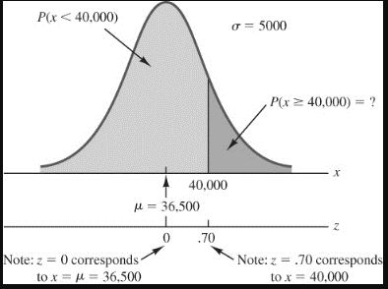
Standard Normal Probability Distribution
Example: Grear Tire Company Problem

Slide 45
Standard Normal Probability Distribution
Example: Grear Tire Company Problem
Area = .7580
Area = 1 - .7580
= .2420
z
0
.7

Slide 46
Standard Normal Probability Distribution
Example: Pep Zone
Pep Zone sells auto parts and supplies including a popular multi-grade motor oil. When the stock of this oil drops to 20 gallons, a replenishment order is placed. The store manager is concerned that sales are being lost due to stockouts while waiting for a replenishment order.
It has been determined that demand during replenishment lead-time is normally distributed with a mean of 15 gallons and a standard deviation of 6 gallons.
The manager would like to know the probability of a stockout during replenishment lead-time. In other words, what is the probability that demand during lead-time will exceed 20 gallons?
P(x > 20) = ?

Slide 47
Standard Normal Probability Distribution
Solving for the Stockout Probability
Step 1: Convert x to the standard normal distribution.
z = (x - μ)/σ
= (20 - 15)/6
= .83
Step 2: Find the area under the standard normal
curve to the left of z = .83.

Slide 48
Standard Normal Probability Distribution
Solving for the Stockout Probability
Step 3: Compute the area under the standard normal
curve to the right of z = .83.
P(z > .83) = 1 – P(z < .83)
= 1- .7967
= .2033
Probability
of a stockout
P(x > 20)

Slide 49
Standard Normal Probability Distribution
Solving for the Stockout Probability
Area = 1 - .7967
= .2033
Area = .7967
z
0
.83

Slide 50
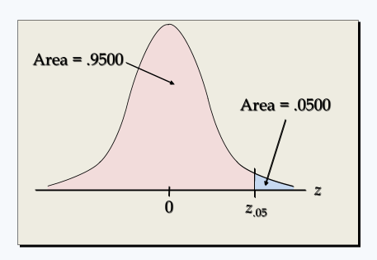
Standard Normal Probability Distribution
Standard Normal Probability Distribution
If the manager of Pep Zone wants the probability of a stockout during replenishment lead-time to be no more than .05, what should the reorder point be?

Slide 51
Standard Normal Probability Distribution
Solving for the Reorder Point
Step 2: Convert z_{.05} to the corresponding value of x.
z = (x - μ)/σ
zσ =(x - μ)
x = μ + z σ
x = μ + z_{.05}σ
= 15 + 1.645(6)
= 24.87 or 25
A reorder point of 25 gallons will place the probability
of a stockout during leadtime at (slightly less than) .05.

Slide 52
Normal Probability Distribution
Solving for the Reorder Point
Probability of no
stockout during
replenishment
lead-time = .95
Probability of a
stockout during
replenishment
lead-time = .05
x
15
24.87

Slide 53
Standard Normal Probability Distribution
Solving for the Reorder Point
By raising the reorder point from 20 gallons to
25 gallons on hand, the probability of a stockout
decreases from about .20 to .05.
This is a significant decrease in the chance that
Pep Zone will be out of stock and unable to meet a
customer’s desire to make a purchase.

Slide 54
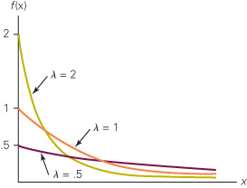
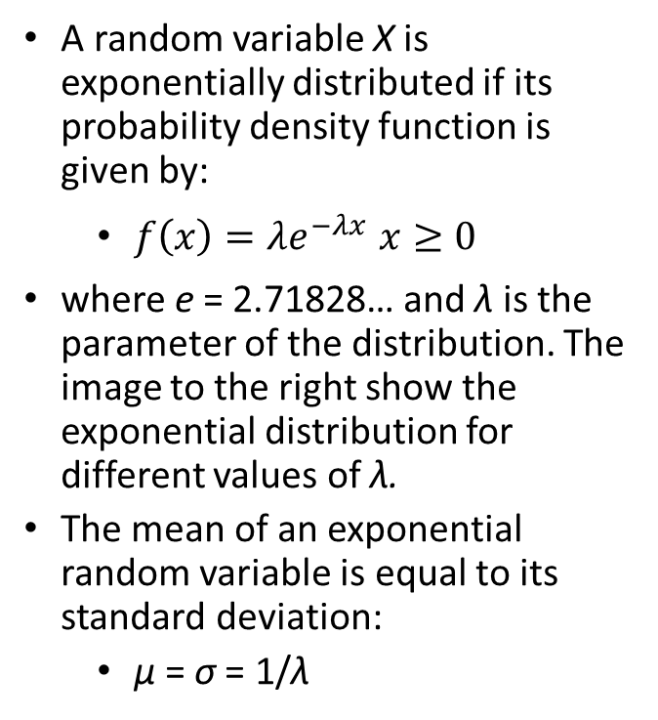
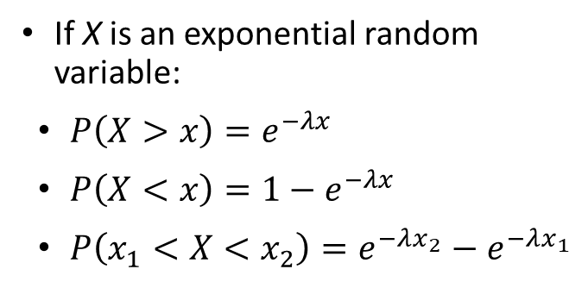
Exponential Distribution
Exponential Probability Density Function
Probability Associated with an Exponential Random Variable
A random variable X is exponentially distributed if its probability density function is given by:
$f\left(x\right)=λe^{−λx} x≥0$
where e = 2.71828… and λ is the parameter of the distribution. The image to the right show the exponential distribution for different values of λ.
The mean of an exponential random variable is equal to its standard deviation:
μ = σ = 1/λ
If X is an exponential random variable:
$P\left(X>x\right)=e^{−λx}$
$P\left(X<x\right)=1−e^{−λx}$
$P\left(x_{1}<X<x_{2}\right)=e^{−λx_{2}}−e^{−λx_{1}}$

Slide 55
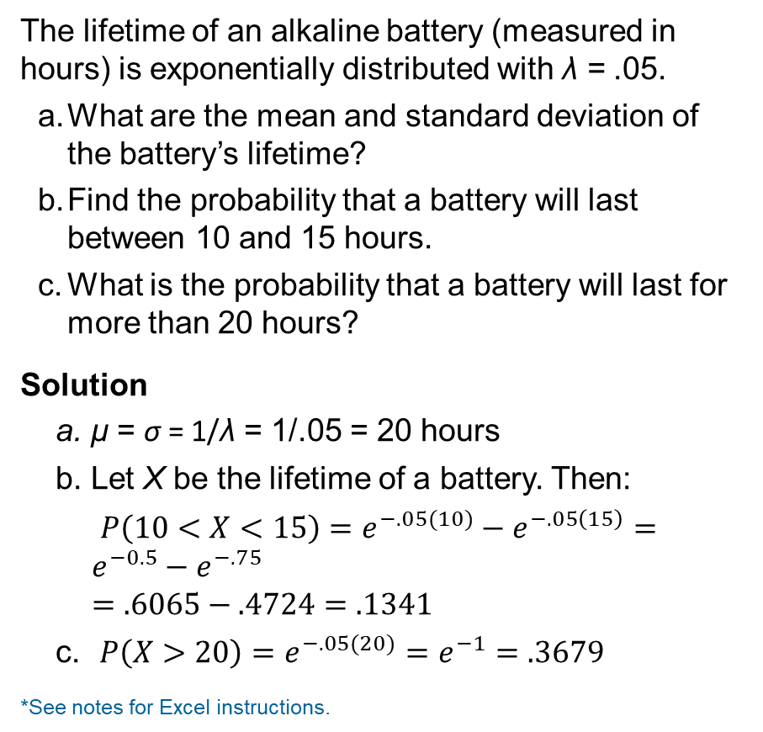
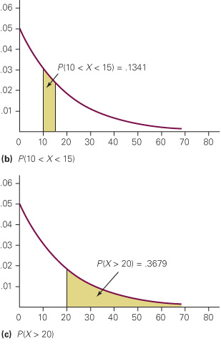
Example – Lifetimes of Alkaline Batteries
Notes:
Excel instructions:
Type (in any cell)
=EXPON.DIST([X],[λ],True)
To produce the answer for Example 8.7c, we would find P(X < 20) and subtract it from 1.
To find P(X < 20), type
=EXPON.DIST(20,.05,True)
which outputs .6321 and hence P(X > 20) = 1 - .6321 = .3679, which is the same number we produced manually.

Slide 56
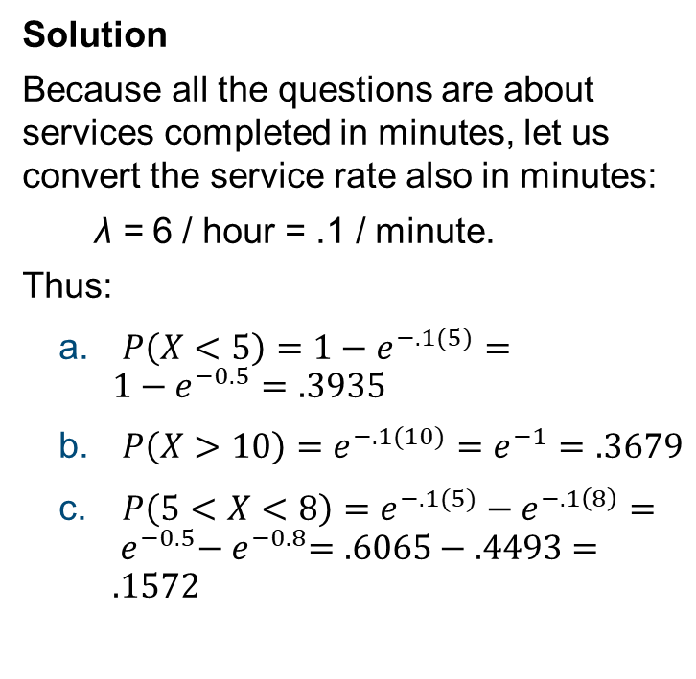
Example – Supermarket Checkout Counter
A checkout counter at a supermarket completes the process according to an exponential distribution with a service rate of 6 per hour.
A customer arrives at the checkout counter.
Find the probability of the following events.
The service is completed in fewer than 5 minutes.
The customer leaves the checkout counter more than 10 minutes after arriving.
The service is completed in a time between 5 and 8 minutes.
Solution
Because all the questions are about services completed in minutes, let us convert the service rate also in minutes:
λ = 6 / hour = .1 / minute.
Thus:
$P\left(X<5\right)={1−e}^{−.1(5)}={1−e}^{−0.5}=.3935$
$P\left(X>10\right)=e^{−.1(10)}=e^{−1}=.3679$
$P\left(5<X<8\right)=e^{−.1(5)}−e^{−.1\left(8\right)}={ e}^{−0.5}−{ e}^{−0.8}=.6065−.4493=.1572$

