Slide 1
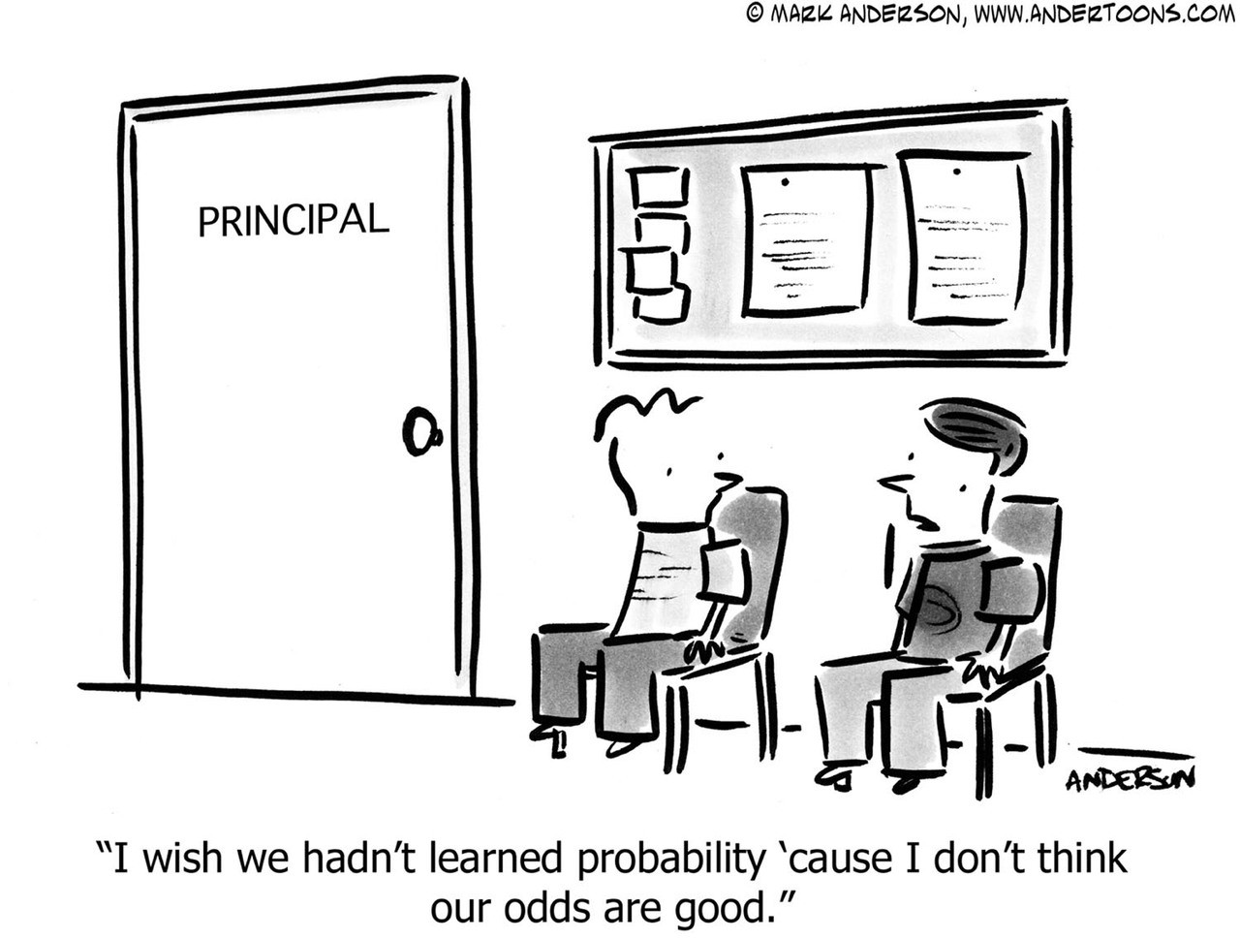
ECON 2110
Fall 2025
Chapter 6: Probability
Instructor: Dennis McCornac

Slide 2
Introduction
Although descriptive statistics consist of a set of useful graphical and numerical methods, we are particularly interested in developing statistical inference about a population from a sample.
Our primary objective in this and the following two chapters is to develop the probability-based tools that are at the basis of statistical inference.

Slide 3
Introduction to Probability
Probability is a numerical measure of the likelihood
that an event will occur.
Probability values are always assigned on a scale
from 0 to 1.
A probability near zero indicates an event is quite
unlikely to occur.
A probability near one indicates an event is almost
certain to occur.

Slide 4
Probability as a Numerical Measure of the Likelihood of Occurrence
Increasing Likelihood of Occurrence
0
.5
1
Probability:
The event
is very
unlikely
to occur.
The occurrence
of the event is
just as likely as
it is unlikely.
The event
is almost
certain
to occur.

Slide 5
Statistical Experiments
In statistics, the notion of an experiment differs
somewhat from that of an experiment in the
physical sciences.
In statistical experiments, probability determines
outcomes.
Even though the experiment is repeated in exactly
the same way, an entirely different outcome may
occur.
For this reason, statistical experiments are some-
times called random experiments.

Slide 6
Random Experiment
A random experiment is an action or process that leads to one of several possible outcomes.
Examples:
Illustration 1. Experiment: Flip a coin.
Outcomes: Heads and tails
Illustration 2. Experiment: Record marks on a statistics test (out of 100).
Outcomes: Numbers between 0 and 100
Illustration 3. Experiment: Record grade on a statistics test.
Outcomes: A, B, C, D, and F
The list of possible outcomes of an experiment must be:
Exhaustive: All possible outcomes must be included
Mutually Exclusive: Two outcomes cannot occur at the same time

Slide 7
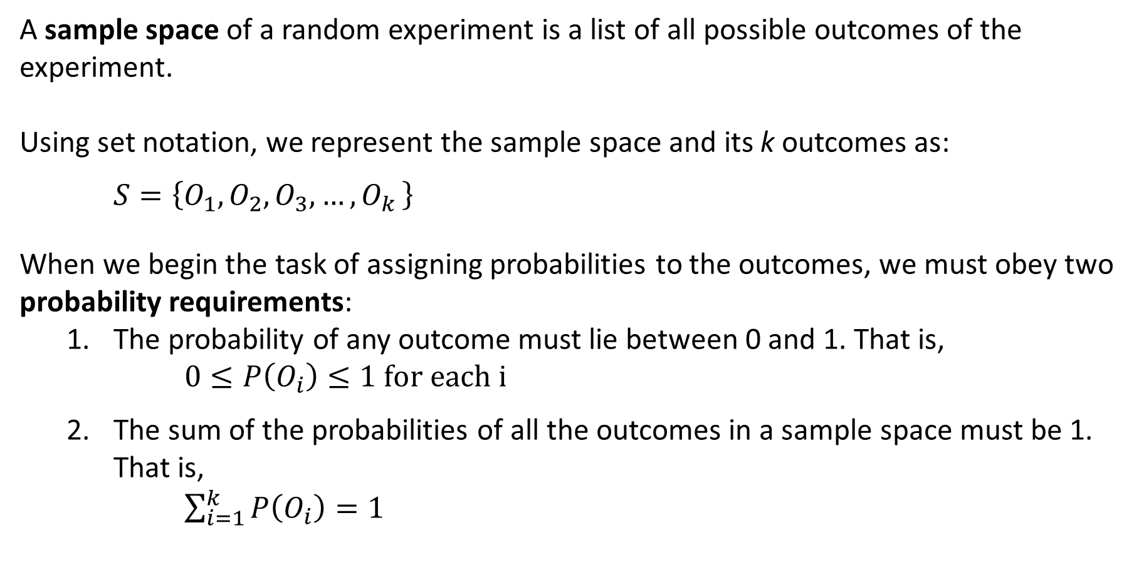
6-1 Sample Space and Probability Requirements
A sample space of a random experiment is a list of all possible outcomes of the experiment.
Using set notation, we represent the sample space and its k outcomes as:
$$S=\left\{O_{1},O_{2},O_{3},{…,O}_{k}\right\}$$
When we begin the task of assigning probabilities to the outcomes, we must obey two probability requirements:
The probability of any outcome must lie between 0 and 1. That is,
$0≤P\left(O_{i}\right)≤1 \text{for} \text{each} \text{i}$
The sum of the probabilities of all the outcomes in a sample space must be 1. That is,
$\sum_{i=1}^{k}{P\left(O_{i}\right)=1}$

Slide 8
An Experiment and Its Sample Space
Experiment
Toss a coin
Inspection of a part
Conduct a sales call
Roll a die
Play a football game
Experiment Outcomes
Head, tail
Defective, non-defective
Purchase, no purchase
1, 2, 3, 4, 5, 6
Win, lose, tie

Slide 9
6-1a Three Approaches to Assigning Probabilities
The classical approach is used by mathematicians to determine probability based on games of chance, and it consists of equally likely outcomes.
The relative frequency approach is applied to experimentation or historical data, and it defines probability as the long-run relative frequency with which an outcome occurs.
The subjective approach assigns probabilities based on a subjective judgment, and it is used when the classical approach is not reasonable and there are no available experimentations or historical data to apply the relative frequency approach.

Slide 10
6-1d Interpreting Probability
No matter what method was used to assign probability, we always interpret it using the relative frequency approach for an infinite number of experiments
Examples:
Subjective approach: an investor assumed that there is a 65% probability that a particular stock’s price will increase over the next month.
Interpretation: if we had an infinite number of stocks with the exact same economic and market characteristics as the one the investor will buy, 65% of them will increase in price over the next month.
Classical approach: the probability that a balanced die lands on the number 5 is 1/6.
Interpretation: the proportion of times that a 5 is observed on a balanced die thrown an infinite number of times.

Slide 11
Classical Method eXAMPLE
Example: Rolling a Die
If an experiment has n possible outcomes, the classical method would assign a probability of 1/n to each outcome.
Experiment: Rolling a die
Sample Space: S = {1, 2, 3, 4, 5, 6}
Probabilities: Each sample point has a
1/6 chance of occurring

Slide 12
Relative Frequency Method example
Example: Lucas Tool Rental
Lucas Tool Rental would like to assign probabilities to the number of car polishers it rents each day, and office records show the following frequencies of daily rentals for the last 40 days.
Each probability assignment is given by dividing the frequency (number of days) by the total frequency (total number of days).
Number of
Polishers Rented
Number
of Days
Probability
0
1
2
3
4
4
6
18
10
2
40
.10
.15
.45
.25
.05
1.00
4/40

Slide 13
Subjective Method
When economic conditions or a company’s
circumstances change rapidly it might be
inappropriate to assign probabilities based solely on
historical data.
We can use any data available as well as our
experience and intuition, but ultimately a probability
value should express our degree of belief that the
experimental outcome will occur.
The best probability estimates often are obtained by
combining the estimates from the classical or relative
frequency approach with the subjective estimate.

Slide 14
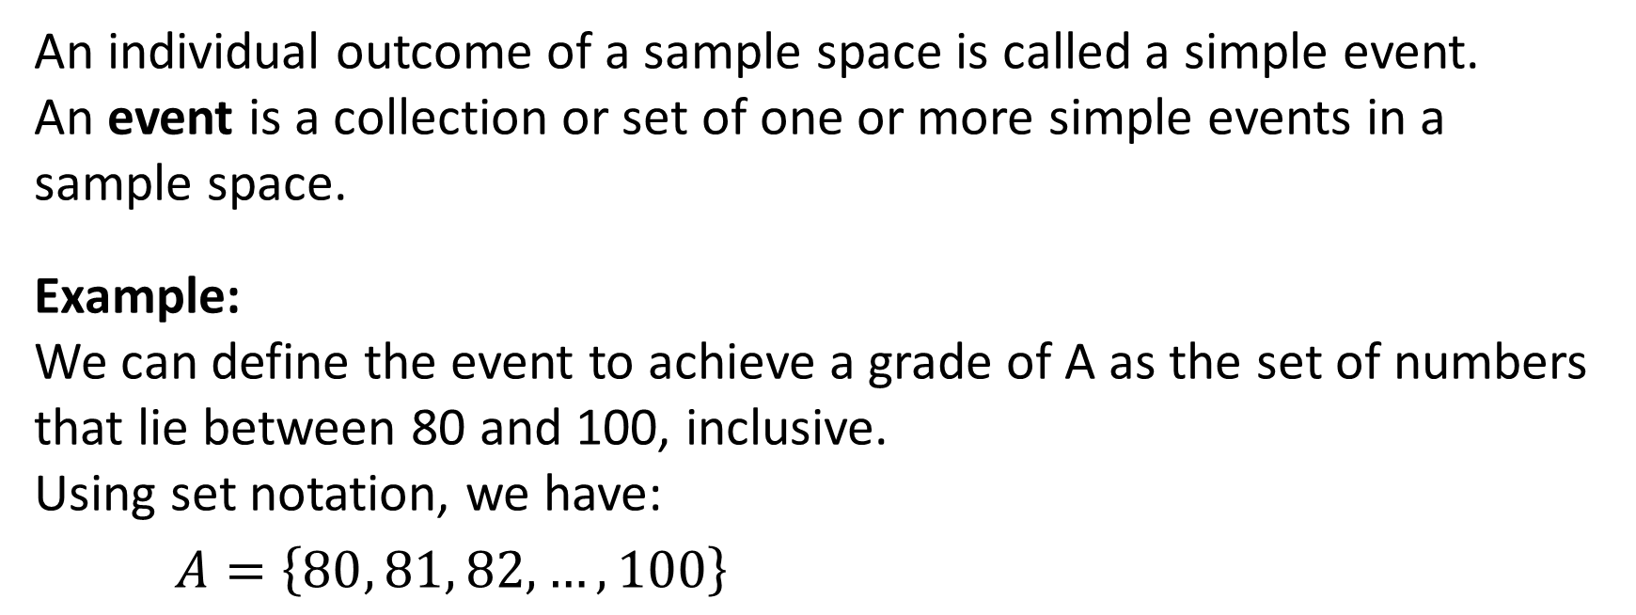
Defining Events
An individual outcome of a sample space is called a simple event.
An event is a collection or set of one or more simple events in a sample space.
Example:
We can define the event to achieve a grade of A as the set of numbers that lie between 80 and 100, inclusive.
Using set notation, we have:
$$A=\left\{80, 81, 82,…, 100\right\}$$

Slide 15
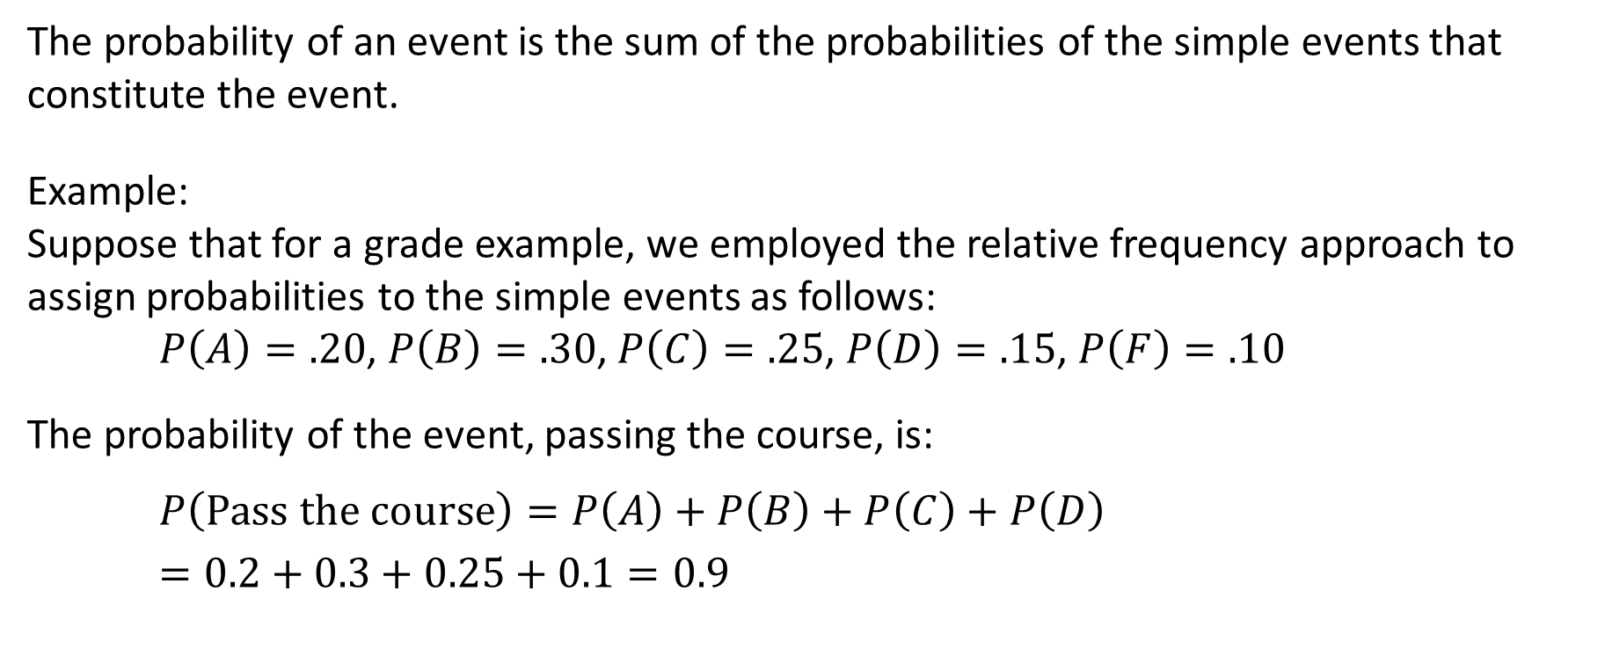
Probability of an Event
The probability of an event is the sum of the probabilities of the simple events that constitute the event.
Example:
Suppose that for a grade example, we employed the relative frequency approach to assign probabilities to the simple events as follows:
$P\left(A\right)=.20$, $P\left(B\right)=.30$, $P\left(C\right)=.25$, $P\left(D\right)=.15$, $P\left(F\right)=.10$
The probability of the event, passing the course, is:
$$P\left(Pass the course\right)=P\left(A\right)+P\left(B\right)+P\left(C\right)+P\left(D\right)$$
$$=0.2+0.3+0.25+0.1=0.9$$

Slide 16
Some Basic Relationships of Probability
There are some basic probability relationships that can be used to compute the probability of an event without knowledge of all the sample point probabilities.
Complement of an Event
Union of Two Events
Intersection of Two Events
Mutually Exclusive Events

Slide 17
Complement of an Event
The complement of event A is defined to be the event
consisting of all sample points that are not in A.
The complement of A is denoted by A^{c}.
Sample
Space S
Event A
A^{c}
Venn
Diagram

Slide 18
Union of Two Events
The union of events A and B is the event containing
all sample points that are in A or B or both.
The union of events A and B is denoted by A ∪ B.
Sample
Space S
Event A
Event B

Slide 19
Intersection of Two Events
The intersection of events A and B is the set of all
sample points that are in both A and B.
The intersection of events A and B is denoted by A ∩ Β.
Sample
Space S
Event A
Event B
Intersection of A and B

Slide 20
An Experiment and Its Sample Space
Example: Bradley Investments
Bradley has invested in two stocks, Markley Oil and Collins Mining. Bradley has determined that the possible outcomes of these investments three months from now are as follows.
Investment Gain or Loss
in 3 Months (in $000)
Markley Oil
Collins Mining
10
5
0
−20
8
−2

Slide 21
Defining Events - Tree Diagram
Example: Bradley Investments
Markley Oil
(Stage 1)
Collins Mining
(Stage 2)
Experimental
Outcomes
Gain 8
(10, 8) Gain $18,000
(10, -2) Gain $8,000
Gain 10
Lose 2
Gain 8
(5, 8) Gain $13,000
Lose 2
(5, -2) Gain $3,000
Gain 5
Gain 8
(0, 8) Gain $8,000
Even
(0, -2) Lose $2,000
Lose 20
Lose 2
Gain 8
(-20, 8) Lose $12,000
Lose 2
(-20, -2) Lose $22,000

Slide 22
Assigning Probabilities - Subjective Method
Example: Bradley Investments
An analyst made the following probability estimates.
Exper. Outcome
Net Gain or Loss
Probability
(10, 8)
(10, −2)
(5, 8)
(5, −2)
(0, 8)
(0, −2)
(−20, 8)
(−20, −2)
$18,000 Gain
$8,000 Gain
$13,000 Gain
$3,000 Gain
$8,000 Gain
$2,000 Loss
$12,000 Loss
$22,000 Loss
.20
.08
.16
.26
.10
.12
.02
.06

Slide 23
EVENTS AND THEIR PROBABILITES
Example: Bradley Investments
Event M = Markley Oil Profitable
M = {(10, 8), (10, −2), (5, 8), (5, −2)}
P(M) = P(10, 8) + P(10, −2) + P(5, 8) + P(5, −2)
= .20 + .08 + .16 + .26
= .70
Event C = Collins Mining Profitable
C = {(10, 8), (5, 8), (0, 8), (−20, 8)}
P(C) = P(10, 8) + P(5, 8) + P(0, 8) + P(−20, 8)
= .20 + .16 + .10 + .02 = 0.48

Slide 24
Union of Two Events
Example: Bradley Investments
Event M = Markley Oil Profitable
Event C = Collins Mining Profitable
M ∪ C = Markley Oil Profitable
or Collins Mining Profitable (or both)
M ∪ C = {(10, 8), (10, −2), (5, 8), (5, −2), (0, 8), (−20, 8)}
P(M ∪ C) = P(10, 8) + P(10, −2) + P(5, 8) + P(5, −2)
+ P(0, 8) + P(−20, 8)
= .20 + .08 + .16 + .26 + .10 + .02
= .82

Slide 25
Intersection of Two Events
Example: Bradley Investments
Event M = Markley Oil Profitable
Event C = Collins Mining Profitable
M ∩ C = Markley Oil Profitable
and Collins Mining Profitable
M ∩ C = {(10, 8), (5, 8)}
P(M ∩ C) = P(10, 8) + P(5, 8)
= .20 + .16
= .36

Slide 26
Addition Law
The addition law provides a way to compute the
probability of event A, or B, or both A and B occurring.
The law is written as:
P(A ∪ B) = P(A) + P(B) − P(A ∩ B)
Remember, we are looking at the UNION of two events

Slide 27
Addition Law
Example: Bradley Investments
Event M = Markley Oil Profitable
Event C = Collins Mining Profitable
M ∪ C = Markley Oil Profitable
or Collins Mining Profitable
We know: P(M) = .70, P(C) = .48, P(M ∩ C) = .36
Thus: P(M ∪ C) = P(M) + P(C) − P(M ∩ C)
= .70 + .48 − .36
= .82
(This result is the same as that obtained earlier
using the definition of the probability of an event.)

Slide 28
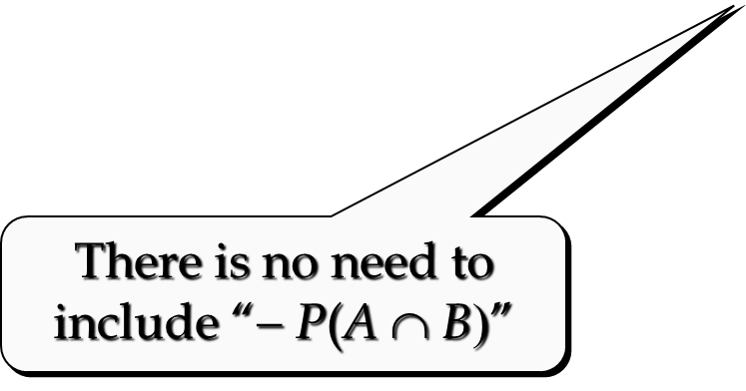


Mutually Exclusive Events
Two events are said to be mutually exclusive if the events have
no sample points in common.
Two events are mutually exclusive if, when one event occurs, the other cannot occur.
If events A and B are mutually exclusive, P(A ∩ B) = 0.
Sample
Space S
Event A
Event B

Slide 29
Conditional Probability
The probability of an event given that another event
has occurred is called a conditional probability.
The conditional probability of A given B is denoted
by P(A|B).
A conditional probability is computed as follows :

Slide 30
Conditional Probability
Example: Bradley Investments
Event M = Markley Oil Profitable
Event C = Collins Mining Profitable
= Collins Mining Profitable
given Markley Oil Profitable
We know: P(M ∩ C) = .36, P(M) = .70
Thus:

Slide 31
Multiplication Law
The multiplication law provides a way to compute the
probability of the intersection of two events.
The law is written as:
P(A ∩ B) = P(A)P(B|A)
or P(A ∩ B) = P(B)P(A|B)

Slide 32
Multiplication Law
Example: Bradley Investments
Event M = Markley Oil Profitable
Event C = Collins Mining Profitable
M ∩ C = Markley Oil Profitable
and Collins Mining Profitable
We know: P(M) = .70, P(C|M) = .5143
Thus: P(M ∩ C) = P(M)P(C|M)
= (.70)(.5143)
= .36
(This result is the same as that obtained earlier
using the definition of the probability of an event.)

Slide 34
Joint Probability Table
Collins Mining
Profitable (C) Not Profitable (C^{c})
Markley Oil
Profitable (M)
Not Profitable (M^{c})
Total
.70
.30
1.00
.36 .34
.12 .18
Total .48 .52
Joint Probabilities
(appear in the body
of the table)
Marginal Probabilities
(appear in the margins
of the table)

Slide 36
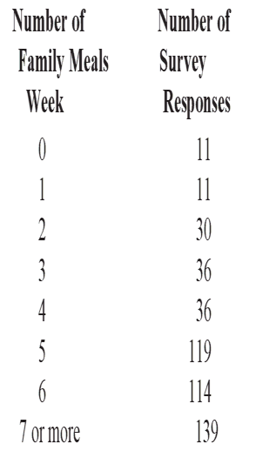

Slide 37
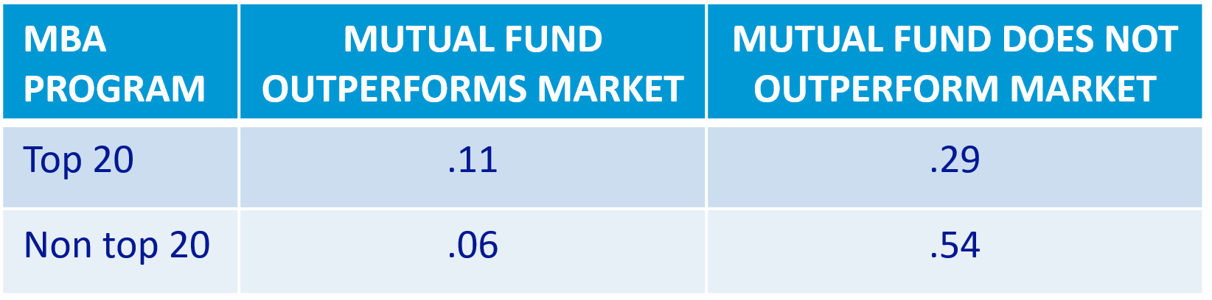
Determinants of Success among Mutual Fund Managers
Suppose that a potential investor examined the relationship between how well the mutual fund performs and which university awarded the manager’s MBA.
After the analysis, the following table of joint probabilities, was developed:
Analyze these probabilities and interpret the results.

Slide 38
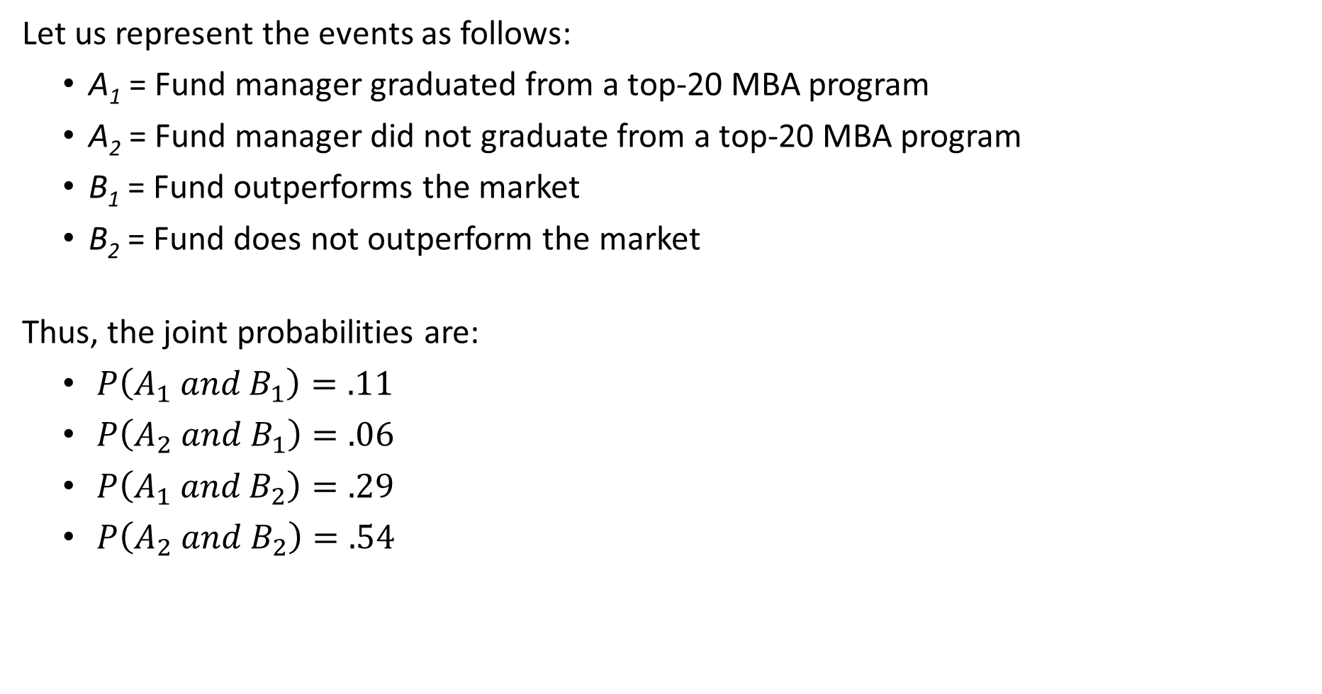
Example – Determinants of Success among Mutual Fund Managers
Let us represent the events as follows:
A₁ = Fund manager graduated from a top-20 MBA program
A₂ = Fund manager did not graduate from a top-20 MBA program
B₁ = Fund outperforms the market
B₂ = Fund does not outperform the market
Thus, the joint probabilities are:
$P\left(A_{1} and B_{1}\right)=.11$
$P\left(A_{2} and B_{1}\right)=.06$
$P\left(A_{1} and B_{2}\right)=.29$
$P\left(A_{2} and B_{2}\right)=.54$

Slide 39
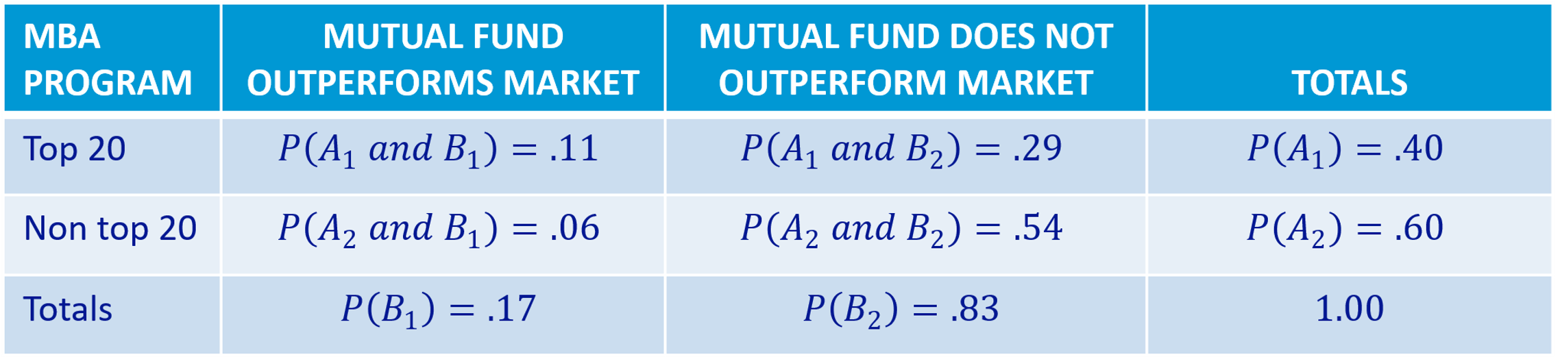
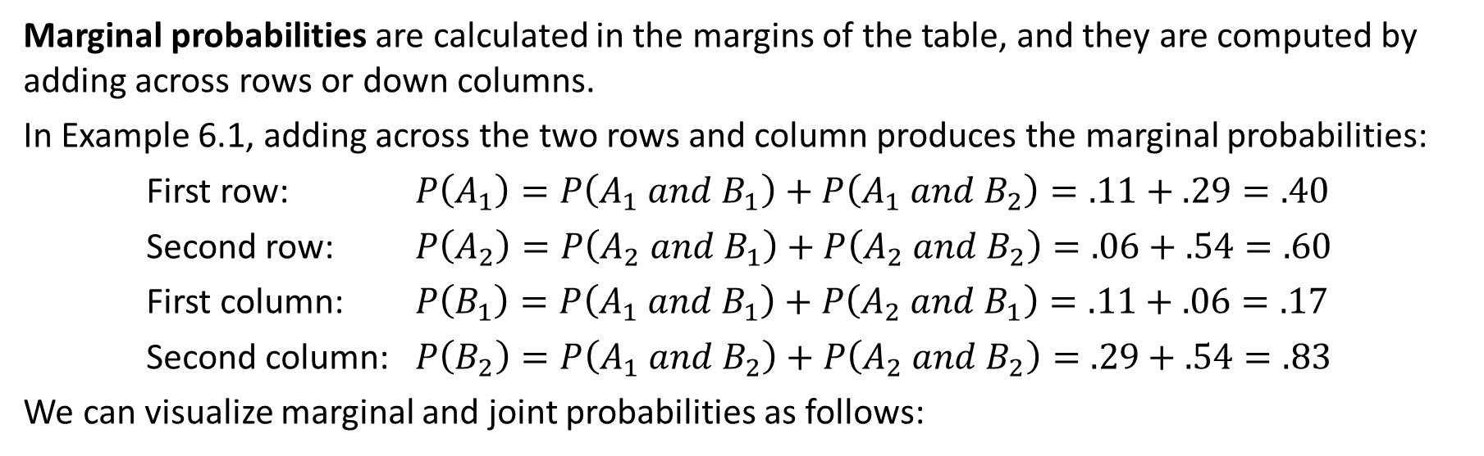
Marginal Probabilities
Marginal probabilities are calculated in the margins of the table, and they are computed by adding across rows or down columns.
In Example 6.1, adding across the two rows and column produces the marginal probabilities:
First row: $P\left(A_{1}\right)=P\left(A_{1} and B_{1}\right)+P\left(A_{1} and B_{2}\right)=.11+.29=.40$
Second row: $P\left(A_{2}\right)=P\left(A_{2} and B_{1}\right)+P\left(A_{2} and B_{2}\right)=.06+.54=.60$
First column: $P\left(B_{1}\right)=P\left(A_{1} and B_{1}\right)+P\left(A_{2} and B_{1}\right)=.11+.06=.17$
Second column: $P\left(B_{2}\right)=P\left(A_{1} and B_{2}\right)+P\left(A_{2} and B_{2}\right)=.29+.54=.83$
We can visualize marginal and joint probabilities as follows:
B1
B2
A1
A2

Slide 40
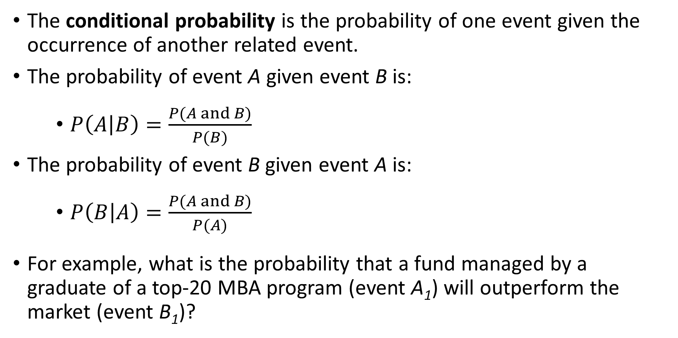
Conditional Probability Once Again
The conditional probability is the probability of one event given the occurrence of another related event.
The probability of event A given event B is:
$P\left(A | B\right)=\frac{P(A and B)}{P(B)}$
The probability of event B given event A is:
$P\left(B | A\right)=\frac{P(A and B)}{P(A)}$
For example, what is the probability that a fund managed by a graduate of a top-20 MBA program (event A₁) will outperform the market (event B₁)?

Slide 41
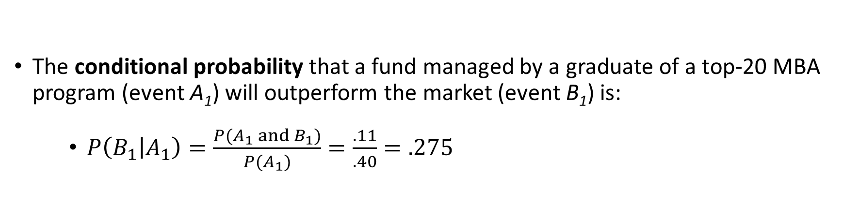
Conditional Probability Once again
The conditional probability that a fund managed by a graduate of a top-20 MBA program (event A₁) will outperform the market (event B₁) is:
$P\left(B_{1} | A_{1}\right)=\frac{P(A_{1} and B_{1})}{P(A_{1})}=\frac{.11}{.40}=.275$
B1
B2
B2
A1
A2

Slide 42
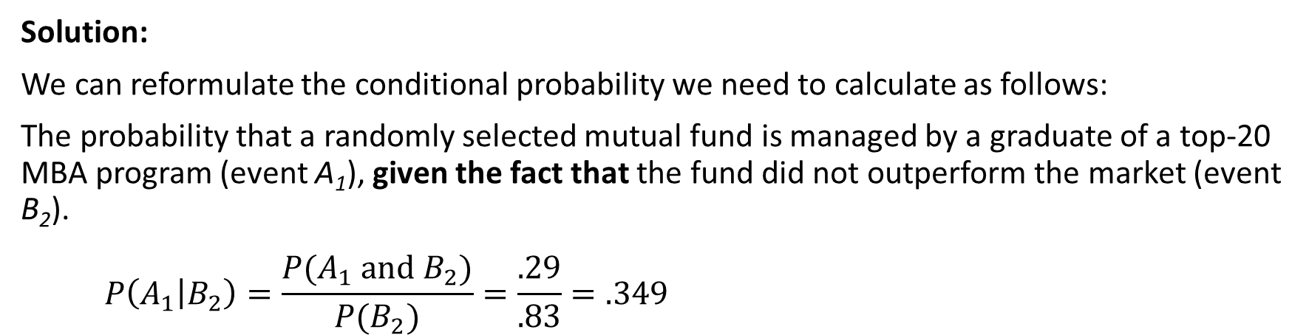
Example – Determinants of Success among Mutual Fund Managers
Solution:
We can reformulate the conditional probability we need to calculate as follows:
The probability that a randomly selected mutual fund is managed by a graduate of a top-20 MBA program (event A₁), given the fact that the fund did not outperform the market (event B₂).
$$P\left(A_{1} | B_{2}\right)=\frac{P(A_{1} and B_{2})}{P(B_{2})}=\frac{.29}{.83}=.349$$
B1
B2
A1
A2

Slide 43
Example – Determinants of Success among Mutual Fund Managers
Suppose that we select one mutual fund at random and discover that it did not outperform the market.
What is the probability that a graduate of a top-20 MBA program manages it?
B1
B2
A1
A2

Slide 44
Conditional Probability – Another Example
Example: Promotion status of police officers over the past two years
 | Men | Women | Total
Promoted | 288 | 36 | 324
Not Promoted | 672 | 204 | 876
Total | 960 | 240 | 1200

Slide 45
Joint Probability Table
 | Men (M) | Women (W) | Total
Promoted (A) | 288/1200 = 0.24 | 0.03 | 0.27
Not Promoted (A^{c} ) | 0.56 | 0.17 | 0.73
Total | 0.80 | 0.20 | 1.00

Slide 46
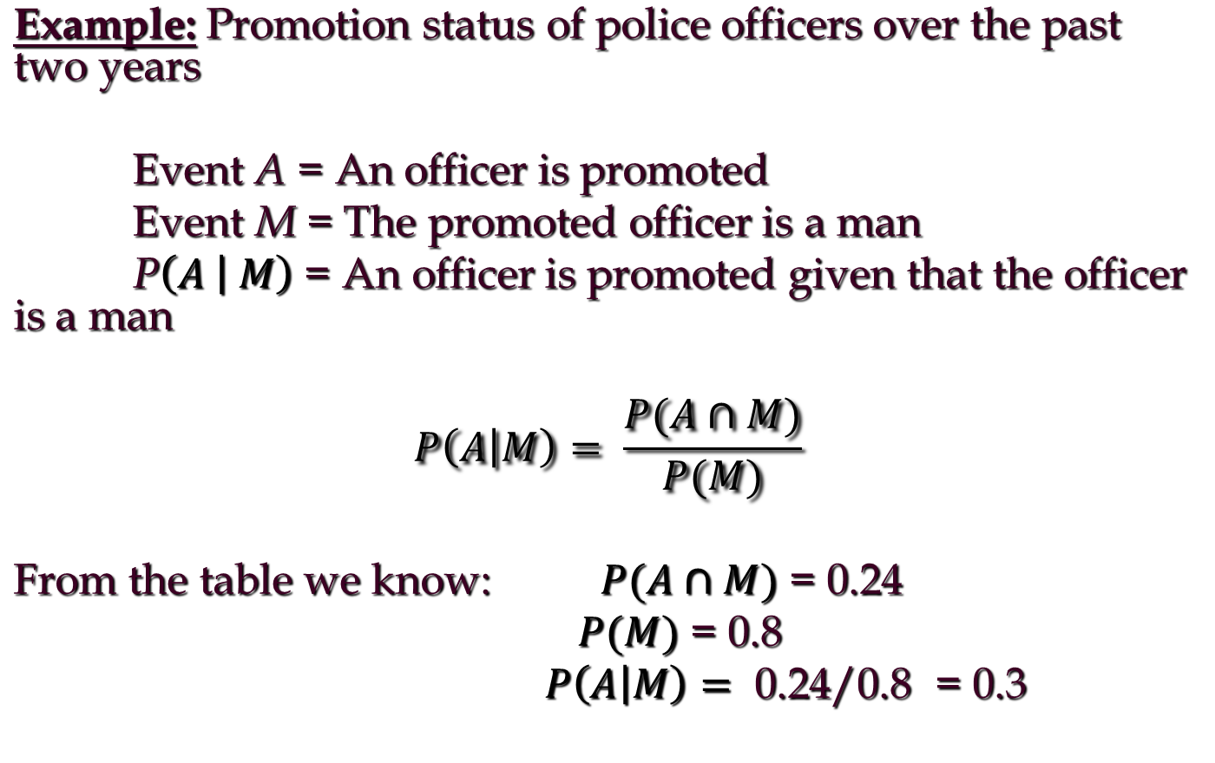
Conditional Probability – Another Example

Slide 47
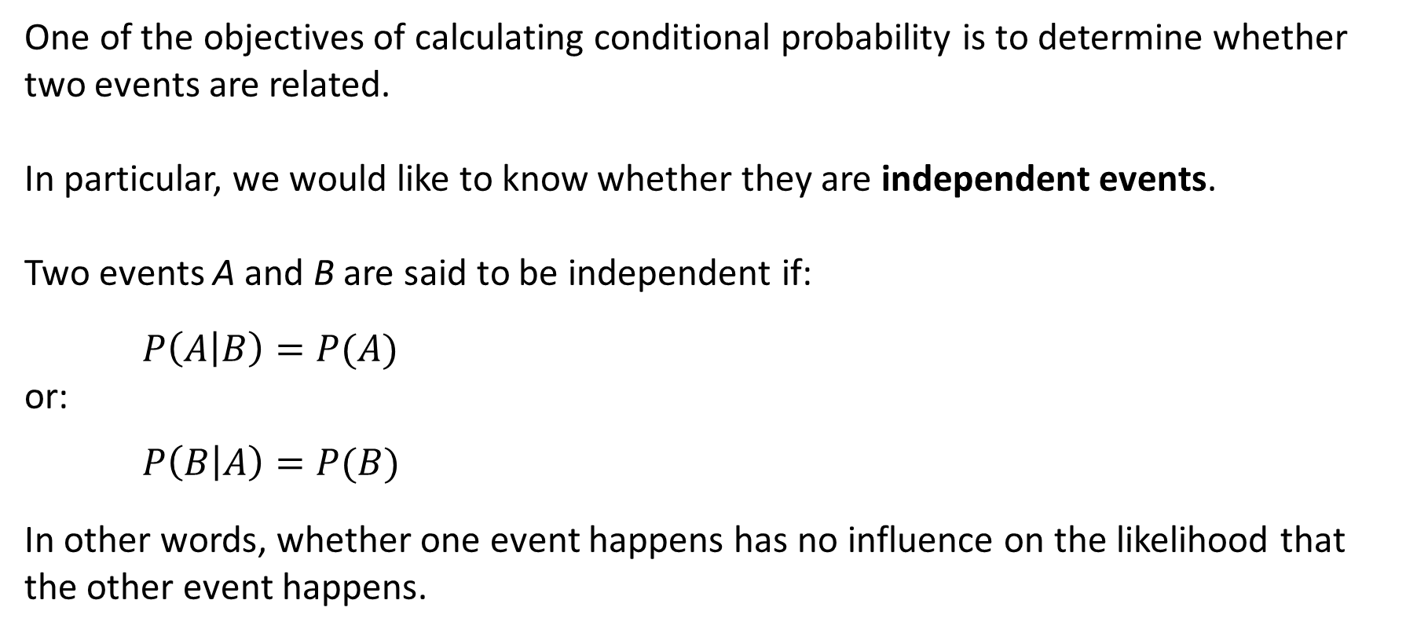
Independence
One of the objectives of calculating conditional probability is to determine whether two events are related.
In particular, we would like to know whether they are independent events.
Two events A and B are said to be independent if:
$$P\left(A | B\right)=P(A)$$
or:
$$P\left(B | A\right)=P(B)$$
In other words, whether one event happens has no influence on the likelihood that the other event happens.

Slide 48
Example – Determinants of Success among Mutual Fund Managers
Determine whether the event that the manager graduated from a top-20 MBA program and the event the fund outperforms the market are independent events.
B1
B2
A1
A2

Slide 49
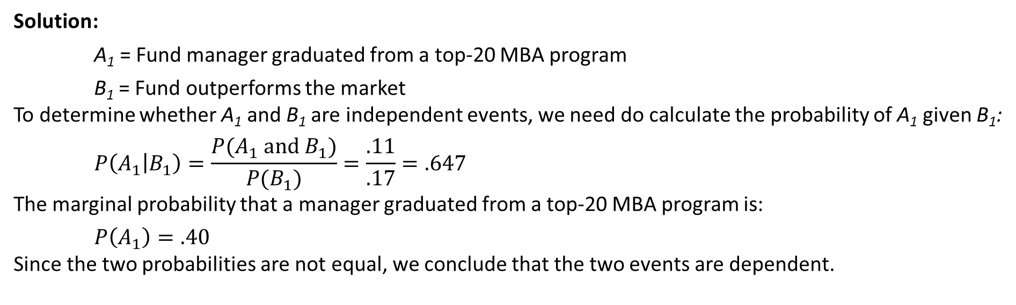
Example – Determinants of Success among Mutual Fund Managers
Solution:
A₁ = Fund manager graduated from a top-20 MBA program
B₁ = Fund outperforms the market
To determine whether A₁ and B₁ are independent events, we need do calculate the probability of A₁ given B₁:
$$P\left(A_{1} | B_{1}\right)=\frac{P(A_{1} and B_{1})}{P(B_{1})}=\frac{.11}{.17}=.647$$
The marginal probability that a manager graduated from a top-20 MBA program is:
$$P\left(A_{1}\right)=.40$$
Since the two probabilities are not equal, we conclude that the two events are dependent.
B1
B2
A1
A2

Slide 50
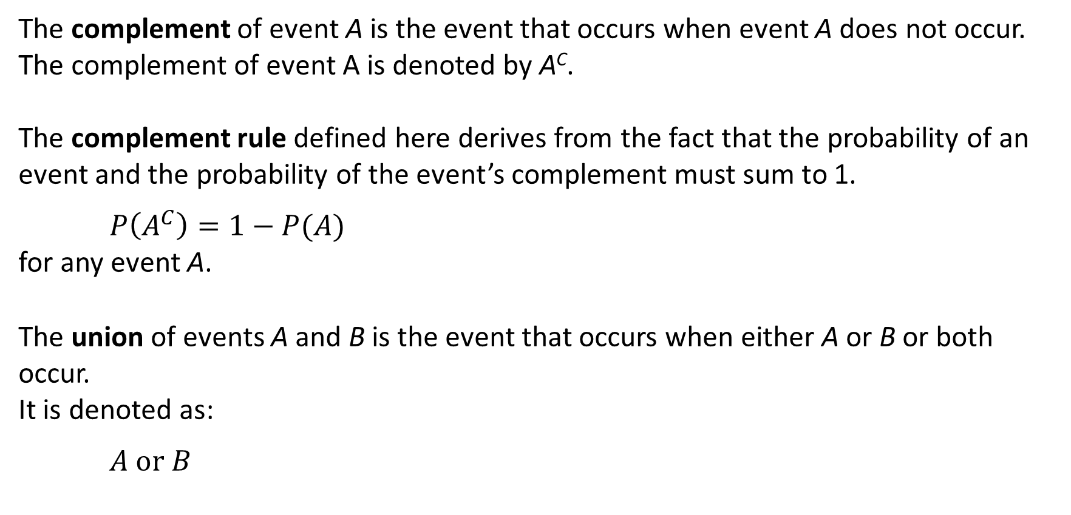
Complement Rule and Union of
Two Events Once Again
The complement of event A is the event that occurs when event A does not occur. The complement of event A is denoted by A^{C}.
The complement rule defined here derives from the fact that the probability of an event and the probability of the event’s complement must sum to 1.
$$P\left(A^{C}\right)=1−P(A)$$
for any event A.
The union of events A and B is the event that occurs when either A or B or both occur.
It is denoted as:
$$A or B$$

Slide 51
Example – Determinants of Success among Mutual Fund Managers
Determine the probability that a randomly selected fund outperforms the market, or the manager graduated from a top-20 MBA program.
→ We want to compute the probability of the union of two events:
P(A₁ or B₁)
B1
B2
A1
A2

Slide 52
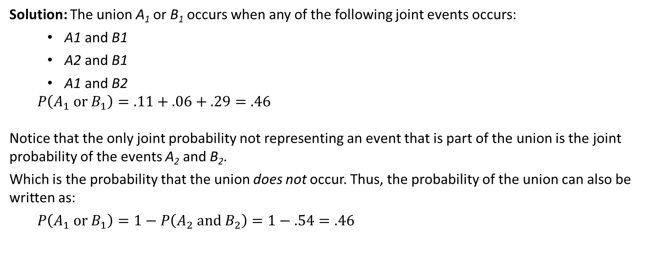
Example – Determinants of Success among Mutual Fund Managers
Solution: The union A₁ or B₁ occurs when any of the following joint events occurs:
A1 and B1
A2 and B1
A1 and B2
$$P\left(A_{1} or B_{1}\right)=.11+.06+.29=.46$$
Notice that the only joint probability not representing an event that is part of the union is the joint probability of the events A₂ and B₂.
Which is the probability that the union does not occur. Thus, the probability of the union can also be written as:
$$P\left(A_{1} or B_{1}\right)=1−P\left(A_{2} and B_{2}\right)=1−.54=.46$$
B1
B2
A1
A2

Slide 53
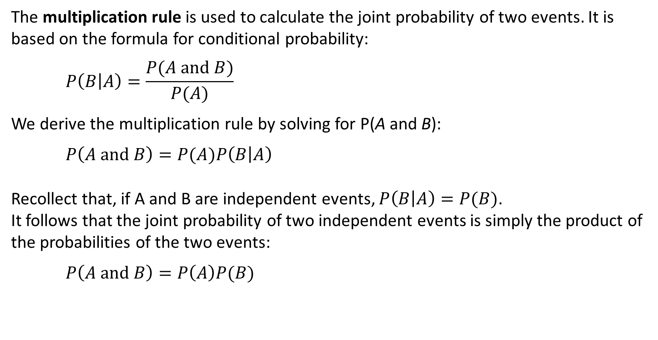
Multiplication Rule Once again
The multiplication rule is used to calculate the joint probability of two events. It is based on the formula for conditional probability:
$$P\left(B | A\right)=\frac{P(A and B)}{P(A)}$$
We derive the multiplication rule by solving for P(A and B):
$$P\left(A and B\right)=P(A)P\left(B | A\right)$$
Recollect that, if A and B are independent events, $P\left(B | A\right)=P(B)$.
It follows that the joint probability of two independent events is simply the product of the probabilities of the two events:
$$P\left(A and B\right)=P\left(A\right)P(B)$$

Slide 54
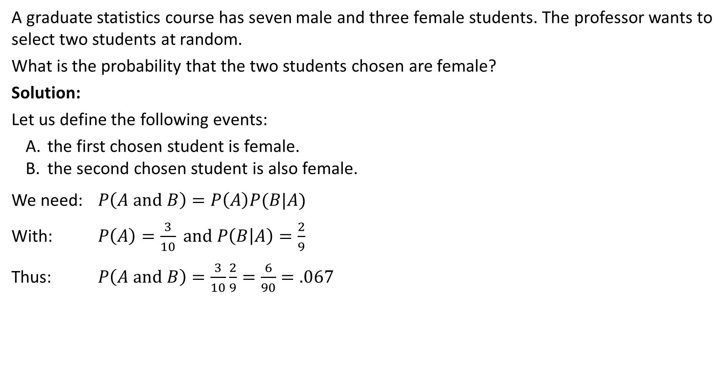
Examples – Selecting Two Students
Example – Without Replacement
A graduate statistics course has seven male and three female students. The professor wants to select two students at random.
What is the probability that the two students chosen are female?
Solution:
Let us define the following events:
the first chosen student is female.
the second chosen student is also female.
We need: $P\left(A and B\right)=P\left(A\right)P(B|A)$
With: $P\left(A\right)=\frac{3}{10} and P\left(B | A\right)=\frac{2}{9}$
Thus: $P\left(A and B\right)=\frac{3}{10}\frac{2}{9}=\frac{6}{90}=.067$

Slide 55
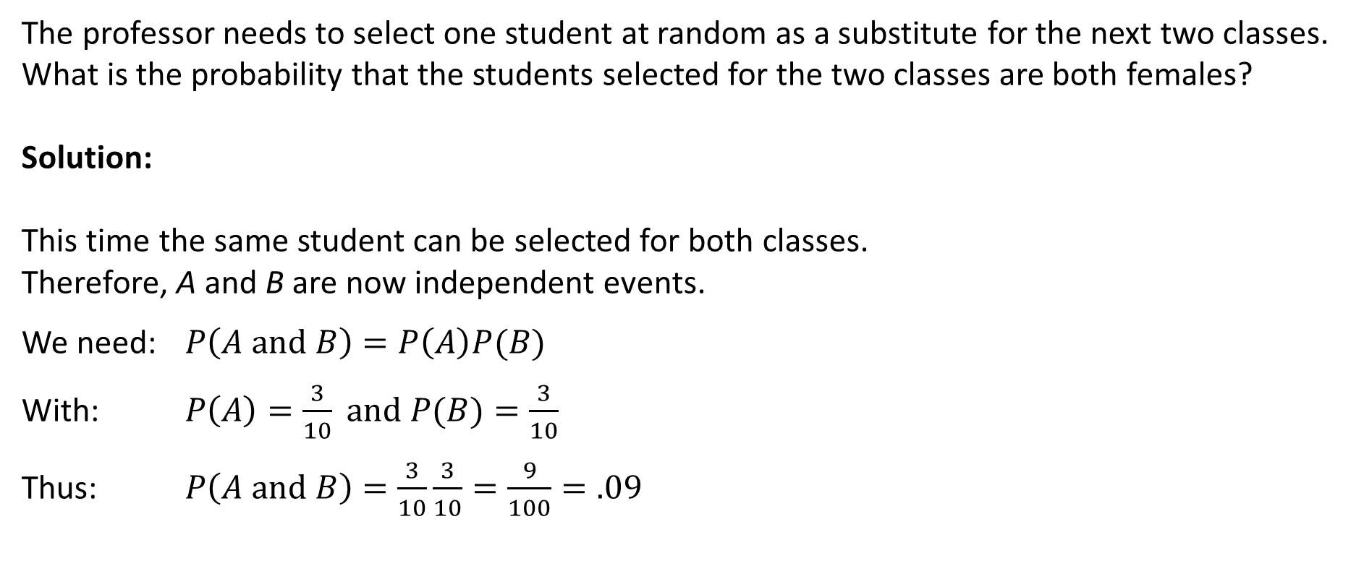
Examples – Selecting Two Students
Example – With Replacement
The professor needs to select one student at random as a substitute for the next two classes.
What is the probability that the students selected for the two classes are both females?
Solution:
This time the same student can be selected for both classes.
Therefore, A and B are now independent events.
We need: $P\left(A and B\right)=P\left(A\right)P(B)$
With: $P\left(A\right)=\frac{3}{10} and P(B)=\frac{3}{10}$
Thus: $P\left(A and B\right)=\frac{3}{10}\frac{3}{10}=\frac{9}{100}=.09$

Slide 56
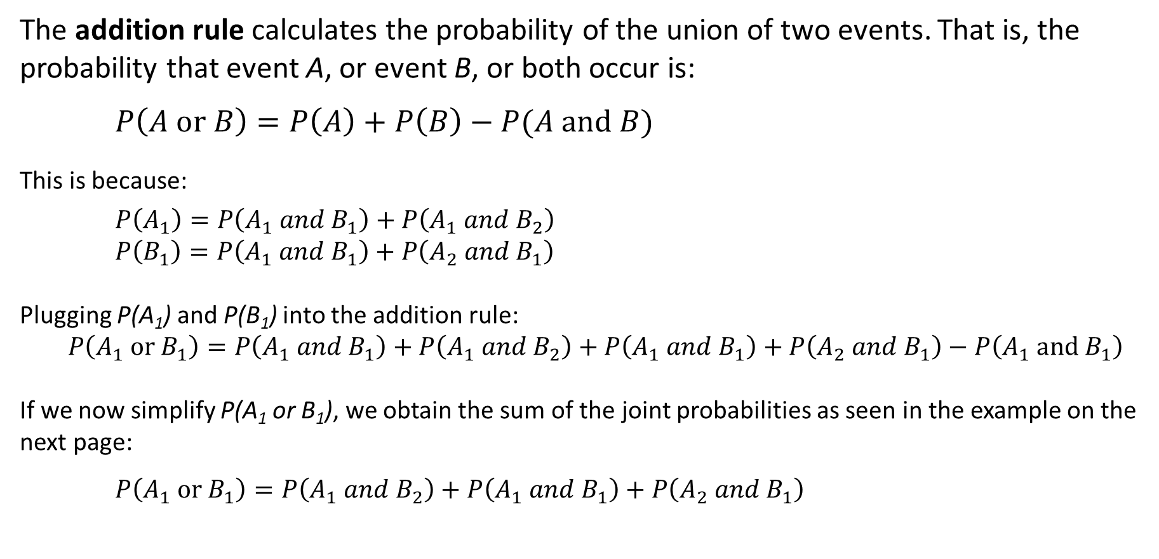
Addition Rule
The addition rule calculates the probability of the union of two events. That is, the probability that event A, or event B, or both occur is:
$$P\left(A or B\right)=P\left(A\right)+P\left(B\right)−P(A and B)$$
This is because:
$$P\left(A_{1}\right)=P\left(A_{1} and B_{1}\right)+P\left(A_{1} and B_{2}\right)$$
$$P\left(B_{1}\right)=P\left(A_{1} and B_{1}\right)+P\left(A_{2} and B_{1}\right)$$
Plugging P(A₁) and P(B₁) into the addition rule:
$P\left(A_{1} or B_{1}\right)=P\left(A_{1} and B_{1}\right)+P\left(A_{1} and B_{2}\right)+P\left(A_{1} and B_{1}\right)+P\left(A_{2} and B_{1}\right)−$ $P\left(A_{1} and B_{1}\right)$
If we now simplify P(A₁ or B₁), we obtain the sum of the joint probabilities as seen in the example on the next page:
$$P\left(A_{1} or B_{1}\right)=P\left(A_{1} and B_{2}\right)+P\left(A_{1} and B_{1}\right)+P\left(A_{2} and B_{1}\right)$$

Slide 57
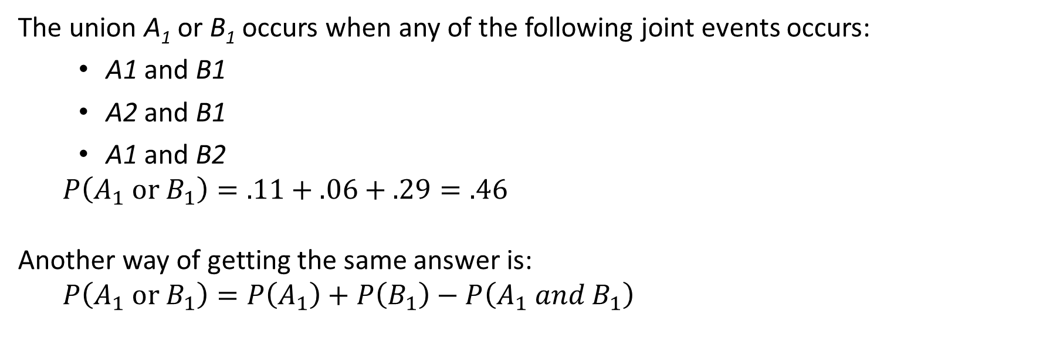
Example – Determinants of Success among Mutual Fund Managers
The union A₁ or B₁ occurs when any of the following joint events occurs:
A1 and B1
A2 and B1
A1 and B2
$$P\left(A_{1} or B_{1}\right)=.11+.06+.29=.46$$
Another way of getting the same answer is:
$$P\left(A_{1} or B_{1}\right)=P\left(A_{1}\right)+P\left(B_{1}\right)−P\left(A_{1} and B_{1}\right)$$
B1
B2
A1
A2

Slide 58
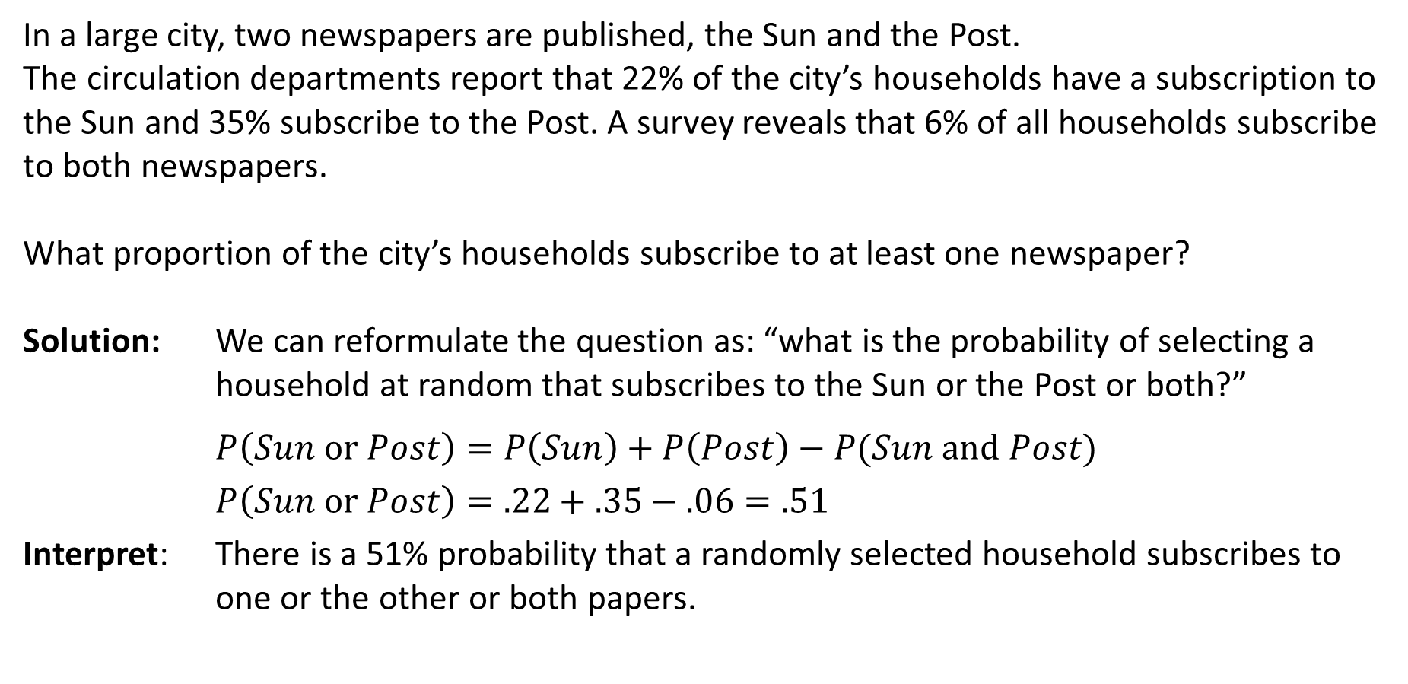
Example – Applying the Addition Rule
In a large city, two newspapers are published, the Sun and the Post.
The circulation departments report that 22% of the city’s households have a subscription to the Sun and 35% subscribe to the Post. A survey reveals that 6% of all households subscribe to both newspapers.
What proportion of the city’s households subscribe to at least one newspaper?
Solution: We can reformulate the question as: “what is the probability of selecting a household at random that subscribes to the Sun or the Post or both?”
$$P\left(Sun or Post\right)=P\left(Sun\right)+P\left(Post\right)−P(Sun and Post)$$
$$P\left(Sun or Post\right)=.22+.35−.06=.51$$
Interpret: There is a 51% probability that a randomly selected household subscribes to one or the other or both papers.

Slide 59
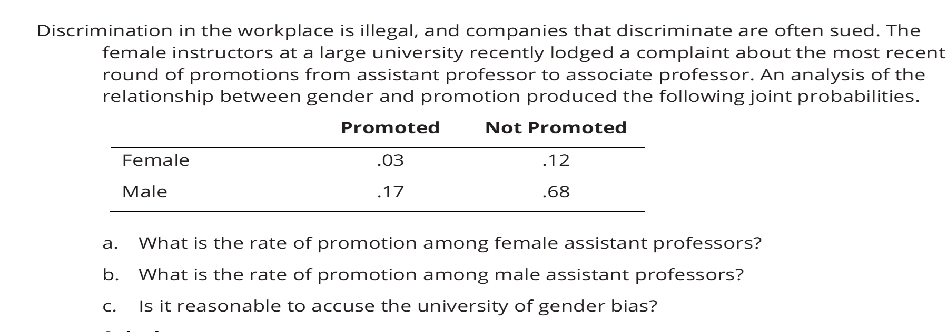

Slide 68
Probability Trees
In a probability tree, the events in an experiment are represented by branches, which are lines linked to each other.
We calculate the joint probabilities by multiplying the probabilities on the linked branches.
Parallel branches from the same node are mutually exclusive and can be added together.

Slide 69
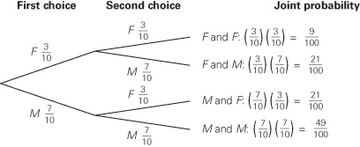
Example – With Replacement Example
The professor needs to select one student at random as a substitute for the next two classes.
What is the probability that the students selected for the two classes are both females?

Slide 70
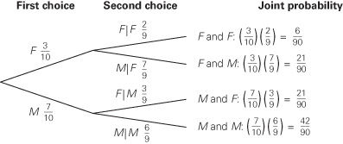
Example 6.5 Without Replacement Example
A graduate statistics course has seven male and three female students.
The professor wants to select two students at random.
What is the probability that the two students chosen are female?

Slide 71
Example - Probability of Passing the Bar Exam
Suppose that the pass rate for law school graduates taking the bar exam for the first time is 72%.
Candidates who fail the first exam may take it again later. Of those who fail their first test, 88% pass on their second attempt.
Find the probability that a randomly selected law school graduate becomes a lawyer.
Assume that candidates cannot take the exam more than twice.

Slide 72
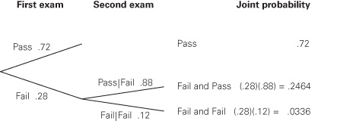
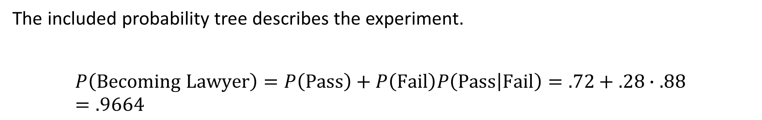
Example - Probability of Passing the Bar Exam
The included probability tree describes the experiment.
$$P\left(Becoming Lawyer\right)=P\left(Pass\right)+P\left(Fail\right)P\left(Pass | Fail\right)=.72+.28∙.88=.9664$$

Slide 73
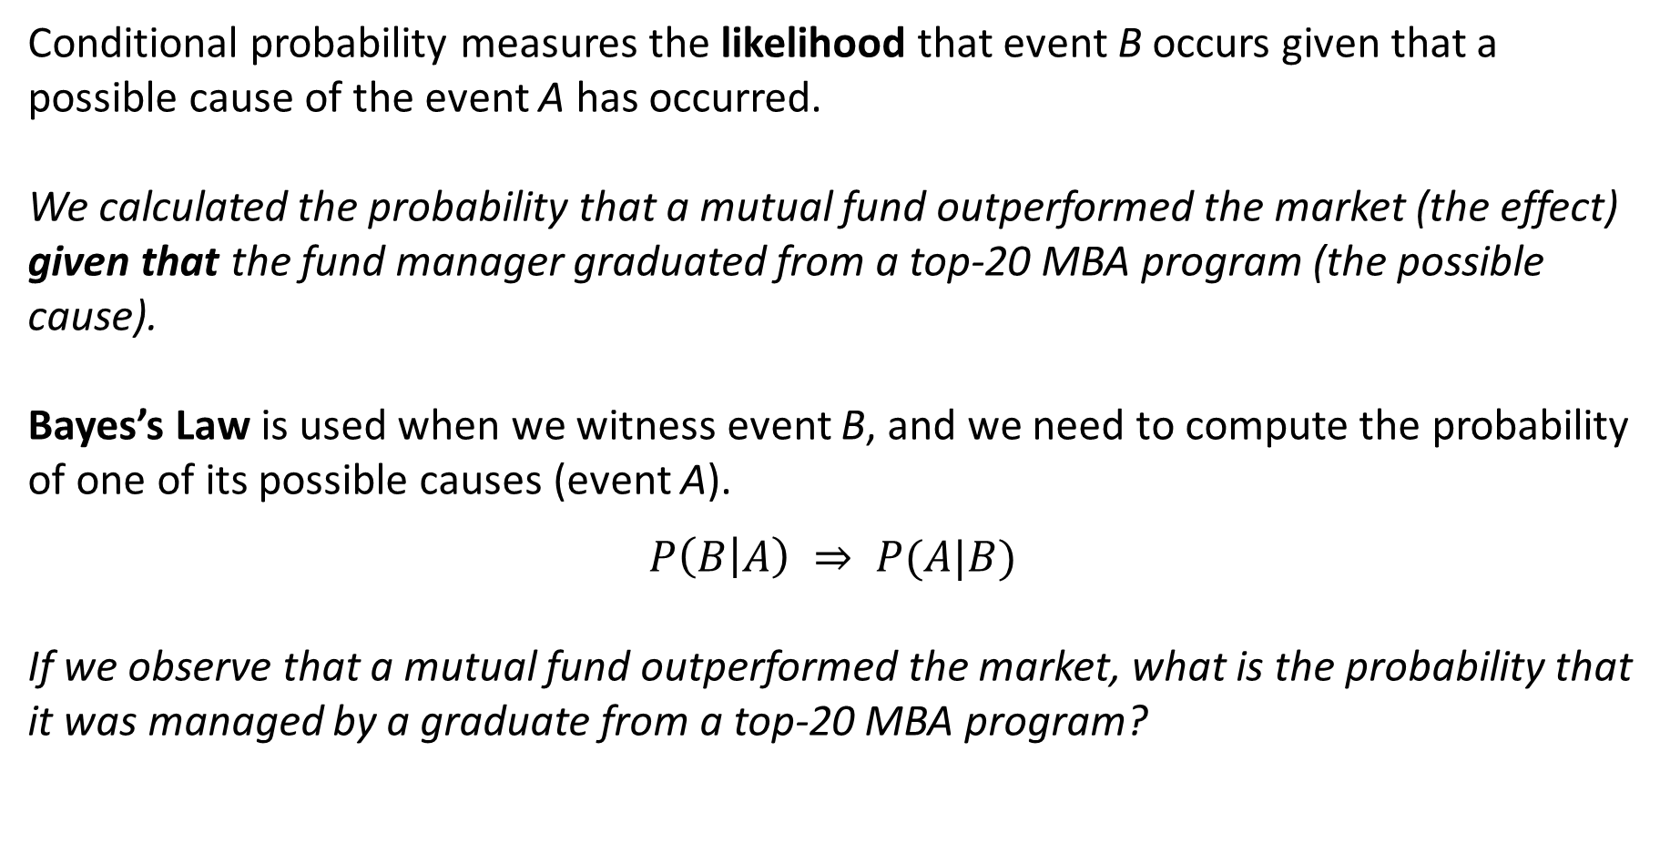
Bayes’s Law
Conditional probability measures the likelihood that event B occurs given that a possible cause of the event A has occurred.
We calculated the probability that a mutual fund outperformed the market (the effect) given that the fund manager graduated from a top-20 MBA program (the possible cause).
Bayes’s Law is used when we witness event B, and we need to compute the probability of one of its possible causes (event A).
$$P\left(B | A\right) ⇒ P(A|B)$$
If we observe that a mutual fund outperformed the market, what is the probability that it was managed by a graduate from a top-20 MBA program?

Slide 74
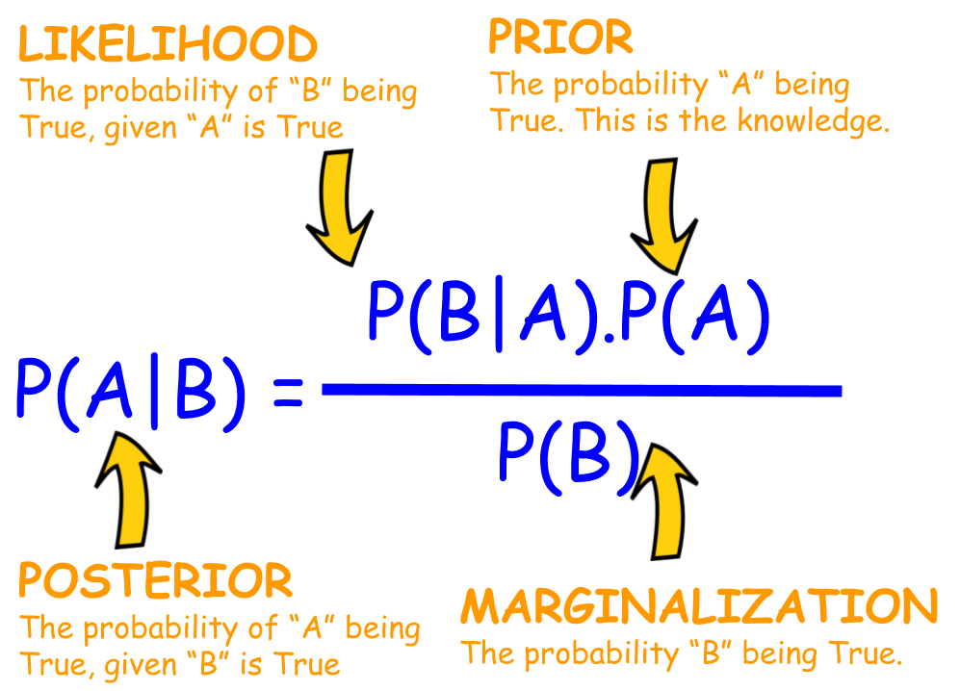
6-4 Bayes’ Law - Terminology
The probabilities P(A) and P(A^{C}) are called prior probabilities because they are determined prior to determining whether event B has taken place.
The conditional probability P(B|A) is called a likelihood probability.
The conditional probability P(A|B) is called a posterior probability (or revised probability), because the prior probability is revised after event B has taken place.
We use Bayes’ rule to determine posterior probabilities (or revised probabilities).

Slide 75

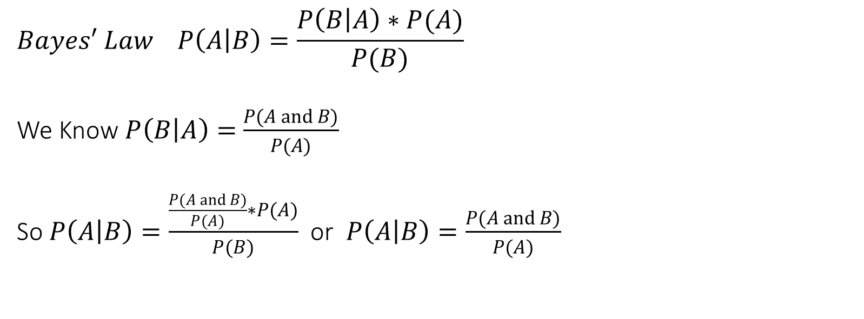
$$Bayes′ Law P\left(A | B\right)=\frac{P\left(B | A\right)∗P(A)}{P(B)}$$
We Know $P\left(B | A\right)=$ $\frac{P(A and B)}{P(A)}$
So $P\left(A | B\right)=\frac{\frac{P(A and B)}{P(A)}∗P(A)}{P(B)}$ or $P\left(A | B\right)=\frac{P(A and B)}{P(A)}$

Slide 76
Example – Building a Probability Tree
Should an MBA Applicant Take a Preparatory Course?
Suppose that a survey of MBA students reveals that among GMAT scores of at least 650, 52% took a preparatory course, whereas among GMAT scores of less than 650, only 23% took a preparatory course.
An applicant to an MBA program knows that the probability of scoring at least 650 is 10%, and he is willing to purchase the prep course only if the probability of achieving at least 650 at least doubles, or 20%.

Slide 77
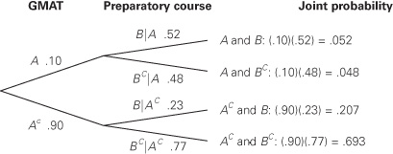
Should an MBA Applicant Take a Preparatory Course?
We can begin by defining the events A and B as follows:
A = GMAT score is 650 or more
B = Took preparatory course
Then, we can define the provided probabilities as:
P(A) = .10
P(A^{c}) = .90
P(B|A) = .52
P(B|A^{c}) = .23
Using the complement and multiplications rules
we can complete the probability tree:

Slide 78
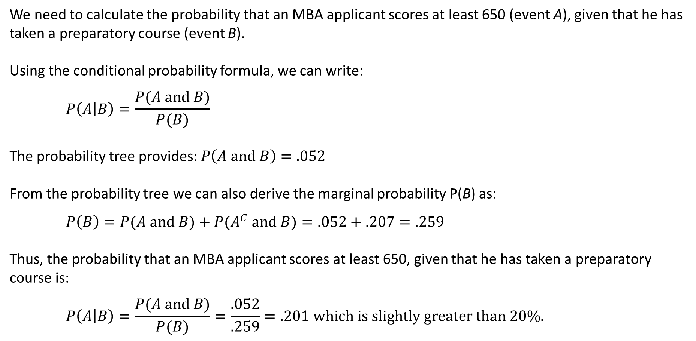
Solving a Probability Tree with Bayes’s Law
We need to calculate the probability that an MBA applicant scores at least 650 (event A), given that he has taken a preparatory course (event B).
Using the conditional probability formula, we can write:
$$P\left(A | B\right)=\frac{P(A and B)}{P(B)}$$
The probability tree provides: $P\left(A and B\right)=.052$
From the probability tree we can also derive the marginal probability P(B) as:
$$P\left(B\right)=P(A and B)+P(A^{C} and B)=.052+.207=.259$$
Thus, the probability that an MBA applicant scores at least 650, given that he has taken a preparatory course is:
$$P\left(A | B\right)=\frac{P(A and B)}{P(B)}=\frac{.052}{.259}=.201 which is slightly greater than 20\%.$$

Slide 79
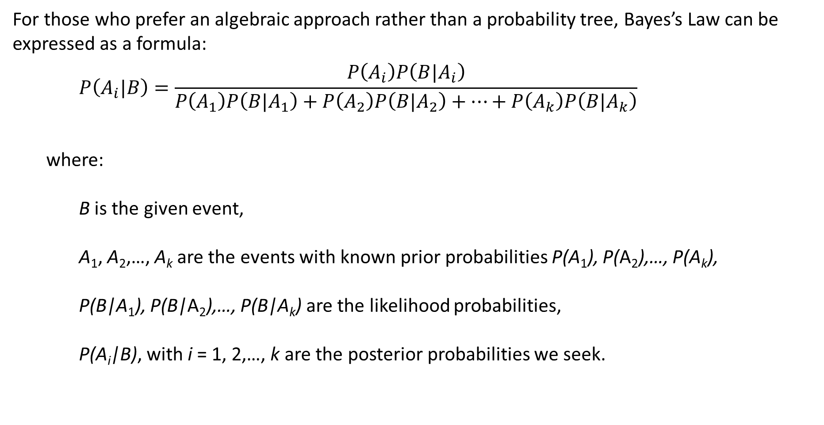
Bayes’s Law Formula
For those who prefer an algebraic approach rather than a probability tree, Bayes’s Law can be expressed as a formula:
$$P\left(A_{i}|B\right)=\frac{P\left(A_{i}\right)P\left(B|A_{i}\right)}{P\left(A_{1}\right)P\left(B|A_{1}\right)+P\left(A_{2}\right)P\left(B|A_{2}\right)+…+P\left(A_{k}\right)P\left(B|A_{k}\right)}$$
where:
B is the given event,
A₁, A₂,…, A_{k} are the events with known prior probabilities P(A₁), P(A₂),…, P(A_{k}),
P(B|A₁), P(B|A₂),…, P(B|A_{k}) are the likelihood probabilities,
P(A_{i}|B), with i = 1, 2,…, k are the posterior probabilities we seek.

Slide 80
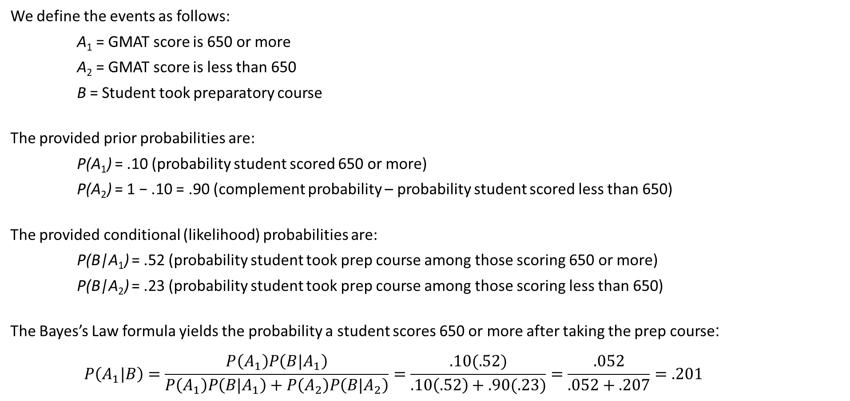
Example - Solving with Bayes’s Law Formula
Should an MBA Applicant Take a Preparatory Course?
We define the events as follows:
A₁ = GMAT score is 650 or more
A₂ = GMAT score is less than 650
B = Student took preparatory course
The provided prior probabilities are:
P(A₁) = .10 (probability student scored 650 or more)
P(A₂) = 1 − .10 = .90 (complement probability – probability student scored less than 650)
The provided conditional (likelihood) probabilities are:
P(B|A₁) = .52 (probability student took prep course among those scoring 650 or more)
P(B|A₂) = .23 (probability student took prep course among those scoring less than 650)
The Bayes’s Law formula yields the probability a student scores 650 or more after taking the prep course:
$$P\left(A_{1}|B\right)=\frac{P\left(A_{1}\right)P\left(B|A_{1}\right)}{P\left(A_{1}\right)P\left(B|A_{1}\right)+P\left(A_{2}\right)P\left(B|A_{2}\right)}=\frac{.10(.52)}{.10\left(.52\right)+.90(.23)}=\frac{.052}{.052+.207}=.201$$

Slide 81
Additional Example – Narcotics
In a particular pain clinic, 10% of patients are prescribed narcotic pain killers. Overall, five percent of the clinic’s patients are addicted to narcotics (including pain killers and illegal substances). Out of all the people prescribed pain pills, 8% are addicts. If a patient is an addict, what is the probability that they will be prescribed pain pills?
Step 1: Figure out what your event “A” is from the question.
The event that happens first (A) is being prescribed pain pills. That’s given as 10%.
Step 2: Figure out what your event “B” is from the question.
Event B is being an addict. That’s given as 5%.
Step 3: Figure out what the probability of event B (Step 2) given event A (Step 1). In other words, find what (B|A) is. We want to know “Given that people are prescribed pain pills, what’s the probability they are an addict?” That is given in the question as 8%.
Step 4: Insert your answers from Steps 1, 2 and 3 into the formula and solve. P(A|B) = P(B|A) * P(A) / P(B) = (0.08 * 0.1)/0.05 = 0.16
The probability of an addict being prescribed pain pills is 0.16 (16%).

Slide 82
6-5 Identifying the Correct Method
The key issue is to determine whether joint probabilities are provided or are required:
Joint probabilities are provided
Compute marginal probabilities by adding across rows and down columns.
Use the joint and marginal probabilities to compute conditional probabilities.
Determine whether the events described by the table are independent.
Apply the addition rule to compute the probability that either of two events occur.
Joint probabilities are required
Apply probability rules or build a probability tree.
Use the multiplication rule to calculate the probability of intersections.
Apply addition and complement rules for mutually exclusive events.
Compute posterior probability using the Bayes’s Law.

