Slide 1
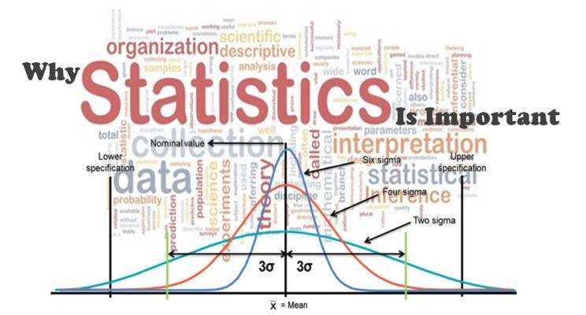
ECON 2110
Fall 2025
Chapter 4: Numerical Descriptive Techniques

Slide 2
Sample Statistic or Population Parameter
A parameter is a descriptive measurement about a population, and a statistic is a descriptive measurement about a sample.
In this chapter, we introduce a dozen descriptive measurements. For each one, we describe how to calculate both the population parameter and the sample statistic.
In most realistic applications, the calculation of parameters are not practical, and they are provided here primarily to teach the concept and the notation.

Slide 3
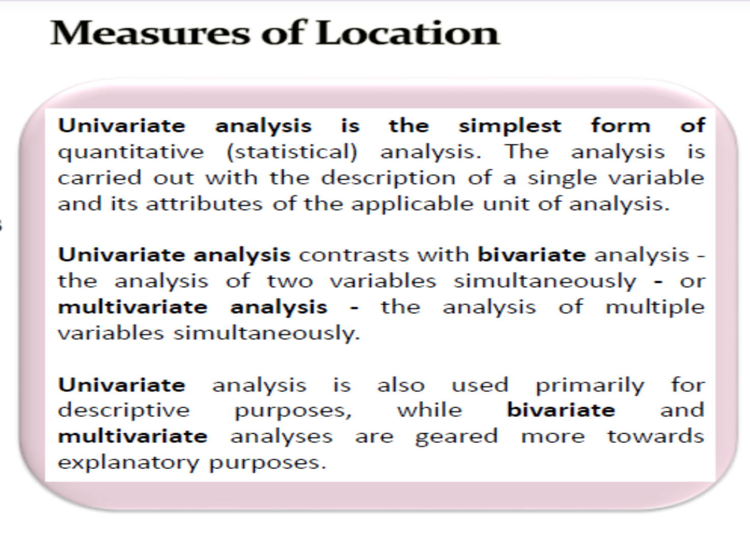

Slide 4
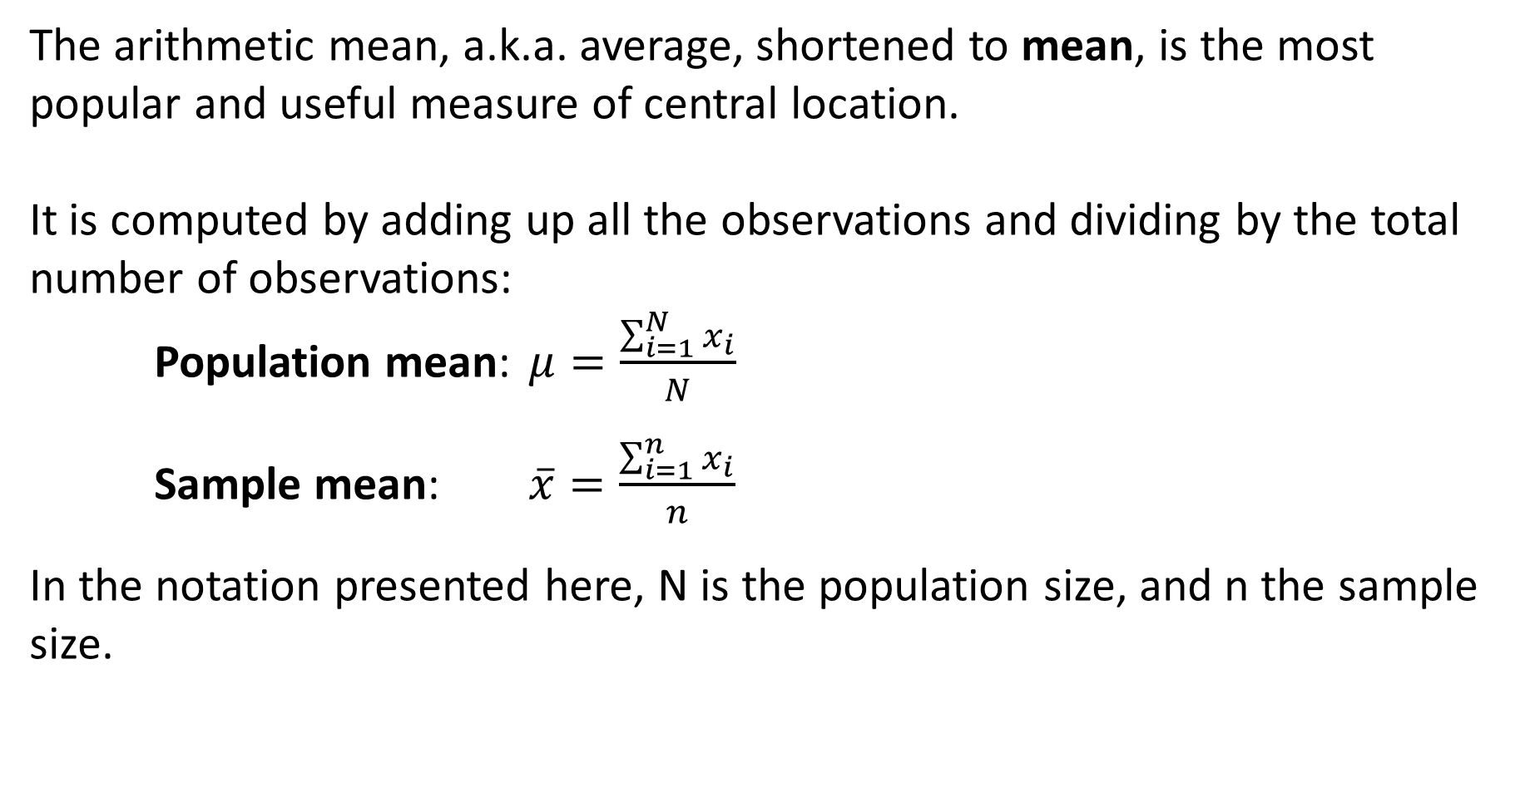
Arithmetic Mean
The arithmetic mean, a.k.a. average, shortened to mean, is the most popular and useful measure of central location.
It is computed by adding up all the observations and dividing by the total number of observations:
Population mean: $μ=\frac{\sum_{i=1}^{N}{x_{i}}}{N}$
Sample mean: $\overline{x}=\frac{\sum_{i=1}^{n}{x_{i}}}{n}$
In the notation presented here, N is the population size, and n the sample size.

Slide 5
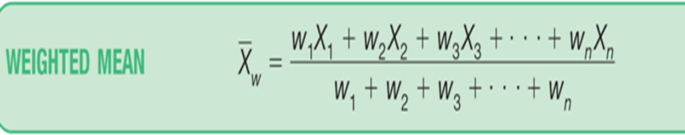
Weighted Mean
The weighted mean of a set of numbers X₁, X₂, ..., X_{n}, with corresponding weights w₁, w₂, ...,w_{n}, is computed from the following formula:

Slide 6
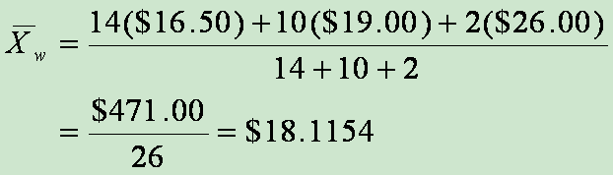
Weighted Mean EXAMPLE – Weighted Mean
The Carter Construction Company pays its hourly employees $16.50, $19.00, or $25.00 per hour. There are 26 hourly employees, 14 of which are paid at the $16.50 rate, 10 at the $19.00 rate, and 2 at the $25.00 rate. What is the mean hourly rate paid the 26 employees?

Slide 7
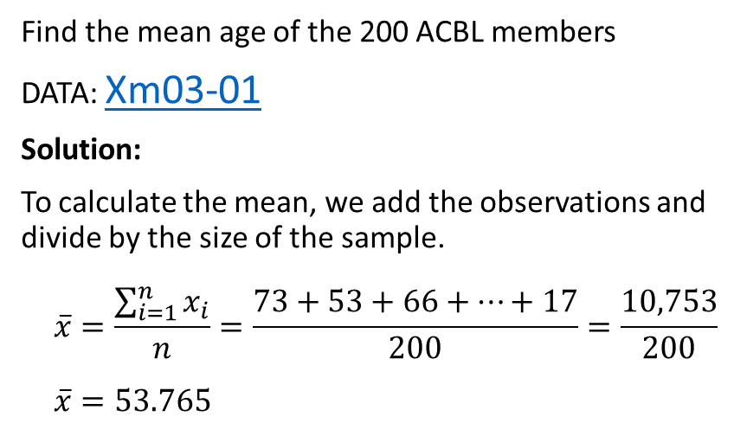
Mean Age of ACBL Members
Question
EXCEL Function
Find the mean age of the 200 ACBL members
DATA: Xm03-01
Solution:
To calculate the mean, we add the observations and divide by the size of the sample.
$$\overline{x}=\frac{\sum_{i=1}^{n}{x_{i}}}{n}=\frac{73+53+66+⋯+17}{200}=\frac{10,753}{200}$$
$$\overline{x}=53.765$$
If we want to compute the mean and no other statistics, we can use the AVERAGE function.
Instructions:
Type or import the data into one or more columns. (Open Xm03-01.) Type into any empty cell:
= AVERAGE([Input Range])
We would type into any empty cell:
= AVERAGE(A2:A201)
The active cell would store the mean as 53.765.
Notes:
Instructions:
Type or import the data into one column. (Open Xm03-01.)
Click Data, Data Analysis, and Descriptive Statistics.
Specify the Input Range (A1:A201) and click Summary Statistics.

Slide 8
Median and Mode
The median is calculated by placing all the observations in order (ascending or descending).
The observation that falls in the middle is the median.
The sample and population medians are computed in the same way.
When there is an even number of observations, the median is determined by averaging the two observations in the middle.
The mode is defined as the observation (or observations) that occurs with the greatest frequency.
Both the statistic and parameter are computed in the same way.

Slide 9
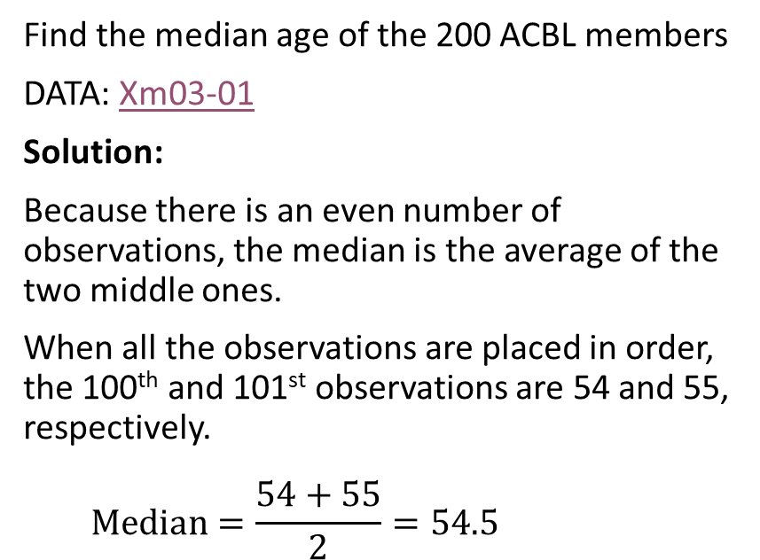
Median Age of ACBL Members
Question
EXCEL Function
Find the median age of the 200 ACBL members
DATA: Xm03-01
Solution:
Because there is an even number of observations, the median is the average of the two middle ones.
When all the observations are placed in order, the 100th and 101st observations are 54 and 55, respectively.
$$Median=\frac{54+55}{2}=54.5$$
If we want to compute the median and no other statistics, we can use the MEDIAN function.
Instructions:
Type or import the data into one or more columns. (Open Xm03-01.) Type into any empty cell:
= MEDIAN([Input Range])
In Example 4.4, we would type into any empty cell:
= MEDIAN(A2:A201)
The active cell would store the median as 54.5.

Slide 10
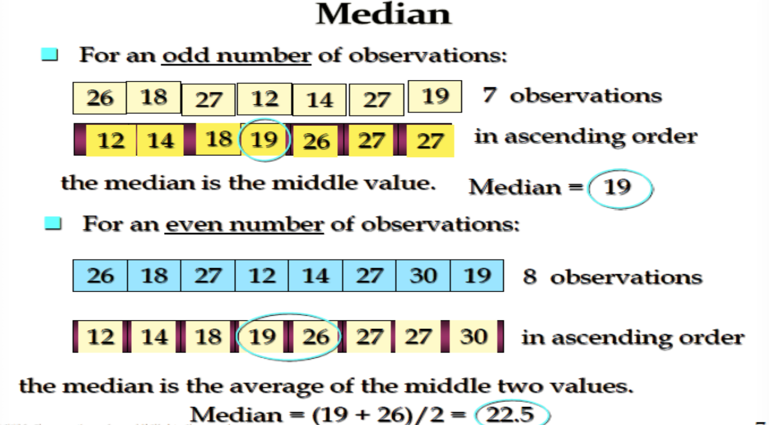

Slide 11
Mode of Ages of ACBL Members
Question
EXCEL Function
Find the mode of ages of the 200 ACBL members.
DATA: Xm03-01
Solution:
The observation that occurs with the greatest frequency is 60, which occurs 8 times.
If we want to compute the mode and no other statistics, we can use the MODE.SNGL function.
Instructions:
Type or import the data into one or more columns. (Open Xm03-01
Type into any empty cell:
= MODE.SNGL([Input Range])
We would type into any empty cell:
= MODE.SNGL(A1:A201)
The active cell would store the mode as 60.
Note that if there is more than one mode, Excel prints only the smallest one, without indicating that there are other modes.
For multiple modes, use the Excel function MODE.MULT.

Slide 12
Mean, Median, Mode: Which Is Best?
With three measures from which to choose, which one should we use?
The mean is generally our first selection.
However, one advantage the median holds is that it not as sensitive to skewed distributions or to extreme values as is the mean.
The mode is seldom the best measure of central location.

Slide 13
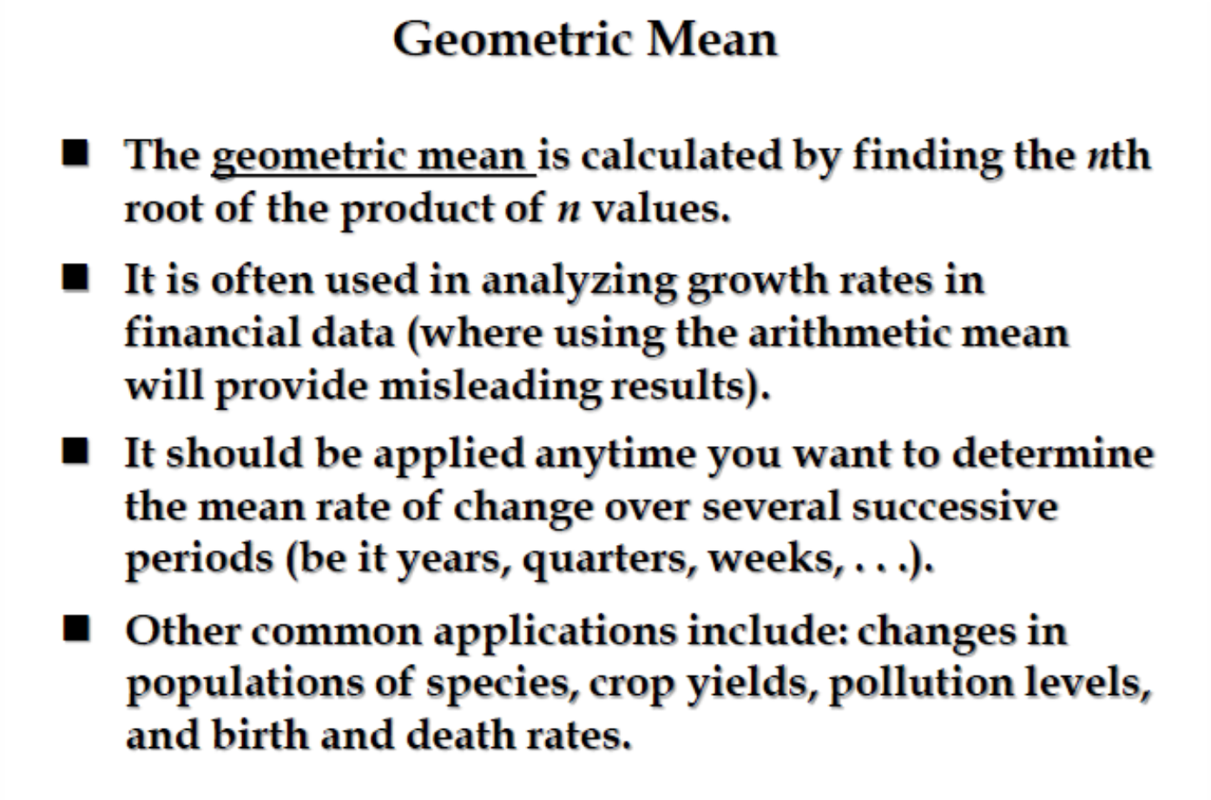

Slide 14
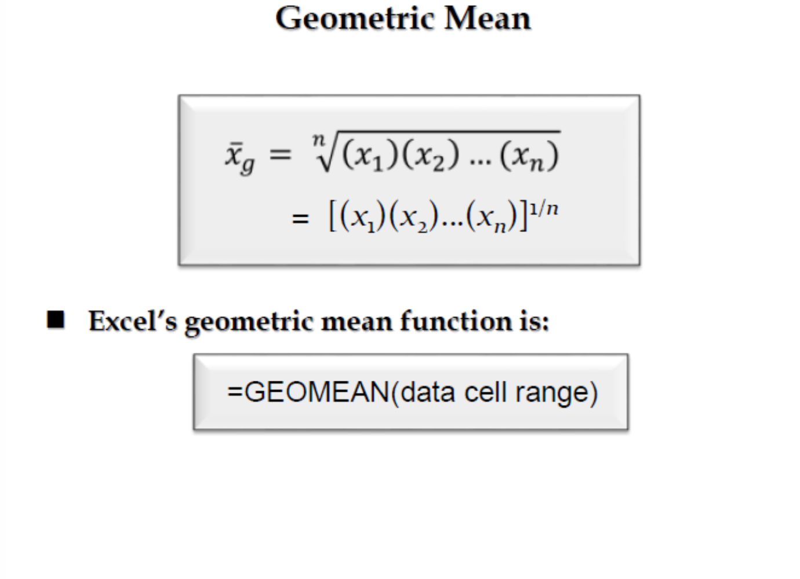

Slide 15
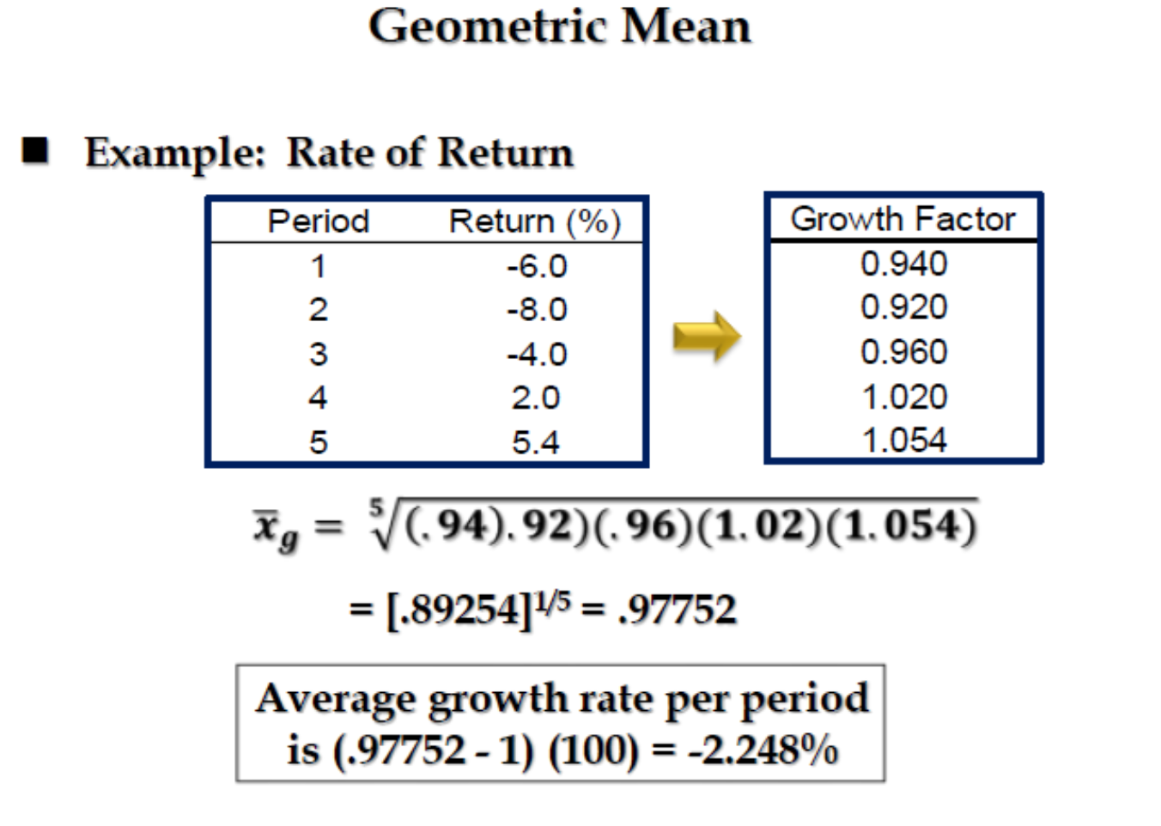

Slide 16
Measures of Central Location for Ordinal and Nominal Data
For ordinal and nominal data, the calculation of the mean is not valid.
Median is appropriate for ordinal data.
For nominal data, a mode calculation is useful for determining the highest frequency but not the “central location”.
Summary of the measures discussed in this section and when to use them:
Measure | Type of Data | Descriptive Measurement
Mean | Interval | Central location
Median | Ordinal or interval | Central location
Mode | Nominal, ordinal, or interval
Geometric Mean | Interval, growth rates

Slide 17
Measures of Variability
Besides the measures of central location, there are other characteristics of data that are of interest to us, such as the spread or variability of the data.
In this section, we introduce four measures of variability for interval data.
We begin with the simplest:
Range = Largest observation – Smallest observation
The range is a very simple measure, but because it only considers the two extreme values in the data, we need to consider other statistics that incorporate all the values.
Example:
Set 1: 4 4 4 4 4 50
Set 2: 4 8 15 24 39 50

Slide 18
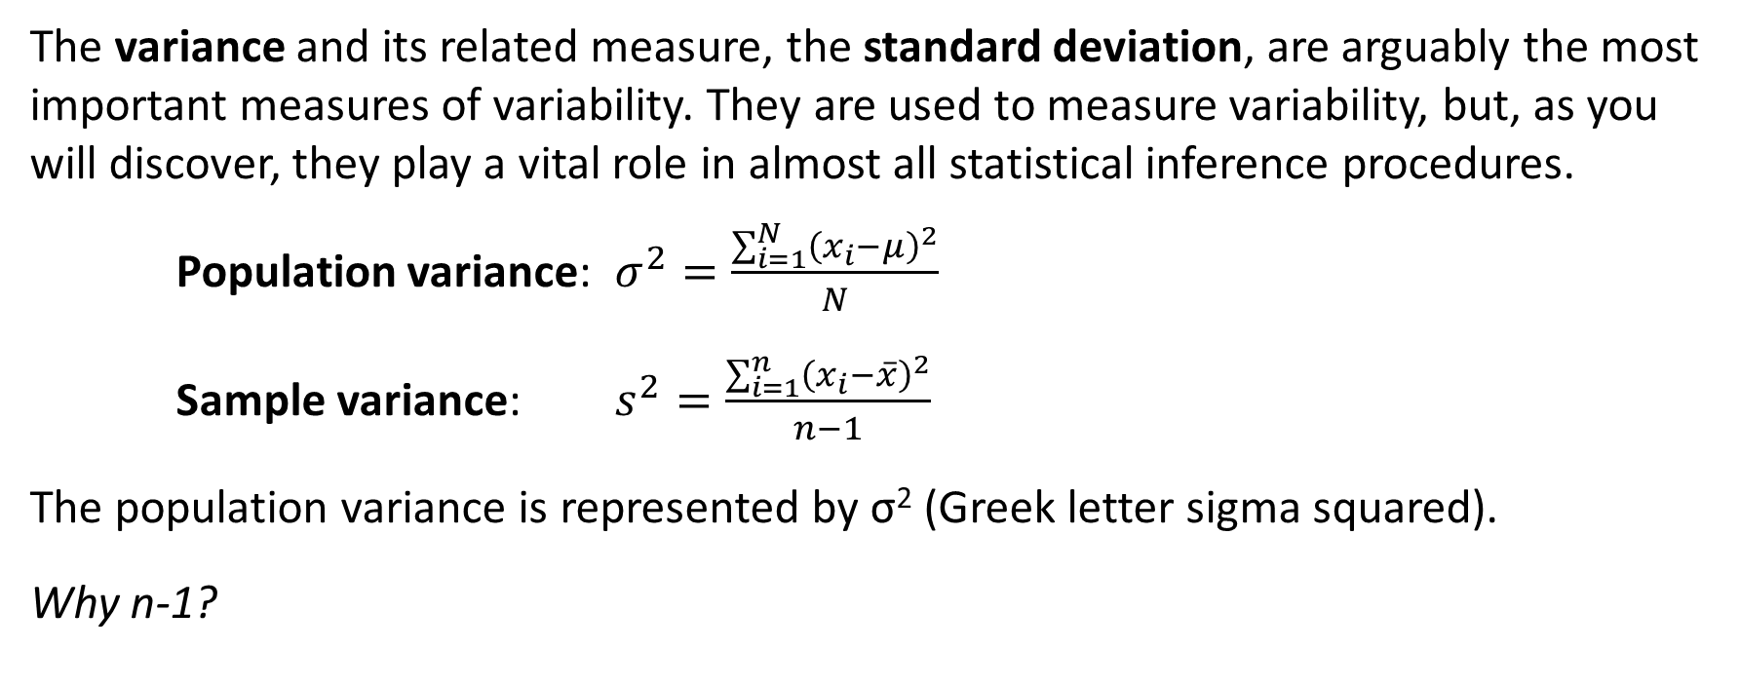
Variance
The variance and its related measure, the standard deviation, are arguably the most important measures of variability. They are used to measure variability, but, as you will discover, they play a vital role in almost all statistical inference procedures.
Population variance: $σ^{2}=\frac{\sum_{i=1}^{N}{{\left(x_{i}−μ\right)}^{2}}}{N}$
Sample variance: $s^{2}=\frac{\sum_{i=1}^{n}{{\left(x_{i}−\overline{x}\right)}^{2}}}{n−1}$
The population variance is represented by σ² (Greek letter sigma squared).
Why n-1?

Slide 19
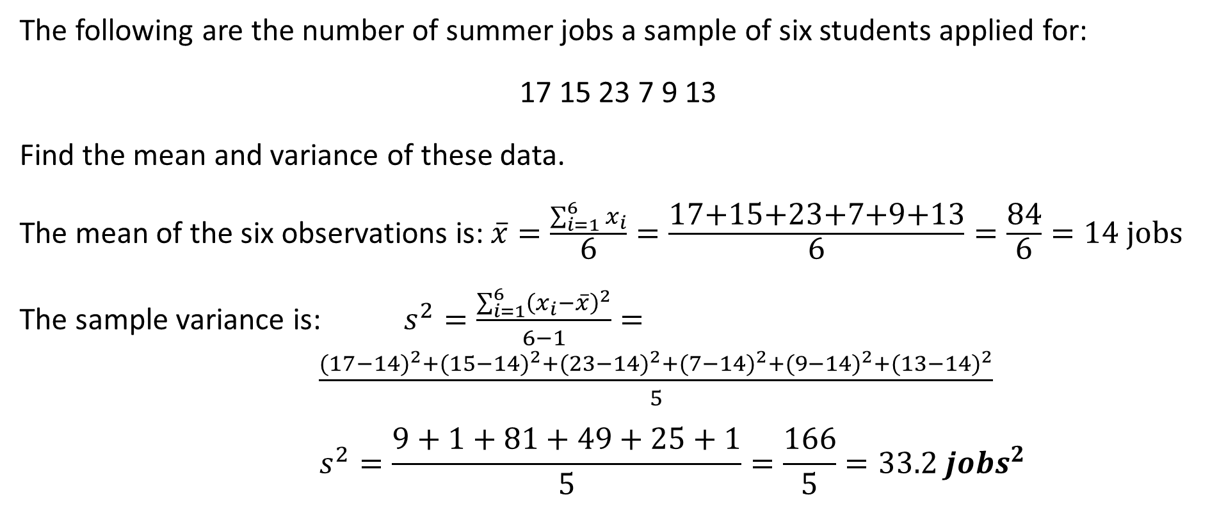
Summer Jobs
Sample Variance
The following are the number of summer jobs a sample of six students applied for:
17 15 23 7 9 13
Find the mean and variance of these data.
The mean of the six observations is: $\overline{x}=\frac{\sum_{i=1}^{6}{x_{i}}}{\text{6}}=\frac{\text{17+15+23+7+9+13}}{\text{6}}=\frac{\text{84}}{\text{6}}=14 jobs$
The sample variance is: $s^{2}=\frac{\sum_{i=1}^{6}{{\left(x_{i}−\overline{x}\right)}^{2}}}{6−1}=\frac{{(17−14)}^{2}+{(15−14)}^{2}+{(23−14)}^{2}+{(7−14)}^{2}+{(9−14)}^{2}+{(13−14)}^{2}}{5}$
$$s^{2}=\frac{9+1+81+49+25+1}{5}=\frac{166}{5}=33.2 {jobs}^{2}$$

Slide 20
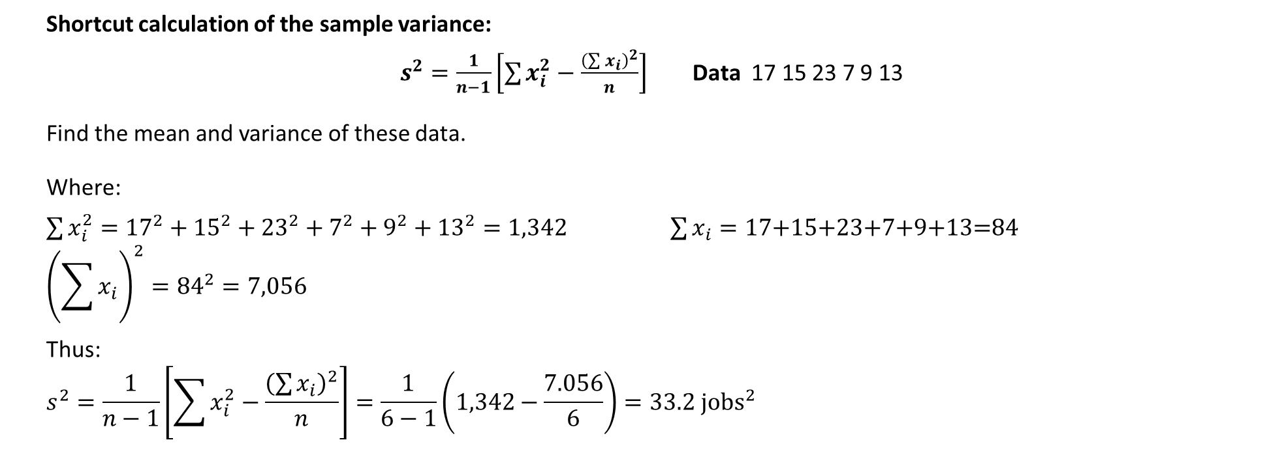
Shortcut calculation of the sample variance
Shortcut calculation of the sample variance:
$s^{2}=\frac{1}{n−1}\left[\sum{x_{i}^{2}−\frac{{\left(\sum{x_{i}}\right)}^{2}}{n}}\right]$ Data 17 15 23 7 9 13
Find the mean and variance of these data.
Where:
$\sum{x_{i}^{2}={17}^{2}+{15}^{2}+{23}^{2}+7^{2}+9^{2}+{13}^{2}=1,342}$ $\sum{x_{i}}=\text{17+15+23+7+9+13=84}$
$${\left(\sum{x_{i}}\right)}^{2}={84}^{2}=7,056$$
Thus:
$$s^{2}=\frac{1}{n−1}\left[\sum{x_{i}^{2}−\frac{{\left(\sum{x_{i}}\right)}^{2}}{n}}\right]=\frac{1}{6−1}\left(1,342−\frac{7.056}{6}\right)=33.2 {jobs}^{2}$$

Slide 21
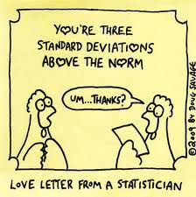
Interpreting the Variance
Because to calculate the variance we squared the deviations from the mean, the unit of the variance is the square of the unit of the original observations.
We resolve this complication by introducing the standard deviation, defined as the square root of the variance.

Slide 22
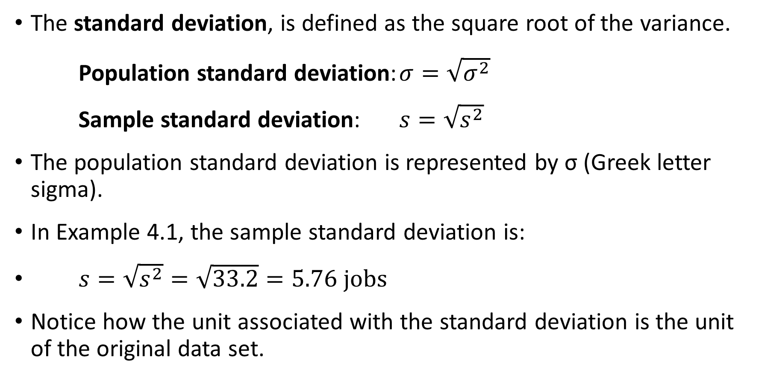
Standard Deviation
The standard deviation, is defined as the square root of the variance.
Population standard deviation: $σ=\sqrt{σ^{2}}$
Sample standard deviation: $s=\sqrt{s^{2}}$
The population standard deviation is represented by σ (Greek letter sigma).
In Example 4.1, the sample standard deviation is:
$s=\sqrt{s^{2}}=\sqrt{33.2}=5.76 jobs$
Notice how the unit associated with the standard deviation is the unit of the original data set.
Notes:
Also explain outliers from prep 101.

Slide 23
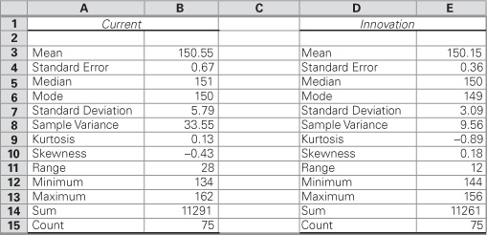
Comparing the Consistency of Two Types of Golf Clubs
A golfer was asked to hit 150 shots using a 7 iron, 75 of which were hit with the current club and 75 with the new innovative 7 iron. The distances were measured and recorded in file Xm04-08. Which 7 iron is more consistent?
Solution:
We use the standard deviations to gauge
consistency. We can use the Excel formula
STDEV.S or we can use the Descriptive
Statistics tool in the Data Analysis, as shown to the right.
Interpret:
Based on this sample, the innovative club is more consistent (5.79 > 3.09.) Because the mean distances are also very similar (150.55 vs. 150.15), it appears that the new club is indeed superior.

Slide 24
The Empirical Rule
Knowing the mean and standard deviation allows the statistics practitioner to extract useful bits of information from the data.
The information depends on the shape of the histogram. If the histogram is bell shaped, we can use the Empirical Rule:
Approximately 68% of all observations fall within one standard deviation of the mean.
Approximately 95% of all observations fall within two standard deviations of the mean.
Approximately 99.7% of all observations fall within three standard deviations of the mean.
Notes:
Explain more on the empirical rule from prep 101 + solve example

Slide 25
Using the Empirical Rule to Interpret
Standard Deviation
After an analysis of the returns on an investment, a statistics practitioner discovered that the histogram is bell shaped and that the mean and standard deviation are 10% and 8% , respectively.
What can you say about the way the returns are distributed?
Solution:
Because the histogram is bell shaped, we can apply the Empirical Rule:
Approximately 68% of the returns lie between: (10 – 8)% = 2% and 10 + 8)% = 18%
Approximately 95% of the returns lie between: [10 – 2(8)]% = –6% and [10 + 2(8)]% = 26%
Approximately 99.7% of the returns lie between: (10 – 3(8)]% = –14% and [10 + 3(8)]% = 34%
Notes:
We don’t need to know all data points anymore

Slide 26
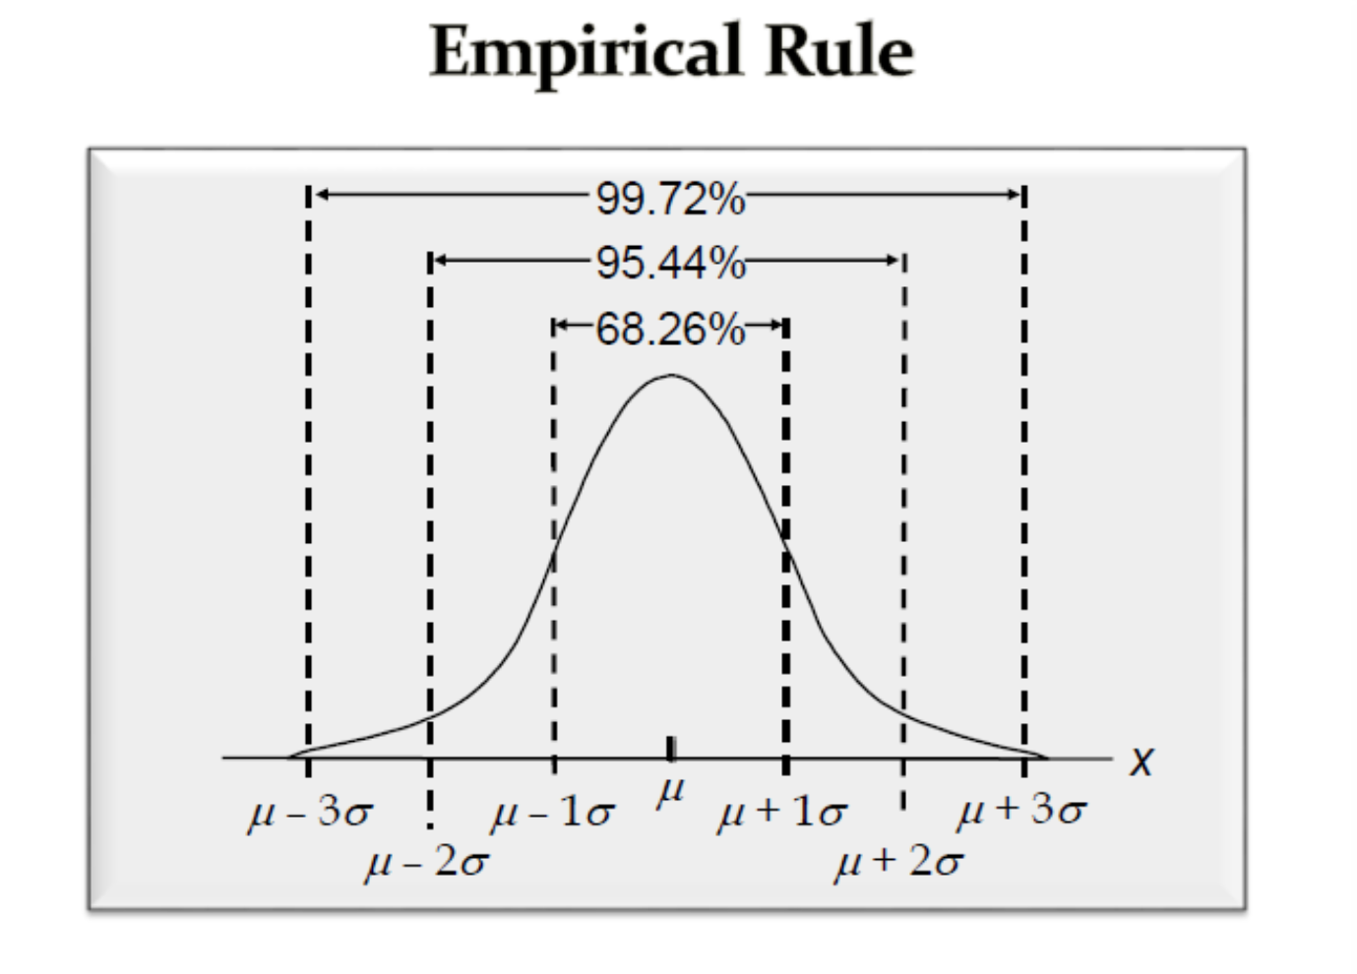

Slide 27
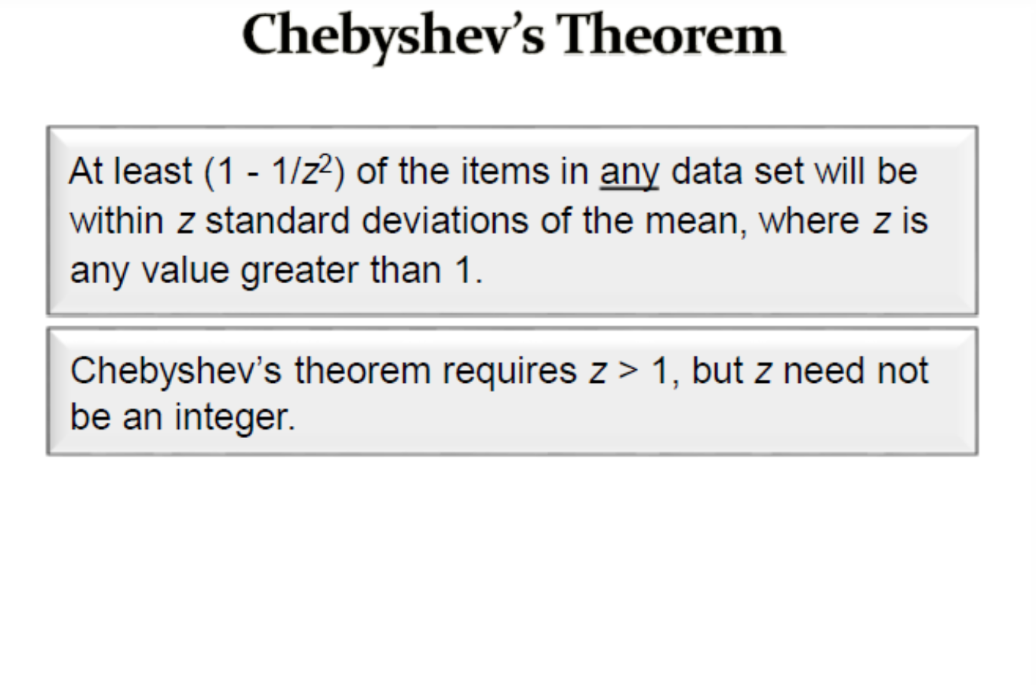
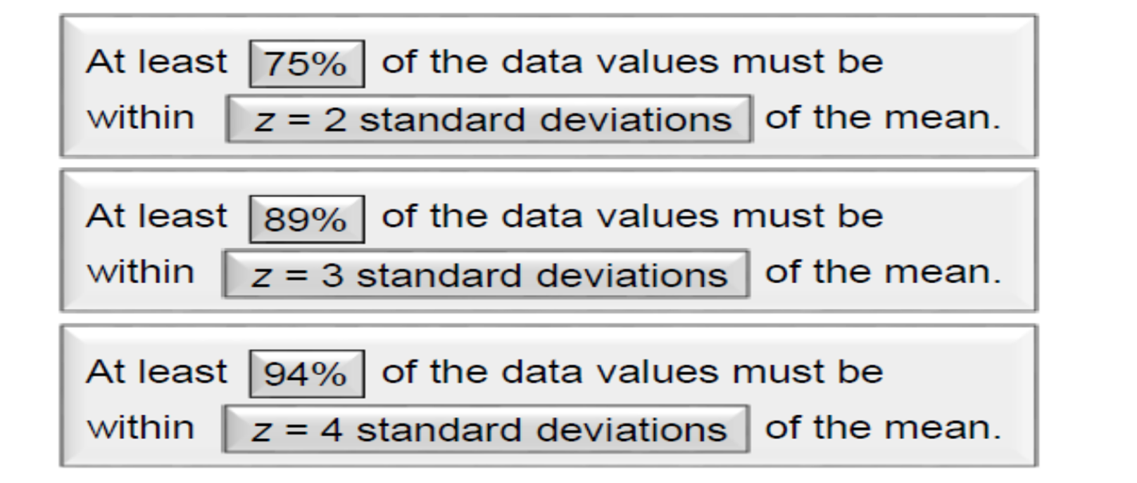

Slide 28
Using Chebysheff’s Theorem to Interpret Standard Deviation
The annual salaries of the employees of a chain of computer stores produced a positively skewed histogram. The mean and standard deviation are $28,000 and $3,000, respectively.
What can you say about the salaries at this chain?
Solution:
Because the histogram is not bell shaped, we must apply Chebysheff’s Theorem instead.
The intervals created by adding and subtracting two and three standard deviations to and from the mean are as follows:
At least 75% of the salaries lie between ($28k – 2 ∙ $3k) = $22k and ($28k + 2 ∙ $3k) = $34k
At least 88.9% of the salaries lie between ($28k – 3 ∙ $3k) = $19k and ($28k + 3 ∙ $3k) = $37k

Slide 29
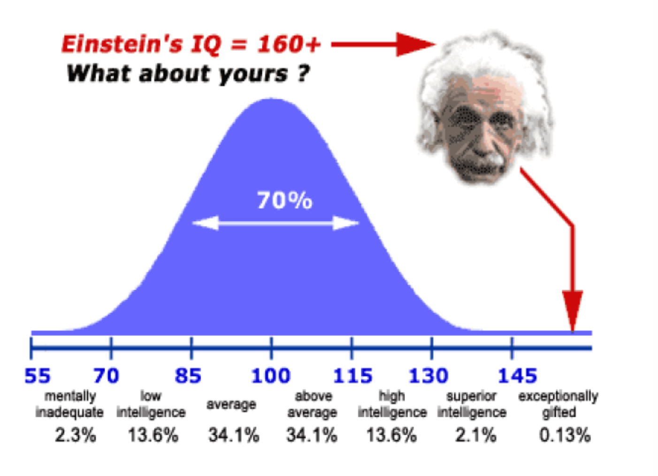

Slide 30
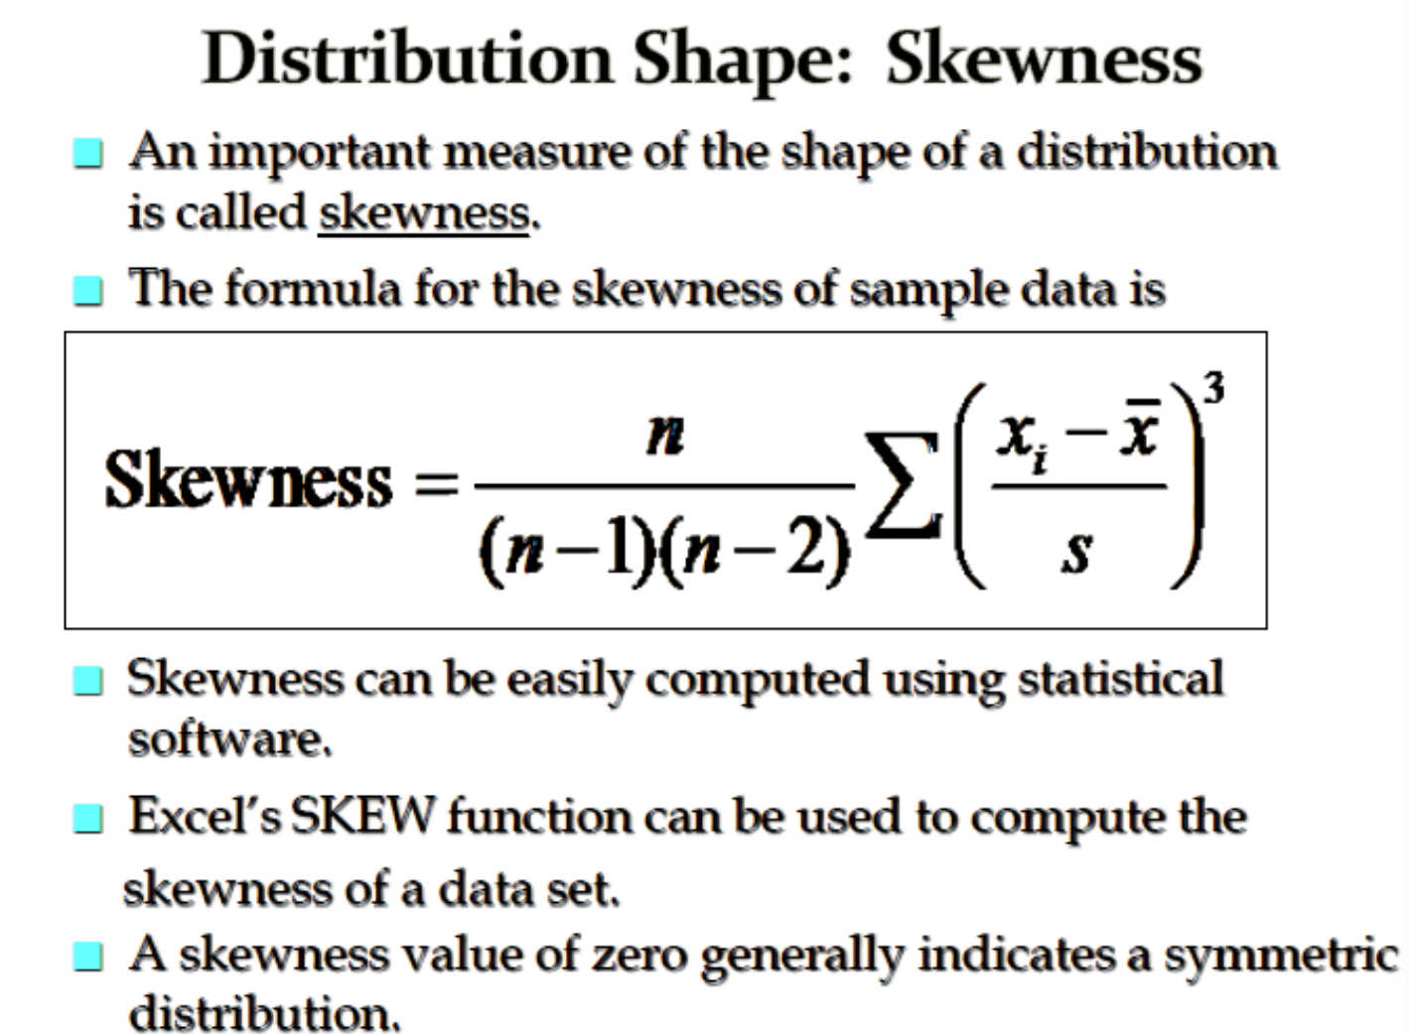

Slide 31
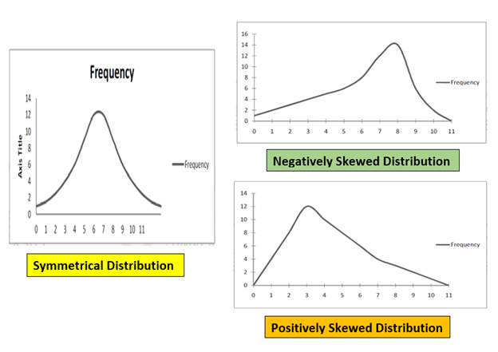

Slide 32
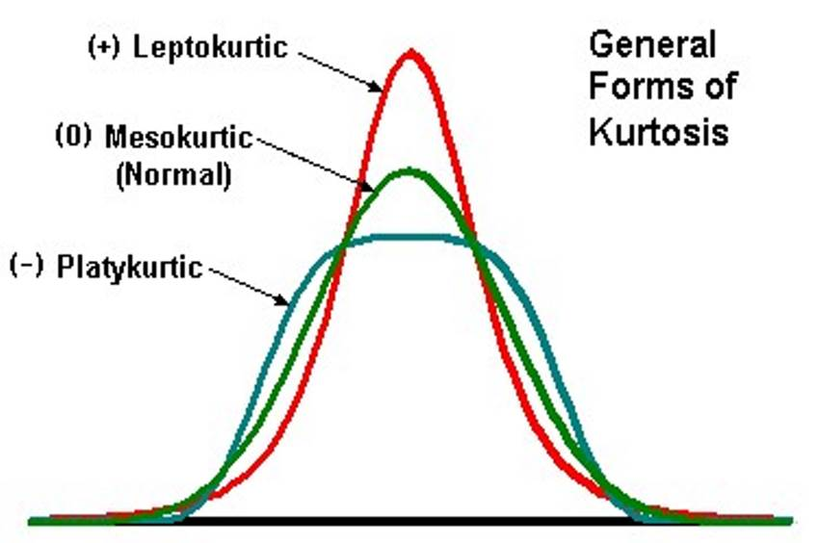
Kurtosis

Slide 33
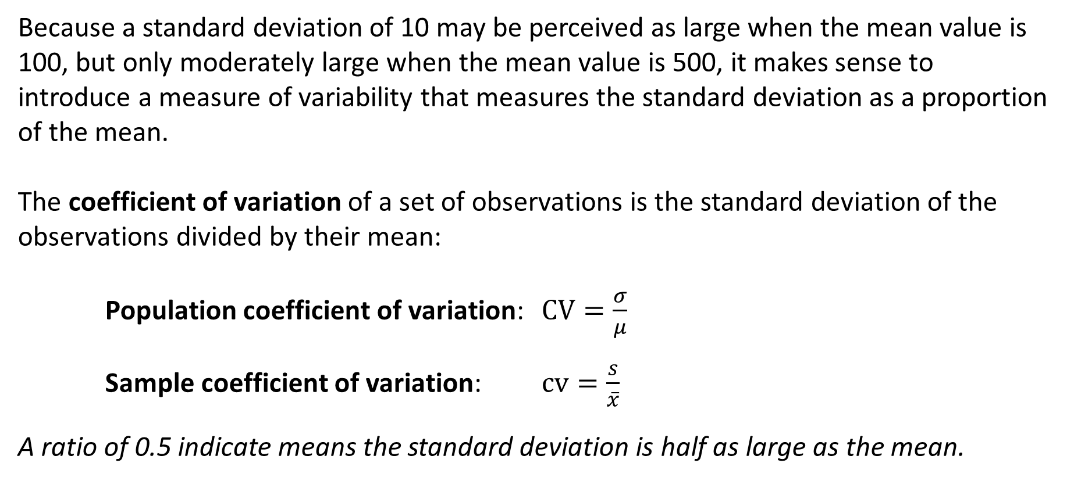
Coefficient of Variation
Because a standard deviation of 10 may be perceived as large when the mean value is 100, but only moderately large when the mean value is 500, it makes sense to introduce a measure of variability that measures the standard deviation as a proportion of the mean.
The coefficient of variation of a set of observations is the standard deviation of the observations divided by their mean:
Population coefficient of variation: $CV=\frac{σ}{μ}$
Sample coefficient of variation: $cv=\frac{s}{\overline{x}}$
A ratio of 0.5 indicate means the standard deviation is half as large as the mean.

Slide 34
Measures of Relative Standing
Measures of relative standing are designed to provide information about the position of a particular value relative to the entire data set.
Percentile
The P^{th} percentile is the value for which P% are less than that value and (100-P)% are greater than that value.
Suppose you scored in the 60th percentile on the SAT, that means 60% of the other scores were below yours, while 40% were above yours.
Of special importance are the 25th, 50th, and 75th percentiles, named first quartile (Q₁), second quartile (Q₂ or the median), and third quartile (Q₃), respectively. We can also convert percentiles into quintiles and deciles.

Slide 35
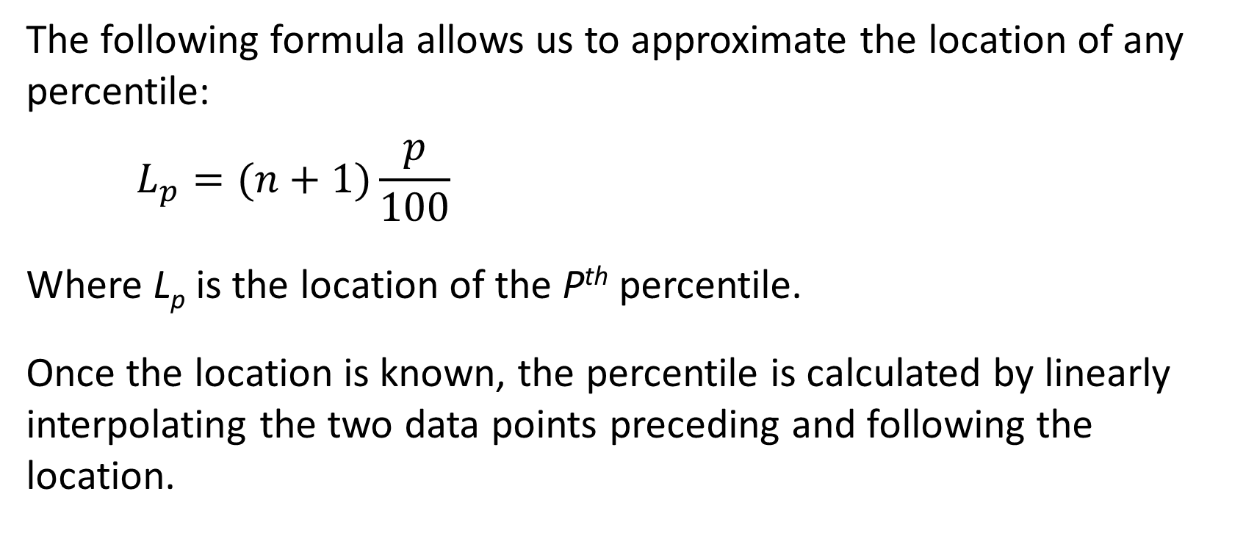
Locating Percentiles
The following formula allows us to approximate the location of any percentile:
$$L_{p}=(n+1)\frac{p}{100}$$
Where L_{p} is the location of the P^{th} percentile.
Once the location is known, the percentile is calculated by linearly interpolating the two data points preceding and following the location.

Slide 36
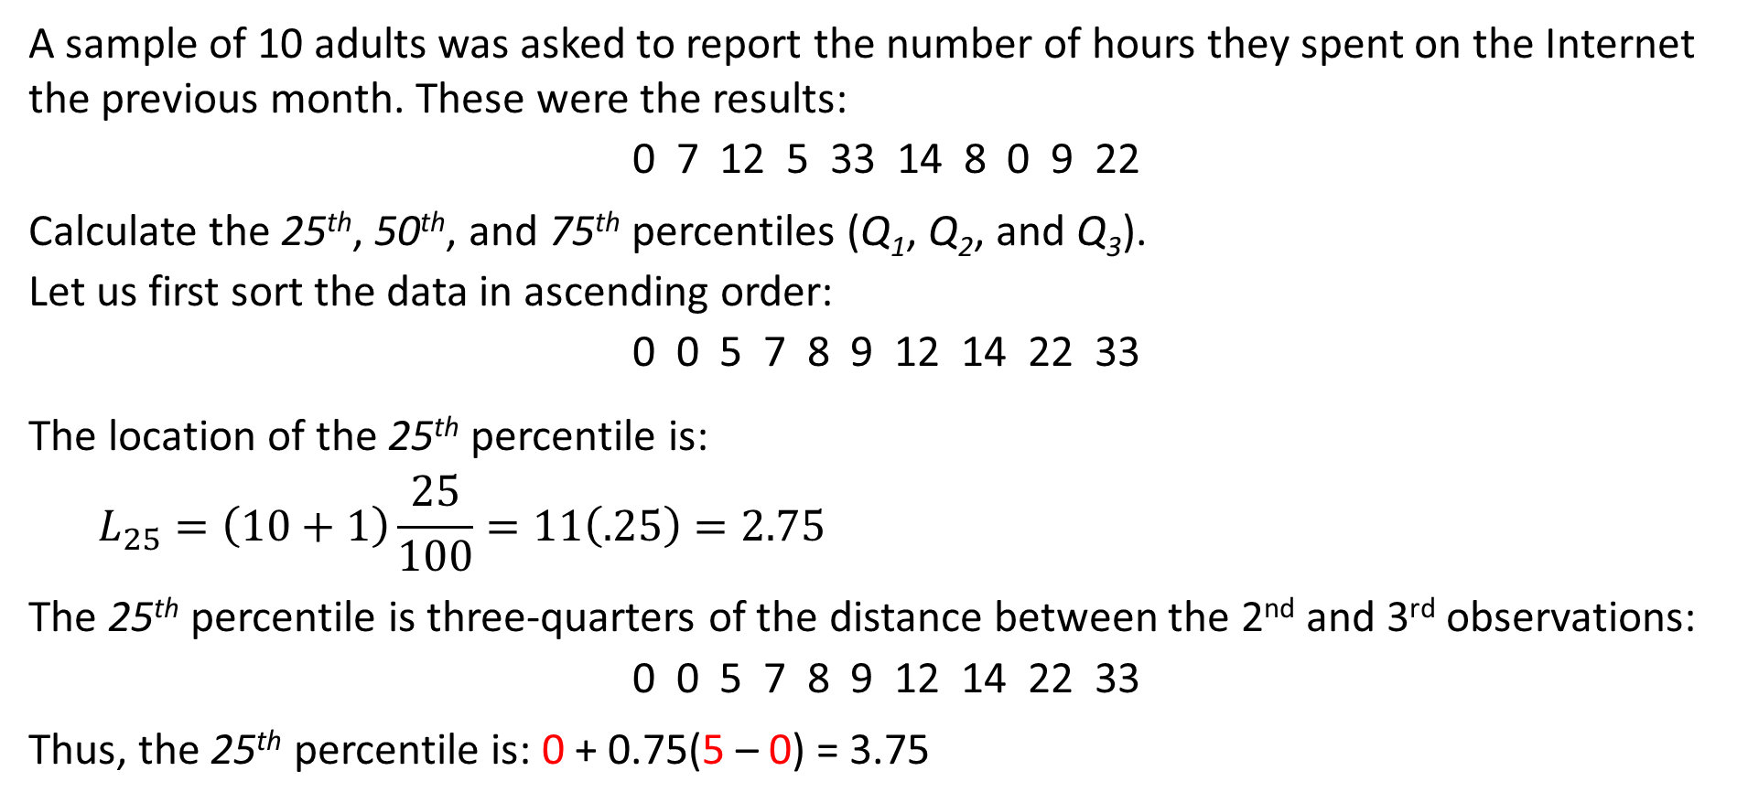
Percentiles of Time Spent on Internet
A sample of 10 adults was asked to report the number of hours they spent on the Internet the previous month. These were the results:
0 7 12 5 33 14 8 0 9 22
Calculate the 25th, 50th, and 75th percentiles (Q₁, Q₂, and Q₃).
Let us first sort the data in ascending order:
0 0 5 7 8 9 12 14 22 33
The location of the 25th percentile is:
$$L_{25}=\left(10+1\right)\frac{25}{100}=11\left(.25\right)=2.75$$
The 25th percentile is three-quarters of the distance between the 2nd and 3rd observations:
0 0 5 7 8 9 12 14 22 33
Thus, the 25th percentile is: 0 + 0.75(5 – 0) = 3.75

Slide 37
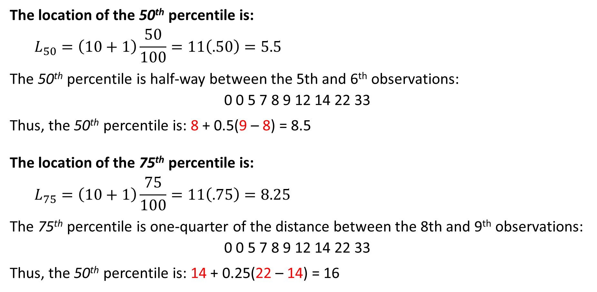
Percentiles of Time Spent on Internet
The location of the 50th percentile is:
$$L_{50}=\left(10+1\right)\frac{50}{100}=11\left(.50\right)=5.5$$
The 50th percentile is half-way between the 5th and 6th observations:
0 0 5 7 8 9 12 14 22 33
Thus, the 50th percentile is: 8 + 0.5(9 – 8) = 8.5
The location of the 75th percentile is:
$$L_{75}=\left(10+1\right)\frac{75}{100}=11\left(.75\right)=8.25$$
The 75th percentile is one-quarter of the distance between the 8th and 9th observations:
0 0 5 7 8 9 12 14 22 33
Thus, the 50th percentile is: 14 + 0.25(22 – 14) = 16

Slide 38
Quartiles and Percentiles of the Ages of ACBL Members
Example 1
Example 2
Determine the quartiles for Example 3.1 with Excel.
DATA: Xm03-01.
The simplest way to instruct Excel to produce quartiles is to use the QUARTILE function.
Type or import the data into one or more columns. (Open Xm03-01.) Type into any empty cell:
= QUARTILE ([Input Range], [Q])
where Q specifies the following: 0 = min, 1 = Q₁, 2 = Q₂ or median, 3 = Q₃, 4 = max.
Here are the outputs:
Q₁ = 36; Q₂ = 54.5; Q₃ = 69
Determine the 5th, 10th, 90th, and 95th percentiles for Example 3.1 with Excel.
DATA: Xm03-01.
Let us use the PERCENTILE function.
Type or import the data into one or more columns. (Open Xm03-01.) Type into any empty cell:
= PERCENTILE ([Input Range], [P])
where P is the percentile, a value between 0 and 1.
The outputs for the 5th, 10th, 90th, and 95th percentiles are, respectively:
24, 27, 78.1, 83

Slide 39
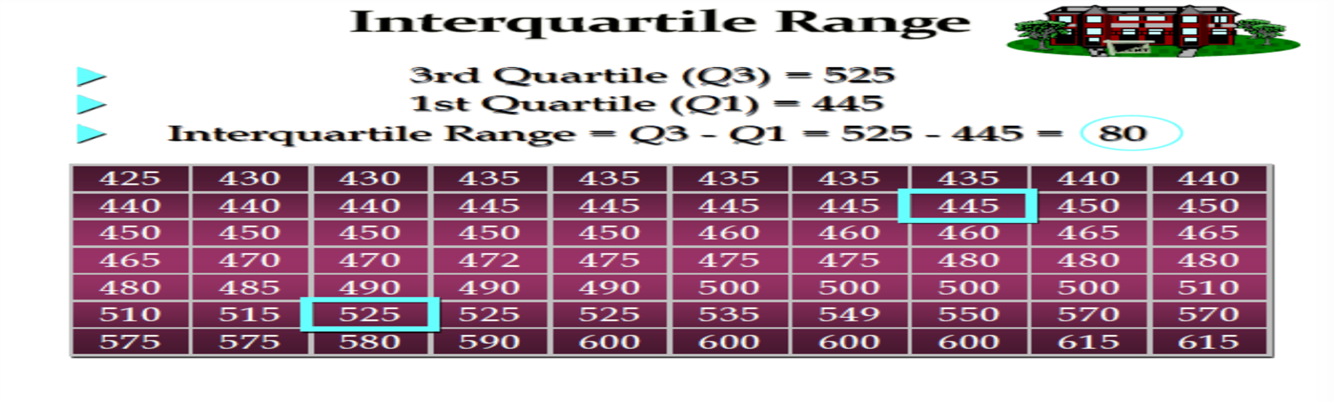
Interquartile Range
The quartiles can be used to create another measure of variability, the interquartile range, which is defined as follows:
Interquartile Range = Q₃ – Q₁
The interquartile range measures the spread of the middle 50% of the observations.

Slide 40
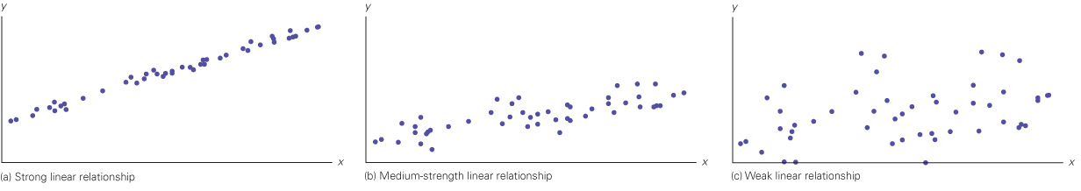
Measures of Linear Relationship
Establish a relationship between two interval variables
Direction and strength of the linear relationship
Three numerical measures:
  Covariance
  Coefficient of correlation
  Coefficient of determination
The least squares line

Slide 41
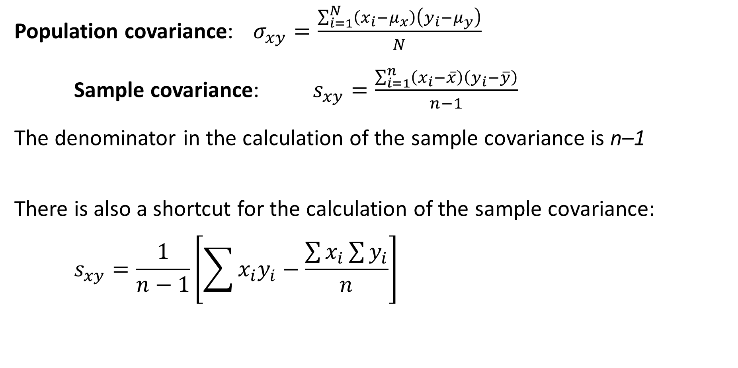
Covariance
Population covariance: $σ_{xy}=\frac{\sum_{i=1}^{N}{\left(x_{i}−μ_{x}\right)\left(y_{i}−μ_{y}\right)}}{N}$
Sample covariance: $s_{xy}=\frac{\sum_{i=1}^{n}{\left(x_{i}−\overline{x}\right)\left(y_{i}−\overline{y}\right)}}{n−1}$
The denominator in the calculation of the sample covariance is n–1
There is also a shortcut for the calculation of the sample covariance:
$$s_{xy}=\frac{1}{n−1}\left[\sum{x_{i}y_{i}−\frac{\sum{x_{i}}\sum{y_{i}}}{n}}\right]$$

Slide 42
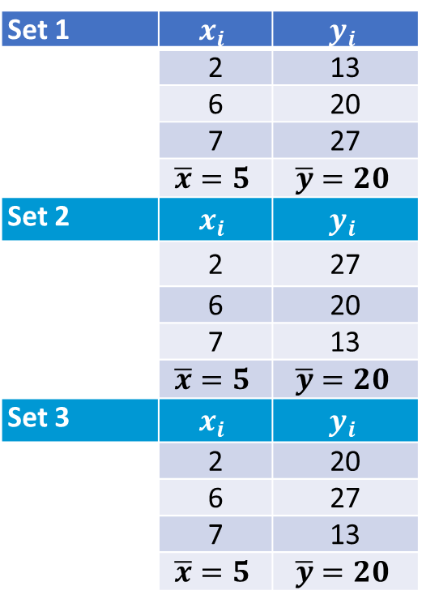
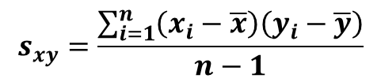
Calculating the Covariance
Compute the variance for the following datasets:
Set 1 | $$x_{i}$$ | $$y_{i}$$
 | 2 | 13
 | 6 | 20
 | 7 | 27
 | $$\overline{x}=5$$ | $$\overline{y}=20$$
Set 2 | $$x_{i}$$ | $$y_{i}$$
 | 2 | 27
 | 6 | 20
 | 7 | 13
 | $$\overline{x}=5$$ | $$\overline{y}=20$$
Set 3 | $$x_{i}$$ | $$y_{i}$$
 | 2 | 20
 | 6 | 27
 | 7 | 13
 | $$\overline{x}=5$$ | $$\overline{y}=20$$
$$s_{xy}=\frac{\sum_{i=1}^{n}{\left(x_{i}−\overline{x}\right)\left(y_{i}−\overline{y}\right)}}{n−1}$$
The x_{i} and y_{i} values are the same across the three sets.
The only difference is the order of the y_{i} values.

Slide 43
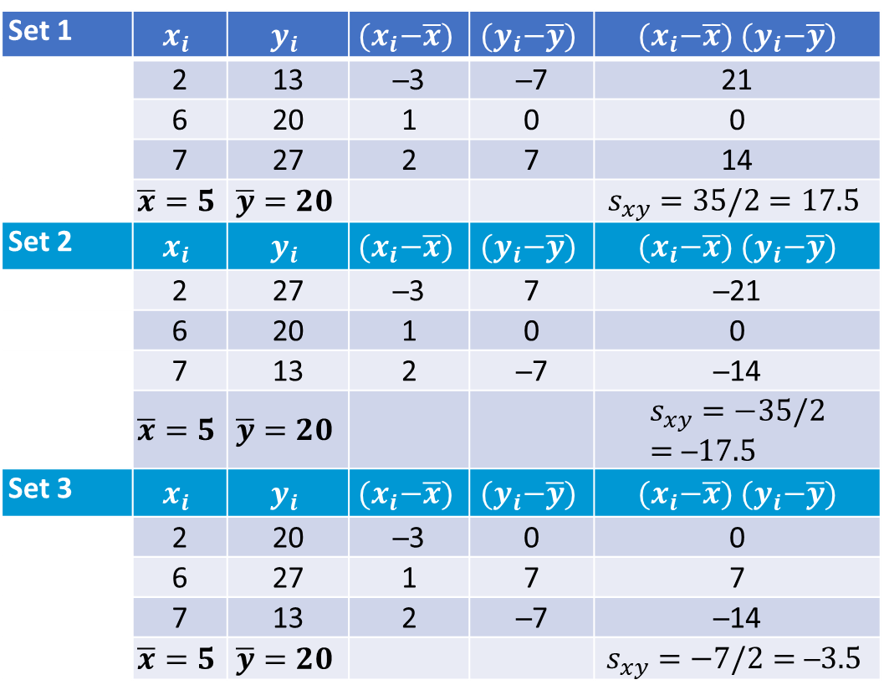
Calculating the Covariance
Interpreting sign and magnitude:
In Set 1, as x increases so does y. As a result, the products of the deviations are also positive, and s_{xy} is large and positive.
In Set 2, as x increases, y decreases. As a result, the products of the deviations are negative, and s_{xy} is large and negative.
In Set 3, as x increases, y does not exhibit any particular direction. As a result, the contributions to the products of the deviations largely cancel each other, and s_{xy} is small.
Limitation: magnitude is hard to interpret!
Set 1 | $$x_{i}$$ | $$y_{i}$$ | $${(x}_{i}−\overline{x})$$ | $${(y}_{i}−\overline{y})$$ | ${(x}_{i}−\overline{x})$ ${(y}_{i}−\overline{y})$
 | 2 | 13 | ─3 | ─7 | 21
 | 6 | 20 | 1 | 0 | 0
 | 7 | 27 | 2 | 7 | 14
 | $$\overline{x}=5$$ | $$\overline{y}=20$$ |  |  | $$s_{xy}=35/2=17.5$$
Set 2 | $$x_{i}$$ | $$y_{i}$$ | $${(x}_{i}−\overline{x})$$ | $${(y}_{i}−\overline{y})$$ | ${(x}_{i}−\overline{x})$ ${(y}_{i}−\overline{y})$
 | 2 | 27 | ─3 | 7 | ─21
 | 6 | 20 | 1 | 0 | 0
 | 7 | 13 | 2 | ─7 | ─14
 | $$\overline{x}=5$$ | $$\overline{y}=20$$ |  |  | $$s_{xy}=−35/2=\text{─}17.5$$
Set 3 | $$x_{i}$$ | $$y_{i}$$ | $${(x}_{i}−\overline{x})$$ | $${(y}_{i}−\overline{y})$$ | ${(x}_{i}−\overline{x})$ ${(y}_{i}−\overline{y})$
 | 2 | 20 | ─3 | 0 | 0
 | 6 | 27 | 1 | 7 | 7
 | 7 | 13 | 2 | ─7 | ─14
 | $$\overline{x}=5$$ | $$\overline{y}=20$$ |  |  | $$s_{xy}=−7/2=\text{─}3.5$$

Slide 44
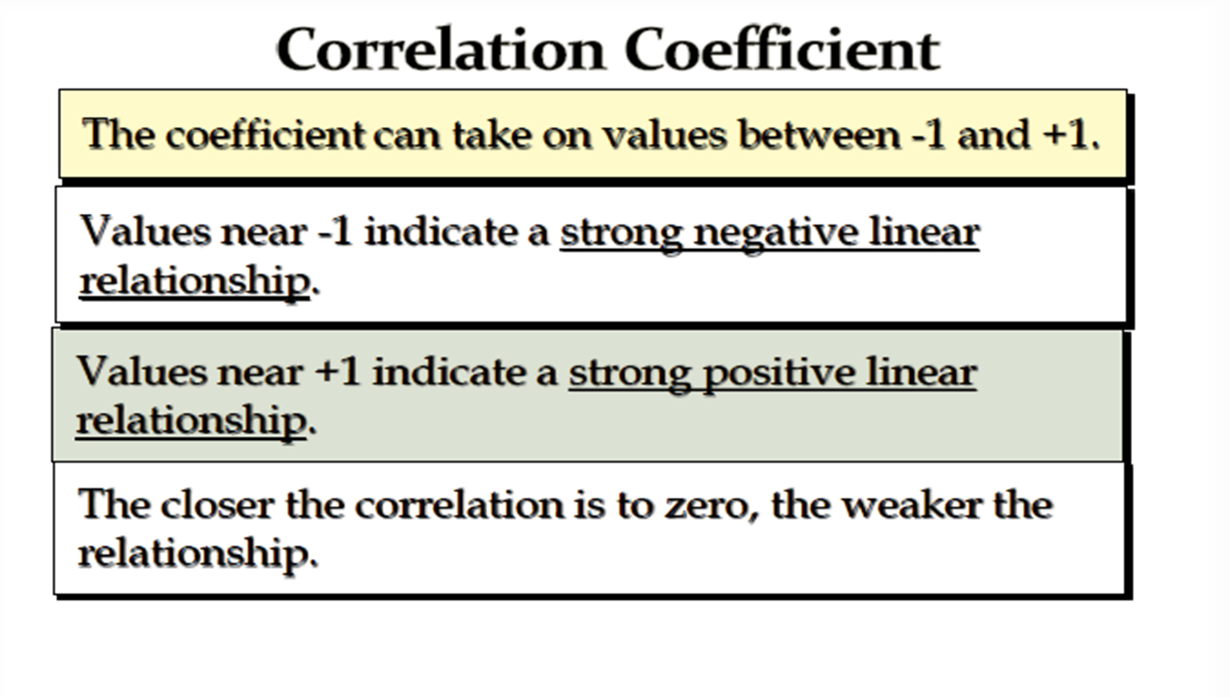

Slide 45
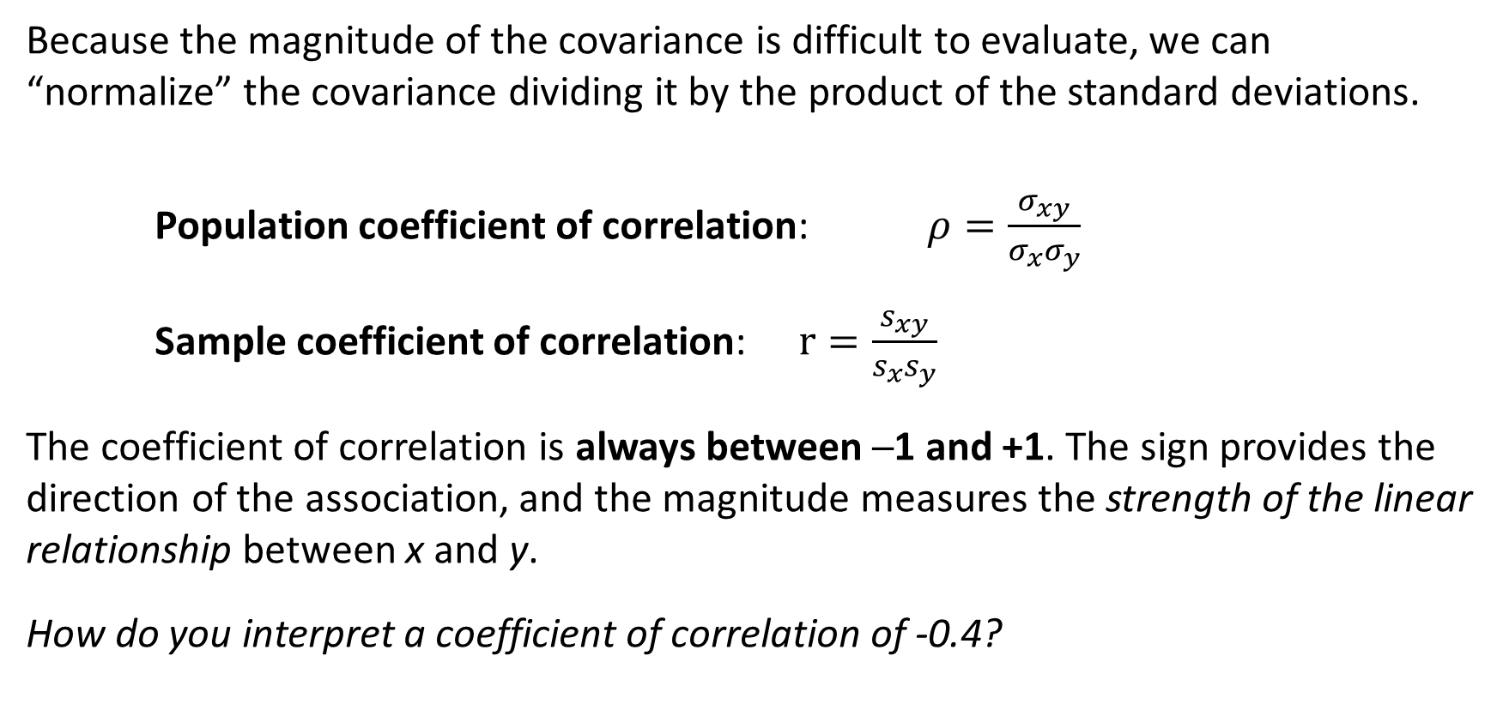
4-4b Coefficient of Correlation
Because the magnitude of the covariance is difficult to evaluate, we can “normalize” the covariance dividing it by the product of the standard deviations.
Population coefficient of correlation: $ρ=\frac{σ_{xy}}{σ_{x}σ_{y}}$
Sample coefficient of correlation: $r=\frac{s_{xy}}{s_{x}s_{y}}$
The coefficient of correlation is always between ─1 and +1. The sign provides the direction of the association, and the magnitude measures the strength of the linear relationship between x and y.
How do you interpret a coefficient of correlation of -0.4?

Slide 46
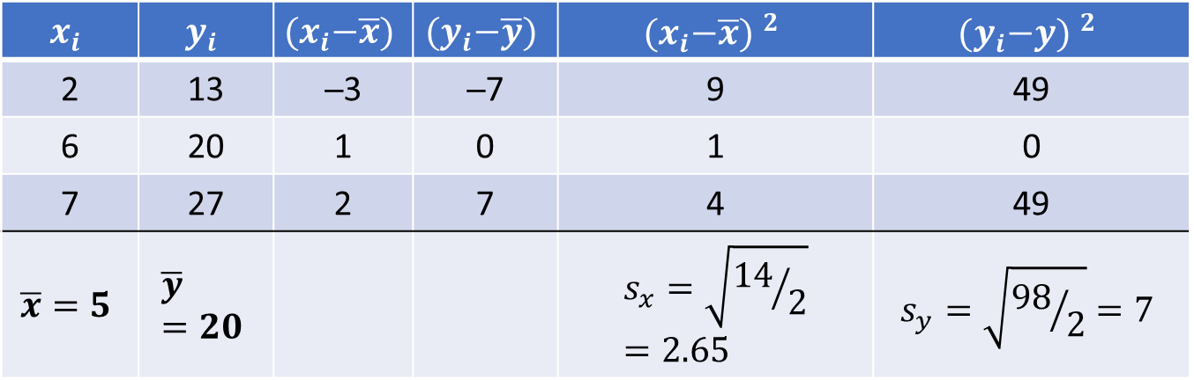
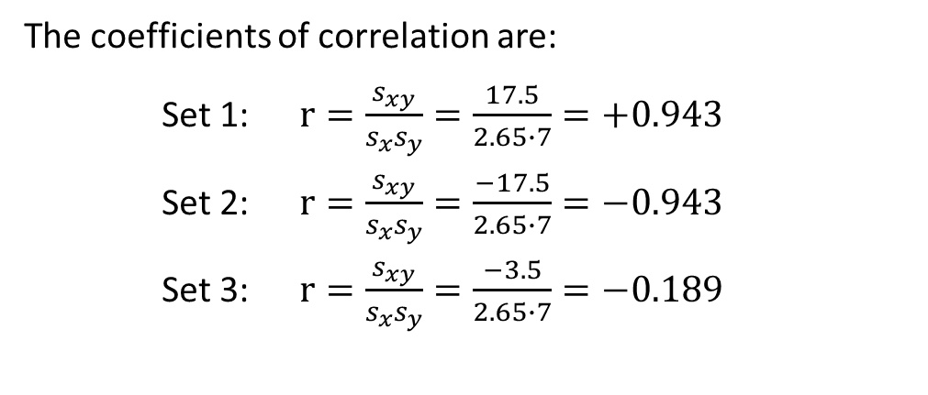
Calculating the Coefficient of Correlation
Calculate the coefficient of correlation for the three sets shown previously.
$$x_{i}$$ | $$y_{i}$$ | $${(x}_{i}−\overline{x})$$ | $${(y}_{i}−\overline{y})$$ | $${{(x}_{i}−\overline{x}) }^{2}$$ | $${{(y}_{i}−y) }^{2}$$
2 | 13 | ─3 | ─7 | 9 | 49
6 | 20 | 1 | 0 | 1 | 0
7 | 27 | 2 | 7 | 4 | 49
$$\overline{x}=5$$ | $$\overline{y}=20$$ |  |  | $$s_{x}=\sqrt{{14}/2}=2.65$$ | $$s_{y}=\sqrt{{98}/2}=7$$
The coefficients of correlation are:
Set 1: $r=\frac{s_{xy}}{s_{x}s_{y}}=\frac{17.5}{2.65∙7}=+0.943$
Set 2: $r=\frac{s_{xy}}{s_{x}s_{y}}=\frac{−17.5}{2.65∙7}=−0.943$
Set 3: $r=\frac{s_{xy}}{s_{x}s_{y}}=\frac{−3.5}{2.65∙7}=−0.189$
It is now easier to see the strength of the
linear relationship between X and Y.

Slide 47
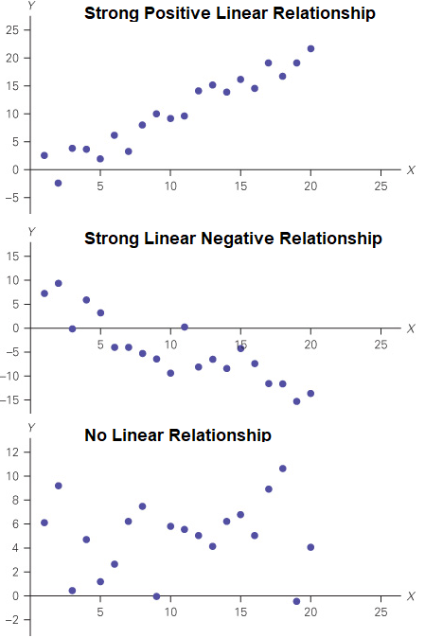
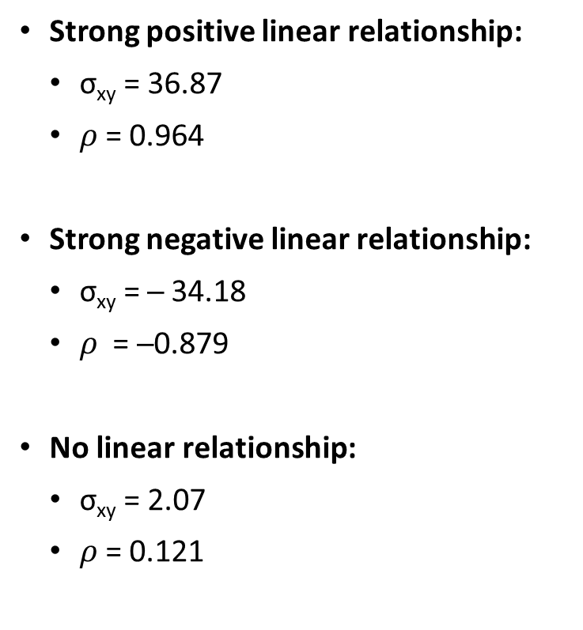
Comparing Scatter Diagrams
Strong positive linear relationship:
σ_{xy} = 36.87
$ρ$= 0.964
Strong negative linear relationship:
σ_{xy} = ─ 34.18
$ρ$ = ─0.879
No linear relationship:
σ_{xy} = 2.07
$ρ$= 0.121

Slide 48
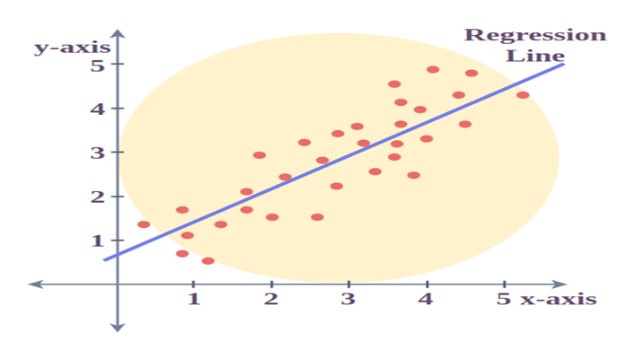
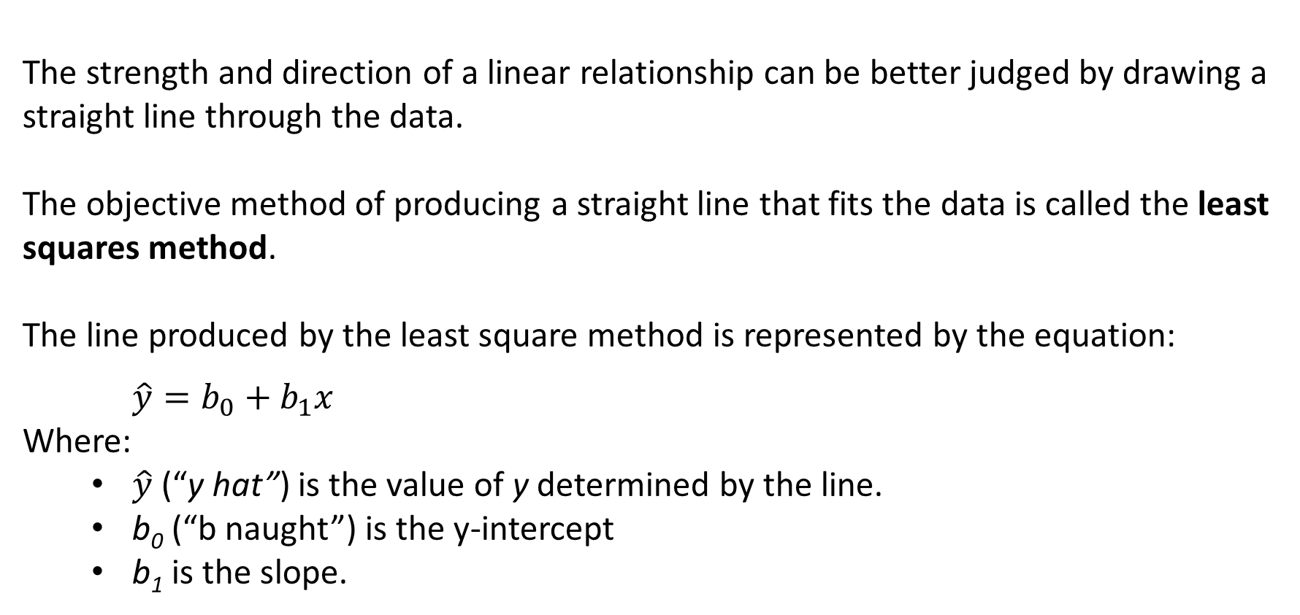
Least Squares Method
The strength and direction of a linear relationship can be better judged by drawing a straight line through the data.
The objective method of producing a straight line that fits the data is called the least squares method.
The line produced by the least square method is represented by the equation:
$$\hat{y}=b_{0}+b_{1}x$$
Where:
$\hat{y}$ (“y hat”) is the value of y determined by the line.
b₀ (“b naught”) is the y-intercept
b₁ is the slope.

Slide 49
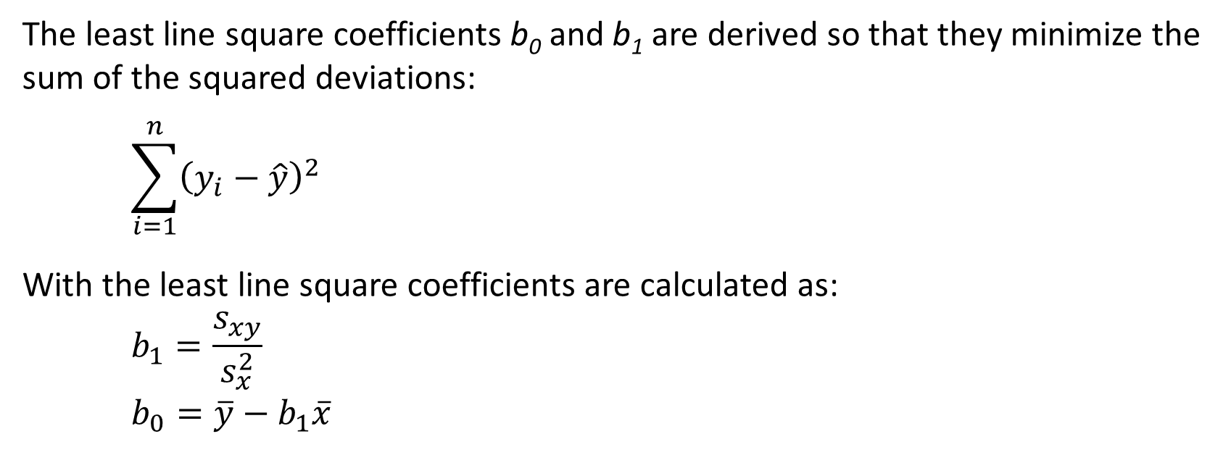
Derivation of Least Line Square Coefficients
The least line square coefficients b₀ and b₁ are derived so that they minimize the sum of the squared deviations:
$$\sum_{i=1}^{n}{{\left(y_{i}−\hat{y}\right)}^{2}}$$
With the least line square coefficients are calculated as:
$$b_{1}=\frac{s_{xy}}{s_{x}^{2}}$$
$$b_{0}=\overline{y}−b_{1}\overline{x}$$

Slide 50
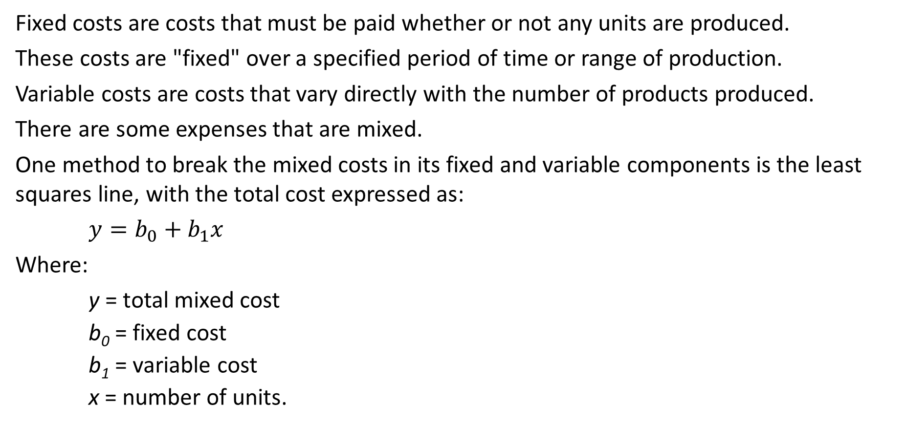
Application in Economics
Example 4.15 – Fixed and Variable Costs
Fixed costs are costs that must be paid whether or not any units are produced.
These costs are "fixed" over a specified period of time or range of production.
Variable costs are costs that vary directly with the number of products produced.
There are some expenses that are mixed.
One method to break the mixed costs in its fixed and variable components is the least squares line, with the total cost expressed as:
$$y=b_{0}+b_{1}x$$
Where:
y = total mixed cost
b₀ = fixed cost
b₁ = variable cost
x = number of units.

Slide 51
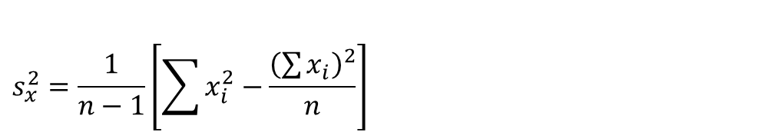
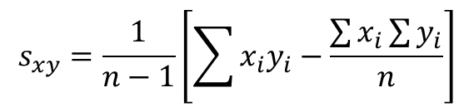
Example 4.15 – Estimating Fixed and Variable Costs
A tool and die maker is considering increasing the size of his business and needs to know more about the cost of electricity to operate his machines.
The daily electricity costs and the number of tools made on that day are shown in the first two columns below. DATA Xm04-15
Determine the fixed and variable electricity costs.
$$s_{xy}=\frac{1}{n−1}\left[\sum{x_{i}y_{i}−\frac{\sum{x_{i}}\sum{y_{i}}}{n}}\right]$$
$$s_{x}^{2}=\frac{1}{n−1}\left[\sum{x_{i}^{2}−\frac{{\left(\sum{x_{i}}\right)}^{2}}{n}}\right]$$

Slide 52
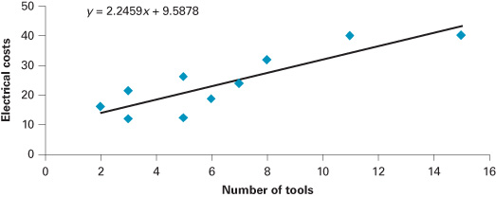
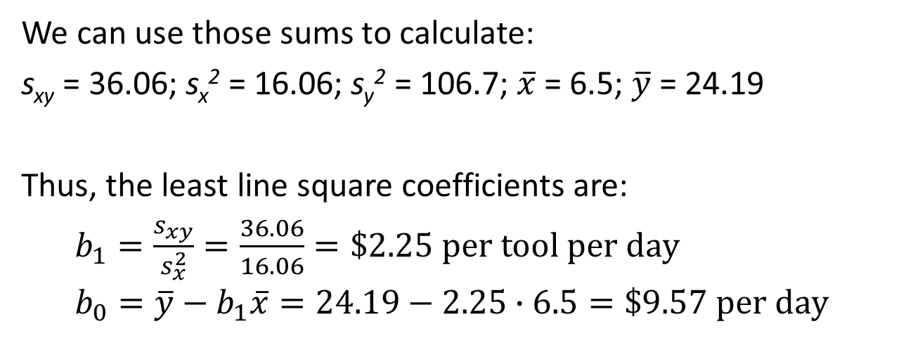
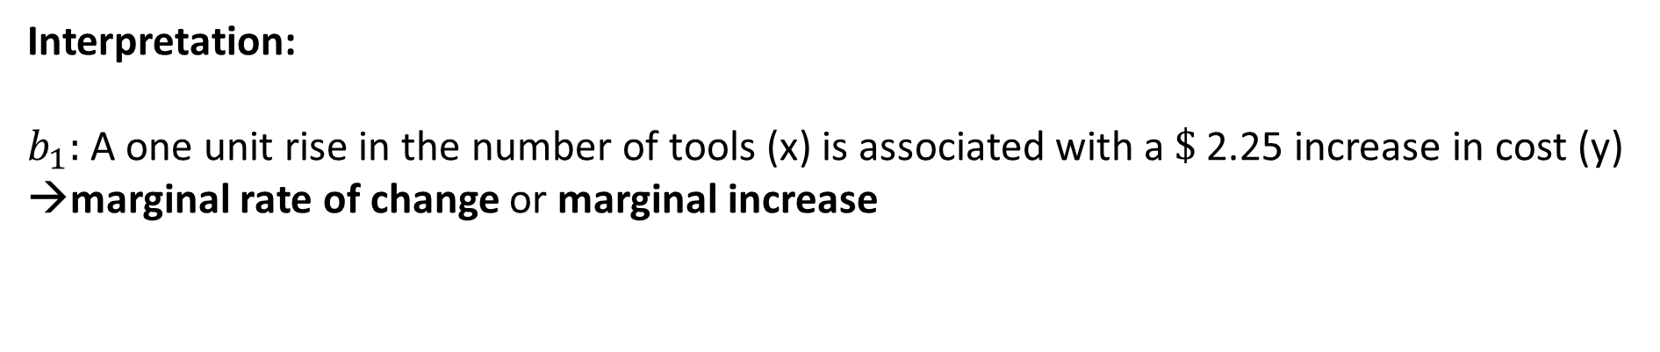
Example 4.15 – Estimating Fixed and Variable Costs
We can use those sums to calculate:
s_{xy} = 36.06; s_{x}² = 16.06; s_{y}² = 106.7; $\overline{x}$ = 6.5; $\overline{y}$ = 24.19
Thus, the least line square coefficients are:
$b_{1}=\frac{s_{xy}}{s_{x}^{2}}=\frac{36.06}{16.06}=\$2.25 per tool per day$
$$b_{0}=\overline{y}−b_{1}\overline{x}=24.19−2.25∙6.5=\$9.57 per day$$
Interpretation:
$b_{1}:$A one unit rise in the number of tools (x) is associated with a $\$$2.25 increase in cost (y)
marginal rate of change or marginal increase
$b_{0}$: When no tools are produced (i.e., x=0), the estimated fixed cost of electricity is $\$9.57$

Slide 53
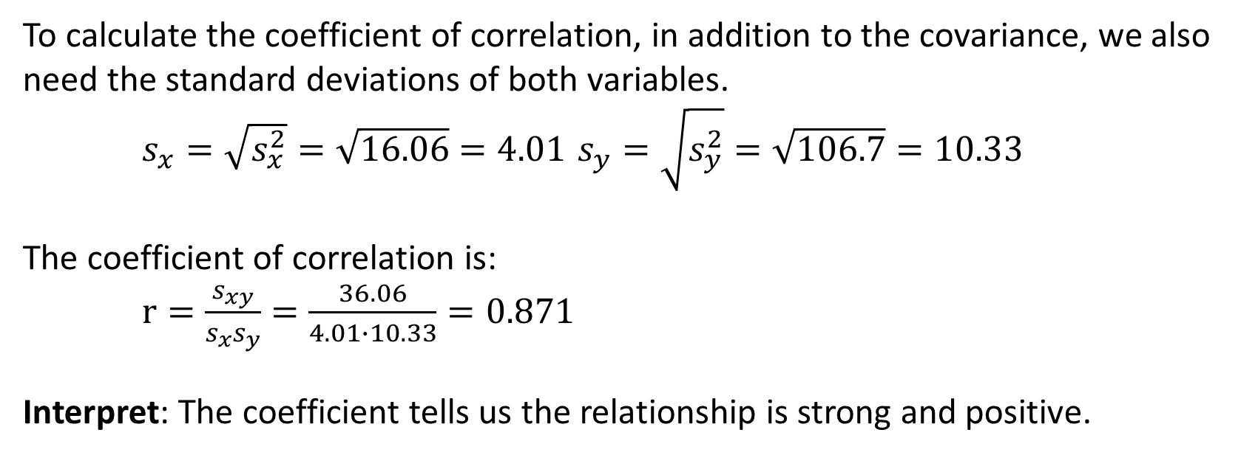
Measuring the Strength of the Linear Relationship
– Coefficient of Correlation
To calculate the coefficient of correlation, in addition to the covariance, we also need the standard deviations of both variables.
$s_{x}=\sqrt{s_{x}^{2}}=\sqrt{16.06}=4.01$ $s_{y}=\sqrt{s_{y}^{2}}=\sqrt{106.7}=10.33$
The coefficient of correlation is:
$r=\frac{s_{xy}}{s_{x}s_{y}}=\frac{36.06}{4.01∙10.33}=0.871$
Interpret: The coefficient tells us the relationship is strong and positive.

Slide 54

Coefficient of Determination
Except in the proximity to −1, 0, and +1, we cannot precisely interpret the meaning of the coefficient of correlation.
The coefficient of determination, which is calculated by squaring the coefficient of correlation, and denoted r², can be precisely interpreted as:
“The amount of variation in the dependent variable that is explained by the independent variable.”
In Example 4.16, the coefficient of correlation was 0.871. Thus, the coefficient of determination is:
$$r^{2}={(0.871)}^{2}=0.759$$
About 76% of the variation in electrical costs is explained by the number of tools. The remaining 24% is unexplained.

Slide 55
Interpreting Correlation
We learned that if two variables are linearly related, it does not mean that X causes Y. Remember:
Correlation is not causation
In the next section we show a few examples of spurious correlation, which happens when there is a large coefficient of correlation, but no reason to be a linear relationship between X and Y because another variable may cause both X and Y, or Y cause X instead.

Slide 56
Examples of Spurious Correlation
Explanation:
The coefficients of correlation in all three examples are large enough to infer that there is a linear relationship between each pair of variables.
However, common sense tells us that no such relationship may actually exist.
To avoid concluding that a relationship exists when there is spurious correlation, follow these steps:
Start with a theory of the relationship between the two variables, not with the coefficient of correlation.
If a relationship may justifiably exist, a large coefficient of correlation would confirm our belief
Example 1:
X: Millions of pounds of uranium stored annually in the US (years 1996–2008)
Y: Number of Mathematics doctorates awarded annually in the United States
r = 0.952 Spurious Correlation 1.xlsx
Example 2
X: Per capita consumption of margarines annually in the US (years 2000–2008)
Y: Divorce rate in Maine (per 1,000)
r = 0.993 Spurious Correlation 2.xlsx
Example 3:
X: Total U.S. imports of crude oil annually (billions of barrels) (years 2000–2009)
Y: Per capita consumption of chicken (pounds)
r = 0.900 Spurious Correlation 3.xlsx

Slide 57


Slide 58


Slide 59


Slide 60
General Guidelines for Exploring Data
The first step in describing and summarizing data is to apply a graphical technique to learn the shape of the distribution.
The shape of the distribution helps answering the following questions.
Where is the approximate center of the distribution?
Are the observations close to one another, or are they widely dispersed?
Is the distribution unimodal, bimodal, or multimodal? If there is more than one mode, where are the peaks, and where are the valleys?
Is the distribution symmetric or skewed? If symmetric, is it bell shaped?

Slide 61


Slide 62

Stata Output and Instructions
Instructions for Descriptive Statistics:
Import or type the data into one column. (Click File/Import/Excel spreadsheet (*xls,*xlsx)/Xm03-01 Check Import first row as variable names.
Click Statistics, Summary, tables, and tests, Summary and descriptive statistics, and Summary statistics.
In the Variables (leave empty for all variables) select Ages. Under Options select Display additional statistics.
STATA prints a variety of statistics. Mean = 53.765; variance = 390.5224; standard deviation = 19.76164; first quartile (25th percentile) = 36, second quartile (50th percentile, median) = 54.5; third quartile (75th percentile) = 69.
Instructions for Least Square Line:
Import or type the data into one column. (Click File/Import/Excel spreadsheet (*xls,*xlsx)/Xm04-15 ) Check Import first row as variable names.
Click Statistics, Linear models and related, and Linear regression.
Select Electrical costs as the Dependent variable: and in the Independent variables: box select Number of tools.
The least squares line is: $\hat{y}=\text{9.587765}+\text{2.245882}×Number of Tools$
Covariance and Coefficient of Correlation
Coefficient of correlation = 0.8711, covariance = 36.0589

Slide 63
Stata Output and Instructions
Instructions for Covariance and Coefficient of Correlation:
Import or type the data into one column. (Click File/Import/Excel spreadsheet (*xls,*xlsx)/Xm03-01 Check Import first row as variable names.
Click Statistics, Summary, tables, and tests, Summary and descriptive statistics, and Correlations and Covariances.
In the Variables (leave empty for all): box select Number of tools, Electrical costs. Click OK.
To output the covariance, repeat steps 1–3 and click Options and check Display covariances.

Slide 64



