Slide 1
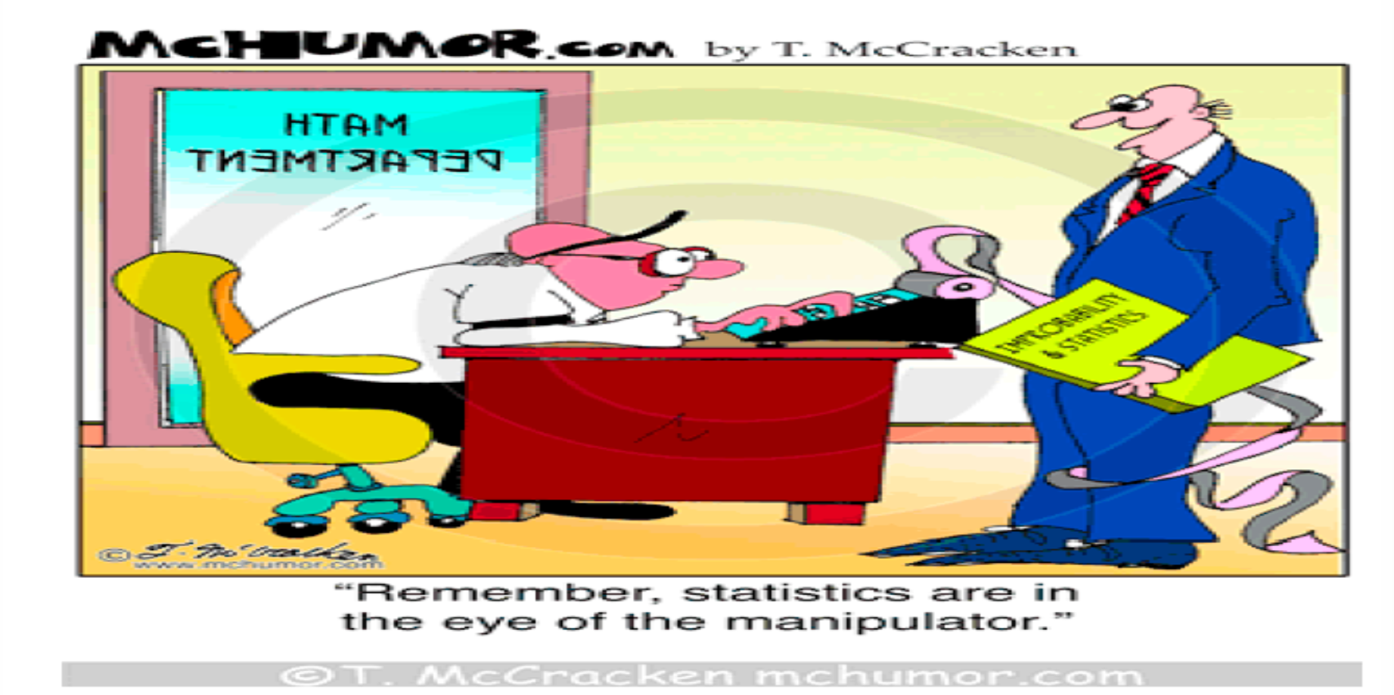
Chapter 3: Graphical Descriptive Techniques II

Slide 2
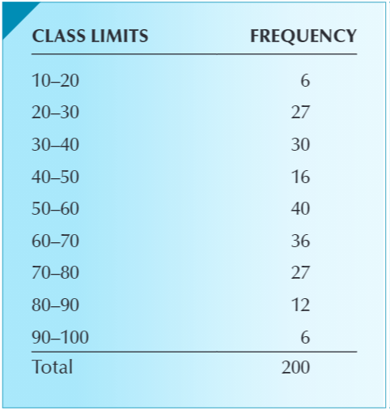
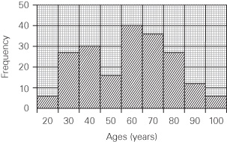
The Histogram
Ages of Duplicate Bridge Players
To learn more about the age
of its players, the American
Contract Bridge league (ACBL)
collects a random sample of the
age for 200 members.
DATA: Xm03-01
Solution:
The ages of the 200 members are
grouped into contiguous and non-
-overlapping classes of 10 years each. Note that the first class includes age 10 but not age 20, the second class includes age 20 but not age 30, etc. so that every data point is included but never double-counted.
Then, we can use the frequency of each class to build a histogram, which is a bar chart with the rectangles’ height representing the frequency of each class, drawn adjacent to each other to convey continuity.
Notes:
The histogram gives us a clear view of the way the ages are distributed. As expected about 40% of the sample are older than 60. About a sixth are in their teens and twenties. There appears to be a good supply of younger players. However, there is an unexpected gap of players in the 40 to 60 range, particularly in the 40 to 50 range.

Slide 3
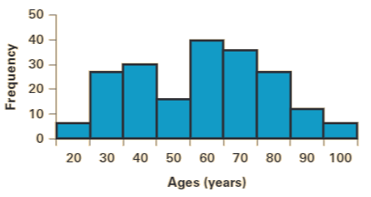
The Histogram with Data Analysis
Excel Instructions
Type or import the data from Xm03-01 into one column. In another column, type the upper limits of the class intervals. Excel calls them bins. Type “Ages” in the first row.
Click Data, Data Analysis, and Histogram.
Specify the Input Range (A1:A201) and the Bin Range (B1:B10). Click Chart Output. Click Labels if the first row contains names.
To remove the gaps, place the cursor over one of the rectangles and click the right button of the mouse. Click (with the left button) Format Data Series. Move the pointer to Gap Width and use the slider to change the number from 150 to 0.

Slide 4
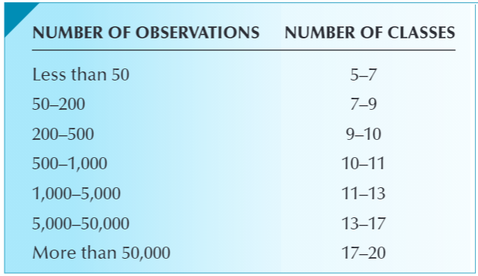
Determining the Number of Class Intervals
Two methods
In Example 3.1, the table to the left suggests using at least 9 classes for a sample of size n = 200.
An alternative to the guidelines listed in the table to the left is to use Sturges’s formula, which recommends that the number of class intervals be determined by the following:
Number of class intervals = 1 + 3.3 log(n)
For n = 200, Sturges’s formula becomes:
Number of class intervals = 1 + 3.3 log(200)
= 1 + 3.3 ∙ 2.3 = 8.6
which we round to 9 classes.

Slide 5
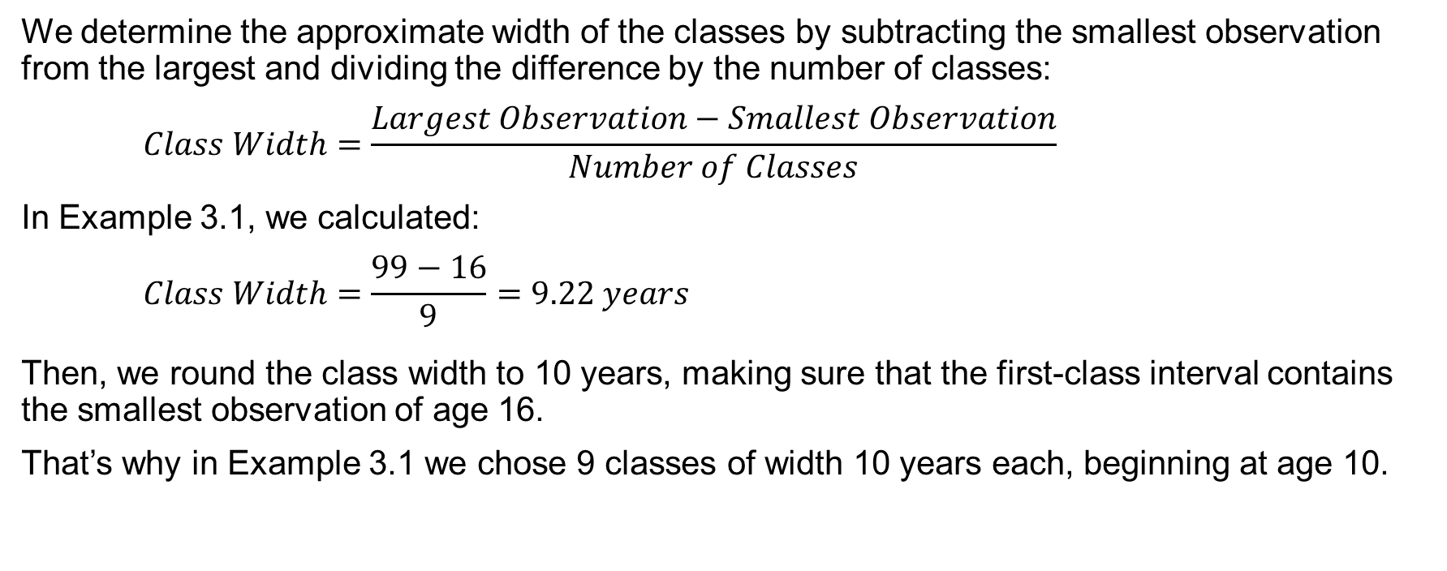
Determining the Class Interval Widths
We determine the approximate width of the classes by subtracting the smallest observation from the largest and dividing the difference by the number of classes:
$$Class Width=\frac{Largest Observation−Smallest Observation}{Number of Classes}$$
In Example 3.1, we calculated:
$$Class Width=\frac{99−16}{9}=9.22 years$$
Then, we round the class width to 10 years, making sure that the first-class interval contains the smallest observation of age 16.
That’s why in Example 3.1 we chose 9 classes of width 10 years each, beginning at age 10.

Slide 6
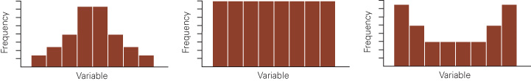
Shapes of Histograms: Symmetry
Three Symmetric Histograms
A histogram is said to be symmetric if, when we draw a vertical line down the center of the histogram, the two sides are identical in shape and size.

Slide 7
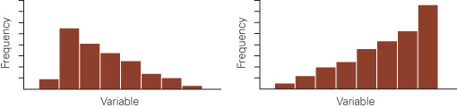
Shapes of Histograms: Skewness
Positively and Negatively Skewed Histograms
A skewed histogram has one of the two tails extending more than the other one. If the longer tail is to the right, the histogram is said to be positively skewed, and if the longer tail is to the left, it is said to be negatively skewed.
Notes:
Incomes of employees in large firms tend to be positively skewed because there is a large number of relatively low-paid workers and a small number of well-paid executives.
The time taken by students to write exams is frequently negatively skewed because few students hand in their exams early; most prefer to reread their papers and hand them in near the end of the scheduled test period

Slide 8
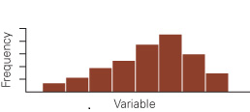
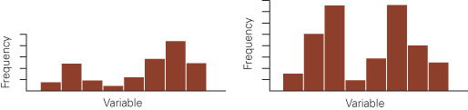
Shapes of Histograms: Number of Modal Classes
A unimodal histogram
Bimodal histograms
A modal class is the class with the largest number of observations.
A unimodal histogram is one with a single peak.
A bimodal histogram is one with two peaks, not necessarily equal in height. Bimodal histograms often indicate that two different distributions are present

Slide 9
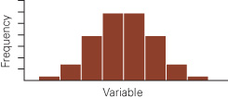
Shapes of Histograms: Bell Shape
Bell-Shaped Histogram
A bell-shaped histogram is a special type of symmetric unimodal histogram. In Chapter 8, we will explain why this type of histogram is important.

Slide 10
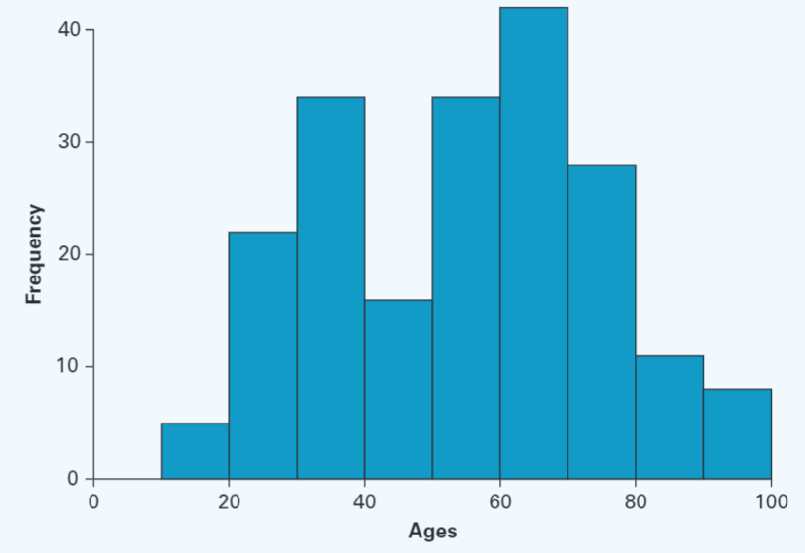
Histograms - Stata
Example 3.1 – Stata Output and Instructions
Instructions:
Import or type the data into one column. (Click File/Import/Excel spreadsheet Xm03-01.) Check Import first row as variable names.
Click Graphics, and Histogram.
Select Ages in the Variable: box. Check Width of bins and type 10. Check Lower limit of first bin and type 10. Select Frequency.

Slide 11
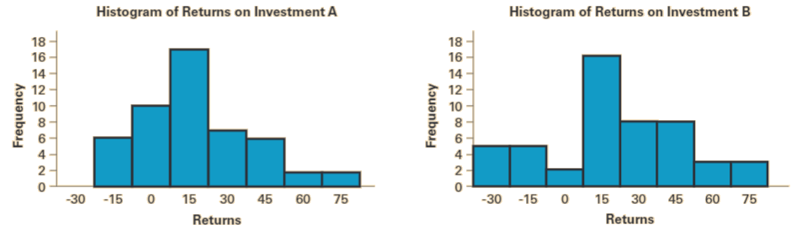
Comparing Returns on Two Investments
The returns for the two types of investments are listed here. Draw histograms for each set of returns and report on your findings. Which investment would you choose and why?
DATA: Xm03-02
Comparing the two histograms, we can extract the following information:
The center of the histogram of the returns of investment A is slightly lower than that for investment B.
The spread of returns for investment A is considerably less than that for investment B.
Both histograms are slightly positively skewed.
These findings suggest that investment A is superior.

Slide 12
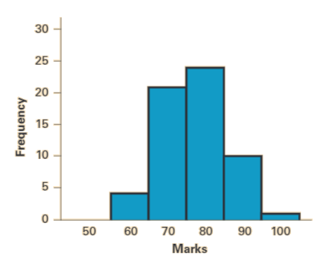
Business Statistics Marks
Concerned about a course’s alleged difficulty, a student asks the professor about last year’s marks.
The professor obliges and provides a list of the final marks, which is composed of term work plus the final exam.
Draw a histogram and describe the result, based on the marks included in file Xm03-03+.
The histogram is unimodal and approximately symmetric.
There are no marks below 50, with the great majority of marks between 60 and 90.
The modal class is 70 to 80, and the center of the distribution is approximately 75.

Slide 13
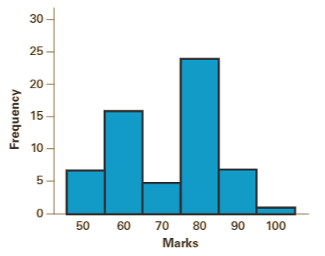
Mathematical Statistics Marks
Suppose the student in Example 3.3 obtained a list of last year’s marks in a mathematical statistics course (DATA: Xm03-03+.
This course emphasizes derivations and proofs of theorems.
Use the accompanying data to draw a histogram and compare it to the one produced in Example 3.3.
What does this histogram tell you?
The histogram is bimodal, suggesting that there are two groups of students.
The larger modal class is composed of the marks in the 80s, and the smaller modal class includes marks in the 50s. There appear to be few marks in the 70s.
The histograms in this example and in Example 3.3 suggest that the courses are quite different from one another and have a completely different distribution of marks.

Slide 14
Describing Time Series Data
Observations measured at the same point in time are called cross-sectional data.
Observations measured at successive points in time are called time-series data.
Time-series data are graphed on a line chart, which plots the value of the variable on the vertical axis against the time periods on the horizontal axis.

Slide 15
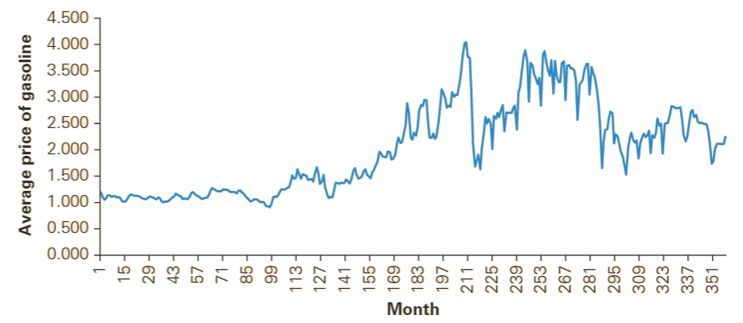
Price of Gasoline
Data file Xm03-05 contains the monthly average retail price of gasoline (regular unleaded in dollars per gallon) since 1991.
Draw a line chart to visualize these figures and describe the results. We can use Excel or Stata
*.
The price of gasoline rose from about $1.00 to over $4.00 in 2008 (around month 200) then dropped precipitously in March 2009 (at the end of the housing meltdown) before rising again and then falling to about $2.00.
Notes:
Instructions:
Type or import the data into one column. (Open Xm03-05.)
Highlight the column of data. Click Insert, Line, and the first 2-D Line. You can draw two or more line charts (for two or more variables) by highlighting all columns of data you wish to graph

Slide 16
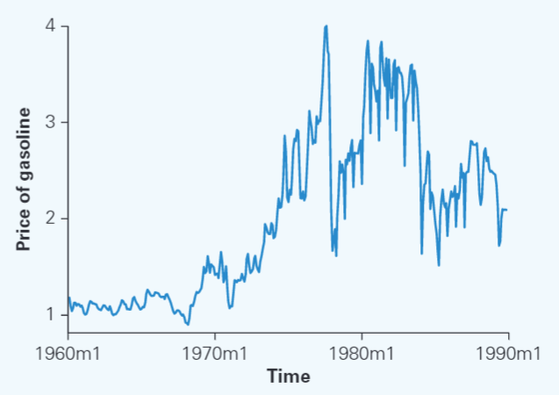
Line Charts - Stata
Example 3.5 – Stata Output and Instructions
Instructions:
Import or type the data into one column. (Click File/Import/Excel spreadsheet (*xls, *xlsx)/Xm03-05.) Check Import first row as variable names. One column must be a time variable. In this data set the variable is Time.
Click Statistics, Time series, Setup and utilities, and Declare data set to be time-series data. Select Time as Time variable. Check Monthly. Click OK.
Click Graphics, Time-series graphs, and Line plots.
Click Create and in the Y variable box select Price of Gasoline. Click Time-series plot. Click Accept. Click OK.

Slide 17
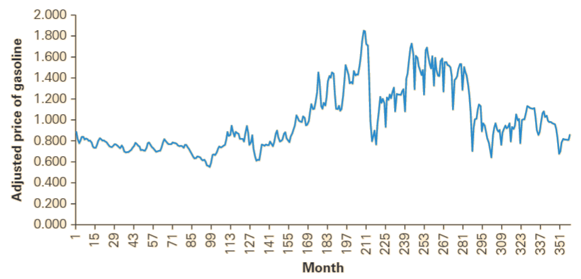
Price of Gasoline in Constant Dollars
Data file Xm03-06 contains the inflation-adjusted monthly average retail price of gasoline (regular unleaded in dollars per gallon) since 1991.
Draw a line chart to visualize these figures and describe how gas price has changed after adjusting for inflation.
Using constant 1982–1984 dollars, we can see that the average price of a gallon of gasoline hit its peak in the middle of 2008 (around month 200). From there, it dropped rapidly and then rose and fell. By 2020 the adjusted price was lower than in January 1991.

Slide 18
Describing the Relationship between Two Interval Variables
Moving from nominal data to interval data, we are frequently interested in how two interval variables are related.
To explore this relationship, we employ a scatter diagram, which plots two variables against one another.
The independent variable is labeled X and is usually placed on the horizontal axis, while the other, dependent variable, Y, is mapped to the vertical axis.
Observations measured at the same point in time are called cross-sectional data.
Observations measured at successive points in time are called time-series data.
Time-series data are graphed on a line chart, which plots the value of the variable on the vertical axis against the time periods on the horizontal axis.

Slide 19
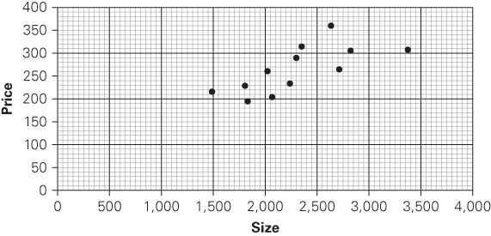
Relationship between Price and Size of House
A real estate agent recorded the price and size for a sample of 12 recently sold houses to analyze the relationship between the selling price of a home ($1,000s) and its size (sqft). Data file: Xm03-07.
Describe the relationship between size and price with a scatter diagram.
The scatter diagram reveals that the greater the size of the house, the greater the price. However, there are other variables that determine price. Further analysis may reveal what these other variables are.
Notes:
Instructions:
Type or import the data into two adjacent columns. Store variable X in the first column and variable Y in the next column. (Open Xm03-07.)
Click Insert and Scatter

Slide 20
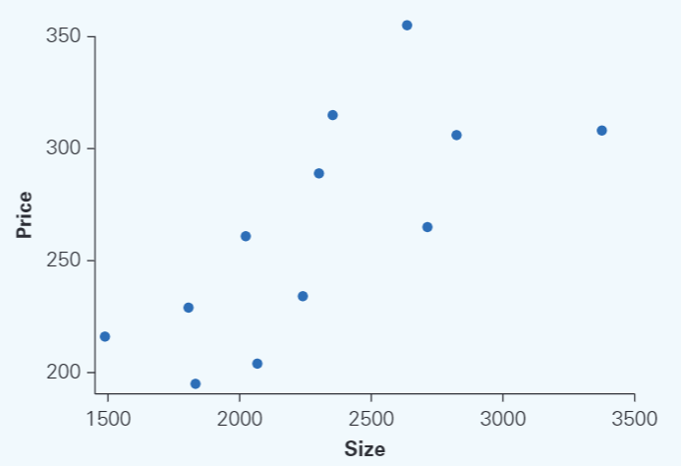
Scatter Diagram - Stata
Example 3.7 – Stata Output and Instructions
Instructions:
Import or type the data into one column. (Click File/Import/Excel spreadsheet (*xls, *xlsx)/Xm03-07.) Check Import first row as variable names.
Click Graphics and Twoway graph (scatter, line, etc.).
Click Create. In the Basic plots (type) box, select Scatter. Select Price for the Y variable: and Size for the X variable: Click Accept. Click OK.

Slide 21
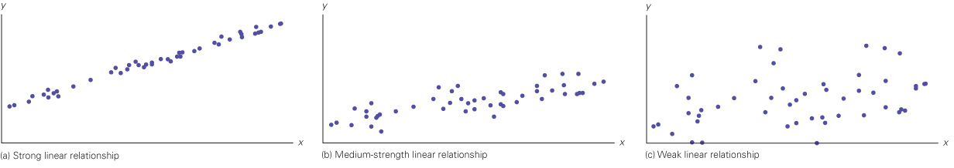
Patterns of Scatter Diagrams: Linearity
Scatter Diagrams Depicting linearity
To determine the strength of the linear relationship, we draw a straight line through the points in such a way that the line represents the relationship.
If most of the points fall close to the line, we say that there is a linear relationship. If most of the points appear to be scattered randomly with only a semblance of a straight line, there is no, or at best, a weak linear relationship. The three scatter diagrams depicted here exhibit various levels of linearity.
Note that there may well be other types of nonlinear relationships, such as quadratic or exponential.

Slide 22
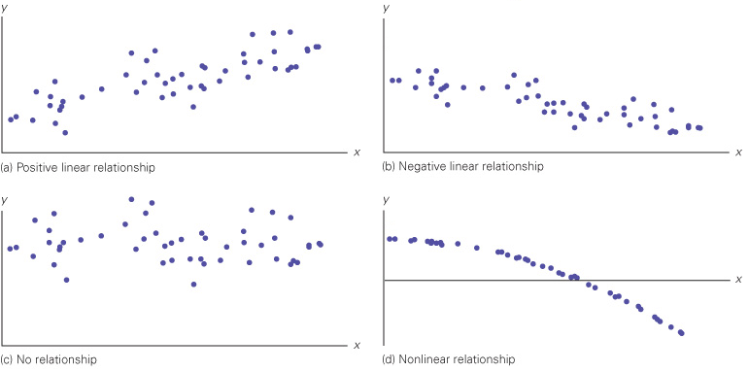
Patterns of Scatter Diagrams: Direction
Scatter Diagrams Describing Direction
If one variable increases when the other does, we say that there is a positive linear relationship.
When the two variables tend to move in opposite directions, we say that there is a negative linear relationship. (The terms positive and negative will be explained in Chapter 4.)
The four scatter diagrams depicted show positive and negative linear relationships, no relationship, and a nonlinear relationship.

Slide 23
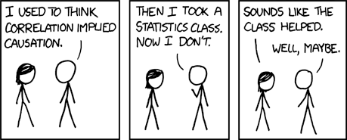
Interpreting a Strong Linear Relationship
The fact two variables are linearly related does not imply that one causes the other.
In fact, we can never conclude that one variable causes another variable, and express the fact more eloquently as:
Correlation is not causation

Slide 24
Graphical Excellence
Graphical excellence is achieved when the following characteristics apply:
The graph presents large data sets concisely and coherently.
The ideas and concepts the statistics practitioner wants to deliver are clearly understood by the viewer.
The graph encourages the viewer to compare two or more variables.
The display induces the viewer to address the substance of the data and not the form of the graph.
There is no distortion of what the data reveal.

Slide 25
Data visualization describes the use of graphical displays to
summarize and present information about a data set.
The goal is to communicate as effectively and clearly as possible
the key information about the data
Creating effective graphical displays is as much art
as it is science.
Here are some guidelines . . .
Give the display a clear and concise title.
Keep the display simple.
Clearly label each axis and provide the units of
measure.
If colors are used, make sure they are distinct.
If multiple colors or lines are used, provide a
legend.

Slide 26
Data Dashboards
A data dashboard is a widely used data
visualization tool.
It organizes and presents key performance indicators
(KPIs) used to monitor an organization or process.
It provides timely, summary information that is easy
to read, understand, and interpret.
Some additional guidelines include . . .
Minimize the need for screen scrolling.
Avoid unnecessary use of color or 3D.
Use borders between charts to improve
readability.

Slide 27
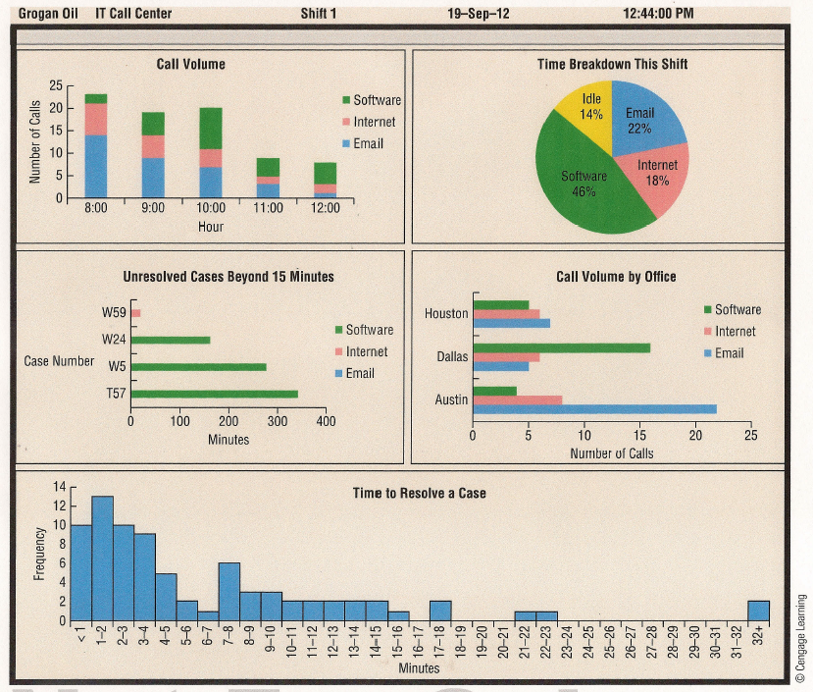
Data Dashboard Example

Slide 28
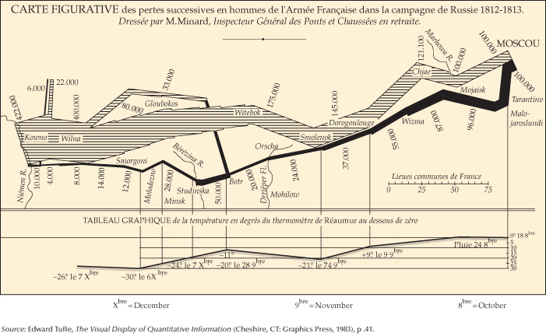
The Best Chart Ever Drawn
Chart Depicting Napoleon’s Invasion and Retreat from Russia in 1812
The striped band represents a time series depicting the size of the French army at various times and places on the map.
When Napoleon invaded Russia in June, he had 422,000 soldiers. By the time the army reached Moscow in October, the number had dwindled to 100,000.
The black band represents the army in retreat. By the time the army returned to France, only 10,000 soldiers remained.
The chart also shows a time series for the temperature, which dipped to -30 °C on December 6.

Slide 29
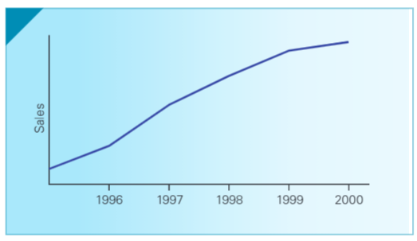
Graphical Deception
It is important to evaluate critically the information presented by means of graphical techniques. Graphical techniques create a visual impression, which can be easily distorted.
The Canadian Institute of Chartered Accountants began setting guidelines for financial graphics, after a study of annual reports of major
corporations found that 8% contained at least one
misleading graph to cover up bad results.
It should be noted that misleading graphs may at time
be the result of inexperience, rather than deception.
To the right we have a time series showing sales
growth without a scale on one axis, making it
Impossible to assess the growth magnitude.
The next few slides illustrate a few more popular
deceptions.
Graph Without Scale

Slide 30
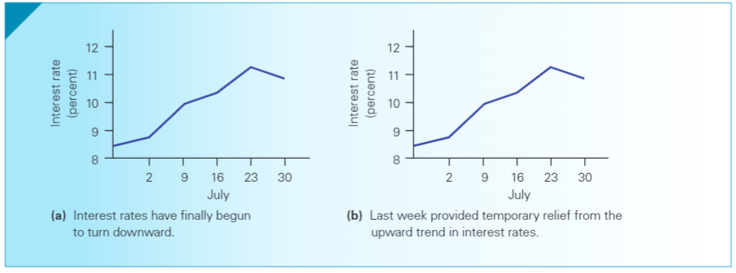
Graphical Deception: Captions
Graphs with Different Captions
Your impression of the trend in interest rates might be different, depending on whether you analyze a graph carrying caption (a) or caption (b).

Slide 31
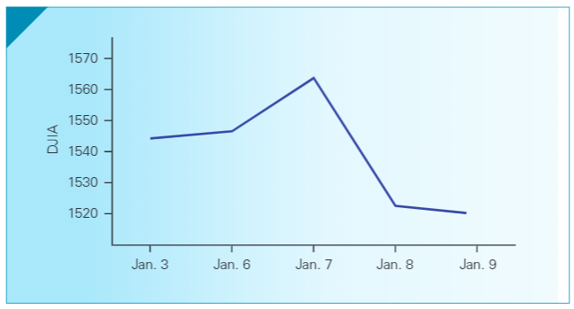
Graphical Deception: Misleading Drop
Graph Showing Drop in the DJIA
Perspective is often distorted if only absolute changes in value, rather than percentage changes, are reported.
On January 9, 1986, newspapers reported that the DJIA reported the worst single day loss ever.
However, the 2.5% loss, albeit significant, was nowhere near the Black Friday’s decline of 12.8% in 1929.

Slide 32
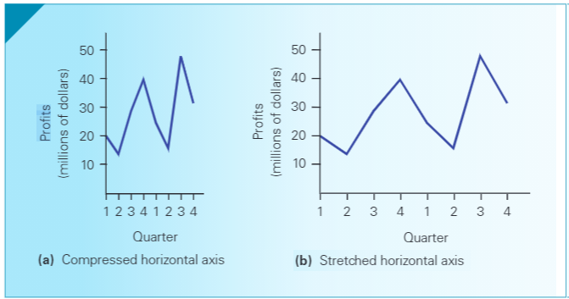
Graphical Deception: Conveying Stability
Graphs Showing Considerable Swings or relative Stability
The opposite effect is obtained by stretching the horizontal axis; that is, spreading out the points on the horizontal axis to increase the distance between them so that slopes and trends will appear to be less steep.

Slide 33
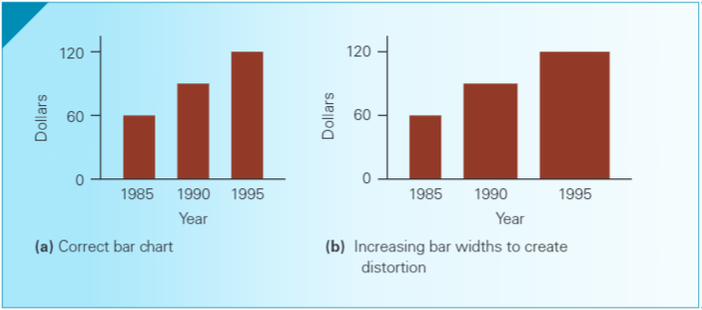
Graphical Deception: Distorted Bar Chart
Graphs Showing Correct and Distorted Bar Charts
The bar chart correctly uses bars of equal width so that both the height and the area of each bar are proportional to the dollar expenditure.
The growth in expenditures is exaggerated by increasing both the bars’ width and height leaving the viewer with the mistaken impression that food expenditures increased far more than they do.

Slide 34
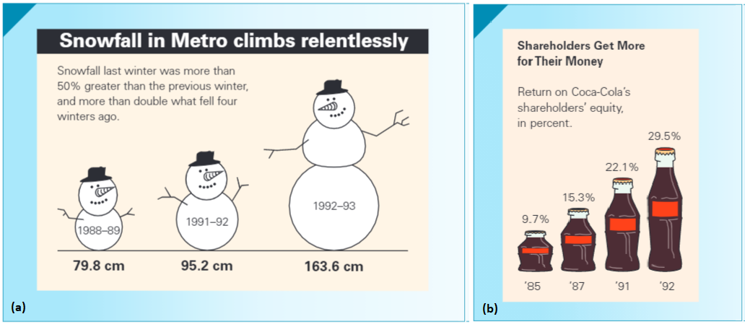
Graphical Deception: Misuse of Pictograms
Misused and Correct Use of Pictograms
Just like with a bar chart, a pictogram containing objects such as bags of money, people, or animals, can also be misused, exaggerating the growth it is meant to convey.
Exaggerated use of a pictogram that shows the increase in snowfall over the years depicting a snowman that grows in width as well as height.
A proper use of a pictogram, in which all the pictures of Coca-Cola bottles are drawn with the same width and varying height.

Slide 35
Dot Plot - Hudson Auto Repair
The manager of Hudson Auto would like to have a better understanding of the cost of parts used in the engine tune-ups performed in her shop. She examines 50 customer invoices for tune-ups.
Sample of Parts Cost ($) for 50 Tune-ups
91 | 78 | 93 | 57 | 75 | 52 | 99 | 80 | 97 | 62
71 | 69 | 72 | 89 | 66 | 75 | 79 | 75 | 72 | 76
104 | 74 | 62 | 68 | 97 | 105 | 77 | 65 | 80 | 109
85 | 97 | 88 | 68 | 83 | 68 | 71 | 69 | 67 | 74
62 | 82 | 98 | 101 | 79 | 105 | 79 | 69 | 62 | 73

Slide 36
Dot Plot - A plot of each data value on a scale or number line
Tune-up Parts Cost
50 60 70 80 90 100 110
Cost ($)
A horizontal axis shows the range of data values.
Then each data value is represented by a dot placed above the axis.

Slide 37
Stem and Leaf Display
A stem-and-leaf display shows both the rank order
and shape of the distribution of the data.
It is similar to a histogram on its side, but it has the
advantage of showing the actual data values.
The first digits of each data item are arranged to the
left of a vertical line.
To the right of the vertical line we record the last
digit for each item in rank order.
Each line (row) in the display is referred to as a stem.
Each digit on a stem is a leaf.

Slide 38
Stem-and-Leaf Display
Example: Hudson Auto Repair
5
6
7
8
9
10
2 7
2 2 2 2 5 6 7 8 8 8 9 9 9
1 1 2 2 3 4 4 5 5 5 6 7 8 9 9 9
0 0 2 3 5 8 9
1 3 7 7 7 8 9
1 4 5 5 9
a stem
a leaf

Slide 39
Stretched Stem-and-Leaf Display
If we believe the original stem-and-leaf display has
condensed the data too much, we can stretch the
display vertically by using two stems for each
leading digit(s).
Whenever a stem value is stated twice, the first value
corresponds to leaf values of 0 - 4, and the second
value corresponds to leaf values of 5 - 9.

Slide 40
Stretched Stem-and-Leaf Display
Example: Hudson Auto Repair
5
5
6
6
7
7
8
8
9
9
10
10
2
7
2 2 2 2
5 6 7 8 8 8 9 9 9
1 1 2 2 3 4 4
5 5 5 6 7 8 9 9 9
0 0 2 3
5 8 9
1 3
7 7 7 8 9
1 4
5 5 9

Slide 41
Additional – Stem and Leaf Notation
The Stem-and-Leaf diagram is an alternative way to write out a distribution
For example, the distribution [12, 14, 19, 23, 27, 29, 31, 33, 36, 38, 44, 45, 48, 55, 59, 60, 67] can be rewritten in Stem-and-Leaf notation as follows:
1 2 4 9
2 3 7 9
3 1 3 6 8
4 4 5 8 5 9
5 5 9
6 0 7
Tens Value: the first number in each row. In the above example, the tens values are 1, 2, 3, 4, 5, 6
Ones Value: each number that follows in that row. In the first row, for example, the ones values are 2, 4, 9.

Slide 42
How to Read a Box Plot

Slide 43
Stacked Bar Chart
A stacked bar chart is another way to display and compare two variables on the same display.
It is a bar chart in which each bar is broken into rectangular segments of a different color.
If percentage frequencies are displayed, all bars will be of the same height (or length), extending to the 100% mark.
Restaurant.xlsx

Slide 44
Stacked Bar Chart

Slide 45
Choosing the Type of Graphical Display
Bar Chart
to show the frequency distribution or relative
frequency distribution for categorical data
Pie Chart
to show the relative frequency or percent
frequency for categorical data
Dot Plot
to show the distribution for quantitative data
over the entire range of the data
Histogram
to approximate the relationship of data in a
scatter diagram
Stem-and-Leaf
Display
to show both the rank order and shape of the distribution for quantitative data
Side-by-Side Bar Chart
to compare two variables
Stacked Bar Chart
to compare the relative frequency or percent frequency of two categorical variables
Scatter Diagram
to show the relationship between two quantitative variables
Trendline
to show the frequency distribution for
quantitative data over a set of class intervals

Slide 46
Tabular and Graphical Methods
Data
Categorical Data
Quantitative Data
Tabular
Methods
Graphical
Methods
Tabular
Methods
Graphical
Methods
Bar Chart
Pie Chart
Frequency
Distribution
Rel. Freq. Dist.
Percent Freq.
Distribution
Crosstabulation
Dot Plot
Histogram
Ogive
Stem-and-
Leaf Display
Scatter
Diagram
Frequency
Distribution
Rel. Freq. Dist.
% Freq. Dist.
Cum. Freq. Dist.
Cum. Rel. Freq.
Distribution
Cum. % Freq.
Distribution
Crosstabulation

Slide 47
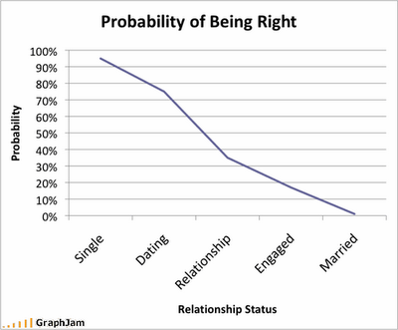
http://www.pmslweb.com/the-blog/wp-content/uploads/2012/03/31-probability-of-being-right-graph.png

Slide 48
