Slide 1
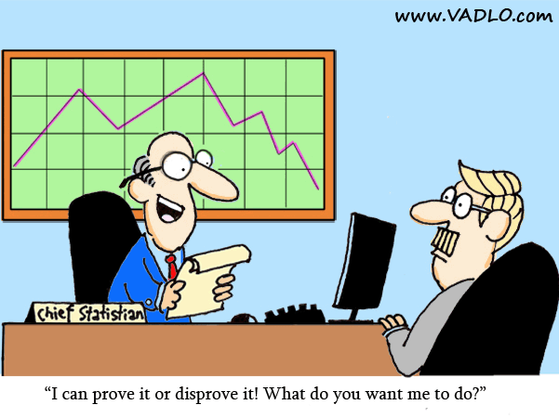
Chapter 2 - Graphical Descriptive Techniques 1

Slide 2
Data and Data Sets
Data are the facts and figures collected, analyzed, and summarized for presentation and interpretation.
All the data collected in a particular study are referred to as the data set for the study.
Elements, Variables, and Observations
Elements are the entities on which data are collected.
A variable is a characteristic of interest for the elements
The set of measurements obtained for a particular element is called an observation.
A data set with n elements contains n observations.
The total number of data values in a complete data set is the is the number of elements multiplied by the number of variables.

Slide 3
Data, Data Sets, Elements, Variables,
and Observations
Observation
Variables
Element
Names
Stock Annual Earn/
Exchange Sales($M) Share($)
Company
Dataram
EnergySouth
Keystone
LandCare
Psychemedics
NQ 73.10 0.86
N 74.00 1.67
N 365.70 0.86
NQ 111.40 0.33
N 17.60 0.13
Data Set

Slide 4
Scales of Measurement
The scale determines the amount of information contained in the data and the statistical analyses that are most appropriate.
Nominal
Data are labels or names used to identify an attribute
of the element.
A nonnumeric label or numeric code may be used.
Example:
Students of a university are classified by the school in which they are enrolled
using a nonnumeric label such as Business, Humanities, Education, and so on.
Alternatively, a numeric code could be used for the school variable
(e.g. 1 denotes Business, 2 denotes Humanities, 3 denotes Education, and so on).

Slide 5
Scales of Measurement
Ordinal
The data have the properties of nominal data and
the order or rank of the data is meaningful.
A nonnumeric label or numeric code may be used.
Example:
Students of a university are classified by their class standing using
a nonnumeric label such as Freshman, Sophomore, Junior, or Senior.
Alternatively, a numeric code could be used for the class standing
variable (e.g. 1 denotes Freshman, 2 denotes Sophomore, and so on).

Slide 6
Scales of Measurement
Interval
The data have the properties of ordinal data, and
the interval between observations is expressed in
terms of a fixed unit of measure.
Interval data are always numeric.
Example:
Melissa has an SAT score of 1885, while Kevin
has an SAT score of 1780. Melissa scored 105
points more than Kevin.

Slide 7
Categorical Data
Data can be further classified as being categorical or quantitative.
Labels or names used to identify an attribute of
each element
Often referred to as qualitative data
Use either the nominal or ordinal scale of
measurement
Can be either numeric or nonnumeric
Appropriate statistical analyses are rather limited

Slide 8
Quantitative Data
Quantitative data indicate how many or how much:
discrete, if measuring how many
continuous, if measuring how much
Quantitative data are always numeric.
Ordinary arithmetic operations are meaningful for
quantitative data.
Example : Latte | Qualitative data: robust aroma frothy appearance strong taste burgundy cup
Example : Latte | Quantitative data:12 ounces of latte serving temperature 150º F. serving cup 7 inches in height cost $4.95

Slide 9
Summarizing Data
Frequency Distribution
Relative Frequency and
Percent Frequency Distributions
Bar Chart
Pie Chart

Slide 10

Categorical data use labels or names
to identify categories of like items.
Quantitative data are numerical values
that indicate how much or how many.
Frequency Distribution
A frequency distribution is a tabular summary of
data showing the frequency (or number) of items
in each of several non-overlapping classes.
The objective is to provide insights about the data
that cannot be quickly obtained by looking only at
the original data.

Slide 11
Frequency Distribution
Example: Marada Inn
Guests staying at Marada Inn were asked to rate the quality of their accommodations as being excellent, above average, average, below average, or poor. The ratings provided by a sample of 20 guests are:
Below Average
Above Average
Above Average
Average
Above Average
Average
Above Average
Average
Above Average
Below Average
Poor
Excellent
Above Average
Average
Above Average
Above Average
Below Average
Poor
Above Average
Average

Slide 12
Using Excel’s COUNTIF Function
to Construct a Frequency Distribution
Excel Formula Worksheet
Note: Rows 9-21 are not shown.

Slide 13
Frequency Distribution
Example: Marada Inn
Rating
Frequency
Poor
Below Average
Average
Above Average
Excellent
2
3
5
9
1
Total 20

Slide 14
Relative Frequency Distribution
The relative frequency of a class is the fraction or
proportion of the total number of data items
belonging to the class.
A relative frequency distribution is a tabular
summary of a set of data showing the relative
frequency for each class.
Percent Frequency Distribution
The percent frequency of a class is the relative
frequency multiplied by 100.

Slide 15
Relative Frequency and
Percent Frequency Distributions
Example: Marada Inn
Relative
Frequency
Percent
Frequency
Rating
Poor
Below Average
Average
Above Average
Excellent
.10
.15
.25
.45
.05
Total 1.00
10
15
25
45
5
100
.10(100) = 10
1/20 = .05

Slide 16
But what if the sample size is much larger?
Chapter2DataFiles\HotelRatings.xlsx
Looking at the Soft Drink Market
Chapter2DataFiles\SoftDrink.xlsx

Slide 17
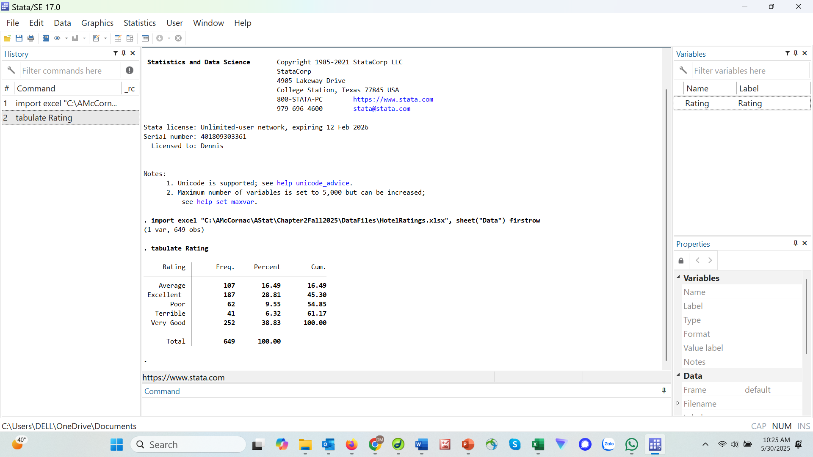

Slide 18
Frequency Distribution
Quantitative Data
Example
Sanderson and Clifford, a small public accounting firm wants to determine time in days required to complete year end audits. It takes a sample of 20 clients.
12 15 20 22 14 | 14 15 27 21 18 | 19 18 22 33 16 | 18 17 23 28 13
DataFiles\Audit.xlsx

Slide 19
Frequency Distribution
Example: Sanderson and Clifford
If we choose five classes:
Approximate Class Width = (33 - 12)/5 = 4.2 ≅ 4
Time in days | Frequency
10-14 | 4
15-19 | 8
20-24 | 5
25-29 | 2
30-34 | 1
Total | 20

Slide 20
Using Excel’s PivotTable to Construct a Pivot Table
Step 1 – Select any cell in the data set
Step 2 – Click Insert on the Ribbon
Step 3 – In the Tables group click Pivot Table
Step 4 - When the Create PivotTable dialog box appears: Click
    (a PivotTable and PivotTable Fields dialog box will appear in a new worksheet)

Slide 21
Using Excel’s PivotTable to Construct a Pivot Table
Step 5 - In the PivotTable Fields dialog box:
Drag Audit time to the Rows area
Drag Audit time to the Values area
Step 6 - Click on Sum of Audit time in the Values area
Step 7 - Click Value Field Settings from the list of options
Step 8 - When the Value Field Settings dialog box appears: Under Summarize value field by, choose Count Click OK

Slide 22
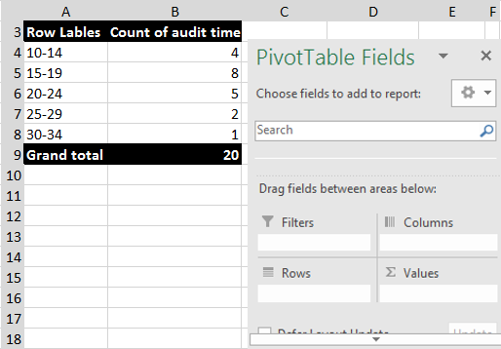
Using Excel’s Pivot table to construct a frequency distribution

Slide 23
Using Excel’s PivotTable to Construct a Frequency Distribution
To construct the frequency distribution, we must group the rows containing audit time.
Step 1 - Right click any cell in the PivotTable report containing a an audit time.
Step 2 - Choose Group from the list of options that appears
Step 3 - When the Grouping dialog box appears:
      Enter 10 in the Starting at box
      Enter 34 in the Ending at box
      Enter 5 in the By box
      Click OK

Slide 24
Relative Frequency and Percent Frequency Distributions
Example: Sanderson and Clifford
Audit time (in days) | Relative Frequency | Percent Frequency
10 – 14 | .20 (4/20) | 20 (0.2 * 100)
15 – 19 | .40 | 40
20 – 25 | .25 | 25
25 – 29 | .10 | 10
30 – 34 | .05 | 5
 | Total 1.00 | 100

Slide 25
Relative Frequency and Percent Frequency Distributions
Example: Sanderson and Clifford
Insights obtained from the Percent Frequency Distribution:
      40% of the audits required from 15 to 19 days.
      Another 25% of the audits required 20 to 25 days.
      Only 5% of the audits required more than 30 days.

Slide 26
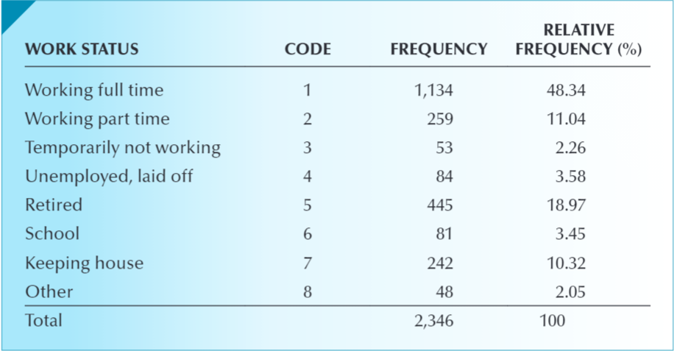
Example– Frequency Distribution
Work Status in the General Social Survey
GSS asked: “Last week were you working full time, part time, going to school, keeping house, or what?”
The responses were as follows:
Working full time
Working part time
Temporarily not working
Unemployed, laid off
Retired
School
Keeping house
Other
DATA: GSS2018
Variable: WRKSTAT (Column X)
Chapter2DataFiles\GSS2018.xlsx
Notes:
Excel instructions to build a relative frequency distribution:
Type or import the data into one or more columns. (Open GSS2018)
Activate any empty cell and type
=COUNTIF ([Input range], [Criteria])
Input range are the cells containing the data. In this example, the range is X1:X2349. The criteria are the codes you want to count: (1) (2) (3) (4) (5) (6) (7) (8). For example, to count the number of 1s (Working full time), type
=COUNTIF (X1:X2349, 1)
and the frequency will appear in the active cell. Change the criteria to produce the fre-quency of the remaining seven categories. To produce the results below, we copied the WRKSTAT variable into Column A in a new spreadsheet. We typed the codes 1 to 8 in rows 1 to 8 in Column B and then employed COUNTIF to get the frequencies. Column C calculated the relative frequencies.
Working with the General Social Survey and the Survey of Consumer Finances:
There are hundreds of exercises scattered throughout this book that use the data in the General Social Survey and the Survey of Consumer Finances. Here are some hints on how to work with these data.
After you have downloaded all the data sets, we recommend that you store them all onto your computer. Make no changes to these files.
To work with one or more columns, we suggest that you copy the column or columns into a new spreadsheet. For example, in this example we need Column X (WRKSTAT) in the GSS2018 file. Copy the entire column into Column A of another worksheet. Then use the new spreadsheet to conduct any graphical or numerical technique.
To take a subset of any column of data use the DATA and SORT commands. Suppose that we are interested in the work status of respondents who have completed a graduate degree (DEGREE: 4 5 graduate).
Proceed as follows.
Copy Column T (DEGREE) into Column A of a new worksheet.
Copy Column X (WRKSTAT) into Column B.
Highlight both columns.
Click DATA and SORT.
Specify Sort by Column A (or use the name of the variable).Scroll down Column A until you reach the rows containing 4s.Use the data in Column B to conduct your statistical analysis.

Slide 27
Pie Chart
The pie chart is a commonly used graphical device
for presenting relative frequency and percent
frequency distributions for categorical data.
First draw a circle; then use the relative frequencies
to subdivide the circle into sectors that correspond to
the relative frequency for each class.
Since there are 360 degrees in a circle, a class with a
relative frequency of .25 would consume .25(360) = 90
degrees of the circle.

Slide 28
Pie Chart
Marada Inn Quality Ratings
Excellent
5%
Poor
10%
Below
Average
15%
Above
Average
45%
Average
25%

Slide 29
But what if the sample size is much larger?
DataFiles\HotelRatings.xlsx
Looking at the Soft Drink Market
DataFiles\SoftDrink.xlsx

Slide 30
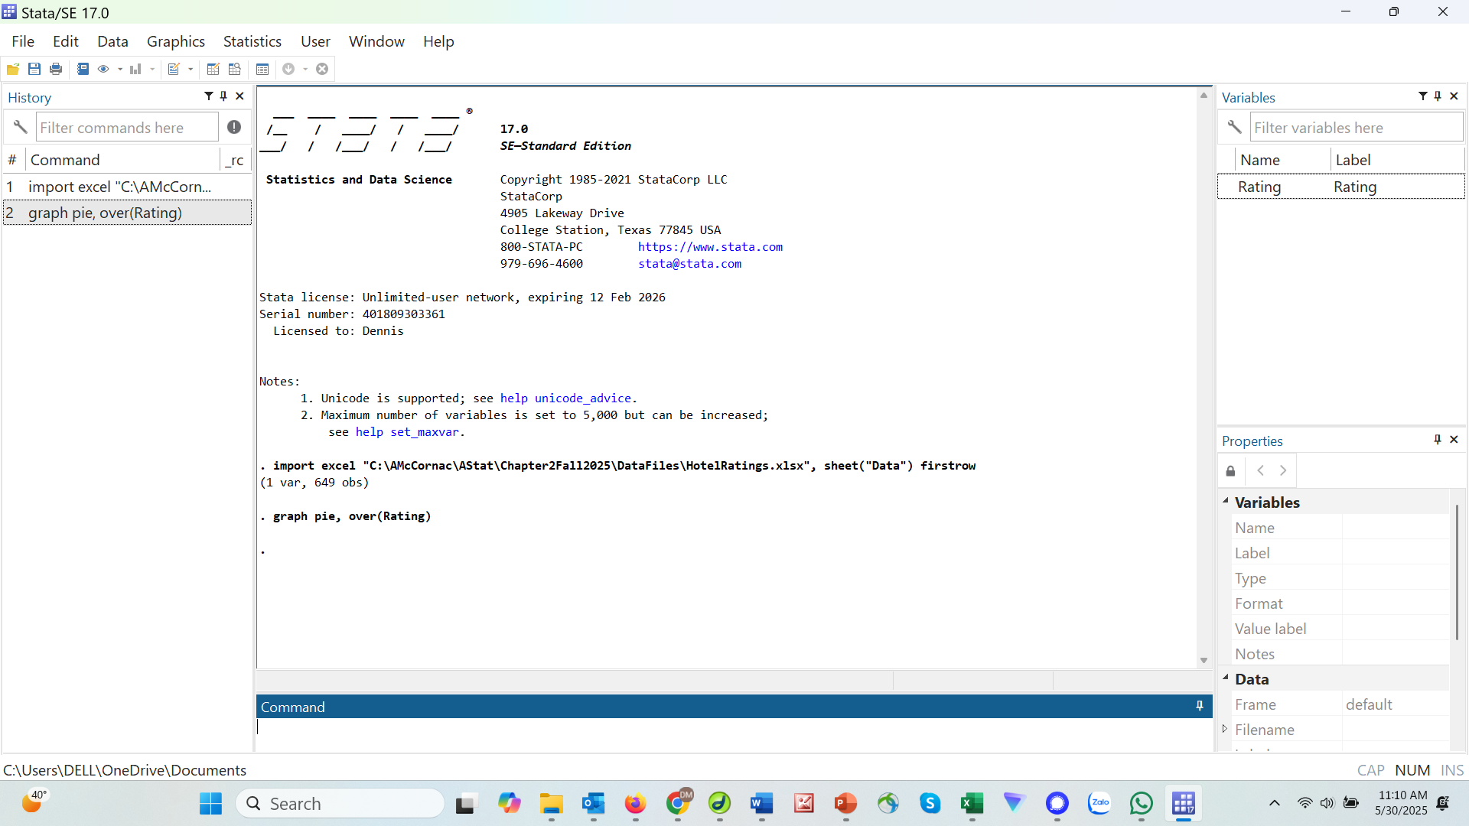

Slide 31
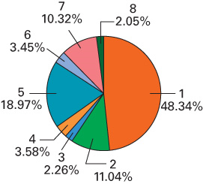
Pie Chart
Work Status in the General Social Survey
A pie chart is used to shows relative frequencies. The pie chart is created by segmenting a circle into several wedges, one for each category.
The angle on each wedge is proportional to the respective relative frequency. The size of the circle is arbitrary.
Interpret:
Only 48.3% of respondents were working full time, Among the rest, 19% were retired, 11% working part time, and 10.3% keeping house. The remaining were in one of the other four categories.
.
Chapter2DataFiles\GSS2018.xlsx
Notes:
Excel instructions to build a pie chart:
After creating the frequency distribution, highlight the column of relative frequencies.
For a bar chart, click Insert, Pie, and the first 2-D Column. You can make changes to the chart using the Chart Tools. We removed the Gridlines, Legend, and clicked the Data Labels to create the titles.

Slide 32
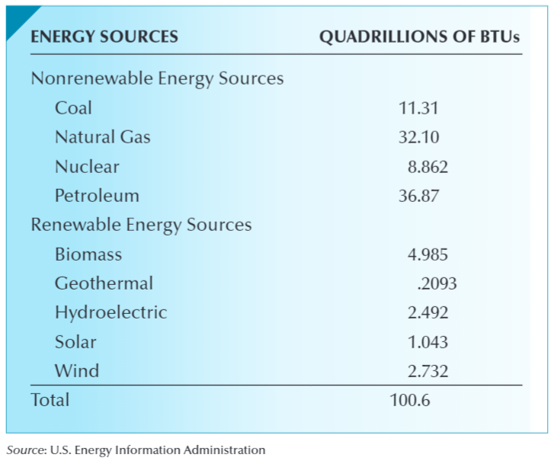
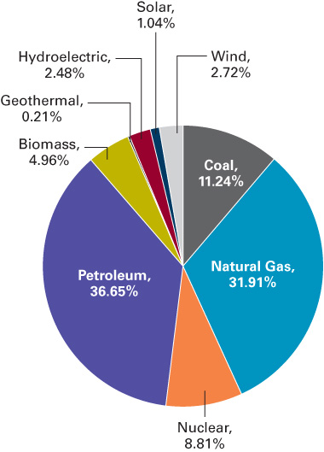
Energy Consumption in the USA in 2019
Use an appropriate graphical technique to depict the total energy consumption of the USA from all sources in 2019.
DATA: Xm02-02
Solution:
The pie chart is the appropriate method to describe the proportion of total energy consumption from each source.
Interpret:
The USA depends heavily on the fossil fuels (80%). Renewables amount to about 11% of the total consumption.
Chapter2DataFiles\Xm02-02.xlsx

Slide 33
Bar Chart
A bar chart is a graphical device for depicting
qualitative data.
On one axis (usually the horizontal axis), we specify
the labels that are used for each of the classes.
A frequency, relative frequency, or percent frequency
scale can be used for the other axis (usually the
vertical axis).
Using a bar of fixed width drawn above each class
label, we extend the height appropriately.
  The bars are separated to emphasize the fact that each
  class is a separate category.

Slide 34
Bar Chart
Marada Inn Quality Ratings
10
9
8
7
6
Frequency
5
4
3
2
1
Rating
Poor
Below
Average
Average
Above
Average
Excellent

Slide 35
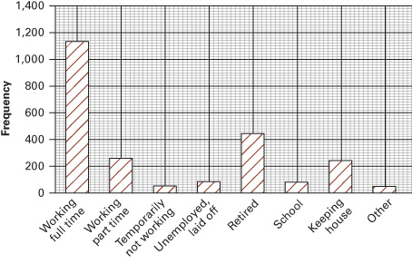
Bar Chart
Work Status in the General Social Survey
Graphical techniques generally catch a reader’s eye more quickly than a table of numbers does.
A bar chart is used to display frequencies.
The bar chart is created by drawing a rectangle representing each category. The height of the rectangle represents the frequency.
The width of the base is arbitrary.
Chapter2DataFiles\GSS2018.xlsx
Notes:
Excel instructions to build a bar chart:
After creating the frequency distribution, highlight the column of frequencies.
For a bar chart, click Insert, Column, and the first 2-D Column. You can make changes to the chart using the Chart Tools. We removed the Gridlines, Legend, and clicked the Data Labels to create the titles.

Slide 36
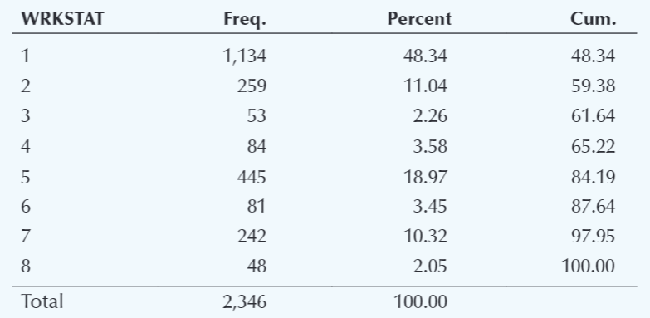
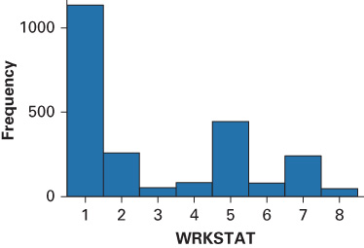
Frequency Distribution and Bar Chart
Example 2.1 – Stata Output and Instructions
Chapter2Stata instructions.pdf
Notes:
Instructions
Import the data into one column. (Click File/Import/Excel spreadsheet (*xls,*xlsx)/GSS2018.)
Check Import first row as variable names.
Click Statistics, Summaries, tables and tests, Frequency tables, and One-way table.
Select WRKSTAT in the Categorical variable: box

Slide 37
Cumulative Distributions
Cumulative frequency distribution − shows the
number of items with values less than or equal to the
upper limit of each class..
Cumulative relative frequency distribution – shows
the proportion of items with values less than or
equal to the upper limit of each class.
Cumulative percent frequency distribution – shows
the percentage of items with values less than or
equal to the upper limit of each class.

Slide 38
Cumulative Distributions
Example: Sanderson and Cliffords
Audit time (Days) | Cumulative Frequency | Cumulative Relative Frequency | Cumulative Percent Frequency
≤ 14 | 4 | .20 | 20
≤ 19 | 12 | .60 | 60
≤ 24 | 17 | .85 | 85
≤ 29 | 19 | .95 | 95
≤ 34 | 20 | 1.00 | 100

Slide 39
Crosstabulation
A crosstabulation is a tabular summary of data for
two variables.
Crosstabulation can be used when:
  one variable is qualitative and the other is
  quantitative,
  both variables are qualitative, or
  both variables are quantitative.
The left and top margin labels define the classes for
the two variables.

Slide 40
Crosstabulation
Example: Finger Lakes Homes
The number of Finger Lakes homes sold for each
style and price for the past two years is shown below.
quantitative
variable
categorical
variable
Price
Range
Home Style
Colonial Log Split A-Frame
Total
< $200,000
> $200,000
18 6 19 12
55
45
12 14 16 3
Total
30 20 35 15
100

Slide 41
Crosstabulation
Frequency
distribution
for the
price range
variable
Example: Finger Lakes Homes
Price
Range
Home Style
Colonial Log Split A-Frame
Total
< $200,000
> $200,000
18 6 19 12
55
45
12 14 16 3
Total
30 20 35 15
100
Frequency distribution for
the home style variable

Slide 42
Crosstabulation: Row Percentages
Example: Finger Lakes Homes
Price
Range
Home Style
Colonial Log Split A-Frame
Total
< $200,000
> $200,000
32.73 10.91 34.55 21.82
100
100
26.67 31.11 35.56 6.67
Note: row totals are actually 100.01 due to rounding.
(Colonial and > $200K)/(All > $200K) x 100 = (12/45) x 100

Slide 43
Crosstabulation: Column Percentages
Example: Finger Lakes Homes
Price
Range
Home Style
Colonial Log Split A-Frame
< $200,000
> $200,000
60.00 30.00 54.29 80.00
40.00 70.00 45.71 20.00
Total
100 100 100 100
(Colonial and > $200K)/(All Colonial) x 100 = (12/30) x 100
Converting the entries in the table into row percentages or column percentages can provide additional insight about the relationship between the two variables.

Slide 44
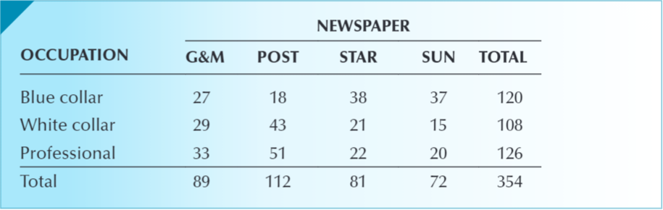
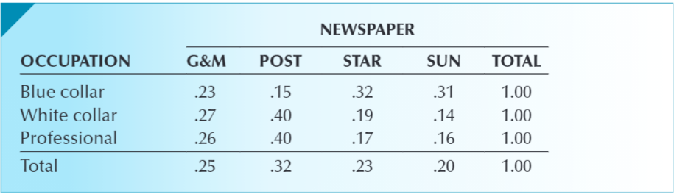
Newspaper Readership Survey
A sample of newspaper readers was asked to report
which newspaper they read: Globe and Mail (1) Post
(2), Star (3), Sun (4), and to indicate whether they
were blue-collar worker (1), white-collar worker (2),
or professional (3).
DATA: Xm02-04
Determine if the two variables are related.
Solution:
By counting the number of times each of the 12
combinations occurs, we produce the cross-
classification table of frequencies.
To investigate if occupation and newspaper are related,
we convert the frequencies in each row to relative
frequencies as shown in the cross-classification table of row proportions.
Notice how the relative frequencies in rows 2 and 3 are similar and how there are large differences between row 1 and rows 2 and 3. This tells us that the variables occupation and newspaper are related.
Cross-tabulation of Frequencies
Cross-tabulation of Row Proportions
Chapter2DataFiles\Xm02-04.xlsx

Slide 45
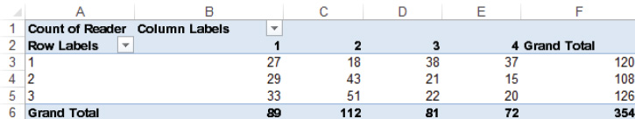
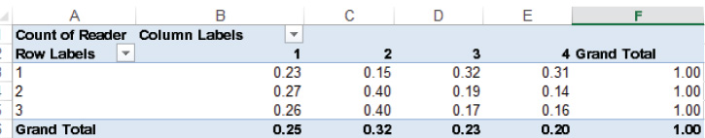
Cross-classification Tables with Excel
Excel can produce a cross-classification table using several methods.
We will use and describe the PivotTable to (1) create the cross-classification table featuring the counts and (2) create a table showing the row relative frequencies.
Instructions:
Click Insert and PivotTable.
Select the whole Table/Range. Click OK.
In the Pivot Table Fields, check Reader
and right-click Add to Values.
Check Occupation and right-click Add to
Row Labels.
Check Newspaper and right-click Add to
Column Labels.
Place the cursor in the table and right-click
Summarize Values by and click Count.
To convert to row percentages, right click any
number, click Show Values As and click % of
Row Total.
PivotTable of Frequencies
PivotTable of Row Proportions

Slide 46
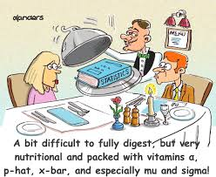
Crosstabulation Examples
Refer to Restaurant Example - Chapter2DataFiles\Restaurant.xlsx

Slide 47
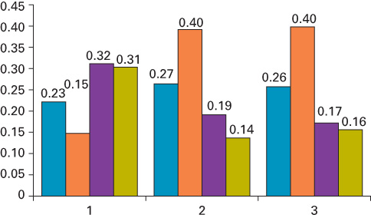
Graphing the Relationship Between Two Nominal Variables with Excel
There are several ways to graphically display
the relationship between two nominal variables.
We have chosen two-dimensional bar charts
for each of the three occupations.
The charts can be created from the output of
the PivotTable either with counts or with row
proportions.
Instructions:
From the cross-classification table, click Insert
and Column. You can do the same from any
completed cross-classification table.
Interpret:
The graphs tell us the same story as the table did. The shapes of the bar charts for occupations 2 and 3 (white collar and professional) are very similar. Both differ considerably from the bar chart for occupation 1 (blue collar).
DataFiles\Xm02-04.xlsx

Slide 48


