Slide 1
Chapter 1 – What is Statistics
The term statistics can refer to numerical facts such as averages, medians, percents, and index numbers that help us understand a variety of business and economic situations.
Statistics can also refer to the art and science of collecting, analyzing, presenting, and interpreting data.
“There are three kinds of lies: lies, damned lies,
and statistics.” ~Benjamin Disraeli (debatable)
“Without data, you’re just another person with an opinion.” ~W. Edwards Deming

Slide 2
Descriptive & Inferential Statistics
Descriptive Statistics
Organize
Summarize
Simplify
Presentation of data
Inferential Statistics
Generalize from samples to population
Hypothesis testing
Relationships among variables
Describing data
Make predictions

Slide 3
Key Statistical Concepts
Population – the group of all items of interest to a statistics practitioner.
Frequently very large; sometimes infinite.
A parameter is a descriptive measure of a population.
Sample – a set of data drawn from the population.
Can also be very large, but always much less than the population.
A statistic is a descriptive measure of a sample.
Statistical inference once again – the process of making an estimate, prediction, or decision about a large population based on sample data.
Because conclusions and estimates are not always going to be correct, we build into the statistical inference “measures of reliability”, namely confidence level and significance level.

Slide 4
Confidence and Significance Levels
The confidence level is the proportion of times that the estimate of a population characteristic is expected to be correct.
Example: a confidence level of 95% means that the estimate of the number of soft drinks consumed by the students at a university may be correct 95% of the time.
The significance level measures how frequently the conclusion about a population will be wrong in the long run.
Example: a 5% significance level means that, in the long run, the conclusion on the winner of an election will be wrong 5% of the time.

Slide 5
Case 1- Background and Data
Pepsi’s Exclusivity Agreement with a University
Case Background
A large university has offered Pepsi-Cola an agreement that would give Pepsi exclusive rights to sell its products at all university facilities for the next year with an option for future years.
In return, the university would receive 35% of the on-campus revenues and an additional lump sum of $200,000 per year.
Pepsi’s Data
The market for soft drinks is measured in terms of 12-ounce cans.
Pepsi currently sells an average of 22,000 cans per week over the 40 weeks of yearly university operations.
The cans sell for an average of $1 each. The costs, including labor, amount to 30 cents per can.
Pepsi suspects its market share to be considerably less than 50%.

Slide 6
Case 1- Survey Approach
Pepsi’s Exclusivity Agreement with a University
Survey
Pepsi assigned a recent university graduate to survey the university’s students to supply the missing information.
The survey consists of tracking the number of soft drinks a random sample of 500 students purchases over 7 days.
A sample is representative of a Population through random sampling, i.e., each potential sample has an equal probability of being selected.
Inferential statistics:
The population in question is the soft drink consumption of the university's 50,000 students.
The cost of interviewing each student would be prohibitive and extremely time consuming.
Instead, we can use inferential statistics to sample a random sample of 500 students and infer from the data the number of soft drinks consumed by all 50,000 students.
We can then estimate annual profits for Pepsi.

Slide 7
Case 1- Analysis and Potential Gain
Pepsi’s Exclusivity Agreement with a University
Analysis
Assuming a 25% market share, and with an exclusivity agreement in place:
88,000 cans/wk x 40 wks = 3,520,000 cans/yr
After deducting the 35% university take:
Gross revenue = 65% x $1/can x 3,520,000 cans/yr = $2,288,000
After subtracting $0.30 cost/can ($1,056,000 total) and $200,000 payment to university:
Net profit = $2,288,000 - $1,056,000 - $200,000 = $1,032,000
Potential Gain:
Pepsi’s current annual profit:
40 wks x 22,000 cans/wk x $0.70 = $616,000
Pepsi’s potential gain at a 25% market share:
$1,032,000 - $616,000 = $416,000
Issue:
Pepsi does not know how many soft drinks are actually sold at the university.

Slide 8
Example 2 - Political Elections and Exit Polls
Political Elections
When an election for political office takes place, the television networks cancel regular programming and provide election coverage instead.
When the ballots are counted the results are reported.
However, for important offices such as president or senator in large states, the networks actively compete to see which will be the first to predict a winner.
Exit Polls
Data for election predictions are collected through exit polls, wherein a random sample of voters who exit the polling booth is asked for whom they voted.
From the data, the sample proportion of voters supporting the candidates is computed.
A statistical technique is applied to determine whether there is enough evidence to infer that a given candidate will win the election.

Slide 9
Example 2 – Data and Inference
Bush vs. Gore, Year 2000 Presidential Election
The exit poll results from the state of Florida during the year 2000 elections were recorded (only the votes of the Republican candidate George W. Bush and the Democrat Albert Gore).
Suppose that the results of 765 people who voted for either Bush or Gore were stored: 1 = Gore, and 2 = Bush.
The network analysts would like to know whether they can conclude that George W. Bush will win the state of Florida.
Sample vs. Population
This is a very common application of statistical inference.
The population:
The television networks wanted to make inferences about the approximately 5 million Floridians who voted for Bush or Gore for president.
The sample:
765 people randomly selected by the polling company who voted for either of the two main candidates.

Slide 10
Example 2 – Estimate of a Population Characteristic
Limitations of an estimate
Because we cannot ask every one of the 5 million voters for whom they voted, we cannot predict the outcome with 100% certainty.
A sample that is only a small fraction of the size of the population can lead to correct inferences only a certain percentage of the time.
You will find that statistics practitioners can control that fraction and usually set it between 90% and 99%.
Population proportion
Population characteristic:
The proportion of the total electorate that voted for Bush.
Specific question:
Did more than 50% of the electorate vote for Bush (counting only those who voted for either the Republican or Democratic candidate)?

Slide 11
Applications in
Business and Economics
Accounting
Public accounting firms use statistical sampling
procedures when conducting audits for their clients.
Economics
Economists use statistical information in making
forecasts about the future of the economy or some
aspect of it.
Finance
Financial advisors use price-earnings ratios and
dividend yields to guide their investment advice.
What about Marketing and Production?

Slide 12
Analytics
Scientific process of transforming data into insight for making better decisions.
  Types
  Descriptive analysis – Analytical techniques that describe what happened in the past.
  Predictive analysis
      Analytical techniques that use models constructed from past data to predict future.
      Helps assess the impact the impact of one variable on another
  Prescriptive analysis – Analytical techniques that yield a best course of action to take.

Slide 13
Data Warehousing
Organizations obtain large amounts of data on a
daily basis by means of magnetic card readers, bar
code scanners, point of sale terminals, and touch
screen monitors.
Wal-Mart captures data on 20-30 million transactions
per day.
Visa processes 6,800 payment transactions per second.
Capturing, storing, and maintaining the data, referred
to as data warehousing, is a significant undertaking.

Slide 14
Data Mining
Analysis of the data in the warehouse might aid in
decisions that will lead to new strategies and higher
profits for the organization.
Using a combination of procedures from statistics,
mathematics, and computer science, analysts “mine
the data” to convert it into useful information.
The most effective data mining systems use automated
procedures to discover relationships in the data and
predict future outcomes, … prompted by only general,
even vague, queries by the user.
The major applications of data mining have been
made by companies with a strong consumer focus
such as retail, financial, and communication firms.

Slide 15
Large Real Data Sets
Throughout the course, subsets from the two following data sources are used:
General Social Survey (GSS)
With the exception of the U.S. Census, the GSS is the most frequently used source of information about American society. The surveys are conducted every second year and feature hundreds of variables and thousands of observations about American attitudes on a wide variety of topics.
Survey of Consumer Finances (SCF)
The SCF is conducted every 3 years to provide detailed information on the finances of U.S. households. The study is sponsored by the Federal Reserve Board in cooperation with the Department of the Treasury.
For this course, we will use EXCEL and STATA software to perform statistical computations on the data in the belief that virtually all university graduates use it now and will in the future.

Slide 16
Ethical Guidelines for Statistical Practice
In a statistical study, unethical behavior can take a
variety of forms including:
Improper sampling
Inappropriate analysis of the data
Development of misleading graphs
Use of inappropriate summary statistics
Biased interpretation of the statistical results
You should strive to be fair, thorough, objective, and
neutral as you collect, analyze, and present data.
As a consumer of statistics, you should also be aware
of the possibility of unethical behavior by others.

Slide 17
Correlation vs. Causation
A study showed that truck drivers weigh more than adults who do not drive trucks. Conclusion: Trucks cause people to gain weight.*
There is a strong relationship between a child’s knowledge of nursery rhymes at age 3 and their reading skills over the next few years. Does this mean that nursery rhymes cause children to be able to read better?**
https://www.proprofs.com/quiz-school/story.php?title=mty4otgwoai1ow
*Taken from Triola, Essentials of Statistics. Addison Wesley.
** http://www.ncbi.nlm.nih.gov/pubmed/2760133

Slide 18
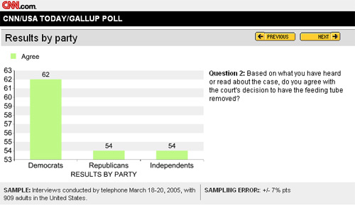
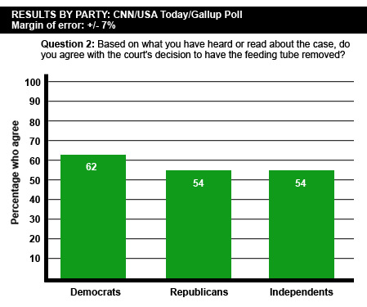
A
L
I
T
T
L
E
M
I
S
L
E
A
D
I
N
g

Slide 19
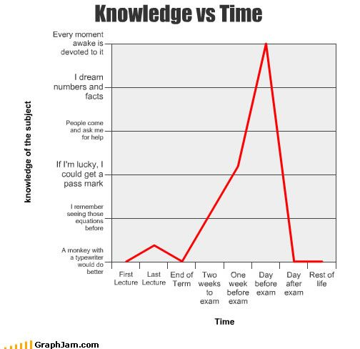

Slide 20
Data Acquisition Considerations
Time Requirement
Searching for information can be time consuming.
Information may no longer be useful by the time it
is available.
Cost of Acquisition
Organizations often charge for information even
when it is not their primary business activity.
Data Errors
Using any data that happen to be available or were
acquired with little care can lead to misleading
information.

Slide 21
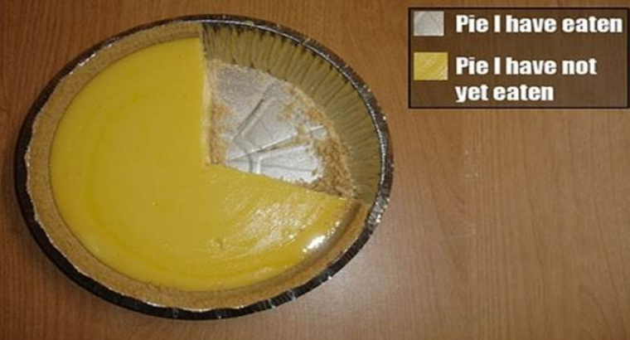

Slide 22
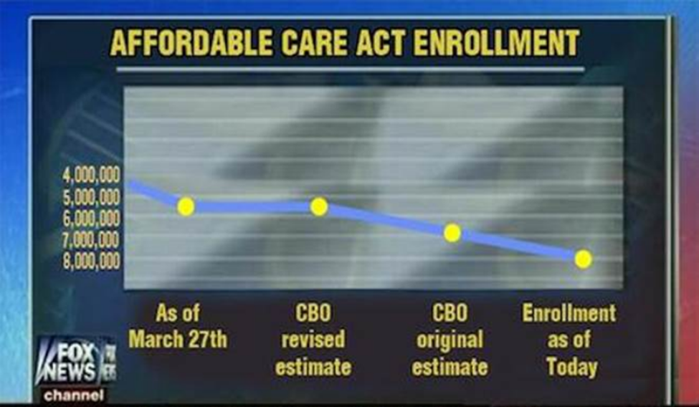

Slide 23
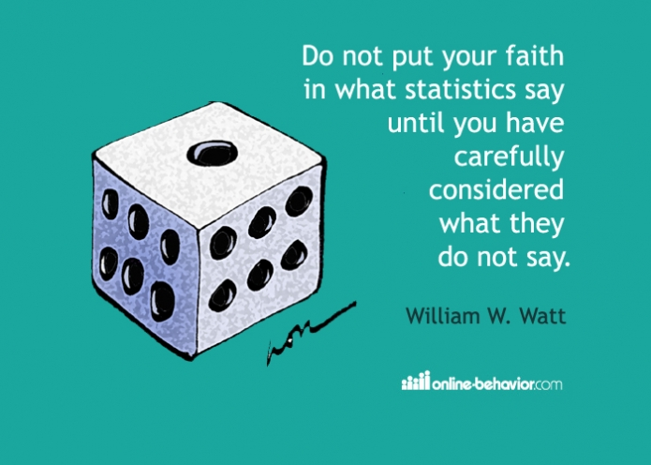

Slide 24
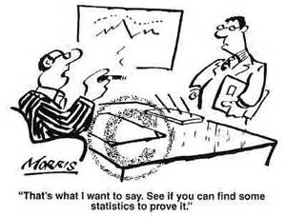
https://lstat.kuleuven.be/images/cartoon-statistics.jpg/image_view_fullscreen

