Slide 1
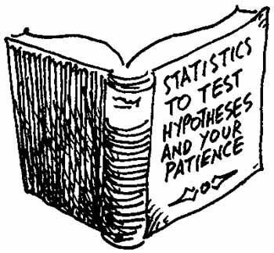
Chapter 11: Introduction to Hypothesis Testing
Instructor: Dennis McCornac

Slide 2
Introduction
In this chapter we present the second general procedure of making inferences about a population – hypothesis testing.
The purpose of hypothesis testing is to determine whether we have enough statistical evidence to conclude that a belief or hypothesis about a parameter is supported by the data.
This chapter represents a critical contribution to your development as a statistics practitioner because it lays the foundation for the rest of the properties.
First, we introduce the concepts of hypothesis testing, and then we develop a method to test a hypothesis about a population mean when the population standard deviation is known.

Slide 3
Concepts of Hypothesis Testing
The critical concepts in hypothesis testing may be summarized as follows:
There are two hypotheses
The null hypothesis (H₀ – pronounced “H nought”)
The alternative (or research) hypothesis (H₁).
The test begins with the assumption that H₀ is true.
The goal of the test is to determine whether there is enough evidence to infer that H₁ is true.
There are two possible decisions
  Reject H₀. Conclude that there is enough evidence to support H₁.
  Do not reject H₀. Conclude that there is not enough evidence to support H₁.

Slide 4
11-1 A Nonstatistical Application of Hypothesis Testing
In a criminal trial, a defendant stands accused of a crime in front of a jury.
It can be said that the jury conducts a test of hypotheses based on the evidence presented by both the prosecution and the defense, that is:
  H₀: The defendant is innocent.
  H₁: The defendant is guilty.
The jury can only make two decisions (i.e., render two verdicts):
Reject H₀. There is enough evidence to conclude that the defendant is guilty: a conviction.
Do not reject H₀. There is not enough evidence to conclude that the defendant is guilty: an acquittal.
Under no circumstances, the decision that H₀ is true, and the defendant is innocent, is ever made.

Slide 5
Error Types
Two possible errors can be made in a test:
  A Type I error occurs when we reject a true null hypothesis.
  P(Type I error) = α, also called the significance level.
  A Type II error occurs when we do not reject a false null hypothesis.
  P(Type II error) = β
The error probabilities α and β are inversely related, and any attempt to reduce one will increase the other. The table on the next slide summarizes the terminology and the concepts.

Slide 6
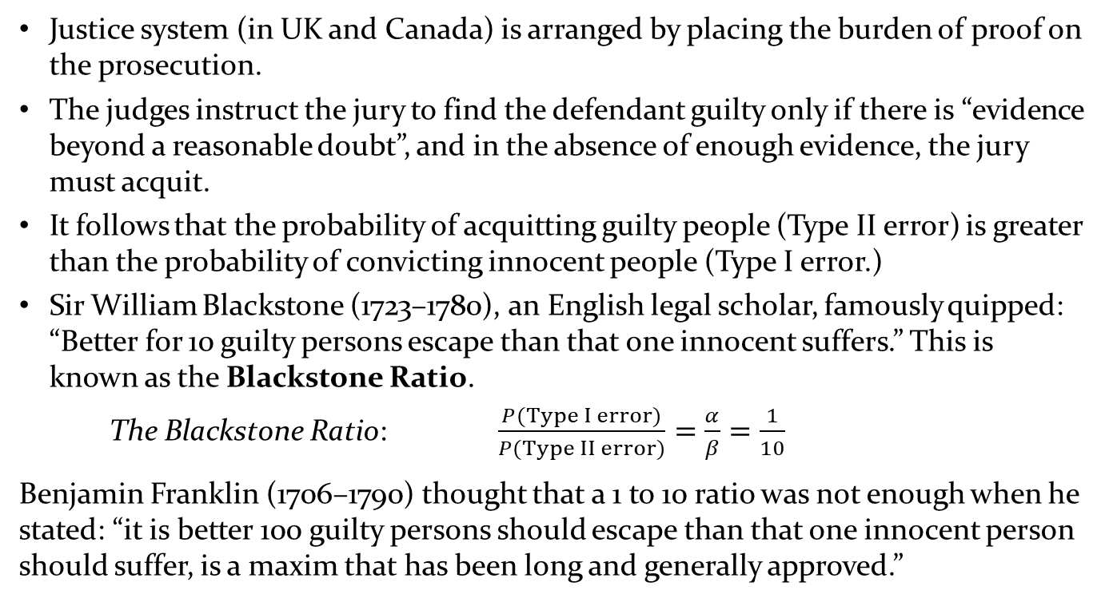
The Blackstone Ratio
Justice system (in UK and Canada) is arranged by placing the burden of proof on the prosecution.
The judges instruct the jury to find the defendant guilty only if there is “evidence beyond a reasonable doubt”, and in the absence of enough evidence, the jury must acquit.
It follows that the probability of acquitting guilty people (Type II error) is greater than the probability of convicting innocent people (Type I error.)
Sir William Blackstone (1723–1780), an English legal scholar, famously quipped: “Better for 10 guilty persons escape than that one innocent suffers.” This is known as the Blackstone Ratio.
  The Blackstone Ratio: $\frac{P(Type I error)}{P(Type II error)}=\frac{α}{β}=\frac{1}{10}$
  Benjamin Franklin (1706–1790) thought that a 1 to 10 ratio was not enough when he stated: “it is better 100 guilty persons should escape than that one innocent person should suffer, is a maxim that has been long and generally approved.”

Slide 7
11-1 A Statistical Application of Hypothesis Testing
Recollect the example of the operations manager at Doll’s Computers wanted to estimate the mean demand during lead time.
Suppose that the manager wants to know instead whether the mean demand is different from 350.
Now the question becomes: “Is there enough evidence to conclude that μ is not equal to 350?”
The hypotheses are set up to reflect a manager’s decision problem wherein the null hypothesis represents the status quo, whereas the burden of proof is placed on the alternative hypothesis.
Thus, we write: H₀: μ = 350
H₁: μ ≠ 350

Slide 8
Type I and Type II Errors
Population Condition
H₀ True
(μ < 12)
H₀ False
(μ > 12)
Conclusion
Accept H₀
(Conclude μ < 12)
Correct
Decision
Type II Error
Reject H₀
(Conclude μ > 12)
Type I Error
Correct
Decision

Slide 9
Statistical Application of Hypothesis Testing
And what if the manager wants to know whether the mean demand has increased from 350?
The new question is now: “Is there enough evidence to conclude that μ is greater than 350?”
We can write the hypotheses as:
H₀: μ = 350
H₁: μ > 350
What if the manager wants to know whether the mean demand has decreased from 350?
We can phrase the question as: “Is there enough evidence to conclude that μ is less than 350?”
And write the hypotheses as:
H₀: μ = 350
H₁: μ < 350

Slide 10
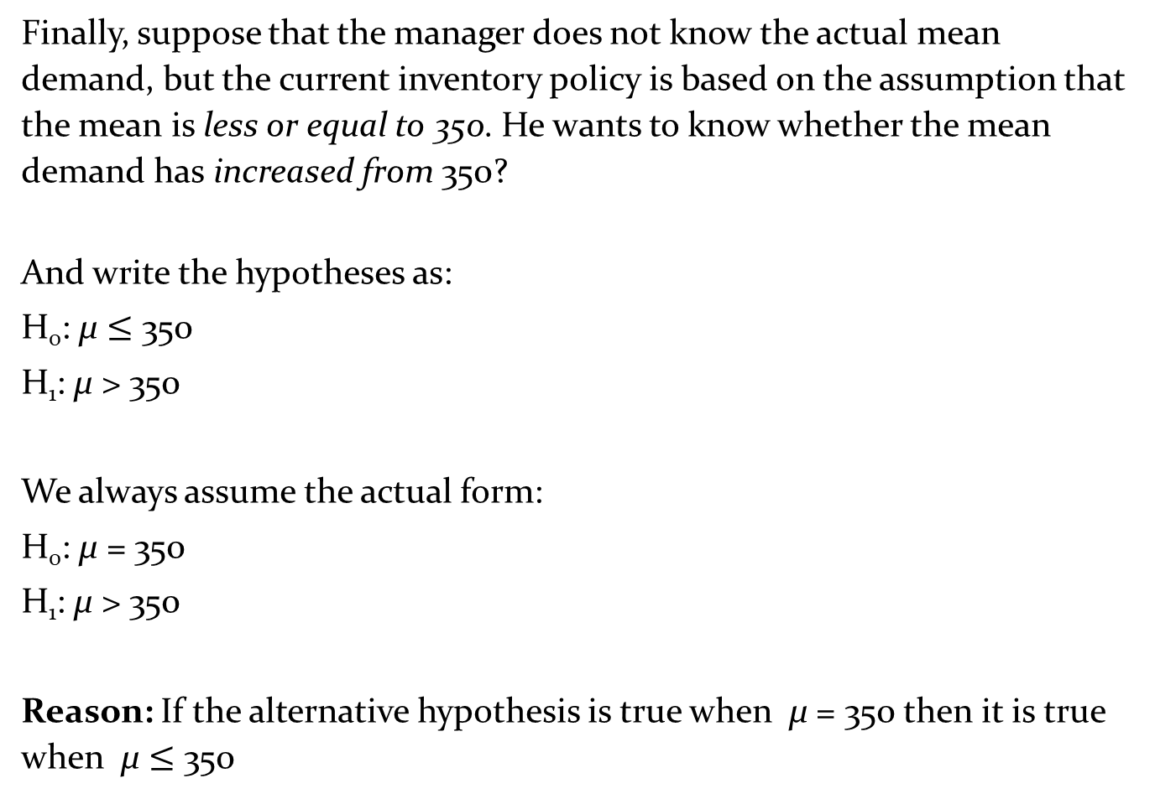
A Statistical Application of Hypothesis Testing
Finally, suppose that the manager does not know the actual mean demand, but the current inventory policy is based on the assumption that the mean is less or equal to 350. He wants to know whether the mean demand has increased from 350?
And write the hypotheses as:
H₀: μ $≤$ 350
H₁: μ > 350
We always assume the actual form:
H₀: μ = 350
H₁: μ > 350
Reason: If the alternative hypothesis is true when μ = 350 then it is true when μ $≤$ 350

Slide 11
The Test Statistic
The test statistic is based on the best estimator of the population parameter, and it is the criterion used to make our decision about the hypotheses.
In the Doll example, the test statistic is the mean of a random sample drawn from the population.
We use the test statistic to make one of the following two decisions:
If the test statistic’s value is inconsistent with the hypothesized mean of 350, we reject H₀ and conclude that there is sufficient evidence that H₁ is true.
If the test statistic’s value is close to the hypothesized mean of 350, we do not reject H₀ and conclude that there is no sufficient evidence that H₁ is true.
In the next section, we show how to use the test statistic’s sampling distribution to define “sufficient evidence.”

Slide 12
Estimating the Population Mean when the Population Standard Deviation is Known
Example – Department Store’s New Billing System
After a thorough financial analysis, the manager of a department store has determined that a new billing system will be cost-effective only if the mean monthly account is more than $170.
A random sample of 400 monthly accounts has a sample mean of $178. The manager knows that the accounts are approximately normally distributed with a standard deviation of $65.
Question: “can the manager conclude that the new system will be cost-effective?”
The null hypothesis can be expressed as:
H₀: μ ≤ 170
However, as discussed in Section 11-1, we actually test μ = 170, so we set the hypotheses as:
H₀: μ = 170 (system is not cost-effective: do not install new system)
H₁: μ > 170 (system is cost-effective: install new system)

Slide 13
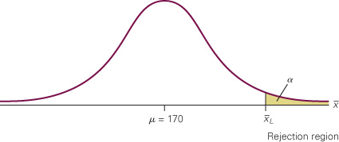
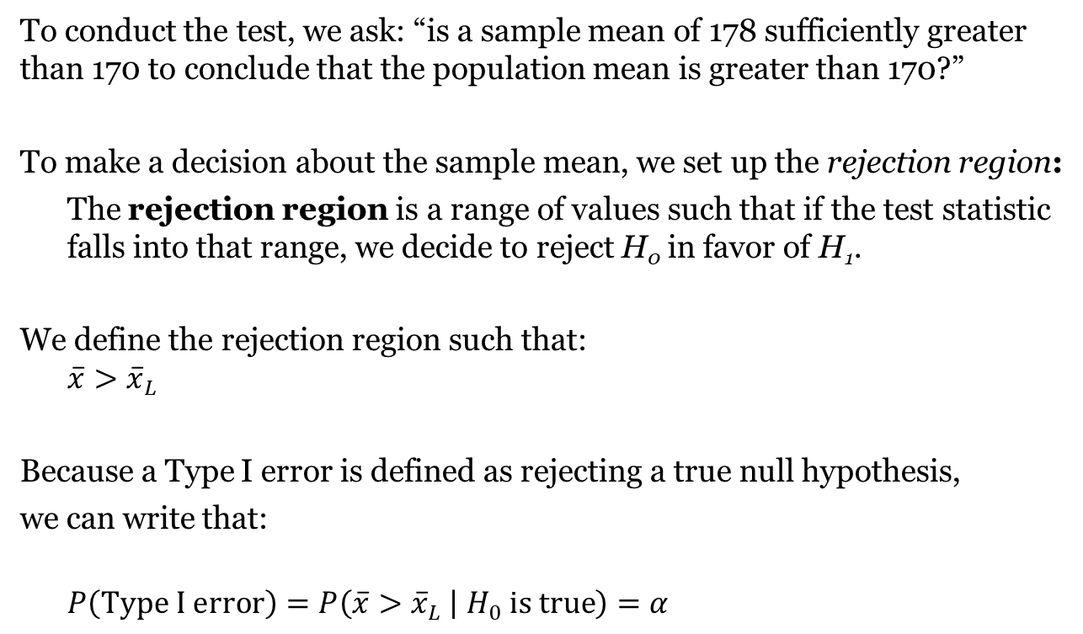
Defining the Rejection Region
Example– Department Store’s New Billing System
To conduct the test, we ask: “is a sample mean of 178 sufficiently greater than 170 to conclude that the population mean is greater than 170?”
To make a decision about the sample mean, we set up the rejection region:
The rejection region is a range of values such that if the test statistic falls into that range, we decide to reject H₀ in favor of H₁.
We define the rejection region such that:
$$\overline{x}>{\overline{x}}_{L}$$
Because a Type I error is defined as rejecting a true null hypothesis,
we can write that:
$$P\left(Type I error\right)=P\left(\overline{x}>{\overline{x}}_{L} | H_{0} is true\right)=α$$

Slide 14
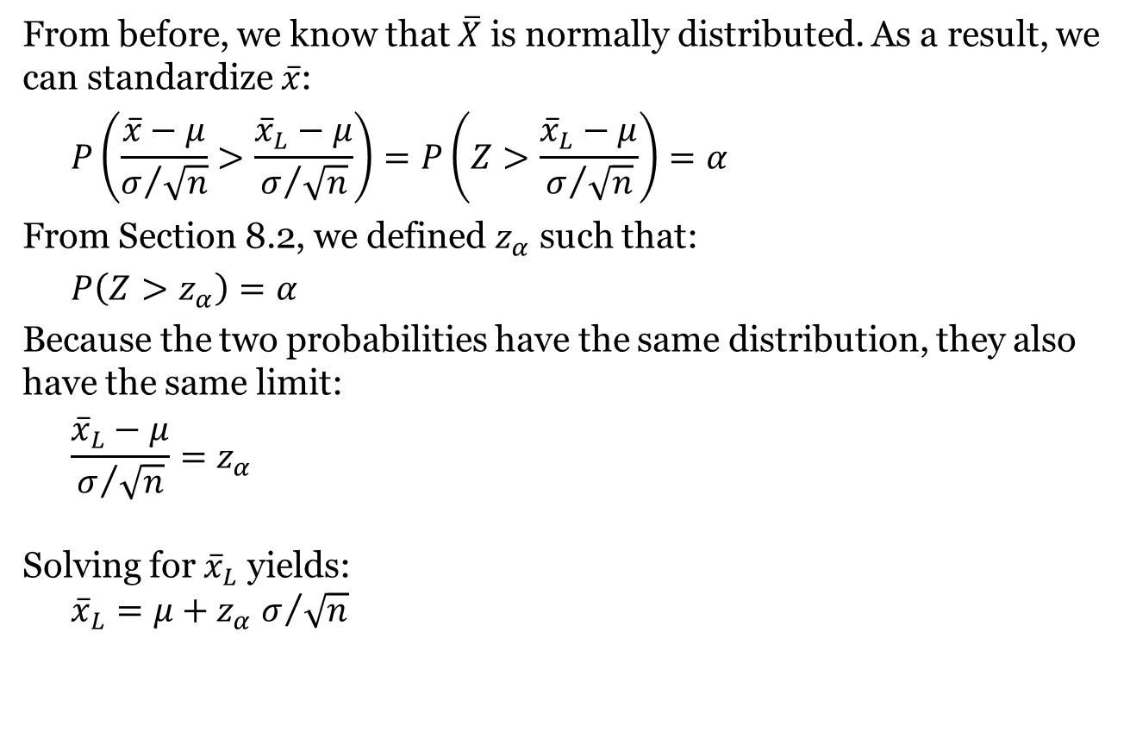
Calculating the Test Statistic from the Rejection Region
Example – Department Store’s New Billing System
From before, we know that $\overline{X}$ is normally distributed. As a result, we can standardize $\overline{x}$:
$$P\left(\frac{\overline{x}−μ}{σ/{\sqrt{n}}}>\frac{{\overline{x}}_{L}−μ}{σ/{\sqrt{n}}}\right)=P\left(Z>\frac{{\overline{x}}_{L}−μ}{σ/{\sqrt{n}}}\right)=α$$
From Section 8.2, we defined $z_{α}$ such that:
$$P\left(Z>z_{α}\right)=α$$
Because the two probabilities have the same distribution, they also have the same limit:
$$\frac{{\overline{x}}_{L}−μ}{σ/{\sqrt{n}}}=z_{α}$$
Solving for ${\overline{x}}_{L}$ yields:
${\overline{x}}_{L}=μ+z_{α}$ $σ/{\sqrt{n}}$

Slide 15
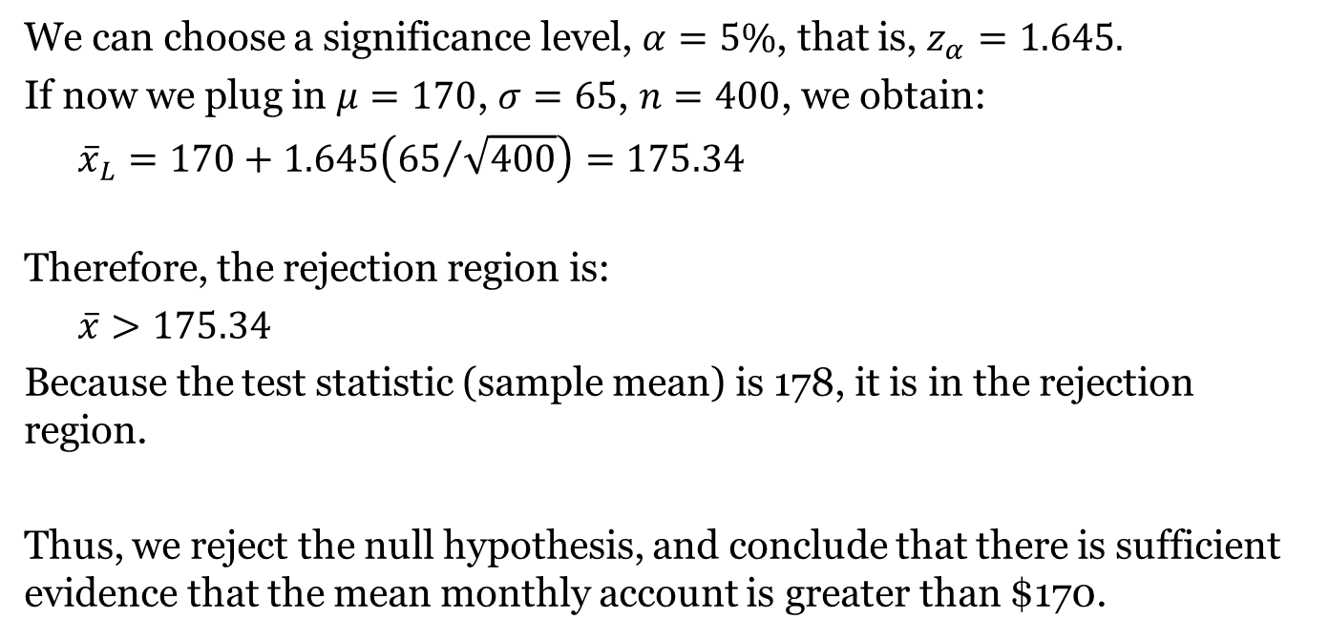
Calculating the Test Statistic from the Rejection Region
Example – Department Store’s New Billing System
We can choose a significance level, $α=5\%$, that is, $z_{α}=1.645.$
If now we plug in $μ=170$, $σ=65$, $n=400$, we obtain:
$${\overline{x}}_{L}=170+1.645\left({65}/{\sqrt{400}}\right)=175.34$$
Therefore, the rejection region is:
$$\overline{x}>175.34$$
Because the test statistic (sample mean) is 178, it is in the rejection region.
Thus, we reject the null hypothesis, and conclude that there is sufficient evidence that the mean monthly account is greater than $170.

Slide 16
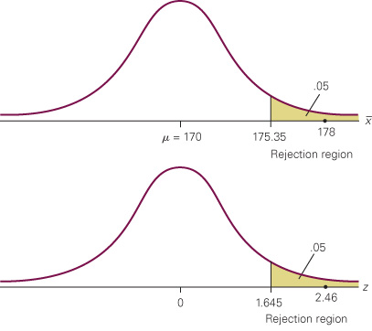
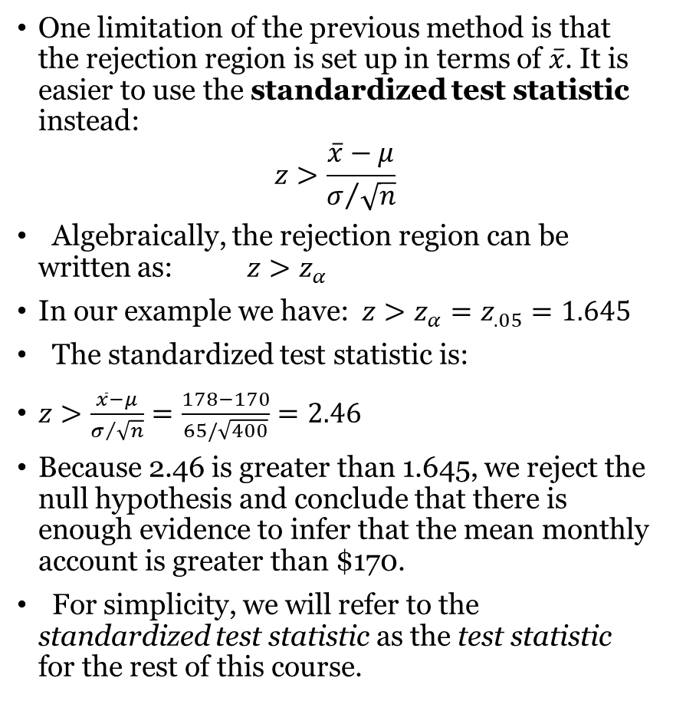
Standardized Test Statistic
One limitation of the previous method is that the rejection region is set up in terms of $\overline{x}$. It is easier to use the standardized test statistic instead:
$$z>\frac{\overline{x}−μ}{σ/{\sqrt{n}}}$$
Algebraically, the rejection region can be written as: $z>z_{α}$
In our example we have: $z>z_{α}=z_{.05}=1.645$
The standardized test statistic is:
$z>\frac{\overline{x}−μ}{σ/{\sqrt{n}}}=\frac{178−170}{65/\sqrt{400}}=2.46$
Because 2.46 is greater than 1.645, we reject the null hypothesis and conclude that there is enough evidence to infer that the mean monthly account is greater than $170.
For simplicity, we will refer to the standardized test statistic as the test statistic for the rest of this course.
Example – Department Store’s New Billing System

Slide 17
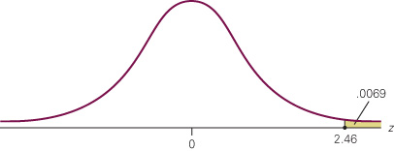
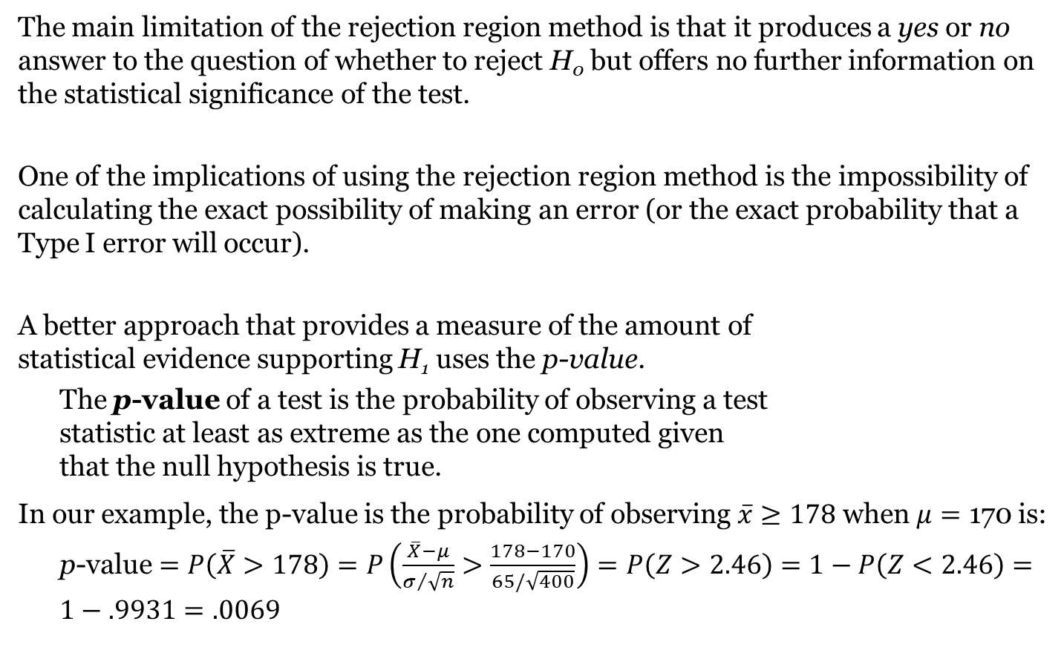
p-Value
The main limitation of the rejection region method is that it produces a yes or no answer to the question of whether to reject H₀ but offers no further information on the statistical significance of the test.
One of the implications of using the rejection region method is the impossibility of calculating the exact possibility of making an error (or the exact probability that a Type I error will occur).
A better approach that provides a measure of the amount of
statistical evidence supporting H₁ uses the p-value.
The p-value of a test is the probability of observing a test
statistic at least as extreme as the one computed given
that the null hypothesis is true.
In our example, the p-value is the probability of observing $\overline{x}≥178$ when $μ=\text{170}$ is:
p-value$=P\left(\overline{X}>178\right)=P\left(\frac{\overline{X}−μ}{σ/{\sqrt{n}}}>\frac{178−170}{65/\sqrt{400}}\right)=P\left(Z>2.46\right)=1−P\left(Z<2.46\right)=1−.9931=.0069$

Slide 18
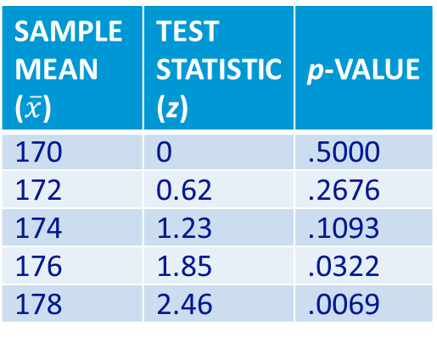
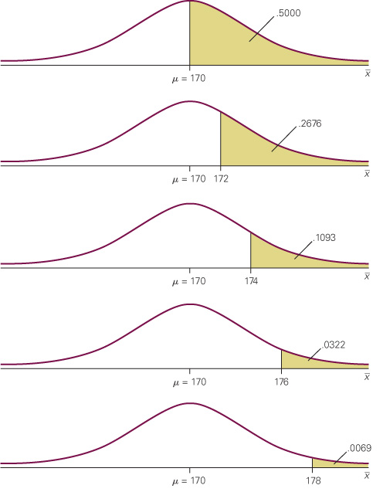

11-2d Interpreting the p-Value
Example – Department Store’s New Billing System
We just concluded that the probability of observing $\overline{x}≥178$ when $μ=\text{170}$ is .0069, which is a very unlikely event.
Consequently, we have reason to reject H₀ and support H₁. But that we cannot make a probability statement about a parameter that is not a random variable.
Incorrect interpretation: the p-value is the probability that the H₀ is true.
Correct interpretation: the p-value measures the amount of statistical evidence that supports H₁.
The table and the graph to the right
show several values of $\overline{x}$, their z-
statistics, and p-values.
Notice how the farther $\overline{x}$ is from the
hypothesized mean of 170, the smaller
the p-value is, and the more the
statistical evidence supports H₁.

Slide 19
Summary of Suggested Guidelines for
Interpreting p-Values
Less than .01
Overwhelming evidence to conclude H_{a} is true.
Between .01 and .05
Strong evidence to conclude H_{a} is true.
Between .05 and .10
Weak evidence to conclude H_{a} is true.
Greater than .10
Insufficient evidence to conclude H_{a} is true.

Slide 20
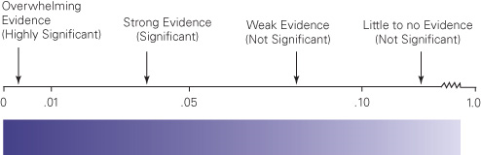
11-2c Describing the p-Value
Example – Department Store’s New Billing System
But how small does the p-value have to be to infer that the alternative hypothesis is true? The answer depends on several factors, including the costs of making Type I and Type II errors.
In the example, a Type I error would occur if the manager adopts the new billing system when it is not cost-effective.
If such cost is high, then we want to reject H₀ when the p-value is quite low by setting a very low significance level, such as α = 1%.
In general, the following descriptive terms apply:
If p-value ≤ .01, there is overwhelming evidence that H₁ is true. The test is highly significant.
If .01 < p-value ≤ .05, there is strong evidence that H₁ is true. The test is significant.
If .05 < p-value ≤ .10, there is weak evidence that H₁ is true. The test is weakly significant.
If p-value > .10, there is little to no evidence that H₁ is true. The test is not significant.

Slide 21
The p-Value and Rejection Region Methods
We can make similar decisions using either method.
When using the rejection region method, the following rules apply:
If the test statistic is within the rejection region, we reject H₀.
If the test statistic is outside the rejection region, we do not reject H₀.
When using the p-value method, the following rules apply:
If p-value ≤ α, we reject H₀.
If p-value > α, we do not reject H₀.

Slide 22
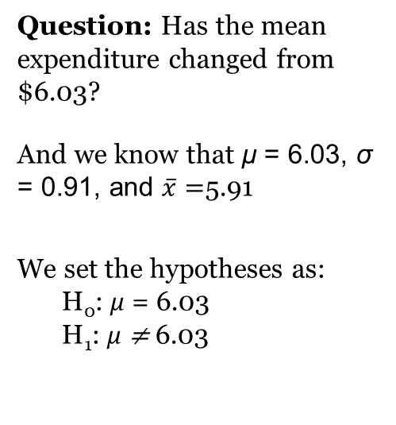
One- and Two-Tail Tests: Identify
Example – The Effects of Kiosks on Sales in Fast-Food Restaurants
The example before was called a one-tail test because the rejection region is located only in one tail of the sampling distribution. We now present an example of a two-tail test.
A restaurant franchise, concerned about possible changes in sales due to the installation of self-serve kiosks, takes a random sample of 100 customers who use the new machines at McDonald’s.
It is known that before the machine’s installation, the average customer at McDonald’s spent $6.03 with a standard deviation of $0.91. The sample mean is found to be equal to $5.91.
Do the data provide enough evidence at the 5% significance level of a change in the size of the transaction for an individual customer?
Question: Has the mean expenditure changed from $6.03?
And we know that μ = 6.03, σ = 0.91, and $\overline{x}=$5.91
We set the hypotheses as:
H₀: μ = 6.03
H₁: μ ≠ 6.03

Slide 23
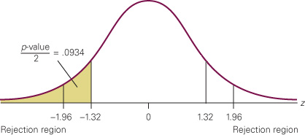
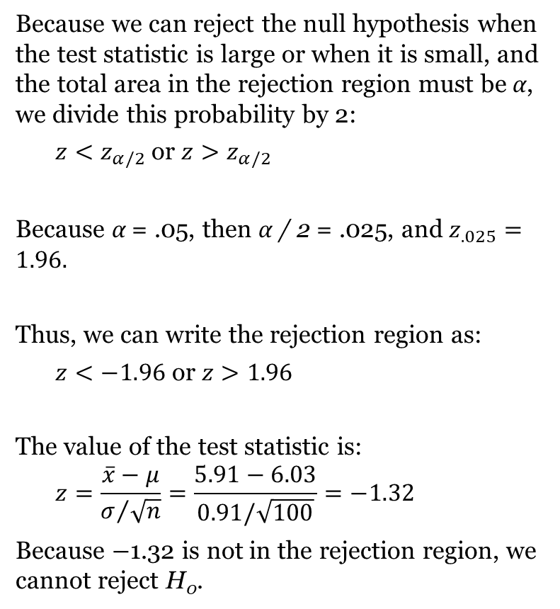
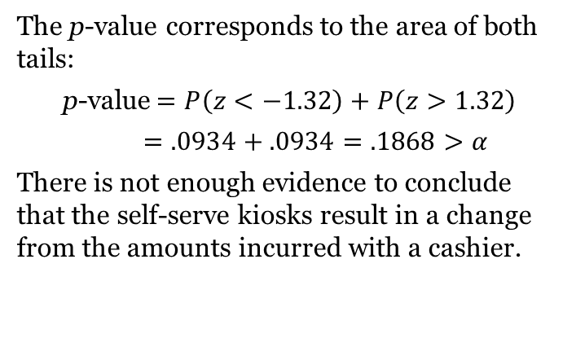
One- and Two-Tail Tests: Compute and Interpret
Because we can reject the null hypothesis when the test statistic is large or when it is small, and the total area in the rejection region must be α, we divide this probability by 2:
$z<z_{α/2}$ or $z>z_{α/2}$
Because α = .05, then α / 2 = .025, and $z_{.025}=1.96.$
Thus, we can write the rejection region as:
$z<−1.96$ or $z>1.96$
The value of the test statistic is:
$$z=\frac{\overline{x}−μ}{σ/{\sqrt{n}}}=\frac{5.91−6.03}{0.91/\sqrt{100}}=−1.32$$
Because −1.32 is not in the rejection region, we cannot reject H₀.
The p-value corresponds to the area of both tails:
p-value$=P\left(z<−1.32\right)+P\left(z>1.32\right)$
$$=.0934+.0934=.1868>α$$
There is not enough evidence to conclude that the self-serve kiosks result in a change from the amounts incurred with a cashier.

Slide 24
When Do We Conduct One- and Two-Tail Tests?
We conduct a two-tail test whenever we want to know whether there is enough evidence to infer that the mean is not equal to the value stated in the null hypothesis:
H₀: μ = μ₀
H₁: μ ≠ μ₀
There are two one-tail tests.
We conduct a right one-tail test whenever we want to know whether there is enough evidence to infer that the mean is greater than the quantity specified by the null hypothesis:
H₀: μ = μ₀
H₁: μ > μ₀
We conduct a left one-tail test whenever we want to know whether there is enough evidence to infer that the mean is less than the quantity specified by the null hypothesis:
H₀: μ = μ₀
H₁: μ < μ₀

Slide 25

Summary of Hypothesis Testing

Slide 26
Critical Value Approach to
Two-Tailed Hypothesis Testing
The critical values will occur in both the lower and
upper tails of the standard normal curve.
Use the standard normal probability distribution
table to find z_{α/2} (the z-value with an area of α/2 in
the upper tail of the distribution).
The rejection rule is:
  Reject H₀ if z < -z_{α/2} or z > z_{α/2}.

Slide 27
Critical Value Approach to
One-Tailed Hypothesis Testing
The test statistic z has a standard normal probability
distribution.
We can use the standard normal probability
distribution table to find the z-value with an area
of α in the lower (or upper) tail of the distribution.
The value of the test statistic that established the
boundary of the rejection region is called the
critical value for the test.
The rejection rule is:
  Lower tail: Reject H₀ if z < -z_{α}
  Upper tail: Reject H₀ if z > z_{α}

Slide 28
Lower-Tailed Test About a Population Mean:
σ Known
Critical Value Approach
Sampling
distribution
of
Reject H₀
α = .10
Do Not Reject H₀
z
−z_{α} = −1.28
0

Slide 29
Upper-Tailed Test About a Population Mean:
σ Known
Critical Value Approach
Sampling
distribution
of
Reject H₀
α = .05
Do Not Reject H₀
z
0
z_{α} = 1.645

Slide 30
p-Value Approach to
Two-Tailed Hypothesis Testing
Compute the p-value using the following three steps:
1. Compute the value of the test statistic z.
2. If z is in the upper tail (z > 0), find the area under
the standard normal curve to the right of z.
If z is in the lower tail (z < 0), find the area under
the standard normal curve to the left of z.
3. Double the tail area obtained in step 2 to obtain
the p –value.
The rejection rule:
Reject H₀ if the p-value < α .

Slide 31
Lower-Tailed Test About a Population Mean:
σ Known
p-Value Approach
p-Value < α ,
so reject H₀.
α = .10
Sampling
distribution
of
p-value
= .072
z
z =
-1.46
-z_{α} =
-1.28
0

Slide 32
Upper-Tailed Test About a Population Mean:
σ Known
p-Value Approach
p-Value < α ,
so reject H₀.
Sampling distribution
of
α = .04
p-Value
= .011
z
0
z_{α} =
1.75
z =
2.29

Slide 33
Summary of Forms for Null and Alternative Hypotheses about a Population Mean
The equality part of the hypotheses always appears
in the null hypothesis.
In general, a hypothesis test about the value of a
population mean μ must take one of the following
three forms (where μ₀ is the hypothesized value of
the population mean).
One-tailed
(lower-tail)
One-tailed
(upper-tail)
Two-tailed

Slide 34
Confidence Interval Approach to
Two-Tailed Tests About a Population Mean
Select a simple random sample from the population
and use the value of the sample mean to develop
the confidence interval for the population mean μ.
If the confidence interval contains the hypothesized
value μ₀, do not reject H₀. Otherwise, reject H₀.
(Actually, H₀ should be rejected if μ₀ happens to be
equal to one of the end points of the confidence
interval.)

Slide 35
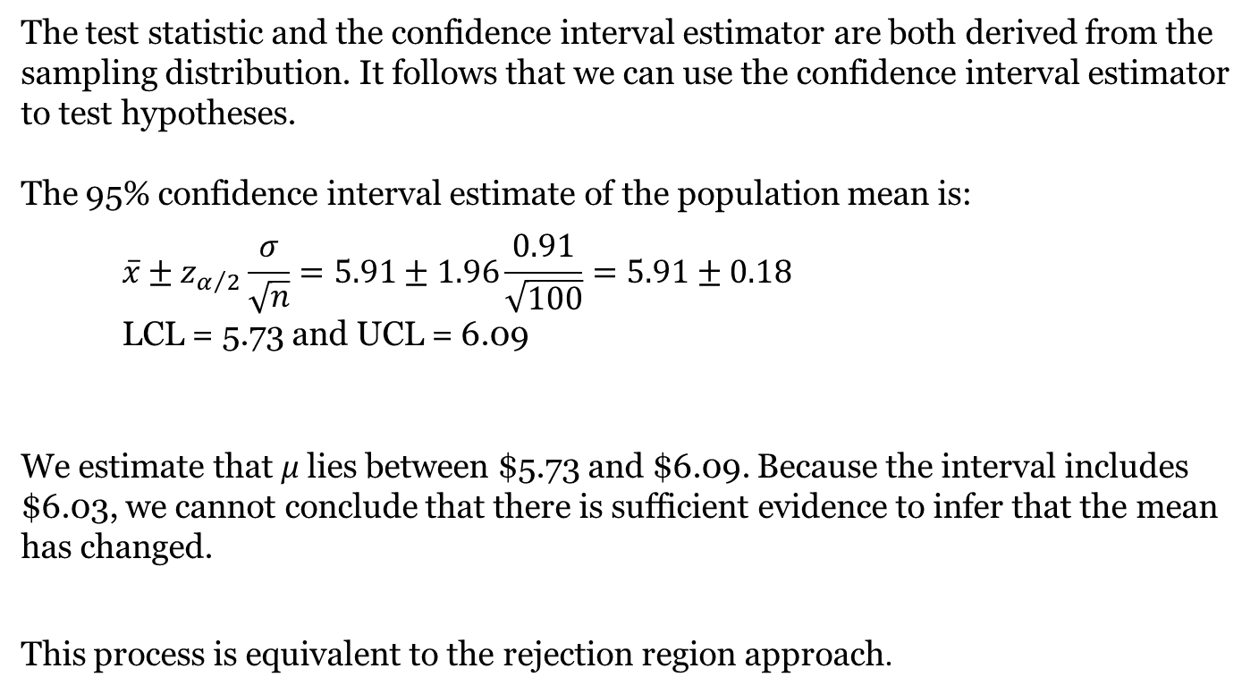
Testing Hypotheses and Confidence Interval Estimators
Example – The Effects of Kiosks on Sales in Fast-Food Restaurants
The test statistic and the confidence interval estimator are both derived from the sampling distribution. It follows that we can use the confidence interval estimator to test hypotheses.
The 95% confidence interval estimate of the population mean is:
$$\overline{x}±z_{α/2}\frac{σ}{\sqrt{n}}=5.91±1.96\frac{0.91}{\sqrt{100}}=5.91±0.18$$
LCL = 5.73 and UCL = 6.09
We estimate that μ lies between $5.73 and $6.09. Because the interval includes $6.03, we cannot conclude that there is sufficient evidence to infer that the mean has changed.
This process is equivalent to the rejection region approach.

Slide 36
Steps of Hypothesis Testing Once Again
Step 1. Develop the null and alternative hypotheses.
Step 2. Specify the level of significance α.
Step 3. Collect the sample data and compute the test statistic.
p-Value Approach
Step 4. Use the value of the test statistic to compute the
p-value.
Step 5. Reject H₀ if p-value < α.
Critical Value Approach
Step 4. Use the level of significance to determine the critical value and the rejection rule.
Step 5. Use the value of the test statistic and the rejection
rule to determine whether to reject H₀.

Slide 37
Null and Alternative Hypotheses Example
Metro EMS
A major west coast city provides one of the most
comprehensive emergency medical services in the
world. Operating in a multiple hospital system
with approximately 20 mobile medical units, the
service goal is to respond to medical emergencies
with a mean time of 12 minutes or less.
The director of medical services wants to
formulate a hypothesis test that could use a sample
of emergency response times to determine whether
or not the service goal of 12 minutes or less is being
achieved.

Slide 38
Null and Alternative Hypotheses
H₀: μ < 12
The emergency service is meeting
the response goal; no follow-up
action is necessary.
H_{a}: μ > 12
The emergency service is not
meeting the response goal;
appropriate follow-up action is
necessary.
where: μ = mean response time for the population
of medical emergency requests

Slide 39
One-Tailed Tests About a Population Mean:
σ Known
Metro EMS
The response times for a random sample of 40
medical emergencies were tabulated. The sample
mean is 13.25 minutes. The population standard
deviation is believed to be 3.2 minutes.
The EMS director wants to perform a hypothesis
test, with a .05 level of significance, to determine
whether the service goal of 12 minutes or less is
being achieved.

Slide 40
One-Tailed Tests About a Population Mean:
σ Known
p -Value and Critical Value Approaches
1. Develop the hypotheses.
H₀: μ < 12
H_{a}: μ > 12
2. Specify the level of significance.
α = .05
3. Compute the value of the test statistic.

Slide 41
One-Tailed Tests About a Population Mean:
σ Known
p –Value Approach
4. Compute the p –value.
For z = 2.47, cumulative probability = .9932.
p–value = 1 − .9932 = .0068
5. Determine whether to reject H₀.
Because p–value = .0068 < α = .05, we reject H₀.
There is sufficient statistical evidence
to infer that Metro EMS is not meeting
the response goal of 12 minutes.

Slide 42
One-Tailed Tests About a Population Mean:
σ Known
p –Value Approach
Sampling
distribution
of
α = .05
p-value
= .0068
z
0
z_{α} =
1.645
z =
2.47

Slide 43
One-Tailed Tests About a Population Mean:
σ Known
Critical Value Approach
4. Determine the critical value and rejection rule.
For α = .05, z_{.05} = 1.645
Reject H₀ if z > 1.645
5. Determine whether to reject H₀.
Because 2.47 > 1.645, we reject H₀.
There is sufficient statistical evidence
to infer that Metro EMS is not meeting
the response goal of 12 minutes.

Slide 44
Two-Tailed Tests About a Population Mean:
σ Known
Example: Glow Toothpaste
The production line for Glow toothpaste is designed to fill tubes with a mean weight of 6 oz. Periodically, a sample of 30 tubes will be selected in order to check the filling process.
Quality assurance procedures call for the continuation of the filling process if the sample results are consistent with the assumption that the mean filling weight for the population of toothpaste tubes is 6 oz.; otherwise the process will be adjusted.

Slide 45
Two-Tailed Tests About a Population Mean:
σ Known
Example: Glow Toothpaste
Assume that a sample of 30 toothpaste tubes provides a sample mean of 6.1 oz. The population standard deviation is believed to be 0.2 oz.
Perform a hypothesis test, at the .03 level of significance, to help determine whether the filling process should continue operating or be stopped and corrected.

Slide 46
Two-Tailed Tests About a Population Mean:
σ Known
p –Value and Critical Value Approaches
H₀: μ = 6
H_{a}:
1. Determine the hypotheses.
2. Specify the level of significance.
α = .03
3. Compute the value of the test statistic.

Slide 47
Two-Tailed Tests About a Population Mean:
σ Known
p –Value Approach
4. Compute the p –value.
For z = 2.74, cumulative probability = .9969
p–value = 2(1 − .9969) = .0062
5. Determine whether to reject H₀.
Because p–value = .0062 < α = .03, we reject H₀.
There is sufficient statistical evidence to
infer that the alternative hypothesis is true
(i.e. the mean filling weight is not 6 ounces).

Slide 48
Two-Tailed Tests About a Population Mean:
σ Known
p-Value Approach
1/2
p -value
= .0031
1/2
p -value
= .0031
α/2 =
.015
α/2 =
.015
z
z = -2.74
0
z = 2.74
-z_{α/2} = -2.17
z_{α/2} = 2.17

Slide 49
Two-Tailed Tests About a Population Mean:
σ Known
Critical Value Approach
4. Determine the critical value and rejection rule.
For α/2 = .03/2 = .015, z_{.015} = 2.17
Reject H₀ if z < -2.17 or z > 2.17
5. Determine whether to reject H₀.
Because 2.74 > 2.17, we reject H₀.
There is sufficient statistical evidence to
infer that the alternative hypothesis is true
(i.e. the mean filling weight is not 6 ounces).

Slide 50
Two-Tailed Tests About a Population Mean:
σ Known
Critical Value Approach
Sampling
distribution
of
Reject H₀
Do Not Reject H₀
Reject H₀
α/2 = .015
α/2 = .015
z
-2.17
0
2.17

Slide 51
Confidence Interval Approach to
Two-Tailed Tests About a Population Mean
The 97% confidence interval for μ is
or 6.02076 to 6.17924
Because the hypothesized value for the
population mean, μ₀ = 6, is not in this interval,
the hypothesis-testing conclusion is that the
null hypothesis, H₀: μ = 6, can be rejected.

Slide 52
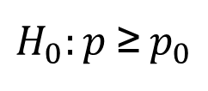
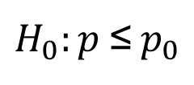
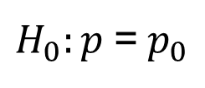
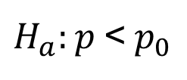
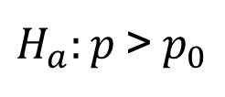
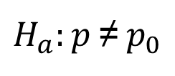
A Summary of Forms for Null and Alternative Hypotheses About a Population Proportion
The equality part of the hypotheses always appears
in the null hypothesis.
In general, a hypothesis test about the value of a
population proportion p must take one of the
following three forms (where p₀ is the hypothesized
value of the population proportion).
One-tailed
(lower tail)
One-tailed
(upper tail)
Two-tailed

Slide 53
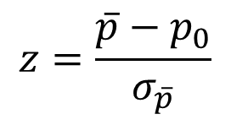
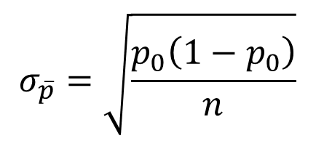
Tests About a Population Proportion
Test Statistic
where:
assuming np > 5 and n(1 – p) > 5

Slide 54
Tests About a Population Proportion
Rejection Rule: p –Value Approach
Reject H₀ if p –value < α
Rejection Rule: Critical Value Approach
H₀: p < p₀
Reject H₀ if z > z_{α}
H₀: p > p₀
Reject H₀ if z < -z_{α}
H₀: p = p₀
Reject H₀ if z < -z_{α/2} or z > z_{α/2}

Slide 55
Two-Tailed Test About a Population Proportion
Example: National Safety Council (NSC)
For a Christmas and New Year’s week, the
National Safety Council estimated that 500 people
would be killed and 25,000 injured on the nation’s
roads. The NSC claimed that 50% of the accidents
would be caused by drunk driving.
A sample of 120 accidents showed that 67 were
caused by drunk driving. Use these data to test the
NSC’s claim with α = .05.

Slide 56
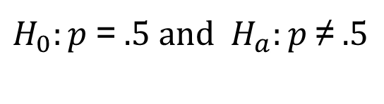
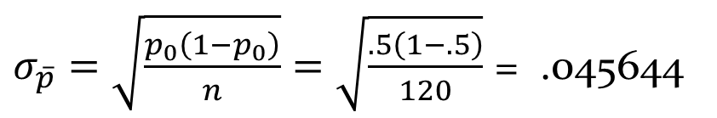
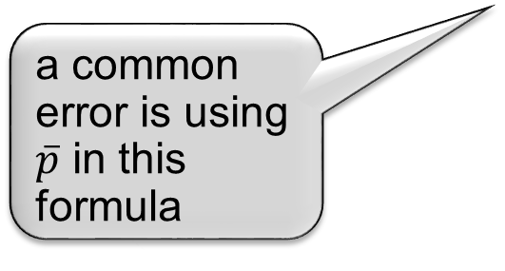
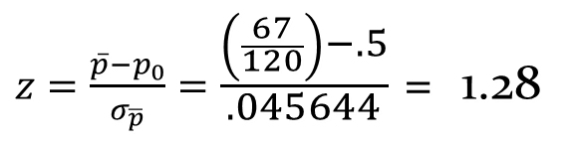
Two-Tailed Test About a Population Proportion
p –Value and Critical Value Approaches
1. Determine the hypotheses.
2. Specify the level of significance.
α = .05
3. Compute the value of the test statistic.

Slide 57
Two-Tailed Test About a Population Proportion
p-Value Approach
4. Compute the p -value.
For z = 1.28, cumulative probability = .8997
p-value = 2(1 - .8997) = .2006
5. Determine whether to reject H₀.
Because p-value = .2006 > α = .05,
we cannot reject H₀.

Slide 58
Interval Estimate of a Population Proportion
The general form of an interval estimate of a
population proportion is
The sampling distribution of plays a key role in
computing the margin of error for this interval
estimate.
The sampling distribution of can be approximated
by a normal distribution whenever np > 5 and
n(1 – p) > 5.

Slide 59
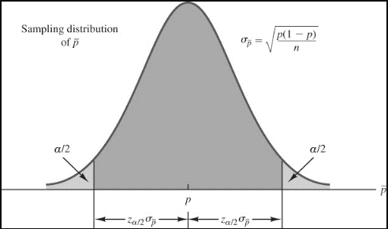
Interval Estimate of a Population Proportion
Normal Approximation of Sampling Distribution of
Sampling
distribution
of
α/2
1 - α of all
values
α/2
p

Slide 60
Interval Estimate of a Population Proportion
Interval Estimate
where: 1 -α is the confidence coefficient
z_{α/2} is the z value providing an area of
α/2 in the upper tail of the standard
normal probability distribution
is the sample proportion

Slide 61
Interval Estimate of a Population Proportion
Example: Survey of women golfers
A national survey of 900 women golfers was conducted to learn how women golfers view their treatment at golf courses in United States. The survey found that 396 of the women golfers were satisfied with the availability of tee times.
Suppose one wants to develop a 95% confidence interval estimate for the proportion of the population of women golfers satisfied with the availability of tee times.

Slide 62
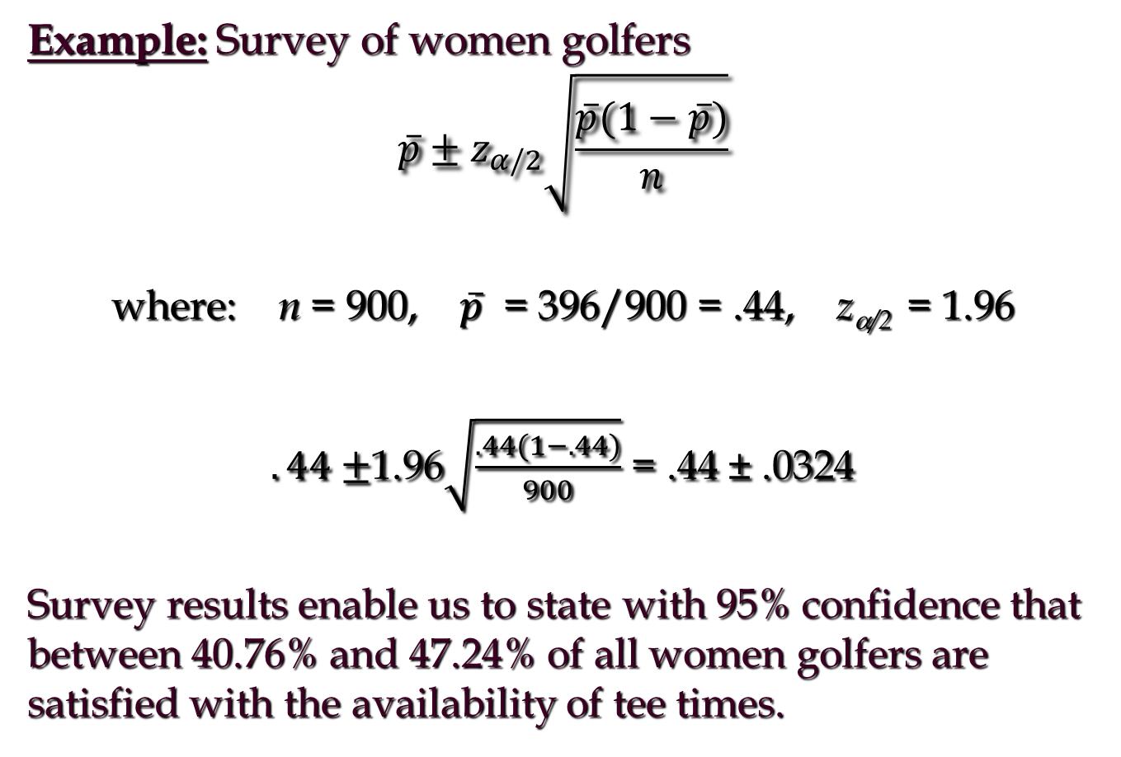
Interval Estimate of a Population Proportion

Slide 63
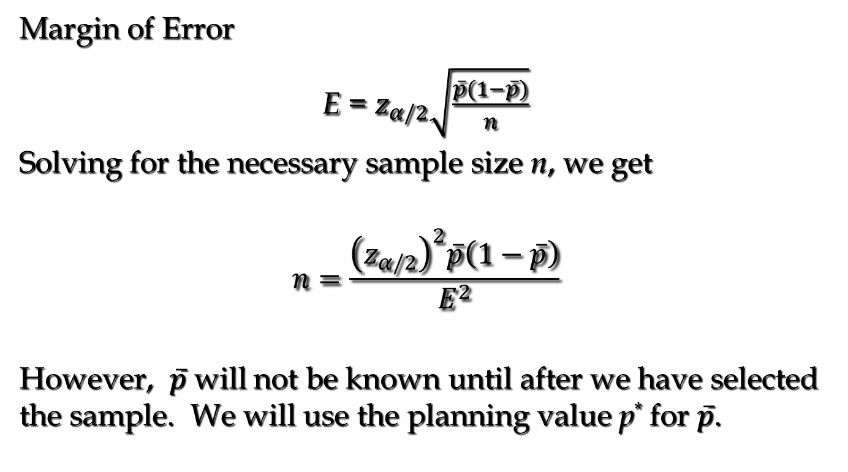
Sample Size for an Interval Estimate of a Population Proportion

Slide 64
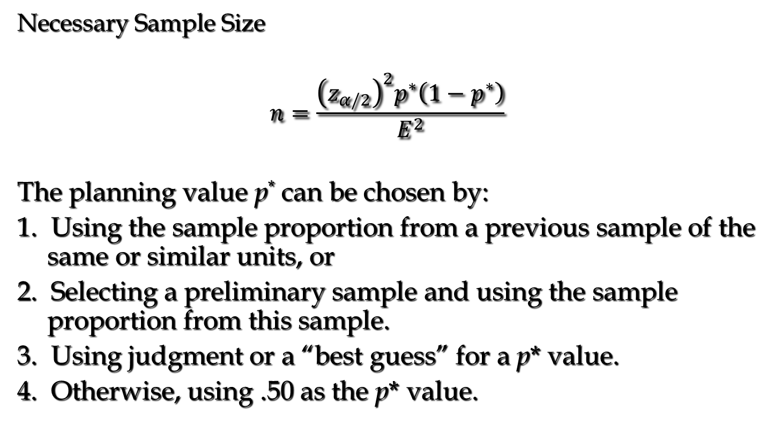
Sample Size for an Interval Estimate of a Population Proportion

Slide 65
Sample Size for an Interval Estimate of a Population Proportion
Example: Survey of women golfers
Suppose the survey director wants to estimate the population proportion with a margin of error of .025 at 95% confidence.
How large a sample size is needed to meet the required precision? (A previous sample of similar units yielded .44 for the sample proportion.)

Slide 66
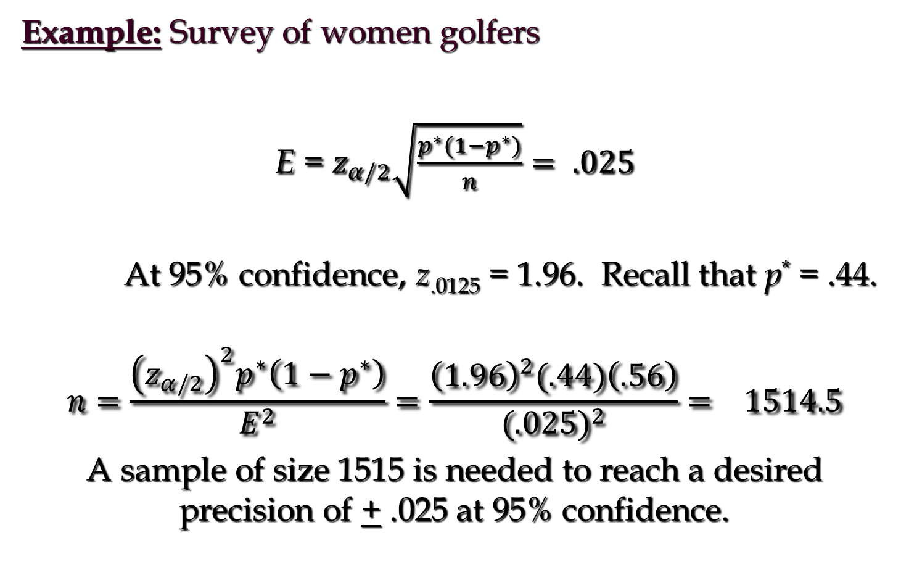
Sample Size for an Interval Estimate of a Population Proportion

Slide 67
Interval Estimate of a Population Proportion
(another example)
Example: Political Science, Inc.
Political Science, Inc. (PSI) specializes in voter polls and surveys designed to keep political office seekers informed of their position in a race. Using telephone surveys, PSI interviewers ask registered voters who they would vote for if the election were held that day.
In a current election campaign, PSI has just found that 200 registered voters, out of 500 contacted, favor a particular candidate. PSI wants to develop a 90% confidence interval estimate for the proportion of the population of registered voters that favor the candidate.

Slide 68
Interval Estimate
of a Population Proportion
where: n = 500, = 200/500 = .40, z_{α/2} = 1.645
PSI is 90% confident that the proportion of all voters
that favor the candidate is between .364 and .436.

Slide 69
Sample Size for an Interval Estimate of a Population Proportion (another example)
Example: Political Science, Inc.
Suppose that PSI would like a .99 probability that
the sample proportion is within + .03 of the
population proportion.
How large a sample size is needed to meet the
required precision? (A previous sample of similar
units yielded .40 for the sample proportion.)

Slide 70
Sample Size for an Interval Estimate
of a Population Proportion
At 99% confidence, z_{.005} = 2.576. Recall that = .40.
A sample of size 1769 is needed to reach a desired
precision of + .03 at 99% confidence.

Slide 71
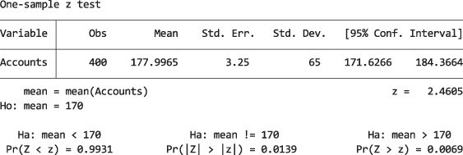
Stata Output and Instructions
Example 11.1 – Testing a Population Mean: Standard Deviation Known
Instructions:
Import the data into one column. (Click File/Import/Excel spreadsheet(*xls,*xlsx)/Chapter11/Xm11-01.) Check Import first row as variable names.
Click Statistics, Summaries, tables and tests, Classical tests of hypotheses, and z-test (mean comparison test known variance).
Select One-sample, select Accounts in the Variable name: box and type 170 in the Hypothesized mean: box. Type 65 for the Standard deviation.

Slide 72
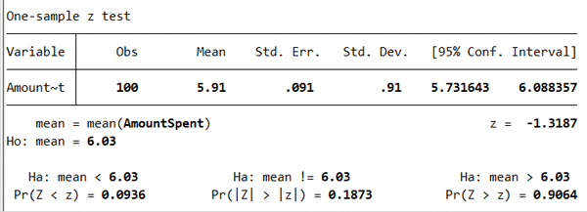
Stata Output and Instructions
Example 11.2 – Testing a Population Mean: Standard Deviation Known
Instructions:
Import the data into one column. (Click File/Import/Excel spreadsheet(*xls,*xlsx)/Chapter11/Xm11-02.) Check Import first row as variable names.
Click Statistics, Summaries, tables and tests, Classical tests of hypotheses, and z-test (mean comparison test known variance).
Select One-sample, select Accounts in the Variable name: box and type 6.03 in the Hypothesized mean: box. Type 0.91 for the Standard deviation.

