Slide 1
Money and Credit
There is a difference between money and credit
Money is what you use to pay for goods and services.
Credit is available savings that are lent to borrowers to spend.
Credit is debt, something you owe.
Money is a direct general claim on goods and services and is distinguished from other assets by its degree of Liquidity or the ability to convert an asset quickly into money without experiencing a loss of value).
Liquidity has two dimensions 1. Time 2. Cost.

Slide 2
Money Supply Defined
The measures of the nation's money stock are called the money aggregates. The measures will differ depending on which country one is discussing and how broadly one wishes to define the money supply. It is also important to note that the money supply aggregates have changed as new financial instruments are created.
M1 = Currency (Held by the public)
+ Checkable Deposits
Institutions offering checkable deposits
Commercial banks
Savings and loan associations
Mutual savings banks
Credit unions
deposits in a checking account that can be transferred quickly from one person or company to another. Includes traveler’s checks.

Slide 3
Money Supply Defined
M2
M1 plus near-monies
Savings deposits including money market deposit accounts or MMDA MMDA is a savings account that offers the competitive rate of interest (real rate) in exchange for larger-than-normal deposits.
Small time deposits
Money market mutual funds or MMMF MMMF are open-end mutual funds which invest only in money markets. These funds invest in short term (one day to one year) debt obligations such as Treasury bills, certificates of deposit, and commercial paper.

Slide 4
Money Supply Definition Summary
M1 | M2
Currency Checkable deposits Institutions offering checkable deposits Commercial banks Savings and loan associations Mutual savings banks Credit unions | M1 plus near-monies Savings deposits including money market deposit accounts (MMDA) Small-denominated time deposits Money market mutual funds (MMMF)
LO1
31-4

Slide 5
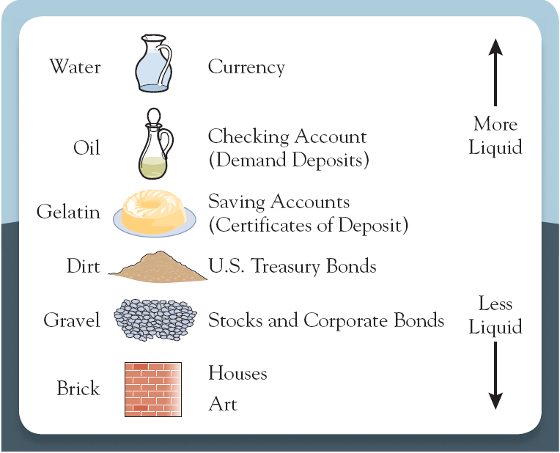
Liquidity Once Again
Liquidity a measure of the ease an asset can be turned into a means of payment (Money).
The Liquidity Spectrum

