Slide 1
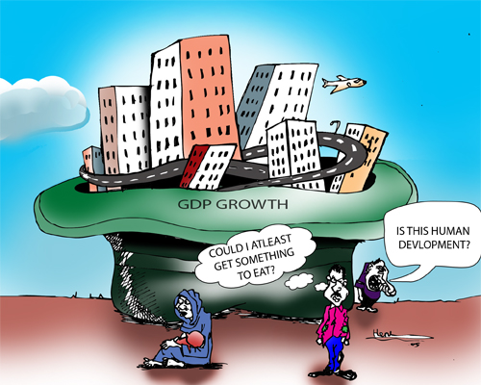
CHAPTER 9 LECTURE - LONG-RUN ECONOMIC GROWTH

Slide 2
WHAT YOU WILL LEARN IN THIS CHAPTER
Why is long-run economic growth measured as the increase in real GDP per capita? How has real GDP per capita changed over time in different countries?
Why is productivity the key to long-run economic growth? How is productivity driven by physical capital, human capital, and technological progress?
Why do long-run growth rates differ so much among countries?
How does growth vary among several important regions of the world? Why does the convergence hypothesis apply to economically advanced countries?
How does scarcity of natural resources and environmental degradation pose a challenge to sustainable long-run economic growth?

Slide 3
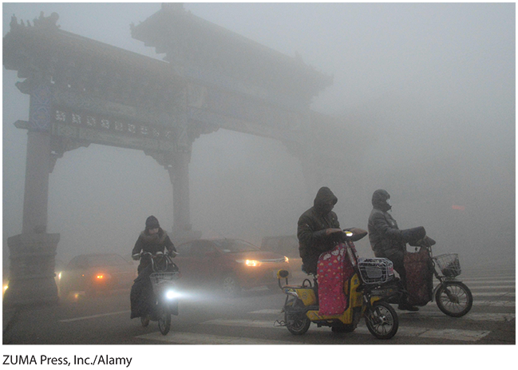

GROWTH HAS BENEFITS AND COSTS
China and India and Pakistan growth (and air pollution) have risen dramatically.

Slide 4
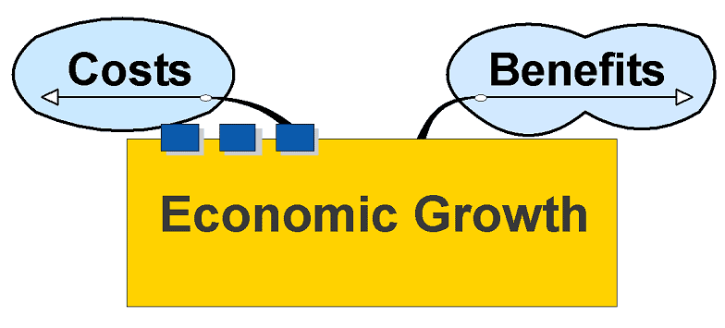
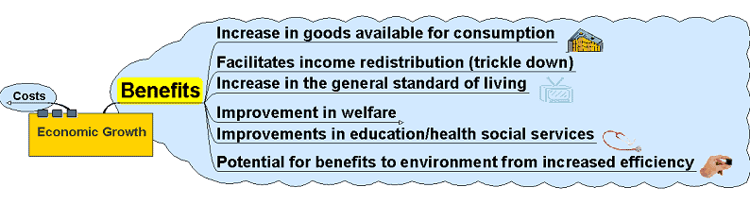

Slide 5
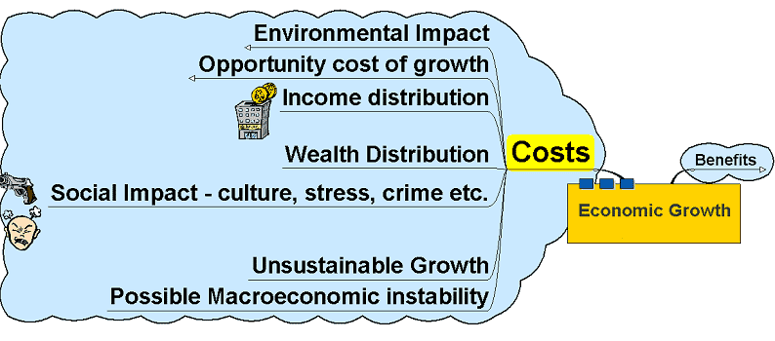
Costs

Slide 6
COMPARING ECONOMIES ACROSS TIME AND SPACE (1/2)
The key statistic is real GDP per capita—real GDP divided by population.
We focus on GDP because GDP measures the income earned in the economy in a given year.
We use real GDP because we want to separate changes in the quantity of goods and services from the effects of a rising price level.
We focus on real GDP per capita because we want to isolate the effect of changes in the population.

Slide 7
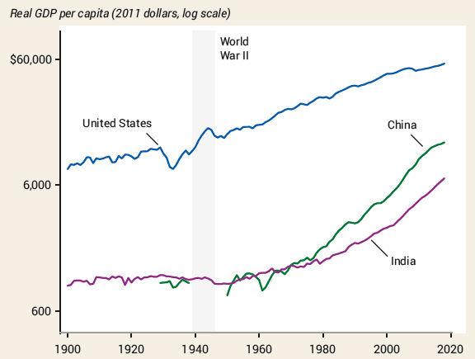
COMPARING ECONOMIES ACROSS TIME AND SPACE (2/2)
Since 1980, India and China had a much higher growth rate than the United States.
The standard of living achieved in the United States in 1900 was attained by China in 2008. As of 2018, India’s standard of living is still below that of the United States in 1900.

Slide 8
LEARN BY DOING: PRACTICE QUESTION 1
Suppose the real GDP for Macronesia is $200 million in 2010. Furthermore, suppose population in Macronesia is 100,000 in 2010. If population increases to 105,000 in 2011 while GDP increases by 5%, then it must be true that real GDP per capita in Macronesia in 2011:
  increased.
  decreased.
  stayed constant.
  may have increased, decreased, or remained constant.

Slide 9
LEARN BY DOING: PRACTICE QUESTION 1
(Answer)
Suppose the real GDP for Macronesia is $200 million in 2010. Furthermore, suppose population in Macronesia is 100,000 in 2010. If population increases to 105,000 in 2011 while GDP increases by 5%, then it must be true that real GDP per capita in Macronesia in 2011:
  increased.
  decreased.
  stayed constant. (correct answer)
  may have increased, decreased, or remained constant.

Slide 10
REAL GDP PER CAPITA
The U.S. economy produces almost eight times as much per person as in 1900.
Table 1 U.S. Real GDP per Capita
Year | Percentage of 1900 real GDP per capita | Percentage of 2018 real GDP per capita
1900 | 100% | 15%
1920 | 126 | 18
1940 | 149 | 22
1960 | 225 | 33
1980 | 368 | 54
2000 | 571 | 83
2018 | 688 | 100

Slide 11
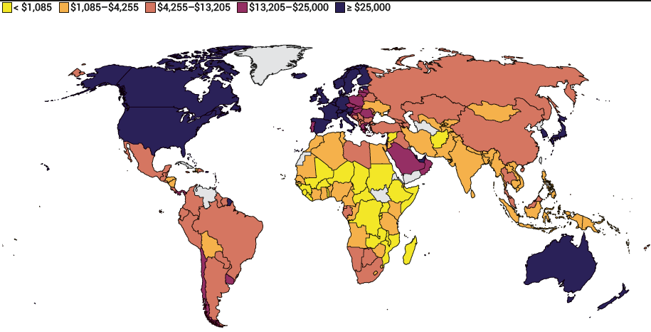
INCOMES AROUND THE WORLD, 2021
The United States has grown quickly, while some nations have stalled.
A quarter of the world’s population lives in countries where the standard of living is lower than it was in the United States in 1900.

Slide 12
The Growth Rate – What it Means
The growth rate between two years, such as 2014 and 2013, is given by the formula:
where GDP₂₀₁₄ is the GDP in 2014 and GDP₂₀₁₃ is the GDP in 2013
If you know the growth rate and, for example, if the rate of growth between 2013 and 2014 is 1.3%, then to find the GDP in 2014, multiply the GDP in 2013 by 1.013.
In order to figure out the GDP over a longer period of time, say between 2009 and 2014 (a period of 5 years):
notice that the growth rate is the average annualized rate (exactly 1.3% growth probably doesn’t occur every year; it is the average annual growth rate or more exactly, the rate that would generate the end year result if one growth rate had obtained for the entire time)

Slide 13
THE RULE OF 70 or 72: THE MAGIC OF COMPOUNDING
Even small differences in growth rates get magnified over time.
The rule of 70:
  Example: If real GDP per capita is growing at an annual growth rate of 3.5%, it will double in:
  70/3.5 = 20 years
  The moral? Small improvements in growth add up fast (the power of compounding).
http://www.moneychimp.com/features/rule72.htm

Slide 14
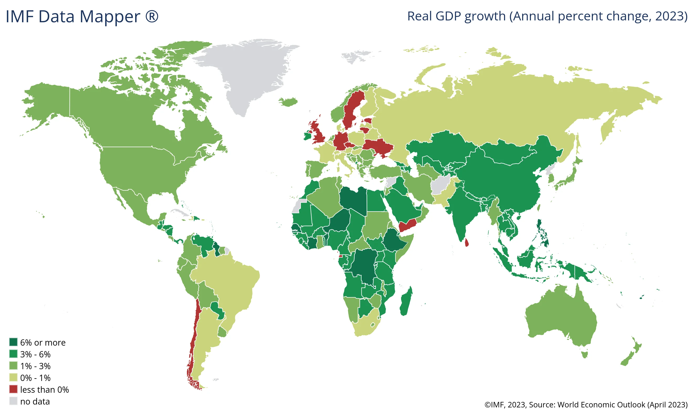
REAL GDP GROWTH - COMPARING ECONOMIES
https://www.imf.org/external/datamapper/NGDP_RPCH@WEO/OEMDC/ADVEC/WEOWORLD

Slide 15
LEARN BY DOING: PRACTICE QUESTION 2
Let's figure out how long it will take for the average Indian to be as wealthy as the average Western European is today. Note that all numbers are adjusted for inflation.
India's GDP per capita is $3,000, and let’s assume real output per person grows at 5% per year. Using the rule of 70, how many years will it take for India to reach Italy's current level of GDP per capita, about $24,000 per year?
  42 years
  14 years
  28 years
  12 years

Slide 16
LEARN BY DOING: PRACTICE QUESTION 2
(Answer)
Let's figure out how long it will take for the average Indian to be as wealthy as the average Western European is today. Note that all numbers are adjusted for inflation.
India's GDP per capita is $3,000, and let’s assume real output per person grows at 5% per year. Using the rule of 70, how many years will it take for India to reach Italy's current level of GDP per capita, about $24,000 per year?
  42 years (correct answer)
  14 years
  28 years
  12 years

Slide 17
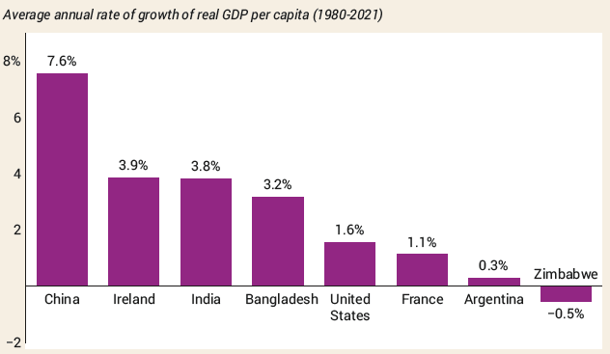
COMPARING RECENT GROWTH RATES

Slide 18
THE SOURCES OF LONG-RUN GROWTH
The crucial importance of productivity
Labor productivity (often referred to simply as productivity): output per worker
Increase in physical capital
Physical capital: human-made resources, such as buildings and machines
Increase in human capital
Human capital: the improvement in labor created by the education and knowledge embodied in the workforce
Technological progress: an advance in technology means of production in goods and services

Slide 19
THE AGGREGATE PRODUCTION FUNCTION
How much does output change when we change inputs?
Aggregate production function: a hypothetical function that shows how productivity (real GDP per worker) depends on the quantities of physical capital per worker and human capital per worker, as well as the state of technology
But can we be more specific? How much does output change when we change inputs?
For instance, China and India may have a production function like this (Brookings Institution estimates):
GDP per worker = T × (physical capital per worker)0.4 × (human capital per worker)0.6
If China had more physical capital than India, that would explain its quicker growth.

Slide 20
Economists Look at Growth in
Per Capita Output
We emphasise per capita output/income?
If no technical progress, per capita output will grow only if:
  Increase in per capita availability of factors of production
If capital stock per capita ⇑, output per capita ⇑, but we have the ‘law of diminishing returns’
Thus, as capital stock per capita ⇑, rate of growth of per capita output falls

Slide 21

THE AGGREGATE PRODUCTION FUNCTION
There are some well-known patterns.
Diminishing returns to physical capital: holding the amount of human capital per worker and the state of technology fixed, each successive increase in the amount of physical capital per worker leads to a smaller increase in productivity
A second computer improves one’s productivity, but not by as much as the first computer did.

Slide 22
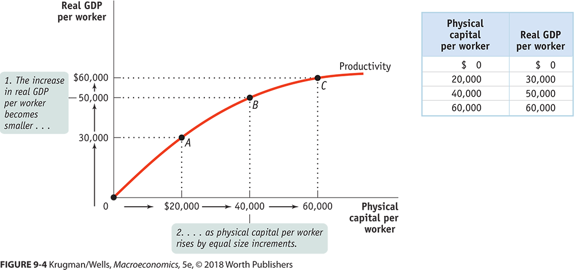
THE AGGREGATE PRODUCTION FUNCTION ACCOUNTING FOR GROWTH

Slide 23
TECHNOLOGY AND PRODUCTIVITY
So additional amounts of physical capital are less productive when the amount of human capital per worker and the technology are held fixed.
But this assumes all other things equal.
Diminishing returns may disappear if we increase the amount of human capital per worker or improve the technology, or both, as the amount of physical capital per worker is increased.

Slide 24
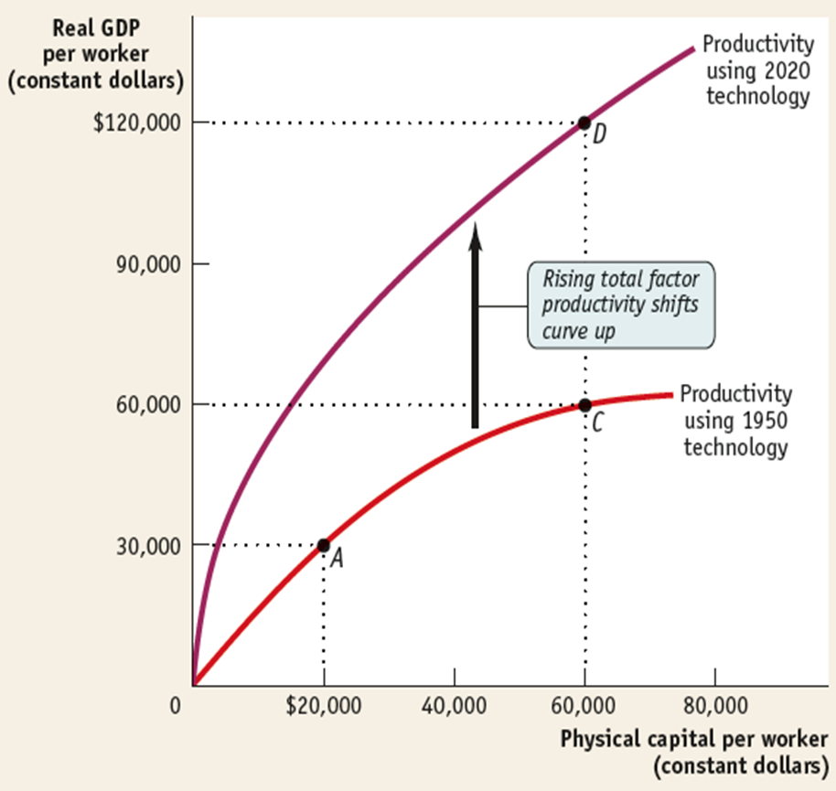
TOTAL FACTOR PRODUCTIVITY

Slide 25
GROWTH ACCOUNTING
How do we tell what caused the growth?
Growth accounting: estimates of the contribution of each major factor in the aggregate production function to economic growth
Total factor productivity: the amount of output that can be produced with a given amount of factor inputs
(When total factor productivity increases, the economy can produce more output with the same quantity of physical capital, human capital, and labor.)
Increases in total factor productivity are crucial for growth.
And increases in total factor productivity likely measure the economic effects of technological progress.
So technological change is crucial to economic growth.

Slide 26
Total Factor Productivity
Total Factor Productivity (TFP) = A = Y/f(K,L)
Basically, TFP is a ‘catch-all’ for anything that effects output other than K and L.
  Workweek of labor and capital
  Quality of labor and capital
  Regulation
  Infrastructure
  Competition
  Specialization
  Innovation
  Strategy (Entrepreneurial methods/new management techniques)

Slide 27
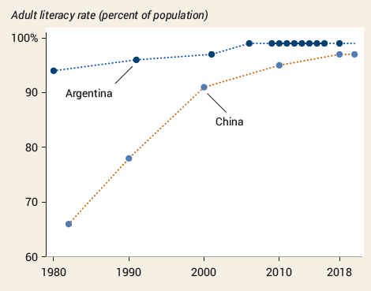
WHY GROWTH RATES DIFFER (3/4)
Education
China’s success at adding human capital is one key to its spectacular long-run growth.

Slide 28
MORE FORMAL MODEL
Output or production (Y or Q is usually measured as Gross Domestic Product (GDP)
Q depends on quantities of factors of production and technology Y = f(K,L)
For economies to grow, however, factors of production must increase and/or there must be technical progress (productivity growth)
Y = Af(K.L)

Slide 29
MORE FORMAL MODEL
To understand this, let’s look at the sources of economic growth….where does production come from?
“is a function of”
Real GDP
Productivity
Labor
Capital Stock
Real GDP = Constant Dollar (Inflation adjusted) value of all goods and services produced in the United States
Capital Stock = Constant dollar value of private, non-residential fixed assets
Labor = Private Sector Employment
Productivity = Production unaccounted for by capital or labor

Slide 30
Cobb-Douglas production function
A convenient functional form for growth accounting is the Cobb-Douglas production function. It takes the form:
where
With the Cobb-Douglas production function, the parameters have clear interpretations:
Capital’s share of income (what % of total income in the US accrues to owners of capital) | Labor’s share of income (what % of total income in the US accrues to owners of labor)
Elasticity of output with respect to capital (% increase in output resulting from a 1% increase in capital) | Elasticity of output with respect to labor (% increase in output resulting from a 1% increase in labor)

Slide 31
Cobb-Douglas production function
Suppose we have the following Cobb-Douglas production function:
A 1% rise in capital raises GDP by 1/3%
A 1% rise in employment raises GDP by 2/3%
We can rewrite the production function in terms of growth rates to decompose GDP growth into growth of factors:
Real GDP Growth (observable)
Productivity Growth (unobservable)
Capital Growth (observable)
Employment Growth (observable)

Slide 32

Contributions to growth from capital, labor, technology vary across time period (USA)
S$olving for \%∆A$ $\%∆A=\%∆Y −α\%∆K −β\%∆L$
$$For the years 1939−1946, the production function was estimated to be$$
 | 1939 - 1948 | 1948 - 1973 | 1973-1990 | 1990-2007 | 2007-2013
Output | 5.79 | 4.00 | 3.10 | 3.60 | 1.1
Capital | 3.34 | 3.70 | 4.20 | 4.10 | 1.4
Labor | 4.46 | 1.00 | 1.90 | 1.60 | -0.1
Productivity | 1.71 | 2.1 | 0.5 | 1.2 | 0.7
A few things to notice:
Real GDP growth is declining over time.
Capital has been growing faster than labor
The contribution of productivity is diminishing!

Slide 33
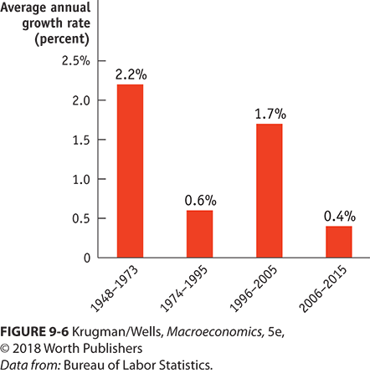
THE RISE AND FALL OF THE PRODUCTIVITY PARADOX
Does it take time for innovations to show up in the productivity data? Why?

Slide 34
Distinction Between Economic Growth and Economic Development
Economic Growth – takes place when there is a sustained (ongoing for at least 1-2 years) increase in a country’s output (as measured by GDP or GNP) or in the per capita output (GDP or GNP per person)
Economic Development – occurs when the standard of living of a large majority of the population rises, including both income and other dimensions like health and literacy
  development includes improvements across several dimensions
    ‘quality of life’: health, education, ‘human rights’ and political rights
    income distribution
  Development and freedom to exercise choices:
  Per capita income growth necessary but not sufficient

Slide 35
Growth Theories, Evidence, and Policies
Policies for Achieving Faster Growth
  Growth accounting tell us that to achieve faster economic growth we must either increase the growth rate of capital per hour of labor or increase the pace of technological change.
  The main suggestions for achieving these objectives are
  Stimulate Saving
  Saving finances investment. So higher saving rates might increase physical capital growth.
  Tax incentives might be provided to boost saving.

Slide 36
Growth Theories, Evidence, and Policies
Stimulate Research and Development
Because the fruits of basic research and development efforts can be used by everyone, not all the benefit of a discovery falls to the initial discoverer.
So the market might allocate too few resources to research and development.
Government subsidies and direct funding might stimulate basic research and development.

Slide 37
Growth Theories, Evidence, and Policies
  Improve the Quality of Education
    The benefits from education spread beyond the person being educated, so there is a tendency to under invest in education.
  Provide International Aid to Developing Countries
    If rich countries give financial aid to developing countries, investment and growth will increase.
    But data on the effect of aid shows that it has had zero or a negative effect.
  Encourage International Trade
    Free international trade stimulates growth by extracting all the available gains from specialization and trade.
    The fastest growing nations are the ones with the fastest growing exports and imports.

Slide 38
THE ROLE OF GOVERNMENT IN PROMOTING ECONOMIC GROWTH
Government policies
  Government subsidies to infrastructure
    Infrastructure: roads, power lines, ports, information networks, and other underpinnings for economic activity
  Government subsidies to education
  Government subsidies to R&D
  Maintaining a well-functioning financial system
Protection of property rights
Political stability and good governance

Slide 39

WHAT CAUSED EAST ASIA’S MIRACLE?
Very high savings rates allow businesses to borrow and add more physical capital per worker.
Very good basic education has permitted a rapid improvement in human capital.
Substantial technological progress

Slide 40
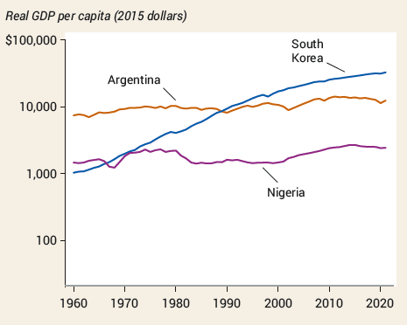
LATIN AMERICA’S DISAPPOINTMENT
What’s holding Argentina (and other Latin American nations) back?
  Irresponsible government action that eroded savings through high inflation
  Lack of emphasis on education
  Political instability

Slide 41
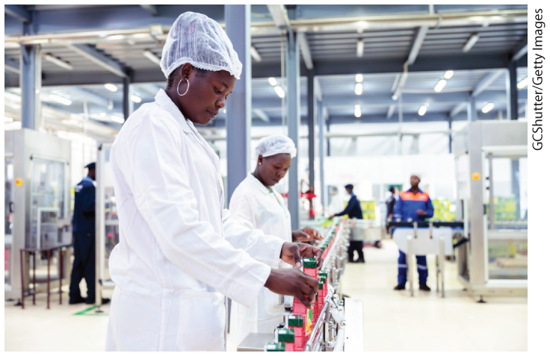
AFRICA’S TROUBLES AND PROMISE
What’s holding much of Africa back?
  Government corruption
  Civil wars and
  political instability
  Unfavorable geography
Is Africa poor because it is politically unstable or unstable because it is poor?
Good news: Nigeria’s per capita GDP, after decades of stagnation, turned upward after 2000, achieving an annual growth rate of 2.5% from 2000 to 2021.

Slide 42
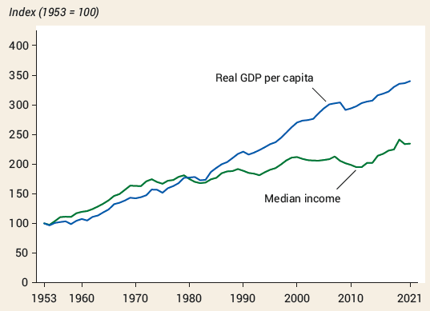
LEFT BEHIND BY GROWTH?
Historically, rising real GDP per capita has translated into real income for most people. This is less and less true in the United States.
A growing share of income went to a few people at the top.
Two qualifications: economic growth still raises the standard of living of the great majority of the population and gives rise to a global middle class.

Slide 43

WHAT ECONOMIC GROWTH LOOKS LIKE AT NIGHT
A famous paper by Vernon, Storeygard, and Weil (AER, 2012) measures economic activities from outer space. This study has a wide range of implications on future studies at regional levels, such as explaining the differences in African communities.

Slide 44
LEARN BY DOING: PRACTICE QUESTION 3
Economic growth can be especially fast:
  for countries playing catch-up with countries that already have high real GDP per capita.
  for relatively poor countries if the convergence hypothesis holds true.
  if the country is able to benefit from adopting the technological advances already used in advanced countries.
  Answers (a), (b), and (c) are all true.

Slide 45
LEARN BY DOING: PRACTICE QUESTION 3
(Answer)
Economic growth can be especially fast:
  for countries playing catch-up with countries that already have high real GDP per capita.
  for relatively poor countries if the convergence hypothesis holds true.
  if the country is able to benefit from adopting the technological advances already used in advanced countries.
  Answers (a), (b), and (c) are all true. (correct answer)

Slide 46
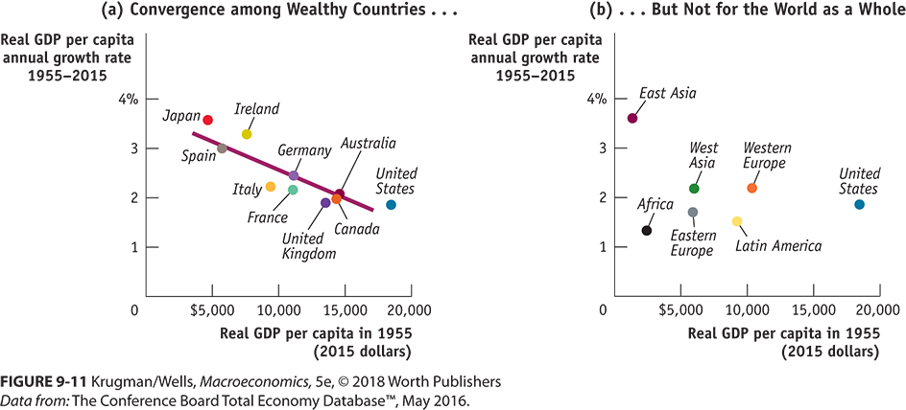
CONVERGENCE HYPOTHESIS
Convergence hypothesis: international differences in real GDP per capita tend to narrow over time

Slide 47
IS WORLD GROWTH SUSTAINABLE?
Sustainable long-run economic growth: long-run growth that can continue in the face of the limited supply of natural resources and the impact of growth on the environment
What is the impact of limited natural resources on long-run economic growth? Three important questions:
  How large are the supplies of key natural resources?
  How effective will technology be at finding alternatives to natural resources?
  Can long-run economic growth continue in the face of resource scarcity?

Slide 48

WHAT ABOUT NATURAL RESOURCES?
In the modern world, human or physical capital matter more than natural resources for the great majority of countries.
The resource curse, also known as the paradox of plenty, refers to the paradox that countries with an abundance of natural resources (such as fossil fuels and certain minerals), tend to have less economic growth, and worse development outcomes than countries with fewer natural resources

Slide 49
ECONOMIC GROWTH & ENVIRONMENT
Can long-run economic growth continue in the face of resource scarcity?
  A question for economists. Resource scarcity and higher prices don’t necessarily cost growth.
Economic growth tends to increase the human impact on the environment. Unlike resource scarcity, environmental problems don’t automatically provide incentives for changed behavior.
Paris Agreement of 2015: 196 countries agreed to reduce their greenhouse gas emissions in an effort to limit the rise in Earth’s temperature to no more than 2 degrees centigrade

Slide 50
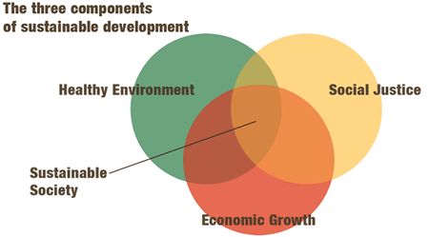
What Are the Objectives of Development?
We can list three objectives of development
  increases in availability and improvements in the distribution of food, shelter, health, protection, etc.
  improvements in ‘levels of living,’ including higher incomes, more jobs, better education, etc.
  expansions in the range of economic and social choices available to individuals and nations

Slide 51


Slide 52
A Further Issue
Development and growth is often discussed as if the population of a given country enjoyed the same rate of change in income
This is certainly not true: there is inequality among the citizens of any given country ➔ some people earn a higher share of national income than other people
Given that there is inequality, is it still true that, when a country grows, all the population benefits from it?
To be able to answer this question, we have to analyze how inequality and poverty change as a country grows

Slide 53
Economic growth is necessary, but not sufficient, to improve the living standards of the whole population:
  If a country is too poor, even redistributing all income in order to have a perfectly egalitarian income distribution, everybody will still be poor (case of China in the 1960s, Vietnam in 1980’s)
  But a country may grow, and income distribution may become so unequal, that the number of people with low living standards may increase
Growth may be associated with worsening of the income distribution when:
  The relatively well-off get most of the benefits of increased income (“the rich get richer, and the poor get poorer”)

Slide 54
Measures of Inequality
To discuss these issues in more detail, we have to be able to measure inequality
And to measure inequality, we must have a precise definition.
Inequality can be measured in several different ways, and each different way may be the most appropriate for a particular kind of analysis
Measures of inequality are based on how the average income of a given country is distributed across its population
To obtain a measure of inequality, we need information of income for each single individual in the country, or for a “sample” of individuals
This information is usually obtained via household surveys. How?

Slide 55
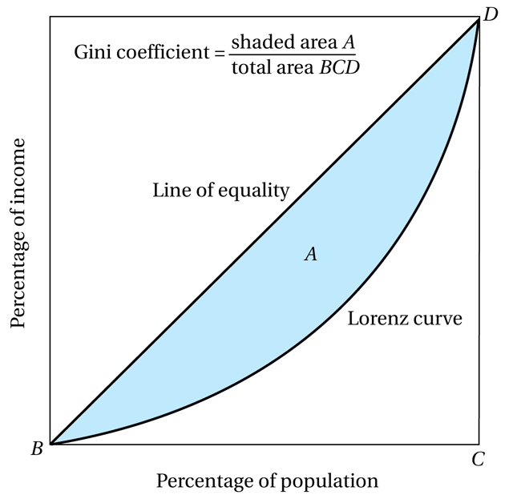
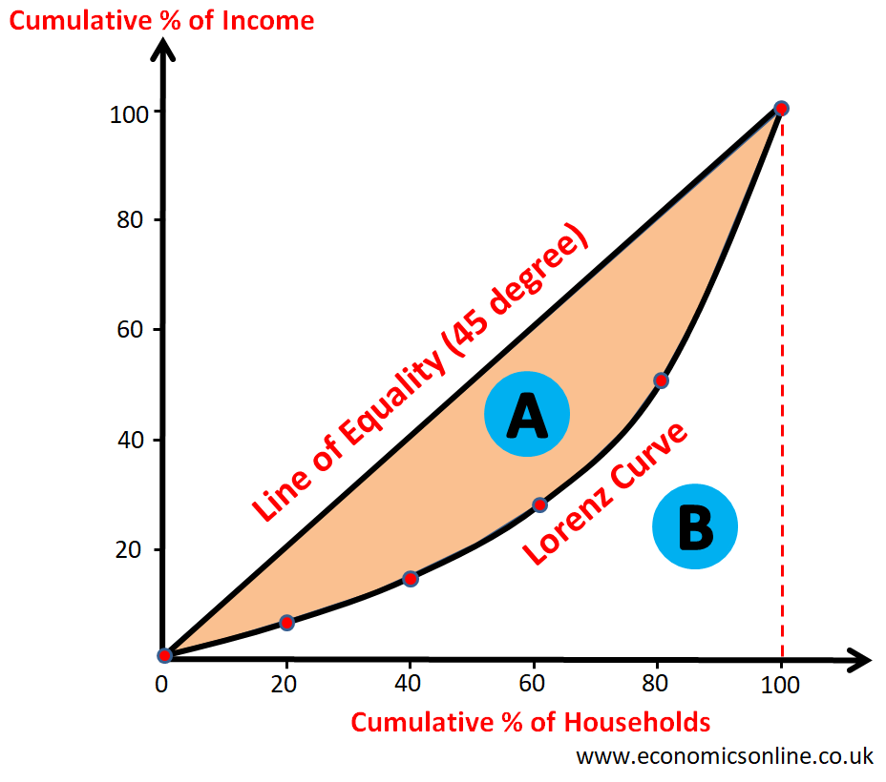
“Examples of Lorenz Curve”
BD - If the income distribution in a given country was completely egalitarian
So, any deviation from the 45º line is due to inequality in the distribution
Gini Coefficent +A/(A+B)
https://ourworldindata.org/income-inequality

Slide 56
To summarize inequality in a single number, some statistics were developed.
The most popular one is the Gini coefficient
  The ratio of the areas A/(A+B)
  Larger Gini coefficient means larger inequality (note that the coefficient is between 0 and 1)
  Keep in mind, however, sometimes the value is based on 100 point scale.
Another popular approach is to compare the income of different fractions of the population; for example: ratio between income of the 20% richest and income of the 20% poorest
https://worldpopulationreview.com/country-rankings/gini-coefficient-by-country

