Slide 1

CHAPTER 7 LECTURE - GDP AND THE CPI: TRACKING THE MACROECONOMY

Slide 2
WHAT YOU WILL LEARN IN THIS CHAPTER
How do economists use aggregate measures to track the performance of the economy?
What is gross domestic product (GDP) and how is it calculated?
What is the difference between real GDP and nominal GDP and why is real GDP the appropriate measure of real economic activity?
What is a price index and how is it used to calculate the inflation rate?
2

Slide 3
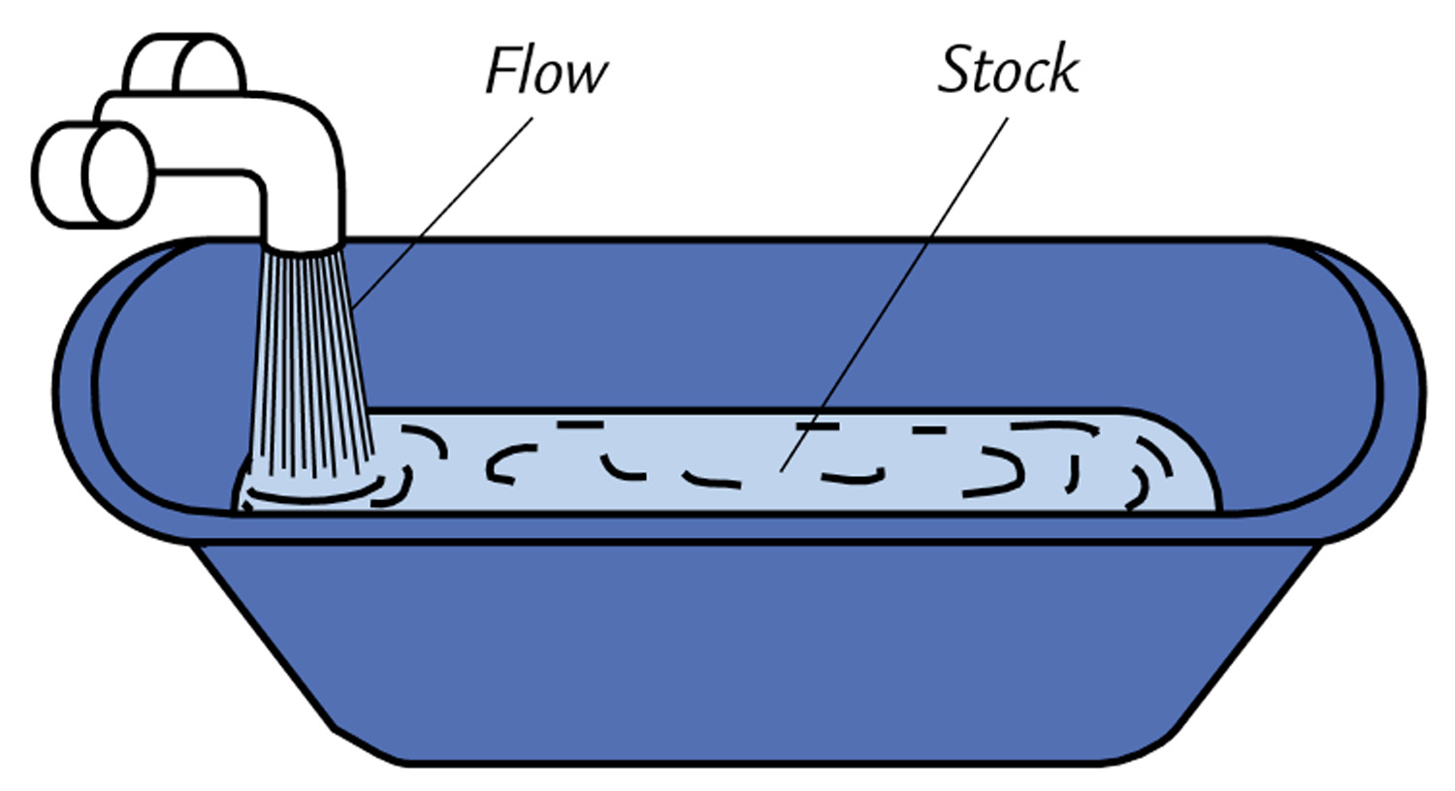
Stocks and Flows
The distinction between a stock and a flow is very important.
A stock is a position at a moment of time, for example, the stock of inventories in the economy at year end 2005. (Balance sheets report stocks.)
A flow is the rate of change in a stock, for example, the change in the stock of inventories in the economy in 2005. (Profit and loss statements report flows.)
If the bath tub is filling up, the stock is rising.
3

Slide 4
Gross Domestic Product
GDP Defined
GDP or gross domestic product is the market value of all final goods and services produced in a country in a given time period.
This definition has four parts:
Market value
Final goods and services
Produced within a country
In a given time period
Excludes financial transactions and income transfers since these do not reflect production.
Net additions to inventory are current period output so are also included.
4

Slide 5
Gross Domestic Product
Market Value
GDP is a market value—goods and services are valued at their market prices.
To add apples and oranges, computers and popcorn, we add the market values so we have a total value of output in dollars.
Final Goods and Services
GDP is the value of the final goods and services produced.
A final good (or service) is an item bought by its final user during a specified time period.
A final good contrasts with an intermediate good, which is an item that is produced by one firm, bought by another firm, and used as a component of a final good or service.
Excluding the value of intermediate goods and services avoids counting the same value more than once.
5

Slide 6
Gross Domestic Product
Produced Within a Country
GDP measures production within a country—domestic production.
In a Given Time Period
GDP measures production during a specific time period, normally a year or a quarter of a year.
Gross National Product (GNP) is the total market value of final goods and services produced during a given period by the citizens of a country no matter where they live. The goods and services are produced by the “nationals” of the country.
GDP is the preferred measure these days. Why?
6

Slide 7
Gross Domestic Product
GDP and the Circular Flow of Expenditure and Income
GDP measures the value of production, which also equals total expenditure on final goods and total income.
The equality of income and value of production shows the link between productivity and living standards.
The circular flow diagram on the next slide illustrates the equality of income and expenditure.
7

Slide 8
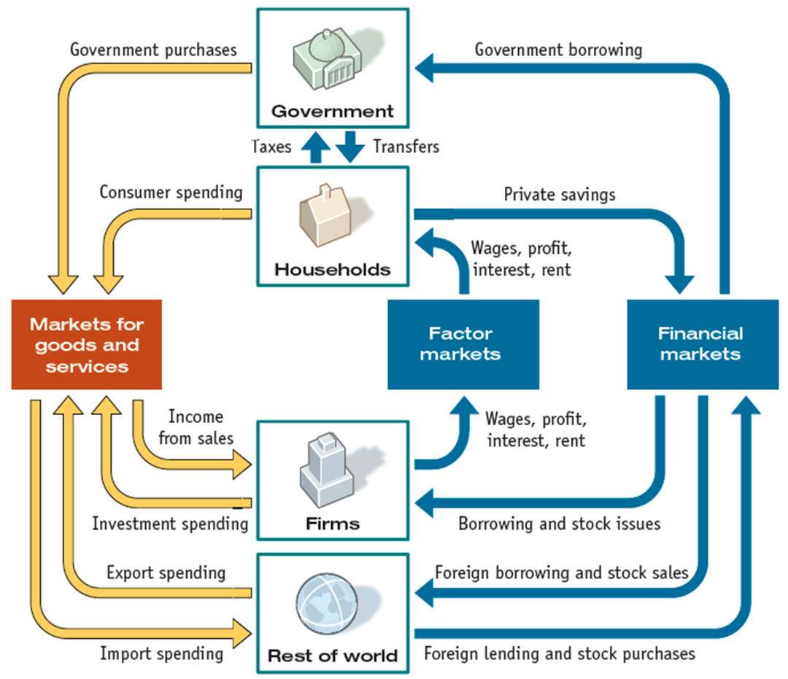
AN EXPANDED CIRCULAR FLOW DIAGRAM
8

Slide 9
Gross Domestic Product
The circular flow shows two ways of measuring GDP.
GDP Equals Expenditure Equals Income
Total expenditure on final goods and services equals GDP.
GDP = C + I + G + X – IM.
Aggregate income equals the total amount paid for the use of factors of production: wages, interest, rent, and profit.
Firms pay out all their receipts from the sale of final goods, so income equals expenditure,
Y = C + I + G + (X – IM).
9

Slide 10
Measuring National Income
3 ways of measuring national income :
GDP by value added
GDP on the expenditure side
GDP on the income side
All methods should result give similar answers when adjusted for market prices versus factor costs.
10

Slide 11
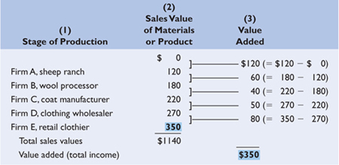
 | Value Added in a Five-Stage Production Process
11

Slide 12
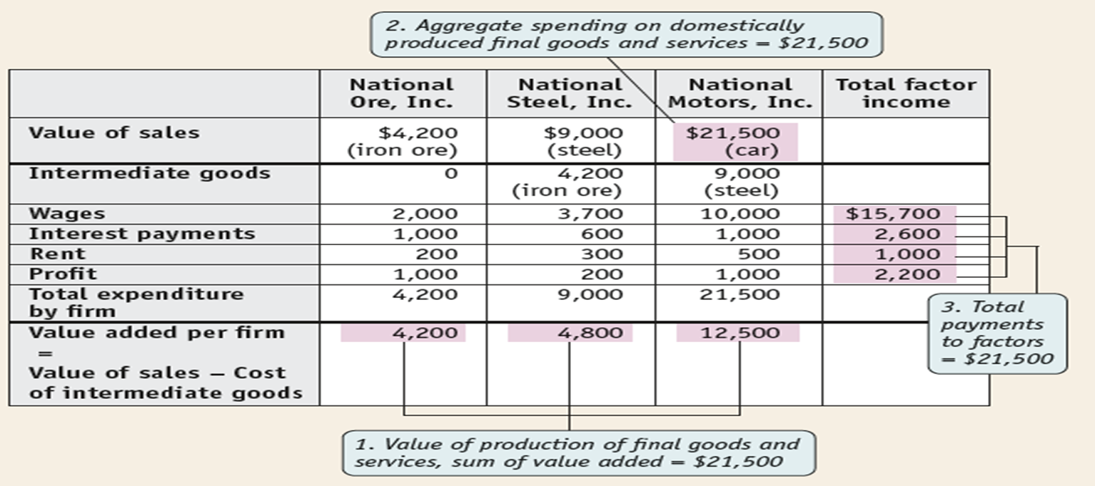
 | Value Added Once more
12

Slide 13
GDP as Expenditures
GDP is the sum of the amount each sector (households, investors, governments, and foreigners) spends on final user goods and services.
There are four components of GDP:
personal consumption expenditures (C),
gross private domestic investment (I),
government purchases (G) of goods and services, and,
net exports (NX) = ( exports - imports )
GDP = C + I + G + NX
13

Slide 14
Personal Consumption
Consumer Durables
Durable has a life of over 3 years: cars, furniture, etc
Consumer Non-Durables
Goods with a life of less than three years: food, utilities, clothing
Services
Housing, healthcare, recreation, education
14

Slide 15
Investment: Adding to the Capital Stock
Flows and Stocks
A stock is a quantity: capital, inventories and wealth are stock variables
A flow is an addition to or a subtraction from a stock: Investment and income are flow variables
Investment in National Stocks
Residential Investment (homes)
Non-residential Investment (business investments in structures and equipment)
Changes in Inventories (changes get registered)
15

Slide 16
Net Investment
Gross Investment
-
Depreciation or Capital Consumption Allowance
=
Net Investment
Net
Investment
Gross
Investment
Depreciation
Increase
Stock of
Capital
Consumption
& Government
Spending
Stock of
Capital
January 1
Year’s GDP
December 31
16

Slide 17
Government
Government Expenditures reflect direct consumption, not transfers
Defense, Government investments in roads and other infrastructure, government services such as Department of Motor Vehicles. Police and Congress are all expenditures.
Transfer payments represent money redistributed from one group of citizens (taxpayers) to another (poor, unemployed, elderly).
While transfers are included in government budgets as outlays they are not purchases of currently produced goods and services.
Does not result in production of new goods and services
Does not included in government purchases or in GDP
Examples: Social Security, Medicare and Medicaid and Interest payments on national debt
17

Slide 18
External Accounts
Imports (M): Product Accounts: Goods and Services
Exports (X): Product Accounts: Goods and Services
Net Exports = NX = X – IM
If NX = X – IM > 0 Trade Surplus
If NX = X – IM < 0 Trade Deficit
Here are some examples of exports of services
Spending of foreign tourists in USA or Qatar
transportation services
insurance / banking services
medical services
retail services (souvenirs)
hotel accommodation services
18

Slide 19
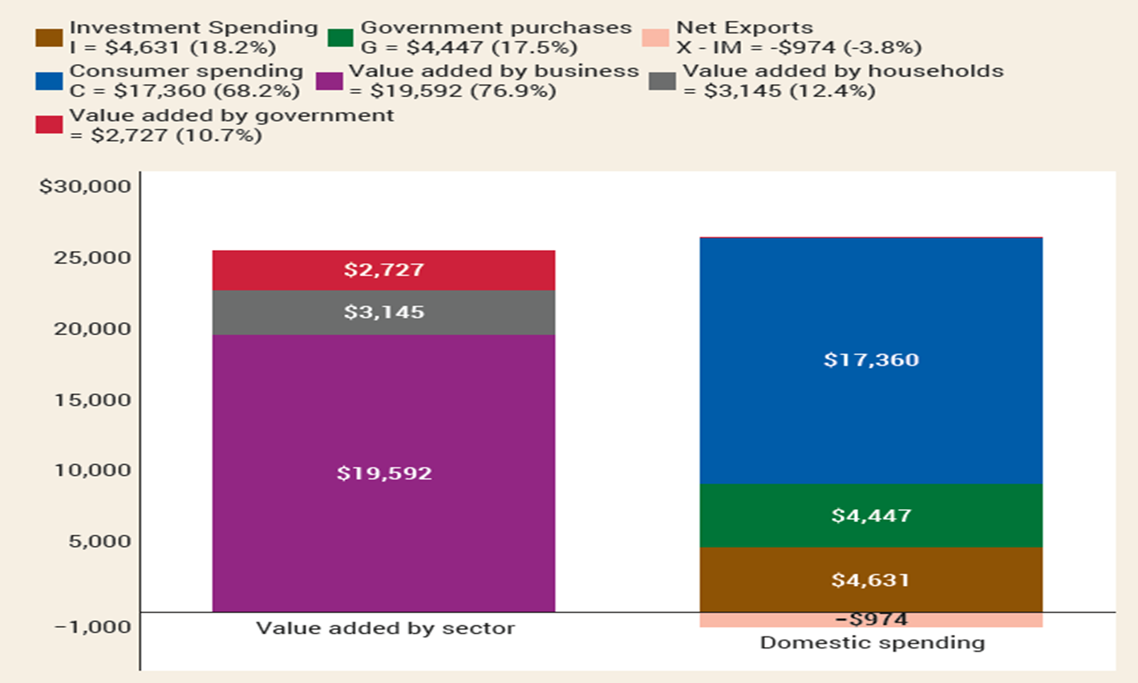
VALUE ADDED VS SPENDING METHOD
19

Slide 20
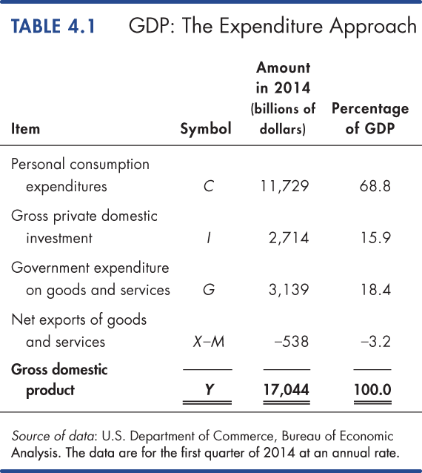
https://www.bea.gov/data/gdp
20
© 2019 Pearson Education

Slide 21
Measuring GDP
The Income Approach
The income approach measures GDP by summing the incomes that firms pay households for the factors of production they hire.
The National Income and Expenditure Accounts divide incomes into two broad categories:
1. Compensation of employees
2. Net operating surplus
Compensation of employees is the payments for labor services. The sum of net wages plus taxes withheld plus social security and pension fund contributions.
Net operating surplus is the sum of other factor incomes. It includes net interest, rental income, corporate profits, and proprietor’s income.
21

Slide 22
Measuring GDP
The sum of all factor incomes is net domestic income at factor cost.
Two adjustments must be made to get GDP:
1. Indirect taxes less subsidies are added to get from factor cost to market prices.
2. Depreciation is added to get from net domestic income to gross domestic income.
22

Slide 23
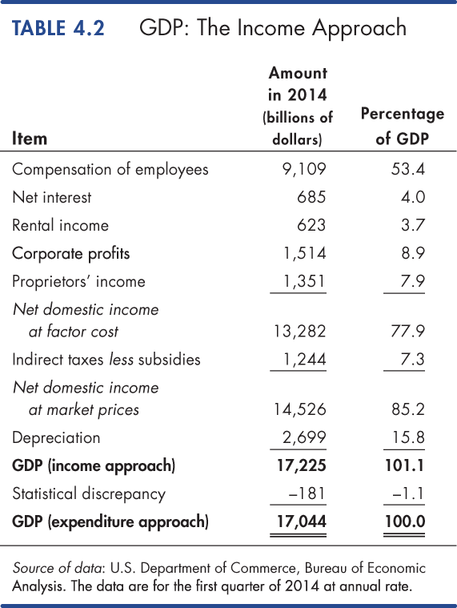
23
© 2019 Pearson Education

Slide 24
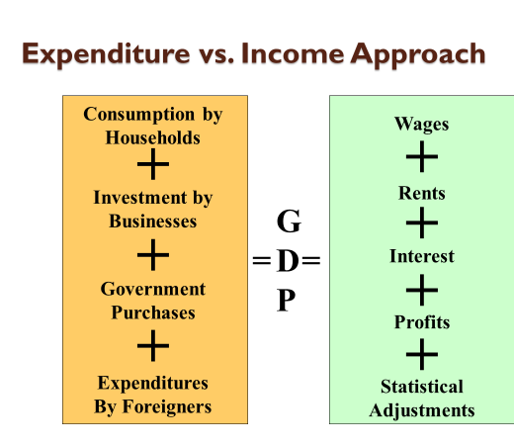
24

Slide 25
LEARN BY DOING: PRACTICE QUESTION 1
Are the following included in U.S. GDP?
(1) The price paid by a German tourist when staying at a New York hotel.
(2) The price paid by an American tourist when staying at a Berlin hotel.
Both are included in U.S. GDP.
Neither are included in U.S. GDP.
Only the price paid by a German tourist when staying at a New York hotel is included in U.S. GDP.
Only the price paid by an American tourist when staying at a Berlin hotel is included U.S. GDP.
25

Slide 26
LEARN BY DOING: PRACTICE QUESTION 1 (Answer)
Are the following included in U.S. GDP?
(1) The price paid by a German tourist when staying at a New York hotel.
(2) The price paid by an American tourist when staying at a Berlin hotel.
Both are included in U.S. GDP.
Neither is included in U.S. GDP.
Only the price paid by a German tourist when staying at a New York hotel is included in U.S. GDP. (correct answer)
Only the price paid by an American tourist when staying at a Berlin hotel is included U.S. GDP.
26

Slide 27
LEARN BY DOING: PRACTICE QUESTION 2
Suppose country A sells $100 million worth of goods and services to country B. Country B sells $50 million worth of goods and services to country A. These are the only two countries in Macroworld. Net exports in country:
B equal −$50 million.
A equal $150 million.
A equal −$150 million.
B equal $50 million.
27

Slide 28
LEARN BY DOING: PRACTICE QUESTION 2 (Answer)
Suppose country A sells $100 million worth of goods and services to country B. Country B sells $50 million worth of goods and services to country A. These are the only two countries in Macroworld. Net exports in country:
B equal −$50 million. (correct answer)
A equal $150 million.
A equal −$150 million.
B equal $50 million.
28

Slide 29
LEARN BY DOING: PRACTICE QUESTION 3
Income spent on imported goods:
represents income that has leaked across national borders.
must be subtracted from spending data to calculate an accurate value for domestic production.
is income that is not spent on domestically produced goods and services.
Answers (a), (b), and (c) are all correct.
29

Slide 30
LEARN BY DOING: PRACTICE QUESTION 3 (Answer)
Income spent on imported goods:
represents income that has leaked across national borders.
must be subtracted from spending data to calculate an accurate value for domestic production.
is income that is not spent on domestically produced goods and services.
Answers (a), (b), and (c) are all correct. (correct answer)
30

Slide 31
Measuring GDP
Nominal GDP and Real GDP
Real GDP is the value of final goods and services produced in a given year when valued at valued at the prices of a reference base year.
The current base year is 2012. Real GDP shows what GDP would have been in each year if it were priced in 2012 dollars. That's how it removes the effect of inflation.
Nominal GDP is the value of goods and services produced during a given year valued at the prices that prevailed in that same year.
Nominal GDP is just a more precise name for GDP.
31

Slide 32
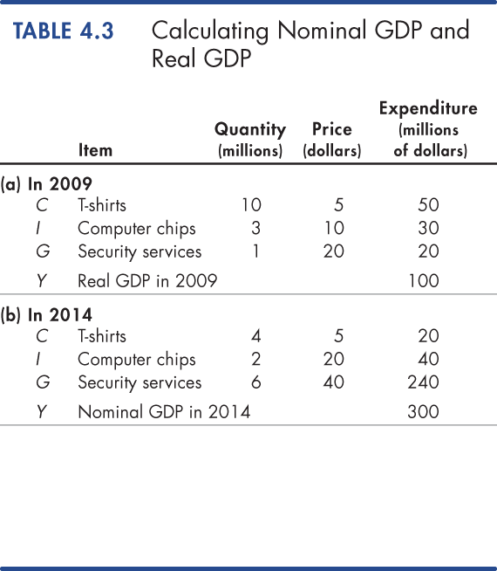
Measuring GDP
Calculating Real GDP
Table 4.3 (a) shows the quantities produced and the prices in 2009 (the base year).
Nominal GDP in 2009 is $100 million.
Because 2009 is the base year, real GDP equals nominal GDP and is $100 million.
Table 4.3(b) shows the quantities produced and the prices in 2014.
Nominal GDP in 2014 is $300 million.
Nominal GDP in 2014 is three times its value in 2009.
32
© 2019 Pearson Education

Slide 33
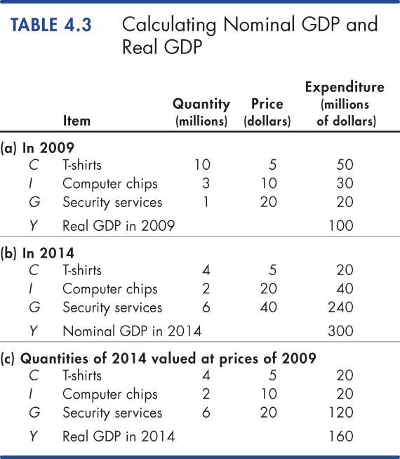
Measuring GDP
In Table 4.3(c), we calculate real GDP in 2014.
The quantities are those of 2014, as in part (b).
The prices are those in the base year (2009) as in part (a).
The sum of these expenditures is real GDP in 2014, which is $160 million.
33
© 2019 Pearson Education

Slide 34
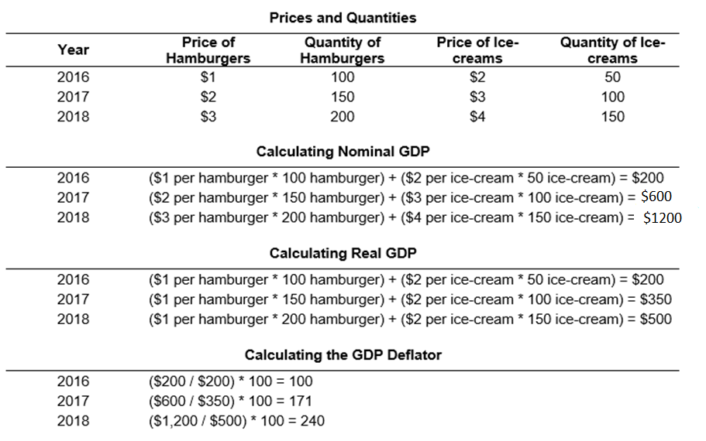
GDP Deflator Formula Calculator
(Base Year = 2016)
34
https://www.omnicalculator.com/finance/gdp-deflator

Slide 35
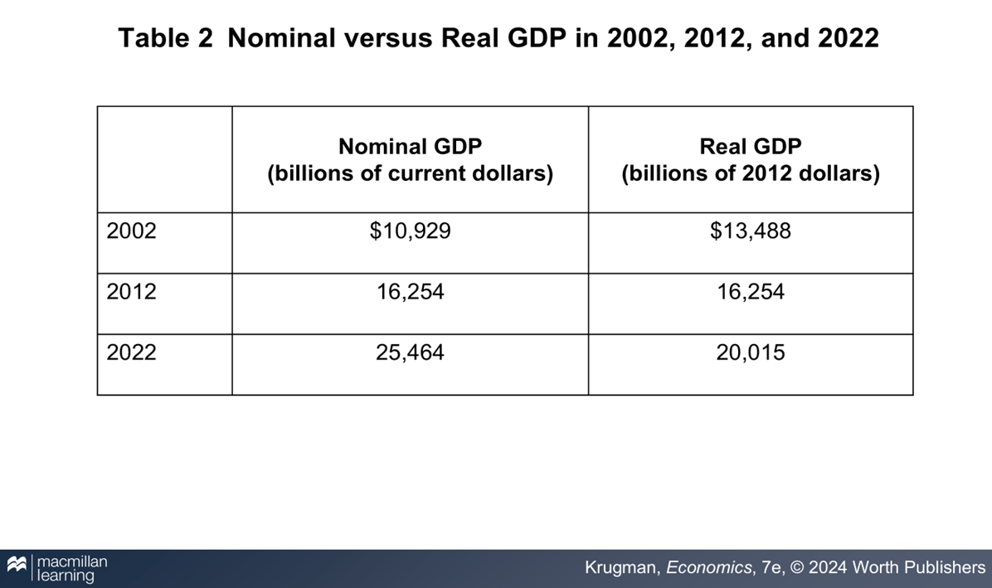
REAL-LIFE GDP
35

Slide 36
REAL VS NOMINAL GDP
Except in the base year, real GDP is not the same as nominal GDP: output valued at current prices.
Chained dollars: the method of calculating changes in real GDP using the average between the growth rate calculated on an early base year and the growth rate calculated on a late base year
GDP per capita: average GDP per person; not by itself an appropriate policy goal
36

Slide 37
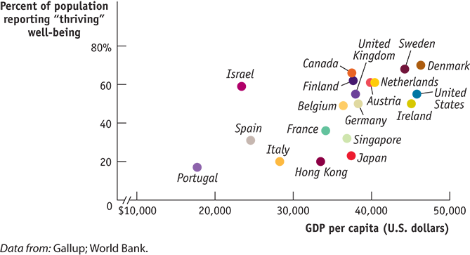
GDP AND THE MEANING OF LIFE
Rich is better.
Money matters less as you grow richer.
Money isn’t everything.
37

Slide 38

PRICE INDEXES AND THE AGGREGATE PRICE LEVEL
Aggregate price level: a measure of the overall level of prices in the economy
To measure the aggregate price level, economists calculate the cost of purchasing a market basket.
Market basket: a hypothetical set of consumer purchases of goods and services
38

Slide 39
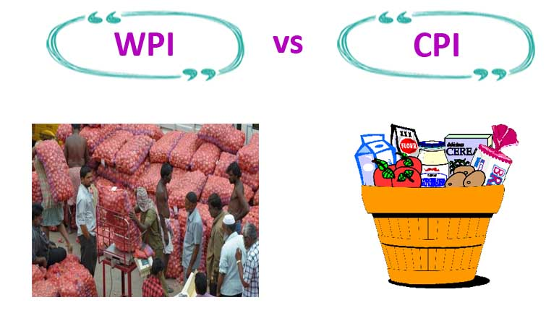
PRICE INDEXES
Price index: the cost of purchasing a given market basket in a given year, where that cost is normalized so that it is equal to 100 in the selected base year
Price index in a given year:
39

Slide 40
MARKET BASKETS AND PRICE INDEXES
Calculating the cost of a market basket
 | Pre-frost | Post-frost
Price of orange | $0.20 | $0.40
Price of grapefruit | 0.60 | 1.00
Price of lemon | 0.25 | 0.45
Cost of market basket (200 oranges, 50 grapefruit, 100 lemons) | (200 × $0.20) + (50 × $0.60) + (100 × $0.25) = $95.00 | (200 × $0.40) + (50 × $1.00) + (100 × $0.45) = $175.00
40

Slide 41
PRICE INDEXES
Price index: the cost of purchasing a given market basket in a given year, where that cost is normalized so that it is equal to 100 in the selected base year.
Price index in a given year:
41

Slide 42
INFLATION RATE, CPI, AND OTHER INDEXES
The inflation rate: the yearly percentage change in a price index, typically based on consumer price index (CPI), the most common measure of the aggregate price level.
The CPI measures the cost of the market basket of a typical urban American family
Inflation rate:
42

Slide 43
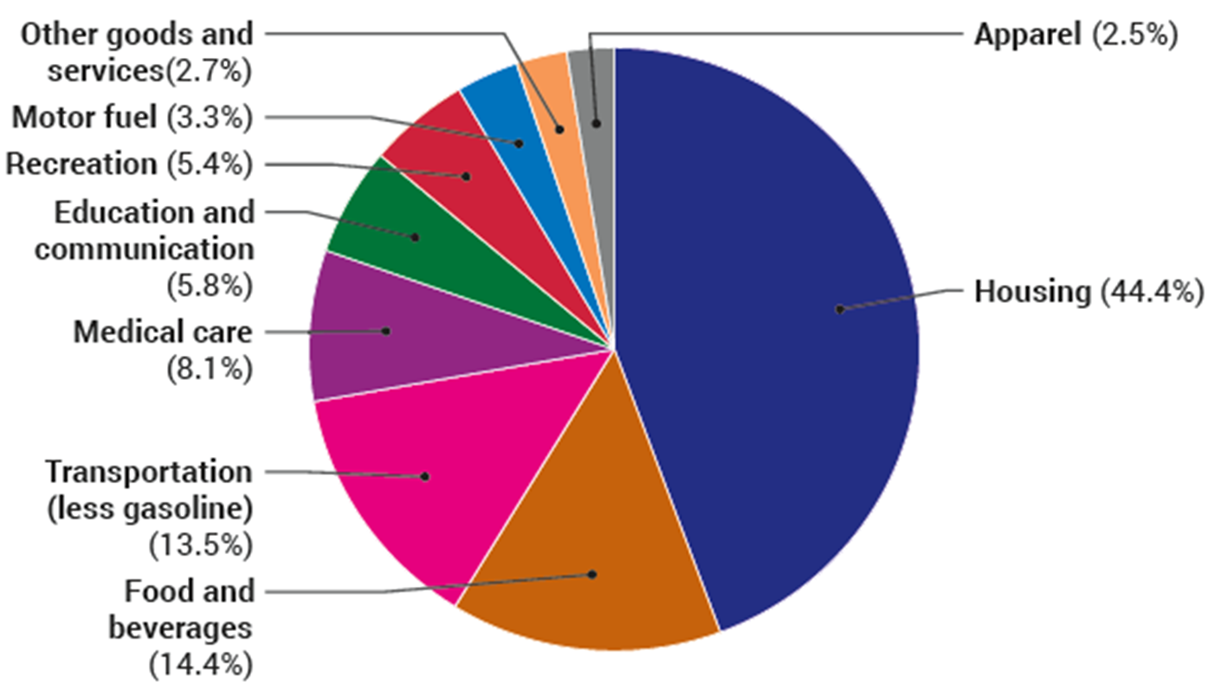
THE CONSUMER PRICE INDEX
The makeup of the consumer price index in 2023
43

Slide 44
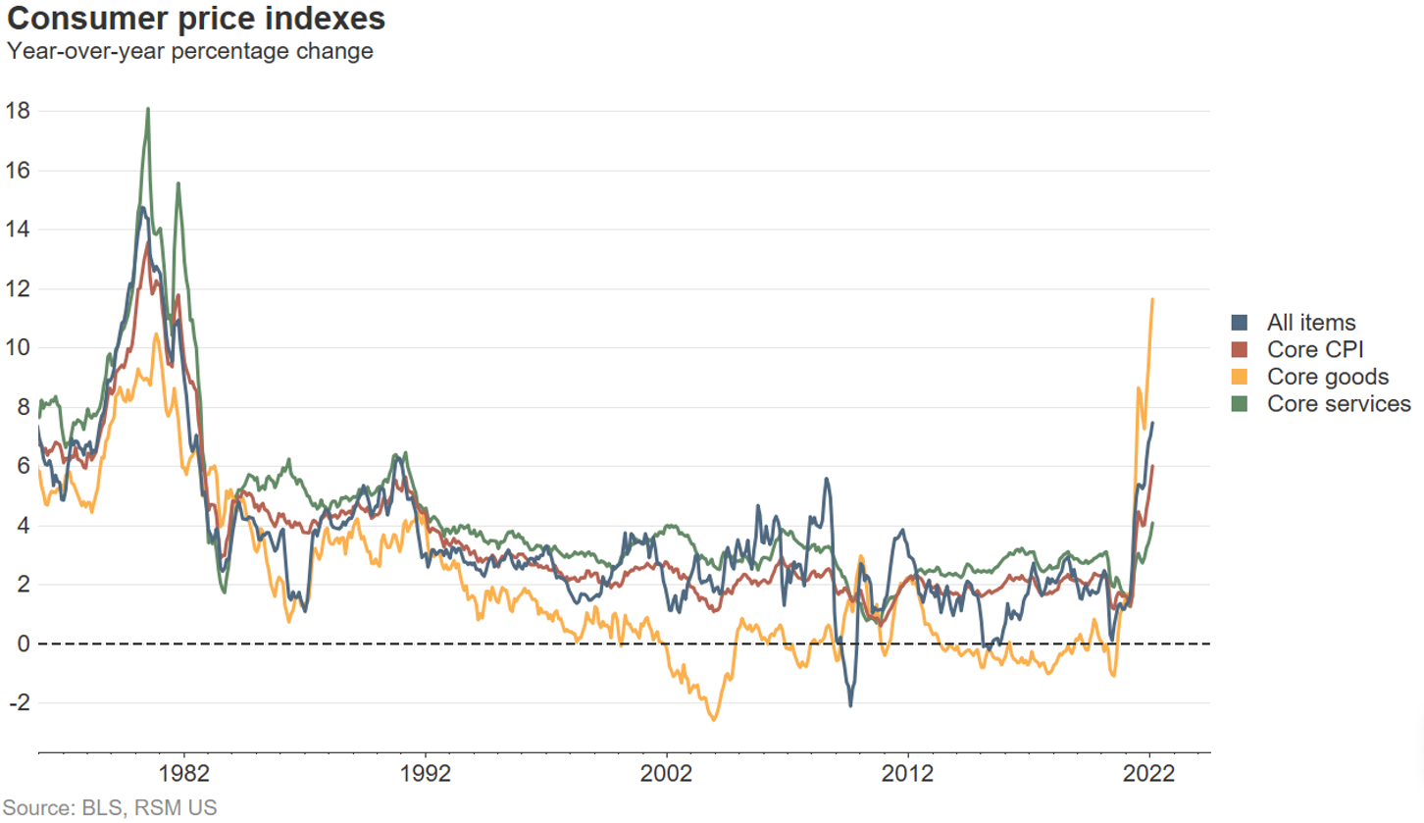
CONSUMER PRICE INDEX OVER TIME
The annual percentage increases in recent years have been much smaller than those of the 1970s and early 1980s, but have picked up after COVID.
44

Slide 45
OTHER PRICE MEASURES
Producer price index (PPI): similar to the CPI but measures changes in the prices of goods purchased by producers
Economists also use the GDP deflator, which measures the price level by calculating the ratio of nominal to real GDP.
The GDP deflator for a given year is 100 times the ratio of nominal GDP to real GDP in that year.
45

Slide 46
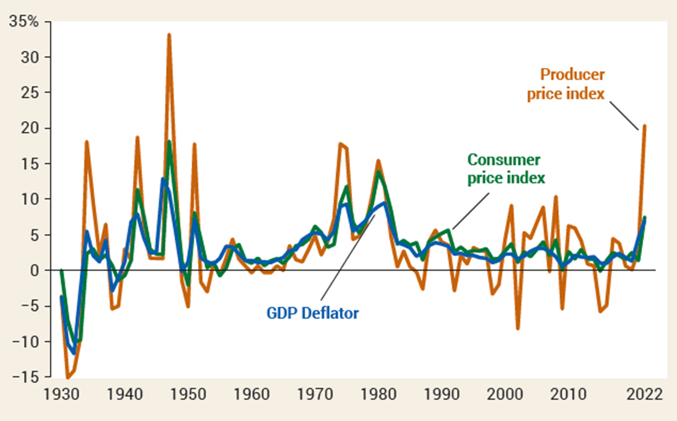
THE CPI, THE PPI, AND THE GDP DEFLATOR
The three measures usually move closely together.
46

Slide 47
The Uses and Limitations of Real GDP
The Standard of Living Over Time
Real GDP per person is real GDP divided by the population.
Real GDP per person tells us the value of goods and services that the average person can enjoy.
By using real GDP, we remove any influence that rising prices and a rising cost of living might have had on our comparison. Long-Term Trend
A handy way of comparing real GDP per person over time is to express it as a ratio of some reference year.
For example, in 1960, real GDP per person was $15,850 and in 2012, it was $42,800.
So real GDP per person in 2012 was 2.7 times its 1960 level—that is, $42,800 ÷ $15,850 = 2.7.
47

Slide 48
GDP as a Measure of Welfare
Shortcomings of GDP as a Measure of Welfare
Nonmarket activities
HOUSEWORK AND CHILDCARE
Leisure
Improved product quality
The underground economy
GDP and the environment
Composition and distribution of the output
Noneconomic sources of well-being
48

Slide 49
What GDP Does and Does Not Capture
Can you think of other activities not captured by GDP that ought to be included?
Genuine Progress Indicator (GPI)*
Adjust GDP for welfare-reducing activities such as resource depletion; environmental damage; crime; and quality of life.
https://dnr.maryland.gov/mdgpi/Pages/what-is-the-GPI.aspx
GDP can also be a poor measure of the living standards in various nations.
To get around the problem, economists use purchasing power parity (PPP), which adjusts for different relative prices among nations before making comparisons.
http://www.indexmundi.com/g/r.aspx?c=mr&v=67
49

Slide 50
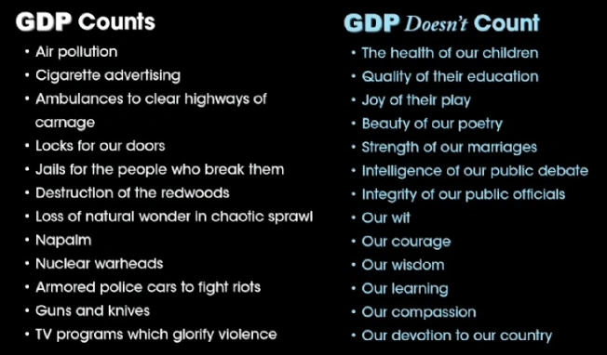

50

Slide 51
Practice Problem 1
 | 2022 |  | 2023 |  | 2024
 | P | Q | P | Q | P | Q
good A | $30 | 900 | $31 | 1,000 | $36 | 1,050
good B | $100 | 192 | $102 | 200 | $100 | 205
Compute nominal GDP in each year.
Compute real GDP in each year using 2022 as the base year.
Answers to Practice Problem, part 1
nominal GDP multiply Ps & Qs from same year 2022: $46,200 = $30 × 900 + $100 × 192 2023: $51,400 2024: $58,300
real GDP multiply each year’s Qs by 2012 Ps 2022: $46,200 2023: $50,000 2024: $52,000 = $30 × 1050 + $100 × 205
51
Notes:
This slide (and a few of the following ones) contain exercises that you can have your students do in class for immediate reinforcement of the material.
This problem requires calculators. If most of your students do not have calculators, you might “hide” this slide and instead pass out a printout of it for a homework exercise. Tell students that if they don’t have Or: just have them write down the expressions that they would enter into a calculator if they had calculators, i.e. Nominal GDP in 2001 = 30*900 + 100*192.

Slide 52
Practice Problem 2
 | Nom. GDP | Real GDP | GDP deflator | Inflation rate
2022 | $46,200 | $46,200 | 100.0 | n.a.
2023 | 51,400 | 50,000 | 102.8 | 2.8%
2024 | 58,300 | 52,000 | 112.1 | 9.1%
Use your previous answers to compute the GDP deflator in each year.
Use GDP deflator to compute the inflation rate from 2022 to 2023, and from 2023 to 2024.
52

Slide 53
An example
We can show the calculation of Real GDP for 2024 using 2012 as the base year.
Example: Given the following figures for 2012 and 2024.
Nominal GDP GDP Deflator Real GDP
2012 100,000,000 100 100,000,000
2024 120,000,000 110 109,090,909
Real GDP in 2024 = Nominal GDP in 2040 X 100.
(Base year = 2012) GDP deflator (2024)
= 120,000,000 X 100 = 109,090,909
110
Real GDP in 2024 = 109,090,909. The statistics indicate that in nominal terms, GDP rose by 20% over the period 2012 to 2024. However, during the same period prices rose by ten percent. Thus, real GDP rose by just over nine percent.
53

Slide 54
GDP Per Capita
GDP Per Capita is GDP divided by the size of the population: it is equal to the average GDP per person.
Not an end in itself as it does not address how a country uses that output to affect living standards.
GDP
Per capita GDP = ---------------------------------
Population
54

Slide 55
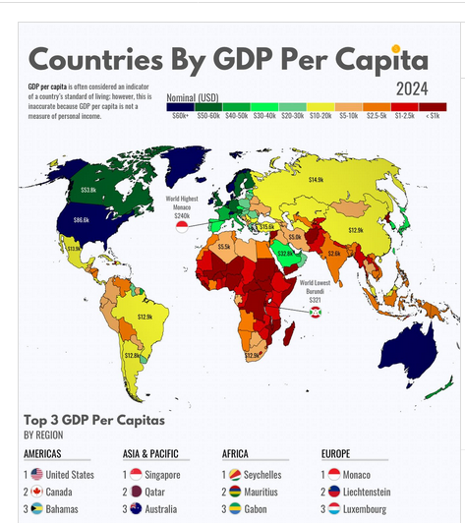
https://ourworldindata.org/grapher/gdp-per-capita-worldbank
https://www.worldometers.info/gdp/gdp-by-country/
/
http://statisticstimes.com/economy/projected-world-gdp-ranking.php
55

Slide 56

56

