Slide 1
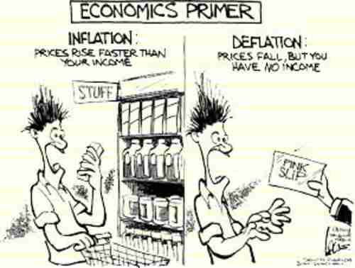
CHAPTER 16 LECTURE- INFLATION, DISINFLATION, AND DEFLATION

Slide 2
WHAT YOU WILL LEARN IN THIS CHAPTER
Why can printing money lead to higher rates of inflation and hyperinflation?
How does the Phillips curve describe the short run trade-off between inflation and unemployment?
Why does the trade off between inflation and unemployment cease in the long run?
Why can even moderate levels of inflation be hard to end?
Why is deflation a problem for economic policy makers?

Slide 3
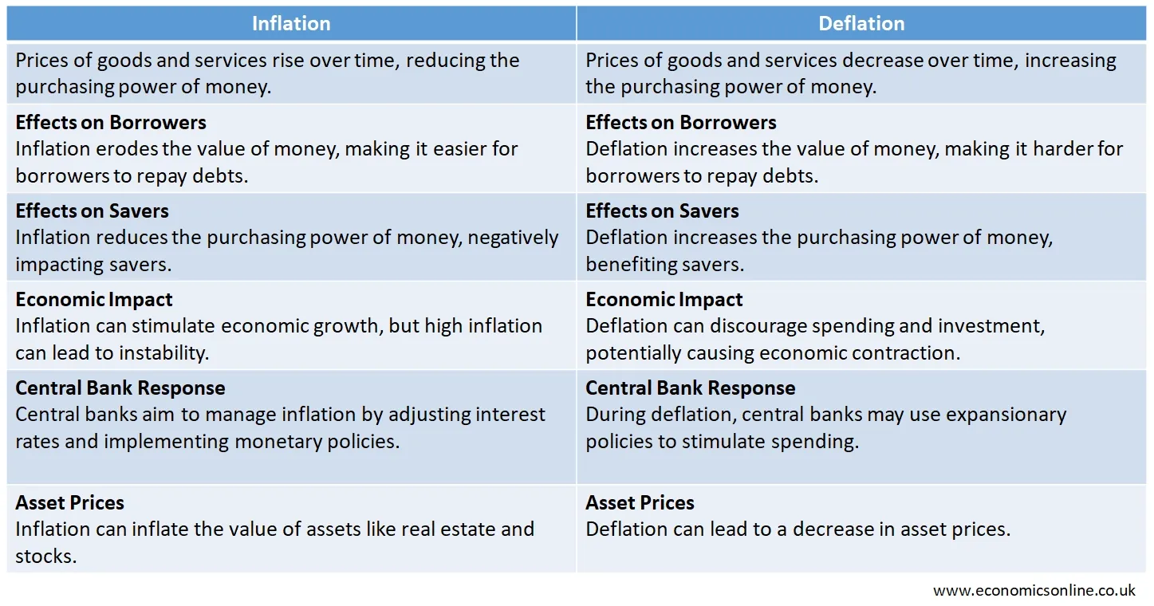

Slide 4
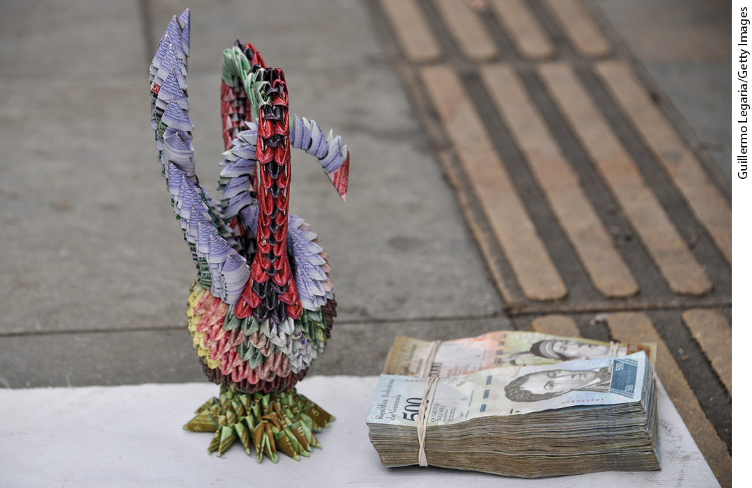
MONEY AND INFLATION
What caused 500 billion percent inflation in Zimbabwe (2008) and Germany (1922–1923)?
Why did inflation spiral out of control in Armenia (27,000%) and Nicaragua (60,000%)?

Slide 5
THE CLASSICAL MODEL OF MONEY AND PRICES
High inflation is always associated with rapid increases in the money supply.
Previously, we learned that in the long run, an increase in the money supply leads to an equal percentage rise in the overall price level.
The classical model of the price level: the real quantity of money is always at its long-run equilibrium level.
Real quantity of money = M/P
where M = nominal money supply and P = price level.

Slide 6
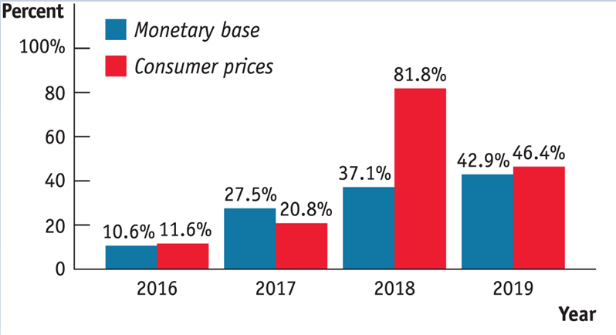
MONEY SUPPLY GROWTH AND INFLATION IN VENEZUELA
In general, inflation and money supply move together, especially during periods of high inflation.

Slide 7
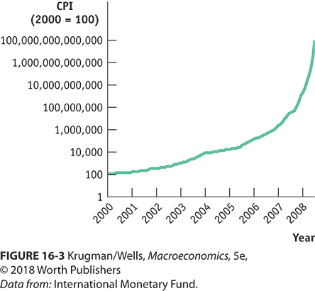
ZIMBABWE’S INFLATION
Over 8 years, consumer prices rose by 80 trillion percent.
Why? When Robert Mugabe rose to power he seized farms owned by the descendants of white colonists and gave them to his supporters.
Production fell, the tax base fell, and Zimbabwe couldn’t borrow money in world markets because of its instability.
What’s left? The printing press.

Slide 8
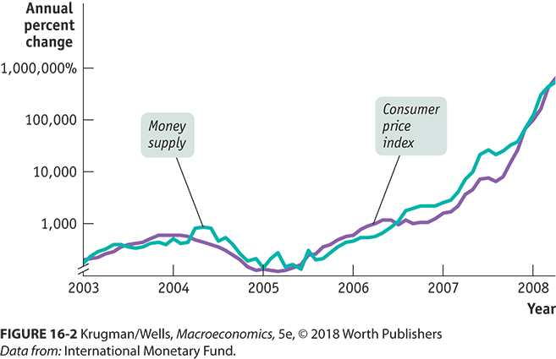
MONEY SUPPLY GROWTH AND INFLATION
In general, inflation and money supply move together, especially during periods of high inflation.

Slide 9
HOW DOES MONEY AFFECT PRICES?
As we have established, an increase in the money supply changes only prices in the long run.
According to the classical model of the price level, the real quantity of money is always at its long-run equilibrium level.
Real quantity of money= M/P
where M = nominal money supply and P = price level.

Slide 10
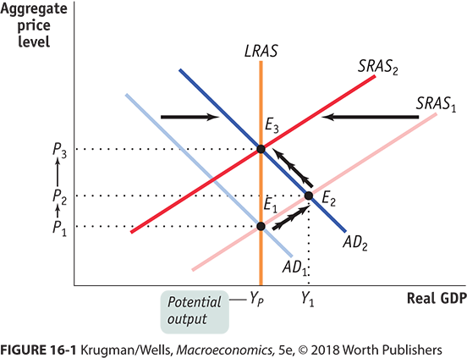
THE EFFECTIVENESS OF MONETARY POLICY
If money supply increases, what happens?
The increase in AD will increase the price level and output and eventually pull up nominal wages, which moves the SRAS curve leftward.

Slide 11
THE CLASSICAL MODEL OF THE PRICE LEVEL
The “classical” (pre-Keynes) model assumes the economy moves directly from E₁ to E₃—not necessarily a good assumption during normal times of low inflation.

Slide 12
LEARN BY DOING: PRACTICE QUESTION 1
Governments that run large deficits can:
  reduce the deficit by raising taxes.
  reduce the deficit by reducing spending.
  finance the deficit by printing money.
  Answers (a), (b), and (c) are all correct.

Slide 13
LEARN BY DOING: PRACTICE QUESTION 1
(ANSWER)
Governments that run large deficits can:
  reduce the deficit by raising taxes.
  reduce the deficit by reducing spending.
  finance the deficit by printing money.
  Answers (a), (b), and (c) are all correct. (correct answer)

Slide 14
THE INFLATION TAX
What is to prevent a government from paying for its expenses by printing money? Nothing.
The Treasury issues debt, and the Fed monetizes it by buying it back from the public through open-market purchases of Treasury bills.
The U.S. government can and does raise revenue by printing money.
Seigniorage: the revenue generated by a government’s right to print money (usually less than 1% of the U.S. government’s budget).
By printing money, a government increases the money supply, which triggers inflation.
Inflation erodes the purchasing power of money.
The inflation tax: the reduction in the real value of money held by the public caused by inflation.

Slide 15
THE LOGIC OF HYPERINFLATION
Seigniorage = ΔM
  where Δ = monthly change and M = money supply
It’s more useful to look at real seigniorage, the revenue created by printing money, divided by the price level, P:
Real seigniorage = ΔM/P
This can be rewritten to:
Real seigniorage = (ΔM/M) × (M/P) or
Real seigniorage = rate of growth of the money supply × real money supply
In the face of high inflation, the public reduces the real amount of money it holds, so M/P gets smaller. The government responds by accelerating the rate of growth of the money supply, ∆M/M. This leads to an even higher rate of inflation, and people respond by reducing their real money holdings, M/P, yet again.
This self-reinforcing process can easily spiral out of control.

Slide 16
A VICIOUS CYCLE
To avoid paying the inflation tax, people reduce their real money holdings and force the government to increase inflation to capture the same amount of real inflation tax.
In some cases, this leads to a vicious circle of a shrinking real money supply and a rising rate of inflation.
This leads to hyperinflation and a fiscal crisis.

Slide 17
MODERATE INFLATION AND DISINFLATION
In the United States, the inflation rate peaked at 14% at the beginning of the 1980s. In Britain, the inflation rate reached 26% in 1975.
Why did policy makers allow this to happen?
  In the short run, policies that produce a booming economy lead to higher inflation, and
  Policies that reduce inflation tend to depress the economy.
This creates both temptations and dilemmas for governments:
  Inflationary policies produce short-term political gains.
  Policies to bring inflation down carry short-term political costs.

Slide 18
THE OUTPUT GAP AND THE UNEMPLOYMENT RATE
Recall that aggregate output fluctuates around potential output in the short run:
  When aggregate output falls short of potential output, a recessionary gap arises.
  When aggregate output exceeds potential output, an inflationary gap arises.
The output gap: the percentage difference between the actual level of real GDP and potential output.
  When actual aggregate output is equal to potential output, the actual unemployment rate is equal to the natural rate of unemployment.
  When the output gap is positive (an inflationary gap), the unemployment rate is below the natural rate. When the output gap is negative (a recessionary gap), the unemployment rate is above the natural rate.
Fluctuations of aggregate output around the long-run potential output correspond to fluctuations of the unemployment around the natural rate.

Slide 19
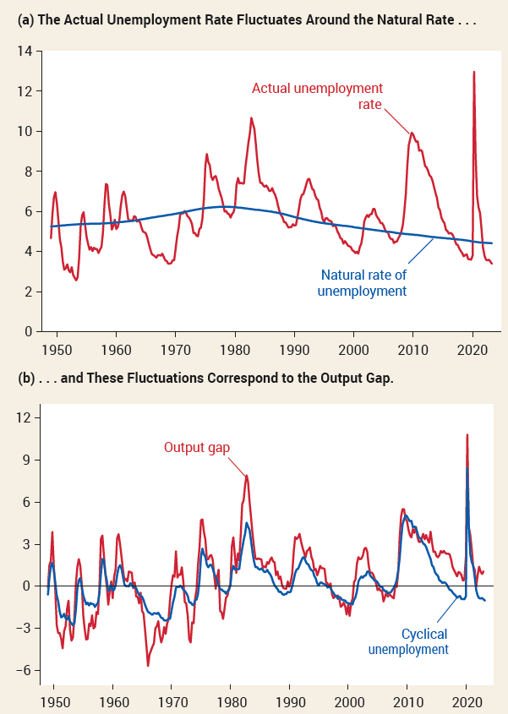
CYCLICAL UNEMPLOYMENT AND THE OUTPUT GAP
The actual unemployment rate fluctuates around the natural rate—and these fluctuations correspond to the output gap.

Slide 20
LEARN BY DOING: PRACTICE QUESTION 2
A positive output gap implies an unemployment rate:
  above the natural rate of unemployment.
  below the natural rate of unemployment.

Slide 21
LEARN BY DOING: PRACTICE QUESTION 2
(ANSWER)
A positive output gap implies an unemployment rate:
  above the natural rate of unemployment.
  below the natural rate of unemployment. (correct answer)

Slide 22
OKUN’S LAW
Cyclical unemployment seems to move less than the output gap.
  The output gap reached −8% in 1982, but cyclical unemployment reached only 4%.
Arthur Okun, John F. Kennedy’s chief economic adviser, discovered this.
Okun’s law: There is a predictable negative relationship between the output gap and the unemployment rate. Modern estimates find that a rise in the output gap of 1% reduces the unemployment rate by about 0.5%.

Slide 23
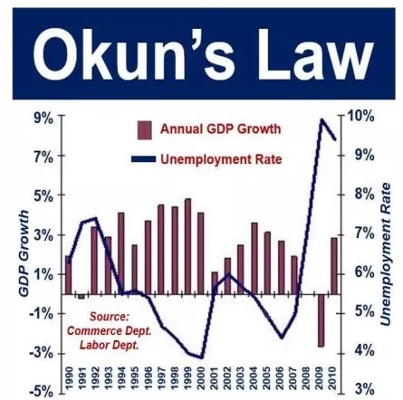
OKUN’S LAW: EXAMPLE
If the natural rate of unemployment is 5.2% and the economy is producing at only 98% of potential output, the output gap is −2%, then Okun’s law predicts an unemployment rate of 5.2% − 0.5 × (−2%) = 6.2%.

Slide 24
LEARN BY DOING: PRACTICE QUESTION 3
Cyclical unemployment and the output gap:
  move together, but cyclical unemployment fluctuates more than the output gap.
  have a relationship that Okun’s law quantifies.
  are negatively related: In the United States, when the output gap rises by 1%, cyclical unemployment rate decreases by 0.5%.
  Answers (a), (b), and (c) are all correct.

Slide 25
LEARN BY DOING: PRACTICE QUESTION 3
(ANSWER)
Cyclical unemployment and the output gap:
  move together, but cyclical unemployment fluctuates more than the output gap.
  have a relationship that Okun’s law quantifies.
  are negatively related: In the United States, when the output gap rises by 1%, cyclical unemployment rate decreases by 0.5%.
  Answers (a), (b), and (c) are all correct. (correct answer)

Slide 26
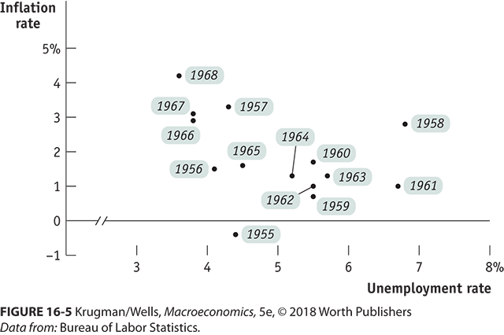
THE SHORT-RUN PHILLIPS CURVE: EVIDENCE
The short-run Phillips curve: the negative short-run relationship between the unemployment rate and the inflation rate

Slide 27
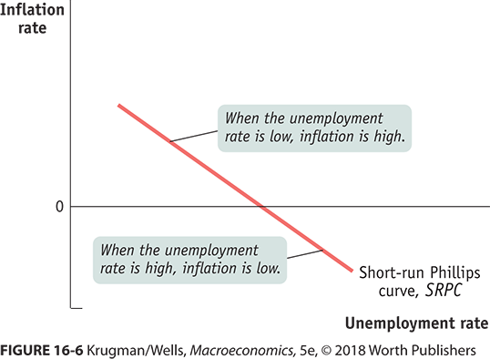
THE SHORT-RUN PHILLIPS CURVE: GRAPH

Slide 28
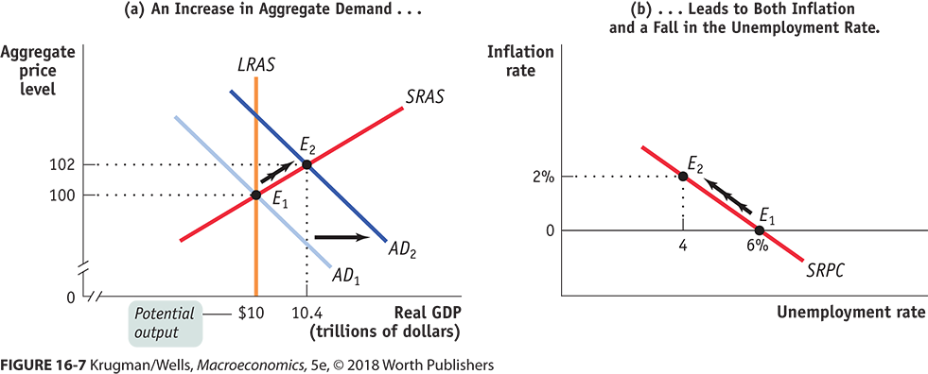
THE AD–AS MODEL AND THE SHORT-RUN PHILLIPS CURVE

Slide 29
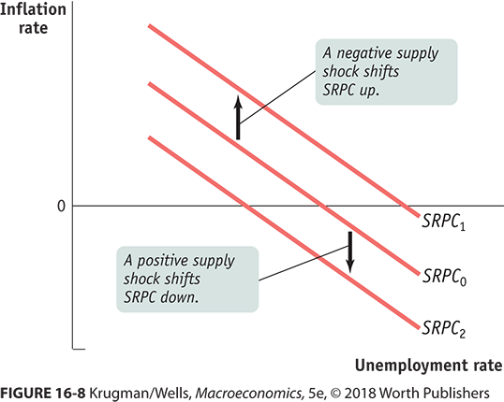
THE SHORT-RUN PHILLIPS CURVE AND SUPPLY SHOCKS

Slide 30
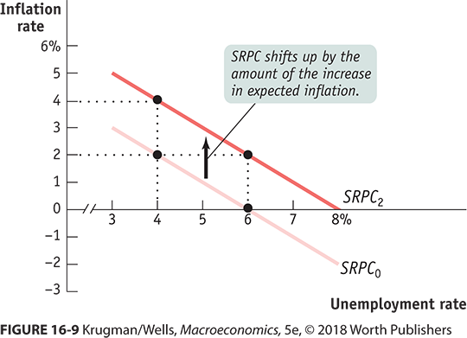
INFLATION EXPECTATIONS AND THE SHORT-RUN PHILLIPS CURVE

Slide 31
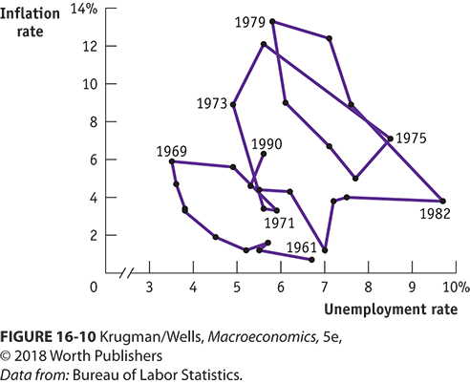
UNEMPLOYMENT AND INFLATION, 1961–1990
The Phillips curve explained fluctuations very well in the 1950s and 1960s. Then along came stagflation. Oil shocks and rising inflationary expectations created real problems.

Slide 32
INFLATION AND UNEMPLOYMENT IN THE LONG RUN
Since the SRPC shifts whenever inflationary expectations change, attempts to reduce unemployment below the natural rate may be effective only in raising prices.
The long-run Phillips curve: the relationship between unemployment and inflation after expectations of inflation have had time to adjust to experience

Slide 33
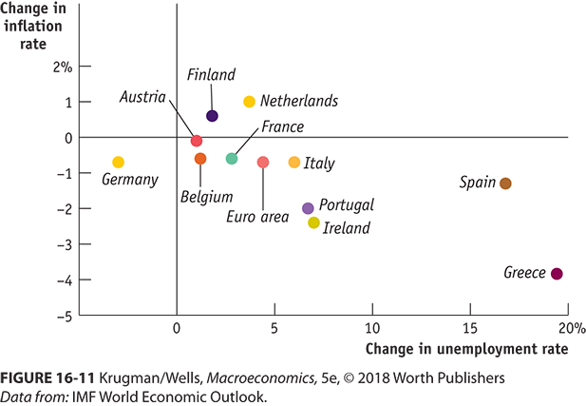
THE PHILLIPS CURVE IN THE GREAT RECESSION
Data from the Great Recession show that there was generally a fall in inflation for most countries that experienced rising unemployment.

Slide 34
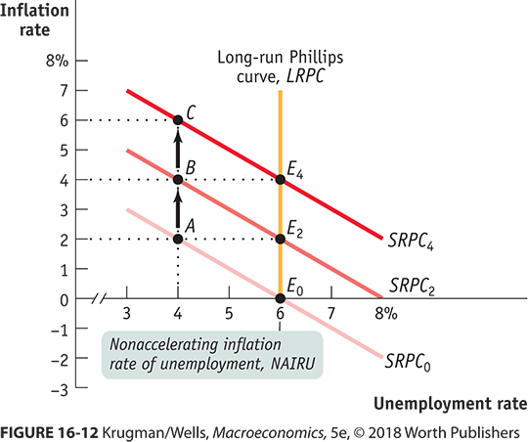
THE NAIRU AND THE LONG-RUN PHILLIPS CURVE

Slide 35
INFLATION AND UNEMPLOYMENT IN THE
LONG RUN
The nonaccelerating inflation rate of unemployment, or NAIRU, is the unemployment rate at which inflation does not change over time.
To avoid accelerating inflation over time, the unemployment rate must be high enough that the actual rate of inflation matches the expected rate of inflation.
Disinflation is the process of bringing down inflation that is embedded in expectations.

Slide 36
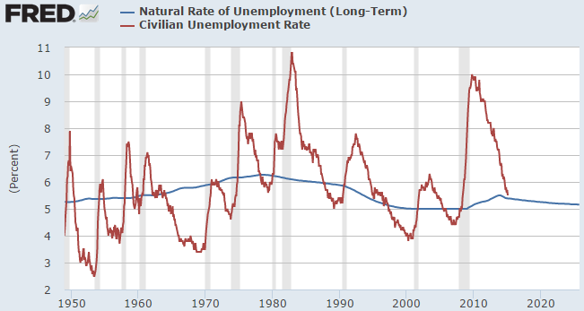
THE NATURAL RATE OF UNEMPLOYMENT
The natural rate of unemployment is the part of the unemployment rate unaffected by the swings of the business cycle.
The NAIRU is another name for the natural rate.
  As of the end of 2018, the CBO estimate of the U.S. natural rate was 5.3%.

Slide 37
COST OF DISINFLATION
Once inflation has become embedded in peoples’ expectations, reducing it can be difficult.
Disinflation can require a recession.
However, policy makers in the United States and other wealthy countries were willing to pay that price to bring down the high inflation of the 1970s.

Slide 38
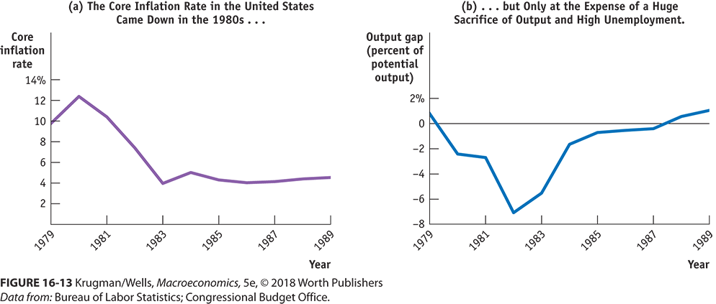
THE GREAT DISINFLATION OF THE 1980S
Beginning in late 1979, the Federal Reserve imposed strongly contractionary monetary policies, which pushed the economy into its worst recession since the Great Depression. It cost 18% of our annual output.

Slide 39
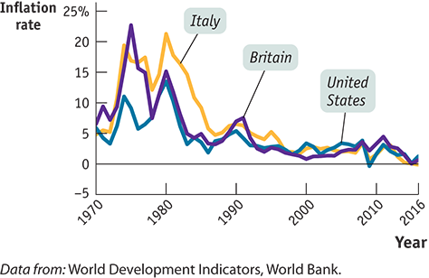
DISINFLATION AROUND THE WORLD
Other nations also brought inflation under control in the 1980s after the oil shocks and inflation of the 1970s.

Slide 40
EFFECTS OF EXPECTED DEFLATION
There is a zero bound on the nominal interest rate: it cannot go below zero.
Liquidity trap: the inability to use monetary policy because nominal interest rates are too low and cannot fall below the zero bound
  A liquidity trap can occur whenever there is a sharp reduction in demand for loanable funds.

Slide 41
Liquidity Trap
A liquidity trap is when a change in monetary policy has no effect on interest rates.
This would be the case if the money demand curve were horizontal at some interest rate, as shown.
If a change in the money supply from M to M′ cannot change interest rates, then, unless there is some other change in the economy, there is no reason for investment or any other component of aggregate demand to change.

Slide 42
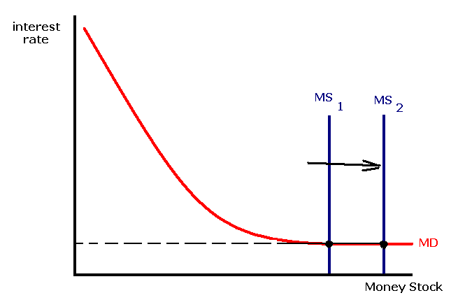
Liquidity Trap

Slide 43
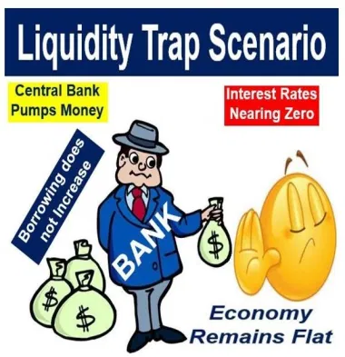

Slide 44
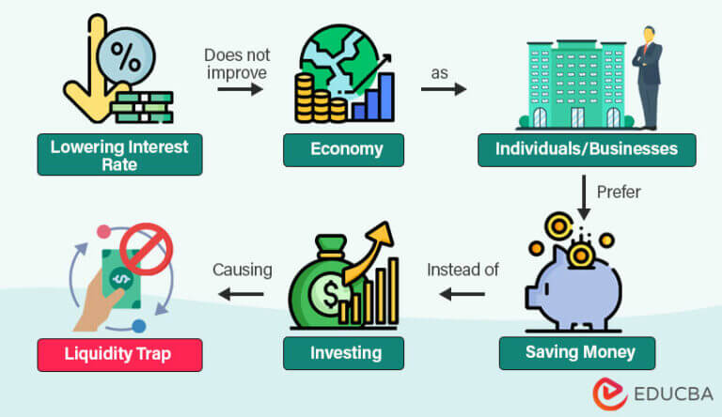

Slide 45
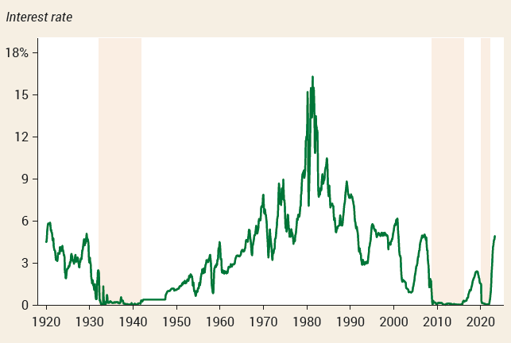
THE ZERO LOWER BOUND IN THE U.S. ECONOMY
The U.S. experienced the zero lower bound in the 1930s and in 2009–2017 when interest rates were virtually zero.

Slide 46
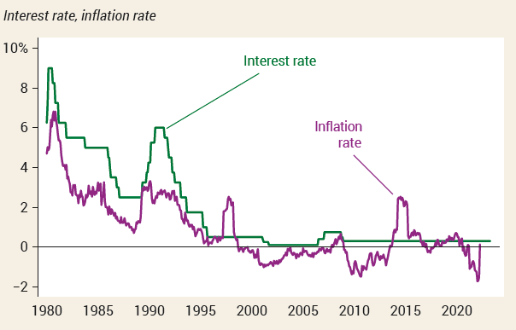
DEFLATION AND THE LIQUIDITY TRAP IN THE JAPANESE ECONOMY
A prolonged economic slump in Japan led to deflation from the late 1990s on. The Bank of Japan responded by cutting interest rates, but eventually ran up against the zero lower bound.

Slide 47
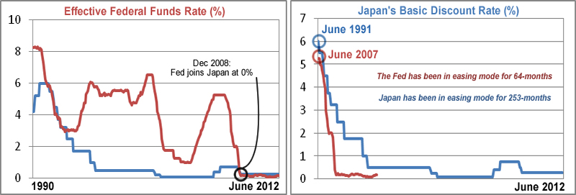
I
DID THE USA TURN JAPANESE?
http://www.marketoracle.co.uk/Article35494.html

Slide 48
