Slide 1


CHAPTER 15 LECTURE – MONETARY POLICY

Slide 2
WHAT YOU WILL LEARN IN THIS CHAPTER
What is the money demand curve?
Why does the liquidity preference model determine the interest rate in the short run?
How does the Federal Reserve implement monetary policy?
Why is monetary policy the main tool for stabilizing the economy?
Why do economists believe in monetary neutrality?

Slide 3
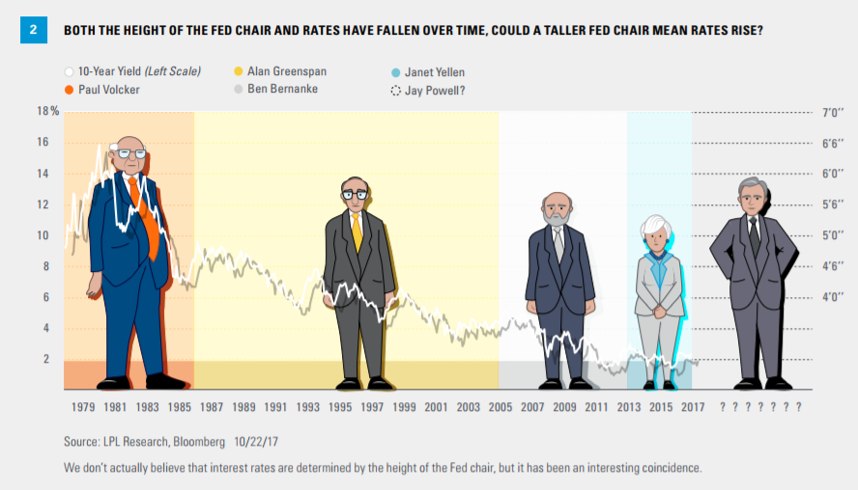
THE MOST POWERFUL PERSON IN GOVERNMENT
The chairmanship of the Federal Reserve is arguably the most powerful position in the U.S. government
Jerome Hayden "Jay" Powell

Slide 4

THE DEMAND FOR MONEY
The Opportunity Cost of Holding Money
We all carry some cash around for the convenience.
When we do, we give up interest income we’d collect if that spending power were in an interest-bearing asset like a bond.
There is a price to be paid for the convenience of holding money.

Slide 5

THE OPPORTUNITY COST OF HOLDING MONEY (1/4)
We all carry some cash for the convenience, but that convenience comes with a price:
Cash yields no return;
We give up the interest that could have been earned by putting money into interest-bearing assets like CDs (certificates of deposits).
A certificate of deposit (CD) allows customers to deposit their funds for a specified amount of time and earn a specified interest rate.

Slide 6
THE OPPORTUNITY COST OF HOLDING MONEY (2/4)
Individuals and firms trade off the benefit of holding cash versus the benefit of holding interest-bearing nonmonetary assets.
Table 1 Selected Interest Rates, February 2023
One-month Treasury bills | 4.51%
Interest-bearing demand deposits | 0.10%
Currency | 0
Data from: Federal Reserve Bank of St. Louis
Funds in demand deposits are more accessible than those in Treasury bills, but they earn only 0.10%.
The most accessible asset—cash in your wallet—earns zero.

Slide 7
THE OPPORTUNITY COST OF HOLDING MONEY (3/4)
Short-term interest rates: the interest rates on financial assets that mature within less than a year.
Long-term interest rates: interest rates on financial assets that mature a number of years in the future.
The higher the interest rate, the higher the opportunity cost of holding money.
The lower the interest rate, the lower the opportunity cost of holding money.

Slide 8
THE OPPORTUNITY COST OF HOLDING MONEY (4/4)
The opportunity cost of holding money declined sharply between 2019 and 2020.
The last two rows summarize this comparison: they give the differences between the interest rates on Treasuries and demand deposits and between the interest rates on Treasuries and currency.
Table 2 Interest Rates and the Opportunity Cost of Holding Money
 | March 2019 | March 2020
Federal funds rate | 2.41% | 0.65%
One-month Treasury bills | 2.45% | 0.37%
Interest-bearing demand deposits | 0.06% | 0.06%
Currency | 0 | 0
Treasury bills minus interest-bearing demand deposits (percentage points) | 2.35 | 0.31
Treasury bills minus currency (percentage points) | 2.41 | 0.37
Data from: Federal Reserve Bank of St. Louis.

Slide 9
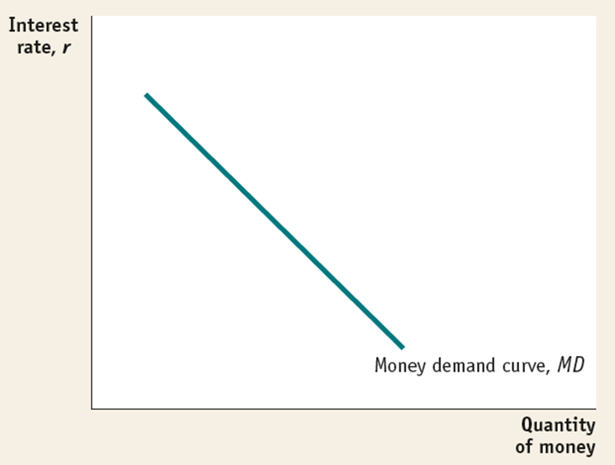
THE MONEY DEMAND CURVE
The money demand curve shows the relationship between the quantity of money demanded and the interest rate.

Slide 10
SHIFTS OF THE REAL MONEY DEMAND CURVE
What shifts the money demand curve?
Changes in aggregate price level
Higher prices mean we need more money for transactions (and vice versa).
Changes in real GDP
More goods and services produced and sold means we need more money (and vice versa).
Changes in technology
The ease of credit cards reduces the need for cash.
Changes in institutions
After 1980 banks were allowed to offer interest on checking accounts. This decreased the cost of holding money, and money demand increased.

Slide 11
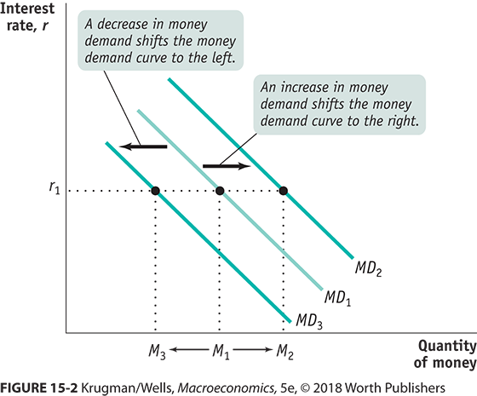
SHIFTS IN THE DEMAND FOR MONEY

Slide 12
MONEY AND INTEREST RATES
So how does the Fed control interest rates?
We need to understand how interest rates are set in the market.
The liquidity preference model of the interest rate asserts that the interest rate is determined by the supply and demand for money.
The money supply curve shows how the nominal quantity of money supplied varies with the interest rate.

Slide 13
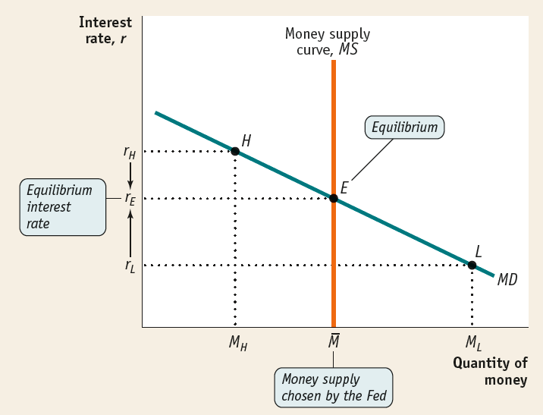
THE EQUILIBRIUM INTEREST RATE
At the interest rate r_{L}, the quantity of money demanded exceeds the money supply. Investors will drive the interest rate up to r_{E}.
At the interest rate r_{H}, the quantity of money demanded is less than the money supply. Investors will drive the interest rate down to r_{E}.
At the interest rate r_{E}, the money market is at equilibrium, where the quantity of money demanded equals the money supply.

Slide 14
LEARN BY DOING: PRACTICE QUESTION 1
Suppose that an economy’s aggregate output level increases. Assuming that the central bank does not engage in monetary policy, which of these statements is true?
The interest rate will increase.
The interest rate will decrease.
The interest rate will be unaffected by this change in aggregate output.
This change in aggregate output will cause a movement along the money demand curve.

Slide 15
LEARN BY DOING: PRACTICE QUESTION 1 (ANSWER)
Suppose that an economy’s aggregate output level increases. Assuming that the central bank does not engage in monetary policy, which of these statements is true?
The interest rate will increase. (correct answer)
The interest rate will decrease.
The interest rate will be unaffected by this change in aggregate output.
This change in aggregate output will cause a movement along the money demand curve.

Slide 16
MONETARY POLICY AND THE INTEREST RATE (1/3)
By adjusting the money supply up or down, the Fed can set the interest rate.
The Fed sets a target federal funds rate and undertakes the appropriate open-market operations.
Target federal funds rate: the Federal Reserve’s desired federal funds rate.

Slide 17
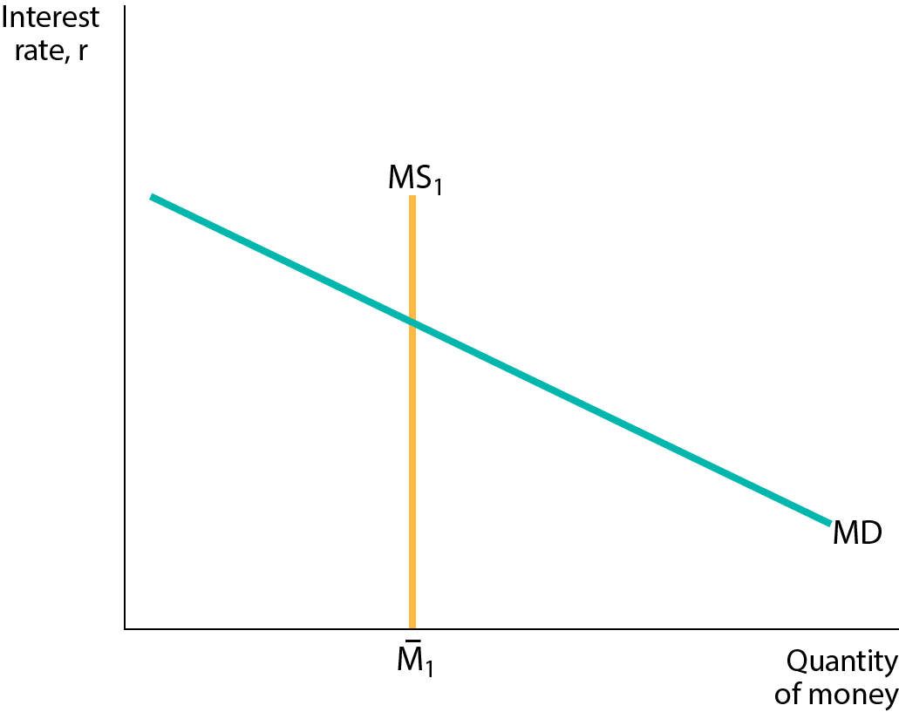
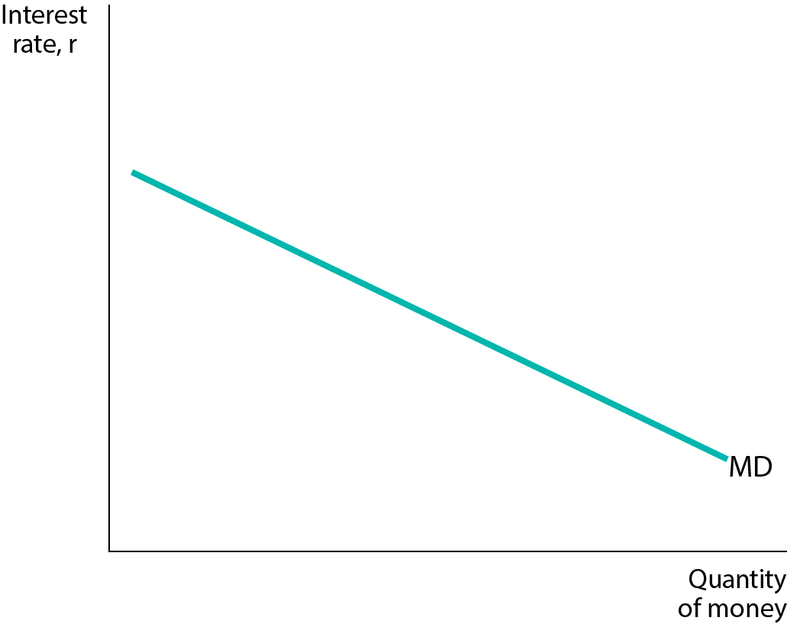
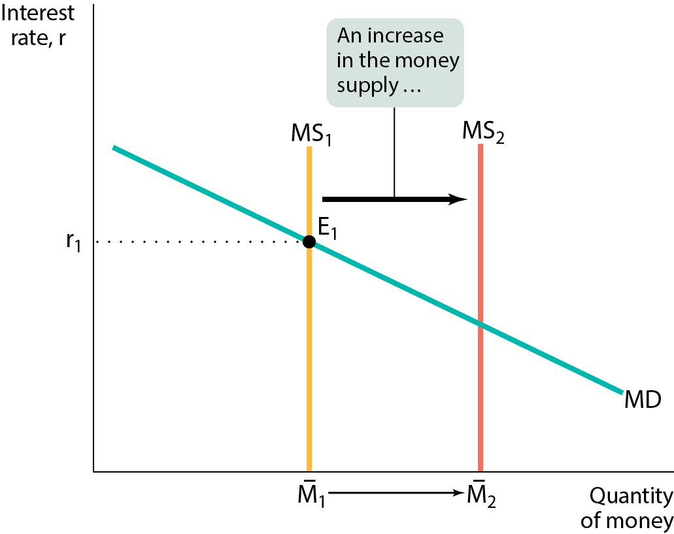
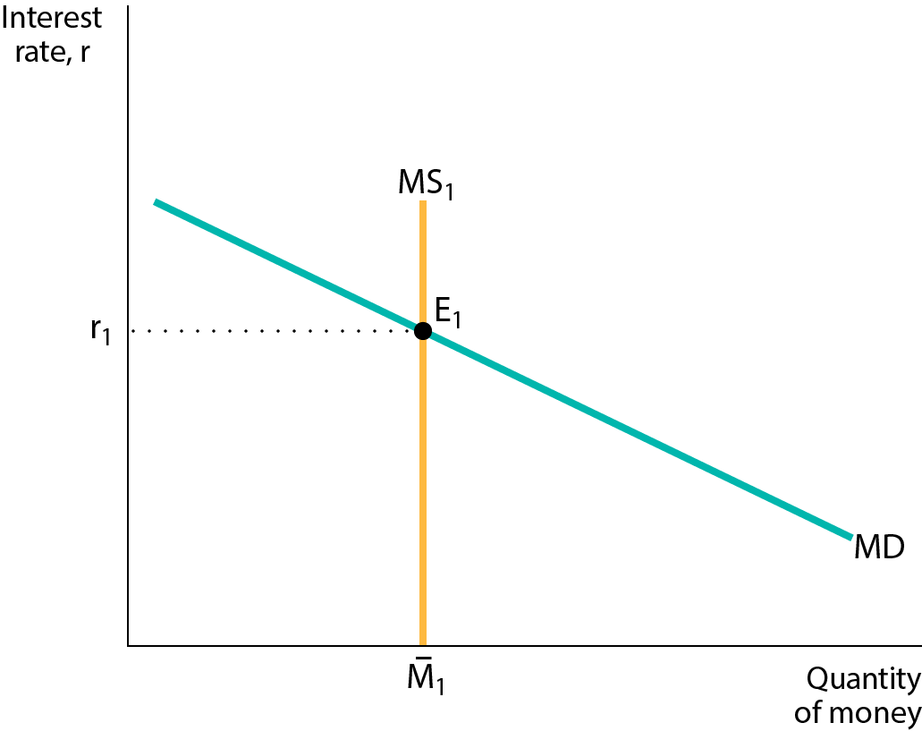

MONETARY POLICY AND THE INTEREST RATE (2/3)
The Fed can lower the interest rate by increasing the money supply.

Slide 18
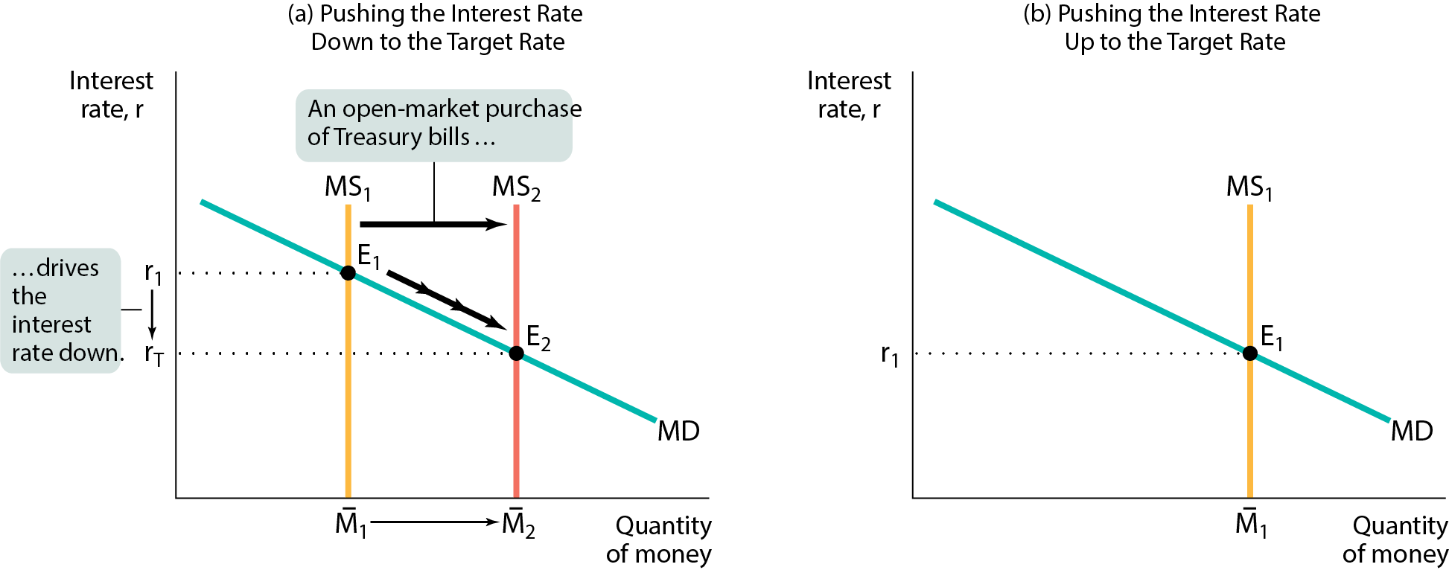
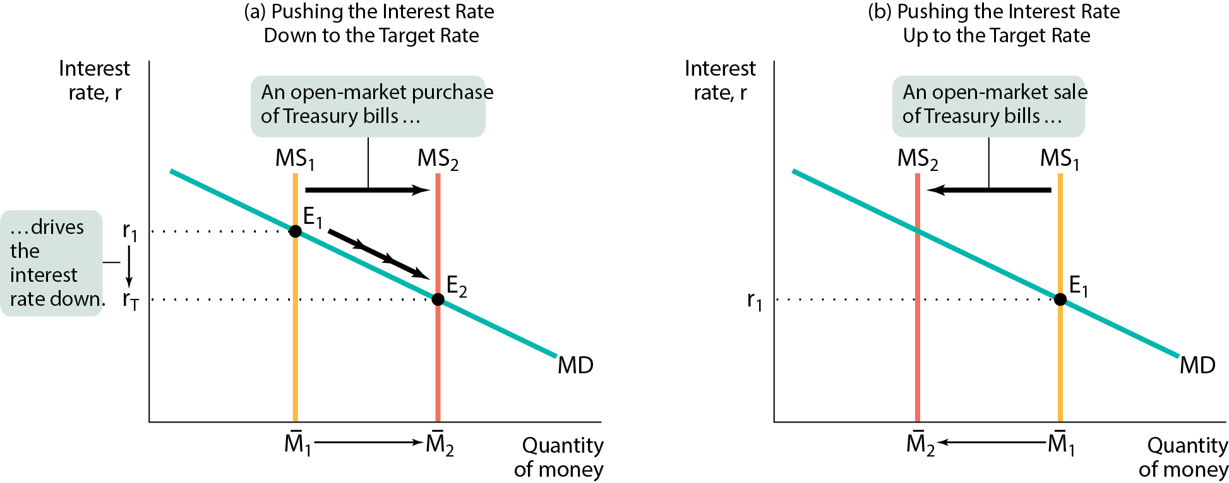
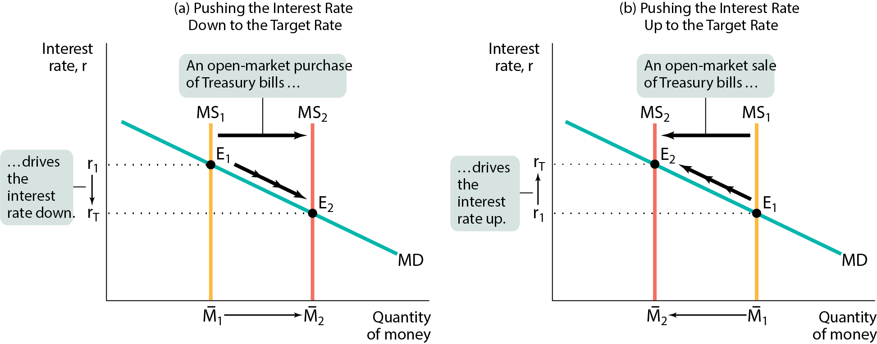
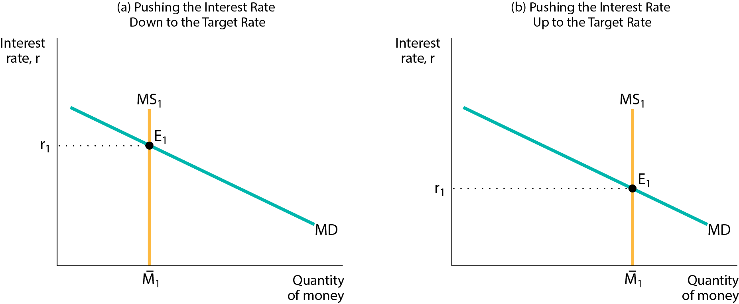
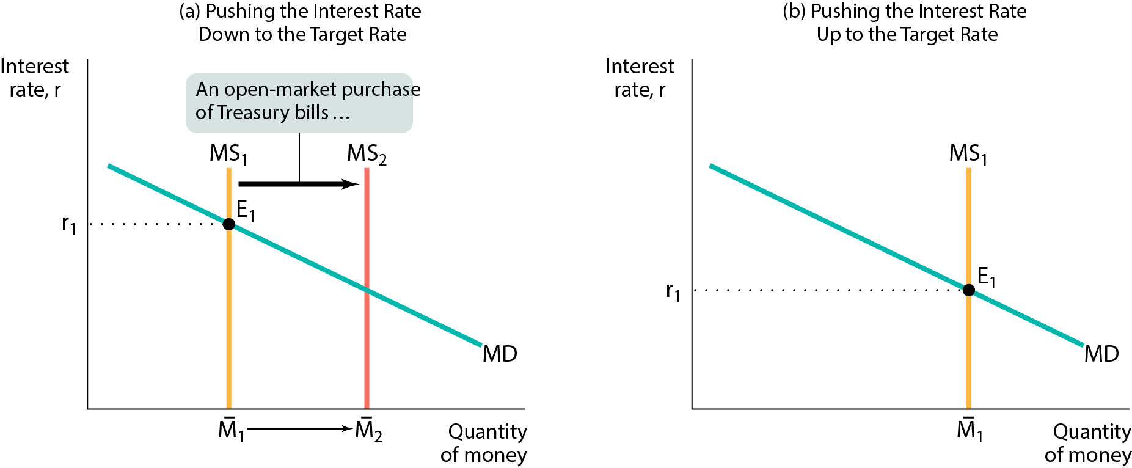
MONETARY POLICY AND THE INTEREST RATE (3/3)
The Fed uses open-market operations to push the interest rate down (or up) to the target rate.

Slide 19
LEARN BY DOING: PRACTICE QUESTION 2
Suppose the money supply curve shifts to the left. The MOST likely cause for this shift is the Fed’s open-market:
purchase of Treasury bills.
sale of Treasury bills.

Slide 20
LEARN BY DOING: PRACTICE QUESTION 2 (ANSWER)
Suppose the money supply curve shifts to the left. The MOST likely cause for this shift is the Fed’s open-market:
purchase of Treasury bills.
sale of Treasury bills. (correct answer)

Slide 21
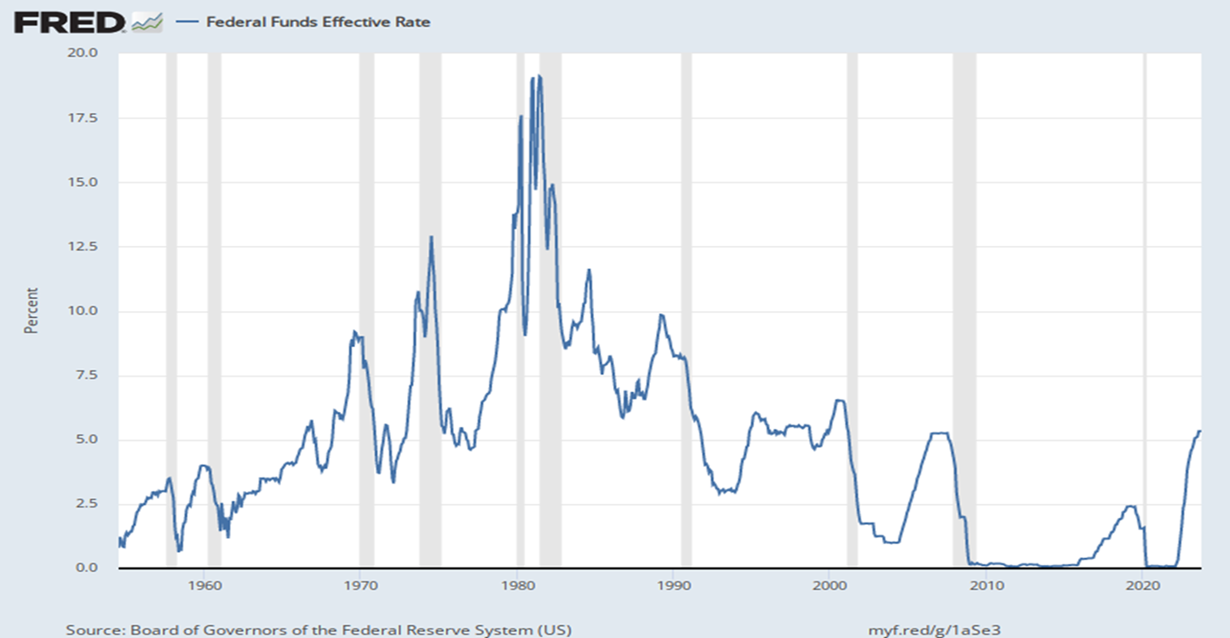
MONETARY POLICY AND THE INTEREST RATE (1/3)
By adjusting the money supply up or down, the Fed can set the interest rate.
The Fed sets a target federal funds rate and undertakes the appropriate open-market operations.
Target federal funds rate: the Federal Reserve’s desired federal funds rate.

Slide 22
MONETARY POLICY AND THE INTEREST RATE (2/3)
The Fed can lower the interest rate by increasing the money supply.

Slide 23
MONETARY POLICY AND THE INTEREST RATE (3/3)
The Fed uses open-market operations to push the interest rate down (or up) to the target rate.

Slide 24
LEARN BY DOING: PRACTICE QUESTION 2
Suppose the money supply curve shifts to the left. The MOST likely cause for this shift is the Fed’s open-market:
purchase of Treasury bills.
sale of Treasury bills.

Slide 25
LEARN BY DOING: PRACTICE QUESTION 2 (ANSWER)
Suppose the money supply curve shifts to the left. The MOST likely cause for this shift is the Fed’s open-market:
purchase of Treasury bills.
sale of Treasury bills. (correct answer)

Slide 26

LONG-TERM INTEREST RATES
Long-term interest rates don’t necessarily move with short-term interest rates.
If investors expect short-term interest rates to rise, they may buy short-term bonds.
In practice, long-term interest rates reflect the market’s average expectation for short-term rates.

Slide 27
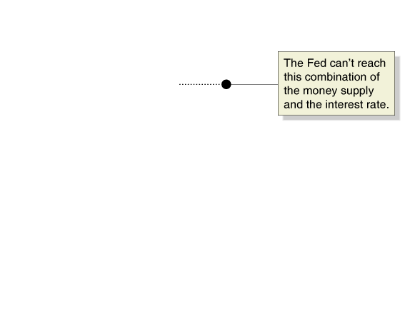
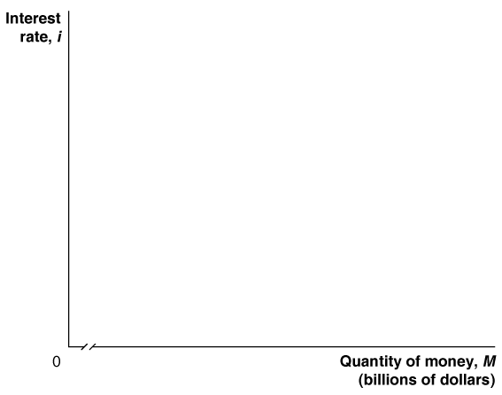
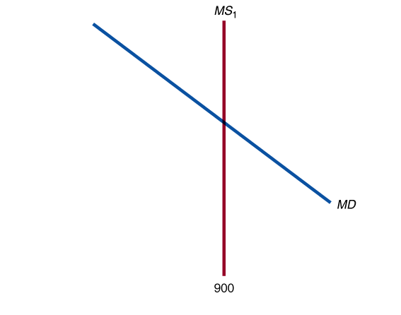
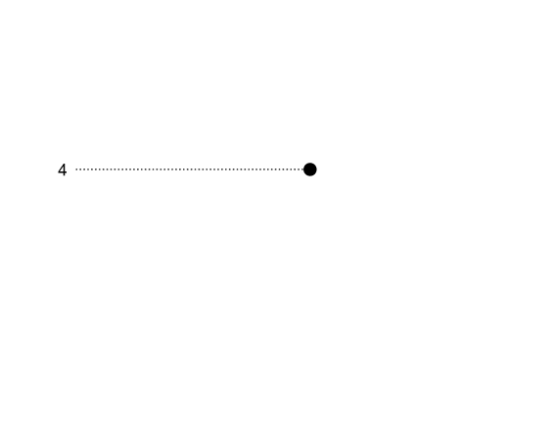
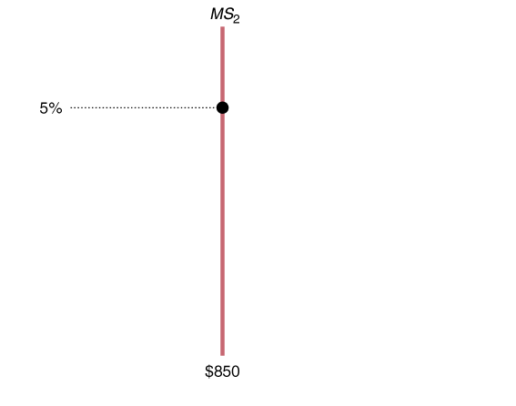
The Fed can’t target both the money supply and the interest rate
It might seem that the Fed could “get the best of both worlds” by targeting both interest rates and the money supply.
But this is impossible: the two are linked through the money demand curve.
So a decrease in the money supply will increase interest rates; an increase in the money supply will decrease interest rates.

Slide 28
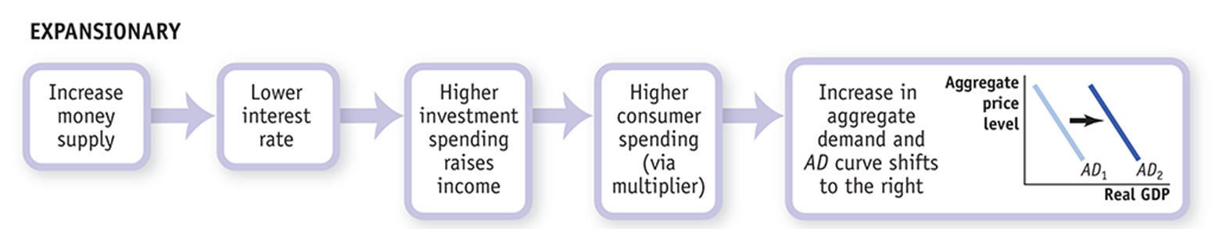
MONETARY POLICY AND AGGREGATE DEMAND
Expansionary monetary policy: monetary policy that increases aggregate demand (also called “easy money policy”)

Slide 29
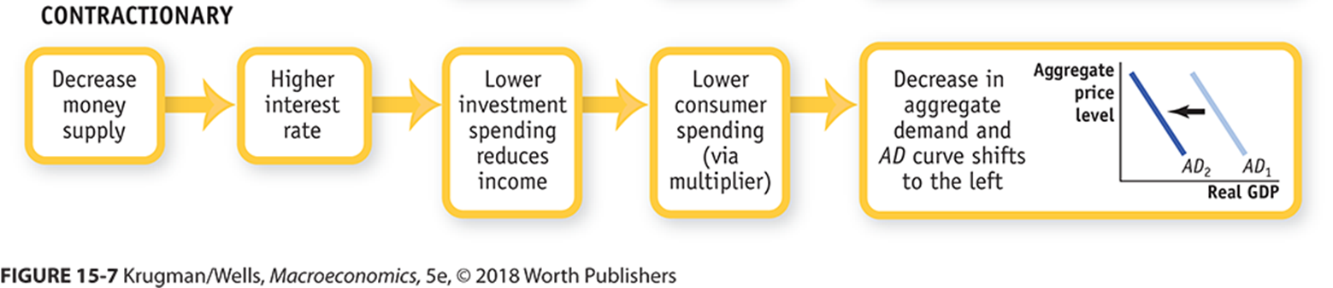
MONETARY POLICY AND AGGREGATE DEMAND
Contractionary monetary policy: monetary policy that reduces aggregate demand (also called “tight money policy”)

Slide 30
LEARN BY DOING: PRACTICE QUESTION 3
When the economy is producing at a short-run level of aggregate output that is less than potential output, it is MOST likely that the Fed will engage in open-market:
purchases of Treasury bills.
sales of Treasury bills.

Slide 31
LEARN BY DOING: PRACTICE QUESTION 3 (ANSWER)
When the economy is producing at a short-run level of aggregate output that is less than potential output, it is MOST likely that the Fed will engage in open-market:
purchases of Treasury bills. (correct answer)
sales of Treasury bills.

Slide 32
MONETARY POLICY IN PRACTICE
How does the Fed decide whether to use expansionary or contractionary monetary policy?
And how does it decide how much is enough?
Policy makers try to fight recessions, as well as to ensure price stability: low (though usually not zero) inflation.
Actual monetary policy reflects a combination of these goals.

Slide 33
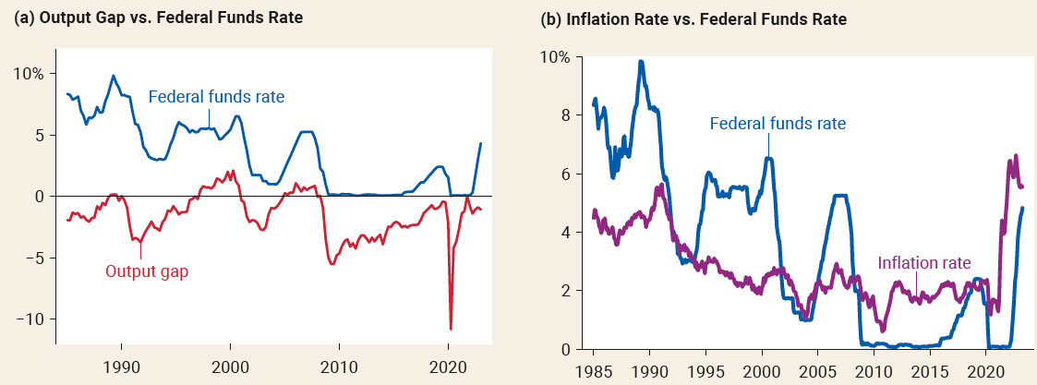
TRACKING MONETARY POLICY USING THE OUTPUT GAP AND INFLATION
Panel (a): The federal funds rate usually rises when the output gap is rising and falls when the output gap is falling.
Panel (b): The federal funds rate tends to be high when inflation is high and low when inflation is low.

Slide 34
THE TAYLOR RULE METHOD OF SETTING MONETARY POLICY
In 1993, Stanford economist John Taylor proposed a simple rule for monetary policy.
Taylor rule for monetary policy: set the federal funds rate according to the level of the inflation rate and either the output gap or the unemployment rate:
Federal funds target rate = 2.07 + 1.28 × inflation rate – 1.95 × unemployment gap
As it turns out, between 1988 and 2008 the Fed did just this.

Slide 35
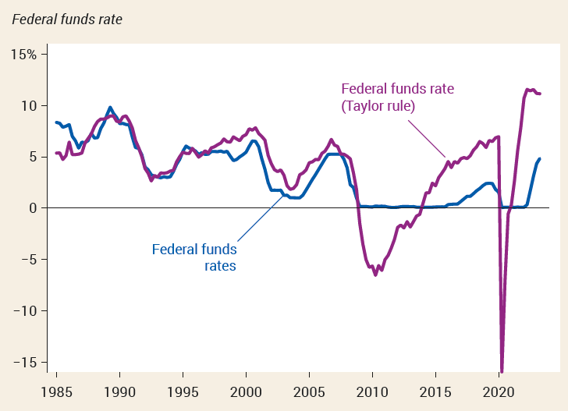
THE TAYLOR RULE AND THE FEDERAL FUNDS RATE
The actual federal funds rate tracked the predicted rate quite closely through the end of 2008.
After that the Taylor rule called for negative interest rates, which aren’t possible.

Slide 36
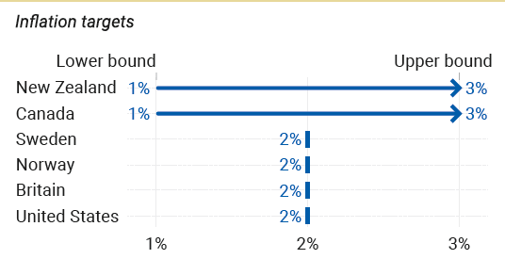
INFLATION TARGETING
Instead of using a Taylor rule, many central banks use inflation targeting.
The central bank sets an explicit target for the inflation rate and uses monetary policy to hit that target.
Consider the target inflation rates of six central banks: There are no significant differences between their target inflation rates.

Slide 37
DOES IT MATTER?
One major difference between the two methods:
Inflation targeting is forward-looking (based on a forecast of future inflation).
The Taylor rule is backward-looking (adjusts monetary policy in response to past inflation).

Slide 38
THE ZERO LOWER BOUND PROBLEM
Zero lower bound for interest rates: Interest rates can’t go below zero without causing significant problems.
By 2016, the Swiss equivalent of the federal funds rate was −0.75%, and both the European Central Bank and the Bank of Japan also had slightly negative rates.
The zero lower bound isn’t an absolute limit. Still, no central bank has tried to push rates significantly below zero.
Running up against the zero lower bound: When inflation is low and the economy is below potential, normal monetary policy runs out of room to operate because short-term interest rates are already at or near zero.
November 2010: Interest rates were at or near zero, and the Fed got creative and tried “quantitative easing” by buying longer-term government bonds.
Despite the Fed’s efforts, the pace of recovery remained disappointingly slow.

Slide 39
LEARN BY DOING: DISCUSSION QUESTION 1
With a partner, draw the SRAS, AD, and LRAS curves for an economy with a recessionary gap. What monetary policy should the Fed pursue with its open-market operations?
Explain what happens to interest rates. Show on a money demand–money supply graph.
Finally, show the effect of the monetary policy on the original graph.

Slide 40
MONEY, OUTPUT, AND PRICES IN THE LONG RUN
What about the economy’s ability to self-correct toward long-run equilibrium through flexible wages and SRAS shifts?
In short, we believe that in the long run, changes in the quantity of money affect the price level but not the output or interest rate.

Slide 41
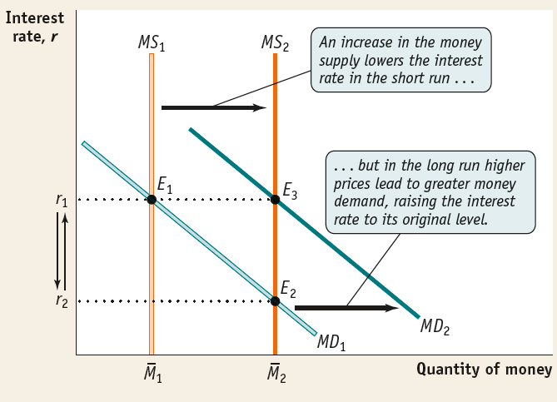
CHANGES IN THE MONEY SUPPLY AND THE INTEREST RATE IN THE LONG RUN
In the long run, changes in the money supply don’t affect the interest rate.
Monetary neutrality: changes in the money supply have no real effect on the economy.

Slide 42
LEARN BY DOING DISCUSSION
With a partner, draw the SRAS, AD, and LRAS curves for an economy with a recessionary gap. What monetary policy should the Fed pursue with its open-market operations?
Explain what happens to interest rates. Show on a money demand–money supply graph.
Finally, show the effect of the monetary policy on the original graph.

Slide 43
MONEY, OUTPUT, AND PRICES IN THE LONG RUN
What about the economy’s ability to self-correct toward long-run equilibrium through flexible wages and SRAS shifts?
In short, we believe that in the long run, changes in the quantity of money affect the price level but not the output or interest rate.

Slide 44
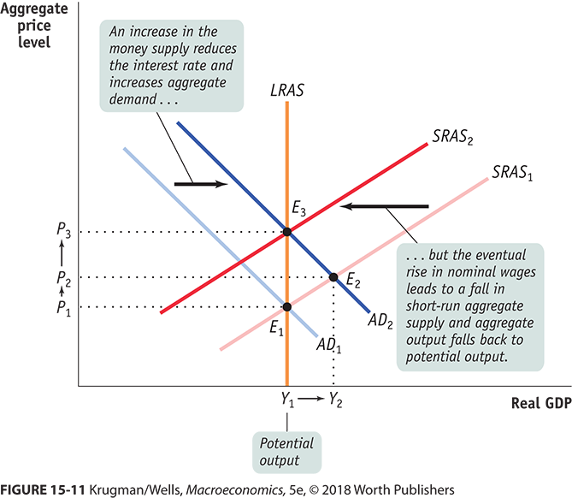
SHORT-RUN AND LONG-RUN EFFECTS OF AN INCREASE IN THE MONEY SUPPLY

Slide 45
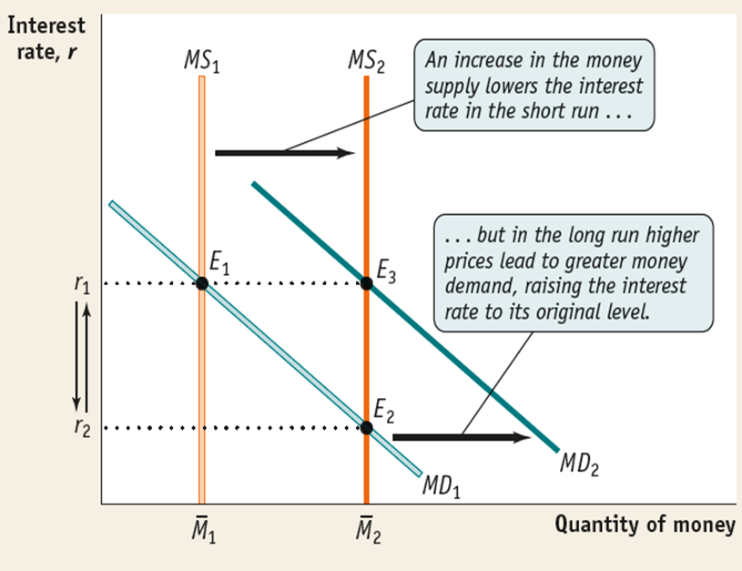
MONETARY NEUTRALITY
In the long run, changes in the money supply don’t affect the interest rate.
Monetary neutrality: changes in the money supply have no real effect on the economy

Slide 46
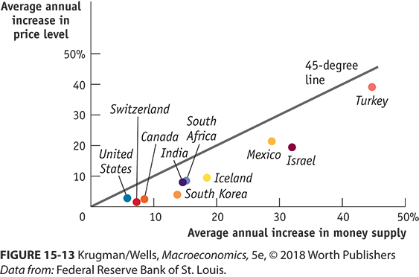
INTERNATIONAL EVIDENCE OF MONETARY NEUTRALITY
Do increases in the money supply really lead to increases in the price level? It’s not exact, but yes.

Slide 47
The Quantity Theory of Money
We explain the quantity theory of money and use it to explain how high rates of inflation occur
Beginning in the sixteenth century, Spain sent gold and silver from Mexico and Peru back to Europe.
These metals were minted into coins, increasing the money supply.
Prices in Europe rose steadily during those years.
This helped people to make the connection between the amount of money in circulation, and the price level.

Slide 48
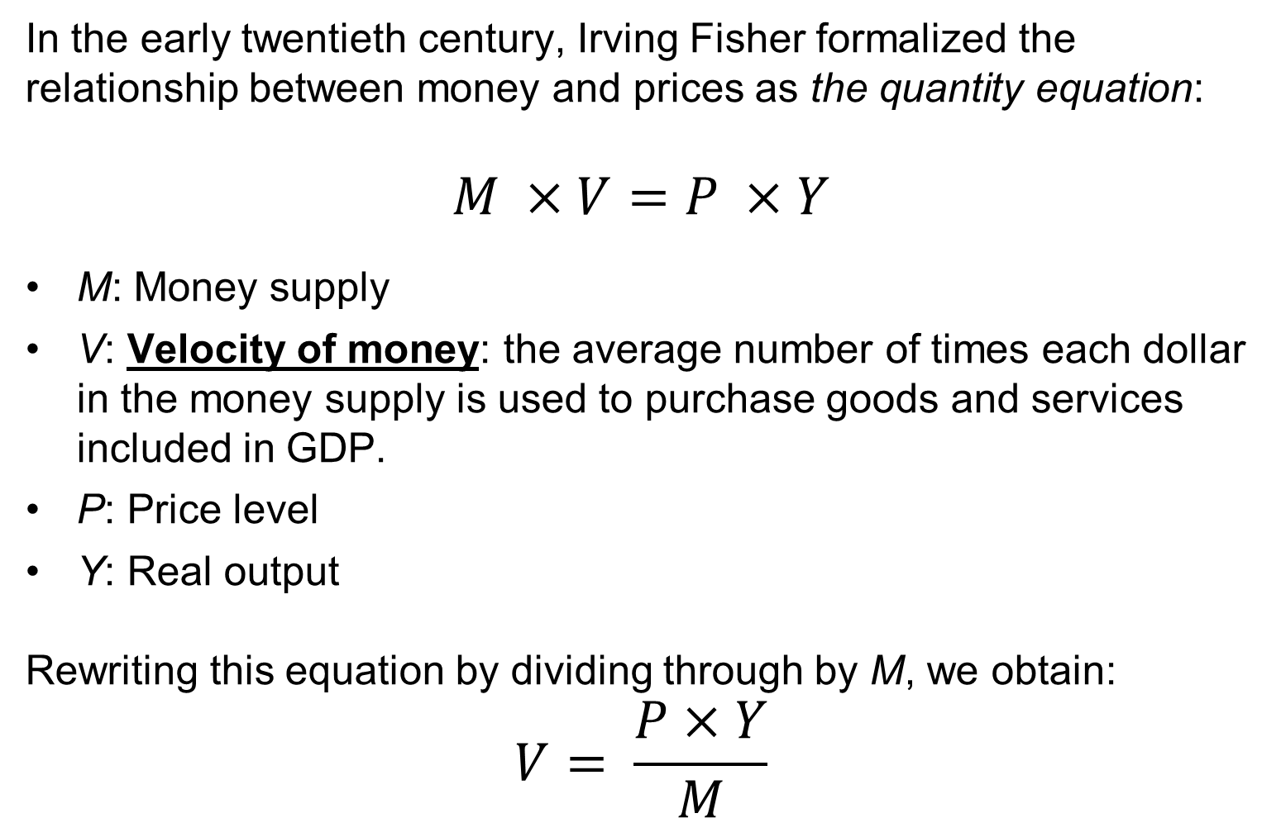
Connecting money and prices: the quantity equation
In the early twentieth century, Irving Fisher formalized the relationship between money and prices as the quantity equation:
$$M ×V=P ×Y$$
M: Money supply
V: Velocity of money: the average number of times each dollar in the money supply is used to purchase goods and services included in GDP.
P: Price level
Y: Real output
Rewriting this equation by dividing through by M, we obtain:
$$V= \frac{P×Y}{M}$$

Slide 49
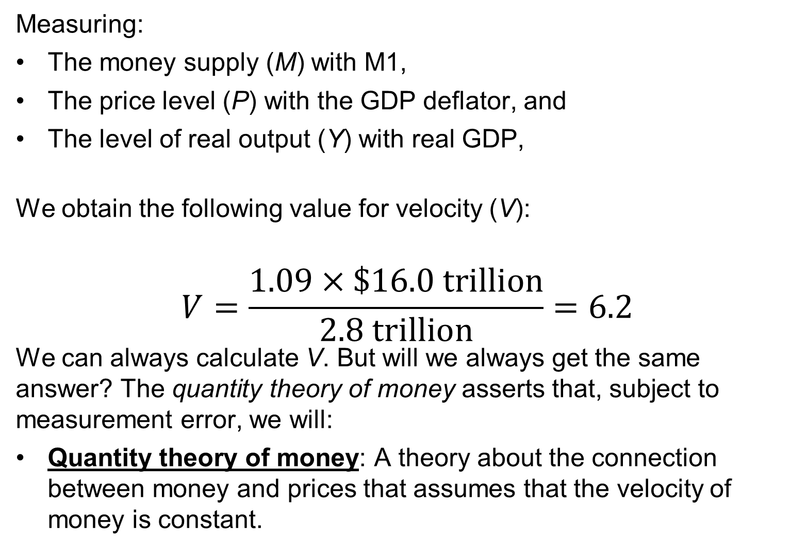
Calculating the velocity of money
Measuring:
The money supply (M) with M1,
The price level (P) with the GDP deflator, and
The level of real output (Y) with real GDP,
We obtain the following value for velocity (V):
$$V=\frac{1.09×\$16.0 trillion}{2.8 trillion}=6.2$$
We can always calculate V. But will we always get the same answer? The quantity theory of money asserts that, subject to measurement error, we will:
Quantity theory of money: A theory about the connection between money and prices that assumes that the velocity of money is constant.

Slide 50
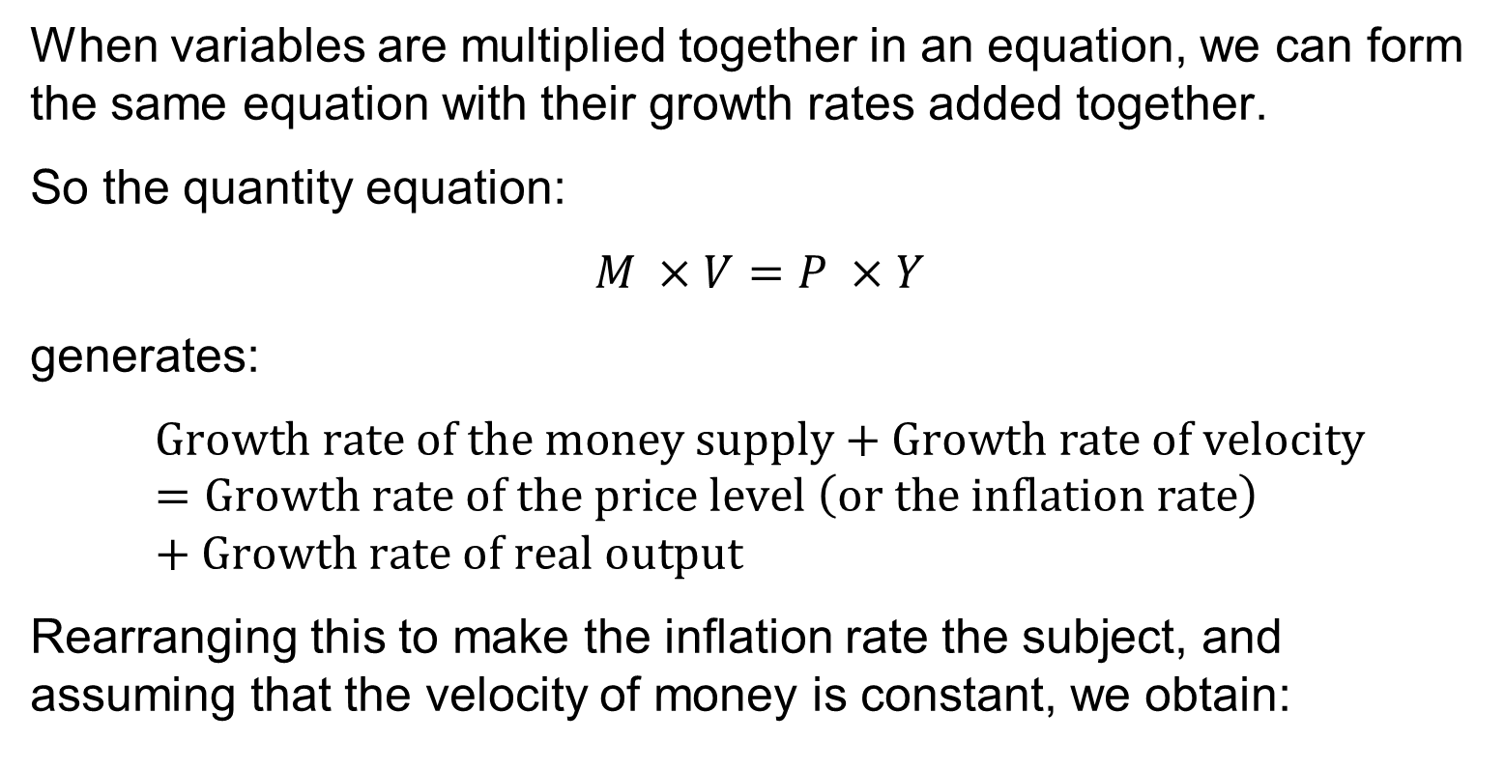
The quantity theory explanation of inflation
When variables are multiplied together in an equation, we can form the same equation with their growth rates added together.
So the quantity equation:
$$M ×V=P ×Y$$
generates:
$$Growth rate of the money supply+Growth rate of velocity=Growth rate of the price level \left(or the inflation rate\right)+Growth rate of real output$$
Rearranging this to make the inflation rate the subject, and assuming that the velocity of money is constant, we obtain:
Inflation rate =Growth rate of the money supply −Growth rate of real GDP or Output

Slide 51
The Quantity Theory of Money Once Again
The equation of exchange states that MV = PY.
Expressing the equation of exchange in growth rates:
In the long run, velocity does not change, so
Inflation rate = Growth Rate of Money Supply − Growth Rate of Real GDP

Slide 52
The inflation rate according to the quantity theory
This equation provides the following predictions:
If the money supply grows faster than real GDP, there will be inflation.
If the money supply grows slower than real GDP, there will be deflation (a decline in the price level).
If the money supply grows at the same rate as real GDP, there will be neither inflation nor deflation: the price level will be stable.
Is velocity truly constant from year to year? The answer is no.
But the quantity theory of money can still provide insight:
In the long run, inflation results from the money supply growing at a faster rate than real GDP.

Slide 53
Hyperinflation
Very high rates of inflation—in excess of 100 percent per year—are known as hyperinflation.
Hyperinflation results when central banks increase the money supply at a rate far in excess of the growth rate of real GDP.
This might happen when governments want to spend much more than they raise through taxes; so they force their central bank to “buy” government bonds.
Recently, hyperinflation has occurred in Zimbabwe; during the 2000s, prices increased by (on average) 7500 percent per year.
At that rate, a can of soda costing $1 this year would cost $75 next year, and over $5,600 the year after that.
Hyperinflation tends to be associated with slow growth, if not severe recession.

Slide 54
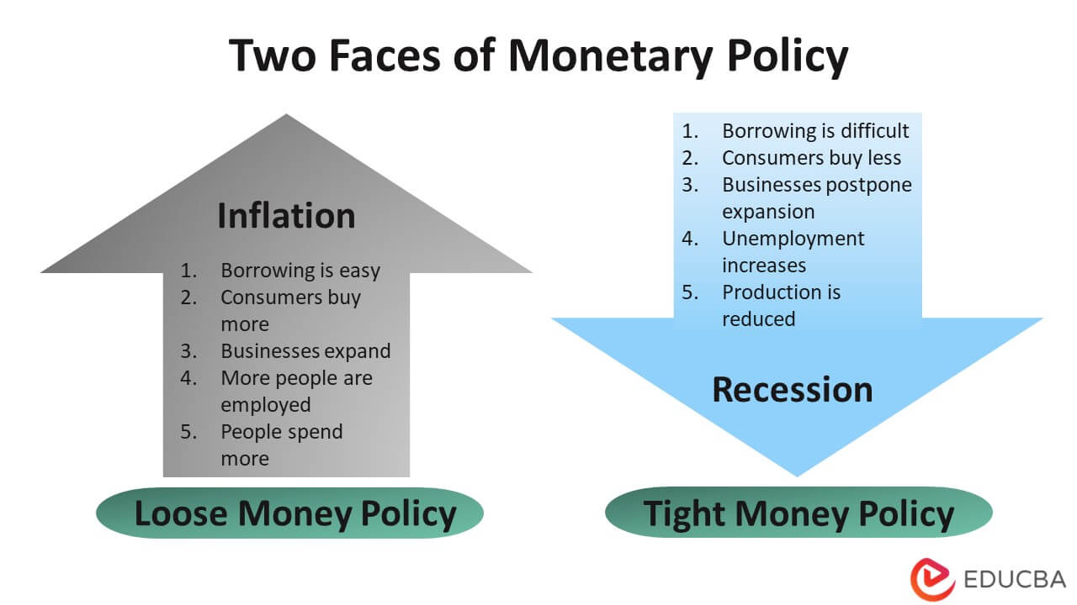

Slide 55
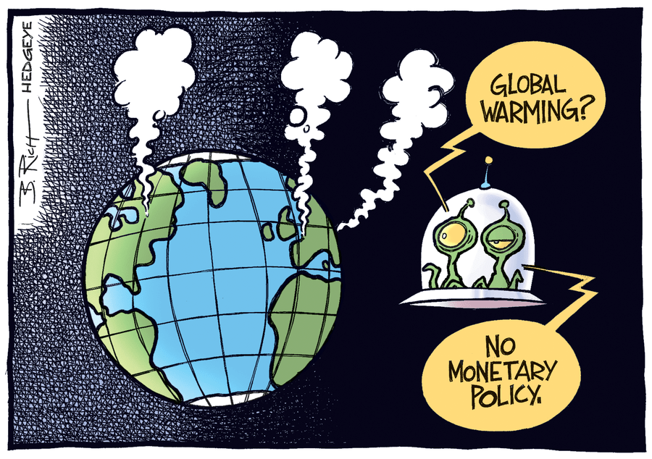

Slide 56


