Slide 1
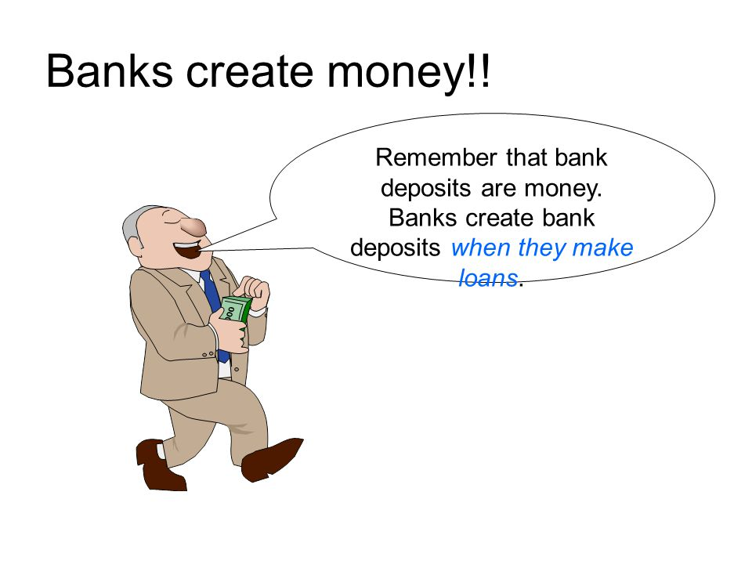
CHAPTER 14 LECTURE - MONEY, BANKING, AND THE FEDERAL RESERVE SYSTEM

Slide 2
WHAT YOU WILL LEARN IN THIS CHAPTER
What are the various roles money plays and what forms does it take?
Why is the level of the money supply so important to the state of the economy?
How do the actions of private banks and the Federal Reserve determine the money supply?
How does the Federal Reserve use open-market operations to change the monetary base?

Slide 3
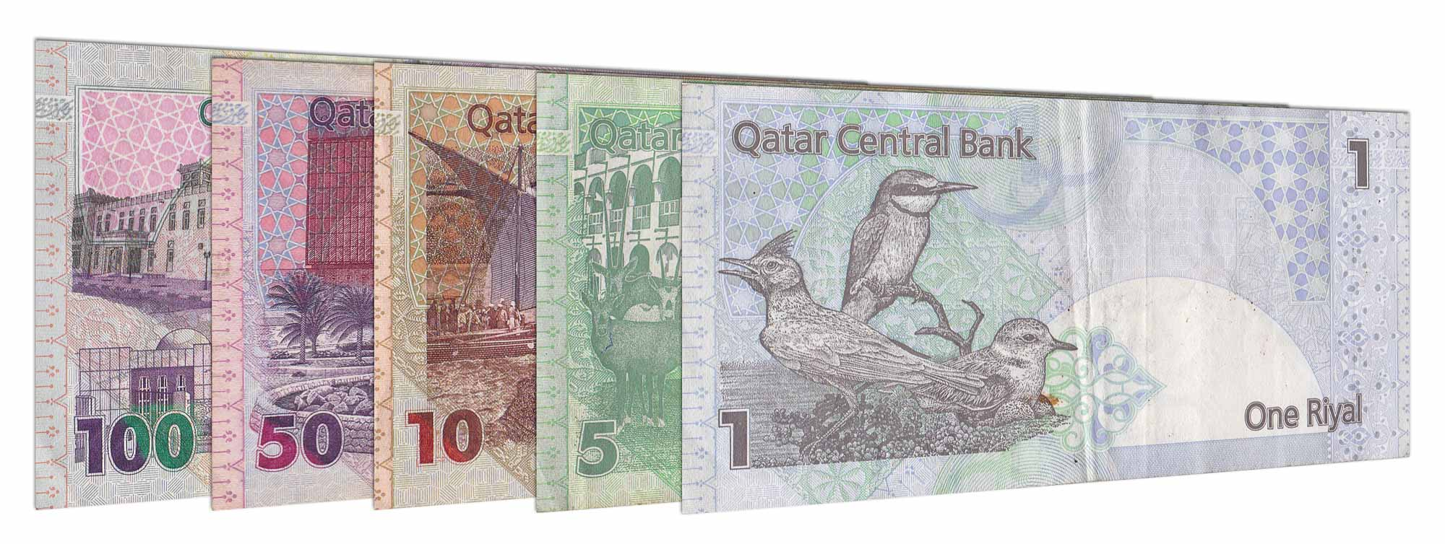
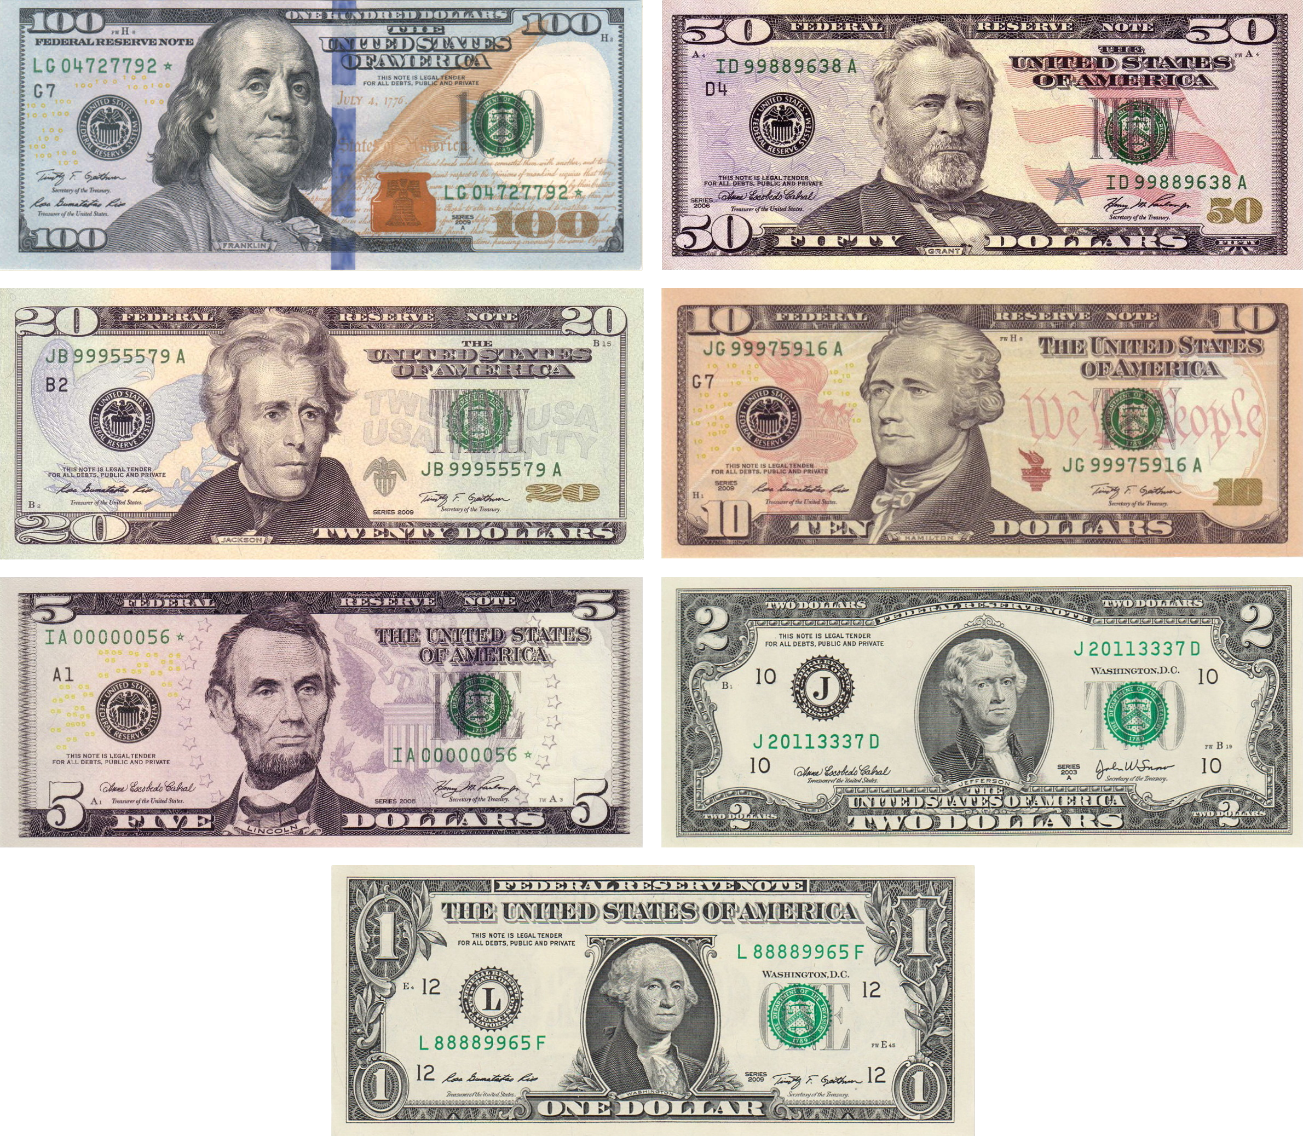
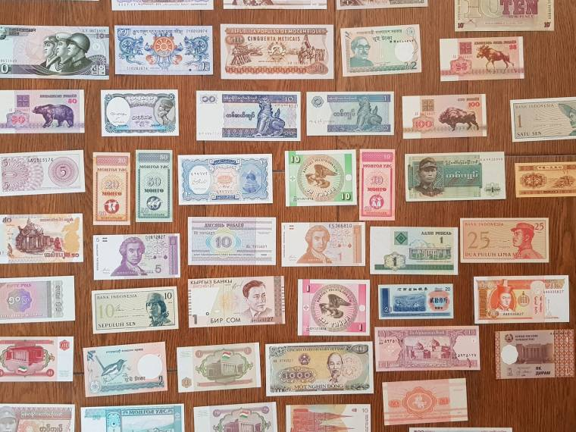
MONEY: THE ESSENTIAL CHANNEL BETWEEN MARKETS
Money plays unique and very important roles in modern economies.

Slide 4
IMPORTANT MONEY DEFINITIONS
Money: any asset that can easily be used to purchase goods and services
Currency in circulation: cash held by the public
Checkable bank deposits: bank accounts on which people can write checks
The money supply is the total value of financial assets in the economy that are considered money

Slide 5
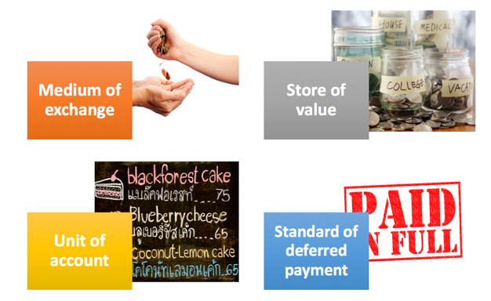
THE ROLES OR FUNCTIONS OF MONEY
Money must function as:
a medium of exchange.
a store of value.
a unit of account
standard of deferred payment.

Slide 6
MEDIUM OF EXCHANGE
Medium of exchange: something people accept as payment for goods and services
(an asset that individuals acquire for the purpose of trading rather than for their own consumption)
STORE OF VALUE
Store of value: Money is a means of holding purchasing power over time.
It enables people to save the money they earn today and use it to buy the goods and services they want tomorrow.

Slide 7
UNIT OF ACCOUNT
Unit of account: Money provides a yardstick for measuring and comparing the values of a wide variety of goods and services.
STANDARD OF DEFERRED PAYMENT
Standard of deferred payment: Money is being widely accepted way to value a debt; thereby allowing goods and services to be acquired now and paid for in the future

Slide 8
TYPES OF MONEY
For thousands of years, societies have used commodity money.
Commodity money: a good used as a medium of exchange that has intrinsic value in other uses
Commodity-backed money: a medium of exchange with no intrinsic value; the ultimate value is guaranteed by a promise that it can be converted into valuable goods
Fiat money: money whose value derives entirely from its official status as a means of payment

Slide 9
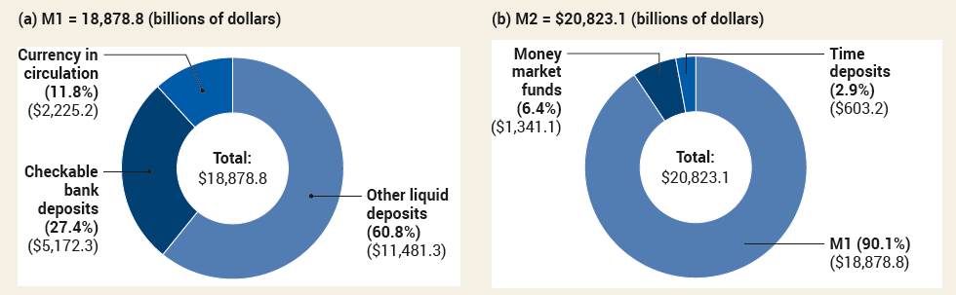
MEASURING THE MONEY SUPPLY
Monetary aggregate: an overall measure of the money supply.
Two measures of the money supply:
M1 includes only the most liquid forms of money.
M2 includes near-moneys: financial assets that can’t be directly used as a medium of exchange but can readily be converted into cash or checkable bank deposits. Example: small-denomination certificates of deposit (CDs), which aren’t checkable but can be withdrawn at any time before their maturity date

Slide 10
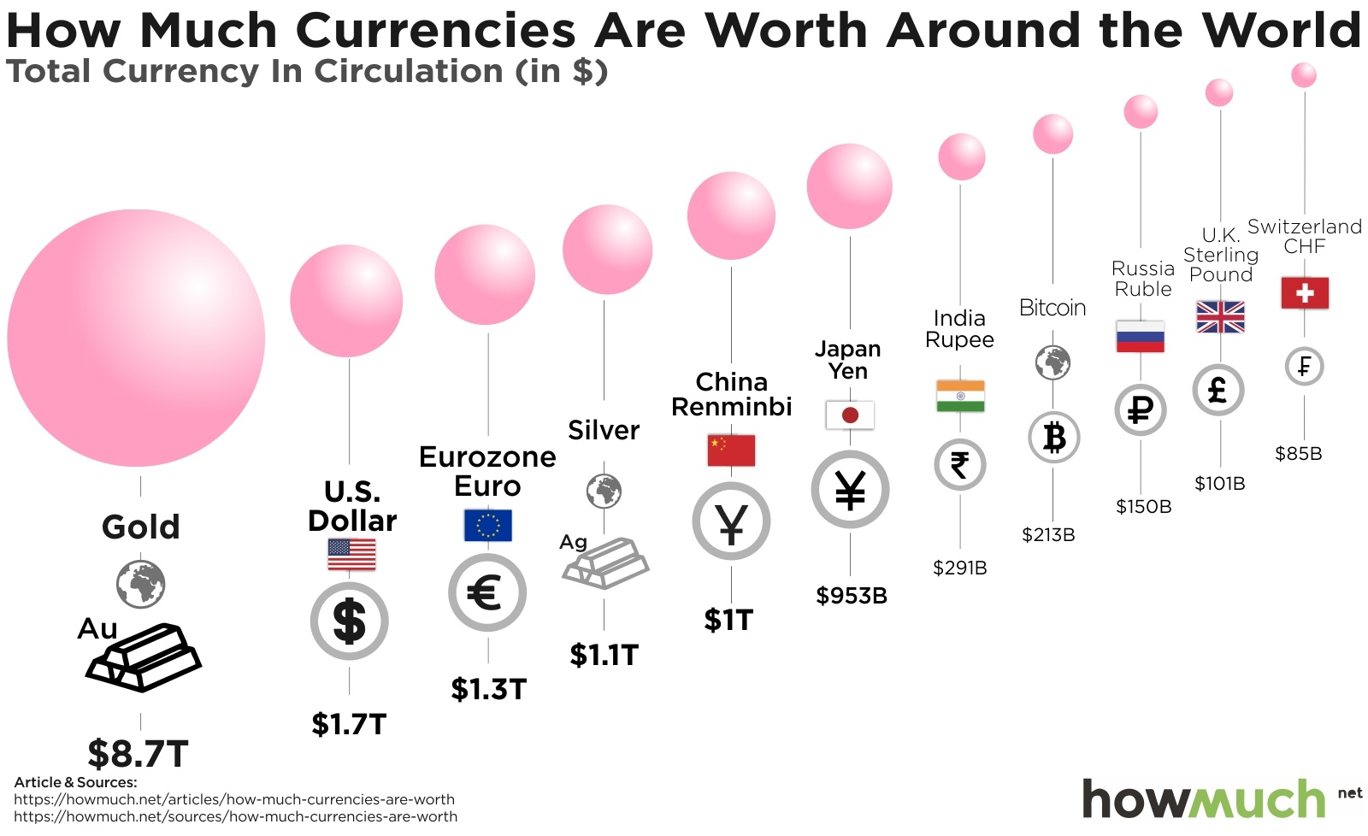

Slide 11
LEARN BY DOING PRACTICE QUESTION 1
Which of these assets would you classify as being the most liquid?
demand deposits
small-time deposits
a house
gold bullion

Slide 12
LEARN BY DOING PRACTICE QUESTION 1 (Answer)
Which of these assets would you classify as being the most liquid?
demand deposits (correct answer)
small-time deposits
a house
gold bullion

Slide 13
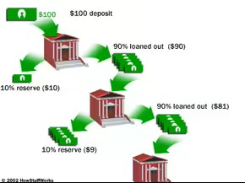
THE MONETARY ROLE OF BANKS
Q: Only half of M1 is currency; where does the rest of the money supply come from?
A: Bank deposits make up half of M1 and most of M2.
How does the banking system create money?

Slide 14
WHAT BANKS DO
Banks are financial intermediaries that use liquid assets (in the form of bank deposits) to finance the illiquid investments of borrowers.
Banks create liquidity because they don’t have to keep all of the funds in highly liquid assets.
To meet depositors’ demands, a bank must keep currency in the its vault or deposits at the Federal Reserve.
Bank reserves: the currency that banks hold in their vaults plus their deposits at the Federal Reserve.

Slide 15
Required and Excess Reserves
The bank must keep some cash available for its depositors; it does this through a combination of vault cash and deposits with the Federal Reserve.
Banks in the U.S. are required to hold required reserves: reserves that a bank is legally required to hold, based on its checking account deposits.
The required reserve ratio (RR) is the minimum fraction of deposits banks are required by law to keep as reserves.
Banks might choose to hold excess reserves: reserves over the legal requirement.

Slide 16
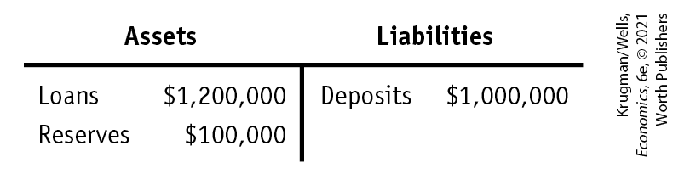
WHAT BANKS DO
T-account: a tool for analyzing a business’s financial position by showing the business’s assets and liabilities.
The reserve ratio: the fraction of bank deposits that a bank holds as reserves ($100,000/$1,000,000 = 10%).
The Federal Reserve sets a minimum required reserve ratio for banks, which since March 2020 has been zero. To understand why banks are regulated, let’s consider a problem banks can face: bank runs.

Slide 17
THE PROBLEM OF BANK RUNS
Banks hold only a fraction of deposits on reserve and use the rest to make loans.
From time to time, people get worried about banks losing their money.
Bank run: a phenomenon in which many of a bank’s depositors try to withdraw their funds because they fear a bank failure.
Historically, bank runs have proved contagious, with a run on one bank leading to a loss of faith in other banks, causing additional bank runs.
In response to bank runs, the United States established a system of bank regulations that protect depositors.

Slide 18
BANK REGULATION
Four main features:
Deposit insurance: a guarantee that a bank’s depositors will be paid even if the bank can’t come up with the funds (the FDIC currently guarantees the first $250,000 of each account).
Capital requirements: requirement that the owners of banks hold substantially more assets than the value of bank deposits.
Deposit insurance creates a well-known incentive problem: banks can take more risks since they are insured.
To help motivate safe behavior, banks’ capital is required to equal 7% or more of their assets.
Reserve requirements: rules set by the Federal Reserve that determine the minimum reserve ratio for a bank.
Discount window: an arrangement in which the Federal Reserve stands ready to lend money to banks in trouble.

Slide 19
LIMITS TO REGULATION’S REACH: SHADOW BANKING
As the financial crisis showed us, there are many large financial firms that don’t accept deposits, so they aren’t covered by deposit insurance or regulation that make conventional banks safer.
These ”shadow banks” include:
investment banks
insurance companies
hedge fund companies
money market fund companies

Slide 20
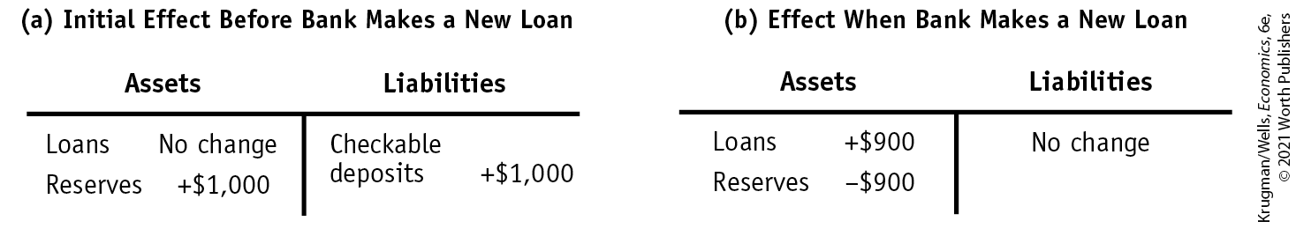
HOW BANKS CREATE MONEY (1/2)
Silas keeps a shoebox full of cash under his bed. Deciding to enter the twenty-first century, he deposits this cash at the bank. What’s the effect of his $1,000?
Assume that the reserve ratio is 10%.
The bank will reserve 10% and lend out 90% of the deposit.

Slide 21
HOW BANKS CREATE MONEY (2/2)
The first bank lends $900 to Maya, who pays the money to Anne, who deposits it at her bank—and the cycle starts all over. Sounds familiar?
TABLE 1 How Banks Create Money
 | Currency in circulation | Checkable bank deposits | Money supply
First stage Silas keeps his cash under his bed. | $1,000 | $0 | $1,000
Second stage Silas deposits cash in First Street Bank, which lends out $900 to Maya, who then pays it to Anne Acme. | 900 | 1,000 | 1,900
Third stage Anne Acme deposits $900 in Second Street Bank, which lends out $810 to another borrower. | 810 | 1,900 | 2,710

Slide 22
RESERVES, BANK DEPOSITS, AND THE MONEY MULTIPLIER
Before, we described the multiplier process when an initial increase in real GDP leads to a rise in consumer spending, which leads to a further rise in real GDP, which leads to a further rise in consumer spending, and so on. Here we have another kind of multiplier—the money multiplier.
Excess reserves: bank’s reserves over and above the reserves required by law or regulation.
Assume that banks don’t want to hold excess reserves.
Increase in bank deposits from $1,000 in excess reserves = $1,000 + [$1,000 × (1 − rr)] + [$1,000 × (1 − rr)²] + [$1,000 × (1 − rr)³] + . . .
This can be simplified to $1,000/rr.

Slide 23
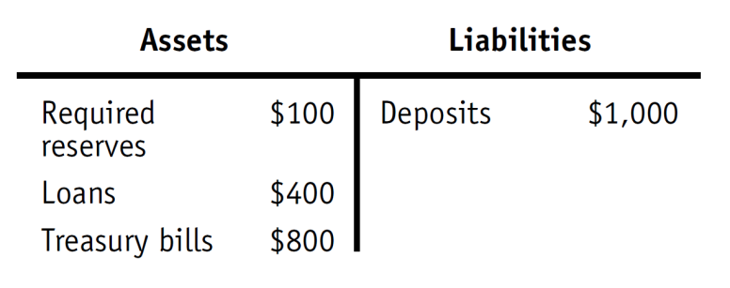
LEARN BY DOING PRACTICE QUESTION 2
Given this T-account and assuming the bank holds no excess reserves, what is the required reserve ratio?
10%
40%
80%
1%

Slide 24
LEARN BY DOING PRACTICE QUESTION 2 (Answer)
Given this T-account and assuming the bank holds no excess reserves, what is the required reserve ratio?
10% (correct answer)
40%
80%
1%

Slide 25
LEARN BY DOING PRACTICE QUESTION 3
Suppose the required reserve ratio initially is 10% of bank deposits and is increased by the Fed to 20% of bank deposits. Holding everything else constant, this will:
reduce the size of the money multiplier.
cause the banking system to contract the level of bank deposits in the banking system.
change the value of the money multiplier from 10 to 5.
Answers (a), (b), and (c) are all correct.

Slide 26
LEARN BY DOING PRACTICE QUESTION 3 (Answer)
Suppose the required reserve ratio initially is 10% of bank deposits and is increased by the Fed to 20% of bank deposits. Holding everything else constant, this will:
reduce the size of the money multiplier.
cause the banking system to contract the level of bank deposits in the banking system.
change the value of the money multiplier from 10 to 5.
Answers (a), (b), and (c) are all correct. (correct answer)

Slide 27
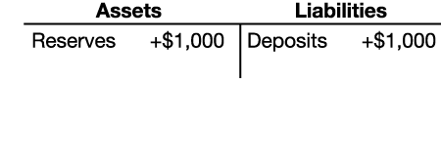
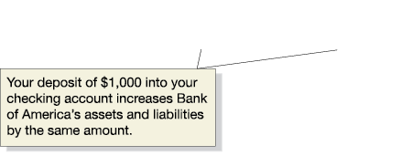
Money creation at Bank of America
When you deposit $1,000 in currency at Bank of America, its reserves increase by $1,000 and so do its deposits.
The currency component of the money supply decreases by the $1,000, since that $1,000 is no longer in circulation; but the checking deposits component increases by $1,000. So there is no net change in the money supply—yet.

Slide 28
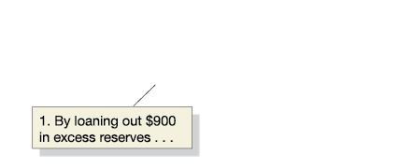
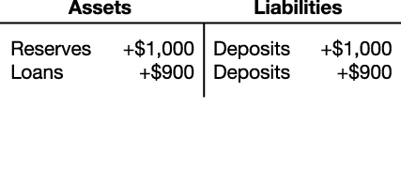
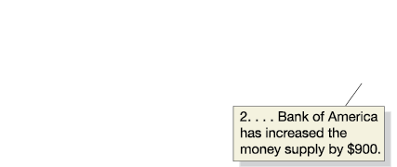
Bank of America lends money out
But Bank of America needs to make a profit; so it keeps 10 percent of the deposit as reserves, and lends out the rest, creating a $900 checking account deposit.

Slide 29
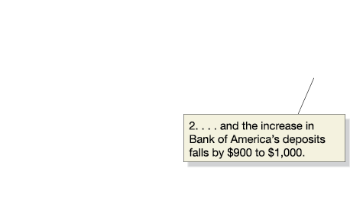
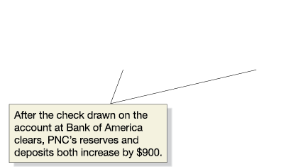
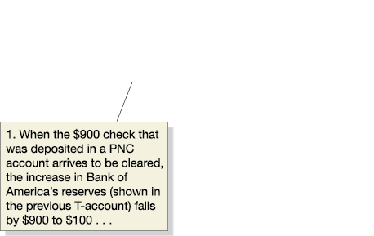
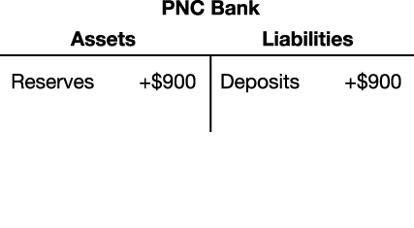
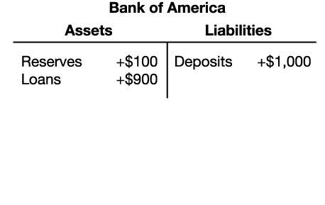
Follow the money…
The $900 initially appears in a BoA checking account, but will soon be spent; and Bank of America will transfer $900 in currency to the bank at which the $900 check is deposited.
And the cycle will continue, with PNC now making a loan.

Slide 30
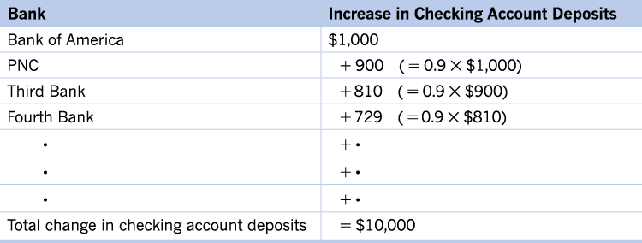
When will it end?
Each “round”, the additional checking account deposits get smaller and smaller.
Every round, 10 percent of the deposits are kept as reserves.
This allows us to tell by how much the checking deposits will eventually increase: the $1,000 in currency will become the 10 percent required reserves for all of the checking deposits, so a total of $10,000 in checking deposits can be created.

Slide 31
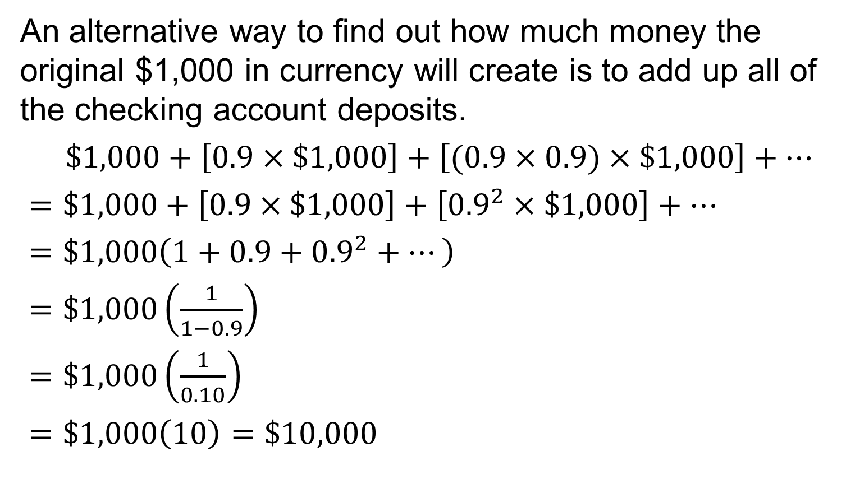
Deposits multiplying
An alternative way to find out how much money the original $1,000 in currency will create is to add up all of the checking account deposits.
$\$1,000+\left[0.9×\$1,000\right]+\left[(0.9×0.9)×\$1,000\right]+…$
$=\$1,000+\left[0.9×\$1,000\right]+\left[{0.9}^{2}×\$1,000\right]+…$
$=\$1,000\left(1+0.9+{0.9}^{2}+…\right)$
$=\$1,000\left(\frac{1}{1−0.9}\right)$
$=\$1,000\left(\frac{1}{0.10}\right)$
$=\$1,000\left(10\right)=\$10,000$

Slide 32
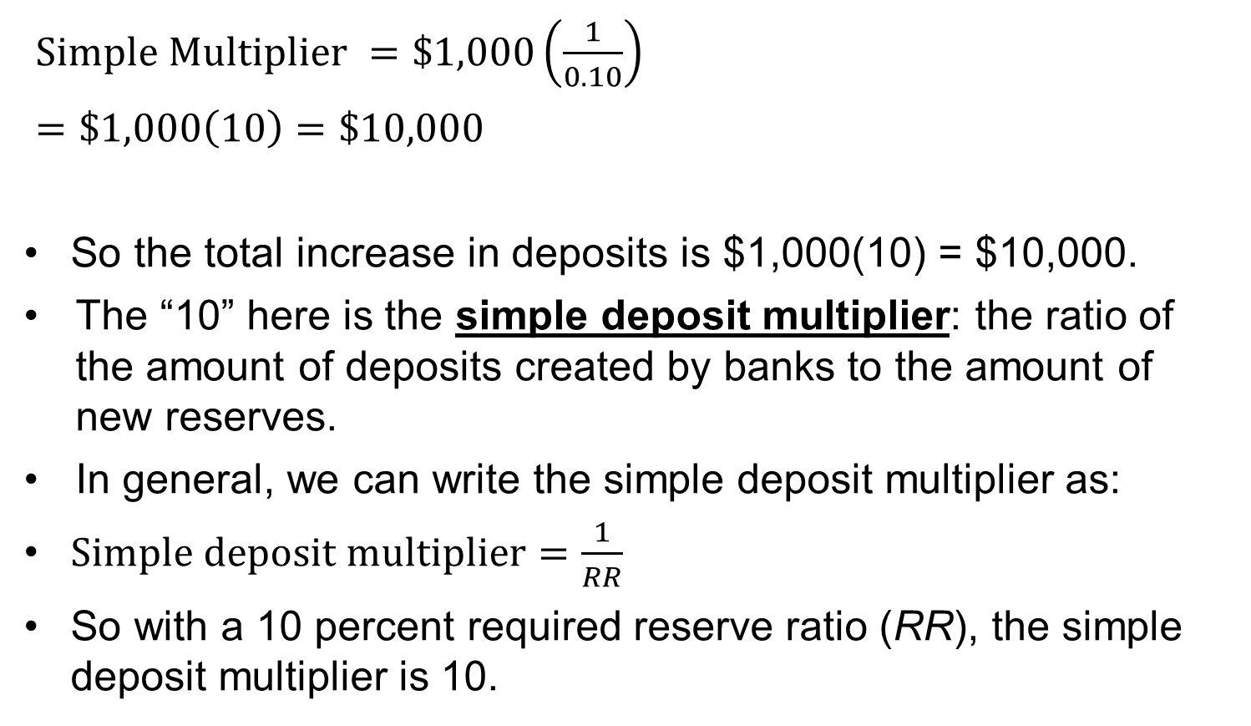
Simple deposit multiplier
$Simple Multiplier =\$1,000\left(\frac{1}{0.10}\right)$
$=\$1,000\left(10\right)=\$10,000$
So the total increase in deposits is $1,000(10) = $10,000.
The “10” here is the simple deposit multiplier: the ratio of the amount of deposits created by banks to the amount of new reserves.
In general, we can write the simple deposit multiplier as:
$Simple deposit multiplier=\frac{1}{RR}$
So with a 10 percent required reserve ratio (RR), the simple deposit multiplier is 10.

Slide 33
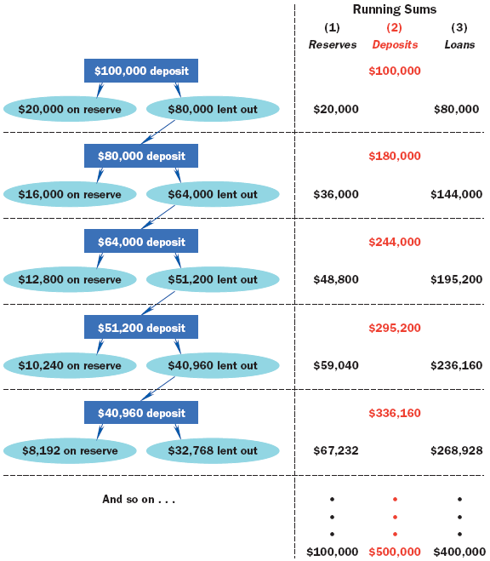
The Chain of Multiple Deposit Creation Once More

Slide 34
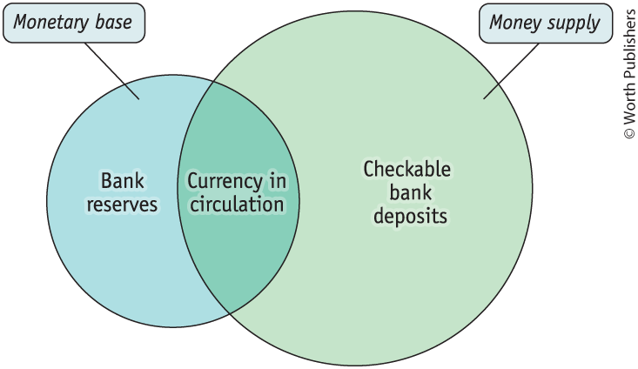
THE MONEY MULTIPLIER IN REALITY (1/2)
The monetary base is the sum of currency in circulation and bank reserves.
The monetary base is different from the money supply in two ways:
Bank reserves, which are part of the monetary base, aren’t part of the money supply.
Checkable bank deposits, which are part of the money supply, aren’t part of the monetary base.

Slide 35
THE MONEY MULTIPLIER IN REALITY (2/2)
The money multiplier is the ratio of the money supply to the monetary base.
Before the financial crisis of 2008, it was 1.6; after the crisis, it was 0.7.
The minimum reserve ratio is 10%. Why is the money multiplier not 1/0.1 = 10?
People hold significant amounts of cash, which reduces bank deposits.

Slide 36

THE FEDERAL RESERVE SYSTEM
The Federal Reserve is a central bank; it oversees and regulates the banking system and controls the monetary base.
Jerome Hayden "Jay" Powell is the 16th and current Chairman of the Federal Reserve, serving in that office since February 2018.

Slide 37
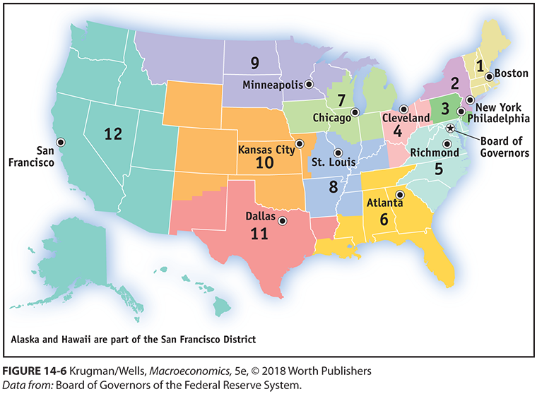
WHERE ARE THE FEDERAL RESERVE BANKS?

Slide 38
FUNCTIONS OF THE FED
Supervises and Regulates the Financial System
Facilitates the Payments Mechanism
Acts as Fiscal Agent for the U.S. Government
Formulates Monetary Policy
Actions taken to insure the safety and soundness of the financial system
Actions taken to insure the safe and efficient transfer of funds
Maintains the Treasury’s transactions account
Actions taken to improve the health of the economy

Slide 39
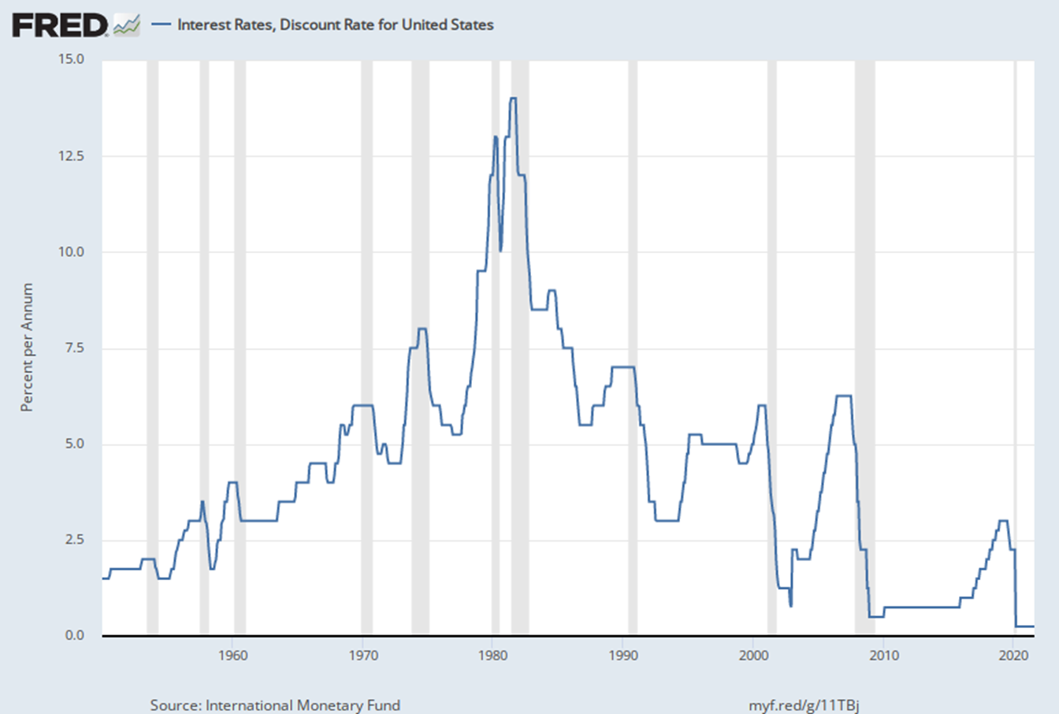
RESERVE REQUIREMENTS AND THE DISCOUNT RATE
The discount rate is the rate of interest the Fed charges on loans to banks.
Normally, the discount rate is set 1 percentage point above the federal funds rate in order to discourage banks from turning to the Fed when they are in need of reserves.

Slide 40
WHAT THE FED DOES: RESERVE REQUIREMENTS AND THE DISCOUNT RATE
The three tools of the Fed:
reserve requirements,
the discount rate,
open-market operations.
The Fed sets a minimum reserve ratio requirement.
If a bank can’t meet the Fed’s reserve requirement, it can borrow reserves at the federal funds market.
The federal funds market allows banks that fall short of the reserve requirement to borrow funds from banks with excess reserves.
The federal funds rate is the interest rate in the federal funds market.
Alternatively, banks can borrow from the Fed via the discount window.
The discount rate is the interest rate the Fed charges on those loans.

Slide 41
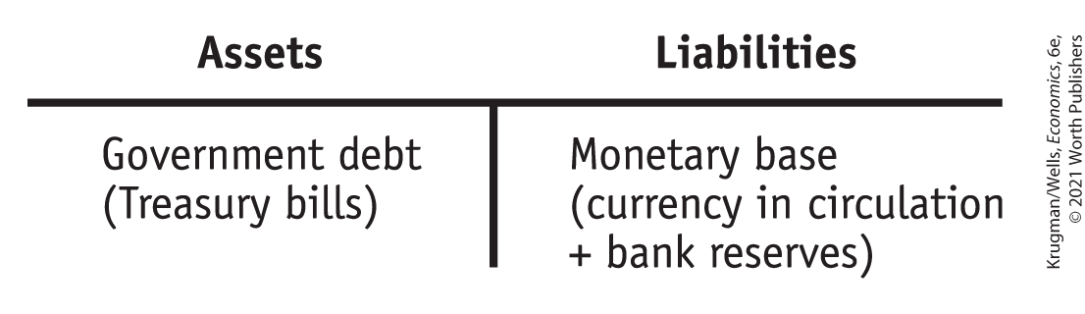
OPEN-MARKET OPERATIONS AND REVERSE REPO OPERATIONS (1/3)
Like any bank, the Federal Reserve has assets and liabilities.
The Fed’s assets are mainly short-term U.S. government bonds, known as U.S. Treasury bills.
The Fed’s liabilities are currency in circulation and bank reserves.

Slide 42
OPEN-MARKET OPERATIONS AND REVERSE REPO OPERATIONS (2/3)
In an open-market operation the Federal Reserve buys or sells U.S. Treasury bills, normally through a transaction with commercial banks (banks that accept deposits and make loans), and investment banks (banks that create and trade assets but don’t accept deposits).
The Fed never buys U.S Treasury bills directly from the federal government.
If it did, it would be printing money to fund the budget deficit, which would trigger inflation.

Slide 43
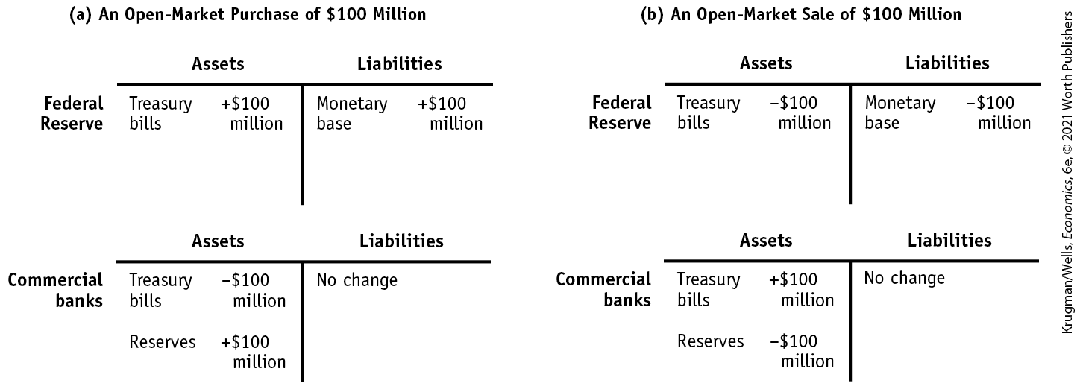
OPEN-MARKET OPERATIONS AND REVERSE REPO OPERATIONS (3/3)
Panel (a):
The Fed buys $100 million of T-bills from banks.
The Fed electronically increases the sellers’ reserves.
With more reserves, banks increase loans.
As banks increase loans, the money supply increases via the money multiplier.
Panel (b):
The Fed sells $100 million of T-bills to banks, decreasing the banks’ reserves.
With fewer reserves, banks decrease loans.
As banks decrease loans, the money supply decreases via the money multiplier.

Slide 44
LEARN BY DOING PRACTICE QUESTION 4
Suppose this is the only bank and all money is held in this bank. There are no excess reserves. If the Fed makes an open-market sale of T-bills worth $50 to this bank, what will happen to the money supply after all adjustments are made?
The money supply will increase by $50.
The money supply will decrease by $50.
The money supply will increase by $500.
The money supply will decrease by $500.
Notes:
The answer is d.

Slide 45
LEARN BY DOING PRACTICE QUESTION 4 (Answer)
Suppose this is the only bank and all money is held in this bank. There are no excess reserves. If the Fed makes an open-market sale of T-bills worth $50 to this bank, what will happen to the money supply after all adjustments are made?
The money supply will increase by $50.
The money supply will decrease by $50.
The money supply will increase by $500.
The money supply will decrease by $500. (correct answer)

Slide 46
HOW OPEN-MARKET OPERATIONS WORK ONCE AGAIN
If the Fed wants to increase the money supply, it will buy T-bills:
If the Fed wants to decrease the money supply, it will sell T-bills:
Fed
electronically
↑reserves of the
seller
M↑ as the
money creation
process ripples
through the
economy
To pay for
the T-bills
With more
reserves, bank
↑ loans
M↓ as the
money creation
process ripples
in reverse through
the economy
Fed sells
T-bills
↓reserves of the buyer
With fewer
reserves, bank
↓ loans

Slide 47
THE EUROPEAN CENTRAL BANK (1/2)
The European Central Bank (ECB) rivals the Fed in terms of importance to the world economy.
Was created in January,1999, when 11 European nations abandoned their national currencies, adopted the euro, and placed their joint monetary policy in the ECB’s hands.
Located in Frankfurt, Germany.
Represents a (combined) economy as large as that of the United States.

Slide 48
THE EUROPEAN CENTRAL BANK (2/2)
Analogies between ECB and the Fed:
Europe’s national banks (the Bank of France, the Bank of Italy, etc.) are like regional Feds: they provide financial services to local banks and businesses and conduct open-market operations.
The counterpart of Fed’s Board of Governors is the ECB’s Executive Board.
The counterpart of the Federal Open Market Committee is the ECB’s Governing Council.
Just as the Fed’s Open Market Committee consists of the Board of Governors plus a rotating group of regional Fed presidents, the ECB’s Governing Council consists of the Executive Board plus the heads of the national central banks.
Like the Fed, the ECB is ultimately answerable to voters, and it tries to maintain its independence from short-term political pressures.

Slide 49
THE EVOLUTION OF THE AMERICAN BANKING SYSTEM
The crisis in American banking in the early twentieth century
The main problem afflicting the system was that the money supply was not sufficiently responsive: It was difficult to shift currency around the country to respond quickly to local economic changes.
Bank panics (bank runs) were too common.
The Panic of 1907: a foreshadowing of the financial crisis of 2008? Large losses from risky speculation destabilized the banking system.

Slide 50
THE CREATION OF THE FEDERAL RESERVE
The panic of 1907 convinced many that the time for central control of bank reserves had come.
In 1913 the Federal Reserve was created.
Now bank reserves were centralized and standardized—but not immune to bank runs.
A series of bank runs in 1930, 1931, and 1933 convinced the Fed that banks needed more regulation.

Slide 51
THE GLASS-STEAGALL ACT
Another new regulation, the Glass-Steagall Act (1933) separated banks into two categories:
Commercial banks: depository banks that accepted deposits and were covered by deposit insurance
Investment banks: banks that engaged in creating and trading financial assets (stocks and corporate bonds), but were not covered by deposit insurance because their activities were considered riskier

Slide 52
THE SAVINGS AND LOAN CRISIS OF THE 1980S
The savings and loan (thrift) crisis of the 1980s arose because Congress deregulated S&Ls, allowing them to engage in risky speculation.
The intent was to allow them to offer higher rates of return, like banks, in an era of high inflation.
They incurred huge losses.
Depositors in failed S&Ls were compensated with taxpayer funds because they were covered by deposit insurance.
The crisis caused steep losses in the financial and real estate sectors, resulting in a recession in the early 1990s.

Slide 53
THE FINANCIAL CRISIS OF 2008 PRELIMS
During the mid-1990s, the hedge fund LTCM (Long-Term Capital Management) used huge amounts of leverage to speculate in global financial markets, incurred massive losses, and collapsed.
Leverage: financing an investment with borrowed funds.
LTCM was so large that it caused balance sheet effects for firms globally, leading to the prospect of a vicious circle of deleveraging.
Balance sheet effect: the reduction in a firm’s net worth due to falling asset prices

Slide 54
THE FINANCIAL CRISIS OF 2008
Vicious circle of deleveraging: asset sales to cover losses forcing creditors to call in their loans, forcing sales of more assets and causing further declines in asset prices
As a result, credit markets around the world froze. The New York Fed coordinated a private bailout of LTCM and revived world credit markets.
2008—The worldwide financial system was in crisis, and banks and other financial institutions wanted to borrow more than $2 trillion. What could be done?

Slide 55
THE FINANCIAL CRISIS OF 2008
Subprime lending helped create the U.S. housing bubble of the 2000s and was made worse with securitization.
Subprime lending: lending to home buyers who don’t meet the usual criteria for being able to make the payments
Securitization: a pool of loans assembled and shares of it sold to investors
When the bubble burst, massive losses by banks and other financial institutions led to widespread collapse in the financial system.
To prevent another Great Depression, the Fed and the U.S. Treasury expanded lending to banks and other financial institutions, provided capital through the purchase of bank shares, and purchased private debt

Slide 56
REGULATION AFTER THE 2008 CRISIS
In July 2010, President Obama signed the Dodd-Frank Act (the Wall Street Reform and Consumer Protection Act).
Gives a special government committee, the Financial Stability Oversight Council, the right to designate institutions as “systemically important” and thus subject to normal bank regulation (even though they are not traditional banks).
Established new rules on the trading of derivatives: They must now be traded in exchanges so their prices and volume are more transparent.

