Slide 1

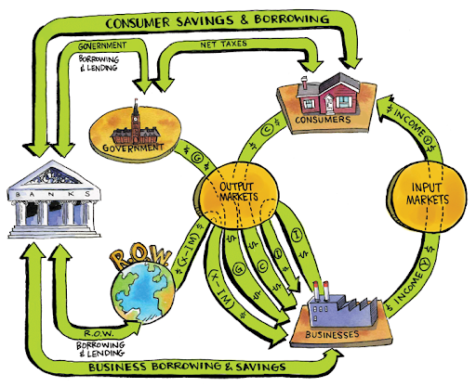
CHAPTER 12 LECTURE - AGGREGATE DEMAND AND AGGREGATE SUPPLY

Slide 2
WHAT YOU WILL LEARN IN THIS CHAPTER
How does the aggregate demand curve illustrate the relationship between the aggregate price level and the quantity of aggregate output demanded?
How does the aggregate supply curve illustrate the relationship between the aggregate price level and the quantity of aggregate output supplied?
Why is the aggregate supply curve different in the short run than in the long run?
How is the AD–AS model used to analyze economic fluctuations?
How can monetary policy and fiscal policy stabilize the economy?

Slide 3
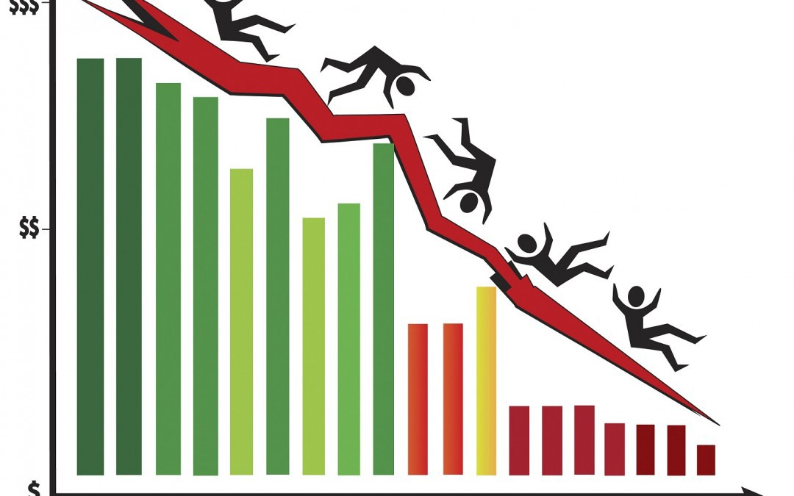
SHOCKS TO THE SYSTEM
What causes recessions?
Why is inflation high in some recessions and not others?
The economy’s behavior can be explained, predicted, and potentially manipulated by looking at
total (aggregate) demand
total (aggregate) supply

Slide 4
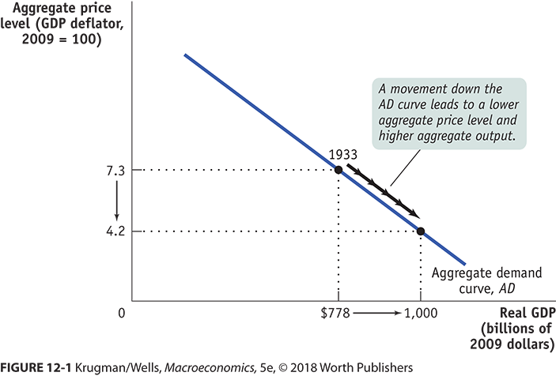
THE AGGREGATE DEMAND CURVE
Aggregate demand curve: the relationship between the aggregate price level and the quantity of aggregate output demanded by households, businesses, the government, and the rest of the world

Slide 5
THE SHAPE OF THE AGGREGATE DEMAND CURVE
Recall: GDP = C + I + G + X − IM
Why does a rise in the aggregate price level reduce C, I, and X − IM?
(Why does the AD curve slope downward?)
The wealth effect: A higher aggregate price level reduces the purchasing power of households’ wealth and reduces consumer spending.
The interest rate effect: A higher aggregate price level makes households hold more money and leads to a rise in interest rates (and a fall in investment spending and consumer spending).

Slide 6
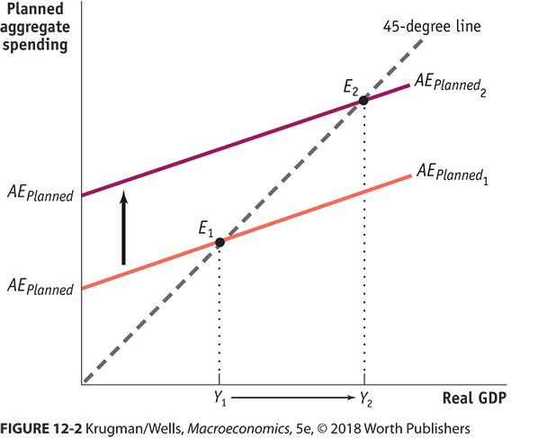
THE AGGREGATE DEMAND CURVE AND THE INCOME–EXPENDITURE MODEL
We now drop the assumption that the overall price level is fixed. When the aggregate price level changes, the AE_{Planned} curve shifts.
(The AD curve is the application of the income expenditure model at different prices.)

Slide 7
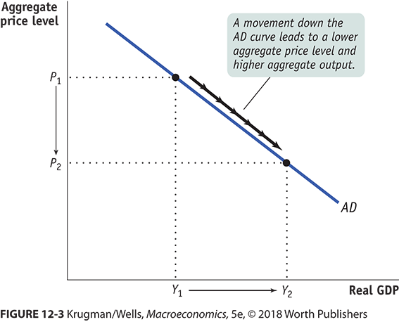
FROM THE THE INCOME–EXPENDITURE MODEL TO THE THE AGGREGATE DEMAND CURVE
If the price level drops, planned spending rises at all output levels (from the wealth and interest-rate effects).
This leads to a multiplier process that moves the income–expenditure equilibrium from E₁ to E₂ and raises real GDP from Y₁ to Y₂.

Slide 8
Factors that Affect AD
AD = C + I + G + NX
Consumption
Income
Wealth
Expectations
Demographics
Taxes
Investment
Interest Rates
Technology
Cost of Capital Goods
Capacity Utilization
Government Spending
Net Exports
Domestic & Foreign Income
Domestic & Foreign Prices
Exchange Rates
Government Policy

Slide 9
SHIFTS OF THE AGGREGATE DEMAND CURVE (1/2)
What happens when some factor changes spending patterns at every price level?
The aggregate demand curve shifts because of changes in:
Expectations: If consumers and firms become more optimistic, aggregate spending rises; if they become more pessimistic, aggregate spending falls.
Wealth: When the real value of household assets rises, their purchasing power also rises, leading to an increase in aggregate spending.
Size of the existing stock of physical capital: Firms plan investment spending depending on how much physical capital they already have: the more they have, the less they will feel a need to add more.

Slide 10
SHIFTS OF THE AGGREGATE DEMAND CURVE (2/2)
What happens when some factor changes spending patterns at every price level?
Fiscal policy:
Government purchases of final goods and services, G, directly affect the aggregate demand curve because government purchases are a component of aggregate demand.
Taxes and government transfers influence the aggregate demand curve indirectly through their effect on disposable income.
Monetary policy:
When the central bank increases the quantity of money in circulation, households and firms have more money to lend out which drives the interest rate down, leading to higher investment spending and higher consumer spending.

Slide 11
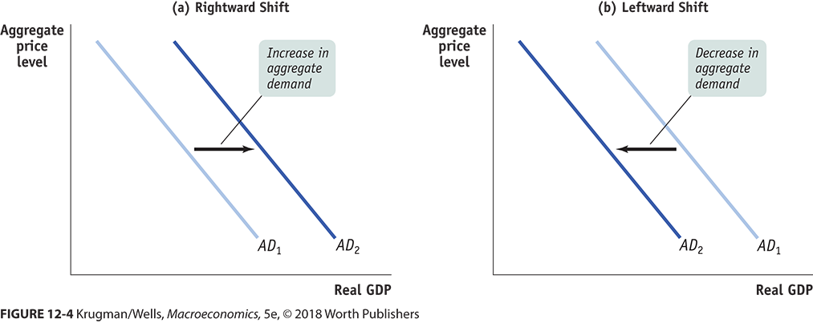
GRAPHING THE SHIFTS OF THE AGGREGATE DEMAND CURVE

Slide 12
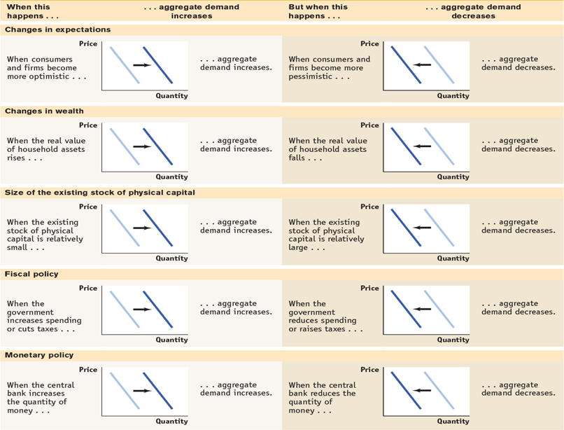
FACTORS THAT SHIFT AGGREGATE DEMAND
Table 12-1 Factors That Shift Aggregate Demand

Slide 13
PITFALLS: MOVING ALONG VS. SHIFTING THE AGGREGATE DEMAND CURVE
Q: Does a change in wealth move us along the AD curve (wealth effect) or shift it?
A: It depends on the source of the change in wealth.
If it’s a change in price level that affects our wealth, it’s a movement along the AD.
Example: Rapid inflation shrinks our wealth.
If it’s a change in something else that affects our wealth, it’s a shift in the AD.
Example: The housing market crashes.

Slide 14
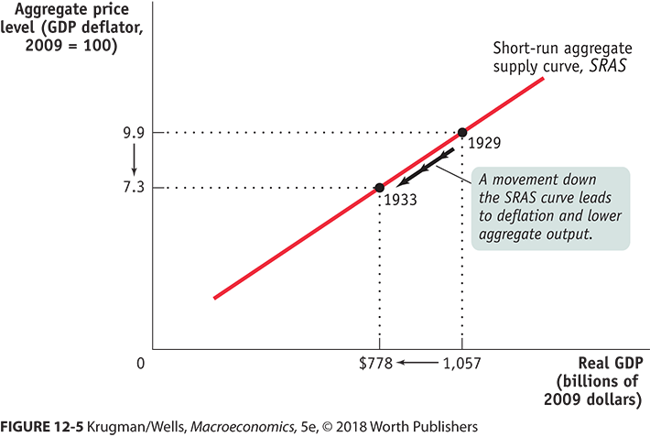
DEFINING THE SHORT-RUN AGGREGATE SUPPLY CURVE
The aggregate supply curve shows the relationship between the aggregate price level and the quantity of aggregate output in the economy.

Slide 15
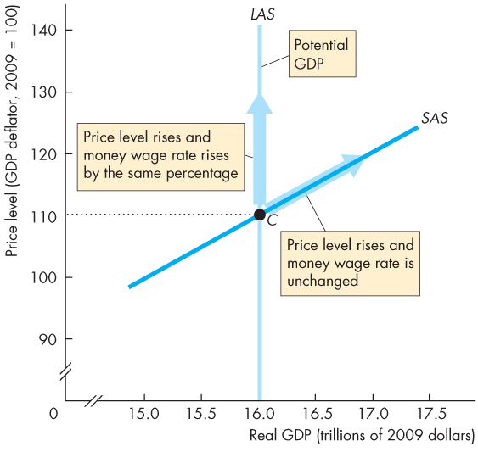
Short Run Aggregate Supply
In the short run, the quantity of real GDP supplied increases if the price level rises.
The SAS curve slopes upward.
A rise in the price level with no change in the money wage rate induces firms to increase production.
In the short run, the quantity of real GDP supplied decreases if the price level fall.
The SAS curve slopes upward.
A fall in the price level with no change in the money wage rate induces firms to decrease production.

Slide 16
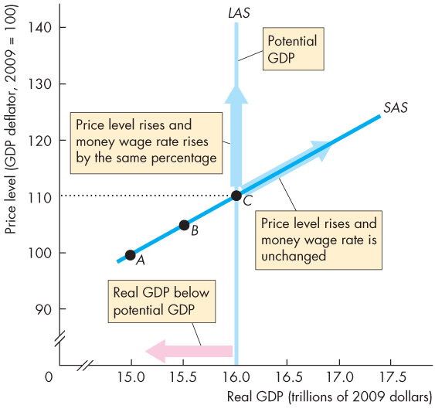
Short Run Aggregate Supply
With a given money wage rate, the SAS curve cuts the LAS curve at potential GDP.
The price level is 110.
With the given money wage rate, as the price level falls below 110 ...
the quantity of real GDP supplied decreases along the SAS curve.
With the given money wage rate, as the price level rises above 110 …
the quantity of real GDP supplied increases along the SAS curve.
Real GDP exceeds potential GDP.

Slide 17
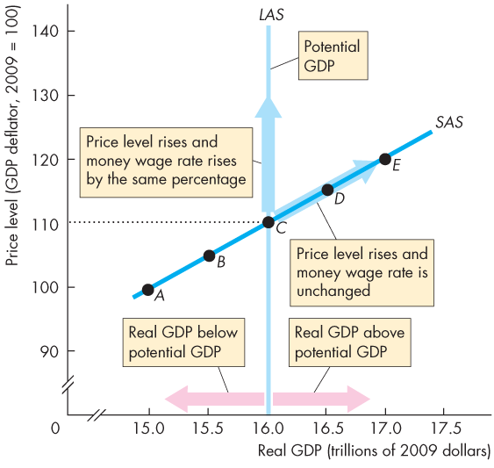
Short and Long Run Aggregate Supply

Slide 18
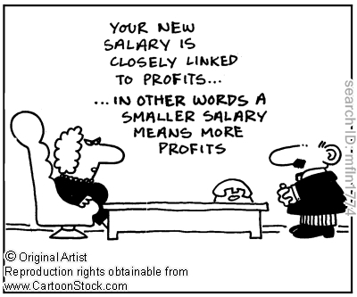
THE SHAPE OF THE SHORT-RUN AGGREGATE SUPPLY CURVE
Why does the SRAS curve slope upward?
…because nominal wages are sticky in the short run.
Nominal wage: the dollar amount of the wage paid
Sticky wages: nominal wages that are slow to fall even in the face of high unemployment and slow to rise even in the face of labor shortages

Slide 19
STICKY WAGES
How do sticky wages affect SRAS?
Profit per unit = price per unit − production cost per unit
Nominal wages are often determined by contracts that were signed some time ago.
Even when there are no formal contracts, there are often informal contracts between management and workers.
A higher aggregate price level leads to higher profits and increased aggregate output in the short run.

Slide 20
SHIFTS OF THE SHORT-RUN AGGREGATE SUPPLY CURVE (1 of 2)
What happens when something changes production levels at every price level?
The SRAS curve shifts because of changes in:
commodity prices
nominal wages
productivity
Each of these factors changes producers’ profits and therefore shifts the SRAS.

Slide 21
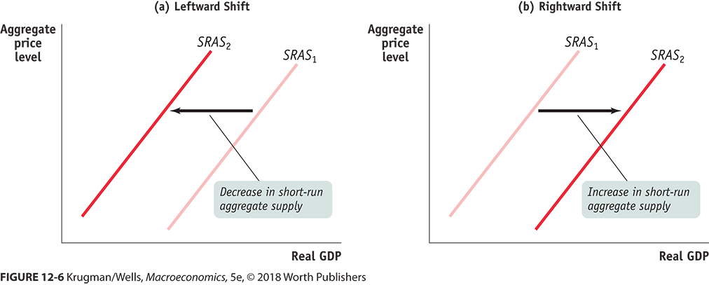
SHIFTS OF THE SHORT-RUN AGGREGATE SUPPLY CURVE (2 of 2)

Slide 22
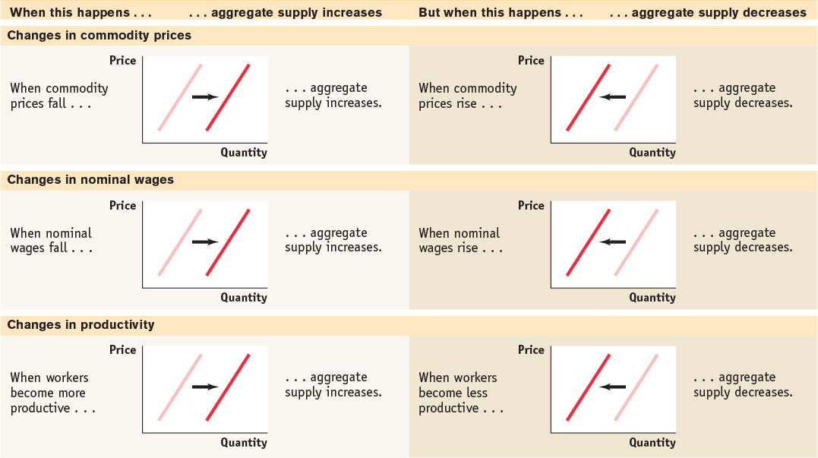
FACTORS THAT SHIFT AGGREGATE SUPPLY
Table 12-2 Factors That Shift Aggregate Supply

Slide 23
LEARN BY DOING PRACTICE QUESTION 1
If the economy is in equilibrium and the real estate market collapses, what will likely happen?
The AD curve will shift rightward.
The AD curve will shift leftward.
The SRAS curve will shift rightward.
The SRAS curve will shift leftward.

Slide 24
LEARN BY DOING PRACTICE QUESTION 1 (Answer)
If the economy is in equilibrium and the real estate market collapses, what will likely happen?
The AD curve will shift rightward.
The AD curve will shift leftward. (correct answer)
The SRAS curve will shift rightward.
The SRAS curve will shift leftward.

Slide 25
LEARN BY DOING PRACTICE QUESTION 2
The short-run aggregate supply curve will shift to the right when:
when input costs rise.
when taxes rise.
when interest rates rise.
when productivity rises.

Slide 26
LEARN BY DOING PRACTICE QUESTION 2 (Answer)
The short-run aggregate supply curve will shift to the right when:
when input costs rise.
when taxes rise.
when interest rates rise.
when productivity rises. (correct answer)

Slide 27
LONG-RUN AGGREGATE SUPPLY CURVE
The long-run aggregate supply curve shows the relationship between the aggregate price level and the quantity of aggregate output supplied that would exist if all prices, including nominal wages, were fully flexible.
The long run is the time it takes for all prices (including nominal wages) to adjust.
Now there is no change to profits SIMPLY BECAUSE PRICES HAVE CHANGED.

Slide 28
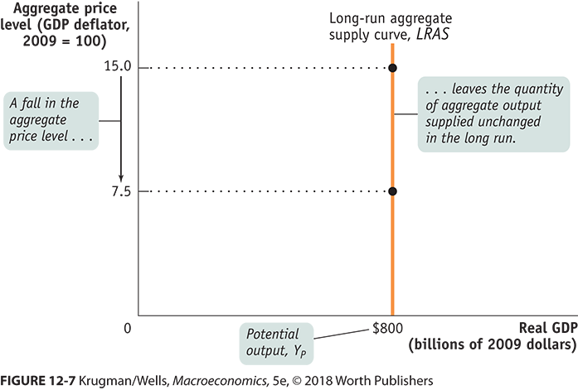
GRAPHING THE LONG-RUN AGGREGATE SUPPLY CURVE
Potential output is the level of real GDP the economy would produce if all prices, including nominal wages, were fully flexible.

Slide 29
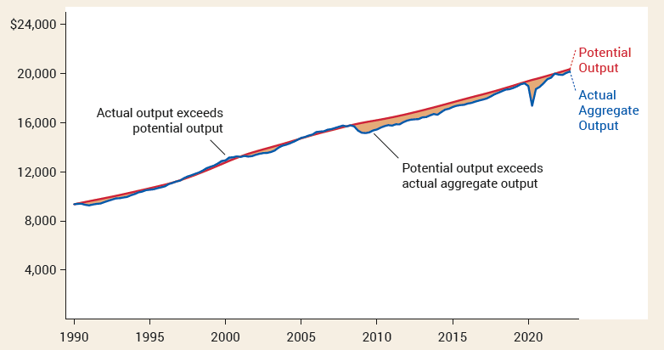
ACTUAL AND POTENTIAL OUTPUT, 1990 to 2022
The level of real GDP is almost always either above or below potential output because of short-run fluctuations.

Slide 30
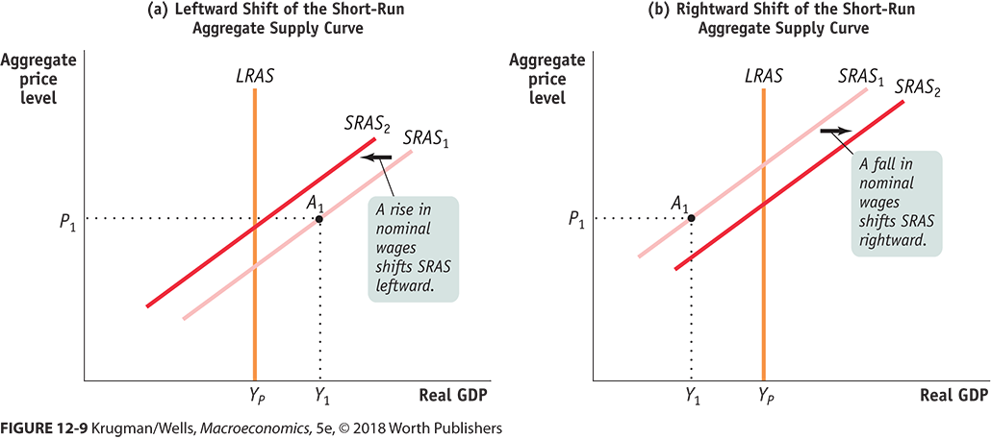
FROM THE SHORT RUN TO THE LONG RUN
If the economy finds itself at a price and output level away from the LRAS, wages will adjust and the SRAS curve will shift toward equilibrium.

Slide 31
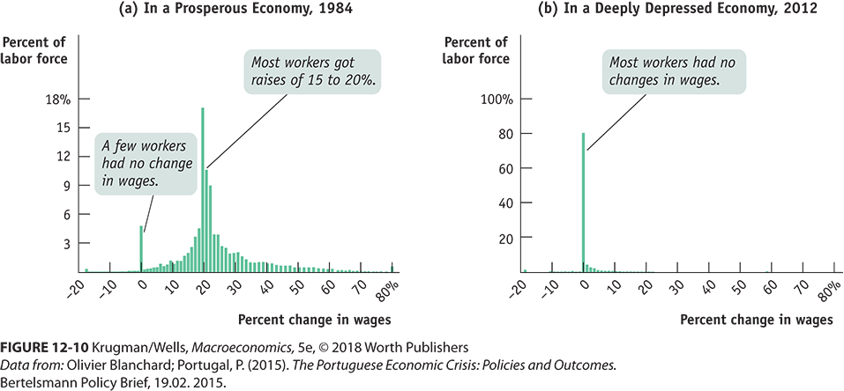
STICKY WAGES IN THE GREAT RECESSION
If the theory of sticky wages were true, we’d find evidence that wages fail to fall even during periods of high unemployment. We do.

Slide 32
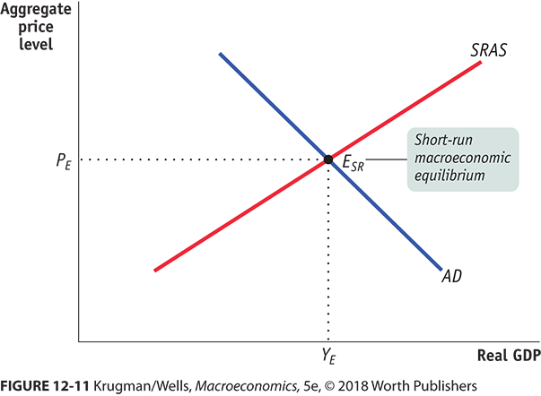
THE AD–AS MODEL
The AD–AS model uses the aggregate supply curve and the aggregate demand curve together to analyze economic fluctuations.

Slide 33
SHIFTS OF AGGREGATE DEMAND: SHORT-RUN
The economy is in short-run macroeconomic equilibrium when the quantity of aggregate output supplied is equal to the quantity demanded.
The short-run equilibrium aggregate price level is the aggregate price level in the short-run macroeconomic equilibrium.
Short-run equilibrium aggregate output is the quantity of aggregate output produced in the short-run macroeconomic equilibrium.
An event that shifts the aggregate demand curve is a demand shock.
An event that shifts the aggregate supply curve is a supply shock.

Slide 34
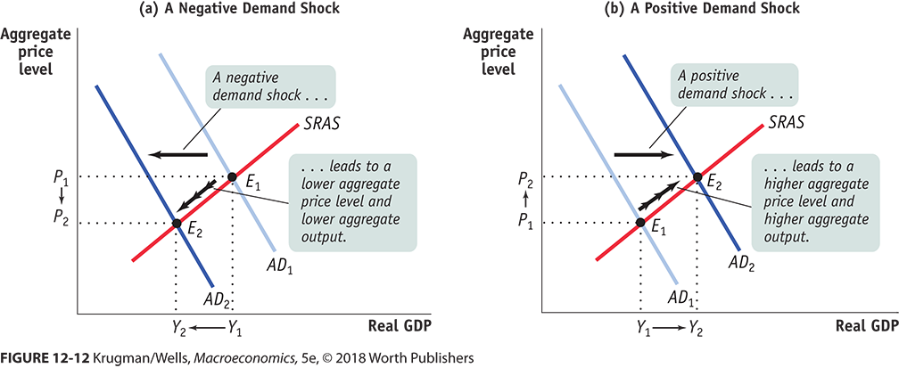
DEMAND SHOCKS

Slide 35
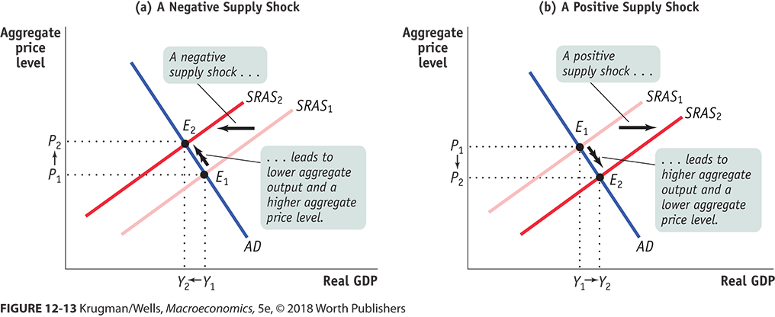
SUPPLY SHOCKS
Stagflation is the combination of inflation and falling aggregate output.

Slide 36
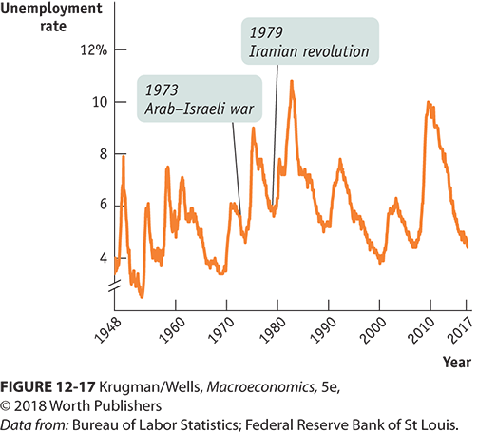
SUPPLY SHOCKS VS. DEMAND SHOCKS IN ACTION
Which type of recession is more common? Demand shocks are the usual culprit. Negative supply shocks are rare but nasty.

Slide 37
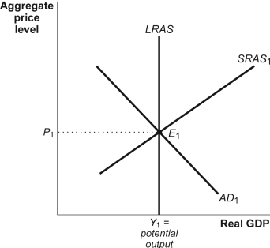
LONG-RUN MACROECONOMIC EQUILIBRIUM
The economy is in long-run macroeconomic equilibrium when the point of short-run macroeconomic equilibrium is on the long-run aggregate supply curve.

Slide 38
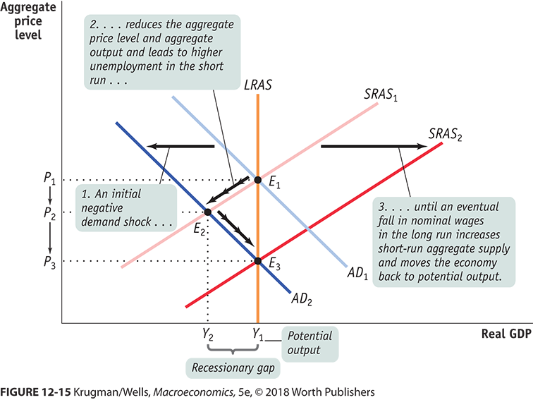
SHORT-RUN VS. LONG-RUN EFFECTS OF A NEGATIVE DEMAND SHOCK

Slide 39
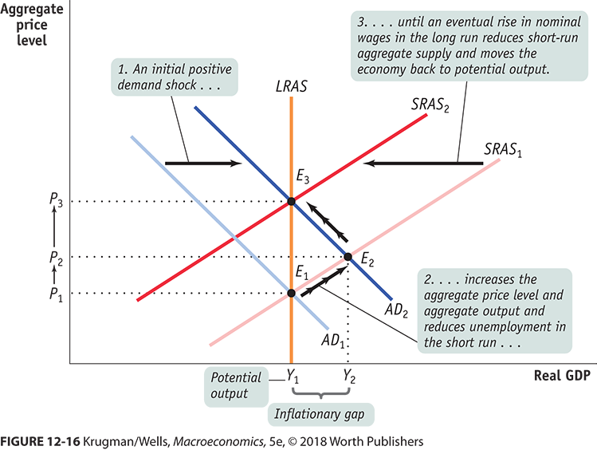
SHORT-RUN VS. LONG-RUN EFFECTS OF A POSITIVE DEMAND SHOCK

Slide 40

Shifts in Aggregate Demand
In the short run, shifts in aggregate demand cause fluctuations in the economy’s output of goods and services.
In the long run, shifts in aggregate demand affect the overall price level but do not affect output.

Slide 41
An Adverse Shift in Aggregate Supply
A decrease in one of the determinants of aggregate supply shifts the curve to the left: Output falls below the natural rate of employment.
Price
Long-run
aggregate
supply
1. An adverse shift in the short-run aggregate-supply curve…
Level
AS₂
Short-run aggregate
supply, AS₁
B
P₂
A
P₁
3. …and the price level to rise.
Aggregate demand
0
Y₂
Y₁
Real GDP
2. …causes output to fall…

Slide 42
Stagflation
Policy Responses to a Recession
Adverse shifts in aggregate supply cause stagflation—a combination of recession and inflation.
Output falls and prices rise.
Policymakers who can influence aggregate demand cannot offset both of these adverse effects simultaneously.
Policymakers may respond to a recession in one of the following ways:
wait for prices and wages to adjust
take action to increase aggregate demand by using monetary and fiscal policy.

Slide 43
Accommodating an Adverse Shift in Aggregate Supply
Price
1. When short-run aggregate supply falls…
Level
Long-run aggregate supply
AS₂
Short-run aggregate supply, AS₁
P₃
C
2. …policymakers can
accommodate the shift
by expanding aggregate
demand…
P₂
A
P₁
3....which causes the price level to rise
4. …but keeps output at its natural rate.
AD₂
Aggregate demand, AD₁
0
Natural rate
of output
Real GDP

Slide 44
GAP RECAP
Recessionary gap: when aggregate output is below potential output
Inflationary gap: when aggregate output is above potential output
Output gap: the percent difference between actual aggregate output and potential output
What happens next? Are we stuck in a gap forever?
We’ll discuss how policy makers can attempt to move us back to potential output next…
But the economy may correct itself in the long run if wages and prices fully adjust.

Slide 45
LEARN BY DOING DISCUSSION QUESTION 1
Suppose an economy is in short-run equilibrium but the level of real GDP is less than potential output. Which of these following statements is true?
In the long run, nominal wages will fall and the SRAS curve will shift left, restoring the economy to potential output.
In the long run, nominal wages will fall and the SRAS curve will shift right, restoring the economy to potential output.
In the long run, nominal wages will fall and the AD curve will shift left, restoring the economy to potential output.
In the long run, nominal wages will fall and the AD curve will shift right, restoring the economy to potential output.

Slide 46
LEARN BY DOING DISCUSSION QUESTION 1 (Answer)
Suppose an economy is in short-run equilibrium but the level of real GDP is less than potential output. Which of these following statements is true?
In the long run, nominal wages will fall and the SRAS curve will shift left, restoring the economy to potential output.
In the long run, nominal wages will fall and the SRAS curve will shift right, restoring the economy to potential output. (correct answer)
In the long run, nominal wages will fall and the AD curve will shift left, restoring the economy to potential output.
In the long run, nominal wages will fall and the AD curve will shift right, restoring the economy to potential output.

Slide 47
LEARN BY DOING DISCUSSION QUESTION 2
Suppose short-run equilibrium real GDP for an economy is greater than potential output. This implies that:
nominal wages will have to adjust upward as the economy moves from the short run to the long run.
the level of unemployment is very low.
jobs are plentiful.
to reach long-run equilibrium, the SRAS curve will shift to the left, resulting in a higher aggregate price level.
Answers (a), (b), (c), and (d) are all correct.
Notes:
.

Slide 48
LEARN BY DOING DISCUSSION QUESTION 2 (Answer)
Suppose short-run equilibrium real GDP for an economy is greater than potential output. This implies that:
nominal wages will have to adjust upward as the economy moves from the short run to the long run.
the level of unemployment is very low.
jobs are plentiful.
to reach long-run equilibrium, the SRAS curve will shift to the left, resulting in a higher aggregate price level.
Answers (a), (b), (c), and (d) are all correct. (correct answer)

Slide 49

MACROECONOMIC POLICY
It’s true that the economy is self-correcting in the long run.
Most economists think it takes a decade or longer.
Stabilization policy: the use of government policy to reduce the severity of recessions and rein in excessively strong expansions
John Maynard Keynes (1883–1946) created the modern field of macroeconomics.
“But this long run is a misleading guide to current affairs. In the long run we are all dead. Economists set themselves too easy, too useless a task if in tempestuous seasons they can only tell us that when the storm is long past the ocean is flat again.”
—J. M. Keynes

Slide 50
The Big Picture Review
Input
Resources
With Prices
Consumption
(C_{a})
Aggregate
Supply
Levels of
Output,
Employment,
Income, and
Prices
Productivity
Sources
Investment
(I_{g})
Aggregate
Demand
Legal-
Institutional
Environment
Net Export
Spending
(X_{n})
Government
Spending
(G)

Slide 51
POLICY IN RESPONSE TO DEMAND SHOCKS
If policy makers react quickly to the fall in aggregate demand, they can use monetary or fiscal policy to shift the aggregate demand curve back to the right.
Instead of going through a recession, the government could make the economy stay at the original equilibrium.
Macroeconomic policy would be desirable because:
The temporary fall in aggregate output is associated with high unemployment.
Preventing deflation is a good thing.
Does this mean that policy makers should always act to offset declines in aggregate demand? Not necessarily. Some policy measures may have long-term costs in terms of lower long-run growth (budget deficits, for example). Also, policy makers aren’t perfectly informed, and the effects of their policies aren’t perfectly predictable. This creates the danger that stabilization policy will do more harm than good.

Slide 52
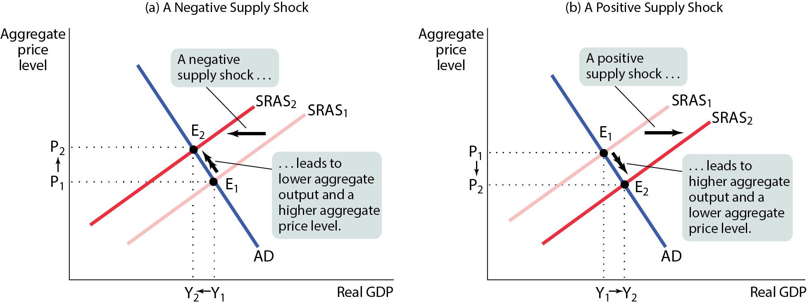
RESPONDING TO SUPPLY SHOCKS
A negative supply shock leads to a rise in prices and a rise in unemployment, which poses a policy dilemma:
Stabilization of unemployment requires an increase in aggregate demand. This leads to inflation.
Stabilization of prices requires a decrease in aggregate demand. This leads to higher unemployment.
In the 1970s, the United States chose to stabilize prices at the cost of higher unemployment.

Slide 53
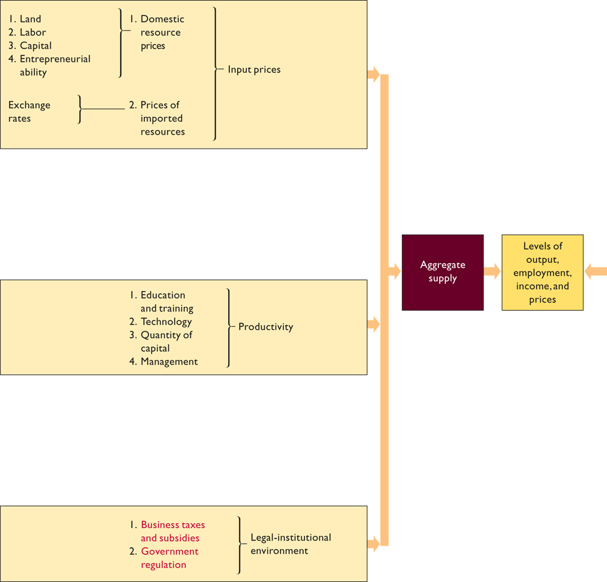

Slide 54
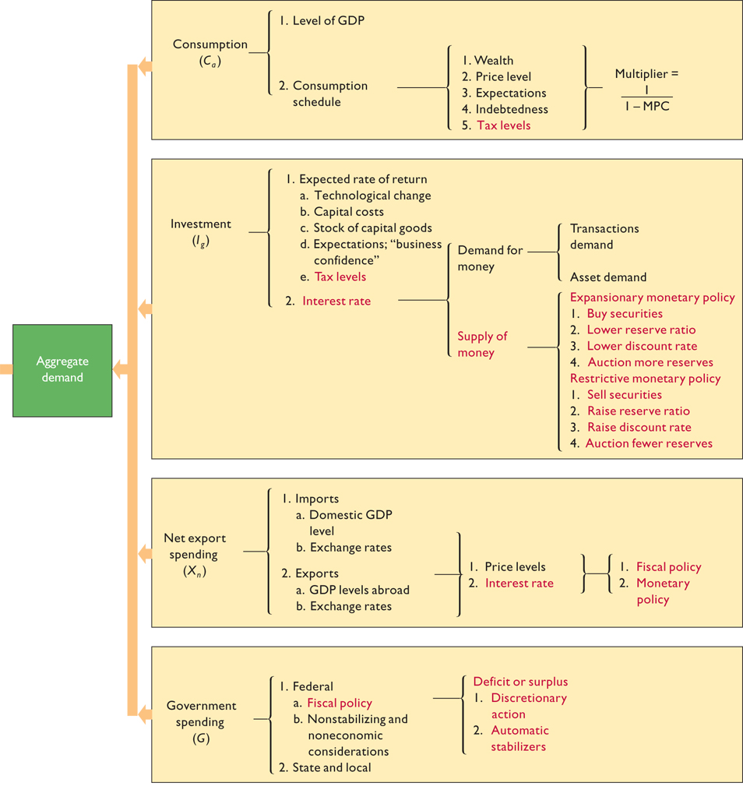

Slide 55
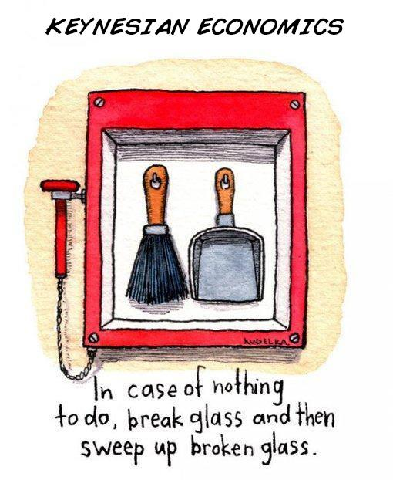

Slide 56
