Slide 1


10
SAVINGS, INVESTMENT SPENDING, AND THE FINANCIAL SYSTEM

Slide 2
WHAT YOU WILL LEARN IN THIS CHAPTER
What is the relationship between savings and investment spending?
How does the loanable funds market match savers with borrowers?
What are the purposes of the four principal types of financial assets: loans, bonds, stocks, and bank deposits?
How do financial intermediaries help investors achieve diversification?
What are the competing views about how asset prices are determined and why asset market fluctuations can be a source of macroeconomic instability?

Slide 3


THE NECESSITY OF FINANCE
Having a good idea isn’t enough to build a business.
Entrepreneurs need funds: You have to spend money to make money.
Copyright 2015 Worth Publishers
Notes:
All image credits courtesy of Morgue File and/or FreeImages.com unless otherwise specified

Slide 4

MATCHING UP SAVINGS AND INVESTMENT SPENDING
Who pays for private investment spending?
In the modern economy, individuals and firms that create physical capital often do it with other people’s money.
Savings–investment spending identity: savings and investment spending are always equal for the economy as a whole.
Notes:
All image credits courtesy of Morgue File and/or FreeImages.com unless otherwise specified

Slide 5
Savings–investment spending identity
GDP = C + I + G.
Total income = total spending. Total income can go to consumer spending (C) or government purchases of goods and service (G) or be saved (S).
GDP = C + G + S.
Total income = consumption spending + savings. Total spending consists of either consumption spending (C + G) or investment spending (I):
GDP = C + G + I.
Total income = consumption spending + investment spending. Putting these equations together, we get:
C + G + S = C + G + I
Consumption spending = consumption spending + savings + investment spending. Subtracting (C + G) from both sides:
S = I or savings = investment spending.

Slide 6
THE SAVINGS–INVESTMENT SPENDING IDENTITY
Now let’s take a closer look at savings.
Government can also save (or not).
Budget surplus: excess of tax revenue over government spending.
Budget deficit: excess of government spending over tax revenue.
Budget balance: the difference between tax revenue and government spending.
National savings: the sum of private savings and the budget balance (the total amount of savings generated within the economy).

Slide 7
THE SAVINGS–INVESTMENT SPENDING IDENTITY IN A CLOSED ECONOMY
S_{Government} = T − TR − G
T = the value of tax revenues and
TR = the value of government transfers.
S_{National} = S_{Government} + S_{Private}
And since S = I has been established, we can say
S_{National} = I
National savings = investment.

Slide 8
THE DIFFERENT KINDS OF CAPITAL
It’s important to stay clear about the different kinds of capital (as explained in the previous chapter):
1. Physical capital consists of manufactured resources, such as buildings and machines.
2. Human capital is the improvement in the labor force generated by education and knowledge.
3. Financial capital is funds from savings that are available for investment spending.

Slide 9

THE SAVINGS–INVESTMENT SPENDING IDENTITY IN AN OPEN ECONOMY
What happens when a country sends savings to or receives savings from abroad? This affects national savings.
Net capital inflow is the total flow of funds into a country minus the total flow of funds out of a country.
A country with a positive net capital inflow has an extra flow of funds from abroad that can be used for investment spending.
Notes:
All image credits courtesy of Morgue File and/or FreeImages.com unless otherwise specified

Slide 10
THE SAVINGS–INVESTMENT SPENDING IDENTITY IN AN OPEN ECONOMY
In an open or international economy, goods and money can flow into and out of the country.
A country can receive inflows of funds—foreign savings that finance investment spending in that country.
A country can also generate outflows of funds—domestic savings that finance investment spending in another country.
Net capital inflow is the total flow of funds into a country minus the total flow of funds out of a country.
A country with a positive net capital inflow has an extra flow of funds from abroad that can be used for investment spending.

Slide 11
THE SAVINGS–INVESTMENT SPENDING IDENTITY IN AN OPEN ECONOMY
A country that spends more on imports than it earns from exports must borrow the difference from foreigners.
NCI = IM − X
Net capital inflow = imports − exports.
Rearrange GDP = C + I + G + X − IM… to
I = (GDP − C − G) + (IM − X)
We know that GDP − C − G is equal to national savings,
I = S_{National} + (IM − X) = S_{National} + NCI
Investment spending = national savings + net capital inflow.

Slide 12
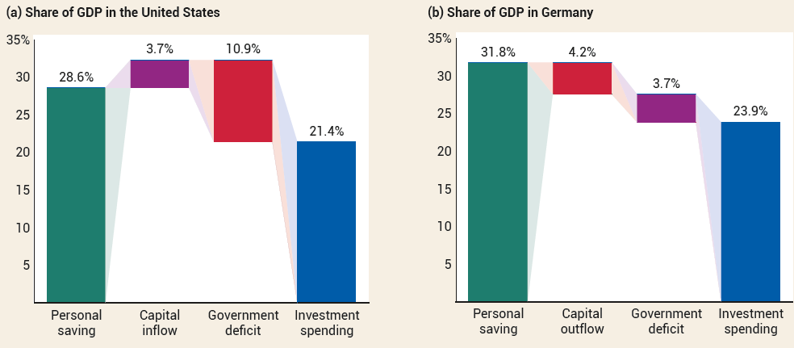
THE SAVINGS–INVESTMENT SPENDING IDENTITY IN OPEN ECONOMIES, 2021
U.S. investment spending was financed by a private savings and positive net capital inflow and partly offset by a government budget deficit.
German investment spending was financed by private savings and a government budget surplus but was offset by a capital outflow.

Slide 13
LEARN BY DOING PRACTICE QUESTION 1
Capital inflow is the:
net inflow of foreign funds plus domestic savings into an economy.
net inflow of funds into a country, or the total inflow of foreign funds into a country minus the total outflow of domestic funds to other countries.
total outflow of domestic funds to other countries minus the net inflow of foreign funds into a country.
total outflow of domestic funds to other countries plus the net inflow of foreign funds into a country.

Slide 14
LEARN BY DOING PRACTICE QUESTION 1 (Answer)
Capital inflow is the:
net inflow of foreign funds plus domestic savings into an economy.
net inflow of funds into a country, or the total inflow of foreign funds into a country minus the total outflow of domestic funds to other countries. (correct answer)
total outflow of domestic funds to other countries minus the net inflow of foreign funds into a country.
total outflow of domestic funds to other countries plus the net inflow of foreign funds into a country.

Slide 15
LEARN BY DOING PRACTICE QUESTION 2
Suppose a country exports $50 million worth of goods and services, while it imports $60 million worth of goods and services. This country
has a positive capital inflow.
lends funds to foreigners.
has a negative capital inflow.
Answers (a) and (b) are both correct.
Answers (b) and (c) are both correct.

Slide 16
LEARN BY DOING PRACTICE QUESTION 2 (Answer)
Suppose a country exports $50 million worth of goods and services, while it imports $60 million worth of goods and services. This country
has a positive capital inflow. (correct answer)
lends funds to foreigners.
has a negative capital inflow.
Answers (a) and (b) are both correct.
Answers (b) and (c) are both correct.

Slide 17
THE MARKET FOR LOANABLE FUNDS
THE MARKET FOR LOANABLE FUNDS
On any given day, the people with money to lend are not usually the same as people who want to borrow.
How are savers and borrowers brought together?
Financial markets channel the savings of households to businesses that want to borrow in order to purchase capital equipment.
There are many financial markets. For our purposes we’ll assume one market where savers and borrowers come together.

Slide 18
THE MARKET FOR LOANABLE FUNDS
THE MARKET FOR LOANABLE FUNDS
The loanable funds market: a hypothetical market that illustrates the market outcome of the demand for funds generated by borrowers and the supply of funds provided by lenders.
We assume the price of loans is the (nominal) interest rate.
(Again, we assume a simplified world with just one interest rate, knowing that the real world contains many interest rates according to length of loan, risk, and customers.)

Slide 19
THE DEMAND FOR LOANABLE FUNDS
The interest rate is the price of borrowing funds.
Firms borrow more when the interest rate falls because more projects will earn enough to pay for themselves.
Interest rate
A
12%
B
4
Demand for loanable funds, D
0
$150
450
Quantity of loanable funds
(billions of dollars)
Notes:
19

Slide 20
PRESENT VALUE
The demand for loanable funds
An investment is worth making only if it generates a future return that is greater than the monetary cost of making the investment today.
Present value is the amount of money needed today to receive a given amount of money at a future date given the interest rate.
If you need $1,000 in a year and the interest rate on savings is r, how much do you need to put in the bank now (X)?
X × (1 + r) = $1,000. Rearrange: X = $1,000/(1 + r).

Slide 21
PRESENT VALUE
A firm has two potential investment projects in mind, each of which will yield $1,000 a year from now.
Each project has different initial costs:
One requires that the firm borrow $900 right now.
The other requires that the firm borrow $950.
Which of these projects is worth borrowing money to finance and undertake?
Depends on the interest rate.
A 10% interest rate means $1,000 is worth $909 now, so only the first project is worth it, since its initial cost ($900) is less than the present value. More projects are worth it as interest rate falls.

Slide 22
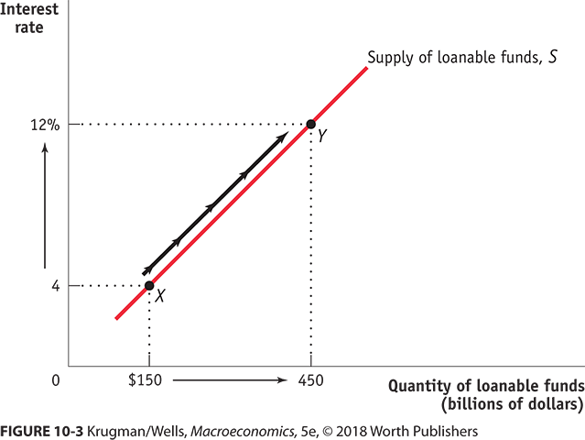
THE SUPPLY OF LOANABLE FUNDS
Interest rate
Supply of loanable funds, S
12%
Y
4
X
0
$150
450
Quantity of loanable funds
(billions of dollars)
Notes:
22

Slide 23

THE SUPPLY OF LOANABLE FUNDS
Why does the supply of loanable funds curve slope upward?
More people are willing to forgo current consumption and make a loan to a borrower when the interest rate is higher.
Notes:
All image credits courtesy of Morgue File and/or FreeImages.com unless otherwise specified

Slide 24
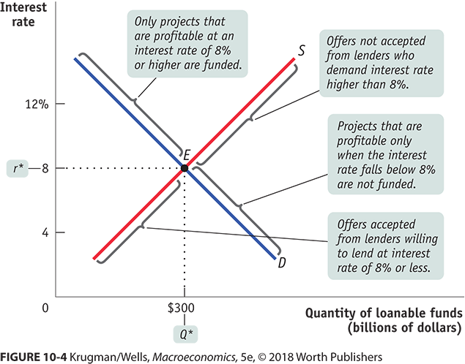
THE EQUILIBRIUM INTEREST RATE
Interest rate
Only projects that are profitable at an interest rate of 8% or higher are funded.
S
12%
8
Offers not accepted from lenders who demand interest rate of more than 8%.
r*
E
Projects with rate of return less than 8% are not funded.
4
Offers accepted from lenders willing to lend at interest rate of 8% or less.
D
0
$300
Quantity of loanable funds
Q*
(billions of dollars)

Slide 25
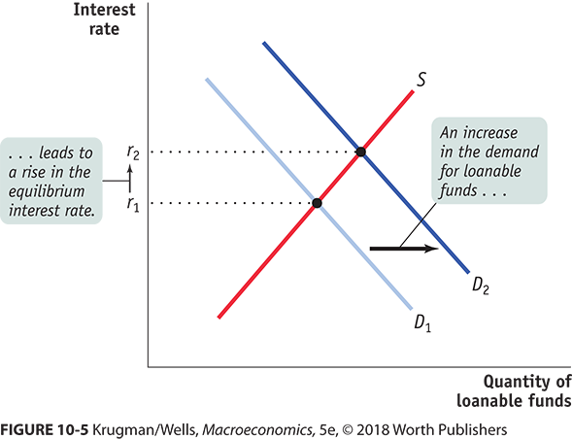
SHIFTS OF THE DEMAND FOR LOANABLE FUNDS
Factors that can cause the demand curve for loanable funds to shift:
changes in perceived business opportunities
changes in government borrowing

Slide 26
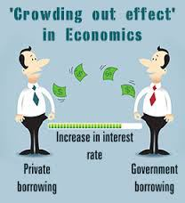
SIDE EFFECTS OF GOVERNMENT BORROWING?
Crowding out occurs when a government budget deficit drives up the interest rate and leads to reduced investment spending.
Crowding out is not a concern in a depressed economy; rather, increased government spending raises income (and private savings).
Notes:
All image credits courtesy of Morgue File and/or FreeImages.com unless otherwise specified

Slide 27
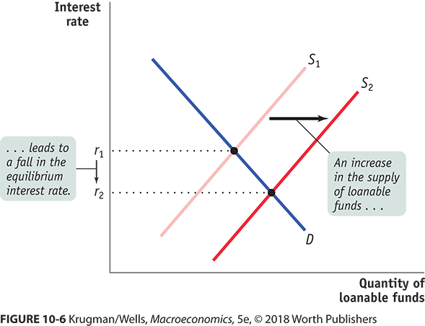
SHIFTS OF THE SUPPLY OF LOANABLE FUNDS
Factors that can cause the supply curve for loanable funds to shift include:
changes in private savings behavior.
changes in net capital inflows.

Slide 28
INFLATION AND INTEREST RATES
Anything that shifts either the supply of loanable funds curve or the demand for loanable funds curve changes the interest rate.
Major changes in interest rates have been driven by many factors, including:
changes in government policy.
technological innovations that created new investment opportunities.
But most important, people’s expectations about future inflation.

Slide 29
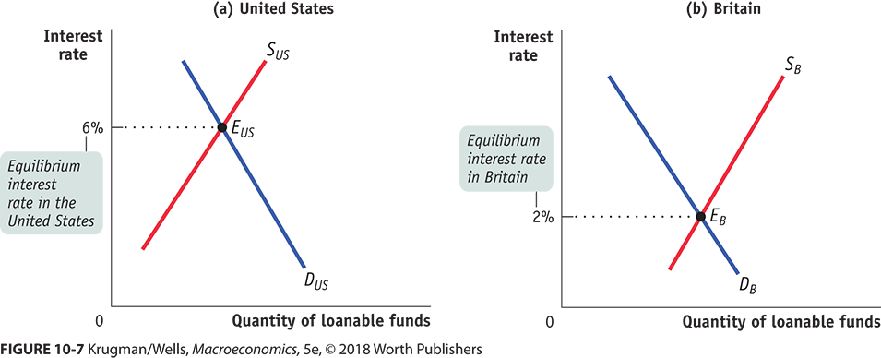
GLOBAL LOANABLE FUNDS
A global loanable funds market arises when international capital flows are so large that they equalize interest rates across countries.
What if the process of capital inflows went all the way and equalized interest rates globally? (There is an incentive for capital to flow to where the returns are higher.)

Slide 30
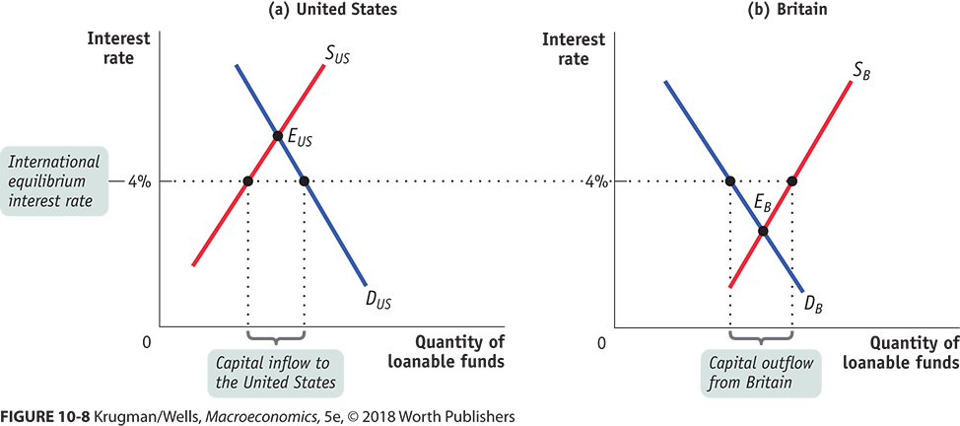
EQUILIBRIUM IN THE GLOBAL LOANABLE FUNDS MARKET
Capital moves away from lower returns toward higher returns.

Slide 31

INFLATION AND INTEREST RATES
Real interest rate = nominal interest rate – inflation rate.
The true cost of borrowing (and payoff to lending) is the real interest rate.
But neither lenders nor borrowers know what inflation will be, so loan contracts specify a nominal interest rate.
Notes:
All image credits courtesy of Morgue File and/or FreeImages.com unless otherwise specified

Slide 32
THE FISHER EFFECT (1/2)
According to the Fisher effect, an increase in expected future inflation drives up the nominal interest rate, leaving the expected real interest rate unchanged.
If the tide rises, these boats will still float on the surface.

Slide 33
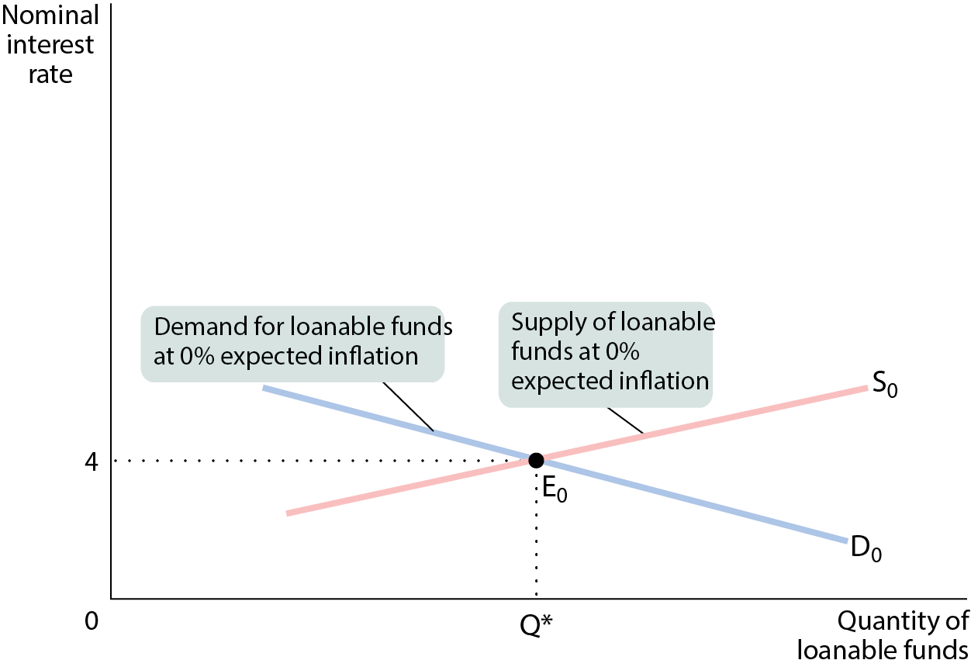
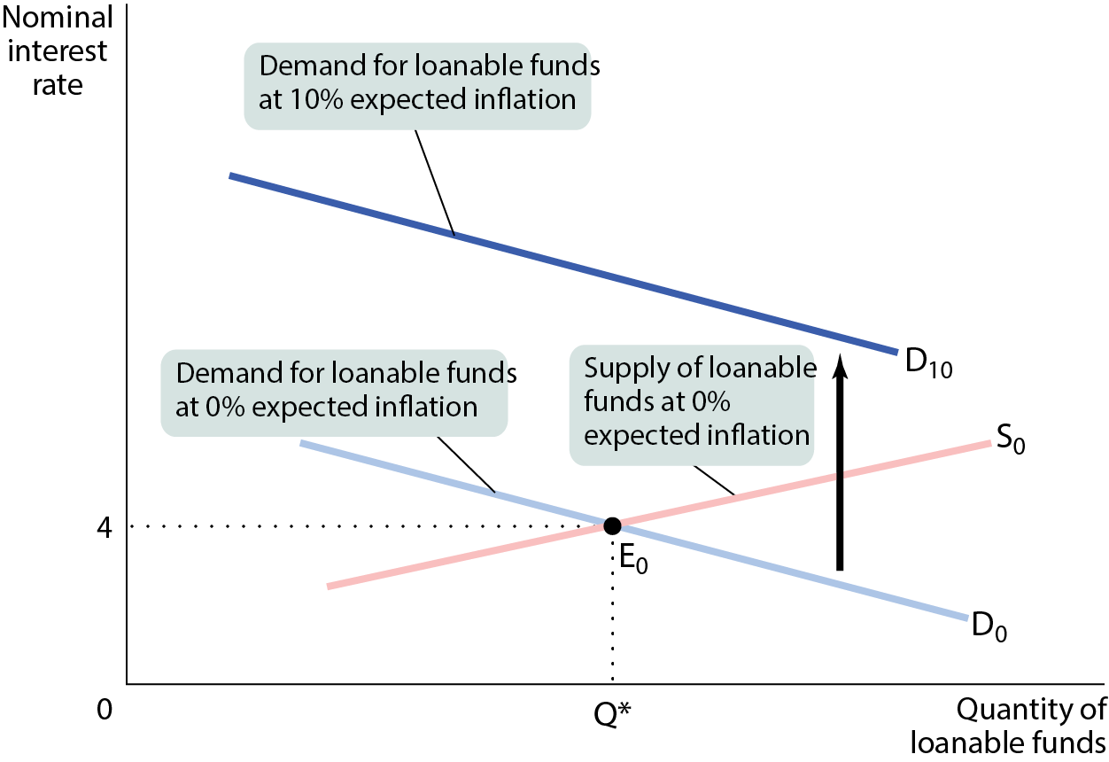
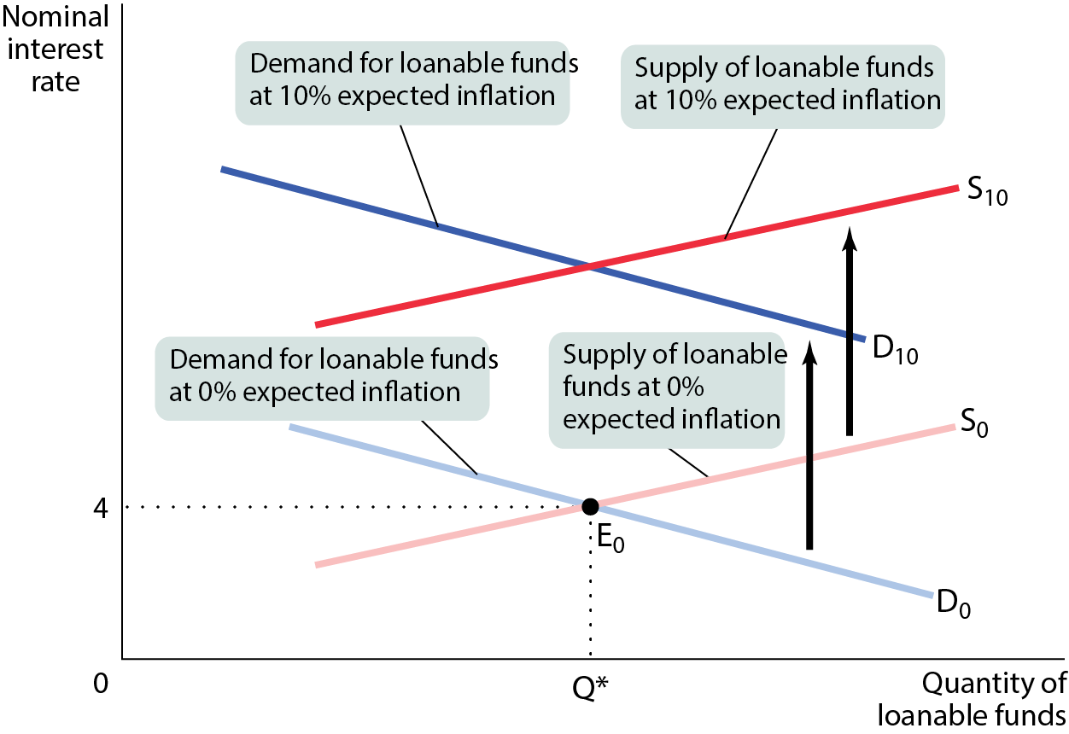
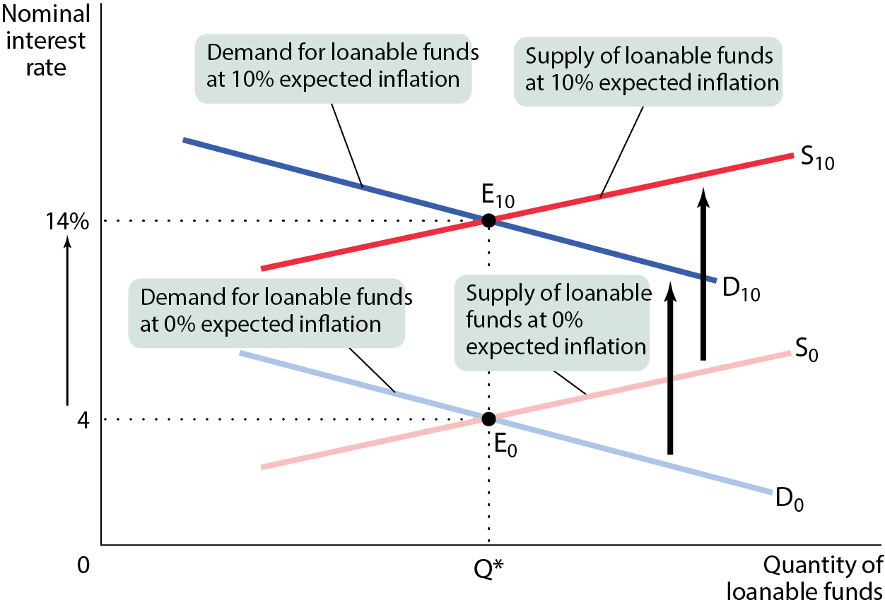
THE FISHER EFFECT (2/2)
The expected real interest rate is unaffected by changes in expected future inflation.

Slide 34
LEARN BY DOING DISCUSSION QUESTION 1
With a partner, answer the following:
Suppose that expected inflation rises from 3% to 6%.
How will the real interest rate be affected by this change?
How will the nominal interest rate be affected by this change?
What will happen to the equilibrium quantity of loanable funds?

Slide 35
THE FINANCIAL SYSTEM
Financial markets are where households invest their current savings and their accumulated savings, or wealth, by purchasing financial assets.
Wealth is the value of a household’s accumulated savings.
A financial asset is a paper claim that entitles the buyer to future income from the seller.
A physical asset is a tangible object that can be used to generate future income.
A liability is a requirement to pay income in the future.

Slide 36

THE NEED FOR A SOUND FINANCIAL SYSTEM
A well-functioning financial system is a critical ingredient in achieving long-run growth because it encourages greater savings and investment spending.
It also ensures that savings and investment spending are undertaken efficiently.

Slide 37
THREE TASKS OF A FINANCIAL SYSTEM
A well-functioning financial system is a critical ingredient in achieving long-run growth because it encourages greater savings and investment spending. It also ensures that savings and investment spending are undertaken efficiently.
Task 1: reducing transaction costs
Transaction costs: the expenses of negotiating and executing a deal.
Task 2: reducing risk
Financial risk: uncertainty about future outcomes that involve financial losses or gains.
Diversification: investing in several assets with unrelated, or independent, risks; reduces risk.
Task 3: providing liquidity
Liquidity: a measure of how quickly an asset can be converted into cash with relatively little loss of value.
If it can be converted quickly, it’s liquid; if not, illiquid.

Slide 38
LEARN BY DOING PRACTICE QUESTION 3
Which of these assets is MOST liquid?
a home with a market value of $300,000
a checking account balance of $1,000
a three-carat diamond engagement ring
a rare edition of an out-of-print book

Slide 39
LEARN BY DOING PRACTICE QUESTION 3 (Answer)
Which of these assets is MOST liquid?
a home with a market value of $300,000
a checking account balance of $1,000 (correct answer)
a three-carat diamond engagement ring
a rare edition of an out-of-print book

Slide 40
LEARN BY DOING PRACTICE QUESTION 4
Financial markets provide a means for:
reducing risk for borrowers and lenders.
reducing transaction costs for borrowers and lenders.
enhancing liquidity for borrowers and lenders.
Answers (a), (b), and (c) are all correct.

Slide 41
LEARN BY DOING PRACTICE QUESTION 4 (Answer)
Financial markets provide a means for:
reducing risk for borrowers and lenders.
reducing transaction costs for borrowers and lenders.
enhancing liquidity for borrowers and lenders.
Answers (a), (b), and (c) are all correct. (correct answer)

Slide 42
FINANCIAL INTERMEDIARIES
Financial intermediary: an institution that transforms the funds it gathers from many individuals into financial assets.
mutual funds
pension funds and life insurance companies
banks

Slide 43
TYPES OF FINANCIAL ASSETS
Bond: an IOU issued by the borrower, usually with a set interest and maturity date
A concern for investors is the possibility of default (failure of a borrower to make payments as specified)
More risky bonds carry higher interest rates
Loan-backed securities: assets created by pooling individual loans and selling shares in that pool (a process called securitization)
With so many loans packaged together, it can be difficult to assess the true quality of the asset, as in the financial crisis of 2008.
Stock: a share in the ownership of a company

Slide 44
MUTUAL FUNDS
In 2022, the largest mutual fund company was Blackrock, with $10.1 trillion in assets in mutual funds. Vanguard is the second largest with $8.1 trillion.
Table 10 Vanguard 500 Index Fund, Top Holdings (as of March 2023).
Data from Morningstar.
Company | Percent of Mutual Fund Assets Invested in a Company
Apple Inc. | 6.62
Microsoft Corp. | 5.58
Amazon.com Inc. | 2.51
NVIDIA Corp. | 1.74
Tesla Inc. | 1.66
Berkshire Hathaway Inc. Class B | 1.65
Alphabet Inc. Class A | 1.62
Alphabet Inc. Class C | 1.44
Exxon Mobil Corp. | 1.36
UnitedHealth Group, Inc. | 1.34

Slide 45
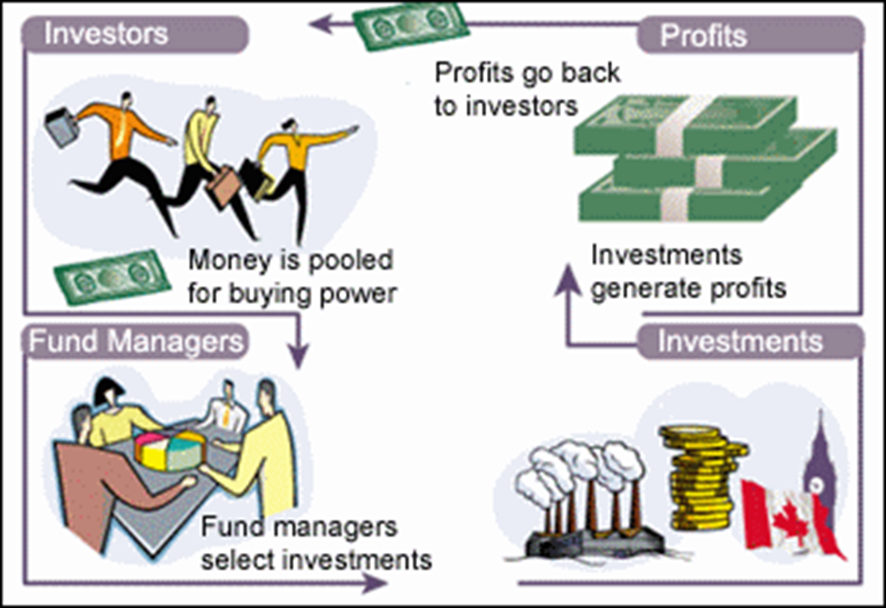
MUTUAL FUNDS

Slide 46
3 LEARN BY DOING PRACTICE QUESTION (Answer)
Use the loanable funds model to analyze the effects of a government budget deficit:
Draw the diagram showing the initial equilibrium.
Determine which curve shifts when the government runs a budget deficit.
Draw the new curve on your diagram.
What happens to the equilibrium values of the interest rate and investment?
Notes:
Now that you have shown students the analysis of Policies 1 and 2, this exercise asks them to do the analysis of Policy 3 (a budget deficit).
In case you prefer to lecture on this material, I have provided a “hidden” slide at the end of this file that contains the budget deficit analysis as a lecture slide instead of an exercise. Move that slide to this location and “unhide” it by unselecting the “hide slide” command on the Slide Show menu.

Slide 47
Answers
A budget deficit reduces national saving and the supply of L.F.
Interest Rate
S₂
S₁
…which increases the eq’m interest rate
6%
5%
and decreases the eq’m quantity of L.F. and investment.
D₁
50
60
Loanable Funds ($billions)
Notes:
The analysis shows that the budget deficit reduces investment, which the preceding chapter shows is important for the long-run standard of living. This is one reason why many economists believe budget deficits are generally undesirable.
In the real world, we sometimes see increases in government budget deficits that are not accompanied by dollar-for-dollar decreases in investment, as the analysis on this slide would predict. Keep in mind, however, that the analysis here is for the closed economy model. In an open economy, firms can finance investment by borrowing from abroad in the face of a decrease in the domestic supply of loanable funds.
This, of course, does not mean that budget deficits are “okay” in an open economy, because the extra indebtedness requires service, such as interest or dividend payments, which reduces the amount of income remaining for residents of the country.

Slide 48
PENSION FUNDS AND LIFE INSURANCE COMPANIES
Pension fund: a type of mutual fund that holds assets to provide retirement income to its members.
Life insurance company: sells policies that guarantee a payment to a policyholder’s beneficiaries when the policyholder dies.

Slide 49
BANKS
Bank deposit: a claim on a bank that obliges the bank to give the depositor their cash when demanded.
Bank: a financial intermediary that provides liquid assets in the form of bank deposits to lenders and uses those funds to finance the illiquid investment spending needs of borrowers who don’t want to use the stock or bond markets.
A bank is lending for long periods of time while its depositors could demand their funds back at any time. How can it manage that?
On average, only a small fraction of depositors will want their cash at the same time. So, the bank needs to keep only a limited amount of cash on hand to satisfy its depositors.
In addition, individual bank deposits are guaranteed up to $250,000 by the Federal Deposit Insurance Corporation, or FDIC. This reduces the incentive to withdraw funds if there are concerns about the bank.

Slide 50
FINANCIAL FLUCTUATIONS (1/3)
The financial system sometimes doesn’t function well and causes instability.
What causes asset price fluctuations?
The demand for stocks
Demand for stocks depends on investors’ expectations about the future stock prices.
It is also affected by attractiveness of bonds and other substitute assets.
The demand for other assets
The demand for other assets depends on the expected income and expected prices.
Demand for housing, for example, depends on implicit rent (an estimate of the amount that homeowners, in effect, pay to themselves).

Slide 51
FINANCIAL FLUCTUATIONS (2/3)
Asset Price Expectations
There are two competing views about asset price expectations:
You look at fundamentals (earnings, for example), you come up with the value, and if the current price is lower, you buy the asset.
The efficient markets hypothesis:
Asset prices reflect all available information.
At any point in time, stock prices are fairly valued. Stock prices are neither overpriced nor underpriced.
Prices are unpredictable—they follow a random walk (the movement of an unpredictable variable).
Many economists regard the efficient market hypothesis as an oversimplification because investors aren’t that rational. Still, economists are very skeptical about anyone claiming that they can outsmart the market.

Slide 52
FINANCIAL FLUCTUATIONS (3/3)
Asset Prices and Macroeconomics
How should economists and policy makers deal with the fact that asset prices fluctuate a lot and that these fluctuations affect the economy?
On one side, policy makers are reluctant to assume that the market is wrong—that asset prices are either too high or too low.
On the other side, the past 25 years were marked by two huge asset bubbles:
The dot-com bubble: In the late 1990s, the prices of technology stocks soared, then plunged, helping to cause the 2001 recession.
The housing bubble: In 2008, the collapse of the housing market triggered a severe financial crisis followed by a deep recession.
These events have prompted much debate over whether and how to limit financial instability. We discuss it in Chapter 14.

Slide 53
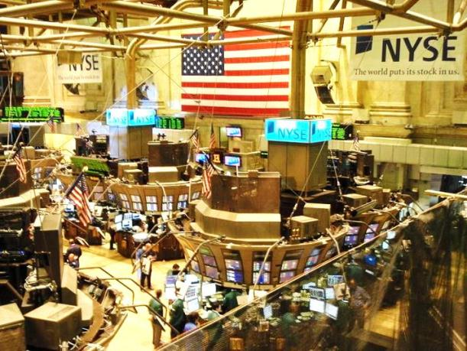
HOW NOW, DOW JONES?
Stock indexes: what and why?
Dow Jones Industrial Average, S&P 500, and NASDAQ are averages of a group of stocks.
Each index gives investors a quick view of how different sectors are doing (or rather, how investors expect them to do in the future).
Notes:
All image credits courtesy of Morgue File and/or FreeImages.com unless otherwise specified

Slide 54
BEHAVIORAL FINANCE
Behavioral economics (and its subfield in finance) study how people make (predictable) mistakes in their decisions.
Investors depart from rationality in systematic ways:
Overconfidence: having misguided faith that they are able to spot a winning stock.
Loss aversion: being unwilling to sell an unprofitable asset and accept the loss.
Herd mentality: buying an asset when its price has already been driven high and selling it when its price has already been driven low.

Slide 55
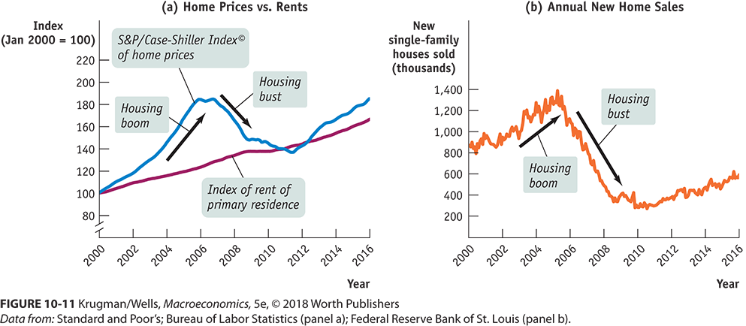
THE GREAT AMERICAN HOUSING BUBBLE
Policymakers didn’t worry about the massive rise in home values until it began to cause economic slowdown.
Credit Crisis Explained

Slide 56
