Slide 1
Chapter 7 Lecture - Equity Markets and Stock Valuation
Notes:
1

Slide 2
Learning Objectives
After studying this chapter, you should be able to:
LO1 Understand how stock prices depend on future dividends and dividend growth
LO2 Be able to compute stock prices using the dividend growth model
LO3 Understand how corporate directors are elected
LO4 Understand how stock markets work
LO5 Understand how stock prices are quoted

Slide 3
The Stock Market
Equity securities represent an ownership interest in a corporation. Holders of equity securities are entitled to the earnings of the corporation when those earning are distributed in the form of dividends; they are also entitled to a prorata share of the remaining equity in case of liquidation.

Slide 4
Cash Flows for Stockholders
If you own a share of stock, you can receive cash in two ways
  The company pays dividends
  You sell your shares, either to another investor in the market or back to the company
As with bonds, the price of the stock is the present value of these expected cash flows
  Dividends → cash income
  Selling → capital gains

Slide 5
One Period Example
Suppose you are thinking of purchasing the stock of Moore Oil, Inc.
  You expect it to pay a $2 dividend in one year
  You believe the dividend payment will increase 5% per year.
  You believe you can sell the stock for $14 at that time.
  You require a return of 20% on investments of this risk
  What is the maximum you would be willing to pay?

Slide 6
One Period Example
D₁ = $2 dividend expected in one year
R = 20%
P₁ = $14
CF₁ = $2 + $14 = $16
Compute the PV of the expected cash flows

Slide 7
Two Period Example
What if you decide to hold the stock for two years? We assume stock price at that time will grow by same rate as dividend.
  D₁ = $2.00 CF₁ = $2.00
  D₂ = $2.10
  P₂ = $14.70
  Now how much would you be willing to pay?
CF₂ = $2.10 + $14.70 = $16.80

Slide 8
Three Period Example
What if you decide to hold the stock for three years?
  D₁ = $2.00 CF₁ = $2.00
  D₂ = $2.10 CF₂ = $2.10
  D₃ = $2.205
  P₃ = $15.435
  Now how much would you be willing to pay?
CF₃ = $2.205 + $15.435 = $17.640

Slide 9
Developing The Model
You could continue to push back when you would sell the stock
You would find that the price of the stock is really just the present value of all expected future dividends

Slide 10
Stock Value = PV of Dividends
^
D₁ D₂ D₃ D∞
P₀ =
+
+
+…+
(1+R)¹ (1+R)² (1+R)³ (1+R)∞
How can we estimate all future dividend payments?

Slide 11
Estimating Dividends Special Cases
Constant dividend/Zero Growth
  Firm will pay a constant dividend forever
  Like preferred stock
  Price is computed using the perpetuity formula
Constant dividend growth
  Firm will increase the dividend by a constant percent every period
Supernormal growth
  Dividend growth is not consistent initially, but settles down to constant growth eventually

Slide 12
Zero Growth
Dividends expected at regular intervals forever = perpetuity
Suppose stock is expected to pay a $0.50 dividend every quarter and the required return is 10% with quarterly compounding. What is the price?

Slide 13
Constant Growth Stock
One whose dividends are expected to grow forever at a constant rate, g.
D₁ = D₀(1+g)¹
D₂ = D₀(1+g)²
D_{t} = D₀(1+g)^{t}
D₀ = Dividend JUST PAID
D₁ to D_{t} = Expected dividends
Projected Dividends
D₀ = $2.00 and constant g = 6%
D₁ = D₀(1+g) = 2(1.06) = $2.12
D₂ = D₁(1+g) = 2.12(1.06) = $2.2472
D₃ = D₂(1+g) = 2.2472(1.06) = $2.3820

Slide 14
Dividend Growth Model
This can be rewritten as:
^
D₀(1+g)
D₁
P₀ =
=
R - g
R - g
“Gordon Growth Model”

Slide 15
DGM – Example 1
Suppose Big D, Inc. just paid a dividend of $.50. It is expected to increase its dividend by 2% per year. If the market requires a return of 15% on assets of this risk, how much should the stock be selling for?
D₀= $0.50
g = 2%
R = 15%

Slide 16
DGM – Example 2
Suppose TB Pirates, Inc. is expected to pay a $2 dividend in one year. If the dividend is expected to grow at 5% per year and the required return is 20%, what is the price?
  D₁ = $2.00
  g = 5%
  r = 20%

Slide 17
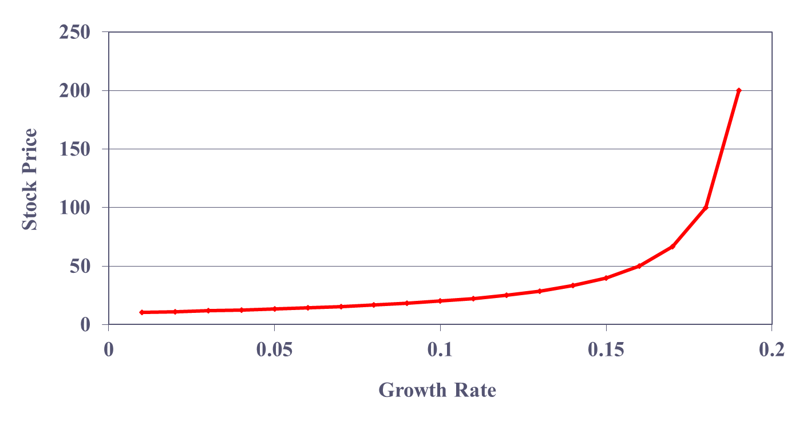
Stock Price Sensitivity to Dividend Growth, g
D₁ = $2; R = 20%

Slide 18
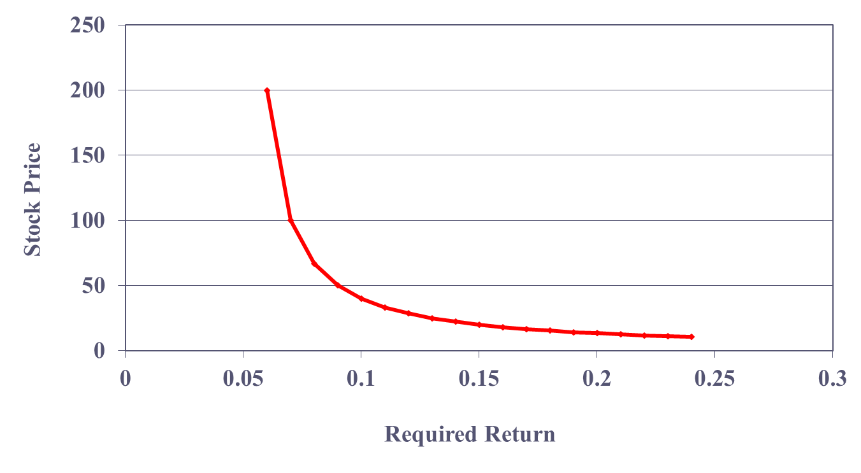
Stock Price Sensitivity to Required Return, R
D₁ = $2; g = 5%

Slide 19
Valuation Using Multiples
For stocks that don’t pay dividends (or have erratic dividend growth rates), we can value them using the price-earnings (PE) ratio and/or the price-sales ratio:
Price at time t = P_{t}
= Benchmark PE ratio X Earnings per share_{t}
Price at time t = P_{t}
= Benchmark price-sales ratio X Sales per share_{t}
  The price-sales ratio can be especially useful when earnings are negative.

Slide 20
Valuation Using Multiples Example
Suppose we are trying to value the company Inactivision, a video game developer that does not pay dividends. If the appropriate industry PE for this type of company is 20 and you predict earnings to be $2.50 per share for the coming year, then the forecasted stock price for a year from now, or target price, is the following:
Target price = 20 x $2.50 = $50

Slide 21
Problems with Market Multiple Methods
It is often hard to find comparable firms.
The average ratio for the sample of comparable firms often has a wide range.
  For example, the average P/E ratio might be 20, but the range could be from 10 to 50.
How do you know whether your firm should be compared to the low, average, or high performers?

Slide 22
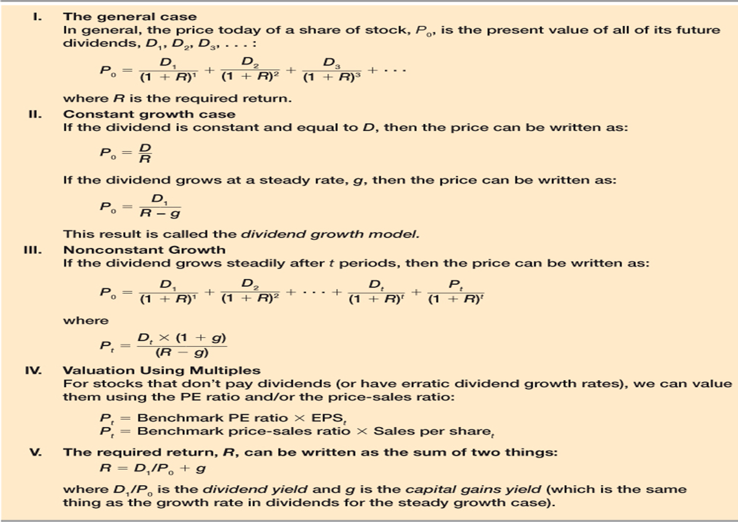
Summary of Stock Valuation

Slide 23
The Stock Market Once Again
There are two types of equity securities: common stock and preferred stock
The key distinction between these two forms of equity securities is the degree to which they may participate in any distribution of earnings and capital and the priority given to each in the distribution of earnings.
Typically, preferred stockholders are entitled to a fixed dividend that they receive before common stockholders may receive dividends.
Preferred stock is referred to as a senior corporate security in the sense that preferred stock interests are senior to the interests of common stockholders

Slide 24
Common Stock: Owners, Directors, and Managers
Common Stock Represents ownership.
Ownership implies control.
Stockholders elect directors.
Directors hire management.
Since managers are “agents” of shareholders, their goal should be: Maximize stock price.
May be various classes of stock, but will depend on firm

Slide 25
Features of Common Stock
Voting Rights
  Stockholders elect directors
  Cumulative voting vs. Straight voting
  Boards are often staggered, or “classified”
  Proxy voting
Classes of stock
  Founders’ shares
  Class A and Class B shares
Other Rights
  Share proportionally in declared dividends
  Share proportionally in remaining assets during liquidation
  Preemptive right
    Right of first refusal to buy new stock issue to maintain proportional ownership if desired

Slide 26
Dividend Characteristics
Dividends are not a liability of the firm until declared by the Board of Directors
  A firm cannot go bankrupt for not declaring dividends
Dividends and Taxes
  Dividends are not tax deductible for firm
  Taxed as ordinary income for individuals
  Dividends received by corporations have a minimum 70% exclusion from taxable income

Slide 27
Preferred Stock
Hybrid security.
Similar to bonds in that preferred stockholders receive a fixed dividend which must be paid before dividends can be paid on common stock.
However, unlike bonds, preferred stock dividends can be omitted without fear of pushing the firm into bankruptcy.
Notes:
33

Slide 28
Features of Preferred Stock
Dividends
  Must be paid before dividends can be paid to common stockholders
  Not a liability of the firm
  Can be deferred indefinitely
  Most preferred dividends are cumulative
    Missed preferred dividends have to be paid before common dividends can be paid
Preferred stock generally does not carry voting rights

Slide 29
Primary Market for Securities
The first time shares are sold in the market is an initial public offering (IPO); additional shares may be sold later as a seasoned offering.
Equities may be:
  sold directly to investors by the firm
  purchased and sold at a higher price (underwriter’s spread) by investment bankers in an underwriting offering
  sold to existing shareholders in a rights offering
The size of the underwriter’s spread is:
  Breadth of the market or the number of varied traders of the stock
  Depth of the market or the extent to which there are conditional orders to buy and sell below and above the current price, respectively

Slide 30
The Secondary Market for Equity Securities -- Subsequent Trading in Securities
Stock may trade on:
  Exchanges
  Over the counter
Broker -gets buyer and seller together
Dealer - takes ownership
A buyer may incur search costs and find a seller on their own, called a direct search.
A broker may bring buyer and seller together, charging a commission.
A dealer may sell/buy (bid/ask) securities from an inventory of securities, reducing search costs. The dealer’s return is the bid/ask spread.
An auction market allocates the selling shares to the highest bidder, providing a buyer/seller.
http://finance.yahoo.com

Slide 31
Foreign Securities
Some Differences:
  terminology
  frequency of dividend payments
  limitations on ownership
  corporate financial structure
  depreciation methods

Slide 32
New York Stock Exchange (NYSE)
NYSE https://www.nyse.com/index
  Merged with Euronext in 2007
  NYSE Euronext merged with the American Stock Exchange in 2008
Members (Historically)
  Buy a trading license (own a seat)
  Designated market makers, DMMs (formerly known as “specialists”)
  Floor brokers
  Supplemental liquidity providers (SLPs)

Slide 33
NASDAQ
NASDAQ OMX (merged 2007)
http://ir.nasdaqomx.com
Computer-based quotation system
Multiple market makers
Electronic Communications Networks
Three levels of information
  Level 1 – median quotes, registered representatives
  Level 2 – view quotes, brokers & dealers
  Level 3 – view and update quotes, dealers only
Large portion of technology stocks

Slide 34
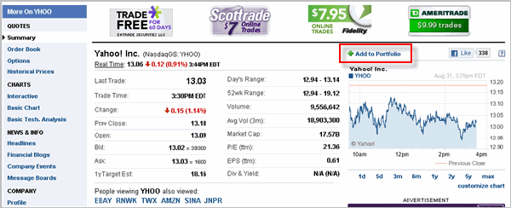
Reading Stock Quotes
What information is provided in the stock quote?
Go to YahooFinance.com or Bloomberg.com, etc. for current stock quotes.

Slide 35
Bonds and Stocks: Similarities
Both provide long-term funding for the organization
Both are future funds that an investor must consider
Both have future periodic payments
Both can be purchased in a marketplace at a price “today”

Slide 36
Bonds and Stocks: Similarities
From the firm’s perspective: a bond is a long-term debt and stock is equity
From the firm’s perspective: a bond gets paid off at the maturity date; stock continues indefinitely.
We will discuss the mix of bonds (debt) and stock (equity) in a future chapter entitled capital structure
A bond has coupon payments and a lump-sum payment; stock has dividend payments forever
Coupon payments are fixed; stock dividends change or “grow” over time

Slide 37
What is a Mutual Fund?
A mutual fund is a collection of stocks, bonds and other securities owned by a group of investors and managed by a professional investment advisory
firm. This investment advisor (also called the mutual fund’s manager) collects money from many investors and invests the pool of money for all of them.
What Advantages Are There to Investing
in Mutual Funds?
Mutual funds provide professional management. The fund’s manager makes the buy and sell decisions, based on the fund’s management philosophy.
Mutual funds offer diversification. A mutual fund often invests in one hundred or more securities.

Slide 38
What Types of Funds are Available?
Mutual funds are also called open-end funds. This means that the fund will usually sell as many shares as investors want to buy.
Closed-end funds, like mutual funds, are collections of securities managed by a professional investment advisor. But unlike mutual funds, there are a fixed number of shares available and these shares are traded on the stock exchange.
Exchange-traded funds, are also like mutual funds in that they are collections of securities managed by a professional advisor, and like closed-end funds are traded on the stock exchange.

Slide 39
How Do You Make Money on a Mutual Fund?
There are Many Types of Mutual Funds:
Stock funds
Bond funds
Sector funds
International Funds
Money market funds
Hybrid funds (also known as balanced and life cycle funds)
A mutual fund investor can make money in several ways:
The fund earns income from interest or dividends on its investments which it distributes to its investors.
The fund produces capital gains by selling securities at a profit and distributes those gains to its investors.
You sell your shares of the mutual fund at a higher price than you paid for them.

Slide 40
