Slide 1
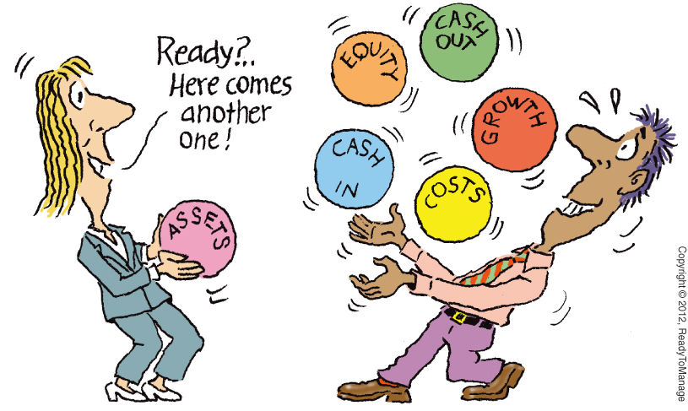
Chapter 3 Lecture - Working with Financial Statements

Slide 2
Learning Objectives
After studying this chapter, you should be able to:
LO 1 Standardize financial statements for comparison purposes.
LO 2 Compute and, more important, interpret some common ratios.
LO 3 Assess the determinants of a firm's profitability and growth.
LO 4 Identify and explain some of the problems and pitfalls in financial statement analysis.

Slide 3
Standardized Financial Statements
Common-Size Balance Sheets
  All accounts = percent of total assets (%TA)
Common-Size Income Statements
  All line items = percent of sales or revenue
  (%SLS)
Standardized statements are useful for:
  Comparing financial information year-to-year
  Comparing companies of different sizes, particularly within the same industry

Slide 4
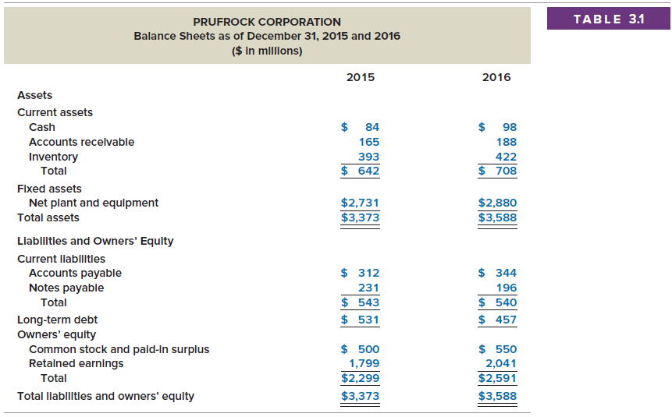
Prufrock Corporation
Balance Sheets

Slide 5
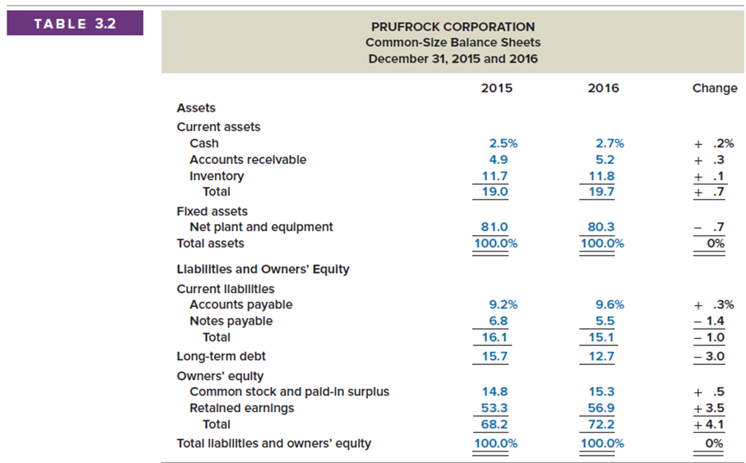
Prufrock Corporation
Common-Size Balance Sheets

Slide 6
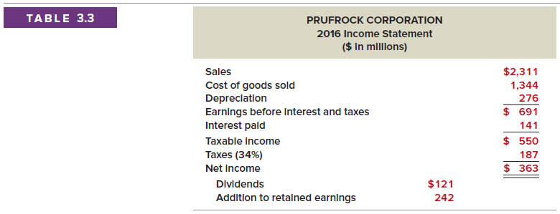
Prufrock Corporation
Income Statement

Slide 7
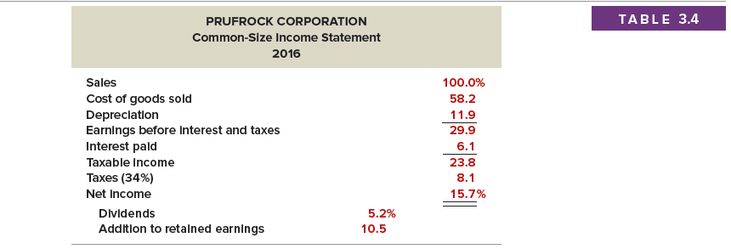
Prufrock Corporation
Common-Size Income Statement
Tells us what happened to each dollar of sales

Slide 8
Ratio Analysis
Allow for better comparison through time or between companies
Used both internally and externally
For each ratio, ask yourself:
  What the ratio is trying to measure
  Why that information is important

Slide 9
Categories of Financial Ratios
Liquidity ratios or Short-term solvency
Financial leverage ratios or Long-term solvency ratios
Asset management or Turnover ratios
Profitability ratios
Market value ratios

Slide 10
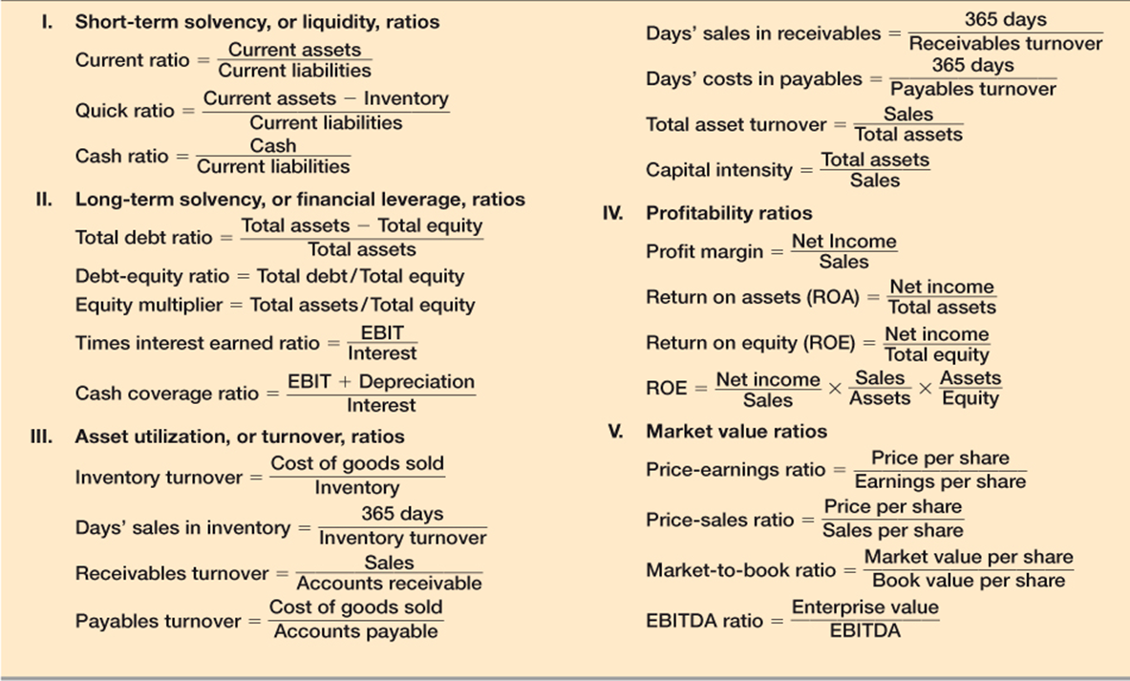
Common Financial Ratios

Slide 11
Liquidity Ratios
Current Ratio = CA / CL
  708 / 540 = 1.31 times
Quick Ratio = (CA – Inventory) / CL
  “Acid Test”
  (708-422) / 540 = 0.53 times
Cash Ratio = Cash / CL
  98/ 540 = .18 times

Slide 12
Financial Leverage Ratios
Total Debt Ratio = (TA – TE) / TA
  (3,588 – 2,591) / 3,588 = 0.28 times
Debt/Equity = TD / TE
  (0.28 / 0.72) = 0.38 times
Equity Multiplier = TA/TE = 1 + D/E
  ($1 / 0.72) = (1 + 0.38) = 1.38

Slide 13
Financial Leverage Ratios
Times Interest Earned = EBIT / Interest
  691 / 141 = 4.9 times
Cash Coverage = (EBIT + Depreciation) / Interest
  (691 + 276) / 141 = 6.9 times

Slide 14
Asset Management: Inventory Ratios
Inventory Turnover = COGS / Inventory
  1,344 / 422 = 3.2 times
Days’ Sales in Inventory = 365 / Inventory Turnover
  365 / 3.2 = 115 days

Slide 15
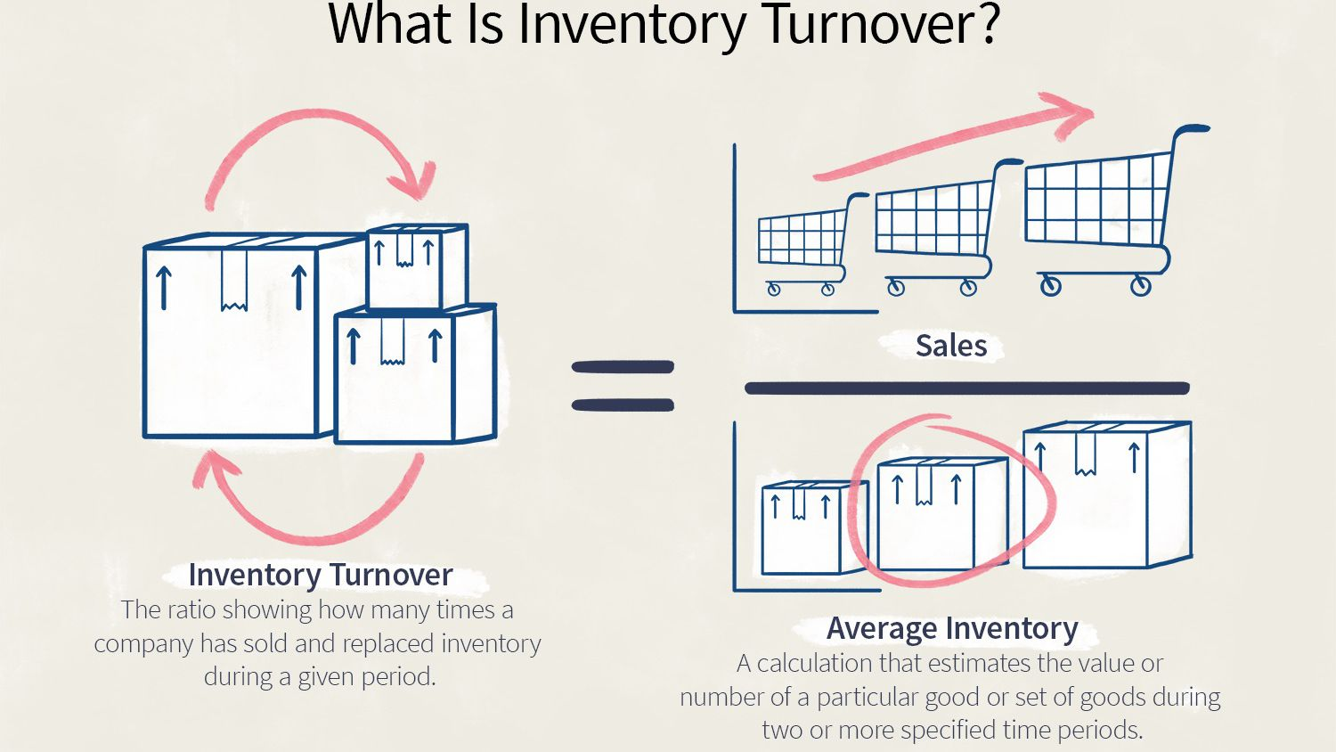

Slide 16
Asset Management: Receivables Ratios
Receivables Turnover = Sales / AR
  2,311 / 188 = 12.3 times
Days’ Sales in Receivables = 365 / Receivables Turnover
  365 / 12.3 = 30 days
The accounts receivable turnover ratio is used to measure how effective your company is at collecting accounts receivable (money owed by clients). Typically measured on an annual basis, a high receivables turnover ratio may mean that your company’s accounts receivable process is effective, and that you have large numbers of high-quality clients who are happy to pay their debt quickly.

Slide 17
Asset Management: Payables Ratios
Payables Turnover = COGS / AP
  1,344 / 344 = 3.9 times
Days’ Costs in Payables = 365 / Payables Turnover
  365 / 3.9 = 94 days
A higher accounts payable ratio indicates that a company pays its bills in a shorter amount of time than those with a lower ratio. Low AP ratios could signal that a company is struggling to pay its bills, but that is not always the case. It could be using its cash strategically.

Slide 18
Asset Management: Asset Turnover Ratios
Total Asset Turnover = Sales / Total Assets
  2,311 / 3,588 = 0.64 times
Capital Intensity Ratio = 1/TAT
  1 / 0.64 = 1.56
Generally, a higher ratio TAT is favored because it implies that the company is efficient in generating sales or revenues from its asset base. A lower ratio indicates that a company is not using its assets efficiently and may have internal problems.

Slide 19
Profitability Measures
Profit Margin = NI / Sales
  = 363 / 2,311 = 15.70%
Return on Assets (ROA) = NI / TA
  = 363 / 3,588 = 10.12%
Return on Equity (ROE) = NI / TE
  = 363 / 2,591 = 14.01%

Slide 20
Market Value Measures
Market Price = $88 per share = PPS
Shares outstanding = 33 million
Earnings per Share = EPS = 363 / 33 = $11
PE ratio = PPS / EPS
  $88 / $11 = 8 times
Price/Sales ratio = PPS/Sales per share
  $88 / ($2,311 / 33) = 1.26 times
Market-to-book ratio = PPS / Book value per share
  Book value per share = Total Equity/shares outstanding
  = $2,591 / 33 = $78.52
  Market-to-Book = $88 / 78.52 = 1.12 times

Slide 21
Market Value Measures
Enterprise value = Total market value of the stock + Book value of all liabilities – Cash
  EV = ($88 x 33) + (3,588 – 2,591) – (98) = 3,803
EBITDA ratio = Enterprise value / EBITDA
  EBITDA = EBIT + Depreciation & Amortization
  = (691 + 276) = 967
  EBITDA ratio = (3,803 / 967) = 3.93 times
As a general guideline, an EV/EBITDA value below 10 is commonly
interpreted as healthy and above average by analysts and
investors.
Cash gets subtracted when calculating Enterprise Value because (1) cash is considered a non-operating asset AND (2) cash is already implicitly accounted for within equity value.

Slide 22
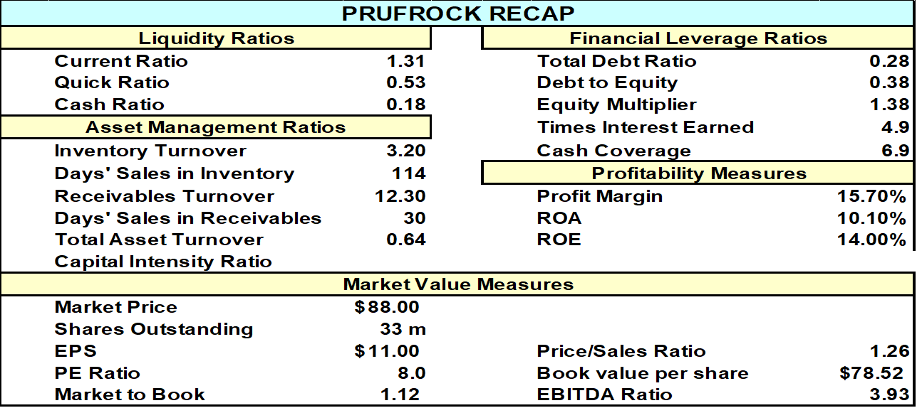
Prufrock Ratios

Slide 23
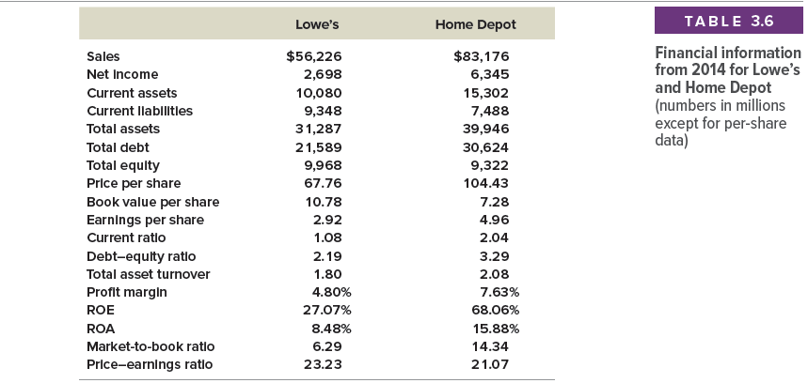
Financial Information Example for 2014 for Lowe’s and Home Depot (millions of dollars)

Slide 24
The DuPont Identity
Return on Equity = Net Income / Total Equity
= Basic Formula
ROE = PM * TAT * EM = DuPont Identity
  PM (profit margin) = Net Income / Sales
  TAT (Total asset turnover ) = Sales / Total Assets
  EM (Equity Multiplier) = Total Assets / Total Equity
Profit Margin Asset Use Leverage = ROE

Slide 25
Using the DuPont Identity
ROE = PM x TAT x EM
  Profit margin
    Measures firm’s operating efficiency
    How well does it control costs
  Total asset turnover
    Measures the firm’s asset use efficiency
    How well does it manage its assets
  Equity multiplier
    Measures the firm’s financial leverage
    EM = TA / TE = 1 + D/E ratio

Slide 26
Prufrock’s DuPont Identity
ROE = PM x TAT x EM
  PM = 15.7%
  TAT = 0.64
  EM = 1.39
ROE = 0.157 x 0.64 x 1.39 = 14%

Slide 27
Payout and Retention Ratios
Cash Dividends
Net Income
Dividend payout ratio =
Retention ratio or plowback ratio
=
Addition to Retained Earnings
Net Income
Dividend payout ratio (“1 – b”) Retention ratio (“b”)

Slide 28
Payout and Retention Ratios
Dividend payout ratio (“1 – b”)
= Cash dividends / Net income
= (DIV / NI) = 121 / 363 = 33.3%
Retention ratio (“b”) = (NI – DIV) / NI
  = Addition to Retained Earnings / Net income
  = $242 / 363 = 66.7%

Slide 29
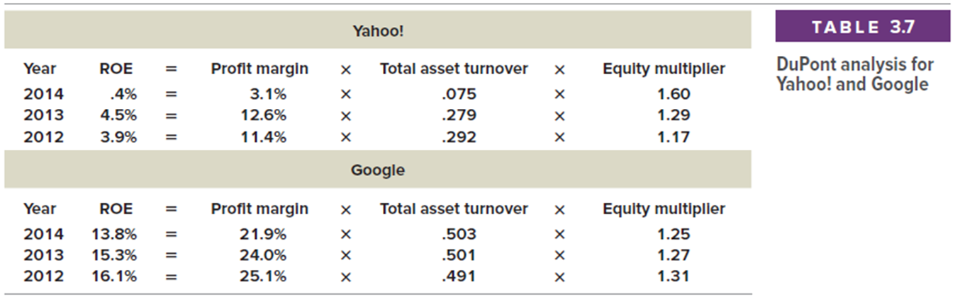
Determinants of Growth
Profit margin – operating efficiency
Total asset turnover – asset use efficiency
Financial leverage – choice of optimal debt ratio
Dividend policy – choice of how much to pay to shareholders versus reinvesting in the firm

Slide 30
Why Evaluate Financial Statements?
Internal uses
  Performance evaluation – compensation and comparison between divisions
  Planning for the future – guide in estimating future cash flows
External uses
  Creditors
  Suppliers
  Customers
  Stockholders
Benchmarking
Ratios need to be compared to something
Time-Trend Analysis
  How the firm’s performance is changing through time
  Internal and external uses
Peer Group Analysis
  Compare to similar companies or within industries
  SIC and NAICS codes
http://siccode.com/en/

Slide 31
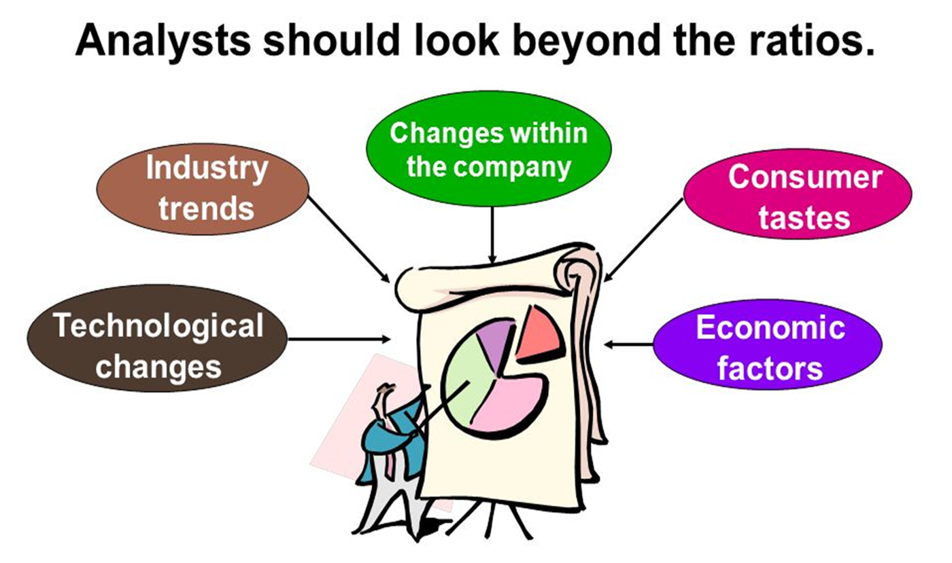
Problems with Financial Analysis
Conglomerates
  No readily available comparables
Global competitors
Different accounting procedures
Different fiscal year ends
Differences in capital structure
Seasonal variations and one-time events

Slide 32
Example: Work the Web
The Internet makes ratio analysis much easier than it has been in the past
Click on the Web surfer to go to www.reuters.com or https://finance.yahoo.com/ or https://www.investing.com/equities/
  Choose a company and enter its ticker symbol
  Click on “Financial Results” and “Key Ratios” to compare the firm to its industry and the S&P 500 for various ratio categories
  Change the ratio category using the links to the left of the chart.

