Slide 1
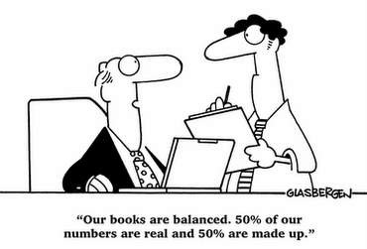
Chapter 2 Lecture - Financial Statements, Taxes, and Cash Flow

Slide 2
Learning Objectives
After studying this chapter, you should be able to:
LO1 Differentiate between accounting value (or “book” value) and market value.
LO2 Distinguish accounting income from cash flow.
LO3 Explain the difference between average and marginal tax rates.
LO4 Determine a firm's cash flow from its financial
Copyright (c) 2017 McGraw-Hill Education. All rights reserved. No reproduction or distribution without the prior written consent of McGraw-Hill Education.

Slide 3

The Balance Sheet
A snapshot of the firm’s assets and liabilities at a given point in time (“as of …”)
Assets
  Left-hand side (or upper portion)
  In order of decreasing liquidity
Liabilities and Owners’ Equity
  Right-hand side (or lower portion)
  In ascending order of when due to be paid
Balance Sheet Identity
  Assets = Liabilities + Stockholders’ Equity

Slide 4
The Balance Sheet
Beginners' Guide to Financial Statements

Slide 5
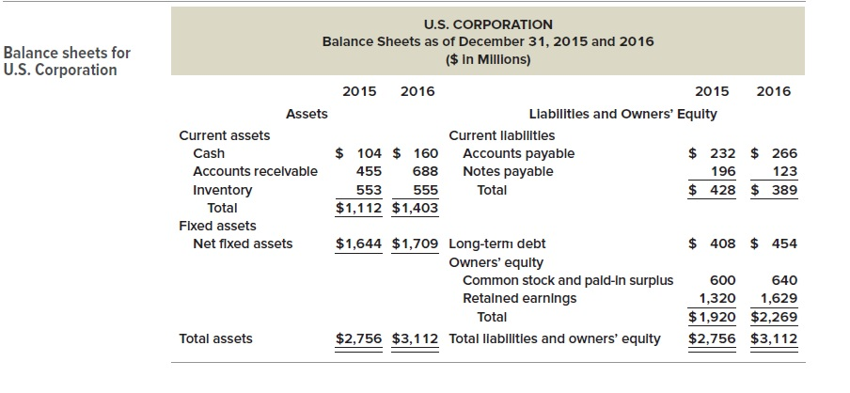
The Balance Sheet
Assets are generally listed based on how quickly they will be converted into cash. Current assets are things a company expects to convert to cash within one year. A good example is inventory.
Fixed assets are those assets used to operate the business but that are not available for sale, such as trucks, office furniture and other property.
Net Fixed Assets is the purchase price of all fixed assets (Land, buildings, equipment, machinery, vehicles, leasehold improvements) less accumulated Depreciation.

Slide 6
Balance Sheet Classification: Overview
ASSETS
LIABILITIES
EQUITY
=
+
Current assets
Property, plant and
equipment
Investments
Other assets
Current liabilities
Long-term debt
Other liabilities
Preferred and common stock
Additional paid-in capital
Retained earnings
Contributed
Capital

Slide 7
Elements of the Balance Sheet
How the money is invested
Where the money came from
ASSETS
LIABILITIES
EQUITY
=
+
Probable future economic benefits
Obtained from past transactions or events
The residual interest
in net assets.
Probable future sacrifices of economic benefits
Arising from present obligations
To transfer assets or provide services in the future
As a result of past transactions or events

Slide 8
The Balance Sheet
Net working capital
  Current Assets minus Current Liabilities
  Usually positive for a healthy firm
Liquidity
  Speed and ease of conversion to cash without significant loss of value
  Valuable in avoiding financial distress
NWC = Current Assets – Current Liabilities

Slide 9

Concept of Liquidity
Ability to convert to cash quickly without a significant loss in value
Liquid firms are less likely to experience financial distress
But liquid assets typically earn a lower return
Trade-off to find balance between liquid and illiquid assets

Slide 10
Balance Sheet Once Again

Slide 11

Debt versus Equity
Shareholders’ Equity = Assets - Liabilities
Versus
Book Value
Market Value
The balance sheet provides the book value of the assets, liabilities, and equity.
Market value is the price at which the assets, liabilities, or equity can actually be bought or sold.
1. Market value and book value are often very different. Why?
2. Which is more important to the decision-making process?

Slide 12
Book versus Market
Current assets and liabilities generally have book values and market values that are very close. This is not necessarily the case with the other assets, liabilities, and equity of the firm.
Assets are listed at historical costs less accumulated depreciation – this may bear little resemblance to what they could actually be sold for today
Liabilities are listed at face value. When interest rates change or the risk of the firm changes, the value of those liabilities change in the market as well. This is especially true for longer-term liabilities.

Slide 13
Book versus Market
Equity is the ownership interest in the firm. The market value of equity (stock price times number of shares) depends on the future growth prospects of the firm and on the market’s estimation of the current value of ALL of the assets of the firm.
The best estimate of the market value of the firm’s assets is market value of liabilities + market value of equity.
Market values are generally more important for the decision making process because they are more reflective of the cash flows that would occur today.

Slide 14
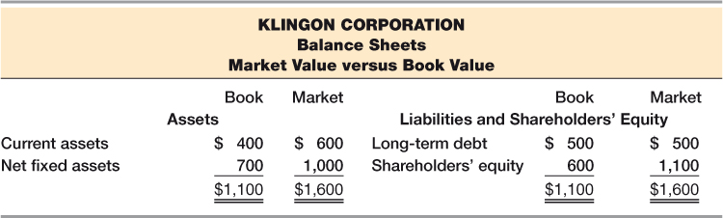

Slide 15
Income Statement
The income statement measures performance over a specified period of time (period, quarter, year).
Report revenues first and then deduct any expenses for the period
End result = Net Income = “Bottom Line”
  Dividends paid to shareholders
  Addition to retained earnings
Income Statement Equation:
  Net Income = Revenue - Expenses

Slide 16
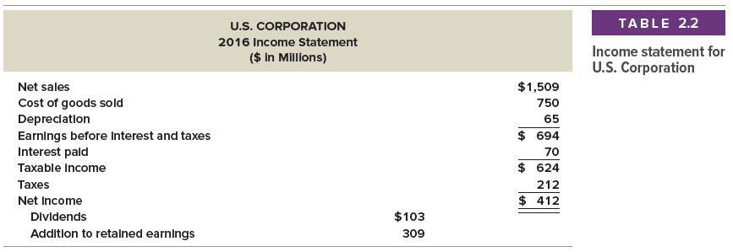

Slide 17
Noncash Items
A primary reason that accounting income differs from cash flow is that an income statement contains noncash items.
The most important of these is depreciation.
Suppose a firm purchases a fixed asset for $5,000 and pays in cash. Obviously, the firm has a $5,000 cash outflow at the time of purchase. However, instead of deducting the $5,000 as an expense, an accountant might depreciate the asset over a five-year period.
If the depreciation is straight-line and the asset is written down to zero over that period, then $5,000/5 = $1,000 would be deducted each year as an expense.
The important thing to recognize is that this $1,000 deduction isn't cash—it's an accounting number. The actual cash outflow occurred when the asset was purchased.

Slide 18
Time and Costs
It is often useful to think of the future as having two distinct parts: the short run and the long run.
The distinction has to do with whether costs are fixed or variable.
The distinction between fixed and variable costs is important, at times, to the financial manager, but the way costs are reported on the income statement is not a good guide as to which costs are which.
Accountants tend to classify costs as either product costs or period costs.
Product costs include such things as raw materials, direct labor expense, and manufacturing overhead. These are reported on the income statement as costs of goods sold, but they include both fixed and variable costs.
Similarly, period costs are incurred during a particular time period and might be reported as selling, general, and administrative expenses

Slide 19

Earnings and Dividend Per Share
EARNINGS AND DIVIDENDS PER SHARE
Suppose U.S. had 200 million shares outstanding at the end of 2014. Based on the income statement on Slide 16, what was EPS? What were dividends per share?
From the income statement, U.S. had a net income of $412 million for the year. Total dividends were $103 million. Since 200 million shares were outstanding, we can calculate earnings per share and dividends per share as follows:

Slide 20
Financial Statements
DEFINITION of 'Generally Accepted Accounting Principles - GAAP'
The common set of accounting principles, standards and procedures that companies use to compile their financial statements. GAAP are a combination of authoritative standards (set by policy boards) and simply the commonly accepted ways of recording and reporting accounting information.
GAAP Matching Principle:
  Recognize revenue when it is fully earned
  Match expenses required to generate revenue to the period of recognition
Noncash Items
  Expenses charged against revenue that do not affect cash flow
  Depreciation = most important

Slide 21
Financial Statements
Time and Costs
  Fixed or variable costs
  Not obvious on income statement
Earnings Management
  Smoothing earnings
  GAAP leaves “wiggle room”
  Global standardization of accounting
    GAAP versus International Financial Reporting Standards

Slide 22
Taxes
The one thing we can rely on with taxes is that they are always changing!
We must distinguish between marginal vs. average tax rates - See next slide
Other taxes
  State
  Local (City or Town)
  Will vary by countries

Slide 23


Slide 24
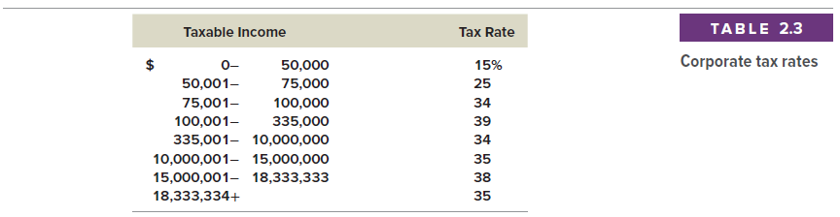
Corporate Progressive Taxes
Marginal Tax Rate: The tax rate you would pay if you had one more taxable dollar
Average Tax Rate: The tax rate you are paying on all of your taxable income which averages across all of your corporate tax categories

Slide 25
Example: Marginal Vs. Average Rates
Suppose your firm earns $4 million in taxable income.
  What is the firm’s tax liability?
  What is the average tax rate?
  What is the marginal tax rate?
If you are considering a project that will increase the firm’s taxable income by $1 million, what tax rate should you use in your analysis?

Slide 26
Tax on $4 million

Slide 27
The Concept of Cash Flow
Cash flow = one of the most important pieces of information that can be derived from financial statements
The accounting Statement of Cash Flows does not provide the same information that we are interested in here
Our focus: how cash is generated from utilizing assets and how it is paid to those who finance the asset purchase.

Slide 28
Cash Flow From Assets
Cash Flow From Assets (CFFA)
= Operating Cash Flow (OCF)
– Net Capital Spending (NCS)
– Changes in NWC (ΔNWC)
Cash Flow From Assets (CFFA)
= Cash Flow to Creditors (CF/CR)
+ Cash Flow to Stockholders (CF/SH)

Slide 29
Example: U.S. Corporation
CFFA = OCF – NCS - ΔNWC
OCF = EBIT + depreciation – taxes
= $694 + 65 – 212 = $547
NCS = ending net FA– beginning net FA + depreciation
= $1709 – 1644 + 65 = $130
ΔNWC = ending NWC – beginning NWC
  = ($1403 – 389) – ($1112 – 428) = $330
CFFA = 547 – 130 – 330 = $87

Slide 30
Example: U.S. Corporation
CFFA = CF/CR (creditors) + CF/SH (shareholders)
CF/CR = interest paid – net new borrowing
= $70 – ($454 – 408) = $24
CF/SH = dividends paid – net new equity
= $103 – ($640 – 600) = $63
CFFA = $24 + $63 = $87

Slide 31
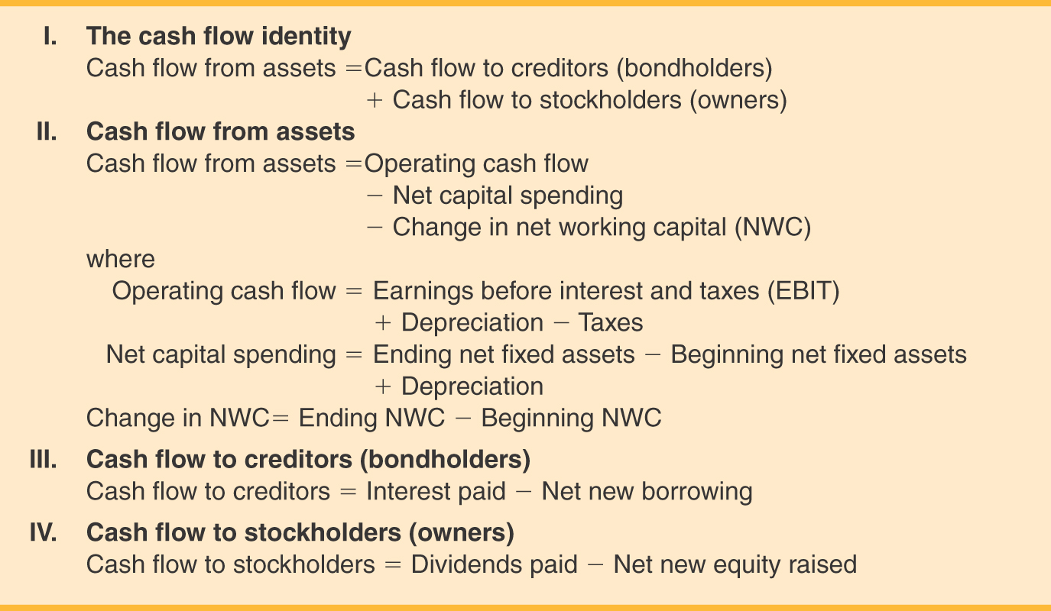
Cash Flow Summary

Slide 32


