Slide 1
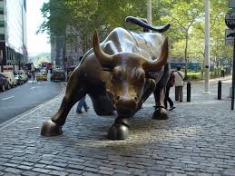



Chapter 1 Lecture - Introduction to Financial Management

Slide 2
Learning Objectives
After studying this chapter, you should be able to:
LO1 Discuss the basic types of financial management decisions and the role of the financial manager.
LO2 Identify the goal of financial management.
LO3 Compare the financial implications of the different forms of business organizations.
LO4 Describe the conflicts of interest that can arise between managers and owners
Copyright (c) 2017 McGraw-Hill Education. All rights reserved. No reproduction or distribution without the prior written consent of McGraw-Hill Education.

Slide 3
Basic Areas Of Finance
Corporate finance = Business Finance
Investments - Work with financial assets such as stocks and bonds. Looks at the value of financial assets, risk versus return, and asset allocation
    Job opportunities such as Stockbroker or Financial Advisor, Portfolio Manager, Security analyst
Financial institutions - Companies that specialize in financial matters
    Banks – commercial and investment, credit unions, savings and loans
    Insurance companies
    Brokerage firms
      Job opportunities such as Banker, Commercial lender etc.
International finance

Slide 4
International Finance
An area of specialization within each of the areas discussed so far
May allow you to work in other countries or at least travel on a regular basis
Need to be familiar with exchange rates and political risk
Need to understand the customs of other countries; speaking a foreign language fluently is also helpful

Slide 5
Why Study Finance?
Marketing
  Budgets, marketing research, marketing financial products
Accounting
  Dual accounting and finance function, preparation of financial statements
Management
  Strategic thinking, job performance, profitability
Personal finance
  Budgeting, retirement planning, college planning, day-to-day cash flow issues

Slide 6
Why is Corporate Finance Important to All Managers?
Corporate finance provides the skills managers need to:
  Identify and select the corporate strategies and individual projects that add value to their firm.
  Forecast the funding requirements of their company, and devise strategies for acquiring those funds
Some important questions that are answered using finance:
What long-term investments should the firm take on?
Where will we get the long-term financing to pay for the investment?
    Should we use debt or equity?
How will we manage the everyday financial activities of the firm?

Slide 7


Financial Managers
Chief Financial Officer (CFO):The top financial manager within a firm
Treasurer: Oversees cash management, credit management, capital expenditures, and financial planning
Controller: Oversees taxes, cost accounting, financial accounting and data processing

Slide 8
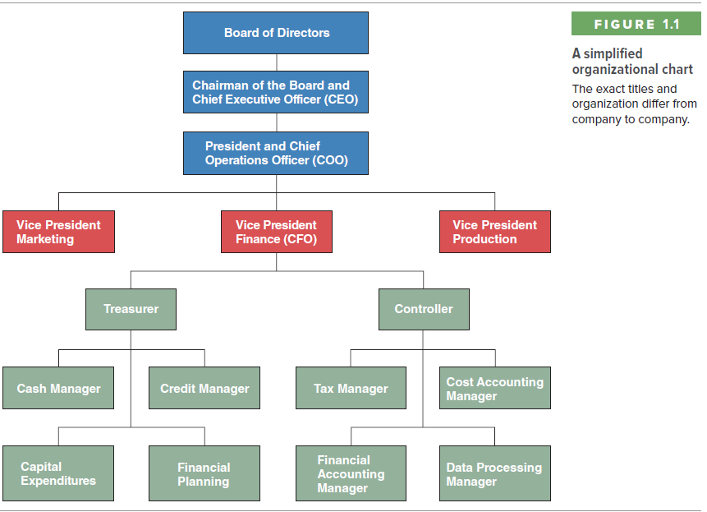
Corporate Organization Chart

Slide 9

Financial Management Decisions
Capital Budgeting - The process of planning and managing a firm's long-term investments. This means that the value of the cash flow generated by an asset exceeds the cost of that asset.
Evaluating the size, timing, and risk of future cash flows is the essence of capital budgeting.

Slide 10
Financial Management Decisions
Capital Structure - ways in which the firm obtains and manages the long-term financing it needs to support its long-term investments.
Needs to be concerned with the specific mixture of long-term debt and equity the firm uses to finance its operations.
The financial manager has two concerns in this area.
  (1) How much should the firm borrow? That is, what mixture of debt and equity is best? The mixture chosen will affect both the risk and the value of the firm.
  (2) What are the least expensive sources of funds for the firm?

Slide 11
Financial Management Decisions
Working Capital Management - working capital refers to a firm's short-term assets, such as inventory, and its short-term liabilities, such as money owed to suppliers.
Managing the firm's working capital is a day-to-day activity that ensures that the firm has sufficient resources to continue its operations and avoid costly interruptions.
Some questions about working capital that must be answered are the following:
  (1) How much cash and inventory should we keep on hand?
  (2) Should we sell on credit? If so, what terms will we offer, and to whom will we extend them?
  (3) How will we obtain any needed short-term financing?

Slide 12
Forms of Business Organization in the U.S.
Sole Proprietorship
  Single Owner
Partnership
  General
  Limited
Corporation
  C-Corporation
  S-Corporation
  Limited Liability Company (LLC)

Slide 13

Sole Proprietorship
Disadvantages:
  Limited to life of owner
  Equity capital limited to owner’s personal wealth
  Unlimited liability
  Difficult to sell ownership interest
Advantages:
  Easiest to start
  Least regulated
  Single owner keeps all the profits
  Taxed once as personal income

Slide 14

Partnership
Advantages:
  Two or more owners
  More capital available
  Relatively easy to start
  Income taxed once as personal income
Disadvantages:
Unlimited liability
General partnership
Limited partnership
Partnership dissolves when one partner dies or wishes to sell
Difficult to transfer ownership

Slide 15
Corporation
Advantages:
  Limited liability
  Unlimited life
  Separation of ownership and management
  Transfer of ownership is easy
  Easier to raise capital
Disadvantages:
  Separation of ownership and management
  Double taxation (income taxed at the corporate rate and then dividends taxed at the personal rate)

Slide 16
Other Types of Business Ownership
Most corporations (in the USA) are C corporations, which are taxed as an entity by the federal government.
The S-corporation gives small business owners limited liability protection, but taxes company profits only once, when they are paid out as dividends. It can’t have more than one hundred stockholders.
A limited-liability company (LLC) is similar to an S-corporation: its members are not personally liable for company debts and its earnings are taxed only once, when they’re paid out as dividends. But it has fewer rules and restrictions than does an S-corporation. For example, an LLC can have any number of members.
A cooperative is a business owned and controlled by those who use its services. Individuals and firms who belong to the cooperative join together to market products, purchase supplies, and provide services for its members.
A not-for-profit corporation is an organization formed to serve some public purpose rather than for financial gain. It enjoys favorable tax treatment.

Slide 17
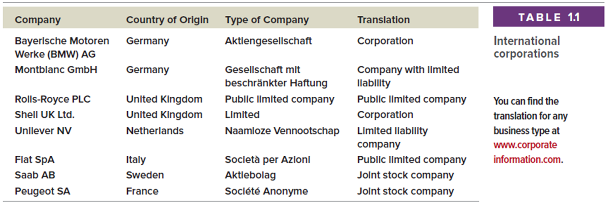
International Corporate Forms
All of these forms feature public ownership and limited liability
http://www.forbes.com/global2000/list

Slide 18
Goal of Financial Management
What should be the goal of a corporation?
  Maximize profits?
  Minimize costs?
  Maximize market share?
  Maximize the current value of the company’s stock?
Does this mean we should do anything and everything to maximize owner wealth?

Slide 19
What Should Management’s Primary Objective Be?
The primary objective should be shareholder wealth maximization, which usually translates to maximizing stock price
Should firms behave ethically? YES!
Do firms have any responsibilities to society at large? YES! Shareholders are also members of society.

Slide 20
Shareholder Wealth Maximization
Considers the timing and risk of the benefits from stock ownership
Determines that a good decision increases the price of the firm's common stock ( c/s )
Is an impersonal objective
Is concerned for social responsibility
Social Responsibility
Ethical issues will constantly confront financial managers as they achieve the goal of the firm ( SWM ).
Managers Must:
Avoid personal conflicts
Maintain confidentiality
Be objective
Act fairly

Slide 21

Maximizing Stock Price – Is it Good for Society, Employees, and Customers?
Employment growth is higher in firms that try to maximize stock price. On average, employment goes up in:
  firms that make managers into owners (such as LBO firms)
  firms that were owned by the government but that have been sold to private investors
What about SOEs?

Slide 22
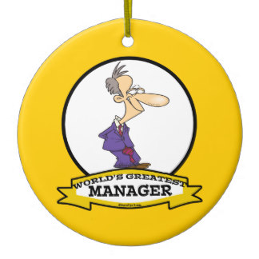
Managing Managers
Managerial compensation
  Incentives can be used to align management and stockholder interests
  The incentives need to be structured carefully to make sure that they achieve their goal
Corporate control
  The threat of a takeover may result in better management
Other stakeholders

Slide 23
The Agency Problem
Agency relationship
  Principal hires an agent to represent his/her interests
  Stockholders (principals) hire managers (agents) to run the company
Agency problem
  Conflict of interest between principal and agent
Management goals and agency costs

Slide 24
Agency Relationship and/or Problem?
An agency relationship arises whenever one or more individuals, called principals, (1) hires another individual or organization, called an agent, to perform some service and (2) then delegates decision-making authority to that agent.
If you are the only employee, and only your money is invested in the business, would any agency problems exist?
  No agency problem would exist.
  A potential agency problem arises whenever the manager of a firm owns less than 100 percent of the firm’s common stock
Notes:
7

Slide 25
Agency Relationship and/or Problem?
An agency relationship could exist between you and your employees if you, the principal, hired the employees to perform some service and delegated some decision-making authority to them.
If you needed additional capital to buy computer inventory or to develop software then you might end up with agency problems if the capital is acquired from outside investors.
Agency problems are less for secured than for unsecured debt, and different between stockholders and creditors.
Thus, it matters whether the new capital comes in the form of an unsecured bank loan, a bank loan secured by your inventory of computers, or from new stockholders.

Slide 26
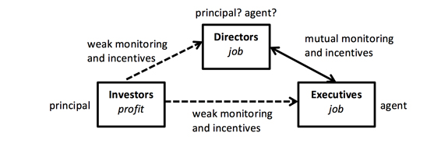
Two Potential Agency Conflicts
Conflicts between stockholders and managers.
  Compensation
  Direct intervention
  Threat of firing
  Hostile Takeovers
Conflicts between stockholders and creditors.
Question: Would expansion increase or decrease potential agency problems?

Slide 27
Why Might You Want to Make Your Financial Statements Look Artificially Good?
A manager might inflate a firm's reported earnings or make its debt appear to be lower if he or she wanted the firm to look good temporarily. For example just prior to exercising stock options or raising more debt.
What are the Potential Consequences of Inflating Earnings or Hiding Debt?
If the firm is publicly traded, the stock price will probably drop once it is revealed that fraud has taken place. If private, banks may be unwilling to lend to it, and investors may be unwilling to invest more money.

Slide 28
What Kind of Compensation Program Might you Use to Minimize Agency Problems?
“Reasonable” annual salary to meet living expenses
Cash (or stock) bonus
Options to buy stock or actual shares of stock to reward long-term performance
Tie bonus/options to value of the company

Slide 29
Transparency in Financial Reporting
Transparency requires that market participants have reliable, accurate information about a particular company.
Sarbanes-Oxley (USA)
An act passed in 2002 that established new regulations for auditors, corporate officers, and securities analysts.
The goal was to make it less likely that companies and securities analysts would mislead investors, and increase the penalties for doing so.

Slide 30
Ethics Issues
Is it ethical for tobacco companies to sell a product that is known to be addictive and a danger to the health of the user? Is it relevant that the product is legal?
Should boards of directors consider only price when faced with a buyout offer?
Is it ethical to concentrate only on shareholder wealth, or should stakeholders as a whole be considered?
Should firms be penalized for attempting to improve returns by stifling competition (e.g., Microsoft)?
Notes:
These Ethics Issues can be addressed throughout the chapter or as a dedicated discussion as given here.
The second issue relates to the buyout offer for Gillette that was rejected due to information regarding the launch of the highly successful “Sensor” razor.

Slide 31
Short-Term vs. Long-Term Price
Management can impact the market price over the short term by releasing incomplete or inaccurate information.
Over the long term the market price will tend towards the fundamental value as more information becomes available.
What about the 2009 financial crisis?
Credit Crisis Explained

Slide 32
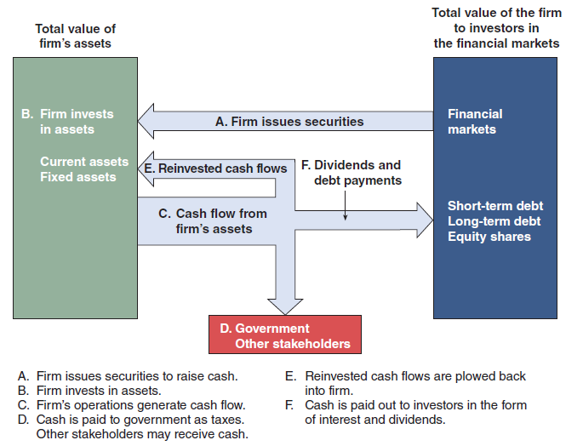
Cash Flows Between the Firm and the Financial Markets

Slide 33
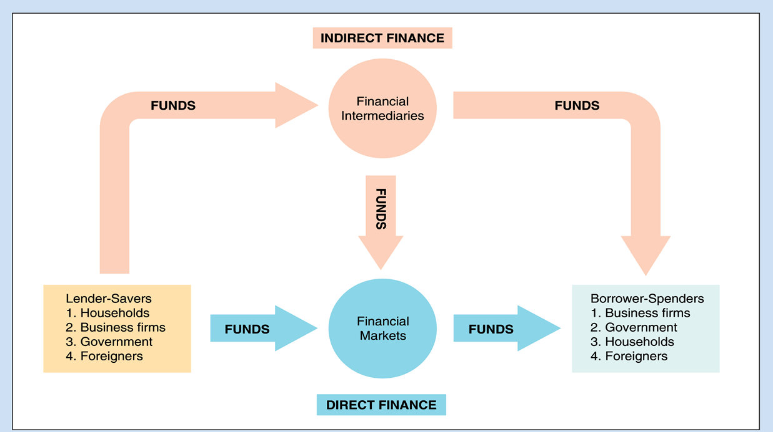
Flows of Funds Through the Financial System
Cash flows to the firm
Primary vs. secondary markets
  Dealer vs. auction markets
  Listed vs. over-the-counter securities

Slide 34
Structure of Financial Markets
Debt and Equity Markets.
  Bonds are debt, stocks are equity.
The primary market is the market where investors purchase newly issued securities.
  Initial public offering (IPO): An IPO occurs when a company offers stock for sale to the public for the first time.
  Seasoned equity offering (SEO): If a company already has public shares, an SEO occurs when a company raises more equity.
The secondary market is the market where investors trade previously issued securities. An investor can trade:
  Directly with other investors.
  Indirectly through a broker who arranges transactions for others.
  Directly with a dealer who buys and sells securities from inventory.
Securities and Exchange Commission
Qatar Financial Markets Authority

Slide 35
Dealer Market
Security dealers sell/buy for their own account
Help to stabilize the market
Commit own capital in process of bringing sellers and buyers together
Expect to earn a profit by “buying low and selling high”
Take a risk on a change of price in the securities they own
Most securities trade in dealer markets
Over-the counter (OTC)
  Network of dealers linked together by telephone or computers
Good marketability of a security implies it can be sold, liquidated, and turned into cash very quickly without a collapse in price

Slide 36
Auction Market
Buyers and sellers confront each other directly to set the price
Either a single trade between all parties at a single price or a series of trades at different prices
Particular rules of the auction determine exactly how buyers and sellers are matched up.
All buy/sell orders are centralized so highest bidders and lowest offers are exposed to each other
Posts—Specific locations where auctions for individual securities take place
Specialists—Individual designated by the exchange to represent buy/sell orders tendered by customers

Slide 37
Brokered Market
Buyers/sellers employ services of a broker to search for information about the “other side” of the trade
Broker’s role is to provide information
Brokers earn a commission
Real estate brokers—provide information for buyers/sellers of homes
Municipal bonds are traded primarily in a brokered market

Slide 38
Structure of Financial Markets
Organized Exchanges and Over-the-Counter (OTC) Markets
Money and Capital Markets
  Money markets deal in short-term debt instruments. Securities with maturity less than a year. Ex: Repo and reverse-repo market. Short-term liquidity is traded in money markets. Trade Volume is higher in money markets. Capital markets deal in longer-term debt and
  equity instruments. Bonds with maturity longer than a year and stocks are capital markets. “Long-term securities” refer to longer than 10 years.
Financial markets
Primary markets
Secondary markets
Money market
Capital market
Organized exchanges
Over-the-counter

Slide 39
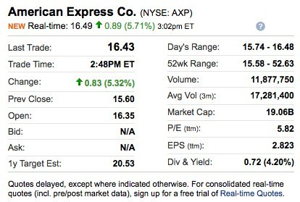
Stock Quotes
Go to finance.yahoo.com and find the current stock prices for Southwest Airlines (LUV), Harley-Davidson (HOG), and Starwood Hotels & Resorts (HOT).
Get an updated quote for American Express (AXP) and follow the “Key Statistics” link. What information is available on this link? What do mrq, ttm, yoy, and lfy mean?

Slide 40
World Stock Markets
Asian-Pacific Stock Indexes
Europe, Africa, Middle East Stock Indexes
Qatar Stock Index
U.S., North/Latin America Stock Indexes
World Stock Indexes

