Slide 1

Chapter 15 Lecture – Raising Capital

Slide 2
Learning Objectives
After studying this chapter, you should be able to:
LO1 Explain the venture capital market and its role in the financing of new, high-risk ventures.
LO2 Describe how securities are sold to the public and the role of investment banks in the process.
LO3 Explain initial public offerings and identify some of the costs of going public.

Slide 3
Venture Capital
“Private Equity”
Private financing for new, high risk businesses in exchange for stock
  Individual investors
  Venture capital firms
Usually involves active participation by VC
Ultimate goal: take company public; the VC will benefit from the capital raised in the IPO
Hard to find
Expensive

Slide 4
Venture Capital Stage Financing
Funding provided in several stages
Contingent upon specified goals at each stage
First stage
  “Ground floor” or “Seed money”
  Fund prototype and manufacturing plan
Second Stage
  “Mezzanine” financing
  Begin manufacturing, marketing & distribution
Choosing a Venture Capitalist
Financial strength
Compatible management style
Obtain and check references
Contacts
Exit strategy

Slide 5
Selling Securities to the Public
Management obtains permission from the Board of Directors
Firm files a registration statement with the SEC
SEC examines the registration during a 20-day waiting period
Securities may not be sold during the waiting period
A preliminary prospectus, called a red herring, is distributed during the waiting period
  - If problems, the company amends the registration, and the waiting period starts over
Price per share determined on the effective date of the registration and the selling effort begins

Slide 6
Issue Methods
Public Issue
  Registration with SEC required
  General cash offer = offered to general public
  Rights offer = offered only to current shareholders
  IPO = Initial Public Offering = Unseasoned new issue
  SEO = Seasoned Equity Offering
Private Issue
  Sold to fewer than 35 investors
  SEC registration not required

Slide 7
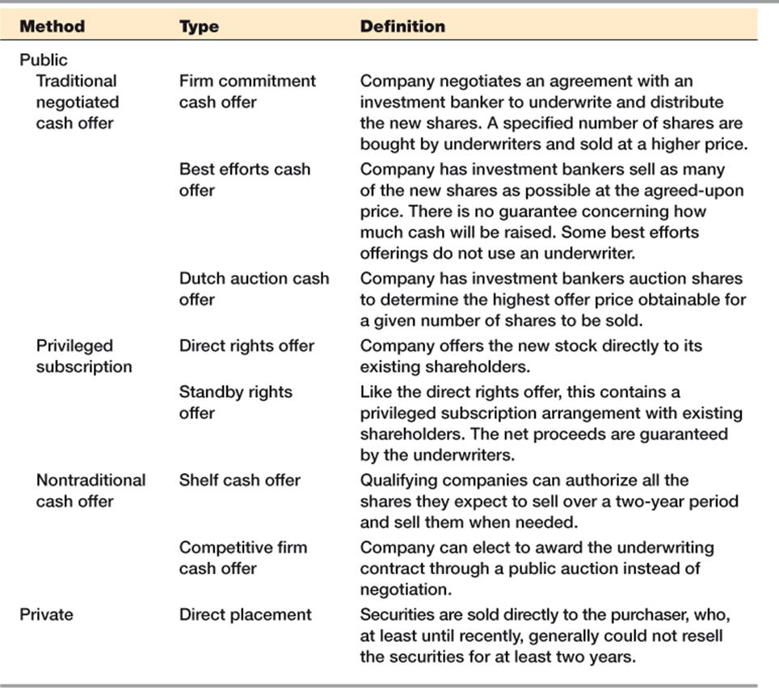
Methods of Issuing New Securities

Slide 8
Underwriters
Underwriting services:
  Formulate method to issue securities
  Price the securities
  Sell the securities
  Price stabilization by lead underwriter in the aftermarket
Syndicate = group of investment bankers that market the securities and share the risk associated with selling the issue
Spread = difference between what the syndicate pays the company and what the security sells for in the market

Slide 9
Dutch or Uniform Price Auction
Buyers:
  Bid a price and number of shares
Seller:
  Work down the list of bidders
  Determine the highest price at which they can sell the desired number of shares
All successful bidders pay the same price per share.
Encourages aggressive bidding

Slide 10
Dutch or Uniform Price Auction Example
The company wants to sell 1,500 shares of stock.
The firm will sell 1,500 shares at $15 per share.
Bidders A, B, C, and D will get shares.

Slide 11
Green Shoe Provision
“Overallotment Option”
Allows syndicate to purchase an additional 15% of the issue from the issuer
Allows the issue to be oversubscribed
Provides some protection for the lead underwriter as they perform their price stabilization function
In all IPO and SEO offerings but not in ordinary debt offerings
Lockup Agreements
Not legally required but common
Restricts insiders from selling IPO shares for a specified time period
  Common lockup period = 180 days
Stock price tends to drop when the lockup period expires due to market anticipation of additional shares hitting the Street

Slide 12
Seasoned Equity Offerings
Stock prices tend to decline when new equity is issued
Signaling explanations:
  Equity overvalued: If management believes equity is overvalued, they would choose to issue stock shares
  Debt usage: Issuing stock may indicate firm has too much debt and can not issue more debt
Issue costs
  Issue costs for equity – direct and indirect - are significantly more than for debt

Slide 13
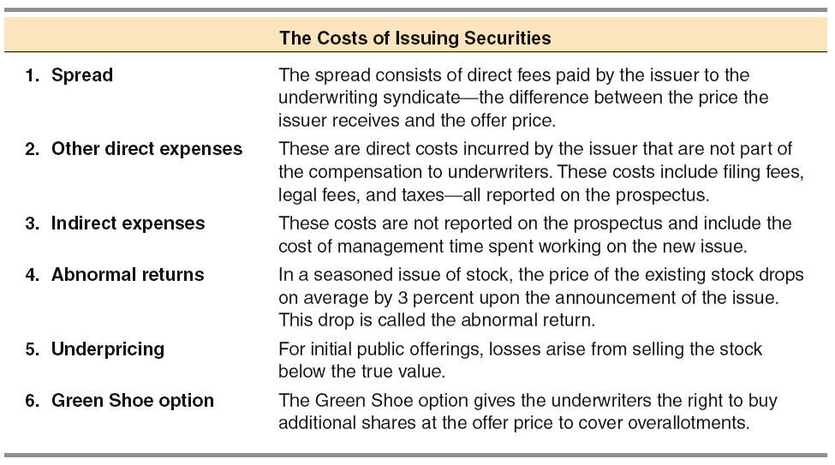
The Cost of Issuing Securities

Slide 14
How are Start-up Firms
Unusually Financed?
Founder’s resources
Angels
Venture capital funds
  Most capital in fund is provided by institutional investors
  Managers of fund are called venture capitalists
  Venture capitalists (VCs) sit on boards of companies they fund

Slide 15
Why Would a Company Consider
Going Public?
Advantages of going public
  Current stockholders can diversify.
  Liquidity is increased.
  Easier to raise capital in the future.
  Going public establishes firm value.
  Makes it more feasible to use stock as employee incentives.
  Increases customer recognition.

Slide 16
Disadvantages of Going Public
  Must file numerous reports.
  Operating data must be disclosed.
  Officers must disclose holdings.
  Special “deals” to insiders will be more difficult to undertake.
  A small new issue may not be actively traded, so market-determined price may not reflect true value.
  Managing investor relations is time-consuming.

Slide 17
What are Equity Carve-Outs?
A special IPO in which a parent company creates a new public company by selling stock in a subsidiary to outside investors.
Parent usually retains controlling interest in new public company.
A rights offering occurs when current shareholders get the first right to buy new shares.
Shareholders can either exercise the right and buy new shares, or sell the right to someone else.
Wealth of shareholders doesn’t change whether they exercise right or sell it.
What is a Rights Offering?

Slide 18
What is Meant by Going Private?
Going private is the reverse of going public.
Typically, the firm’s managers team up with a small group of outside investors and purchase all of the publicly held shares of the firm.
The new equity holders usually use a large amount of debt financing, so such transactions are called leveraged buyouts (LBOs).

Slide 19
Advantages of Going Private
Gives managers greater incentives and more flexibility in running the company.
Removes pressure to report high earnings in the short run.
After several years as a private firm, owners typically go public again. Firm is presumably operating more efficiently and sells for more.
Firms that have recently gone private are normally leveraged to the hilt, so it’s difficult to raise new capital.
A difficult period that normally could be weathered might bankrupt the company.
Disadvantages of going private

Slide 20
More on Angel Investors (vs. private investors)
Invest money in seed, startup
and early stage companies
Invest time in entrepreneurs and their companies
      Business acumen
      Mentoring and coaching
      Serve on boards
      Make business introductions
Notes:
This slide addresses some confusion about angel investing, specifically:
In most deals, angel do not compete with VCs to fund entrepreneurs. Most VCs are later stage investors and are not looking to make investments in the range of $250,000 to $1,000,000. Angels dominate this early stage market.
Investors who provide equity capital in the range of $250,000 to $1,000,000 to early stage companies are not angel investors unless they have also made a substantial commitment of time to spend mentoring and coaching entrepreneurs and serving on Board of portfolio companies. It is not necessary for angels to be engaged with all portfolio companies, but some substantial commitment of time working with entrepreneurs is required. Those who do not commit time to entrepreneurs and choose to remain passive are private investors. Private investors provide important capital to starting companies but do not fall within the definition of angels.

Slide 21
Who are these Angel Investors
Often successful, exited entrepreneurs or retired business persons – active investors
  Invest both time and money in companies
Accredited Investors - SEC definition
Angels invest their own money (not money managers)
Investing in local companies
Notes:
While successful entrepreneurs and businesspersons who still hold full time positions in their ventures can bring substantial money and important experiences to angel investing, the heavy lifting of angels in angel groups is done by retired businesspersons and exited entrepreneurs. The differentiating element is the amount of time that can be dedicated to running the organization and working with portfolio companies. It is difficult to operate a member-led angel organization when all members have full time jobs, which often leads to choosing a manager-led organizational model.
Unlike VCs (who are money managers), angel investors are investing their own money in early stage companies. Because they are investing their own money, angels have a variety of motivations for angel investing.

Slide 22
Motivation: Why Become an Angel Investor?
Helping entrepreneurs
Stay engaged – using skills and
experiences to help build a business
Giving back to community or university
An active form of investing –
not just watching markets
Return on Investment is the metric
Notes:
Each angel investors seems to be motivated by a different set of these factors. There is no single model for describing the motivation of angel investors.

Slide 23
Entrepreneur-Friendly Communities
VCs
Service
Providers
Funding
Sources
Grants
Banks
SBIRs
Angels
Mentors
Coaches
Role models
ENTREPRENEURS
Colleges &
Universities
Entrepreneurship
Center
Companies
Sources of
Technology
Innovations
Product Ideas
Bus Plans
Education
Networking
Talented People
Labs
Notes:
An entrepreneur-friendly community has many components.
Sources of product ideas, high tech or no tech.
Knowledgeable service providers.
Experienced businesspersons and exited entrepreneurs are needed for mentoring and coaching start-up entrepreneurs.
An Entrepreneurship center to provide educational and networking opportunities and to help with the development of business plans.
A pool of talented people with both technical and management skills.
And, as these critical ingredients are established, it is also necessary to foster a variety of funding sources for entrepreneurs. Angel investors are a critical source of seed/startup and early stage venture capital.

Slide 24
