Slide 1
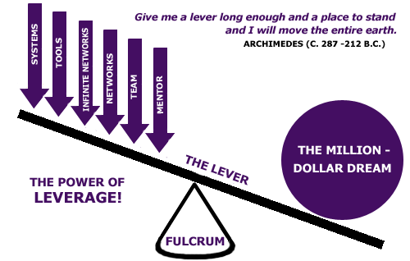
Chapter 13 Lecture - Leverage and Capital Structure

Slide 2
Capital Structure
Capital structure = percent of debt and equity used to fund the firm’s assets
  “Leverage” = use of debt in capital structure
Capital restructuring = changing the amount of leverage without changing the firm’s assets
  Increase leverage by issuing debt and repurchasing outstanding shares
  Decrease leverage by issuing new shares and retiring outstanding debt

Slide 3
Capital Structure & Shareholder Wealth
The primary goal of financial managers:
  Maximize stockholder wealth
Maximizing shareholder wealth =
  Maximizing firm value
  Minimizing WACC
Objective: Choose the capital structure that will minimize WACC and maximize stockholder wealth

Slide 4
Business Risk versus Financial Risk
Business risk:
  Uncertainty in future EBIT.
  Depends on business factors such as competition, operating leverage, etc.
Financial risk:
  Additional business risk concentrated on common stockholders when financial leverage is used.
  Depends on the amount of debt and preferred stock financing.

Slide 5
Business Risk
The variability or uncertainty of a firm’s operating income (EBIT).
Stock-
holders
EBIT
FIRM
EPS
Affected by:
Sales volume variability
Competition
Cost variability
Product
Diversification
Product demand
Operating Leverage

Slide 6
Business Risk: Uncertainty about Future Pre-tax Operating Income (EBIT)
Probability
Low risk
High risk
0
E(EBIT)
EBIT
Note that business risk focuses on operating income, so it ignores financing effects.

Slide 7
Financial Risk
The variability or uncertainty of a firm’s earnings per share (EPS) and the increased probability of insolvency that arises when a firm uses financial leverage.
Stock-
holders
EBIT
FIRM
EPS

Slide 8
So What Exactly is Leverage?
Ability to influence a system, or an environment, in a way that multiplies the outcome of one's efforts without a corresponding increase in the consumption of resources. In other words, leverage is an advantageous-condition of having a relatively small amount of cost yield a relatively high level of returns. Thus, "doing a lot with a little."

Slide 9
What is Leverage in Business?
Remember it is the use of special forces and effects to magnify or produce more than the normal results from a given course of action
Leverage involves using fixed costs to magnify the potential return to a firm
  Can produce beneficial results in favorable conditions
  Can produce highly negative results in unfavorable conditions

Slide 10
Leverage in a Business
Determining type of fixed operational costs
  Plant and equipment
    Can reduce expensive labor in production of inventory
  Expensive labor
    Lessens opportunity for profit but reduces risk exposure
Determining type of fixed financial costs
  Debt financing
    Can produce substantial profits, but failure to meet contractual obligations can result in bankruptcy
  Selling equity
    May reduce potential profits for existing shareholders, but reduces their risk exposure

Slide 11
Two Concepts that Enhance Understanding of Risk
Operating Leverage - affects a firm’s business risk.
2) Financial Leverage - affects a firm’s financial risk.
The use of fixed operating costs as opposed to variable operating costs.
A firm with relatively high fixed operating costs will experience more variable operating income if sales change.
The use of fixed-cost sources of financing (debt, preferred stock) rather than variable-cost sources (common stock).

Slide 12
Operating Leverage and the Break-Even (Quantity) Point
Break-Even Point – The sales volume required so that total revenues and total costs are equal; may be in units or in sales dollars
  How to find the quantity break-even point:
  P = Price per unit AVC = Variable costs per unit
  TFC = Fixed costs Q = Quantity (units) produced
  and sold
  EBIT = TR – TC = PQ – AVC(Q) – TFC
  EBIT = (P – AVC)Q - TFC

Slide 13
Break-Even (Quantity) Point
Breakeven occurs when EBIT = 0
  EBIT = (P – AVC) Q – TFC = 0
  (P – AVC) Q_{BE} – TFC = 0
  (P – AVC) Q_{BE} = TFC
  Q_{BE} = TFC / (P – AVC)
a.k.a. Unit Contribution Margin
A leveraged firm has a high BE point
A non-leveraged firm has a low BE point

Slide 14
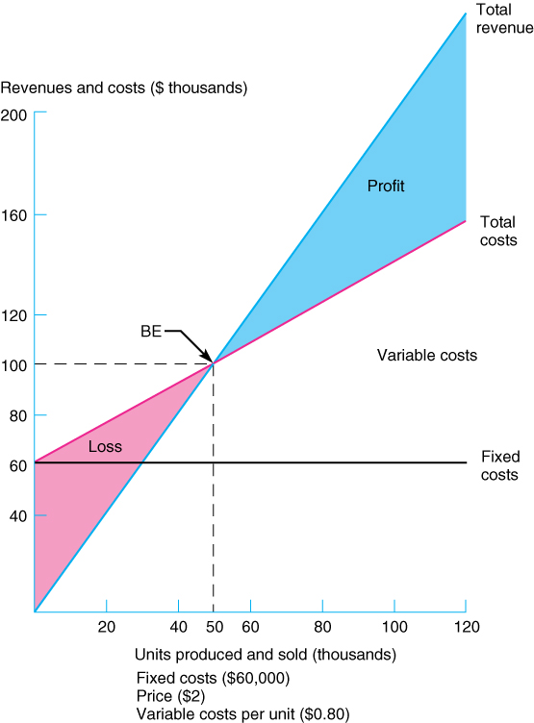
Break-Even Chart: Leveraged firm

Slide 15
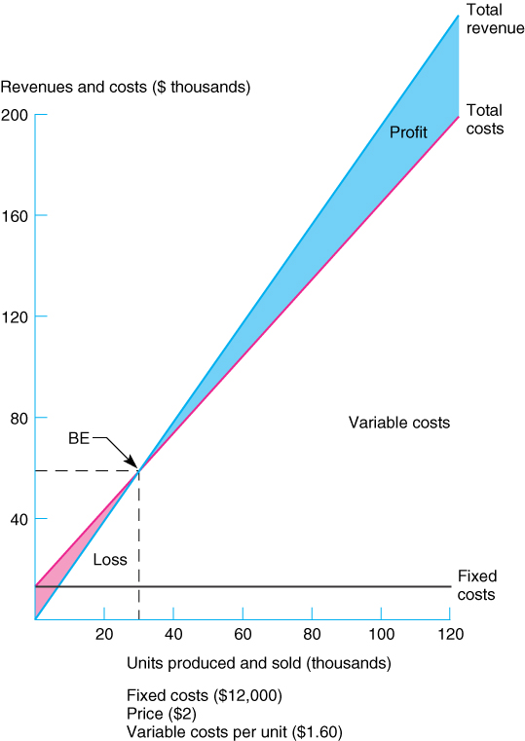
Break-Even Chart: Conservative or Unleveraged firm

Slide 16
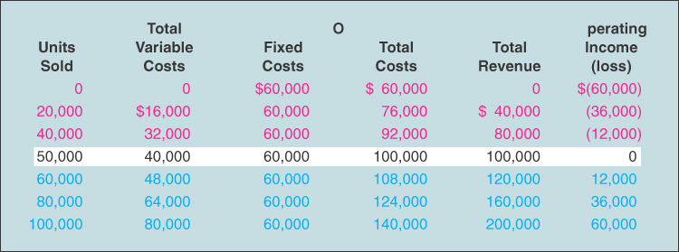
Volume-Cost-Profit Analysis:
Leveraged Firm

Slide 17
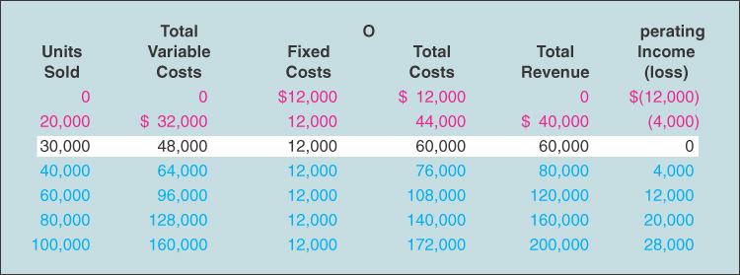
Volume-Cost-Profit Analysis:
Conservative or Unleveraged Firm

Slide 18
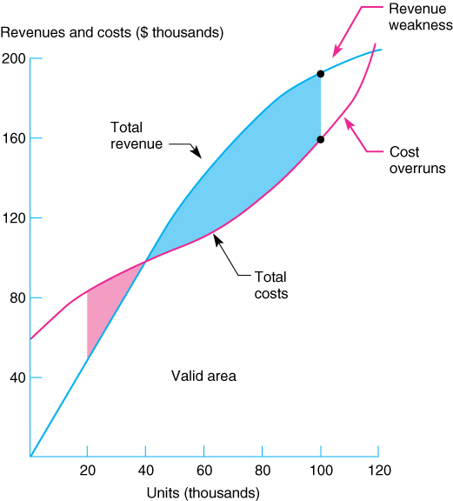
Nonlinear Break-Even Analysis

Slide 19
Degree of Operating Leverage (DOL)
Measure of the amount of fixed operating costs used by a firm.
Operating leverage amplifies changes in sales volume into larger changes in EBIT
Degree of Operating Leverage (DOL) = %⬇ in EBIT (or Operating Income) / % ⬇ in Sales
DOL = Q(P-AVC) / (Q(P-AVC) – TFC)
Operating Leverage measures the sensitivity of a firm’s operating income to a ⬇ in sales.

Slide 20
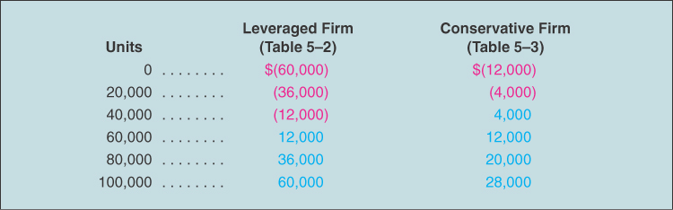
Operating Income or Loss

Slide 21
Computing the DOL – Leveraged Firm
DOL (at Q = 40000) = Q(P-AVC) / (Q(P-AVC) – TFC)
= TR - TVC/(TR – TVC – TFC
= (80000 – 32000)/(80000 – 32000 - 60000) = 48000/-12000 = -4
DOL (at Q = 60000) = Q(P-AVC) / (Q(P-AVC) – TFC)
= TR - TVC/(TR – TVC – TFC
= (120000 – 48000)/(120000 – 480000 - 60000) = 72000/12000 = 6
DOL (at Q = 80000) = Q(P-AVC) / (Q(P-AVC) – TFC)
= TR - TVC/(TR – TVC – TFC
= (160000 – 64000)/(160000 – 640000 - 60000) = 96000/36000 = 2.67

Slide 22
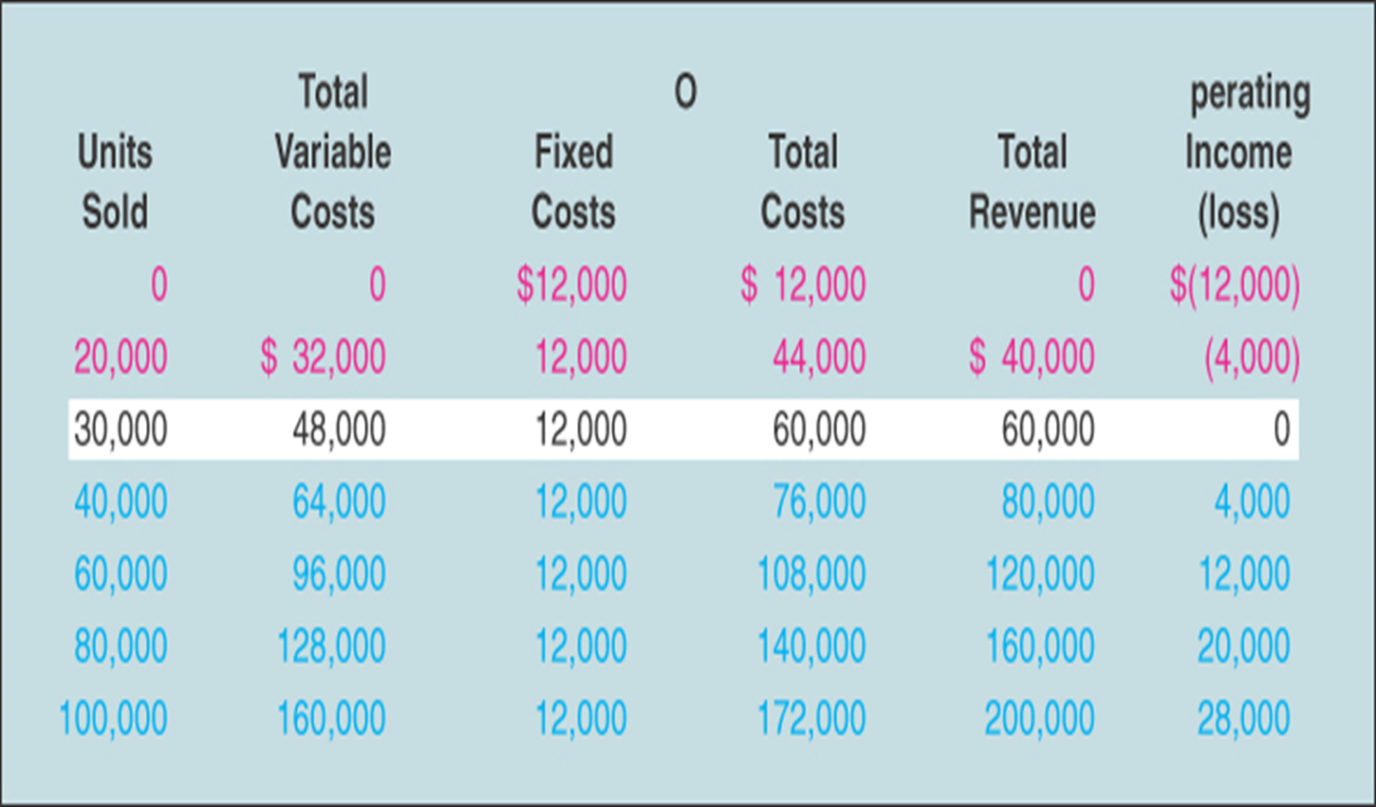
Computing the DOL – Conservative Firm
DOL (at Q = 40000) = Q(P-AVC) / (Q(P-AVC) – TFC)
= TR - TVC/(TR – TVC – TFC
= (80000 – 64000)/(80000 – 64000 - 12000) = 16000/4000 = 4
DOL (at Q = 60000) = Q(P-AVC) / (Q(P-AVC) – TFC)
= TR - TVC/(TR – TVC – TFC
= (120000 – 96000)/(120000 – 96000 - 12000) = 24000/12000 = 2
DOL (at Q = 80000) = Q(P-AVC) / (Q(P-AVC) – TFC)
= TR - TVC/(TR – TVC – TFC
= (160000 – 128000)/(160000 – 128000 - 60000) = 32000/20000 = 1.6

Slide 23
Interpretation of the DOL
  DOL is a quantitative measure of the “sensitivity” of a firm’s operating profit to a change in the firm’s sales.
  The closer that a firm operates to its break-even point, the higher is the absolute value of its DOL.
  When comparing firms, the firm with the highest DOL is the firm that will be most “sensitive” to a change in sales.
  DOL is only one component of business risk and becomes “active” only in the presence of sales and production cost variability.
  DOL magnifies the variability of operating profits and, hence, business risk.

Slide 24
Financial Leverage
“Financial leverage” = the use of debt
Leverage amplifies the variation in both EPS and ROE
We will ignore the effect of taxes at this stage
We look at what happens to EPS and ROE when we issue debt and buy back shares of stock?
The use of borrowed money incurs interest, which is like a fixed cost
If returns are greater than the interest rate then financial leverage will improve a firm’s ROE and EPS
However, if returns are lower than the interest rate then borrowing money will worsen EPS and ROE

Slide 25
Trans Am Corporation Example

Slide 26
Trans Am Corp
With and Without Debt

Slide 27
Leverage Effects
Variability in ROE
  Current: ROE ranges from 6.25% to 18.75%
  Proposed: ROE ranges from 2.50% to 27.50%
Variability in EPS
  Current: EPS ranges from $1.25 to $3.75
  Proposed: EPS ranges from $0.50 to $5.50
The variability in both ROE and EPS increases when financial leverage is increased

Slide 28
Example: Break-Even EBIT
EPS are for both Capital Structures
EBIT
EBIT
−
$400,000 (interest)
=
400,000sh
200,000sh
⎡
400,000
⎤
(
)
EBIT
=
⎢
⎥
EBIT
−
$400,000
⎣
200,000
⎦
EBIT
=
2
×
EBIT
−
$800,000
EBIT
=
$800,000
800,000
EPS
=
=
$2.00
400,000

Slide 29
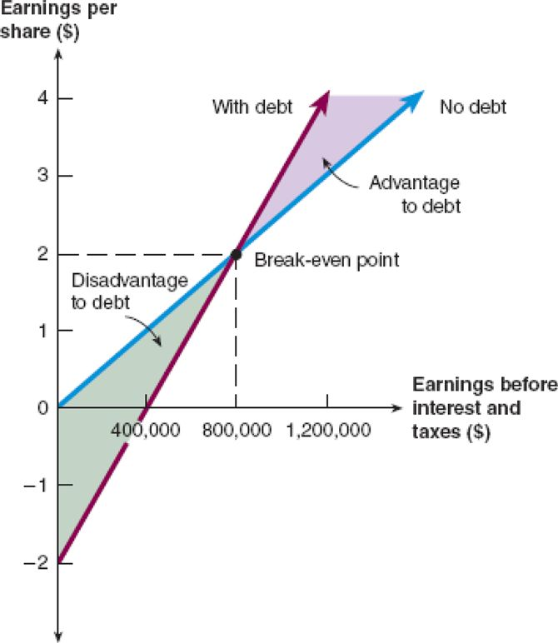
Break-Even EBIT
If we expect EBIT to be greater than the break-even point, then leverage is beneficial to our stockholders
If we expect EBIT to be less than the break-even point, then leverage is detrimental to our stockholders

Slide 30
Trans Am Corp Conclusions
The effect of leverage depends on EBIT
  When EBIT is higher, leverage is beneficial
Under the “Expected” scenario, leverage increases ROE and EPS
Shareholders are exposed to more risk with more leverage
  ROE and EPS more sensitive to changes in EBIT

Slide 31
Some Additional Information
- Asymmetric Information and Signaling
Managers know the firm’s future prospects better than investors.
Managers would not issue additional equity if they thought the current stock price was less than the true value of the stock (given their inside information).
Hence, investors often perceive an additional issuance of stock as a negative signal, and the stock price falls.

Slide 32
