Slide 1
Chapter 12 Lecture – The Cost of Capital

Slide 2
Learning Objectives
After studying this chapter, you should be able to:
LO1 Determine a firm's cost of equity capital.
LO2 Determine a firm's cost of debt.
LO3 Determine a firm's overall cost of capital.
LO4 Identify some of the pitfalls associated with a firm's overall cost of capital and what to do about them.

Slide 3
What Types of Long-term
Capital do Firms Use?
Long-Term Capital
Long-Term Debt
Preferred Stock
Common Stock
Retained Earnings
New Common Stock

Slide 4
Cost of Capital Basics
The cost to a firm for capital funding = the return to the providers of those funds
  The return earned on assets depends on the risk of those assets
  A firm’s cost of capital indicates how the market views the risk of the firm’s assets
  A firm must earn at least the required return to compensate investors for the financing they have provided
  The required return is the same as the appropriate discount rate

Slide 5
Cost of Equity
The cost of equity is the return required by equity investors given the risk of the cash flows from the firm
Two major methods for determining the cost of equity
      - Dividend growth model
      - SML or CAPM

Slide 6
The Dividend Growth Model Approach
Start with the dividend growth model formula and rearrange to solve for R_{E}

Slide 7
Example: Dividend Growth Model
Your company is expected to pay a dividend of $4.40 per share next year. (D₁)
Dividends have grown at a steady rate of 5.1% per year and the market expects that to continue. (g)
The current stock price is $50. (P₀)
What is the cost of equity?

Slide 8
Example: Estimating the Dividend Growth Rate
One method for estimating the growth rate is to use the historical average
  Year Dividend Percent Change
  2009 1.23
  2010 1.30
  2011 1.36
  2012 1.43
  2013 1.50
(1.30 – 1.23) / 1.23 = 5.7%
(1.36 – 1.30) / 1.30 = 4.6%
(1.43 – 1.36) / 1.36 = 5.1%
(1.50 – 1.43) / 1.43 = 4.9%
Average = (5.7 + 4.6 + 5.1 + 4.9) / 4 = 5.1%

Slide 9
Advantages and Disadvantages of Dividend Growth Model
Advantage – easy to understand and use
Disadvantages
  Only applicable to companies currently paying dividends
  Not applicable if dividends aren’t growing at a reasonably constant rate
  Extremely sensitive to the estimated growth rate
  Does not explicitly consider risk

Slide 10
The SML Approach
Use the following information to compute the cost of equity
  Risk-free rate, R_{f}
  Market risk premium, E(R_{M}) – R_{f}
  Systematic risk of asset, β

Slide 11
Example: SML
Company’s equity beta = 1.2
Current risk-free rate = 7%
Expected market risk premium = 6%
What is the cost of equity capital?

Slide 12
Advantages and Disadvantages of SML
Advantages
  Explicitly adjusts for systematic risk
  Applicable to all companies, as long as beta is available
Disadvantages
  Must estimate the expected market risk premium, which does vary over time
  Must estimate beta, which also varies over time
  Relies on the past to predict the future, which is not always reliable

Slide 13
Weighted Average Cost of Capital
(WACC)
Use the individual costs of capital to compute a weighted “average” cost of capital for the firm
This “average” = the required return on the firm’s assets, based on the market’s perception of the risk of those assets
The weights are determined by how much of each type of financing is used

Slide 14
WACC
WACC = (E/V) x R_{E} + (P/V) x R_{P +} (D/V) x R_{D x} (1- T_{C})
Where:
(E/V) = % of common equity in capital structure
(P/V) = % of preferred stock in capital structure
(D/V) = % of debt in capital structure
R_{E} = firm’s cost of equity
R_{P} = firm’s cost of preferred stock
R_{D} = firm’s cost of debt
T_{C} = firm’s corporate tax rate
Weights
Component costs

Slide 15
Estimating Weights
Given:
Stock price = $50
3m shares common stock
$25m preferred stock
$75m debt
40% Tax rate
Component Values:
V_{E} = $50 x (3 m) = $150m
V_{P} = $25m
V_{D} = $75m
V_{F} = $150+$25+$75=$250m
Weights:
E/V = $150/$250 = 0.6 (60%)
P/V = $25/$250 = 0.1 (10%)
D/V = $75/$250 = 0.3 (30%)

Slide 16
WACC
Component | W | R
Debt (before tax) | 0.30 | 10%
Preferred Stock | 0.10 | 9%
Common equity | 0.60 | 14%
WACC = E/V x R_{E} + P/V x R_{P} + D/V x R_{D} (1 - T_{C})
WACC = 0.6(14%) + 0.1(9%) + 0.3(10%)(1-.40)
WACC = 8.4% + 0.9% + 1.8% = 11.1%

Slide 17
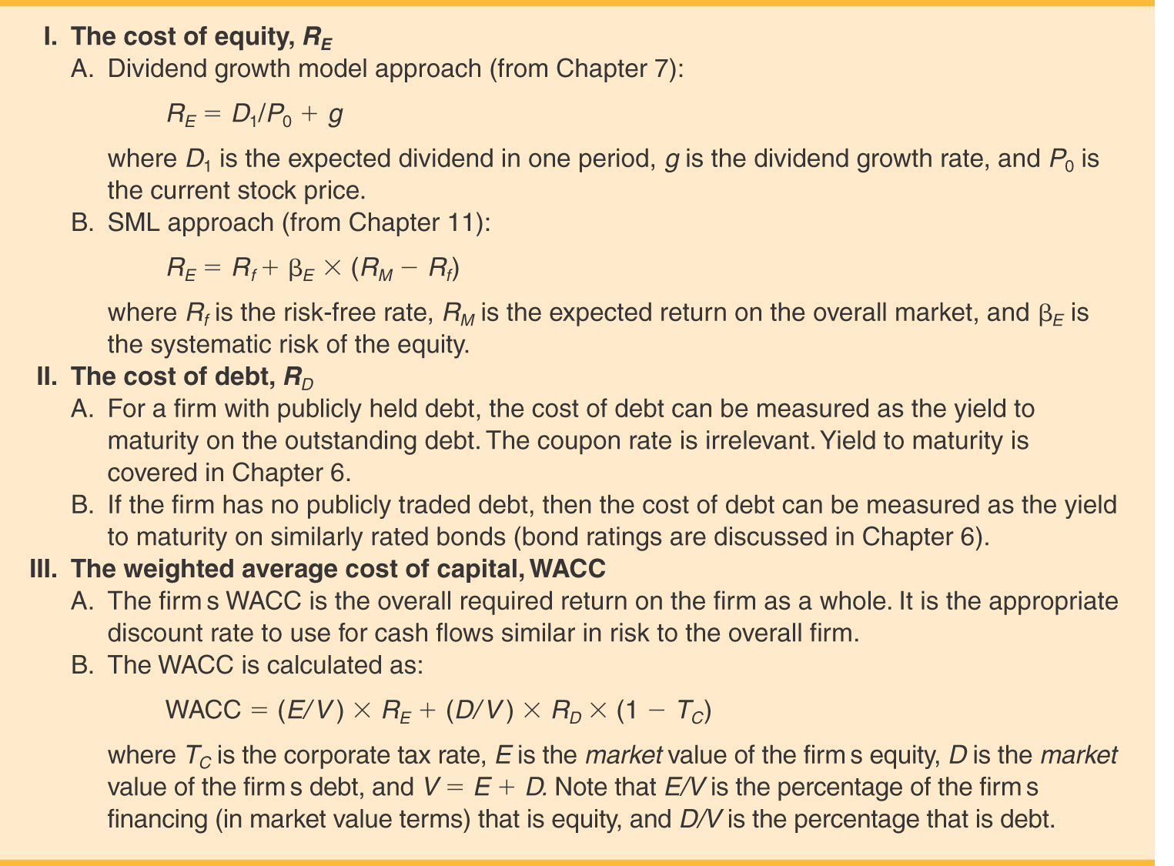

Slide 18
Factors that Influence a
Company’s WACC
Market conditions, especially interest rates, tax rates and the market risk premium
The firm’s capital structure and dividend policy
The firm’s investment policy
  Firms with riskier projects generally have a higher WACC

Slide 19
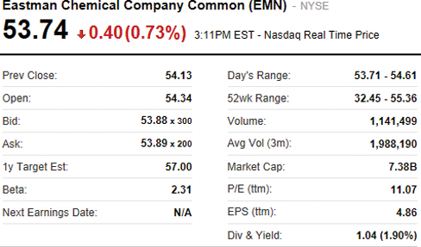
Eastman Chemical – 1
Equity Data
Source: http://finance.yahoo.com

Slide 20
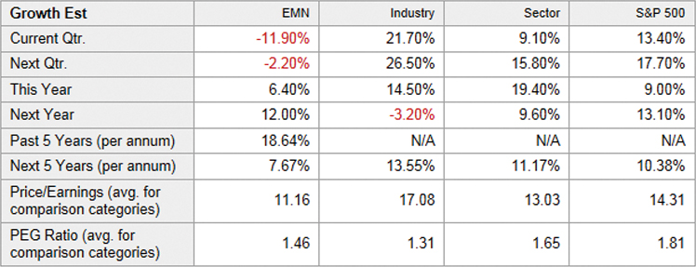
Eastman Chemical – 2
Dividend Growth
Source: http://finance.yahoo.com
http://www.investopedia.com/terms/p/pegratio.asp

Slide 21
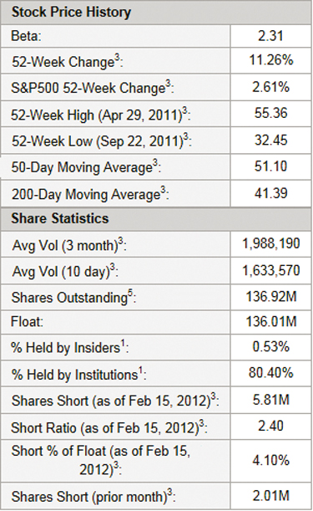
Eastman Chemical - 3
Beta and Shares Outstanding
Source: http://finance.yahoo.com

Slide 22
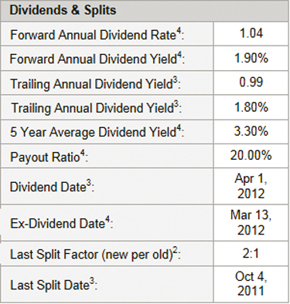
Eastman Chemical - 4
Dividends
Source: http://finance.yahoo.com

Slide 23
Eastman Chemical - 5
Cost of Equity - SML
Beta: Yahoo Finance 2.31
  Value Line 1.25
  (1.25 is a more reasonable value)
T-Bill rate = 0.05% (Yahoo Finance bonds section)
Market Risk Premium = 7% (assumed)
Cost of Equity (SML) = 0.05% + (1.25)(7%) = 8.80%

Slide 24
Eastman Chemical - 6
Cost of Equity - DCF
Growth rate 7.67%
Last dividend $1.04
Stock price $53.74
Cost of Equity (DCF) =

Slide 25
Eastman Chemical - 7
Cost of Equity
Cost of Equity Method | Estimated Value
SML | 8.80%
DCF | 9.75%
Average | 9.28%

Slide 26
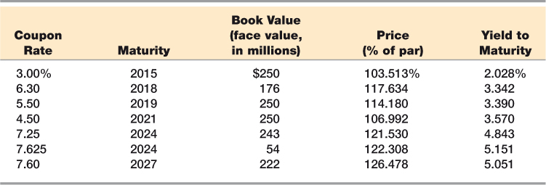
Eastman Chemical - 8
Bond Data
Source: http://www.sec.gov

Slide 27
How to Find Cost of Debt
Method 1: Ask an investment banker what the coupon rate would be on new debt.
Method 2: Find the bond rating for the company and use the yield on other bonds with a similar rating.
Method 3: Find the yield on the company’s debt, if it has any.

Slide 28
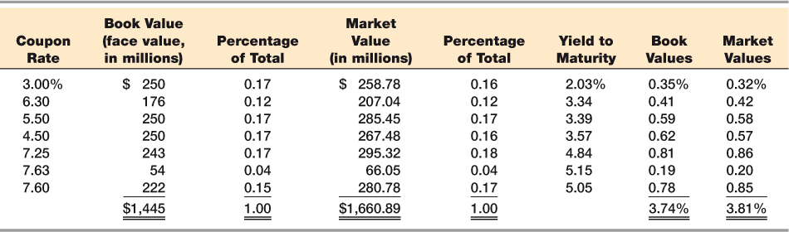
Eastman Chemical - 9
Cost of Debt
For Eastman, the cost of debt is similar when using either book values or market values.

Slide 29
Eastman Chemical - 10
WACC
Capital structure weights (market values):
  E = 136.92 million x $53.74 = $7.358 billion
  D = 1.661 billion
  V = $7.358 + 1.661 = 9.019 billion
  E/V = 7.358 / 9.019 = .82
  D/V = 1.661 / 9.019 = .18
  Tax rate (assumed) = 35%
WACC = .82(9.28%) + .18(3.81%)(1-.35) = 8.02%
Cost of Equity Method | Estimated Value
SML | 8.80%
DCF | 9.75%
Average | 9.28%
WACC = (E/V) x R_{E} + (P/V) x R_{P +} (D/V) x R_{D x} (1- T_{C})

Slide 30
Risk-Adjusted WACC
http://thatswacc.com
A firm’s WACC reflects the risk of an average project undertaken by the firm
  “Average”  risk = the firm’s current operations
Different divisions/projects may have different risks
  The division’s or project’s WACC should be adjusted to reflect the appropriate risk and capital structure

Slide 31
What Factors Influence a Company’s WACC?
Market conditions, especially interest rates and tax rates.
The firm’s capital structure and dividend policy.
The firm’s investment policy. Firms with riskier projects generally have a higher WACC.
Is the firm’s WACC correct for each division?
NO! The composite WACC reflects the risk of an average project undertaken by the firm.
Different divisions may have different risks. The division’s WACC should be adjusted to reflect the division’s risk and capital structure.

Slide 32
