Slide 1

Chapter 11 Lecture – Risk and Return

Slide 2
Learning Objectives
After studying this chapter, you should be able to:
LO1 Calculate expected returns.
LO2 Explain the impact of diversification.
LO3 Define the systematic risk principle.
LO4 Discuss the security market line and the risk-return trade-off.

Slide 3
What are Investment Returns?
Investment returns measure the financial results of an investment.
Returns may be historical or prospective (anticipated).
Returns can be expressed in:
  Dollar (or any other currency) terms.
  Percentage terms.
What is the return on an investment that costs $1,000 and is sold after 1 year for $1,100?
Dollar return:$ Received - $ Invested
$1,100 - $1,000= $100.
Percentage return:$ Return/$ Invested
$100/$1,000 = 0.10 = 10%.

Slide 4
What is Investment Risk?
Typically, investment returns are not known with certainty.
Investment risk pertains to the probability of earning a return less than that expected.
The greater the chance of a return far below the expected return, the greater the risk.
Risk-averse investors require higher rates of
return to invest in higher-risk securities
Notes:
2

Slide 5
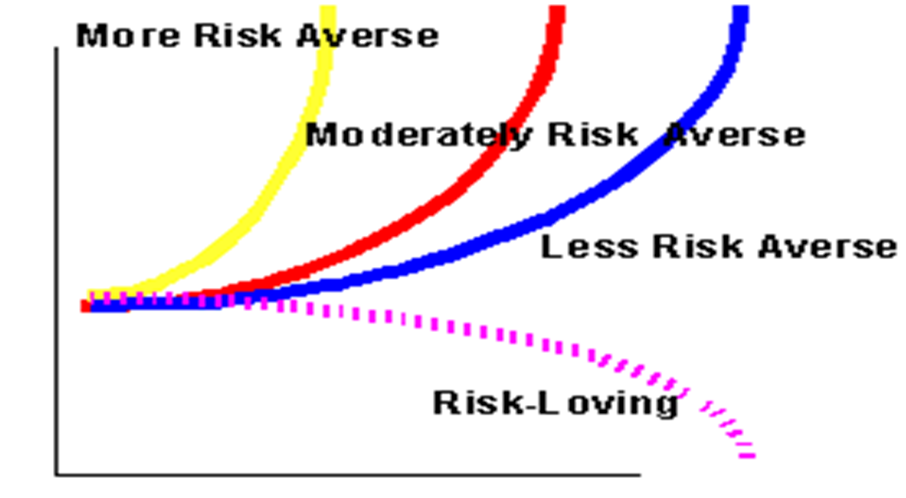
Indifference Curves for Risk Adverse and Risk-Loving Investors
Expected Returns

Slide 6
Expected Returns
Expected returns are based on the probabilities of possible outcomes
Where:
pi = the probability of state “i” occurring
Ri = the expected return on an asset in state i

Slide 7
Example: Expected Returns

Slide 8
Probability distribution
Stock X
Stock Y
Rate of
return (%)
-20
0
15
50
Which stock is riskier? Why?
Notes:
3

Slide 9
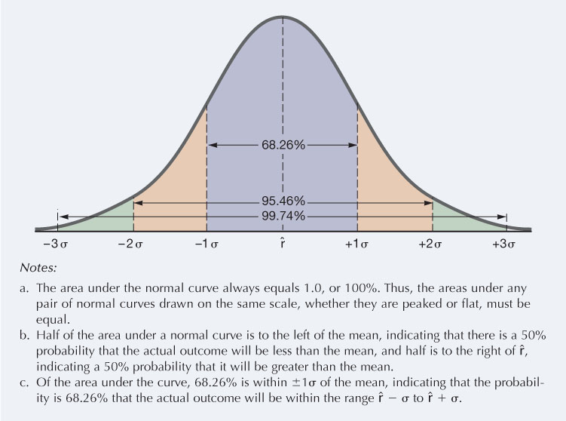

Slide 10
Variance and Standard Deviation
Variance and standard deviation measure the volatility of returns
Variance = Weighted average of squared deviations
Standard Deviation = Square root of variance

Slide 11
Variance & Standard Deviation
Notes:
11

Slide 12
Example - Assume the Following Investment Alternatives
Economy | Prob. | T-Bill | Stock Al | Stock Bob | Stock Cuc | Market
Recession | 0.10 | 8.0% | -22.0% | 28.0% | 10.0% | -13.0%
Below avg. | 0.20 | 8.0 | -2.0 | 14.7 | -10.0 | 1.0
Average | 0.40 | 8.0 | 20.0 | 0.0 | 7.0 | 15.0
Above avg. | 0.20 | 8.0 | 35.0 | -10.0 | 45.0 | 29.0
Boom | 0.10 | 8.0 | 50.0 | -20.0 | 30.0 | 43.0
 | 1.00
Notes:
4

Slide 13
What is Unique about the Treasury bill Return? What is Correlation?
The T-bill will return 8% regardless of the state of the economy.
Is the T-bill riskless? Explain. Do the returns of Stocks Al, Bob and Cuc move with or counter to the economy? Stock Al moves with the economy, so it is positively correlated with the economy. Positively correlated stocks have rates of return that move in the same direction.
Stock Bob moves counter to the economy. Such negative correlation is unusual. Negatively correlated stocks have rates of return that move in opposite directions.
Notes:
5

Slide 14
Calculate the Expected Rate of Return on Each Alternative.
^
r = expected rate of return.
^
r_{Al} = 0.10(-22%) + 0.20(-2%)
+ 0.40(20%) + 0.20(35%)
+ 0.10(50%) = 17.4%.
Al has the highest rate of return. Does that make it best?
^
 | r
Market | 15.0
Cuc | 13.8
T-bill | 8.0
Bob | 1.7
Notes:
8

Slide 15
What is the Standard Deviation of Returns for Each Alternative?
σ_{Al} = ((-22 - 17.4)²0.10 + (-2 - 17.4)²0.20
+ (20 - 17.4)²0.40 + (35 - 17.4)²0.20
+ (50 - 17.4)²0.10)^{1/2} = 20.0%.
Notes:
10

Slide 16
Al:
σ = ((-22 - 17.4)²0.10 + (-2 - 17.4)²0.20
+ (20 - 17.4)²0.40 + (35 - 17.4)²0.20
+ (50 - 17.4)²0.10)^{1/2} = 20.0%.
σ_{T-bills} = 0.0%.
σ_{Bob} = 13.4%.
σ_{Cuc} = 18.8%.
σ_{Market} = 15.3%.
σ_{Al} = 20.0%.
Notes:
11

Slide 17
Standard deviation measures the stand-alone risk of an investment.
The larger the standard deviation, the higher the probability that returns will be far below the expected return.
Prob.
T-bill
Cuc
Al
0
8
13.8
17.4
Rate of Return (%)
An alternative measure of stand-alone risk is the Coefficient of Variation (CV). CV = Standard deviation/expected return
Notes:
12

Slide 18
Expected Return versus Risk versus Coefficient of Variation
 |  | Expected
Security |  | return |  | Risk, σ
Al |  | 17.4% |  | 20.0%
Market |  | 15.0 |  | 15.3
Cuc |  | 13.8 |  | 18.8
T-bills |  | 8.0 |  | 0.0
Bob |  | 1.7 |  | 13.4
CV_{T-bills} = 0.0%/8.0% = 0.0.
CV_{Al} = 20.0%/17.4% = 1.1.
CV_{Bob} = 13.4%/1.7% = 7.9.
CV_{Cuc} = 18.8%/13.8% = 1.4.
CV_{Market} = 15.3%/15.0% = 1.0.
Notes:
14

Slide 19
Portfolios
Portfolio = collection of assets
An asset’s risk and return impact how the stock affects the risk and return of the portfolio
The risk-return trade-off for a portfolio is measured by the portfolio expected return and standard deviation, just as with individual assets

Slide 20
Portfolio Expected Returns
The expected return of a portfolio is the weighted average of the expected returns for each asset in the portfolio
Weights (w_{j}) = % of portfolio invested in each asset

Slide 21
Example: Portfolio Weights

Slide 22
Portfolio Risk
Variance & Standard Deviation
Portfolio standard deviation is NOT a weighted average of the standard deviation of the component securities’ risk
  If it were, there would be no benefit to diversification.

Slide 23
JUST TO SCARE YOU
Variance and Standard Deviation of Portfolio
The standard deviation of the portfolio return (s_{p}) or (σ_{p})is used as a measure of portfolio risk. For a two‑security portfolio, the standard deviation is:
where σ_{A}² and σ_{B}² are the variances of returns for securities A and B,
σ_{A} and σ_{B} are their standard deviations, and ρ_{A,B} is the correlation coefficient of the returns between securities A and B.

Slide 24
Two-Stock Portfolios
Two stocks can be combined to form a riskless portfolio if ρ = -1.0.
Risk is not reduced at all if the two stocks have ρ = +1.0.
In general, stocks have ρ ≈ 0.65, so risk is lowered but not eliminated.
Investors typically hold many stocks.
What happens when ρ = 0?
Notes:
22

Slide 25
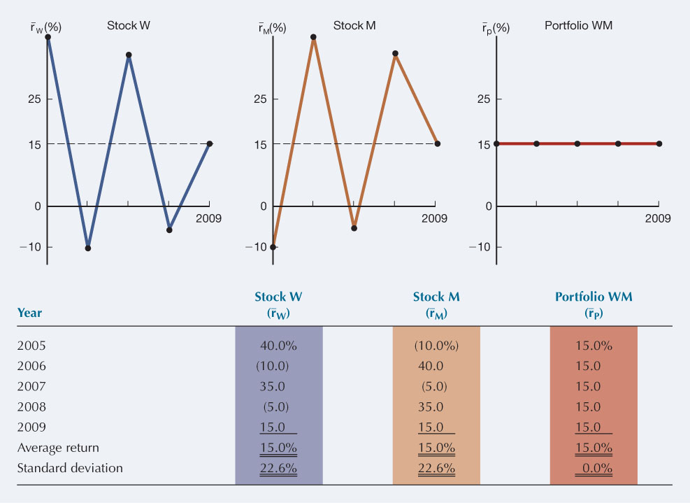
Returns Distribution for Two Perfectly Negatively Correlated Stocks ( ρ = -1.0) and for Portfolio WM:

Slide 26
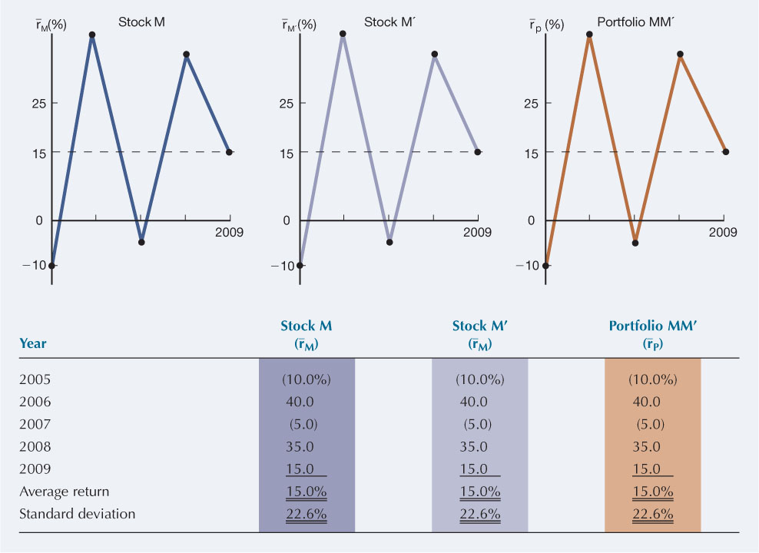
Returns Distribution for Two Perfectly Positively Correlated Stocks ( ρ = 1.0) and for Portfolio WM

Slide 27
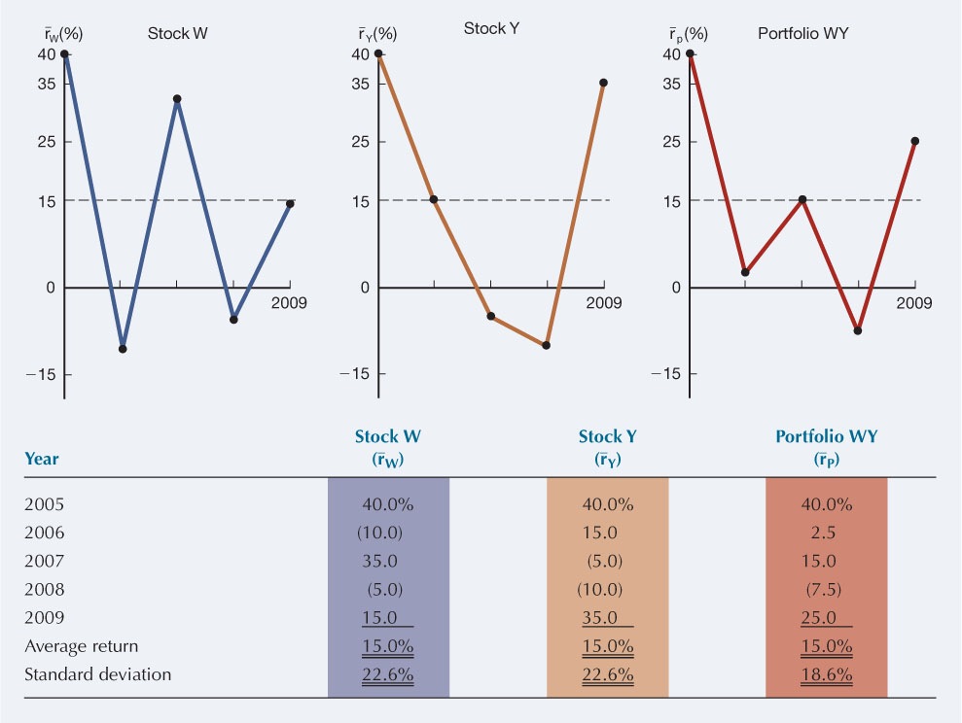
What About These Stocks?

Slide 28
Announcements, News and Efficient markets
Announcements and news contain both expected and surprise components
The surprise component affects stock prices
Efficient markets result from investors trading on unexpected news
  The easier it is to trade on surprises, the more efficient markets should be
Efficient markets involve random price changes because we cannot predict surprises

Slide 29
Systematic Risk
Factors that affect a large number of assets
“Non-diversifiable risk”
“Market risk”
Caused by events that affect most stocks similarly
Is market wide
Examples would include changes in macroeconomic factors such interest rates, inflation, and business cycle.

Slide 30
Unsystematic Risk
= Diversifiable risk
Risk factors that affect a limited number of assets
Risk that can be eliminated by combining assets into portfolios
“Unique risk” or “Asset-specific risk”
  Example would include litigation, poor management, labor strife, and raw material shortages
Examples: labor strikes, part shortages, etc.

Slide 31
Returns
Total Return = Expected return + unexpected return
R = E(R) + U
Unexpected return (U) = Systematic portion (m) +
Unsystematic portion (ε)
Total Return = Expected return E(R) +
Systematic portion ( m) +
Unsystematic portion (ε)
R = E(R) + m + ε

Slide 32
The Principle of Diversification
Diversification can substantially reduce risk without an equivalent reduction in expected returns.
  Reduces the variability of returns
  Caused by the offset of worse-than-expected returns from one asset by better-than-expected returns from another
Minimum level of risk that cannot be diversified away = systematic portion

Slide 33
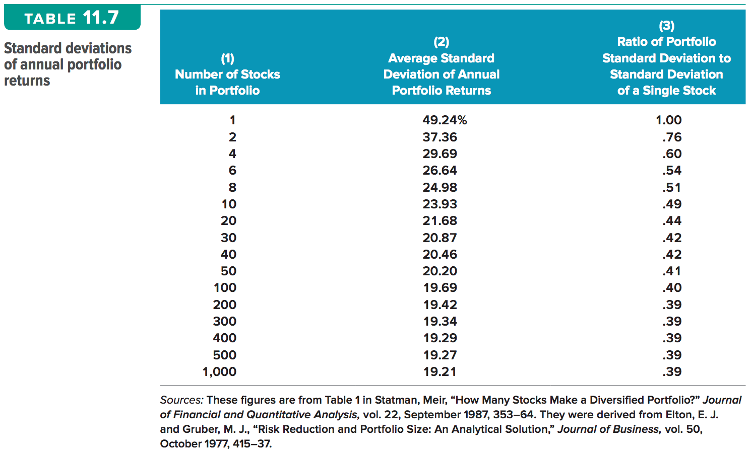
Standard Deviations of Annual Portfolio Returns

Slide 34
Portfolio Conclusions
As more stocks are added, each new stock has a smaller risk-reducing impact on the portfolio
− σ_{p} falls very slowly after about 40 stocks are included
  The lower limit for σ_{p} ≈ 20% = σ_{M.}
Forming well-diversified portfolios can eliminate about half the risk of owning a single stock.
Notes:
31

Slide 35
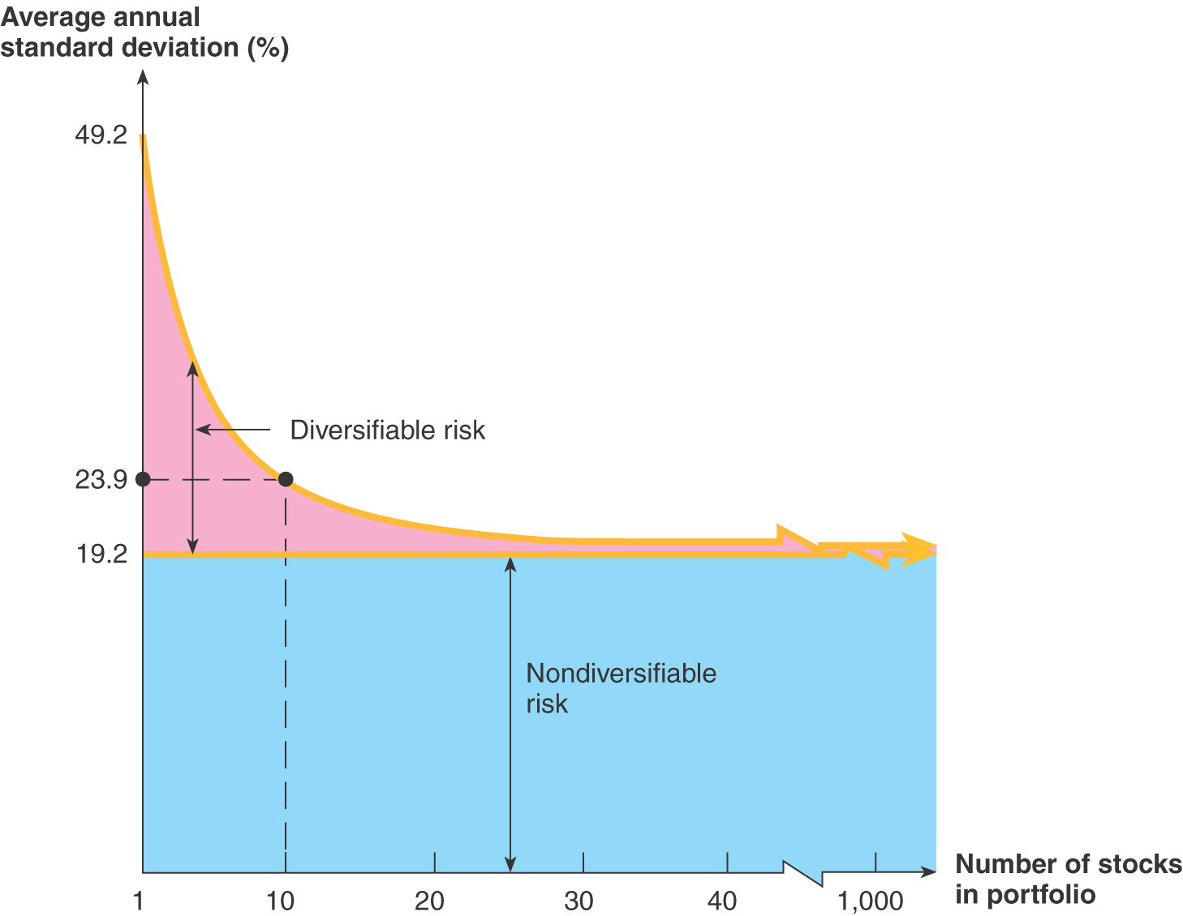
Portfolio Diversification
Firm Specific (Diversifiable) Risk
Market Risk

Slide 36
Prob.
What would happen to the risk of an average 1-stock portfolio as more randomly selected stocks were added?
Large
2
σ_{p} would decrease because the added stocks would not be perfectly correlated, but r_{p} would remain relatively constant.
1
0
15
Return
σ₁ ≈ 35% ; σ_{Large} ≈ 20%.
Notes:
26

Slide 37
Systematic Risk Principle
There is a reward for bearing risk.
There is no reward for bearing risk unnecessarily.
The expected return (market required return) on an asset depends only on that asset’s systematic or market risk.

Slide 38
Total Risk = Stand-Alone Risk
Total risk = Systematic risk + Unsystematic risk
  The standard deviation of returns is a measure of total risk.
For well-diversified portfolios, unsystematic risk is very small.
  Total risk for a diversified portfolio is essentially equivalent to the systematic risk.

Slide 39
Market Risk for Individual
Securities
The contribution of a security to the overall riskiness of a portfolio
Relevant for stocks held in well-diversified portfolios
Measured by a stock’s beta coefficient, β_{j}
Measures the stock’s volatility relative to the market
Notes:
34

Slide 40
Interpretation of Beta
If β = 1.0, stock has average risk
If β > 1.0, stock is riskier than average
If β < 1.0, stock is less risky than average
Most stocks have betas in the range of 0.5 to 1.5
Beta of the market = 1.0
Beta of a T-Bill = 0
Notes:
39

Slide 41
How to Estimated Beta
Run a regression with returns on the stock in question plotted on the Y axis and returns on the market portfolio plotted on the X axis
The slope of the regression line, which measures relative volatility, is defined as the stock’s beta coefficient, or β
Notes:
35

Slide 42
Calculating Beta for DennisCo.
Data on Course Outline
Estimating Beta
40%
In this example, β = 0.83
20%
0%
r
M
-40%
-20%
0%
20%
40%
-20%
r
DC
= 0.83r
M
+ 0.03
-40%
2
R
= 0.36

Slide 43
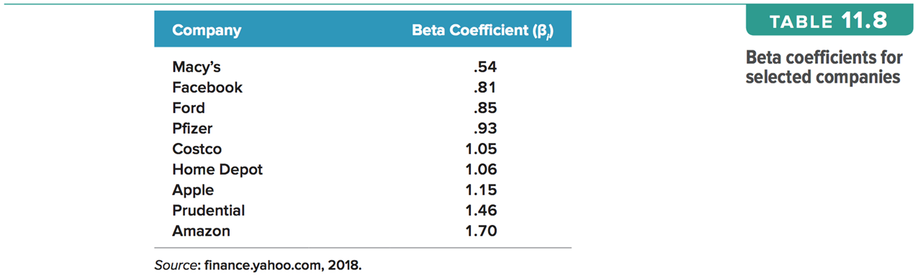
Beta Coefficients for Selected Companies

Slide 44
Portfolio Beta
β_{p} = Weighted average of the Betas of the assets in the portfolio
Weights (w_{j})= % of portfolio invested in asset j
Notes:
47

Slide 45
Quick Quiz:
Total vs. Systematic Risk
Consider the following information:
  Standard Deviation Beta
  Security C 20% 1.25
  Security K 30% 0.95
Which security has more total risk?
Which security has more systematic risk?
Which security should have the higher expected return?

Slide 46
Beta and the Risk Premium
Risk premium = E(R ) – R_{f}
The higher the beta, the greater the risk premium should be
Can we define the relationship between the risk premium and beta so that we can estimate the expected return?
  YES!

Slide 47
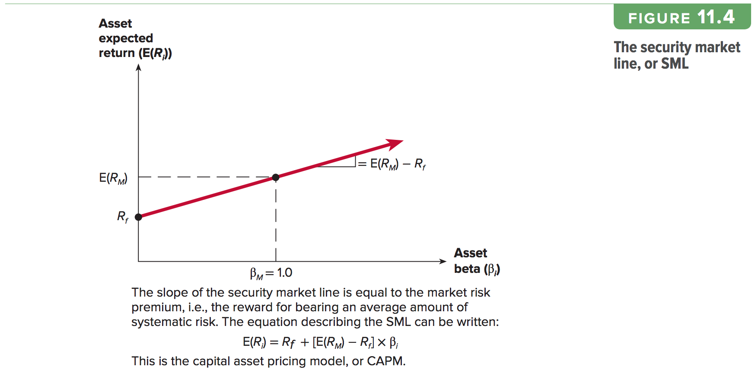
Security Market Line (SML) and Equilibrium

Slide 48
Reward-to-Risk Ratio
Reward-to-Risk Ratio:
= Slope of line on graph
In equilibrium, ratio should be the same for all assets
When E(R) is plotted against β for all assets, the result should be a straight line

Slide 49
Market Equilibrium
In equilibrium, all assets and portfolios must have the same reward-to-risk ratio
Each ratio must equal the reward-to-risk ratio for the market

Slide 50
Security Market Line
The security market line (SML) is the representation of market equilibrium.
The slope of the SML = reward-to-risk ratio:
(E(R_{M}) – R_{f}) / β_{M}
Slope = E(R_{M}) – R_{f} = market risk premium
  Since β of the market is always 1.0

Slide 51
The SML and Required Return
The Security Market Line (SML) is part of the Capital Asset Pricing Model (CAPM).
  R_{f} = Risk-free rate (T-Bill or T-Bond)
  R_{M} = Market return ≈ S&P 500
  RP_{M} = Market risk premium = E(R_{M}) – R_{f}
  E(R_{j}) = “Required Return of Asset j”
Notes:
43

Slide 52
Capital Asset Pricing Model
The capital asset pricing model (CAPM) defines the relationship between risk and return.
E(R_{A}) = R_{f} + (E(R_{M}) – R_{f})β_{A}
If an asset’s systematic risk (β) is known, CAPM can be used to determine its expected return.
Copyright ©2020 McGraw-Hill Education. All rights reserved. No reproduction or distribution without the prior written consent of McGraw-Hill Education.
11-52

Slide 53
Buy Low, Sell High
An asset is said to be overvalued if its price is too high given its expected return and risk. Suppose you observe the following situation:
Security Expected Return Beta
Fama Co. 14% 1.3
French Co. 10 .8
The risk-free rate is currently 6 percent. Is one of the two securities above overvalued relative to the other?
To answer, we compute the reward-to-risk ratio for both. For Fama, this ratio is (14% − 6%)/1.3 = 6.15%. For French, this ratio is 5 percent. What we conclude is that French offers an insufficient expected return for its level of risk, at least relative to Fama. Because its expected return is too low, its price is too high. In other words, French is overvalued relative to Fama, and we would expect to see its price fall relative to Fama’s. Notice that we could also say Fama is undervalued relative to French.

Slide 54
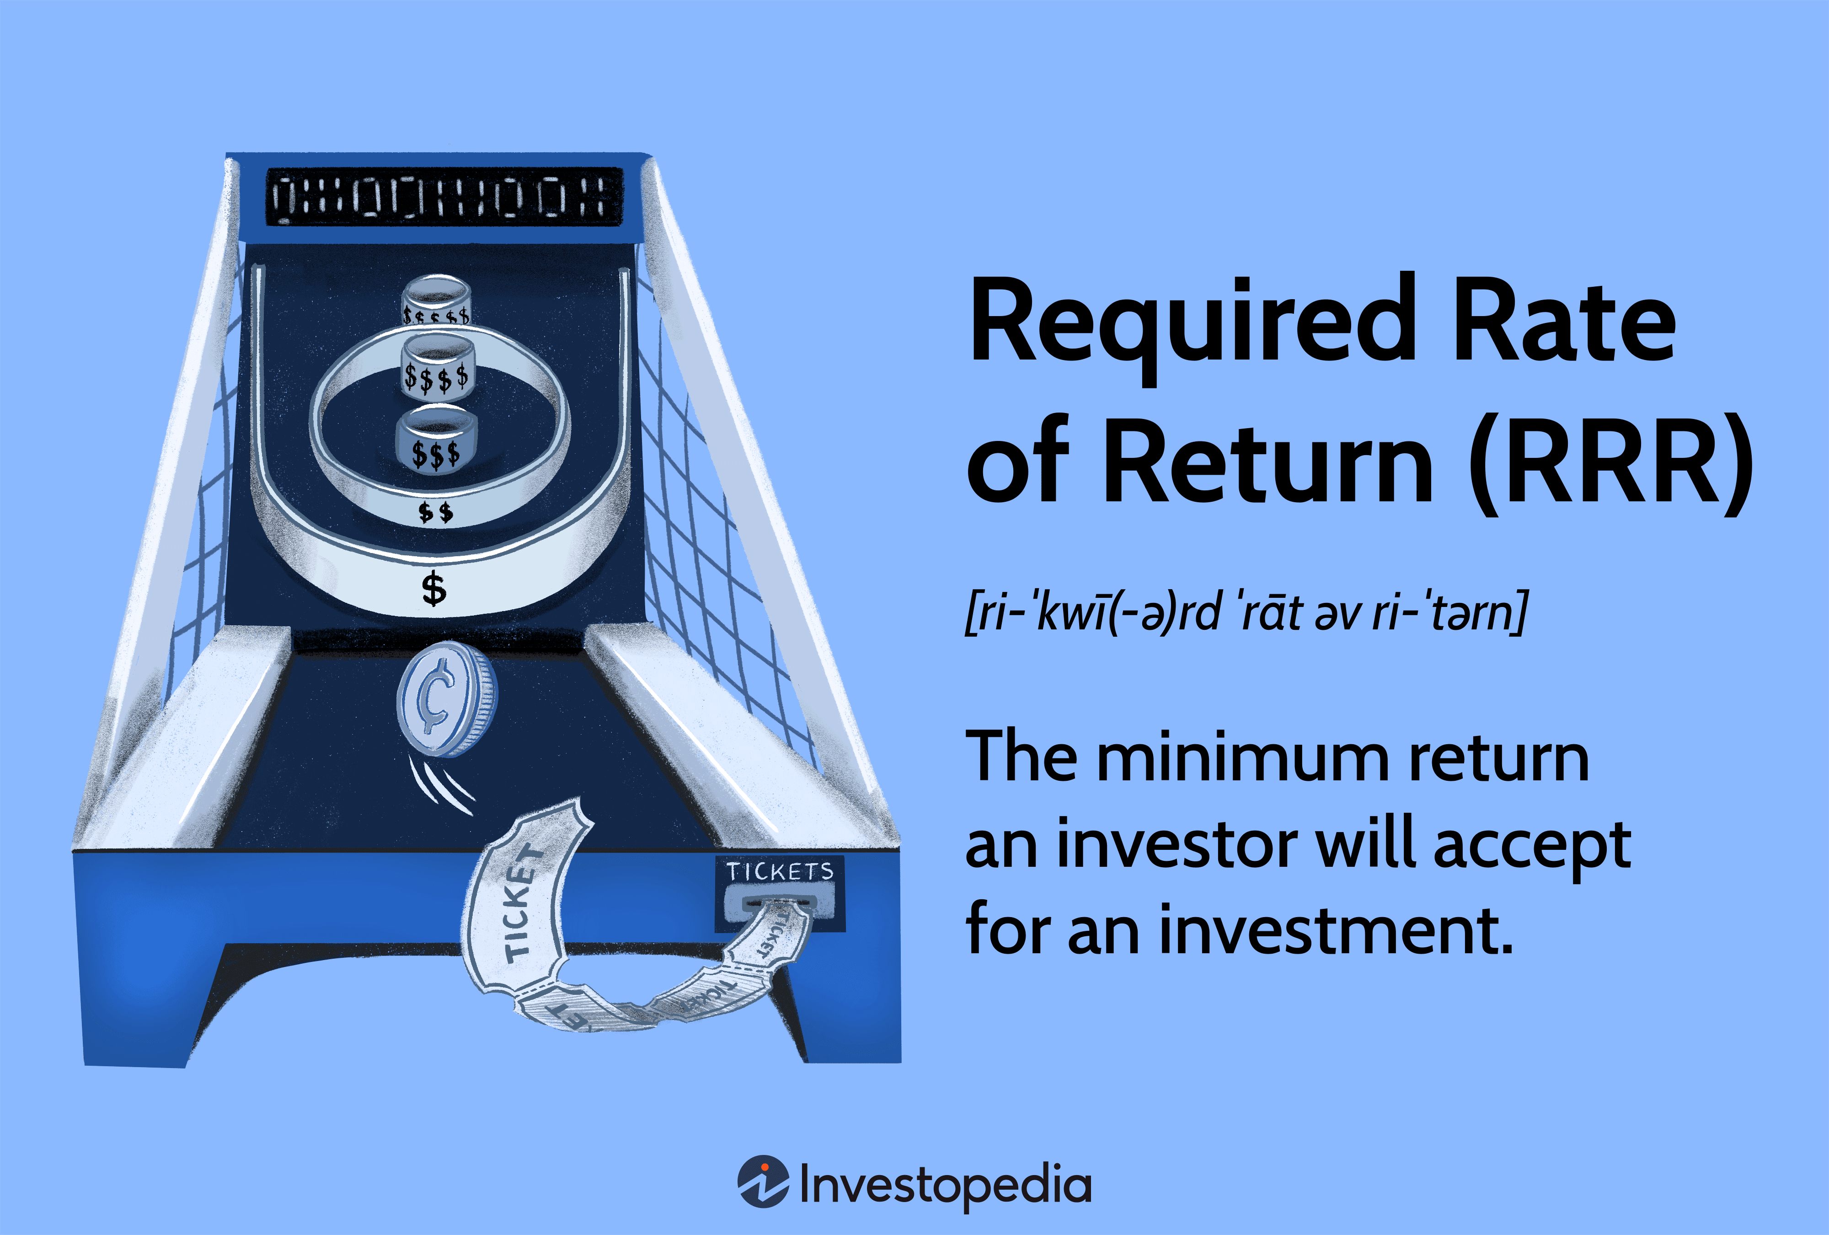
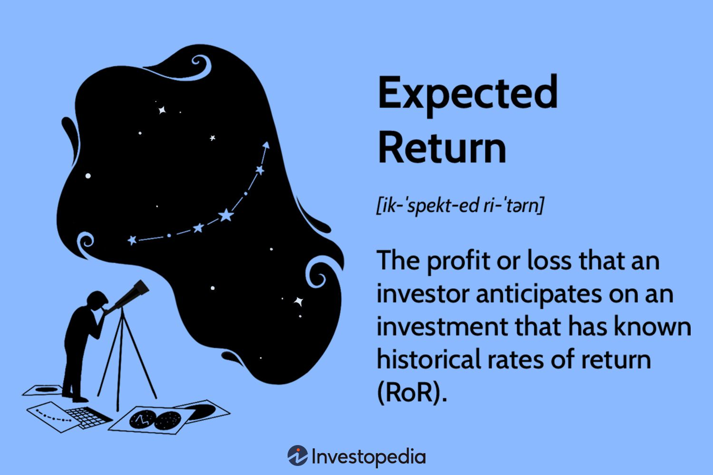

Slide 55
International Diversification
Including foreign stocks and bonds in a portfolio of U.S. corporate and government securities enhances risk reduction.
Over a longtime horizon international diversification strategies tend to yield returns superior to those yielded by domestic strategies
Investors must beware of political risks involved with international investing.

Slide 56
