Slide 1
Chapter 10 Lecture - Some Lessons from Capital Market History

Slide 2
  Learning Objectives
After studying this chapter, you should be able to:
LO1 Calculate the return on an investment.
LO2 Discuss the historical returns on various important types of investments.
LO3 Explain the historical risks on various important types of investments.
LO4 Assess the implications of market efficiency

Slide 3

Risk–Return Tradeoff
Two key lessons from capital market history:
  There is a reward for bearing risk
  The greater the potential reward, the greater the risk

Slide 4
Dollar & Percent Returns
Total dollar return = the return on an investment measured in dollars
  $ Return = Dividends + Capital Gains
  Capital Gains = Price received – Price paid
Total percent return = the return on an investment measured as a percentage of the original investment.
  % Return = $ Return/$ Invested

Slide 5
Percent Return
Dividend Yield
Capital Gains Yield

Slide 6
Example: Calculating Total Dollar and Total Percent Returns
You invest in a stock with a share price of $25.
After one year, the stock price per share is $35
Each share paid a $2 dividend
What was your total return?
 | Dollars | Percent
Dividend | $2.00 | $2/25 = 8%
Capital Gain | $35 - $25 = $10 | $10/25= 40%
Total Return | $2 + $10 = $12 | $12/$25 = 48%

Slide 7
Arithmetic vs. Geometric Mean
Arithmetic average:
  Return earned in an average period over multiple periods
  Answers the question: “What was your return in an average year over a particular period?”
Geometric average:
  Average compound return per period over multiple periods
  Answers the question: “What was your average compound return per year over a particular period?”
Geometric average < arithmetic average unless all the returns are equal

Slide 8
Geometric Average Return
Where:
R_{i} = return in each period
T = number of periods
Where:
Π = Product (like Σ for sum)
T = Number of periods in sample
R_{i} = Actual return in each period
Notes:
The Geometric Average Return is calculated as the Nth root of the product of one plus each period’s actual return, minus “1.”
Adding the “1” to each period’s return makes sure the product increases and is reversed by subtracting “1” from the result.
The Pi symbol (Π) works for multiplication like the Sigma (Σ) works for summation.
The calculations are shown on the next slide

Slide 9
Example: Calculating a
Geometric Average Return

Slide 10
Arithmetic vs. Geometric Mean
Which is better?
The arithmetic average is overly optimistic for long horizons
The geometric average is overly pessimistic for short horizons
Depends on the planning period under consideration
  15 – 20 years or less: use arithmetic
  20 – 40 years or so: split the difference between them
  40 + years: use the geometric

Slide 11
Efficient Capital Markets
The Efficient Market Hypothesis:
  Stock prices are in equilibrium
  Stocks are “fairly” priced
  Informational efficiency
If true, you should not be able to earn “abnormal” or “excess” returns
Efficient markets DO NOT imply that investors cannot earn a positive return in the stock market

Slide 12
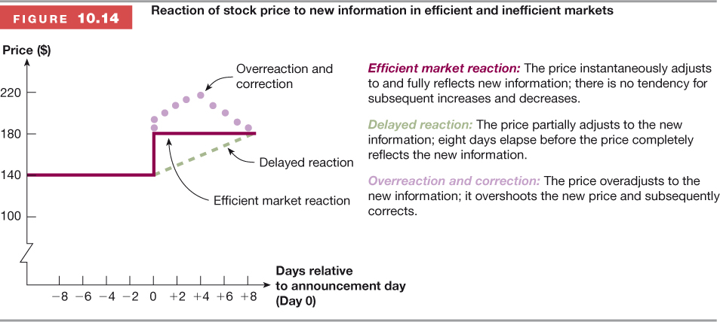
Reaction of stock price to new information in efficient and inefficient markets

Slide 13
Forms of Market Efficiency
Strong-form Efficient Market:
  Prices reflect all information, including public and private
  If true, then investors can not earn abnormal returns regardless of the information they possess
  Empirical evidence indicates that markets are NOT strong form efficient
    Insiders can earn abnormal returns (may be illegal)

Slide 14
Forms of Market Efficiency
Semistrong Form Efficiency
  Prices reflect all publicly available information including trading information, annual reports, press releases, etc.
  If true, then investors cannot earn abnormal returns by trading on public information
  Implies that fundamental analysis will not lead to abnormal returns

Slide 15
Forms of Market Efficiency
Weak Form Efficiency
  Prices reflect all past market information such as price and volume
  If true, then investors cannot earn abnormal returns by trading on market information
  Implies that technical analysis will not lead to abnormal returns
  Empirical evidence indicates that markets are generally weak form efficient

Slide 16
Common Misconceptions about EMH
EMH does not mean that you can’t make money
EMH does mean that:
  On average, you will earn a return appropriate for the risk undertaken
  There is no bias in prices that can be exploited to earn excess returns
  Market efficiency will not protect you from wrong choices if you do not diversify – you still don’t want to put all your eggs in one basket

