Slide 1
General Questions
What is an environmentally sustainable society?
What is pollution, and what can we do about it?
Why do we have environmental problems?
People with different environmental worldviews often disagree about the seriousness of environmental problems and what we should do about them. How can we deal with this issue?
What tools can economists use to solve environmental problems?

Slide 2
Sample Problem: Static efficiency
The demand curve for a product is given by
Q_{D} = 400 - 20P and the supply curve for a product is given by Q_{S} = -32 + 16P.
Illustrate the demand curve and the supply curve on the same graph.
Find the equilibrium price and quantity.
Find numerical values for the consumer surplus and the producer surplus.
Identify consumer surplus and producer surplus on your graph.
e. What is the area of the total willingness to pay for the equilibrium quantity and the total variable cost of supplying the equilibrium quantity. Identify these areas on your graph.

Slide 3
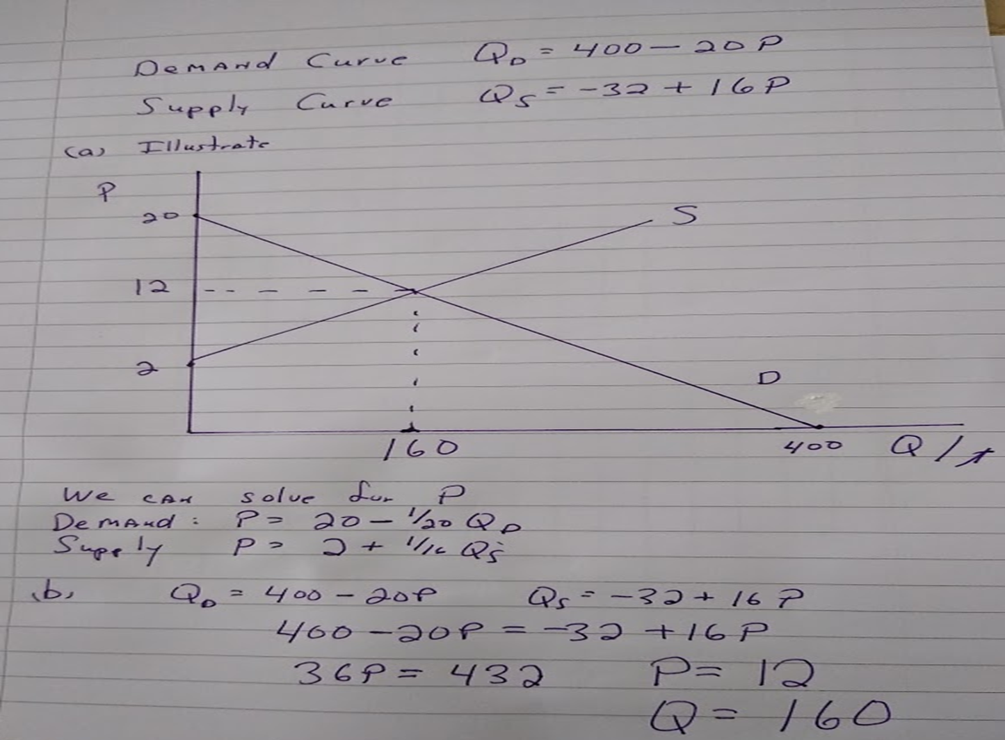

Slide 4
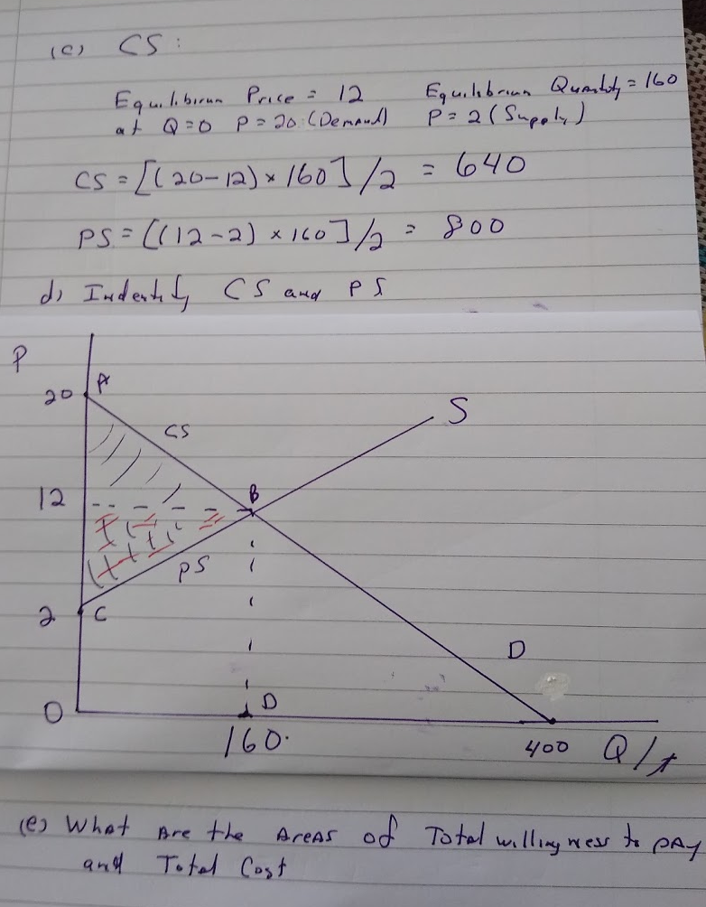

Slide 5
Discuss:
In a well-known legal case, Miller v. Schoene (287 U.S. 272), a
classic conflict of property rights was featured. Red cedar trees, used only for ornamental purposes, carried a disease that could destroy apple orchards within a radius of two miles. There was no known way of curing the disease except by destroying the cedar trees or by ensuring that apple orchards were at least two miles away from the cedar trees. Apply the Coase theorem to this situation. Does it make any difference to the outcome whether the cedar tree owners are entitled to retain their trees or the apple growers are entitled to be free of them? Why or why not?

