Slide 1
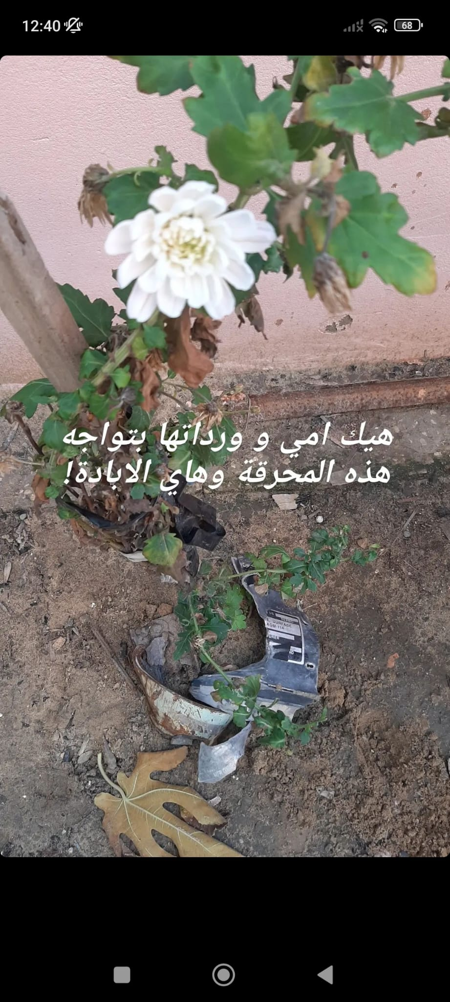
Zionist Ecocide in Palestine:
By Mira Aliane
Understanding coloniality of nature in Occupied Palestine

Slide 2
The Coloniality of Nature
Dualist Ontology
Settler Colonial Logic
Nature as Political
Colonial processes reduce nature to a resource for extraction and control
three mechanisms: dualist human-nature ontology, resource exploitation, epistemic violence against indigenous knowledge
Settler colonialism treats indigenous people AND indigenous ecosystems as threats to eliminate
Nature as a political relationship and not a technical problem

Slide 3
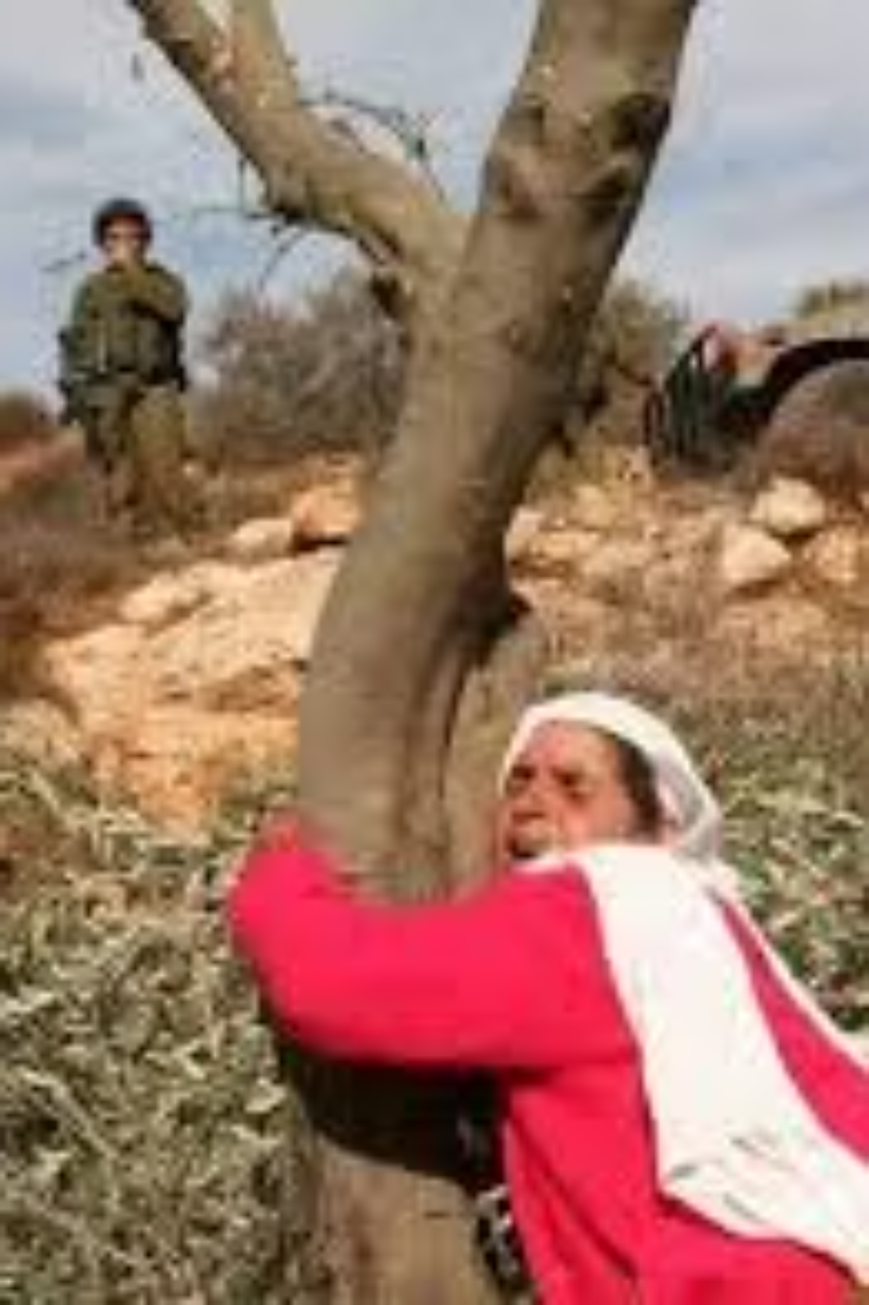
Introduction: Palestine's Environmental Crisis
1
Deliberate Policy
Environmental destruction in Gaza cannot be taken as a side effect of genocide
2
Already Unlivable
Gaza was already "unlivable" before October 2023: 95% of water unfit for consumption
3
Unprecedented Damage
Since October 2023, UNEP describes damage as unprecedented and potentially irreversible
4
A Story Beginning in 1948
This is a story that begins in 1948, not October 7

Slide 4
What is Ecocide?
Definition
International Crime
Mass destruction of ecosystems through deliberate action or recklessness
Being considered as a fifth international crime under the Rome Statute
Palestine's Continuum
UNEP (2024)
In Palestine: ecocide is a continuum of ecological erasure since 1948
"risks locking its people into a painful, long recovery"

Slide 5
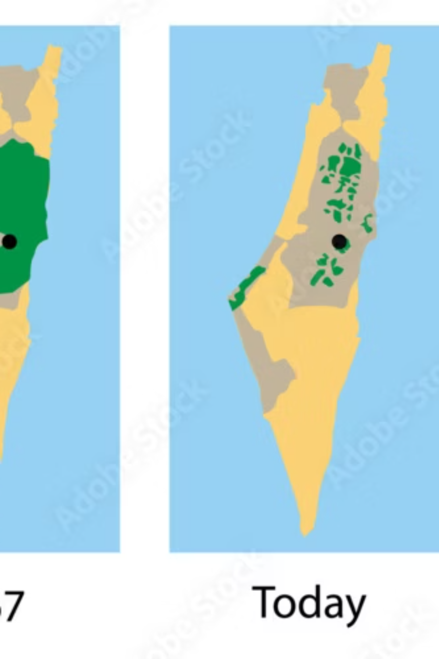
A History of Environmental Erasure
1
1948
Begining of ethnic cleansing and seteller colonial project
maximum land with minimum number of Palestinians (within Israeli state)
maximum amount of Palestinians on a minimum amount of land (Gaza and West Bank)
2
1967
Israel granted itself exclusive control over all West Bank and Gaza water sources and agricultural lands
3
Settlements Era (a country with no land)
Israeli settlements occupied 40% of Gaza's land until 2005, serving only 10,000 settlers
Over 200 settlements in the West Bank, housing over 700,000 Zionist settelers
4
Apartheid Wall
Apartheid wall severed animal corridors, uprooted trees, altered watersheds
5
Ongoing
Environmental destruction in Palestine has never not been happening

Slide 6
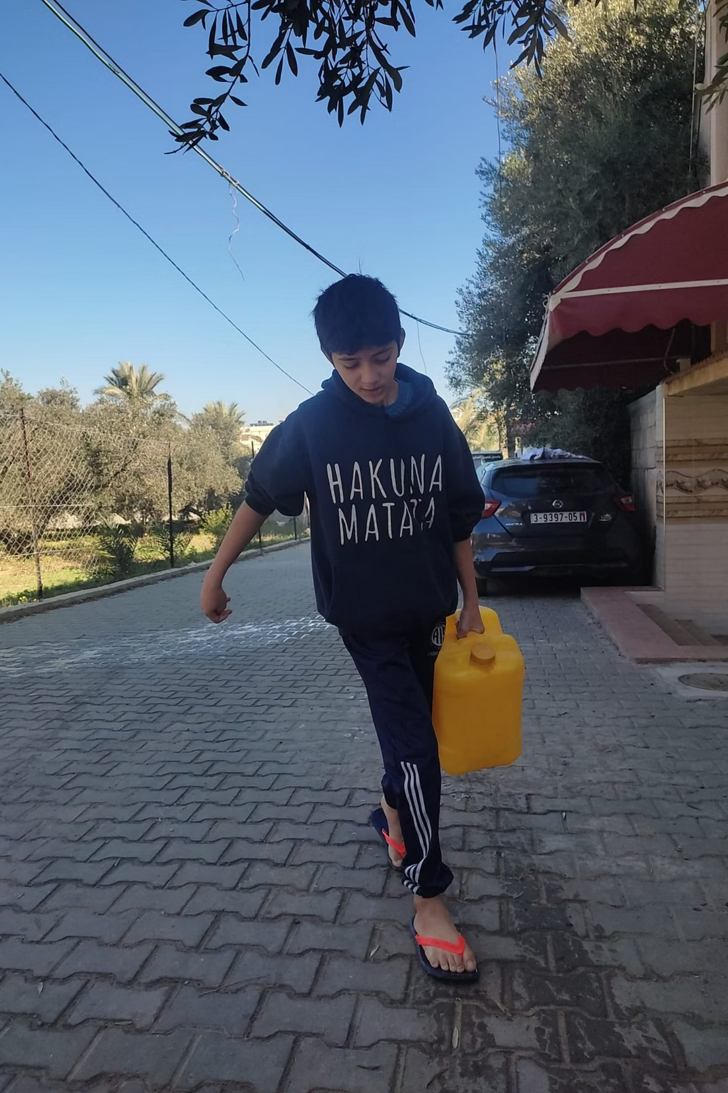

Water as a Weapon
57%
130K
Infrastructure Destroyed
m³ Raw Sewage Daily
of water infrastructure destroyed since October 2023 — 162 wells, 2 of 3 pipelines
All wastewater facilities destroyed → 130,000 m³ of raw sewage into the sea daily
384x
Hepatitis A Surge
Hepatitis A cases up 384-fold; acute diarrhoea up 36-fold
Israel is salinating Gaza's coastal aquifer by pumping in seawater

Slide 7
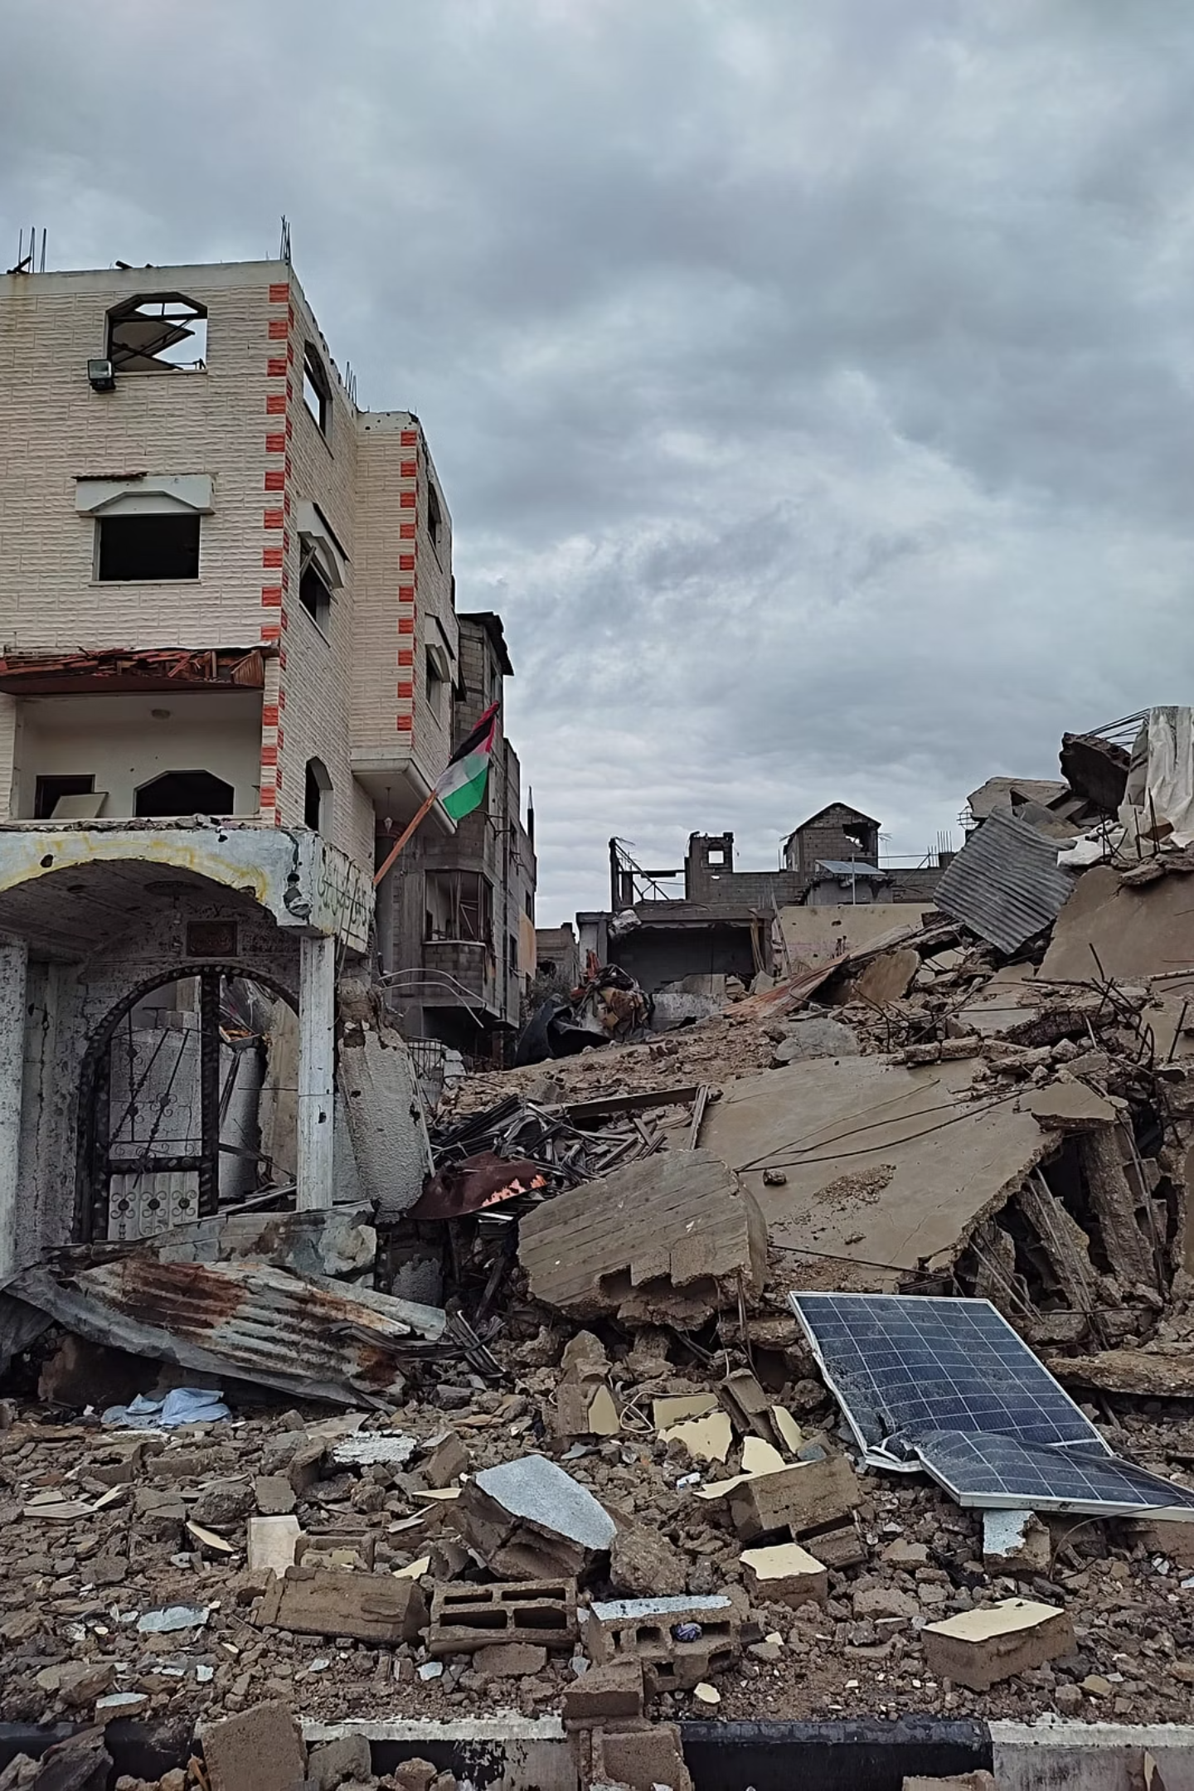
When the Air Itself Becomes a Weapon
40 Million Tons of Debris
1
20x more than all Gaza conflicts since 2008 combined
Toxic Composition
2
Debris contains asbestos, heavy metals, carcinogens, and unexploded ordnance
Collapsed Waste Management
3
Collapsed waste management → open burning → toxic air across the entire strip
15 Years to Clear
4
Under optimal conditions that do not currently exist

Slide 8
Environmental Nakba
Tree Crops Destroyed
Shrubland Destroyed
Crops Destroyed
Over 500,000 people in famine; 1 million more in food emergency
Indigenous seed banks, farming cooperatives, and land organizations criminalized
"Not about what we get from the land — but what we give to it" — Yasmeen El-Hasan, SOAS 2024

Slide 9
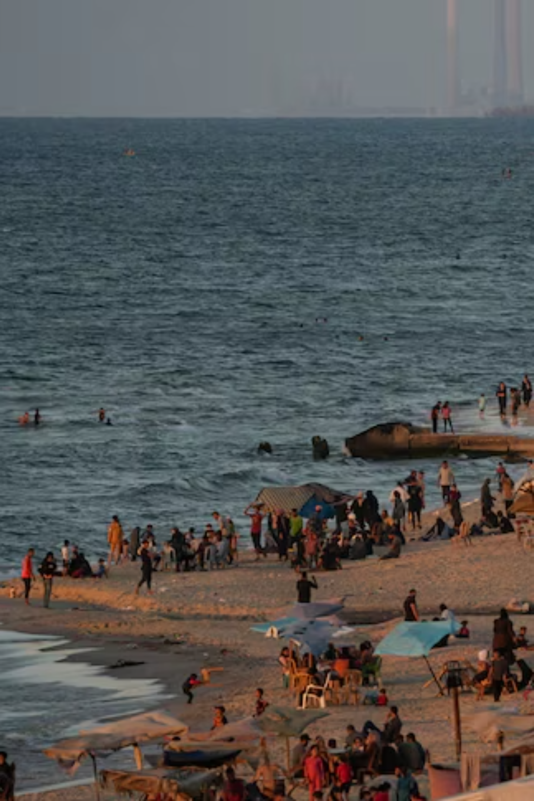
Who Owns What Lies Beneath?
Blocked Resources
Marine-1 and Marine-2 gas fields off Gaza's coast have both been blocked from Palestinian access
Colonial Extractivism
Palestinian resources absorbed under Israeli military control
Sovereignty Tension
Tension: Palestinian economic sovereignty vs. fossil fuel dependency

Slide 10
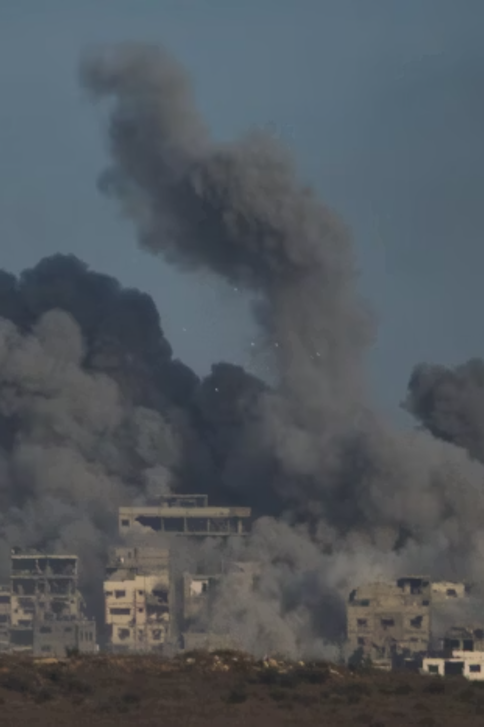
Frameworks That Doesn't Serve Justice
Non-Binding Law
1
International law frameworks are non-binding and wholly ignored
Technical Fixes
2
Aid agencies offer technical fixes in the form of desalination and new pipelines all while the siege continues
Israel at COP28
3
Israel attended COP28 while carrying out this destruction

Slide 11
Conclusion: Toward Ecological Justice
Ecocide in Palestine is structural, deliberate, and ongoing, rooted in 1948
Palestinian communities are caretakers of the land, not its victims
No climate justice without Palestinian sovereignty
Environmental crises are products of centuries of settler colonialism and capitalism, with their extractivism and degradation of life
Ecological justice is justice for all beings, it is anti colonial and anti capitalists

Slide 12
References
Magalhães Teixeira, B. (2025). Coloniality of Nature. Rewriting Peace and Conflict.
Qumsiyeh & Casiday (2024). Destroyed Ecosystems. This Week in Palestine.
UNEP (2024). Environmental Impact of the Conflict in Gaza.
UNEP (2025). Environmental Damage in Gaza Strip Harming Human Health.
SOAS ICOP (2024). Water, Land, and Destruction [Panel]. YouTube.
Abuhashem et al. (2025). Environmental Destruction of Gaza. AJPH, 115(7).
The Guardian / Middle East Environment (2024). Ecocide in Gaza.

