Slide 1
WATER SCARCITY IN QATAR
By Najla, Lolwa, and Aisha
Notes:
Good morning everyone. Today we’ll be discussing water scarcity in Qatar, one of the most water-scarce countries in the world despite being one of the wealthiest.
Our presentation explores how Qatar’s relationship with water has changed over time — from historical dependence on the Gulf through pearling and maritime life, to modern dependence on desalination for survival.

Slide 2
INTRODUCTION: QATAR AT A GLANCE
Location:
Peninsula in the Arabian Gulf
One of the
RICHEST
countries
on Earth
Area:
11,586 km²
Population:
~3.37 million (2026) — up from 50,000 in 1960
yet one of the
MOST
WATER-POOR
countries
on Earth
Rainfall:
~80 mm/year average — one of the lowest on Earth
Evaporation:
Over 2,000 mm/year — 25× more than rainfall
Economy:
One of the highest GDPs per capita in the world
Source: Baalousha & Ouda, 2017;
Darwish et al., 2016
Sources: Baalousha & Ouda (2017); Darwish et al. (2016); KAHRAMAA Annual Statistics Report (2022)
Notes:
“To understand Qatar’s water crisis, we first need to understand Qatar’s geography and climate.
Qatar is a small peninsula in the Arabian Gulf with an area of around 11,586 square kilometers. Despite its rapid modernization and economic growth, it remains an extremely arid desert environment. The country receives only around 80 millimeters of rainfall annually, while evaporation exceeds 2,000 millimeters per year. This means water disappears far faster than nature can replenish it. At the same time, Qatar’s population increased dramatically — from around 50,000 people in 1960 to millions today — increasing pressure on already limited water resources.
“And this dependence on water is deeply connected to Qatar’s historical relationship with the Arabian Gulf.”

Slide 3
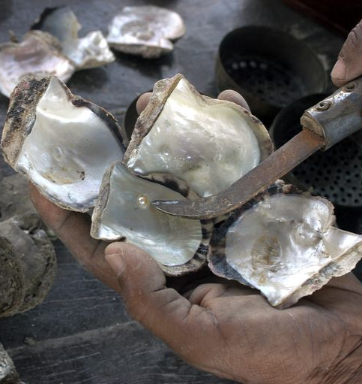
Qatar & the Gulf: A Historical Relationship
Historical Dependence on the Sea:
Before oil and gas, Qatar’s economy depended heavily on the Arabian Gulf through pearl diving, fishing, and maritime trade.
Most communities were concentrated along the coast because survival depended on access to the sea.
Pearling shaped Qatar’s economy, social life, and cultural identity for centuries.
Modern Dependence on the Sea:
Today, Qatar still depends on the Gulf — but now through desalination instead of pearls.
Nearly all domestic water is produced from desalinated seawater.
The Gulf remains essential to Qatar’s survival in an extremely arid environment.
Environmental Connection:
The same marine environment that once supported pearl diving now faces pressure from desalination, brine discharge, and environmental stress.
Qatar’s relationship with the Gulf reflects both survival and environmental vulnerability.
Notes:
“Historically, Qatar’s existence depended on the sea. Before oil and gas, communities along the coast survived through pearl diving, fishing, and maritime trade.
Pearling was not just an economic activity — it shaped social life, migration patterns, and cultural identity across the Gulf. Entire coastal settlements were built around access to the sea. The Gulf was central to everyday survival, trade networks, and movement across the region. Coastal life connected Qatar to wider Indian Ocean and Gulf economies. Pearling was a key part of Qatar’s national heritage and collective memory, representing resilience and adaptation to a harsh desert environment.”
“Today, Qatar still depends on the Gulf — but now through desalination rather than pearls. Qatar now relies on it for drinking water itself. Nearly all domestic water comes from desalinated seawater. However, this modern dependence also creates environmental pressure on marine ecosystem.

Slide 4
THE CORE PROBLEM: EXTREME WATER STRESS
🗺 WRI Aqueduct Water Risk Atlas: Qatar rated EXTREMELY HIGH (4–5/5) on Overall Water Risk
WATER BALANCE
IN QATAR
Natural Supply
80mm
250
60
60 Mm³
Total Demand
Annual rainfall
(avg.)
Million m³/yr
groundwater extracted
Million m³/yr
natural recharge
750+ Mm³
The gap is bridged entirely by
energy-intensive desalination
⚠ Extraction is 4× recharge rate → Aquifers depleting fast
Freshwater lens (TDS <1,000 mg/L) shrank from 15% of Qatar's land area (1971) to just 2% (2009)
Seawater intrusion has moved further inland as groundwater tables collapse
Qatar withdraws several times more water annually than its naturally renewable freshwater resources can replenish.
Source: Darwish et al. (2016)
No surface water courses exist; rainfall recharge is far below any sector's demand
Sources: WRI Aqueduct Atlas; Baalousha & Ouda (2017); Darwish et al. (2016); Saif et al. (2014)
Notes:
One of the biggest problems Qatar faces today is extreme water stress. Qatar falls within the highest possible category for water risk. This means the country withdraws significantly more water annually than its renewable natural resources can replace.
Qatar naturally receives only around 60 million cubic meters of renewable groundwater annually, but extraction reaches around 250 million cubic meters per year. This means groundwater is being extracted around four times faster than nature can recharge it. The country also has no rivers or natural surface water sources. Rainfall recharge remains far below agricultural and domestic demand. As a result, Qatar relies heavily on desalination to bridge this massive water gap.

Slide 5
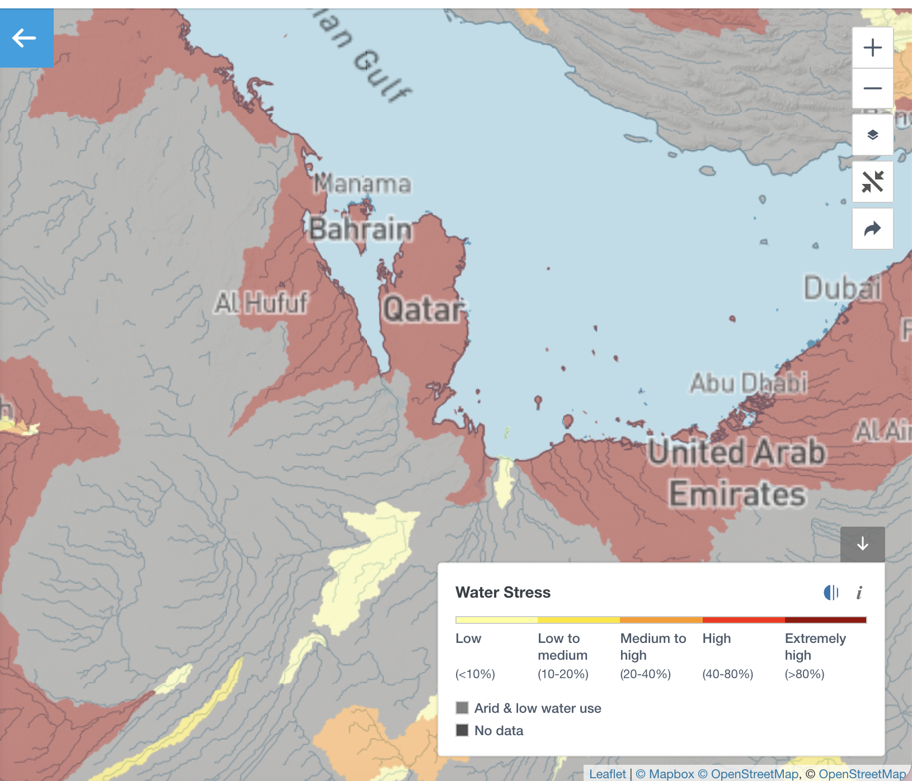
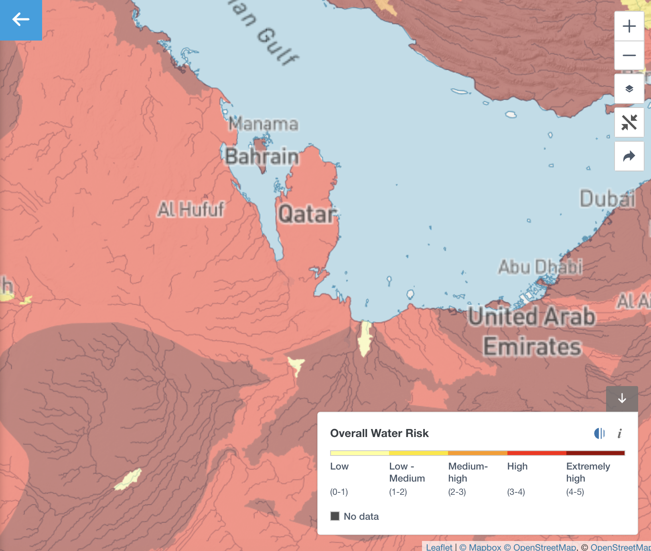
Notes:
The first image shows water stress levels across the Gulf region, while the second shows overall water risk. Qatar appears in dark red in both maps, meaning it falls within the extremely high’ category.
In the Aqueduct system, extremely high water stress means a country is withdrawing more than 80 percent of its available renewable water supply every year. The maps also show that this is not only a local issue — the wider Gulf region faces similar environmental pressures due to arid climates, low rainfall, and extremely high dependence on desalination and groundwater extraction.

Slide 6
GROUNDWATER DEPLETION IN DETAIL
FRESHWATER LENS COLLAPSE (Northern Qatar)
15%
12%
9%
4%
2%
1971
1982
1995
2008
2009
1,683 km²
1,278 km²
999 km²
622 km²
186 km²
Area with TDS < 1,000 mg/L (suitable for irrigation) as % of Qatar land
Water Table Drop
Saltwater Intrusion
Levels fell by 10+ meters in some areas due to over-pumping
Seawater has moved further inland as coastal aquifers collapse
Quality Deterioration
Legal Response
TDS rising across all aquifers; wells being abandoned as water becomes too brackish for crops
Ministerial Decree No. 20 banned new production wells, but existing abstraction (~250 Mm³/yr) continues
Sources: Baalousha & Ouda (2017); Darwish et al. (2016)
Notes:
This slide shows how severe groundwater depletion has become over time. In 1971, freshwater suitable for irrigation covered around 15 percent of Qatar’s land area. By 2009, that shrank to only 2 percent. At the same time, water tables dropped significantly because of over-pumping.
As groundwater levels decline, seawater intrusion moves further inland and increases salinity inside aquifers. This creates serious agricultural problems because wells become too salty for crops. In some areas, farms have already been abandoned due to water quality.
Researchers also warn that groundwater overexploitation contributes to soil salinization and desertification. Even though Qatar introduced restrictions on new wells, extraction levels remain unsustainable.

Slide 7
DESALINATION: QATAR'S LIFELINE
99%
2022 WATER PRODUCTION BY FACILITY (Million m³)
UHP (Umm Al Houl)
288 Mm³
Ras Laffan B
81 Mm³
of domestic
water from
desalination
Ras Laffan C
80 Mm³
RAF A3
59 Mm³
Ras Laffan A
51 Mm³
RAF A1
35 Mm³
RAF B
28 Mm³
RAF A2
26 Mm³
RAF B2
21 Mm³
TOTAL 2022 PRODUCTION: 672 Million m³ | Total Contracted Capacity: 538 MIGD
Source: KAHRAMAA Annual Statistics Report (2022); Darwish et al. (2016)
Notes:
Because natural freshwater resources are insufficient, Qatar now depends almost entirely on desalination. Research shows that approximately 99 percent of domestic water demand is met through desalinated seawater.
This slide shows Qatar’s major desalination facilities, including Umm Al Houl and Ras Laffan. According to the KAHRAMAA Annual Statistics Report, Qatar produced around 672 million cubic meters of desalinated water in 2022 alone.
Without desalination, modern urban life in Qatar would not be possible. But desalination is also extremely energy intensive because most plants are powered by fossil fuels, creating another environmental challenge.

Slide 8
CONSUMPTION: AMONG THE WORLD'S HIGHEST PER CAPITA
AVERAGE WATER PER CAPITA CONSUMPTION (m³/person/year)
KEY FIGURES (2022)
236 m³
per capita/year (2022)
~500 L
per capita/day (historical peak)
249
246
426,738
water customers in 2022
242
+4.9%
customer growth rate (2022)
236
231
5.74%
network water loss rate (2022)
$2.74/m³
production cost vs $1.21+ tariff
2018
2019
2020
2021
2022
WATER CUSTOMERS GROWTH
Source: KAHRAMAA Annual Statistics Report (2022); Saif et al. (2014)
Notes:
“Qatar also has one of the highest water consumption rates per capita globally. As shown in the graph, per capita consumption remained extremely high between 2018 and 2022. Historical estimates also show daily consumption reaching nearly 500 liters per person per day. The reasons for this. Rapid urbanization, economic growth, subsidized pricing, landscaping demands, and rising standards of living all contribute to overconsumption.
Another important issue is cost. Producing desalinated water is extremely expensive and energy intensive. Production costs reach around 2.74 dollars per cubic meter, while tariffs paid by consumers remain much lower due to government subsidies. This reduces incentives for conservation because water feels relatively cheap and constantly available.
In 2022 alone, Qatar had over 426,000 water customers, with customer growth increasing by nearly 5 percent. Although Qatar successfully reduced network water losses to around 5.74 percent through monitoring systems and infrastructure improvements, overall demand still remains extremely high.”

Slide 9
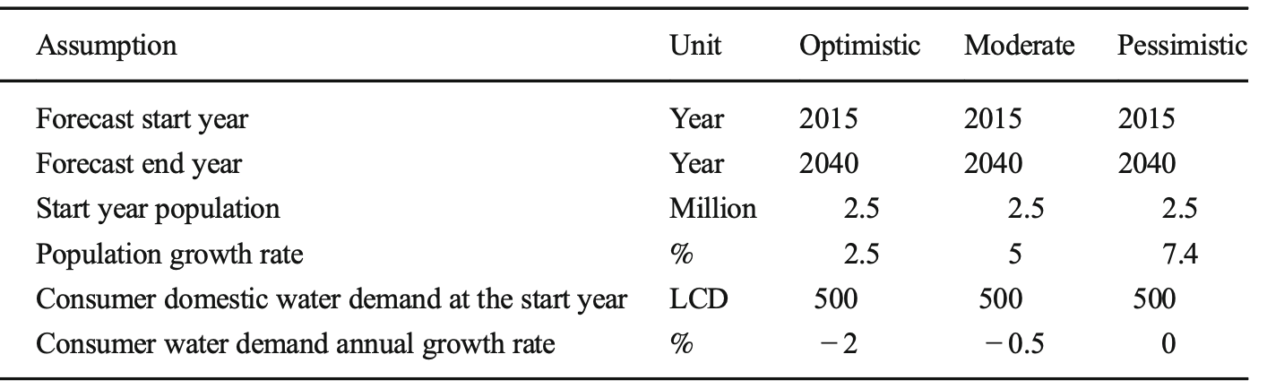
FUTURE PROJECTIONS: A GROWING CRISIS
WRI Aqueduct Future Scenario (2030, Optimistic): Qatar's region remains HIGH to EXTREMELY HIGH water stress — even under best-case climate and policy assumptions
BEST CASE
MIDDLE CASE
WORST CASE
OPTIMISTIC
MODERATE
PESSIMISTIC
Population 2040:
Population 2040:
Population 2040:
4.6M by 2040
8.5M by 2040
14.9M by 2040
Water Demand 2040:
Water Demand 2040:
Water Demand 2040:
516 Mm³/yr
1,205 Mm³/yr
2,718 Mm³/yr
Notes:
“This slide shows three possible future scenarios for Qatar’s water demand by 2040: optimistic, moderate, and pessimistic.
In the optimistic scenario, the population reaches around 4.6 million, with water demand at 516 million cubic meters annually. This would require strong conservation efforts and lower daily water use. The moderate scenario projects a population of around 8.5 million people and water demand of over 1.2 billion cubic meters annually. In this case, Qatar would need about double its current desalination capacity.
In the pessimistic scenario, the population could reach almost 15 million by 2040, with water demand rising to around 2.7 billion cubic meters annually. That would require nearly five times the current desalination capacity.

Slide 10
ENVIRONMENTAL IMPACTS OF WATER SCARCITY & DESALINATION
🌊 Brine Discharge
♻️ Greenhouse Gas Emissions
Desalination plants discharge hyper-saline, chemically-laden brine into the Arabian Gulf. Brine salinity is often double ambient seawater — threatening corals, mangroves, and fish. The Gulf's semi-enclosed nature makes cumulative impacts especially severe.
Abu Dhabi alone emits 4–9 million tons CO₂/year from desalination. These figures do not include indirect emissions.
🌿 Groundwater & Soil Degradation
🐠 Marine Organism Harm
Over-pumping causes subsidence and soil salinization. Deteriorating groundwater quality forces farm abandonment. The freshwater lens — once covering 15% of Qatar — is now just 2%. Seawater intrusion continues to worsen.
Seawater intake pipes impinge and entrain marine organisms — one of the most under-studied impacts. Chemical pre-treatment additives (antiscaling, antifoaming, halogenated compounds) also enter the marine environment with brine discharge.
🚽 Wastewater Underutilization
⚡ Energy-Water Security Link
~40% of treated sewage effluent (TSE) was historically discharged into open fields or the sea rather than reused. This represents a major missed opportunity in a country with near-zero natural water resources.
99% of Qatar's water depends on fossil fuel energy. Any disruption to power plants or oil spill near desalination intakes could trigger an immediate water crisis. Strategic reserve was only 2 days until recent reservoir expansion.
Sources: Saif et al. (2014); Darwish et al. (2016); Baalousha & Ouda (2017)
Notes:
“Although desalination secures water supply, it also creates major environmental impacts. One of the biggest concerns is brine discharge. Desalination plants release highly concentrated salt and chemicals back into the Arabian Gulf. The Gulf is semi-enclosed, meaning water circulation is relatively limited. Because of this, environmental impacts accumulate more easily compared to open oceans. Brine discharge threatens coral reefs, mangroves, and fish populations, while seawater intake systems can harm marine organisms through impingement and entrainment.”
Desalination also depends heavily on fossil fuel energy, linking water security directly to energy security. This creates what researchers call the water-energy nexus, where water production depends on energy systems, and energy production itself requires water. ”
So the same Gulf environment that historically supported pearl diving communities is now under pressure from the technologies needed for modern survival.”

Slide 11
WHAT IS BEING DONE? GOVERNMENT RESPONSES
01
Qatar National Vision 2030
02
Tarsheed Conservation Program
Acknowledges that subsidized water pricing is unsustainable. Explicitly calls for pricing that reflects the true scarcity value of water and warns against government subsidizing depletion of natural resources.
KAHRAMAA's public awareness and conservation initiative targeting residential overconsumption through education campaigns, tips, and behavior-change tools.
03
Mega Reservoir Construction
04
SCADA Network Monitoring
Water storage capacity grew from 1,481 MIG (2018) to 2,397 MIG (2022). Qatar now has ~7 days of backup supply — significantly more resilient than the 2-day reserve of a decade ago.
$58 million invested in Supervisory Control and Data Acquisition systems to monitor the distribution network and cut leakage losses — reduced from >30% to ~5.74% by 2022.
05
TSE Reuse Expansion
06
30-Year Water & Power Master Plan
Treated Sewage Effluent increasingly used for landscaping, fodder crops, and parks. Plans to expand tertiary and quaternary treatment for broader non-potable applications.
Qatar initiated a 30-year master plan (2009) to add 1.72 million m³/day of new desalination capacity by 2032 — a ~140% increase over existing capacity.
Sources: KAHRAMAA (2022); Saif et al. (2014); Baalousha & Ouda (2017)
Notes:
“To address these challenges, Qatar has implemented several major initiatives.
Qatar National Vision 2030 recognizes that current water consumption patterns are unsustainable and emphasizes long-term resource management.”
“One important initiative is the Tarsheed conservation campaign, which encourages residents to reduce excessive water and electricity use through awareness programs.”
“Qatar has also expanded strategic water reservoirs. According to recent reports, backup reserves increased from roughly two days of supply to around seven days. ”
“Another major development is the SCADA monitoring system, which reduced leakage losses dramatically — from over 30 percent to around 5.74 percent by 2022.”

Slide 12
GAPS & CRITICISMS: WHAT STILL NEEDS TO HAPPEN
⚠ Water Pricing Reform Still Incomplete
Subsidized tariffs remain well below production cost ($1.21/m³ vs $2.74/m³ to produce). Qatar National Vision 2030 itself identified this as a priority — yet meaningful reform has been slow.
⚠ TSE Reuse Infrastructure Lagging
Despite improvements, treated wastewater infrastructure to deliver reclaimed water to potential users is largely absent. Full utilization of TSE could eliminate the need for groundwater in agriculture entirely.
⚠ Agricultural Groundwater Unsustainable
~92% of groundwater goes to agriculture via flood/open-channel irrigation — the least efficient method. Despite banning new wells, existing abstraction (~250 Mm³/yr) remains 4× the recharge rate.
⚠ Aquifer Storage & Recovery Early Stage
Aquifer recharge using treated water or desalinated water would provide strategic emergency reserves measured in months, not days — but programs remain small-scale and experimental.
⚠ Behavioral Change Lagging Behind Infrastructure
Campaigns like Tarsheed are positive but insufficient alone. International experience shows meaningful per capita reductions require structural pricing signals, not just awareness.
Sources: Darwish et al. (2016); Baalousha & Ouda (2017); Saif et al. (2014); KAHRAMAA (2022)
Notes:
Despite these efforts, major gaps still remain. One issue is that water pricing reform has been relatively slow, even though subsidized pricing encourages overconsumption. Another challenge is agriculture. Around 90 percent of groundwater extraction is still directed toward agriculture, often through inefficient irrigation systems.
Wastewater reuse also remains underdeveloped. Studies show much treated wastewater is still discharged instead of fully reused for irrigation or landscaping. This demonstrates that infrastructure expansion alone is not enough — behavioral and policy changes are also necessary.

Slide 13
RECOMMENDATIONS & CONCLUSION
1
Reform water tariffs to reflect true scarcity value and reduce overconsumption
2
Transition from MSF to energy-efficient SWRO desalination technology
3
Scale up TSE reuse to quaternary (near-potable) quality for all non-drinking uses
4
Expand Aquifer Storage & Recovery for strategic emergency reserves
5
Enforce strict limits on agricultural groundwater abstraction
6
Invest in solar-powered desalination to decouple water security from fossil fuels
CONCLUSION
Qatar faces a structural water crisis unlike almost any other nation — no rivers, minimal rainfall, and a population and economy that demand hundreds of times more water than nature provides. The country has the financial resources and institutional capacity to address this challenge, but bold policy reform — particularly on pricing and wastewater reuse — is just as critical as continued infrastructure investment.
Notes:
To improve long-term sustainability, Qatar will likely need both technological and structural reforms.These include reforming water tariffs, expanding treated wastewater reuse, transitioning toward more energy-efficient desalination technologies like reverse osmosis, and investing in renewable-energy-powered desalination.Ultimately, Qatar’s water crisis reflects a larger story about survival in an arid environment.
Historically, Qatar depended on the Gulf. Today, Qatar still depends on the Gulf — but now for desalinated drinking water. This continuity shows how deeply connected Qatar’s history, economy, and environment are to the sea.
But it also highlights an important contradiction: the same Gulf that sustains life is increasingly under environmental pressure because of the systems required to maintain modern development.”

Slide 14
DISCUSSION QUESTION
Would people in Qatar actually change their water usage habits if water prices increased?

Slide 15
REFERENCES
Baalousha, Husam Musa, and Omar K. M. Ouda. “Domestic Water Demand Challenges in Qatar.” Arabian Journal of Geosciences, vol. 10, no. 24, 2017, p. 537.
Darwish, Mohamed A., and Rabi Mohtar. “Qatar Water Challenges.” Desalination and Water Treatment, vol. 51, no. 1–3, 2013, pp. 75–86.
Darwish, Mohamed A., et al. “The Role of Energy to Solve Water Scarcity in Qatar.” Desalination and Water Treatment, vol. 57, no. 40, 2016, pp. 18639–18667.
Kahramaa Annual Statistics Report 2022. Kahramaa Official Website, 2022. Accessed 11 May 2026.
“Pearling, a National Heritage.” Hamad Bin Khalifa University. Accessed 13 May 2026.
Saif, Omar, Toufic Mezher, and Hassan A. Arafat. “Water Security in the GCC Countries: Challenges and Opportunities.” Journal of Environmental Studies and Sciences, vol. 4, no. 4, 2014, pp. 329–346.
“The City and the Sea.” Georgetown University in Qatar – Environmental History of Doha. Accessed 13 May 2026.
Water Risk Atlas. World Resources Institute, Aqueduct, 2030, World Resources Institute Aqueduct Water Risk Atlas. Accessed 11 May 2026.

