Slide 1
China’s Air Pollution Crisis
Reem and Tamadhar

Slide 2
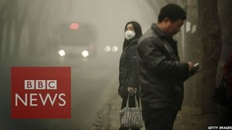

Slide 3
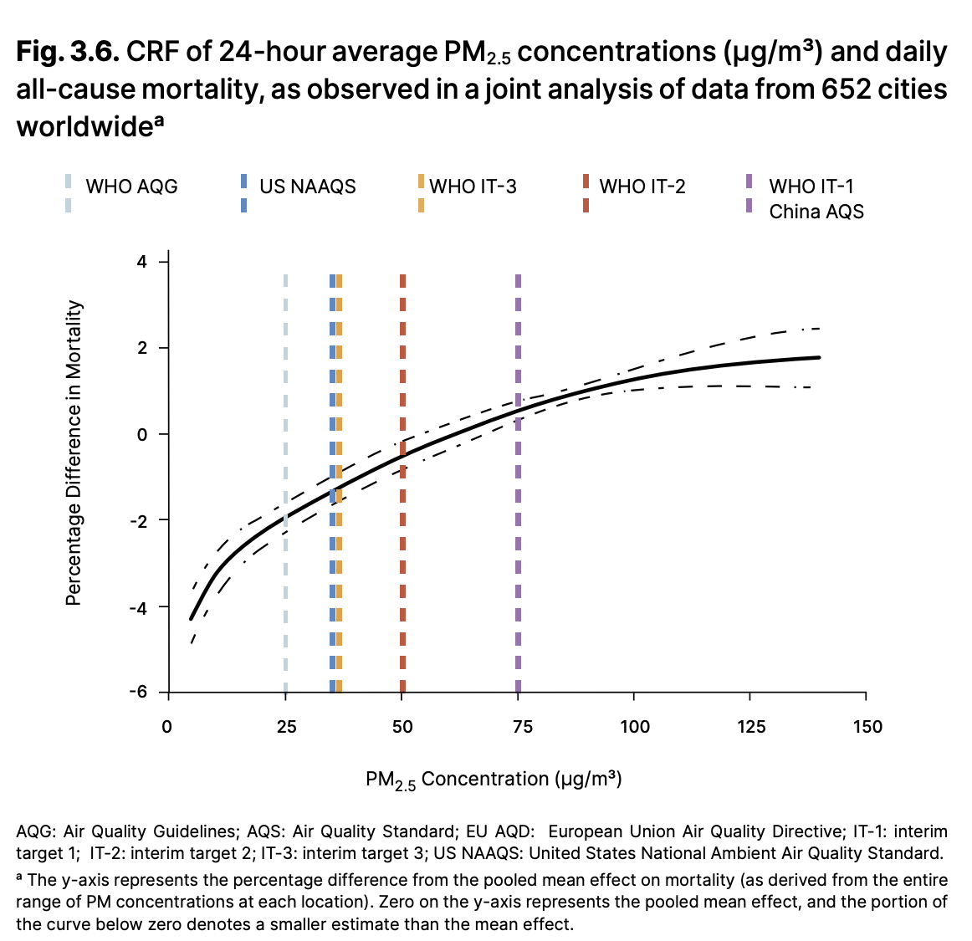
Why This Issue Matters
Public health crisis
PM2.5 exposure is linked to higher daily mortality rates → people die earlier
Small particles enter deep into the lungs and bloodstream
Higher PM2.5 levels increase risk of heart and lung disease
Long-term exposure can reduce life expectancy
Vertical lines = standards/targets
micrograms per cubic meter
World Health Organization. WHO Global Air Quality Guidelines: Particulate Matter, Ozone, Nitrogen Dioxide, Sulfur Dioxide and Carbon Monoxide, 2021, Fig. 3.6. Reprinted from Liu et al. 2019.

Slide 4
What Is Air Pollution?
Air pollution occurs when harmful particles and gases accumulate in the atmosphere.
In China, the most serious pollutants include PM2.5, sulfur dioxide, and nitrogen oxides, which are mainly produced by coal combustion, transportation, and industrial activity.

Slide 5
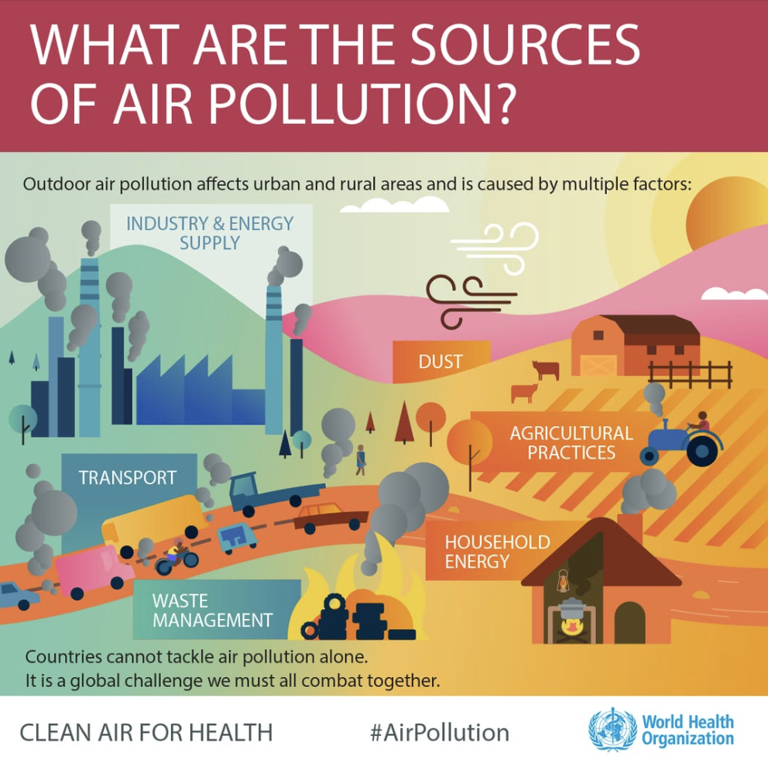
Main Causes
Coal-fired power and heating → coal combustion contributed about 40% of PM2.5 concentrations across 74 major Chinese cities in 2013
Heavy industries: steel, cement, chemicals
Construction dust
Vehicle emissions
Regional transport of pollution
Large-scale manufacturing and global production → “world’s factory”
Demand for Cheap China’s Environmental Pressure

Slide 6
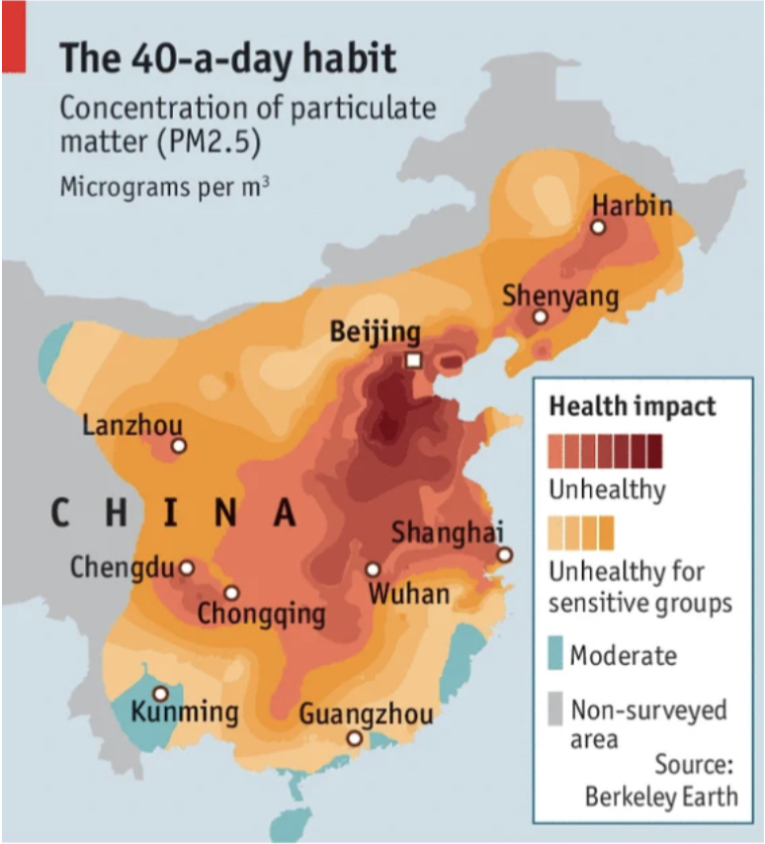
Where Air Pollution Is Worst in China
Northern industrial regions such as Beijing, Tianjin, and Hebei Province experience the country’s highest pollution levels.
Coal-powered heating systems, steel production, and dense urban populations contribute to frequent smog events and hazardous air quality.

Slide 7
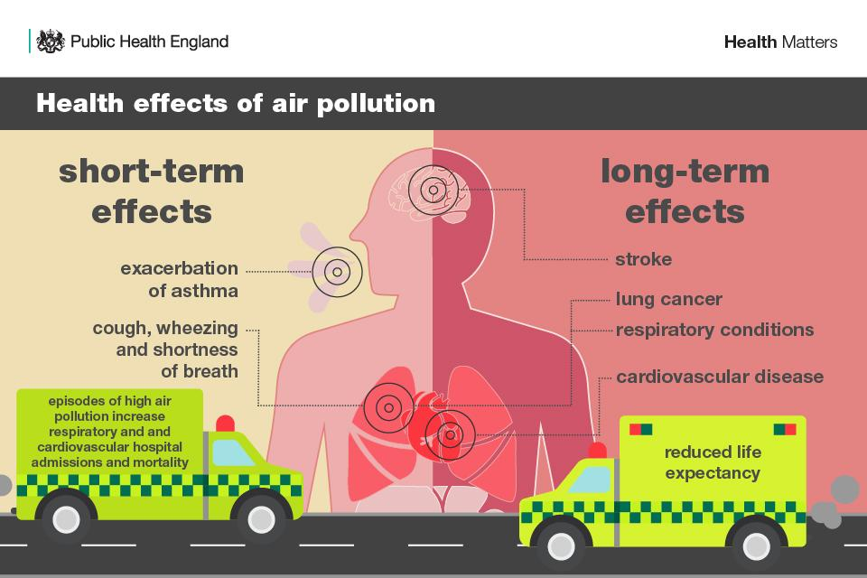
Health & Social Impacts
PM2.5 enters the lungs and bloodstream
Linked to asthma, lung disease, heart disease, stroke, and lung cancer
Increases premature death risk
Can lower life expectancy
Social impacts: missed school/work, reduced outdoor activity
Inequality → low-income communities closer to factories → but cannot afford healthcare/purifiers

Slide 8
Economic & Daily-Life Impacts
Air pollution in China has reduced productivity, increased healthcare spending, disrupted transportation, and lowered overall quality of life.
Severe smog events have affected businesses, schools, tourism, and the daily routines of millions of residents.

Slide 9
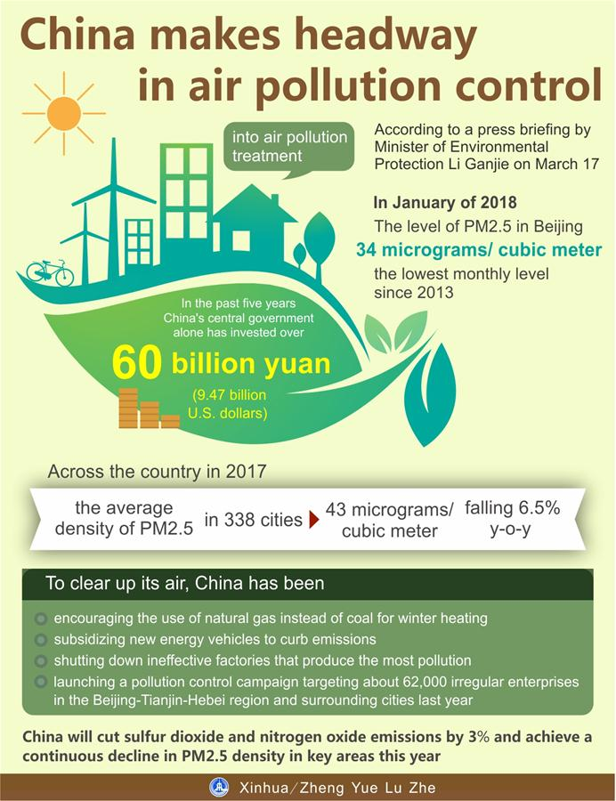
Government Response
2013 Air Pollution Prevention and Control Action Plan
Invested billions into air pollution treatment
Shifted some winter heating from coal to natural gas
Subsidized new-energy vehicles
Shut down or regulated highly polluting factories
Targeted industrial violations in polluted regions

Slide 10
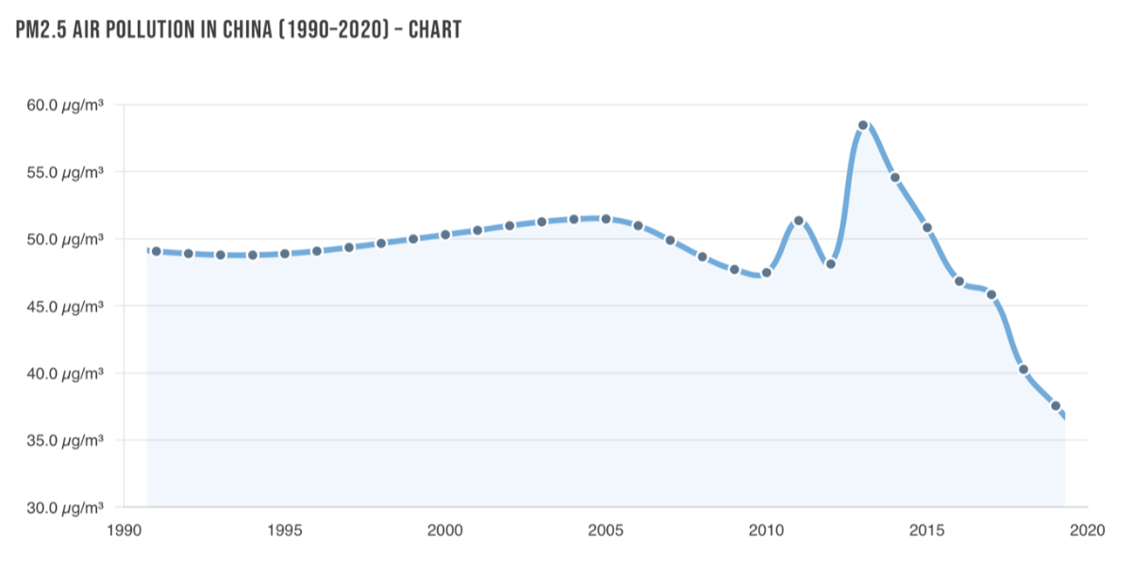
Progress & Remaining Problems
China introduced major anti-pollution policies after 2013, including the Air Pollution Prevention and Control Action Plan.
These measures reduced PM2.5 levels in several major cities, but coal dependence and industrial emissions continue to challenge long-term progress.

Slide 11
Conclusion
Clean air is essential for public health and quality of life
China’s progress shows environmental policy can work
Long-term improvement requires continued enforcement and cleaner development

Slide 12
References
Airly. “China Air Pollution – Sources, Causes, and Effects of This Problem.” Airly, https://airly.org/en/air-pollution-in-china-what-causes-it/.
Air Quality Life Index. “China: National Air Quality Action Plan (2013).” Energy Policy Institute at the University of Chicago, 23 Aug. 2023, https://aqli.epic.uchicago.edu/post/china-national-air-quality-action-plan-2013.
Asia Pacific Energy Portal. “Air Pollution Prevention and Control Action Plan.” United Nations ESCAP, https://policy.asiapacificenergy.org/node/2875.
Air Pollution and Mental Health: Evidence from China https://www.aeaweb.org/articles?id=10.1257/pandp.20241062
Cosford, Paul, Chris Whitty, and Karen Exley. “Health Matters: Air Pollution – Sources, Impacts and Actions.” UK Health Security Agency, 14 Nov. 2018, https://ukhsa.blog.gov.uk/2018/11/14/health-matters-air-pollution-sources-impacts-and-actions/.
World Health Organization. “Air Pollution in China.” WHO China, https://www.who.int/china/health-topics/air-pollution.
World Health Organization. “Ambient Air Pollution.” Global Health Observatory, https://www.who.int/data/gho/data/themes/topics/topic-details/GHO/ambient-air-pollution.
World Health Organization. WHO Global Air Quality Guidelines: Particulate Matter (PM2.5 and PM10), Ozone, Nitrogen Dioxide, Sulfur Dioxide and Carbon Monoxide. 22 Sept. 2021, https://www.who.int/publications/i/item/9789240034228.
Xinhua. “Graphic: China Makes Headway in Air Pollution Control.” Xinhua, 18 Mar. 2018, https://www.xinhuanet.com/english/2018-03/18/c_137048301.htm.
Severe Air Pollution and Psychological Distress in China: The Interactive Effects of Coping and Perceived Controllability https://www.frontiersin.org/journals/psychology/articles/10.3389/fpsyg.2021.601964/full

