Slide 1
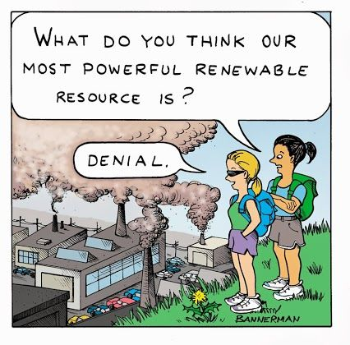
Econ 2675 – Environmental Economics
Chapter 7 Lecture - Energy: The Transition from Depletable to Renewable Resources

Slide 2
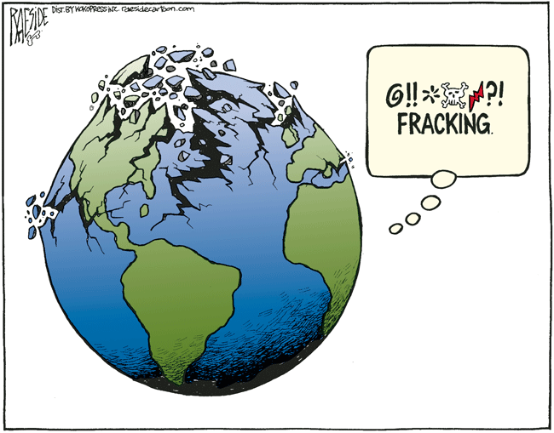
Fracking (Hydraulic fracturing)
A form of technical progress that combines horizontal drilling with an ability to fracture deep shale deposits using a mixture of high pressure water, sand, and chemicals.
  It releases large quantities of natural gas.
  It costs less.
  It also brings some controversy.

Slide 3
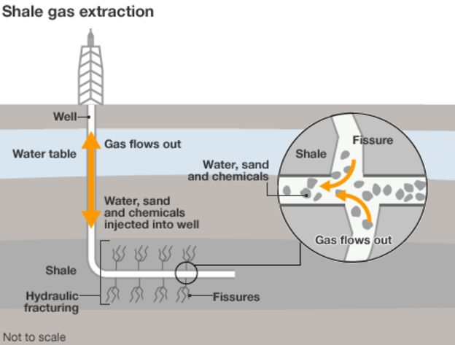
Fracking (Hydraulic fracturing)

Slide 4
Oil: The Cartel Problem
The member countries of the international cartel called the Organization of Petroleum Exporting Countries (OPEC) collude in order to gain monopoly power.
Effective cartelization needs to consider:
  Price elasticity of demand
  Income elasticity of demand
  Supply responsiveness of non-cartel producers
  Compatibility among members of the cartel.

Slide 5
Oil: The Cartel Problem
Price Elasticity of Demand
  The lower the price elasticity of demand (in absolute value), the larger the potential gains from cartelization.
  The price elasticity of demand depends on the opportunities for conservation, as well as on the availability of substitutes.
Income Elasticity of Demand
  At constant prices, as income grows, demand for the cartels should grow.
  The income elasticity of demand is important, because it registers how sensitive demand is to the business cycle.
    Recessions can thus put pressure on the cartel and expansions are beneficial to the cartel.

Slide 6
Oil: The Cartel Problem
Non-member
  The cartel must take non-members into account when setting prices (Salant 1976)
  Example of the impact of the competitive fringe:
    Recessions can thus put pressure on the cartel and expansions are beneficial to the cartel.
Compatibility of Member Interests
  Individual cartel members have incentives to cheat on production agreements.
  Price elasticity of demand facing each individual member is higher than for the cartel. With higher price elasticity, lowering price maximizes profit.
  Enforcing the collusive agreement is essential for the success of the cartel

Slide 7
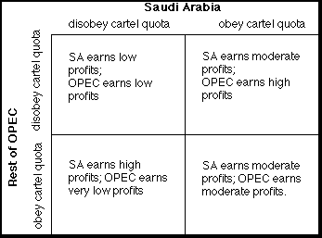
Game Theory and OPEC

Slide 8
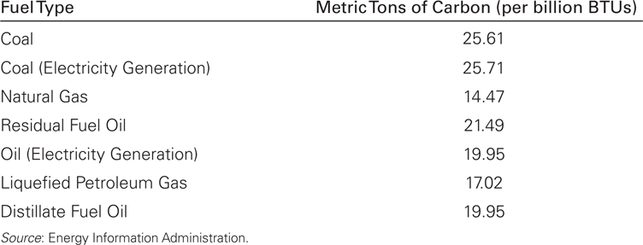
Fossil Fuels: National Security Considerations
National security is a public good. The market would generally result in an excessive dependence on imports.
The long run domestic supply curve of oil reflects increasing availability of domestic oil at high prices.
“Global energy security is a vital part of America's national security.”
Joe Biden

Slide 9
Fossil Fuels: National Security Considerations
Domestic supply is reflected by two options:
  S_{d1}, is the long-run domestic supply curve without considering the climate change damages resulting from burning more oil,
  S_{d2}, is the domestic supply curve that includes these per-unit damages.
Supply curves reflect increasing availability of domestic oil at higher prices.
  P_{w1} reflects the observed world price,
  P_{w2} includes a “vulnerability premium” in addition to the world price,
  P_{w3} adds in the per-unit climate change damages due to consuming more imported oil.

Slide 10
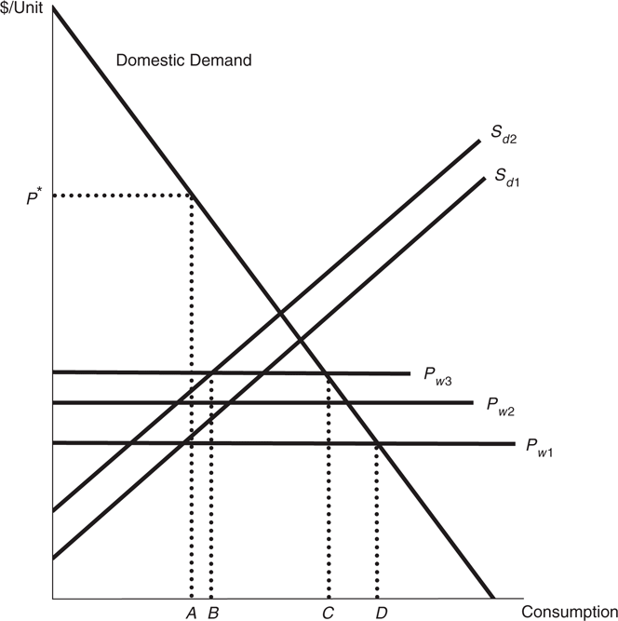
The National Security Problem
In the absence of any correction for national security and climate change considerations, the market would generally demand and receive D units of oil. Of this total amount, A would be domestically produced and D – A would be imported.
In an efficient allocation, incorporating the national security and climate change considerations, only C units would be consumed. Of these, B would be domestically produced and C – B would be imported.

Slide 11
What Would Happen During an Embargo?
Assuming domestic supply cannot be increased quickly, in the short run, the supply curve becomes perfectly inelastic (vertical) at A. The price will rise to P* to equate supply and demand. As the graph indicates, the loss in consumer surplus during an embargo can be very large indeed.

Slide 12
Fossil Fuels: National Security Considerations
Self-sufficiency is not an efficient strategy for an importing country.
Another strategy is to developed a stockpile of oil.
The U.S. has developed strategic petroleum reserve
Conservation can help decrease reliance on foreign imports. A tax on energy consumption is one tool that can be used to encourage conservation.
Domestic subsidies are another possible tool.
Impose tariffs and quotas on imports.
Expand domestic supply

Slide 13
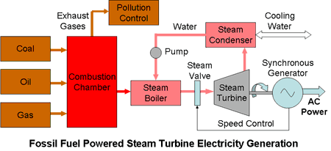
Electricity: The Role of Depletable Resources
Electricity generation depends heavily on conventional sources such as oil, coal, and gas.
In terms of both climate change and national security issues, the solution involves a transition to domestic renewable sources of energy that do not emit greenhouse gases.

Slide 14
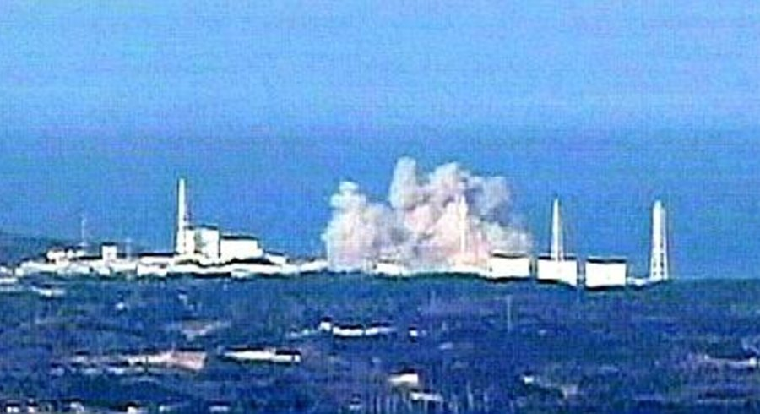
Electricity: The Role of Depletable Resources
Uranium
  Limitations: abundance and safety
    Breeder reactors can greatly enhance resource availability.
  Safety is the major concern: nuclear accidents and storage of radioactive waste.
  Resurgence of interest in nuclear power and the influence of the Fukushima accident.

Slide 15
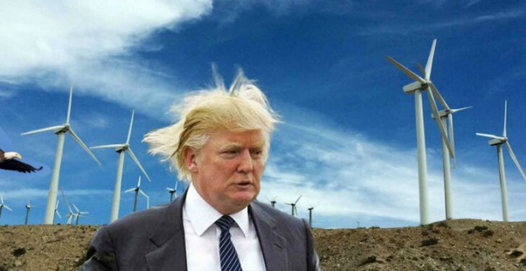
Electricity: Transitioning to Renewables
Renewable energy sources include:
1. Hydroelectric power
2. Wind power
3. Photovoltaics
4. Active and passive solar energy
5. Ocean tidal power
Market penetration depends upon their relative cost and consumer acceptance.
https://www.youtube.com/watch?v=ec9P3C1OXqE

Slide 16
Electricity: Transitioning to Renewables
Establishing specific renewable resource goals with deadlines such a the E.U. Renewable Energy Directive
Subsidizing investment via tax code
Production or investment tax credits
Combining Renewable Portfolio Standard (RPS) with Renewable energy Credits (RECs)
  RPSs stipulate a minimum percentage of the total electricity that must be generated from specified renewable sources such as wind or solar.
  An independent generator of electricity can sell the renewable energy credit (REC) that turns the environmental attributes into a legally recognized form of property.
Feed-in tariff

Slide 17
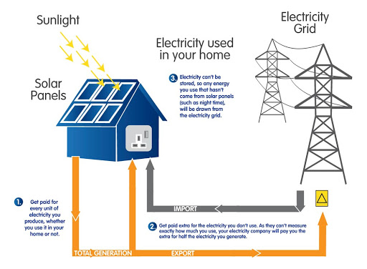
Electricity: Transitioning to Renewables
The feed-in tariff, heavily used in Europe, determines the prices received by anyone who installs qualified renewable capacity that sells electricity to the grid.

Slide 18
Energy Efficiency
An activity is said to be energy efficient if it is produced with the minimum amount of energy input necessary to produce a given level of that activity.
  Government intervention and externalities
  Forward Capacity Market
    It uses market forces to facilitate the planning of future electric capacity investment by entities.
    A forward capacity market is an administrative market run by a regional system operator who collects supply bids to meet planning targets for regional peak capacity needs, runs a competitive auction to establish capacity prices, and then procures capacity at the market clearing price to meet the resource adequacy

Slide 19
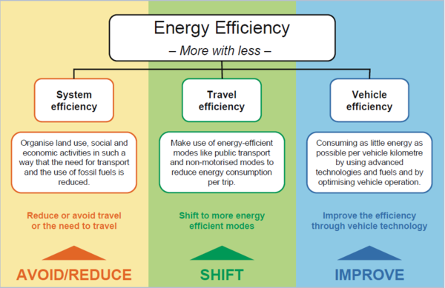
Energy Efficiency Transportation

Slide 20
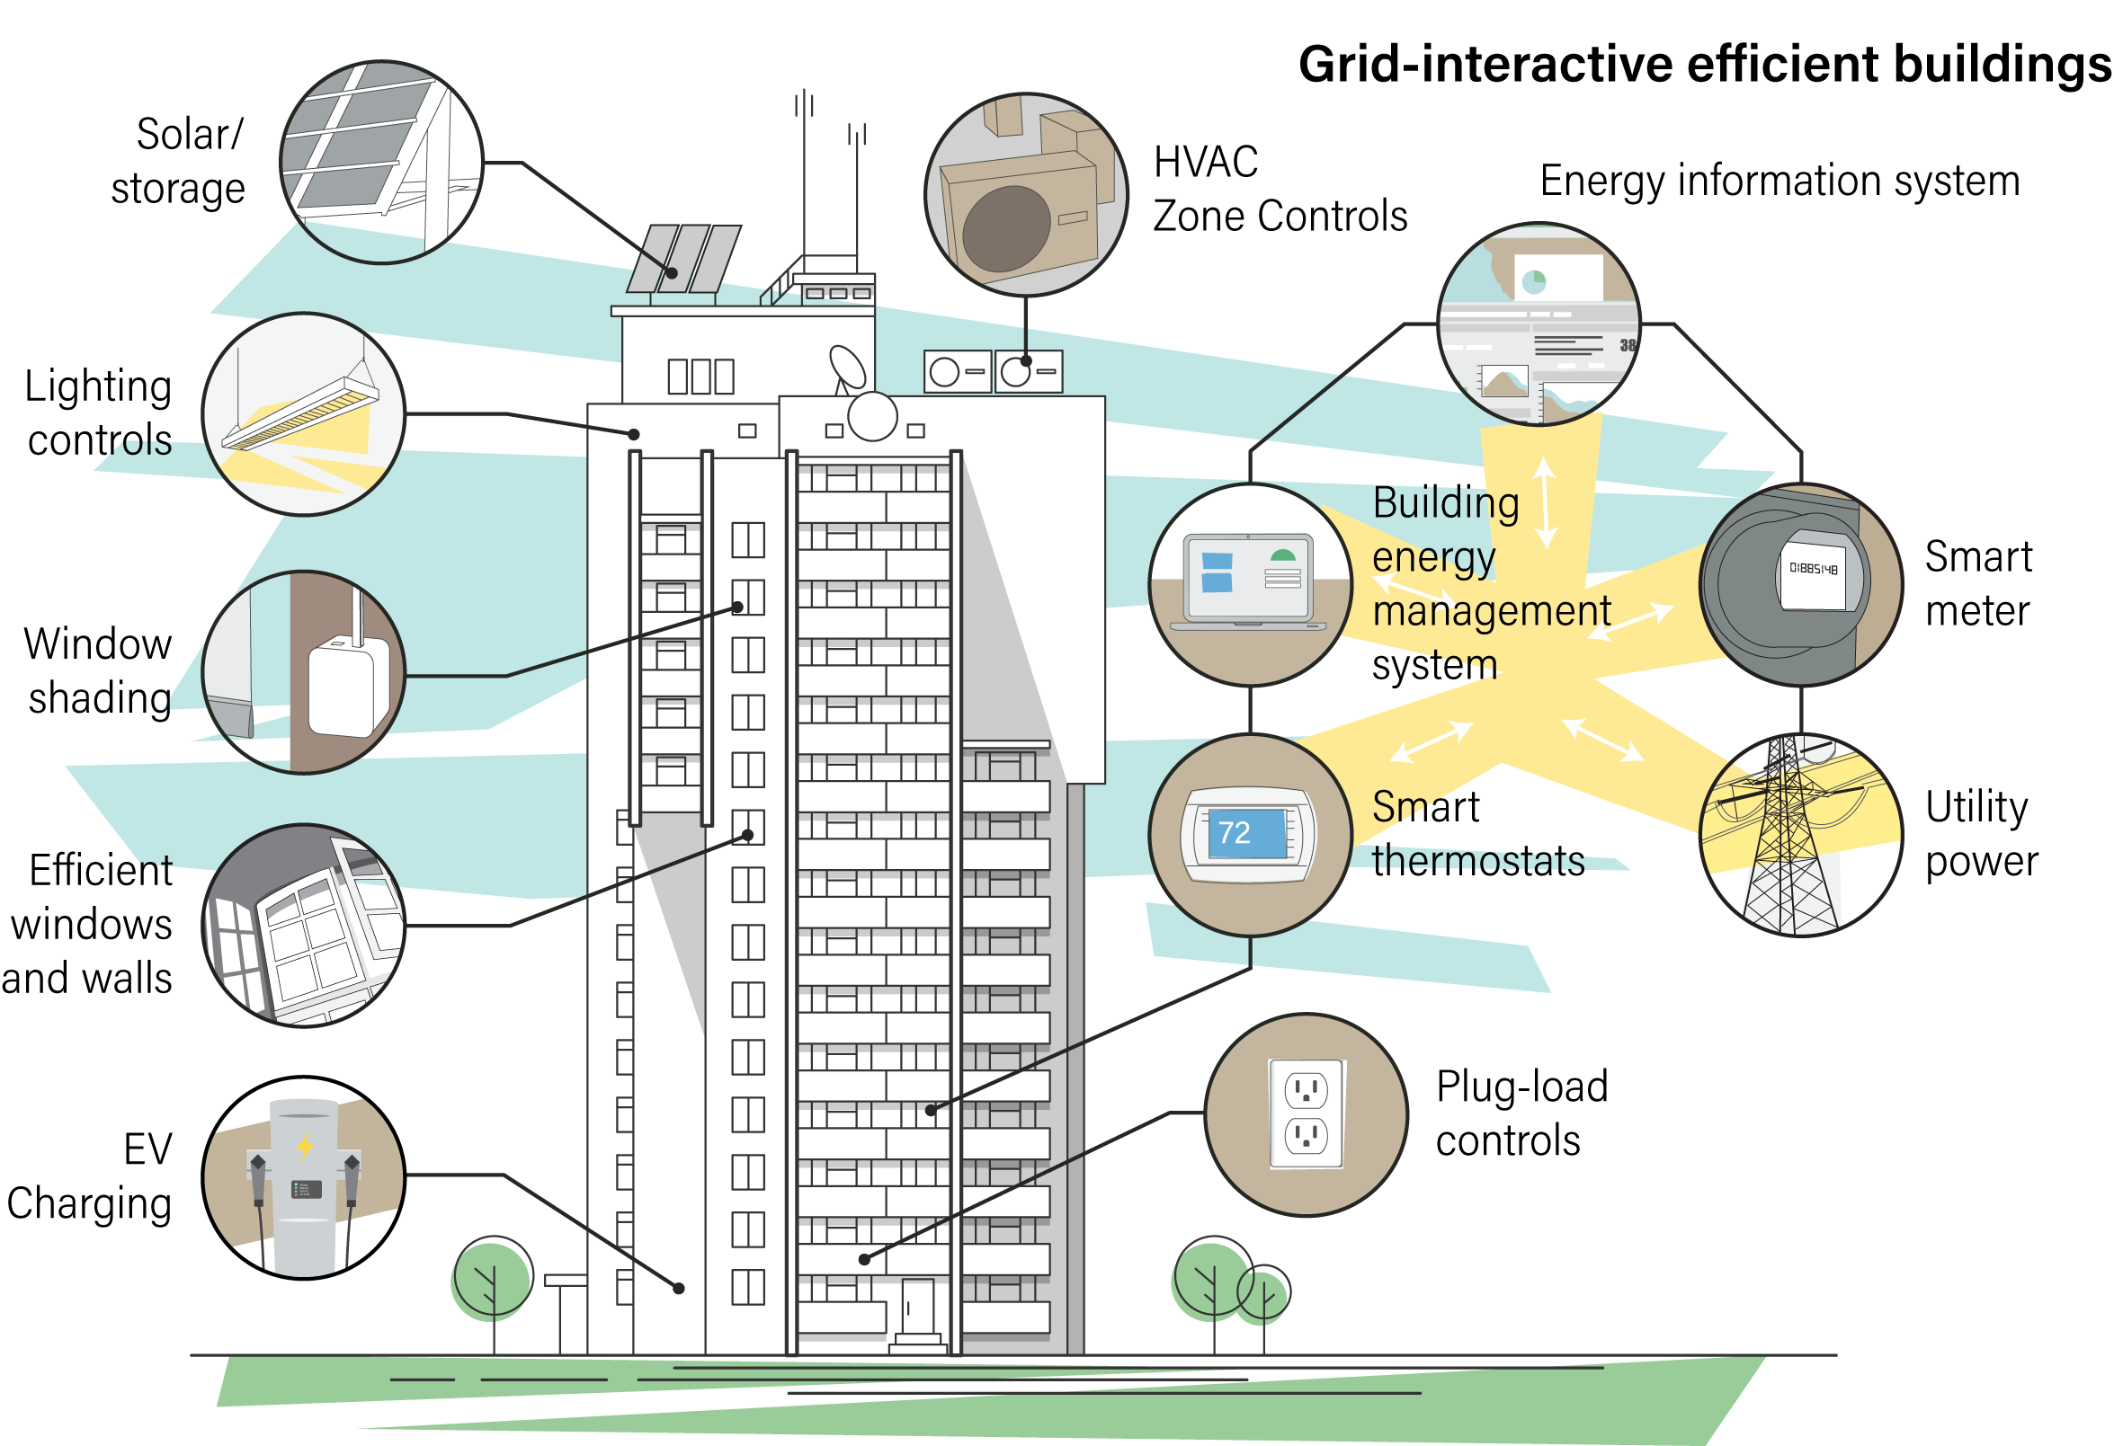

Slide 21
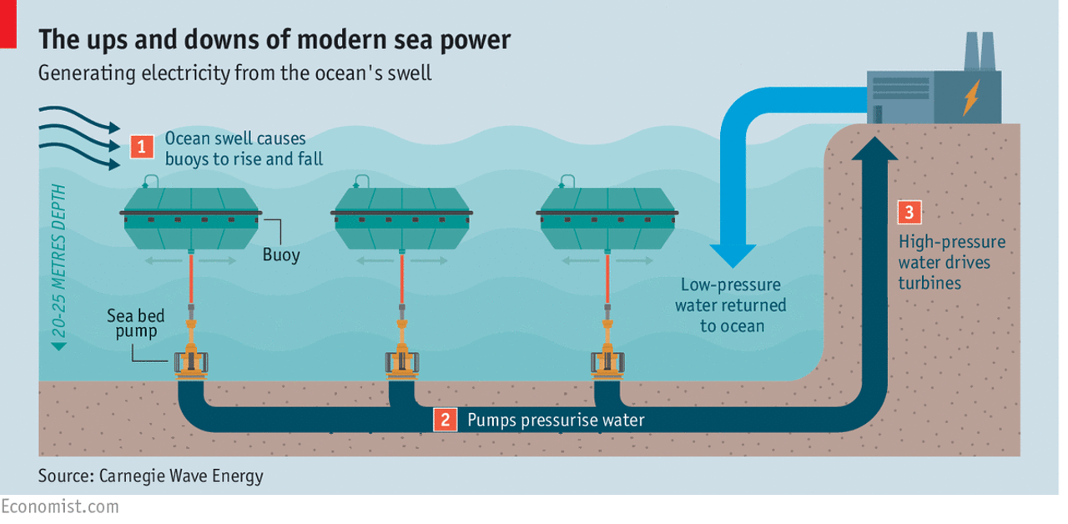

Slide 22
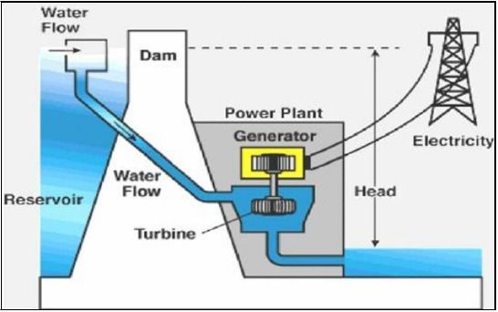
Principle of Hydroelectric Power Plant

Slide 23
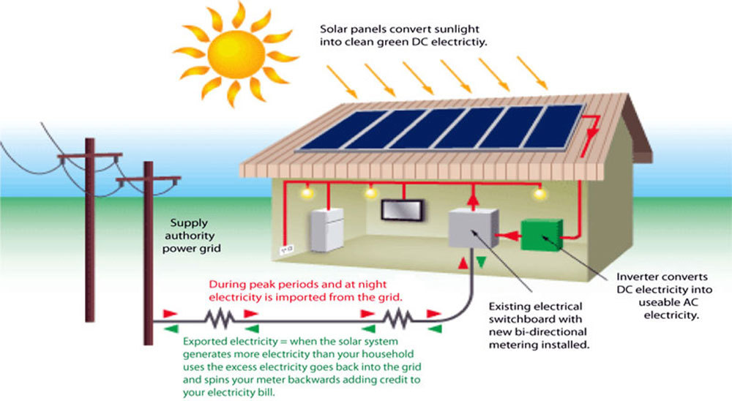
Photovoltaic System

Slide 24
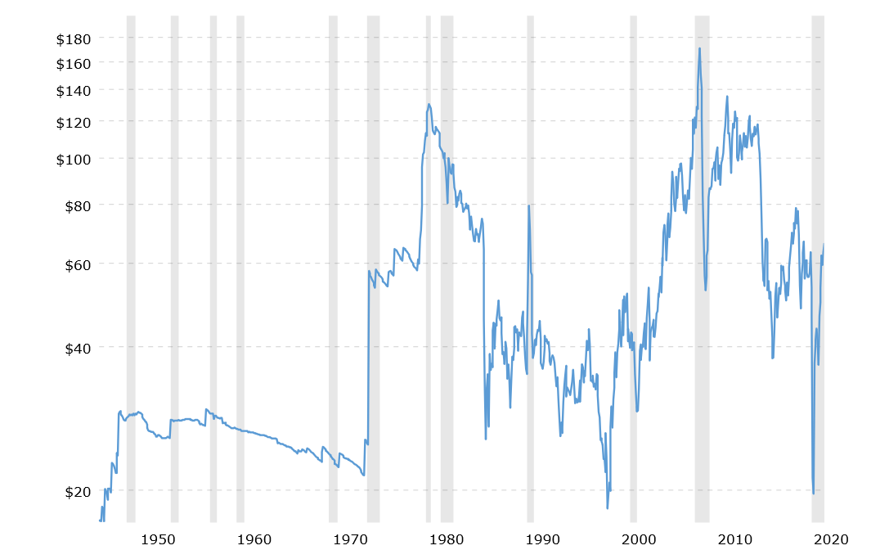
Crude Oil Prices - 70 Year Historical Chart
https://www.macrotrends.net/1369/crude-oil-price-history-chart

