Slide 1

Econ 2675 – Environmental Economics
Chapter 6 Lecture - Depletable Resource Allocation: The Role of Longer Time Horizons, Substitutes, and Extraction Cost

Slide 2
A Resource Taxonomy
A resource taxonomy is a classification system used to distinguish various categories of resource availability.
  Identified resources: specific bodies of mineral-bearing material whose location, quality, and quantity are known from geological evidence, supported by engineering measurements.
  Measured resources: material for which quantity and quality estimates are within a margin of error of less than 20 percent, from geologically well-known sample sites.

Slide 3

A Resource Taxonomy
  Indicated resources: material for which quantity and quality have been estimated partly from sample analyses and partly from reasonable geological projections.
  Inferred resources: material in unexplored extensions of demonstrated resources based on geological projections.

Slide 4
A Resource Taxonomy
Undiscovered resources: unspecified bodies of mineral-bearing material surmised to exist on the basis of broad geological knowledge and theory.
Hypothetical resources: undiscovered materials reasonably expected to exist in a known mining district under known geological conditions.
Speculative resources: undiscovered materials that may occur in either known types of deposits in favorable geological settings where no discoveries have been made, or in yet unknown types of deposits that remain to be recognized.

Slide 5
A Resource Taxonomy
  Classifications of the stock of depletable resources
Current reserves are resources that can be extracted profitably at current prices.
Potential reserves are resources that are potentially available. They depend on people’s willingness to pay and technology.
Resource endowment represents the natural occurrence of resources in the earth.

Slide 6
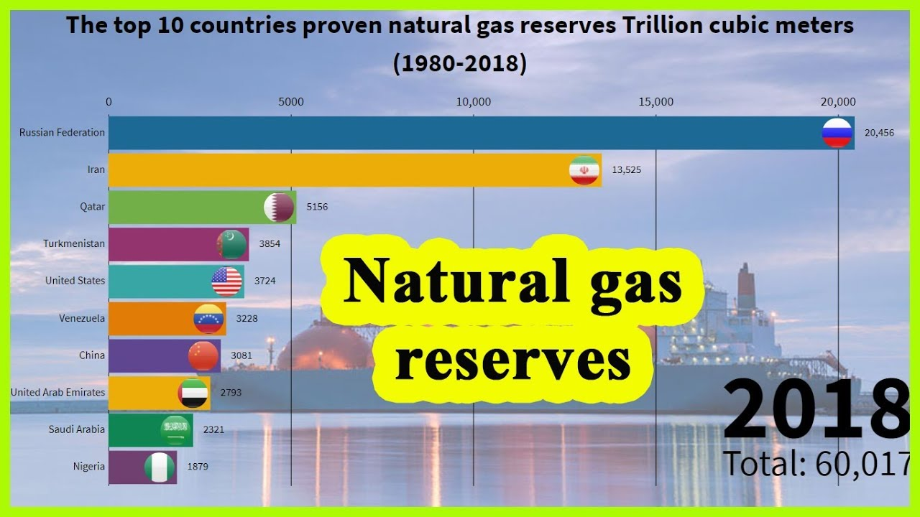

Slide 7
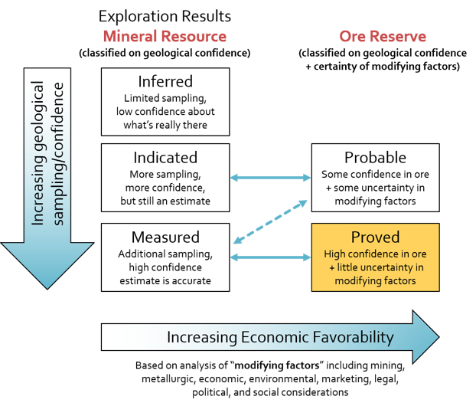
Copper Mining

Slide 8
A Resource Taxonomy
A depletable resource is not naturally replenished or is replenished at such a low rate that it can be exhausted.
  The depletion rate is affected by demand, and thus by the price elasticity of demand, durability and reusability.
A recyclable resource has some mass that can be recovered after use.
  Copper is an example of a depletable, recyclable resource.
A renewable resource is one that is naturally replenished.
  Examples are water, fish, forests, and solar energy.

Slide 9
A Resource Taxonomy
The potential resources of depletable, recyclable resource can be exhausted.
Not all depletable resources can be recycled or reused.
Storage of renewable resources smoothes out the cyclical imbalance of supply and demand.
Storage of depletable resources extends their economic life.
The management problem for depletable resources is how to allocate dwindling stocks among generations while transitioning to a renewable alternative.
The management problem for renewable resources is in maintaining an efficient and sustainable flow.

Slide 10
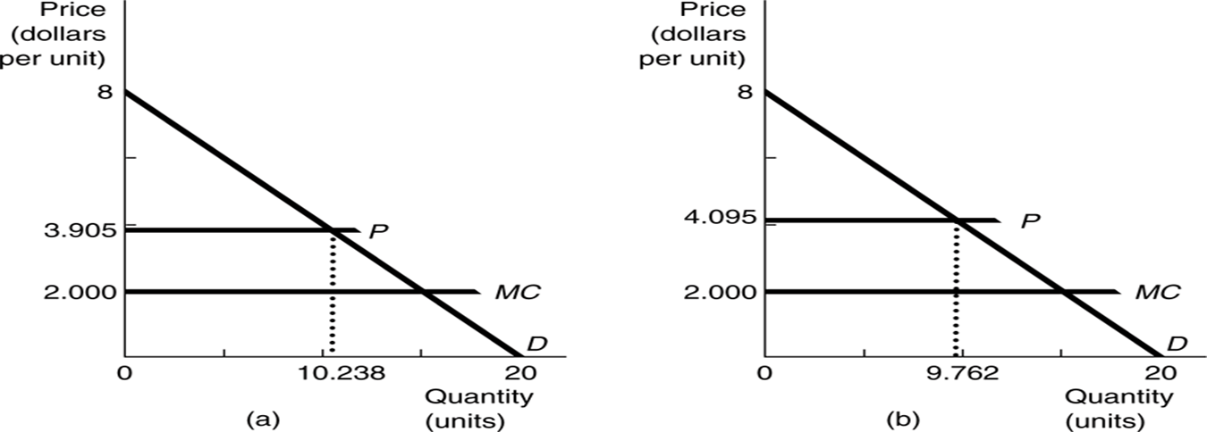
Efficient Intertemporal Allocations
The Two-Period Model Revisited
  Dynamic efficiency is the primary criterion when allocating resources over time.
  Recall the two-period model from the last chapter. This model can be generalized to longer time periods.
  The marginal user cost for each period in an efficient market is the difference between the price and the marginal extraction cost.

Slide 11
Efficient Intertemporal Allocations
The N-Period Constant-Cost Case
  With constant marginal extraction cost, total marginal cost (or the sum of marginal extraction costs and marginal user cost) will rise over time.
  The figure on the next slide shows total marginal cost and marginal extraction cost.
  The vertical distance between the two equals the marginal user cost. The horizontal axis measures time.
  Rising marginal user cost reflects increasing scarcity and the intertemporal opportunity cost of current consumption on future consumption.

Slide 12
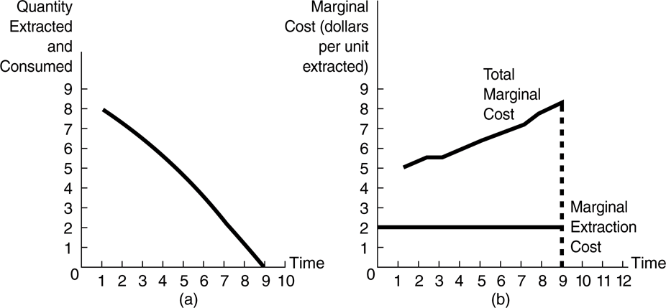
(a) Constant Marginal Extraction Cost with No Substitute Resource: Quantity Profile.
(b) Constant Marginal Extraction Cost with No Substitute Resource: Marginal Cost Profile

Slide 13
Efficient Intertemporal Allocations
Once again - The efficient marginal user cost rises steadily to reflect the scarcity and opportunity cost.
As costs rise, quantity extracted falls over time.
  Quantity extracted falls to zero at the point where total marginal cost reaches the maximum willingness to pay (or choke price) for the resource such that demand and supply simultaneously equal zero.
  If P = 8 – 0.4q then you can show if MC = 8, q = 0.

Slide 14
Efficient Intertemporal Allocations
Transition to a Renewable Substitute
  An efficient allocation thus implies a smooth transition to exhaustion and/or to a renewable substitute.
  The transition point to the renewable substitute is called the switch point.
  At the switch point the total marginal cost of the depletable resource equals the marginal cost of the substitute.

Slide 15
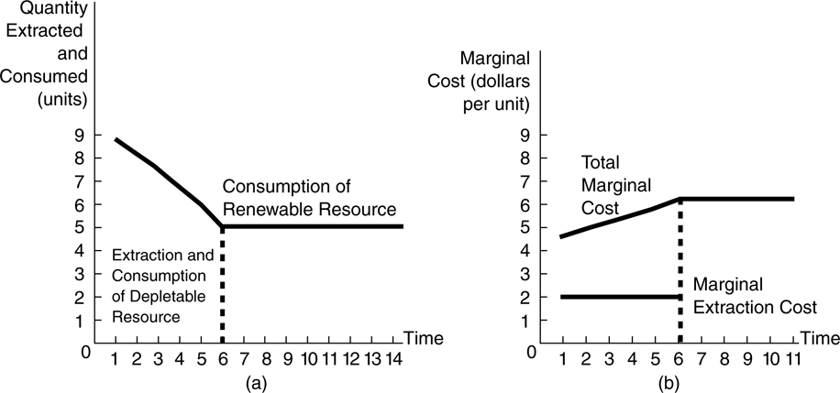
(a) Constant Marginal Extraction Cost with Substitute Resource: Quantity Profile. (b) Constant Marginal Extraction Cost with Substitute Resource: Marginal Cost Profile

Slide 16
Efficient Intertemporal Allocations
Transition to a Renewable Substitute
  The transition for two depletables with different marginal costs will also be a smooth one.
  The rate of increase of total marginal cost slows down after the time of transition because the marginal user cost represents a smaller portion of total marginal cost for the second, higher cost resource.

Slide 17
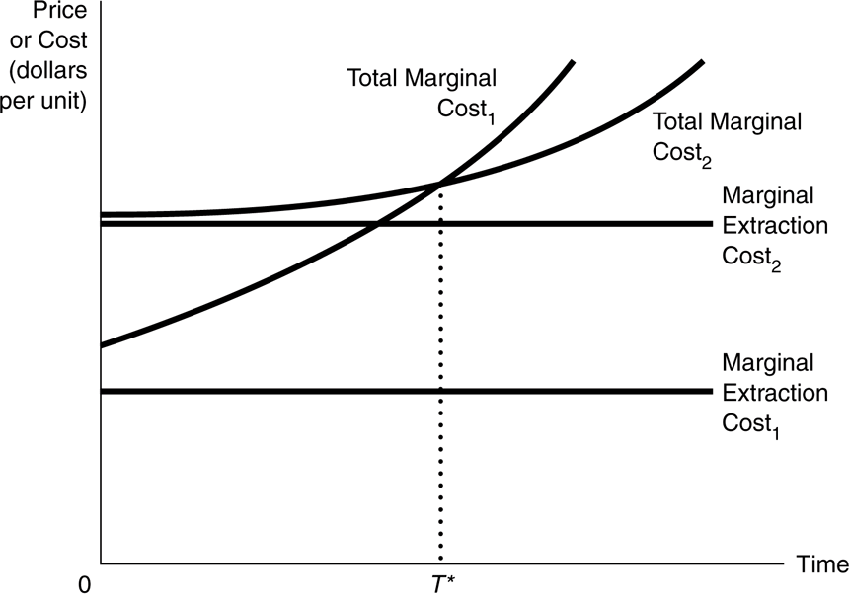
The Transition from One Constant-Cost Depletable Resource to Another

Slide 18
Efficient Intertemporal Allocations
Increasing Marginal Extraction Cost
  In this case, the marginal user cost declines over time and reaches zero at the transition point.
  The resource reserve is not exhausted.
  The marginal cost of exploration can be expected to rise over time as well.
  Successful exploration would cause a smaller and slower decline in consumption while dampening the rise in total marginal cost.

Slide 19
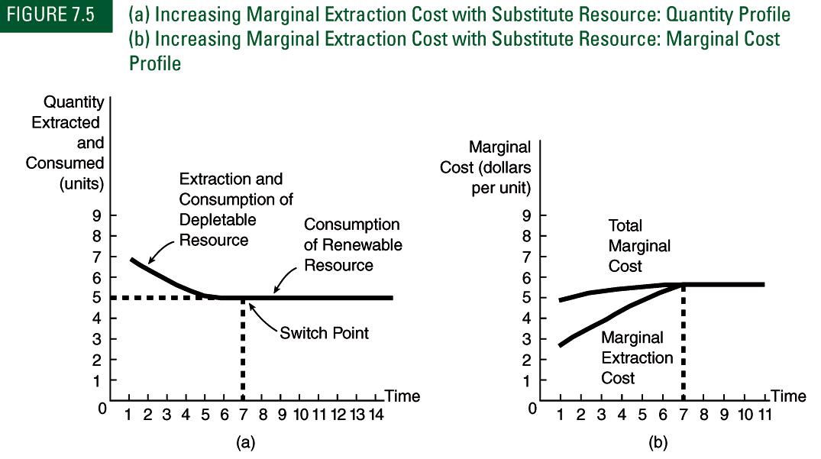
(a) Increasing Marginal Extraction Cost with Substitute Resource: Quantity Profile. (b) Increasing Marginal Extraction Cost with Substitute Resource: Marginal Cost Profile

Slide 20
Efficient Intertemporal Allocations
Exploration and Technological Progress
  Technological progress would also reduce the cost of extraction.
    Lowering the future marginal cost of extraction would move the transition time further into the future.
    Total marginal cost could actually fall with large advances in technology.

Slide 21
Market Allocations of Depletable Resources
Appropriate Property Rights Structures
  Markets will behave well as long as the property-rights structures governing the resources are exclusive, universal, transferable and enforceable.
  A resource governed by a well-defined property rights structure will then have both a use value and an asset value to its owner Environmental Costs
  The inclusion of environmental costs would result in higher prices
    Which will dampen demand and have supply side effects, which causes the transition point to be sooner
    Which effect dominates depends on the shape of the marginal extraction cost curve.
  The concept of external environmental costs ties together the fields of environmental and natural resource economics.

Slide 22
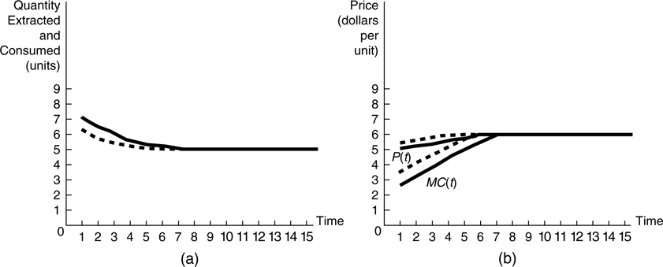
(a) Increasing Marginal Extraction Cost with Substitute Resource in the Presence of Environmental Costs: Quantity Profile. (b) Increasing Marginal Extraction Cost with Substitute Resource in the Presence of Environmental Costs: Price Profile (Solid Line—without Environmental Costs; Dashed Line—with Environmental Costs)

Slide 23
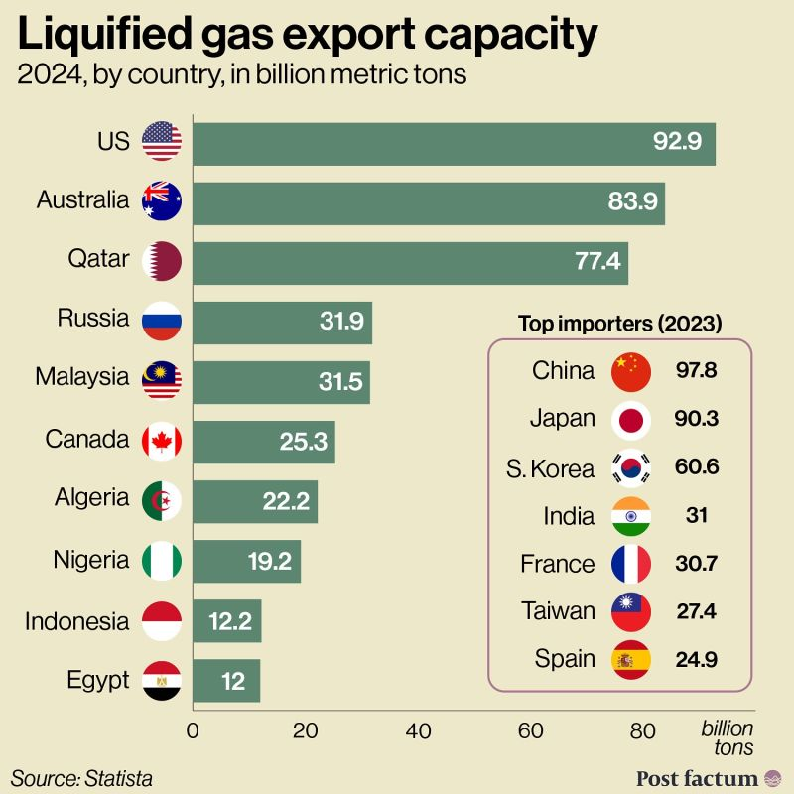

Slide 24
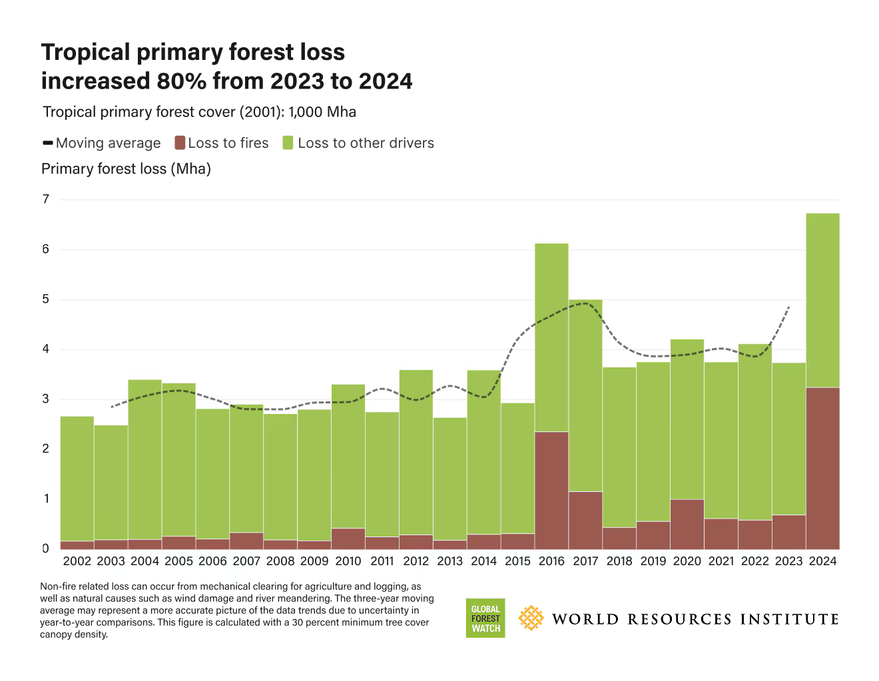
https://www.weforum.org/stories/2025/05/tropical-forest-loss-2024-nature-climate-news/

