Slide 1
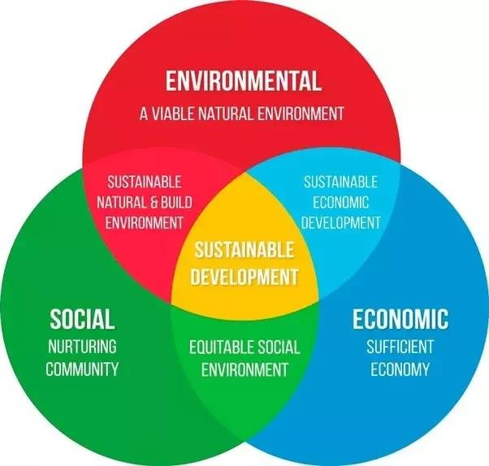
Econ 2675 – Environmental Economics
Chapter 5 Lecture- Dynamic Efficiency and Sustainable Development

Slide 2
Dynamic Efficiency
Dynamic efficiency balances present and future uses of a depletable resource by maximizing the present value of the net benefits derived from its use.
This implies a particular allocation of the resource across time.
We can illustrate the properties of this allocation with the aid of a simple numerical example.
We begin with the simplest of models—deriving the dynamic efficient allocation across two time periods.

Slide 3

The Allocation of an Abundant Depletable Resource:
(a) Period 1 (b) Period 2
Assumptions
  Fixed supply of certain depletable resource (assume more than 30).
  Consider two time periods only
  Demand or marginal willingness to pay (WTP) is constant and the same for both periods:
  We can show that q_{d} in each period would be 15.
  If supply is sufficient to meet demand, then a static efficient solution will provide the optimal allocations over time, regardless of the discount rate.
$$P = 8 − 0.4q \\ MC = \$2$$

Slide 4
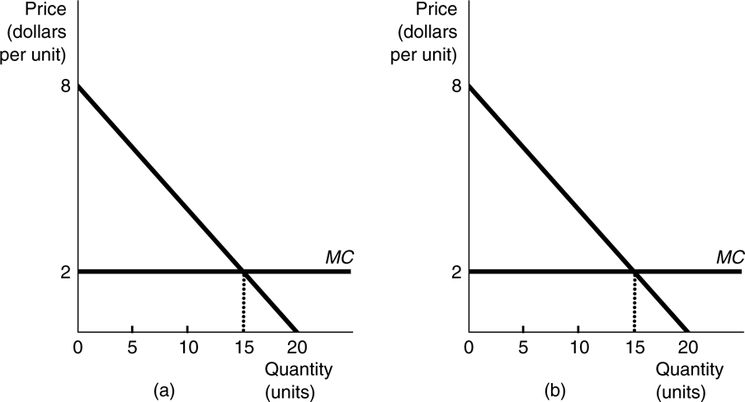
A Two-Period Model
If total supply amount is 30, regardless of discount rate, what efficiency criterion can we use?
As shown by the demand curve, 15 units of resources would be used in period 1 and 15 units in period 2. Price in each period would be 2.

Slide 5
A Two-Period Model
Note that if the total supply (Q) were 30 or greater, and we were concerned only with these two periods, an efficient allocation would allocate 15 units to each period, regardless of the discount rate
Thirty units would be sufficient to cover the demand in both periods; the consumption in Period 1 would not reduce the consumption in Period 2.
In this case the static efficiency criterion is sufficient because the allocations are not temporally interdependent—abundance eliminates the scarcity

Slide 6
A Two-Period Model
If supply is not sufficient (say only 20) we must determine the optimal allocation using the dynamic efficiency criterion: maximize the present value of net benefits.
You can see that if the supply is 20 and the demand is 15 in period 1, then only five can be consumed in period 2.
Thus, we have to look at maximizing the present value of net benefits.
The present value for a two-period model is the sum of the present values in each of the two years.
The present value in each period is the portion of the area under the demand curve and above the supply curve or the area under the marginal net benefit curve (which is the demand curve minus the marginal cost).

Slide 7
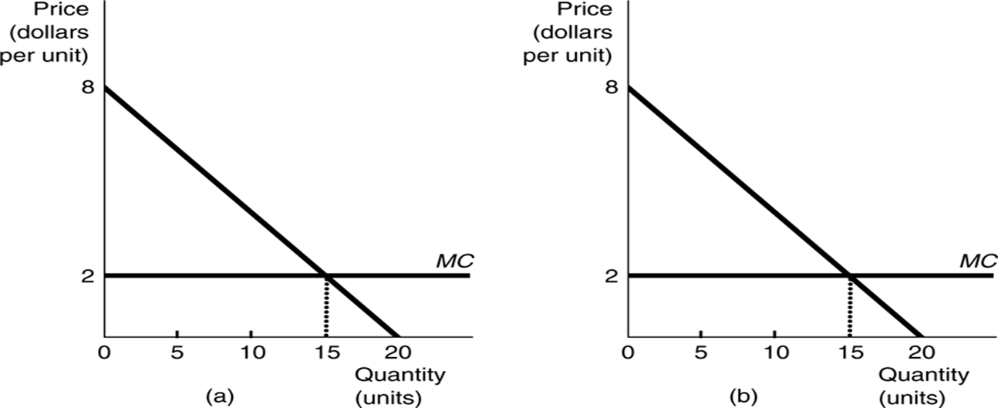
6
The present value in the first period would be that portion of the geometric area under the demand curve that is over the supply curve = (6 x 15) x ½ = $45.00.
The present value in the second period is that portion of the area under the demand curve that is over the supply curve from the origin to the five units received, multiplied by 1/(1 + r).
Calculating, (6 – 2) x 5 = 20 plus [(8 – 6) x 5] x ½ = 5
Total = 20 + 5 = 25
If we use r = 0.10, then the present value of the net benefit received in the second period is 25/(1.10) = $22.73 and the present value of the net benefits for the 2 years is $67.73.

Slide 8
A Two-Period Model
The dynamically efficient allocation will satisfy the condition that the present value of the marginal benefit from the last unit in period 1 (MNB₁) equals the present value of the marginal net benefit in period 2 (MNB₂).
Since the Willingness to Pay (WTP) or Present Value of Marginal Benefit must be the same for both periods, we first calculate quantity in each period.
We calculate prices by inserting the efficient quantities into the willingness to pay function and solving for price.

Slide 9
A Two-Period Model
To get marginal net benefits (MNB), we subtract MC from demand.
Period One Present Value of Marginal Net Benefits (MNB₁) =
8 - 0.4 q₁ - 2 = 6 - 0.4q₁
Period Two Present Value of Marginal Net Benefits (MNB₂) =
(8 - 0.4 q₂- 2) (1/(1 + 0.1)) = (6 - 0.4 q₂) (1/1.1) = 5.45 - .36q₂
Key Idea: The first time period is not discounted because it is considered the current period. The second time period is discounted.

Slide 10
A Two-Period Model
From the previous slide:
Period One Present Value of Marginal Net Benefits (MNB₁) =
8 - 0.4 q₁ - 2 = 6 - 0.4q₁
Period Two Present Value of Marginal Net Benefits (MNB₂) =
(8 - 0.4 q₂- 2) (1/(1 + 0.1)) = (6 - 0.4 q₂) (1/1.1) = 5.45 - .36q₂
Optimal allocation is found by setting MNB₁ = PVMNB₂ and the resource amount constraint q₂ = 20 - q₁.
Substituting the resource constraint into the equilibrium conditions one obtains 6 - 0.4 q₁ = 5.45 - .36 (20 - q₁)
  You can show that q₁ = 10.238 and q₂ = 9.762
  P₁ = 3.905 and P₂ = 4.095

Slide 11
A Two-Period Model
A two-period model can be illustrated graphically by flipping the graph of period 2 such that the zero axis for the period 2 net benefits is on the right side, rather than the left.
The size of the box represents the resource constraint.
Any point on the horizontal axis sums to the amount of the resource constraint (=20 units).
(MNB₁) = 8 - 0.4 q₁ - 2 = 6 - 0.4q₁
(MNB₂) = (6 - 0.4 q₂)/(1/(1.1) = 5.45 - .36q₂

Slide 12
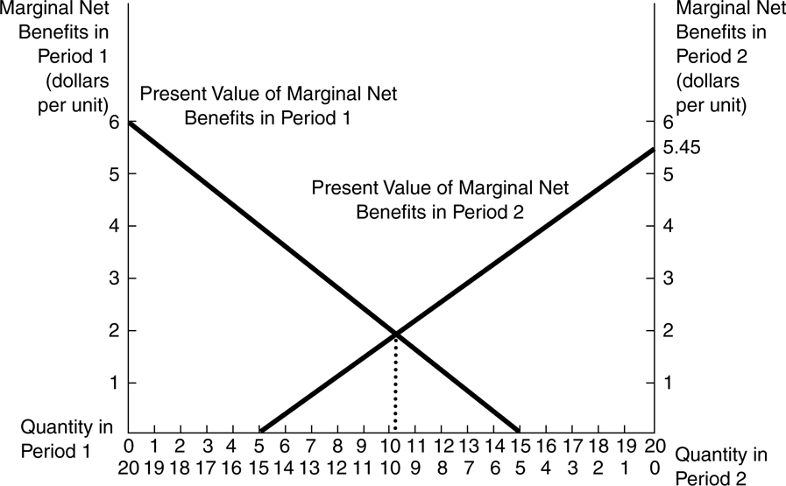
The Dynamically Efficient Allocation
5.45 - .36 ( q₂)
6 - 0.4 q₁)
q₁ =10.238 and q₂ = 9.762
P₁ = 3.905 and P₂ = 4.095

Slide 13
A Two-Period Model
The opportunity cost caused by intertemporal scarcity is called the marginal user cost (MUC).
The marginal user cost for each period in an efficient market is the difference between the price and the marginal extraction cost.
  MUC₁ = 1.905 and MUC₂ =1.905(1+r)= 2.095

Slide 14
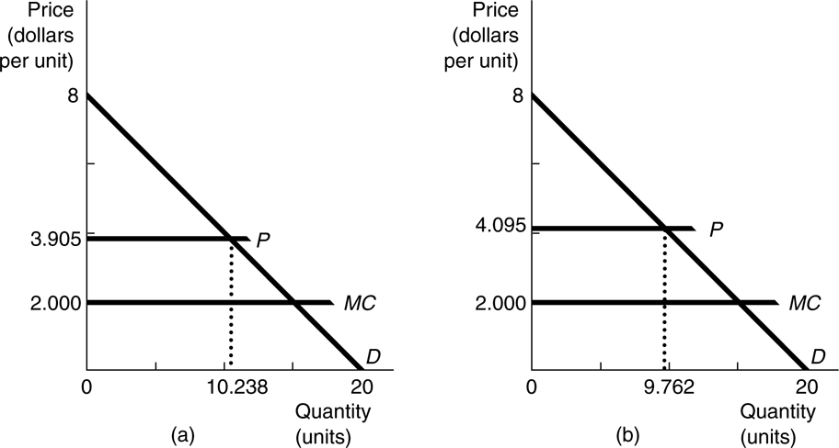
The Efficient Market Allocation of a Depletable Resource: The Constant-Marginal-Cost Case: (a) Period 1 and (b) Period 2
  MUC₁ = 1.905 MUC₂ =1.905(1+r)= 2.095
Marginal user cost rises over time at the rate of discount causing efficient prices to rise over time and thus reflecting scarcity.
A higher discount rate will favor the present. The amount allocated to the second period falls as the discount rate rises.

Slide 15
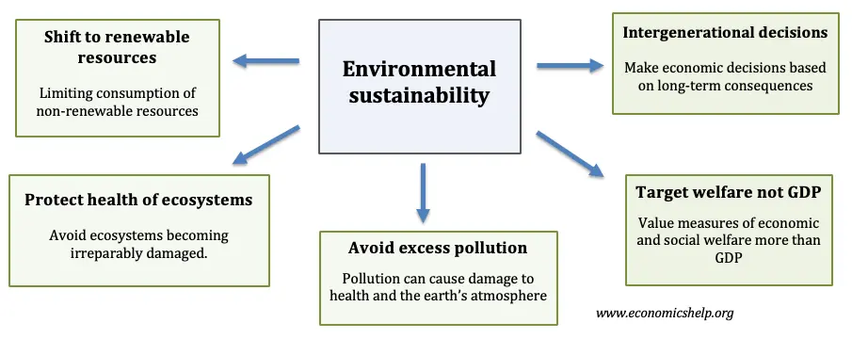
Defining Intertemporal Fairness
How much should we leave for future generations? What is the appropriate rate of discount?
  A Theory of Justice by John Rawls—everyone with unknown generations, standing behind a “veil of ignorance,” decides the rules.
  Sustainability criterion—future generations should be left no worse off than current generations and should perhaps be left better off.

Slide 16
Weak Sustainability. Resource use by previous generations should not exceed a level that would prevent subsequent generations from achieving a level of well-being at least as great.
Strong Sustainability. According to this interpretation, the value of the remaining stock of natural capital should not decrease.
Environmental Sustainability. Under this definition, the physical flows of individual resources should be maintained, not merely the value of the aggregate. One operational implication of this definition is that the value of the capital stock (natural plus physical capital) should not decline.

