Slide 1

Econ 275 – Environmental Economics
Chapter 20 Lecture - The Quest for Sustainable Development

Slide 2
Sustainable Development
  “Development that meets the needs of the present without compromising the ability of future generations to meet their own needs.”

Slide 3
Four Scenarios of Sustainability of Development
These scenarios suggest that three dimensions of sustainability are important:
1. The existence of a positive sustainable level of welfare.
2. The magnitude of the ultimate sustainable level of welfare compared to the current welfare level.
3. The sensitivity of the future level of welfare to actions by previous generations.
Looking at the graph on the next slide.
Scenario D (a steady increase in per capita welfare) is infeasible due to resource scarcity.
The existence of renewable resources guarantees a positive sustainable welfare level, so scenario A can be ruled out (zero per capita welfare).
Scenarios B and C eventually result in some sustainable constant level of per capita welfare.
It is not clear whether this level of per capita welfare will be higher or lower than existing per capita welfare.

Slide 4
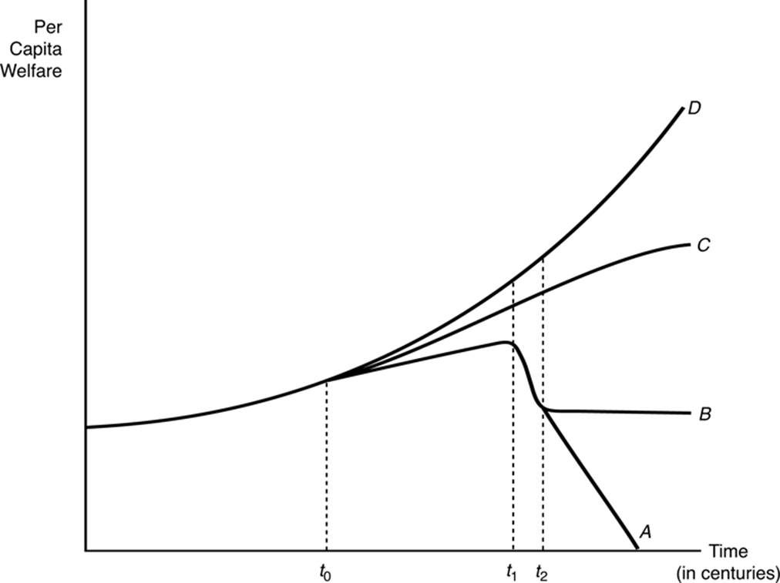
Sustainability of Development

Slide 5
Sustainability of Development
Predictions of societal collapse seem to be exaggerated.
Current generations can have both positive and negative effects on the sustainable welfare levels of future generations.
Investments in human capital are positive contributions to the future, while fossil fuel use, reductions in biodiversity, and pollution will have negative effects.

Slide 6
Sustainability of Development
Market Allocations
  Market failures and imperfect markets can promote unsustainable outcomes.
    Free access to resources or open access to resources promotes unsustainable harvesting.
    Intertemporal externalities also interfere with sustainability.
  Some market imperfections have the opposite effect and would help promote conservation.
    An oil cartel, for example, restricts supply, which conserves more for the future than a perfect market would.
    Renewable alternatives may be discovered in the presence of scarcity. Fish farming is one example.

Slide 7
Sustainability of Development
Efficiency and Sustainability
  Restoring or ensuring efficiency is not sufficient to produce sustainability.
  Efficient allocations of depletable resources show declining consumption over time, which is not sustainable without transfers.
  Efficient allocations of depletable resources do not necessarily produce sustainable growth.

Slide 8
Sustainability of Development
Renewable resource models suggest that sustained growth of welfare with renewable resources can only occur if the resource growth rate exceeds the sum of both the discount rate and the population growth and if the initial food supply is sufficient for the existing population.
The notion of sustainability gets even more complicated when we acknowledge that we do not know the values of the future.
The starting point will determine whether or not restoring efficiency will result in a sustainable outcome.
Efficient markets cannot always achieve sustainability, but this does not mean that efficient markets will not result in sustainable allocations.

Slide 9
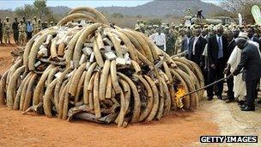
Sustainability of Development
Trade and the Environment
  The Role of Property Rights
    Trade can have detrimental effects on the environment when some nations (usually developing) have poorly defined property rights. This tragedy of the commons problem can be intensified by freer trade.

Slide 10
Would the Protection of Elephant Populations be Enhanced or Diminished by Allowing Limited International Trade in Ivory?
Since elephant populations were being endangered by poaching and other illegal activities, in 1990 a cross-border ivory ban was imposed by CITES (the Convention on International Trade in Endangered Species). It has not been sufficient since Central Africa has lost 64% of its elephants in a decade.
One proposed change suggests allowing trade in ivory from stockpiled ivory. Since no elephants are harmed in its collection, CITES considers this stockpiled ivory legal to hold, along with the ivory from elephants shot for justifiable management reasons (such as controlling problem animals). This management source contributes roughly a similar amount a year to African stockpiles. The proposed trade would be based on regular auctions of legal ivory from African countries that have stable elephant populations and are motivated enough to organize credible recovery and stockpiling systems. The proceeds would then be used to bolster unfunded elephant conservation programs. Buying countries would be limited to those that have transparent enforcement and are equally motivated to prevent illicit trafficking. CITES could revoke a country’s selling or buying status at any time.
Opponents maintain that the assumption that the ivory collected from Africa’s elephant populations through natural mortality and sustainable management practices can supply enough to satisfy demand is naïve. They note the majority of African countries with elephant populations oppose the trade in ivory. If legal supply is based on supply from a handful of countries that support trade, the populations in countries that oppose trade will continue to be targeted and the illegal market will continue to thrive.
They further suggest that distinguishing between legal and illegal ivory trade is too difficult to manage as demonstrated by the fact that existing permitting and regulation systems clearly do not work. Opponents also argue that what’s needed is not reopening a limited ivory market, but better regulation and enforcement of the existing ban.
If you were on the CITES governing Board, how would you vote?
Sources: Brad Scriber, “100,000 Elephants Killed by Poachers in Just Three Years, Landmark Analysis Finds” National Geographic (August 18,2014); http://news.nationalgeographic.com/news/2014/08/140818-elephants-africa-poaching-cites-census/ ; Mary Rice, “The Case Against a Legal Ivory Trade: It Will Lead to More Killing of Elephants” Environment 360 (13 October 2014) ; http://e360.yale.edu/feature/counterpoint_the_case_against_a_legal_ivory_trade_it_will_lead_to_more_killing_of_elephants/2815/; John Frederick Walker, “The Case for a Legal Ivory Trade: It Could Help Stop the Slaughter” Environment 360 (13 October 2014) ; http://e360.yale.edu/feature/point_the_case_for_a_legal_ivory_trade_it_could_help_stop_the_slaughter/2814/

Slide 11
Sustainability of Development
  Pollution Havens and the Race to the Bottom
    “Pollution Havens” suggest that free trade can produce pollution hotspots if strict environmental regulations in one country encourage domestic production facilities to move to countries with less strict regulations.
    Pollution levels in the havens can change due to the composition effect, the technique effect, and the scale effect.
    Studies of this hypothesis have found little evidence to support it. Pollution control costs are a small portion of total production costs.

Slide 12
Sustainability of Development
  The Porter “Induced Innovation” Hypothesis
    The Porter hypothesis suggests that firms in areas with the most stringent regulations will be at a competitive advantage.
    Strict environmental regulations encourage firms to innovate. Innovations make firms more competitive.

Slide 13
Sustainability of Development
  The Environmental Kuznets Curve (EKC)
    The EKC hypothesis suggests that environmental degradation increases with higher incomes up to some income level (the turning point) and then, after that certain income level is reached, high incomes result in lower environmental degradations.
    The empirical support for this theory is mixed.
    Evidence suggests that environmental regulations are not a major factor in firm location decisions or in the direction of trade.

Slide 14
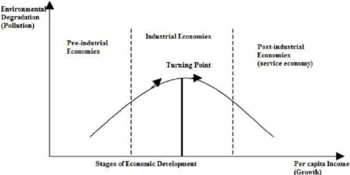
The Environmental Kuznets Curve (EKC)

Slide 15
Sustainability of Development
Trade Rules Under GATT and the WTO
  Under the General Agreement on Tariffs and Trade (GATT) rules and the World Trade Organization (WTO), a disputed environmental action that discriminates against goods from another country is unacceptable.
  We will look at the most controversial of these rules that involves a distinction between “product” concerns and “process” concerns.

Slide 16
Should an Importing Country Be Able to Use Trade Restrictions to Influence Harmful Fishing Practices in an Exporting Nation?
Yellowfin tuna in the Eastern Tropical Pacific often travel in the company of dolphins. Recognizing that this connection could be exploited to more readily locate tuna, tuna fishermen used it to increase their catch with deadly effects for dolphins. Having located dolphins, tuna vessels would use giant purse seines to encircle and trap the tuna, capturing (and frequently killing) dolphins at the same time.
In response to public outrage at this technique, the US enacted the Marine Mammal Protection Act (MMPA). This prohibited the importation of fish caught with commercial fishing technology that results in the incidental kill or serious injury of ocean mammals in excess of US standards.
In 1991, a GATT panel ruled on an action brought by Mexico asserting that US law violated GATT rules because it treated physically identical goods (tuna) differently. According to this ruling, countries could regulate products that were harmful (as long as they treated domestic and imported products the same), but not the processes by which the products were harvested or produced in foreign countries. Using domestic regulations to selectively ban products as a means of securing change in the production or harvesting decisions of other countries was ruled a violation of international trade rules.
The United States responded by mandating an ecolabeling program. Under this law, tuna caught in ways that killed dolphins could be imported, but those imports were not allowed to use the “dolphin-safe” label. Tuna caught with purse seines could only use the “dolphin-safe” label if special on-board observers witnessed no dolphin deaths. Disputes over some of the technical aspects of how this program is implemented are continuing.
Source: The official history of the case can be found at www.wto.org/english/tratop_e/dispu_e/cases_e/ds381_e.htm#top. (Last accessed on Dec. 21, 2016.)

Slide 17
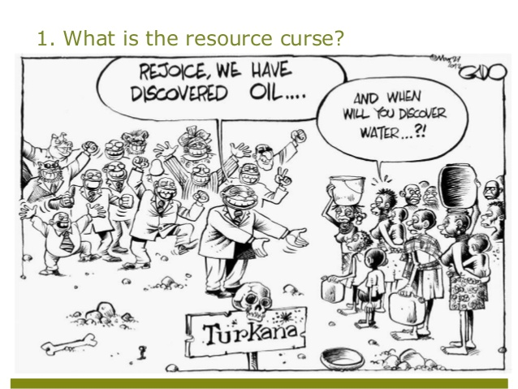
Sustainability of Development
The Natural Resource Curse
  It is said that those countries with abundant resource endowments would be more likely to prosper.
  In fact, the evidence suggests the opposite—resource-abundant countries are less likely to experience rapid development.

Slide 18
The “Natural Resource Curse” Hypothesis
Perhaps, surprisingly, robust evidence suggests that countries endowed with an abundance of natural resources are likely to develop less rapidly than countries with a more modest natural resource base. And it is not merely because resource-rich countries are subject to volatile commodity prices.
Why might a large resource endowment exert a drag on growth? Several possibilities have been suggested. Most share the characteristic that resource-rich sectors are thought to “crowd out” investment in other sectors that might be more likely to support development:
• One popular explanation, known as the “Dutch Disease,” is usually triggered by a significant increase in revenues from raw material exports. The resulting boom draws both labor and capital out of traditional manufacturing and causes it to decline.
• Another explanation focuses on how the increase in domestic prices that typically accompanies the resource boom impedes the international competitiveness of manufactured exports and therefore export-led development.
• A third explanation suggests that the large rents to be gained from the resource sectors in resource-abundant countries would cause entrepreneurial talent and innovation to be siphoned away from other sectors. Thus, resource-rich countries could be expected to have lower rates of innovation, which, in turn, results in lower rates of development.
• Finally, countries endowed with natural resources can give rise to domestic institutions in which autocratic or corrupt political elites finance themselves through physical control of the natural resources.
While countries with large resource endowments may not have the significant opportunities for development that might have been expected, it is encouraging to note that lots of countries without large resource endowments have not been precluded from achieving significant levels of development.
Sources: Sachs, J. D., & Warner, A. M. (2001). The curse of natural resources. European Economic Review, 45(4–6), 827–838; Auty, R .M. Sustaining development in mineral economies: The resource curse thesis. London: Routledge, Inc.; Kromenberg, T. (2004). The curse of natural resources in the transition economies. Economics of Transition, 12(3), 399–426; Frankel, J. A. (April 2012). The natural resource curse: A survey of diagnoses and some prescriptions. Harvard Kennedy School Faculty Research Working Paper Series RWP12-014.

Slide 19
The Growth–Development Relationship
Conventional Measures
  Welfare measure is a true measure of development, which would increase whenever we, as a nation or as a world, were better off and decrease whenever we were worse off. However, no conventional existing measure is designed to be a welfare measure.
  Output measures attempt to indicate how many goods and services have been produced.
    Gross domestic product
    Net domestic product
    Real consumption per capita

Slide 20
The Growth–Development Relationship
Alternative Measures
  Ecological footprint attempts to measure the amount of renewable and nonrenewable ecologically productive land area that is required to support the resource demands and to absorb the wastes of a given population or specific activities.
    It is expressed in “global acres.” Each unit corresponds to one acre of biologically productive space with “world average productivity.”

Slide 21
The Growth–Development Relationship
  Genuine Progress Indicator adjusts national personal consumption expenditures for income distribution; more equal income distributions adjust the GPI upward, while less equal income distributions reduce it.
  Using personal consumption expenditures adjusted for income inequality as its base, the GPI then adds or subtracts categories of spending based on national well-being.

Slide 22
The Growth–Development Relationship
  Human Development Index
    This index has three major components: longevity, knowledge, and income.
  Gross National Happiness
    Includes nine core dimensions: psychological well-being, time use, community vitality, culture, health, education, environmental diversity, living standard, and governance

Slide 23
The Growth–Development Relationship
  All of the alternative measures offer potential contributions.
  However, some of the characteristics of the alternative measures rely on prices to weight their importance, but in many nonmarket circumstances those prices are difficult, but not impossible, to measure.
  The above measures all suggest that intrinsic values are important. The ability to measure these values with some confidence is vital, but difficult.

Slide 24

Econ 275 – Environmental Economics
Chapter 21 Lecture - Visions of the
Future Revisited

Slide 25
Addressing the Issues
Conceptualizing the Problem
  The growth in demand for resources is sensitive to their scarcity, for example, price and population growth.
  Characterizing the resource base as finite is misleading:
    It ignores the existence of a substantial renewable resource.
    It focuses attention on the wrong issue.
    It supports ill-conceived attempts to measure the size of the resource base.
  Correct conceptualization of the resource scarcity suggests that both extremely pessimistic and extremely optimistic views are wrong.
  Improper incentives and inadequate information are more serious problems.

Slide 26
Addressing the Issues
Institutional Responses
  Markets have responded swiftly and automatically to deal with the resources with higher prices.
  The market would not automatically choose a dynamically efficient or a sustainable path.
  Externalities are a barrier in the transition to sustainability.
  The relationship between the economic and political sectors has to be treated on a case-by-case basis.

Slide 27
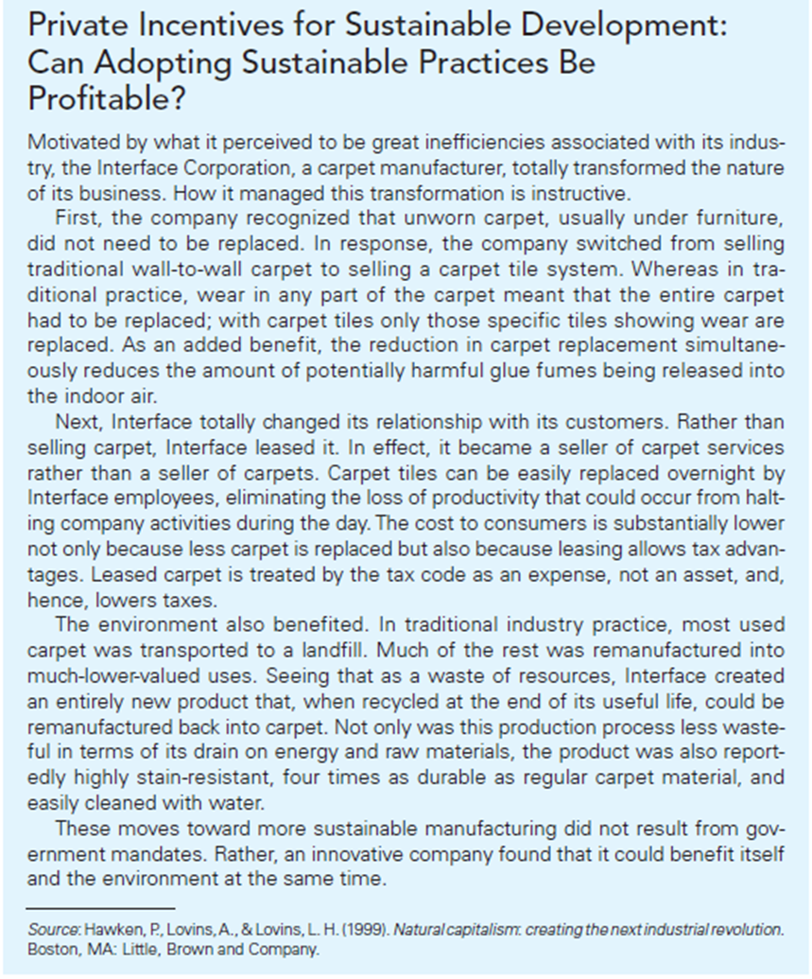

Slide 28
Addressing the Issues
Efficient markets do not necessarily produce sustainable development.
The capacity of the market for self-healing is not always adequate.
Government intervention is needed.
However, government intervention is not uniformly benign. For example, tough legislation and price controls are counterproductive.

Slide 29
Addressing the Issues
Sustainable Development
  Empirical evidence suggests that increased environmental control has not currently had a large impact on the economy.
  The notion that respecting the environment is inevitably incompatible with a healthy economy is wrong.
  Economic growth will not automatically benefit people, especially in developing countries. Environmental problems are severe.
  New sustainable forms of development will be necessary.

Slide 30
Addressing the Issues
The experience in the United States, Europe, and Asia suggests that allowing business great flexibility within a regulatory framework that harmonizes private and social costs in general is both feasible and effective.
The economic incentive approach to environmental and natural resource regulation has become a significant component of environmental and natural resource policy.
Public policy and sustainable development must proceed in a mutually supportive relationship.

Slide 31
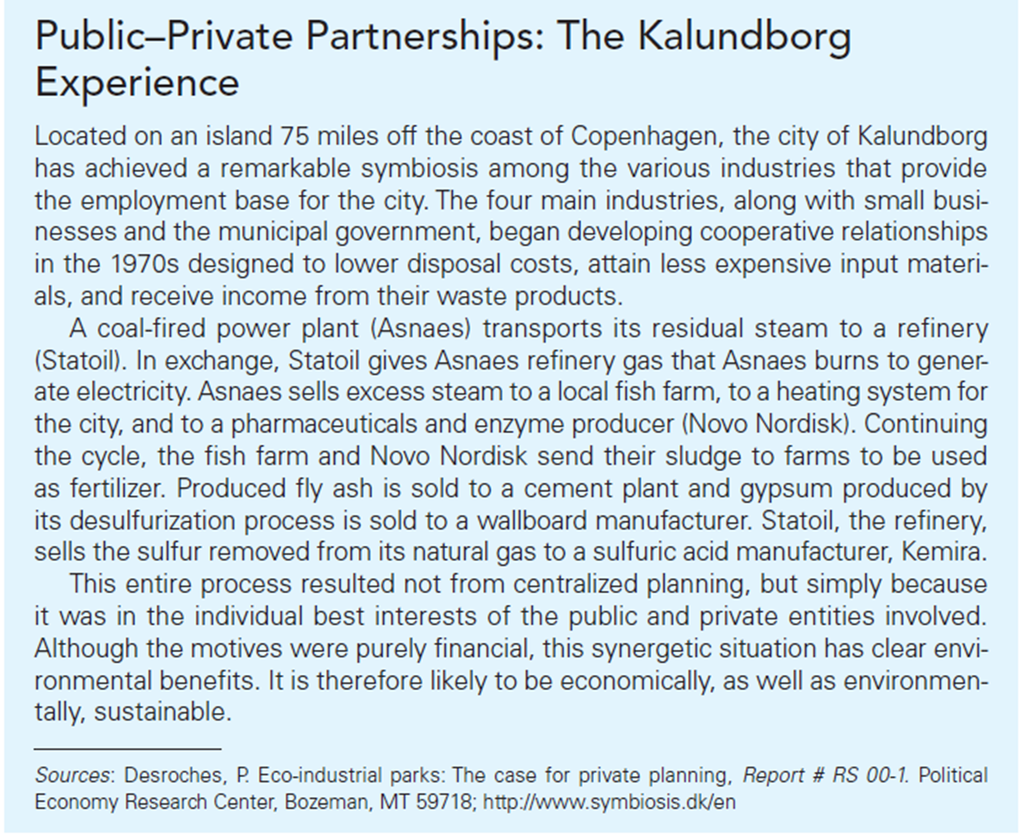

Slide 32
Addressing the Issues
Solving global environmental problems includes
  An agreement on resource gains
  Economic incentives approaches
  Using judicial remedies for environmental problems
A Concluding Comment
Our society is evolving, but we are not out of the woods yet.
Not all behavior can be regulated, and the government can only do so much. Ultimately, industries creating the toxic substances need to be concerned about the safety of their products.
Markets serve the consumers’ need, so we need to change our demands to more environmentally-friendly choices if we want to see change.

