Slide 1
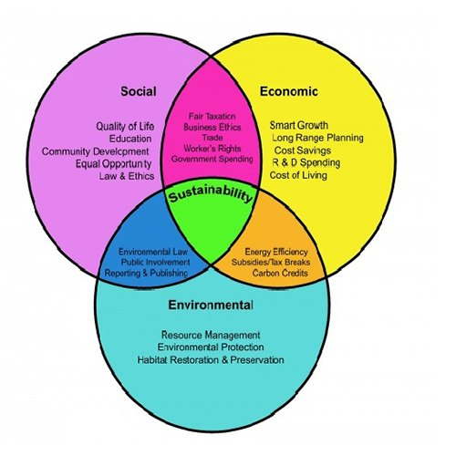
Econ 2675 – Environmental Economics
Chapter 1 Lecture - Visions of the Future

Slide 2
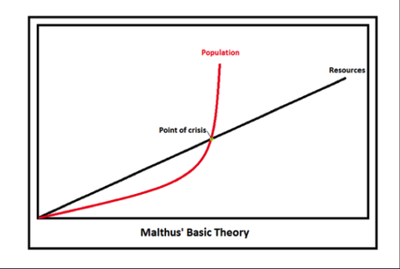
Introduction
The Self-Extinction Premise
  Some historic examples and views
    The Roman empire
    Thomas Malthus and An Essay on the Principle of Population
© 2018 Taylor & Francis

Slide 3


    Easter Island
A rising population, coupled with a heavy reliance on wood for housing, canoe building, and statue transportation, decimated the forest.
Food production failed to keep pace with the increasing population.

Slide 4

Future Environmental Challenges
Climate Change
  Greenhouse effect
  Greenhouse gas and human activities
  Climate change and moral dimension
  Climate change and international coordination
Water Accessibility
  Increasing water stress
  Nonuniformly distributed water stress
  Demand for water and human activities

Slide 5
How Will Societies Respond?
International Cooperation
Resilient Market System
Understanding Feedback Loops
  Positive Feedback Loops
    Positive feedback loops refer to those in which secondary effects tend to reinforce the basic trends.
    Examples include capital accumulation, emissions of methane, and global warming.
    Scientists believe, for example, that the relationship between emissions of methane and climate change may be described as a positive feedback loop.
  Negative Feedback Loops
    A negative feedback loop is a self-limiting rather than self-reinforcing process.
    For example, the Gaia hypothesis
© 2018 Taylor & Francis

Slide 6
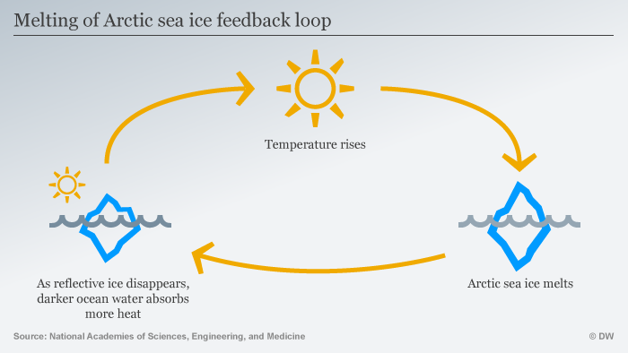
Positive Feedback

Slide 7
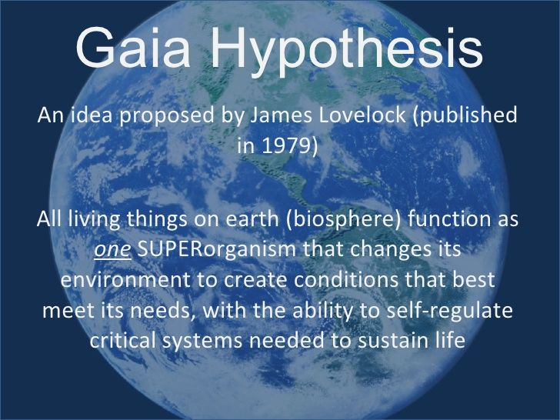
Could the coronavirus be envisioned as a dark cloud with a silver lining. Should we consider the COVID-19 virus as Gaia's defensive system, an army of foot soldiers, conveying a strong message that our planet is sick and some remedial measures are necessary to restore its health.
https://www.statesmanjournal.com/story/opinion/2020/04/03/view-covid-19-pandemic-through-gaia-hypothesis-opinionwe/5109940002/

Slide 8
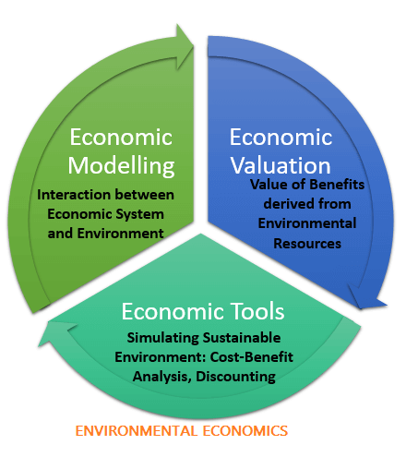
The Role of Economics
The Role of Economics
  Understanding human behavior
The Use of Models
  Simplified characterization of reality
  Experimental economics

Slide 9
Ecological Economics and Environmental Economics
Environmental (and resource) economics The environment (“land”) is a “factor of production” There are substitutes for environmental goods and services Environmental problems can be addressed by adjustments in the economic systems | Ecological economics People (and economies) are part of the environment There are no substitutes for many environmental goods and services Addressing environmental problems requires contribution of disciplines other than economics

Slide 10
The Road Ahead
  Is the problem correctly conceptualized as exponential growth with fixed, immutable resource limits? Does the earth have a finite carrying capacity? Do current levels of economic activity exceed the carrying capacity?
  How does the economic system respond to scarcities? Is the process mainly characterized by positive or negative feedback loops?
© 2018 Taylor & Francis

Slide 11
The Road Ahead
  What is the role of the political system in controlling these problems? In what circumstances is government intervention necessary?
  Can our economic and political institutions respond to the uncertainty in reasonable ways or does uncertainty become a paralyzing force?
  Can the economic and political systems work together to eradicate poverty and social injustice while respecting our obligations to future generations?

Slide 12
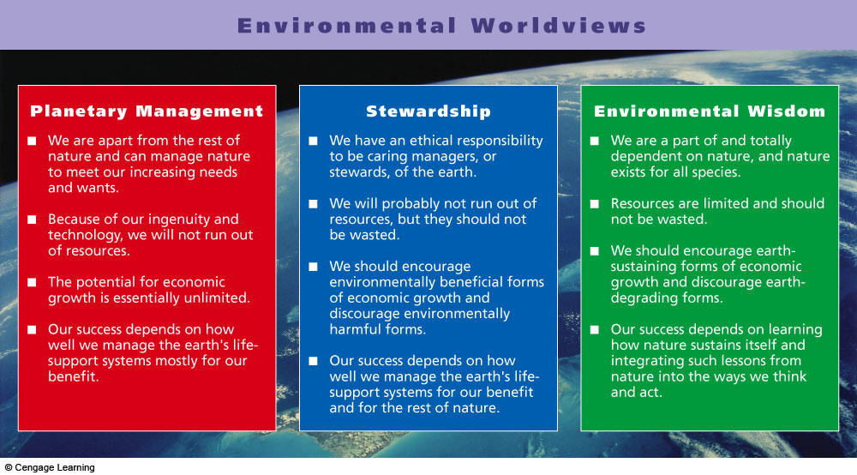
Comparison of Three Major Environmental Worldviews

Slide 13
Natural Resource Economics
Natural resource economics deals with the supply, demand and allocation of the earth natural resource.
Main objective of natural resource economics is to better understand the role of natural resources in the economy in order to develop more sustainable methods of managing those resources to ensure their availability to future generations.

Slide 14
Natural Resource Economics
Resource economists study interactions between economic and natural systems, with the goal of developing a sustainable and efficient economy.
Natural resource management refers to the management of natural resource such as land, water, soil, plants and animals with a particular focus on how management affects the quality of life for both present and future generations.
Natural resource management deals brings together land use planning, water management, biodiversity conservation and the future sustainability of industries like agriculture, mining, fishing, etc.

Slide 15
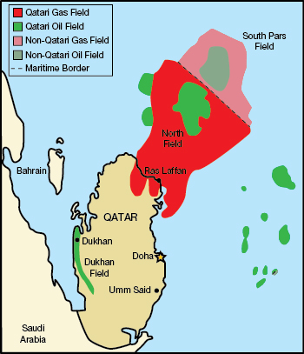

Slide 16
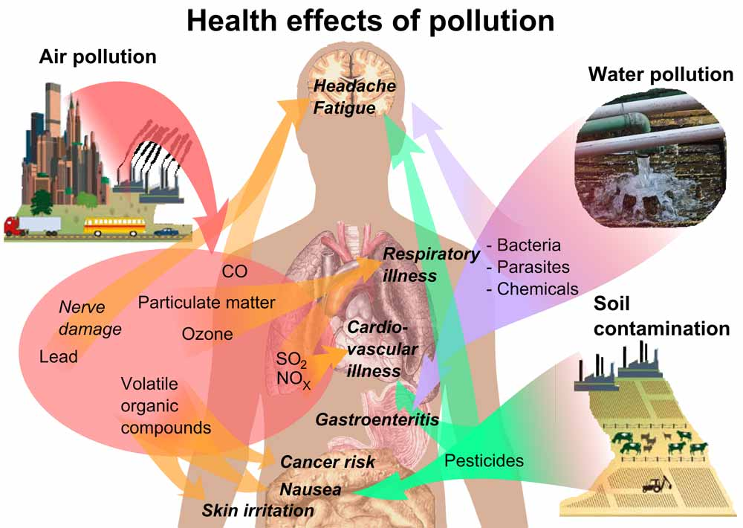
https://commons.wikimedia.org/wiki/File:Health_effects_of_pollution.svg

