Slide 1

Econ 275 – Environmental Economics
Chapter 19 Lecture - Toxic Substances and Environmental Justice

Slide 3
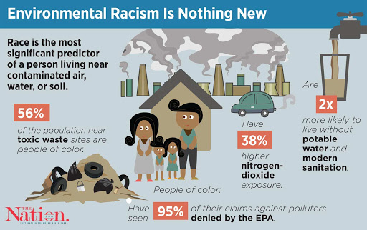

Slide 4
Toxic Substances and
Environmental Justice
Many laws and regulations are in place to deal with toxic substances and hazardous wastes.
They deal with health effects, compensation to victims, responsibility, appropriate disposal, etc.
Nature of Toxic Substance Pollution
  A main objective of the current legal system for controlling toxic substances is to protect human health, although protecting other forms of life is a secondary objective.
  The primary health concerns from exposure to toxic substances are the risk of cancer and the effects on reproduction.

Slide 5
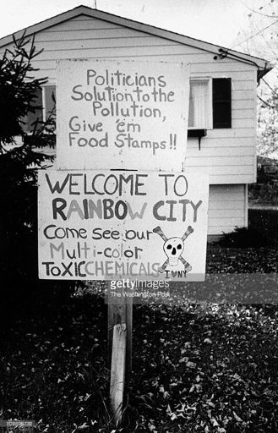
Policy Issues
  Three important aspects must be considered when making a policy:
    the number of substances involved
    the period of latency
    the uncertainty on the based scientific evidence.

Slide 6
Market Allocations and Toxic Substances
Occupational Hazards
  Higher risks call for higher wages. The difference in wages is called a risk premium.
  The higher wages represent the real cost of risk to the employer.
  The higher wages should also produce incentives to create a safer work environment.
  Efficient markets will equate the marginal cost of the increase in wages with the marginal cost of precaution when determining the optimal degree of precaution.

Slide 7
Market Provision of Occupational Safety

Slide 8
Market Allocations and Toxic Substances
  Occupations with more risk will also attract workers who are less averse to risk.
  Empirical studies suggest that willingness to pay for risk reductions is substantial, but varies significantly across individuals.
  Market solutions to occupational hazards present ethical concerns.
  Another problem arises due to the lack of information about the degree of risk.
  Due to the inefficiencies of the market in providing information, some states have enacted “Right-to-Know” laws.

Slide 9
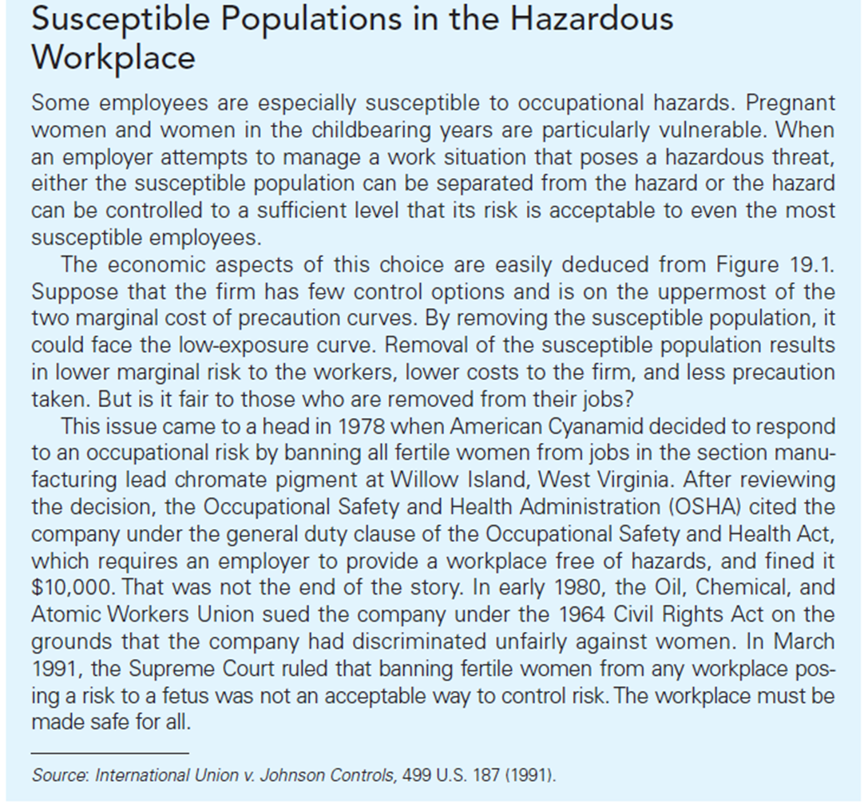

Slide 10
Market Allocations and Toxic Substances
Product Safety
  Safer products are typically more expensive and thus, somewhat analogous to the risk premium in wages; the higher price tag should represent the reduced risk.
  Products with varying degrees of safety should be supplied by the market. Uniform product safety would not be economically efficient.
  However, the market does not have complete enough information to provide such self-regulation.

Slide 11
Market Allocations and Toxic Substances
Third Parties
  Third parties have the least power to influence producers and consumers and thus the argument for government intervention is strongest for these individuals.
  Liability law provides a method for internalizing the external costs to third parties.
  Liability law can force sources to choose efficient levels of precaution and unlike regulation, provides compensation to the victims.

Slide 12
The Incidence of Hazardous Waste Siting Decisions
Environmental Justice Research and the Emerging Role of GIS
  The application of geographic information system (GIS) can be combined with U.S. Census data and the EPA’s Toxic Release Inventory data to analyze the distribution of hazardous waste.
    Race
    Income
    House values

Slide 13
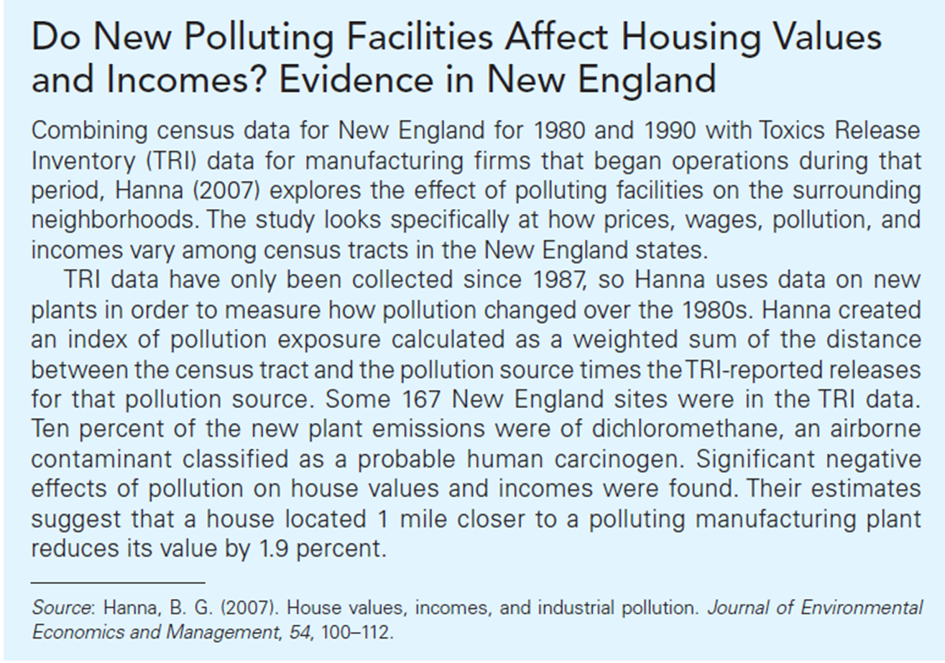

Slide 14
The Incidence of Hazardous Waste Siting Decisions
The Economics of Site Location
  Need to consider the incentives from the owners of the proposed facility and the recipient community
    Owners: low cost
    Recipient community: benefits outweigh costs
  Low-income communities are attractive.
  Race also becomes a more important predictor.

Slide 15
The Incidence of Hazardous Waste Siting Decisions
The Role of Risk Perception
    Not-In-My-Backyard attitude
    Delayed clean-up negatively affects property value.
Compensation as a Policy Instrument
    Paying compensation or hose fees to communities accepting waste facilities is one feasible policy device.
    Both benefits and costs accrue to the local community.
    It would internalize cost.
    However, it is not always effective.

Slide 16
The Incidence of Hazardous Waste Siting Decisions
International Agreements
  The Basal Convention on the Control of Transboundary Movements of Hazardous Wastes and Their Disposal was developed in 1989.
  It requires OECD countries to obtain written permission from the government of any developing country before sending toxic waste there for disposal.
  In 1994 an additional agreement prohibited the export of toxic wastes from any OECD country to a non-OECD country.

